Slide 1
IBM PureSystems
A new family of expert integrated systems
Joe Armstrong
Version 1.0
with significant help from John Banchy, Bob Schuster and others

Slide 2
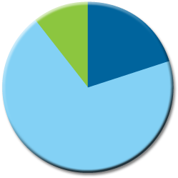
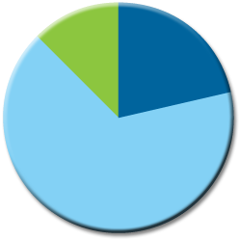



Worldwide IT Spending on Servers, Power, Cooling and Management Administration
New server spending
11%
Power and cooling costs
Server management and admin costs
20%
12%
22%
16%
69%
33%
11%
66%
8%
43%
51%
46%
2013
29%
63%
2011
$247B est.
2006
$217B
2001
$175B
1996
$130B
$100B
Integrated Systems are designed to reduce this
Source: IDC, 2012
2
Notes:
IDC has been tracking IT spending for almost two decades, and a definitive trend has emerged. When we look back at 1996, this was the day of Big Iron. Servers were large and expensive. The initial purchase was hefty, but the management and administration costs were low. That’s because you don’t have that many of these monsters in your environment.
Then, in 2001, distributed computing on x86 systems really took off. Servers cost dramatically less, but you had so many of them. There was a shift in IT budgets, where now you spent the majority of your dollars on maintaining this growing infrastrcuture. In 2006, we reached a tipping point, and very little was spent on new systems, but powering these massive farms, and manually integrating these systems into your environment was a huge burden. And so arose virtualization in the x86 space.
By 2011, less and less was being spent on hardware, and virtualizing assets reduced the power and cooling costs somewhat, but administration of the environment…whether physical or virtual, was still consuming the lion’s share of IT budgets. And so that’s where we are today. But if you’re spending all your time and money on maintaining environments, how do you then find the time and money to deliver new technologies required to drive the business?
That’s where integrated systems come in. <Button Click>. Integrated systems are designed to recapture the portion of your IT budget related to keeping the lights on. The goal is to repurpose that spend towards new technologies designed to drive revenue and value for your company. They’re designed to properly align your IT efforts with the needs of the business.
2

Slide 3


Unsustainable Growth in Operating Costs
Typical IT Spend
Management
and Energy
“Starting in 2011, an average of 10,000 baby boomers will be eligible to retire every day for the next 19 years”
Source: Gartner, http://www.signaturetechnology.com/media/4031/march_3_top_10_trends_to_watch_dcappuccio.pdf
3x to 4x
New Servers
Source: The Value of Smarter Datacenter Services, IDC, 2011
Notes:
This is a supply and demand problem. The demand for people is growing. Customers now spend 3x to 4x more on people than server hardware. According to Gartner, the supply of qualified people due to retirements is reducing. These numbers are all industries but IT will be feeling this impact as it gets harder to find qualified people.

Slide 4
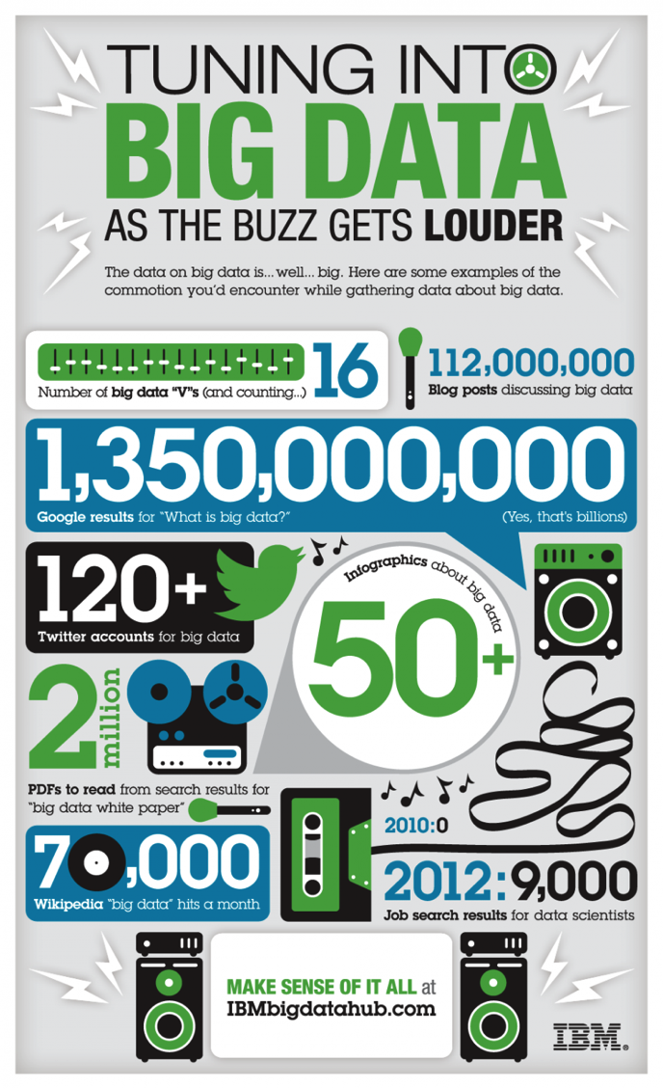
Growth in IT is Not Slowing Down
Big Data and Analytics
Mobile devices
Cloud computing
In-house disaster recovery
Video on demand
Virtual Desktop
“Every two days now we create as much information as we did from the dawn of civilization up until 2003.”
Eric Schmidt, CEO Google

Slide 5






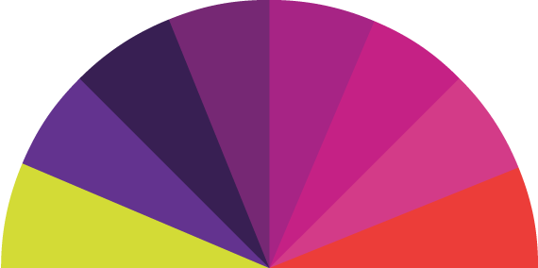


Clients need to address critical imperatives in this environment
Accelerate new applications, big data and analytics
Improve IT efficiency by simplifying the IT lifecycle
Simplify cloud application platforms and infrastructure
Mobile
Social
Big Data
Analytics
34% of new IT Projects
deploy late
Only 1 in 5
Can allocate 50% or more of their IT budget to new projects¹
90% plan to implement cloud
by 2015
From a commissioned study conducted by Forrester Consulting on behalf of IBM
IBM, Data center operational efficiency best practices, April 2012.
* IBM GBS 2011 IBV Study, “The power of cloud: driving business model innovation
Notes:
Some key questions to ask yourself:
Are you able to devote enough time and resource to supporting the business agenda?
Are you ready to meet the big data challenge of growing volume, velocity and variety of data as you apply analytics to improve your business?
Are you shifting resources from business-as-usual to new application development and deployment?
Are you transforming your organization to adopt a cloud delivery model?
As they wrestle with the new demands for mobile, social, big data and analytics and other new application needs for their industry and as they approach cloud as a path for delivery, organizations around the world, have consistently articulated three imperatives for their IT organization.
They need to:
Accelerate new applications, big data and analytics. This isn’t easy. If you look at the timetables for the way we delivery new applications today IT’s business customers are screaming that they are too slow to meet their needs – and even then 34% deploy even later. Demands for delivery of new mobile and social apps is on an even more rapid and more iterative cycle. Business has mountains of big data accumulating and desperately needs to be able analyze it and derive usable insight more quickly.
Improve IT efficiency by simplifying the IT lifecycle. As mentioned earlier, a new level of operational excellence on what we have today is required to solve the complexity gap. Only 1 in 5 IT organizations can actually allocate more than half their budget to innovation. How can existing environments be further consolidated, optimized and moved to the cloud. Then add on top of that the need to be efficient as we deliver new things like mobile, social and cloud so that today’s innovations don’t become tomorrow’s management nightmare.
Simplify cloud application platforms and infrastructure. Nearly everybody is looking at cloud as the delivery mechanism to move to. Again this takes skills and expertise in a new set of technologies. How can this transformation happen more quickly and easily while reducing the risk?

Slide 6
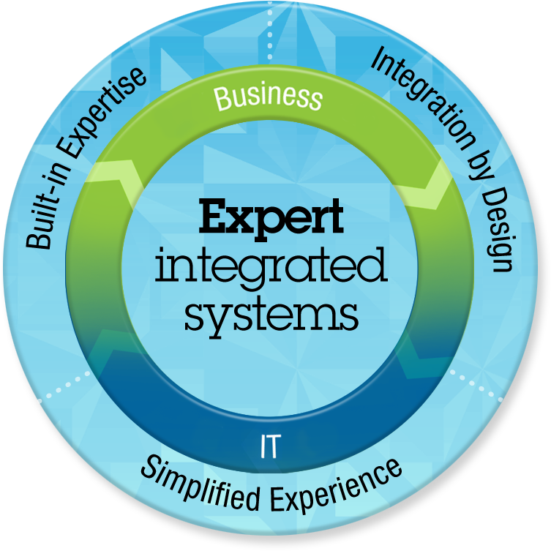
The Time has Come for a New Breed of Systems
Built-in Expertise
Capturing and automating what experts do
Integration by Design
Deeply integrating and tuning hardware and software
Simplified Experience
Making every part of the IT lifecycle easier
Integrated management of the entire system
A broad open ecosystem of optimized solutions

Slide 7
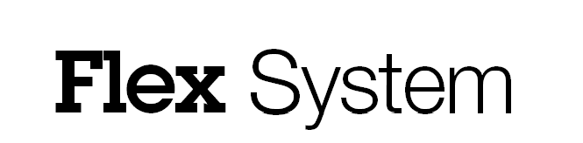



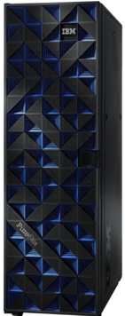
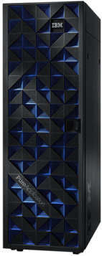
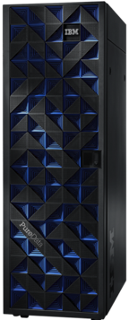
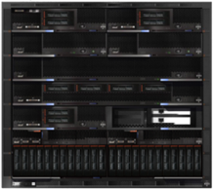
IBM PureSystems Family
Infrastructure Components
Beyond Blades
Integrated Infrastructure
Delivering Cloud
Infrastructure Services
Application Platform
Delivering Cloud Application
Platform Services
Data Platform
Delivering Big Data
Platform Services

Slide 8
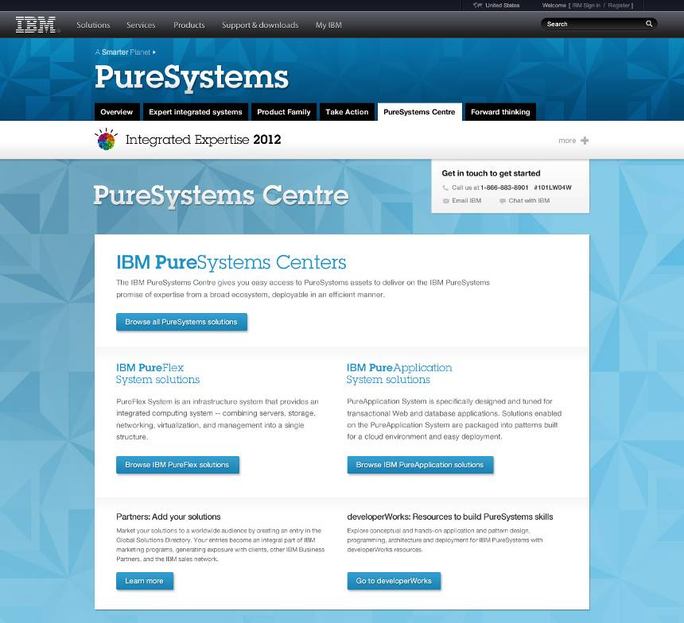
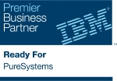



























IBM PureSystems Centre
Optimized solutions from nearly 200 leading ISV partners
Search by solution area, industry or system
Gain access to ISV application patterns for trial and production
Certified through ‘Ready for IBM PureSystems’ program
All of your existing AIX, IBM i,
Linux and Windows applications
will run on IBM PureFlex System
The SAP logo is a trademark or registered trademark of SAP AG in Germany and several other countries and is reproduced with the permission of SAP AG.
Notes:
8
Now let’s talk about what IBM is doing with its long and growing list of ISVs. Over 200 ISVs and Partners are writing their applications specifically to run on PureFlex. They’re codifying their expertise and we’re building it into PureSystems.
Because we have a fully integrated system and a deep understanding and control of the underlying infrastructure, our ISVs can build patterns to be easily deployed and automatically scaled on PureSystems. Think about being able to go out to a website, download the SugarCRM pattern, fill out some questions about max concurrent users, IP addresses, etc., and in 45 minutes you have a fully deployed implementation of SugarCRM. Database, application, http servers, all the interconnects, the automated scaling policies, everything. 45 minutes instead of 45 days.
We can do this today will several ISVs. More and more every month. The iTunes store of IT!
<Button Click>
And don’t forget, all of your existing applications can already run on PureFlex. There’s nothing new here from a chipset standpoint. There’s nothing you have to re-write

Slide 9
Flex System Elements

Slide 10
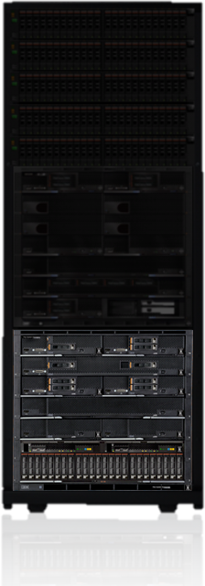
Integrated Infrastructure
1 system for compute,
storage and systems networking
Up to 896 cores, 43 TB memory, 480 TB storage and 26M IO operations per second, per rack
Up to 4 chassis per rack scalable up to 4 racks
10U Chassis
14 Node Bays
Notes:
10
First, we'll start with the integrated infrastructure. IBM offers you one system that brings your resources together. It's designed for future generations of technology. It delivers energy efficient power and cooling, which is key to getting the maximum performance out of all the components over future generations.
And, unlike a lot of other solutions, we support multiple architectures, but don't require a lot of expensive, non standard components. IBM PureFlex System provides incredible capacity for compute, memory, and storage with a high-level of IO operations in a single rack – with the ability to have up to four full racks in a single system.
10

Slide 11
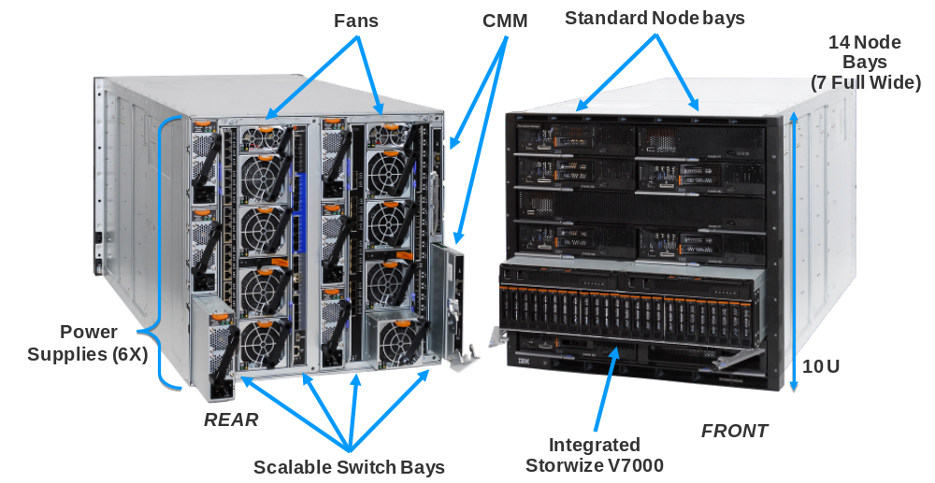
Enterprise Chassis Design
Chassis
IBM Flex System Chassis
Infrastructure to support the compute, storage and networking components
◊
Energy efficient cooling
and power system
◊
Easy to use with integrated single-point management
◊
Designed to support future advancements in I/O, processors, memory, and storage
System infrastructure
Integrated Storage Node
4 scalable switch bays
10U Chassis, 14 bays
Standard and Full width node support
Up to 6 * 2500W power supplies N+N or N+1 configurations
Up to 8 cooling fans (scalable)
Integrated chassis management through CME
Notes:
11

Slide 12
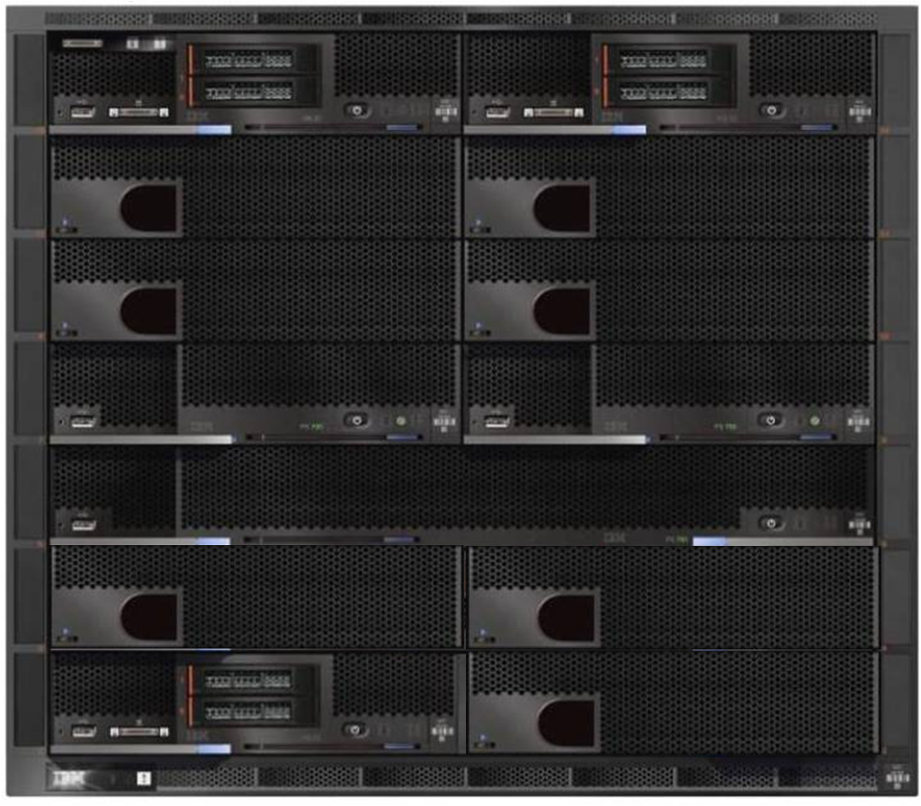
IBM Flex System Enterprise Chassis Front View
Flex System Mgr
IBM Flex System x240
Filler
Filler
Filler
Filler
Size: 10 U
19” Rack
IBM Flex System p260
IBM Flex System p260
14 Node Bays
(7 Full Wide)
IBM Flex System p460 ( Full Width )
Nodes:
Power
Intel
Flex System Mgr
Filler
Filler
IBM Flex System x240
Filler
Notes:
12

Slide 13
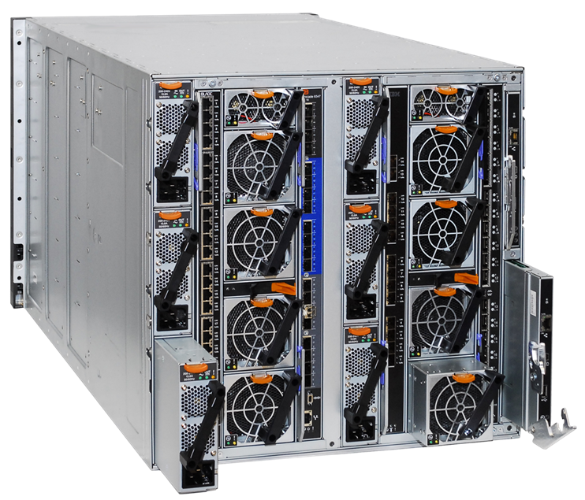
IBM Flex System Enterprise Chassis Rear View
Fans
CMM
10 U
Power Supplies
(6X)
High Speed Switch (4X)
Notes:
13

Slide 14
Compute
POWER 7 & x86
No compromise design for the next decade

Slide 15







Integrated Compute Nodes
Support multiple architectures using up to 14 POWER7 or x86 nodes per chassis
Support for applications across 4 operating environments
Secure startup for both physical and virtual environments
POWER7
AIX®, i®, Linux®
x86
Linux®, Windows®
Notes:
15
No compromise designs for integrated compute nodes that support POWER7 or x86 architectures provide the performance behind the IBM PureFlex System.
It allows you to share your network, storage and other resources across Power and X86 applications. And we've built in the security so that when you start the system up, it's doing all the validation and checks across the physical and virtual environments to reduce risk and save administrator time in configuring security.
15

Slide 16




Diverse offerings to match the diverse workloads
Compute
IBM Flex System x220
IBM Flex System x240
System Portfolio tuned to workloads
◊
Reduce acquisition costs through virtualization consolidation
◊
Maximum platform capability provides deployment flexibility
IBM Flex System x440
System infrastructure
IBM Flex System p260
IBM Flex System p24L
IBM Flex System p460
Notes:
16

Slide 17

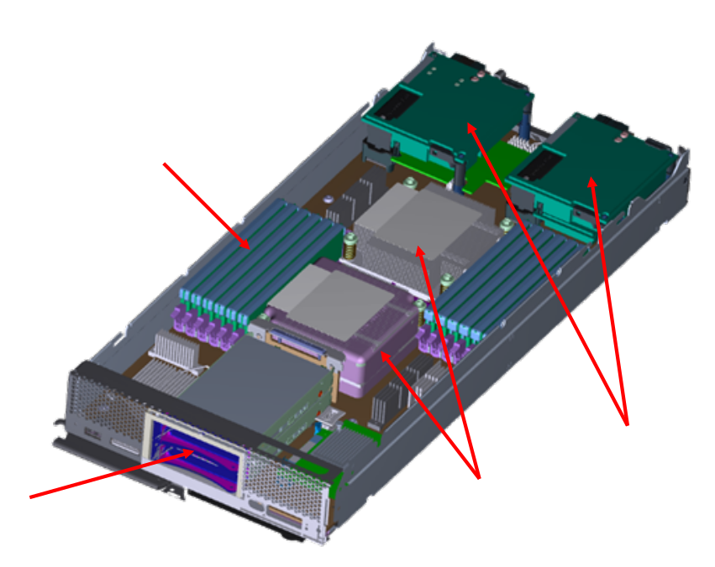
IBM Flex System x220 - 2S EN Compute Node
Compute
IBM Flex System x220
Entry cost optimized compute, designed for energy-efficiency, ideal for native and point application workloads
Standard Width compute node
◊
2-socket Intel E5 2400
Sandy Bridge EN
◊
12 LP DDR3 DIMMs / 1333MHz / 1600MHz
◊
1Gb LOM
◊
2 hot swap 2.5” SAS/SATA SSDs or HDDs
◊
Dual Enabled Hypervisor – ESXi on Flash Key Option
12x LP DIMMs
System infrastructure
2x IO Mezzanine Cards
2x Hot Swap, Small Form Factor HDDs
2x Intel E5 2400
Processors
Notes:
17

Slide 18

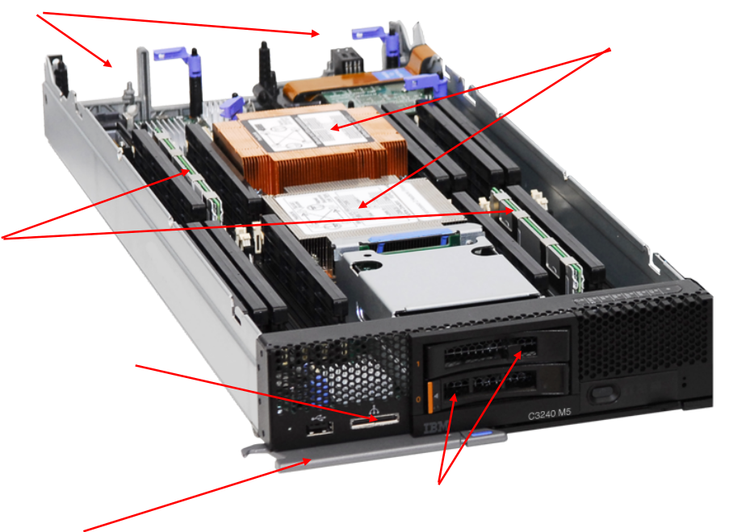
IBM Flex System x240 – 2S EP Compute Node
Compute
IBM Flex System x240
Uncompromised Compute, IO, and Storage performance, designed for mainstream virtualization, and a broad range of workloads
2x IO Mezzanine Cards
2x Intel E5 2600
Processors
Standard Width compute node
◊
2-socket Intel E5 2600 Sandy Bridge-EP
◊
24 LP DDR3 DIMMs / 1333MHz / 1600MHz
◊
10Gb Converged LOM
◊
2 hot swap 2.5” SAS/SATA SSDs or HDDs
◊
Dual Enabled Hypervisor – ESXi on Flash Key Option
System infrastructure
24 LP
DIMMs
Keyboard, Mouse, Video Dongle connector
2x Hot Swap, Small Form Factor HDDs
Release latch
Notes:
Remove power connector
18

Slide 19
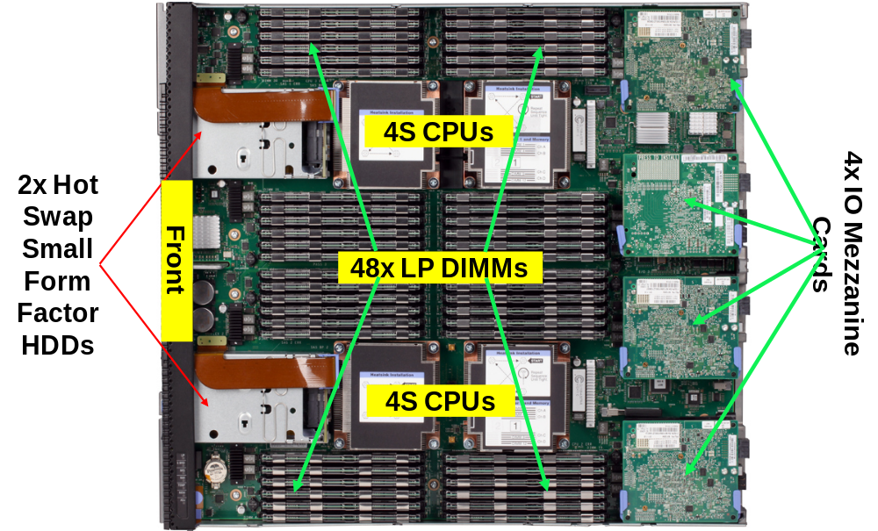
IBM Flex System x440 Compute Node
Compute
Delivers maximum CPU, memory, and IO performance, ideal for database and large VM deployment
Full Width compute node
◊
4-socket Sandy Bridge-EP
◊
48 LP DDR3 DIMMs / 1333MHz / 1600MHz
◊
10Gb LOM
◊
2 hot swap 2.5” SAS/SATA SSDs or HDDs
◊
Dual Enabled Hypervisor – ESXi on Flash Key Option
System infrastructure
Notes:
19

Slide 20

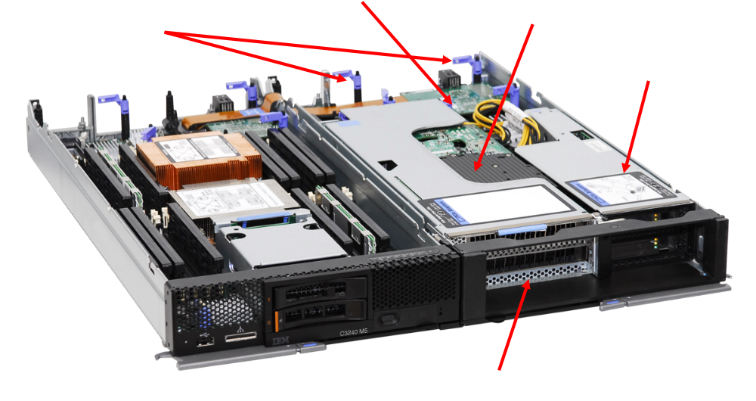
IBM Flex System PCIe Expansion Node
Compute
A new I/O expansion Compute sidecar
  Industry standard PCIe cards
  Additional Next Generation Platform fabric I/O
  Graphics, Storage, and I/O adapters
  Attaches to 2-socket x240 and x220 nodes
Utilize high-capacity, flash based storage to significantly boost transaction based workloads
◊
Utilize high performance GPUs to boost computationally capabilities
◊
Enable attachment of external drive enclosures
◊
Tap all available I/O of modern CPU architectures
PCIe Full Width, Full Height Slots (2)
PCIe Bridge Chip
2 Extra Mezz slots
PCIe Low Profile Slots (2)
System infrastructure
PCIe Adapters load from front
Notes:
20

Slide 21
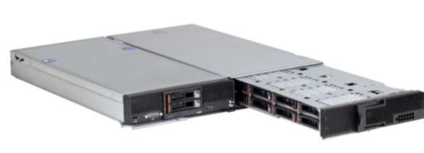
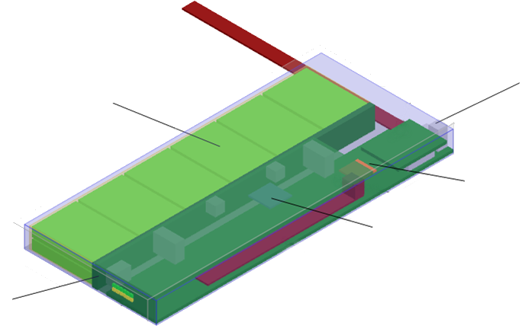
Direct Attach Storage Options
Storage
IBM Storage Expansion Node
Provides cost optimized, high capacity, direct attached storage to meet today's needs data intensive workloads
IBM Flex System x220 / x240 With Storage Expansion Node
Dedicated storage “side-car” that attaches to single width compute node
◊
12 x HS 2.5” hot swap HDDs or SSDs
◊
Integrated RAID function
◊
1 GB RAID Cache (optional)
Chassis Management / Power Interface
12 x 2.5” drive module
System infrastructure
RAID Controller
SAS Expander
Hot Swap drive tray
Up to
12 TB
of storage
Notes:
21

Slide 22
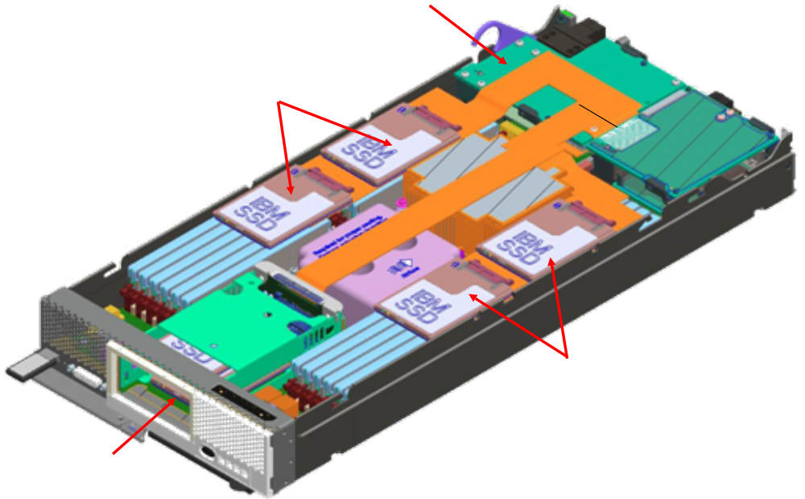
Direct Attach Storage Options
Storage
IBM eX Flash for high IOPS storage expansion
Low cost IOPS performance, optimized for transaction processing, media streaming, and business intelligence applications
SAS Mezz Cards
Supports 8 1.8” SSDs
◊
4 drives over DIMMs and 4 in the drive bays
◊
1.6 TB - 3.2 TB Total Capacity
(200GB/400GB SSD Drives)
2 SSDs
System infrastructure
2 SSDs
4 SSDs
Notes:
22

Slide 23

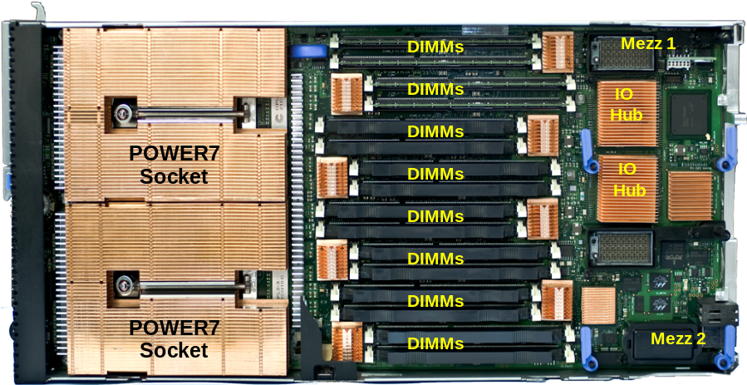
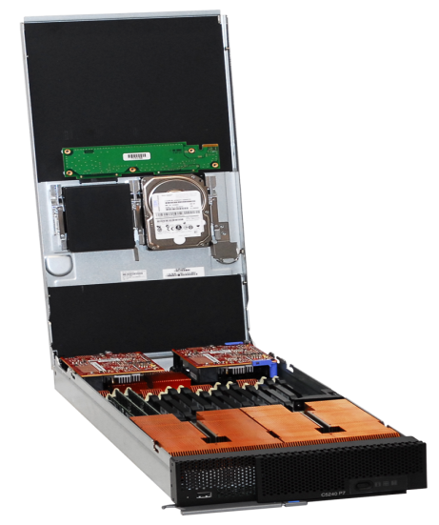
IBM Flex System p260
Compute
IBM Flex System p260
Power is Performance Redefined
Delivers over 30% greater performance with similar density and energy use of the previous POWER7 blades
Standard Width compute node
◊
2-socket POWER7®
◊
64-bit POWER7+
® processor
◊
16 core : 2 Socket x8 core
◊
16 DIMMs DDR3, 1066 MHz, 512 GB Max
◊
Dual Mezz cards and IO Hubs
System infrastructure
RAID Controller
2 x SAS 2.5” HDD
  HDD: 300 / 600 / 900 GB
  Memory 4 or 8GB dimms
or 2 x 1.8” SDD drives
  SDD: 177 GB
  2 / 4 / 8 /16 GB dimms
Notes:
23

Slide 24
IBM Flex System p24L
Compute
IBM 2S Power7 Compute Node for Linux only
Power is Performance Redefined
Actualize cost savings through reduced power consumption, shared resources, and increased utilization
Linux only Compute Node optimized for POWER architecture
◊
Tuned for PowerLinux Strategic Solutions
◊
2-socket Power7®
◊
12 to 16 cores : multiple speed
◊
16 DIMMs DDR3, 1066 MHz, 512 GB Max
System infrastructure
RAID Controller
2 x SAS 2.5” HDD
or 2 x 1.8” SDD drives

Slide 25

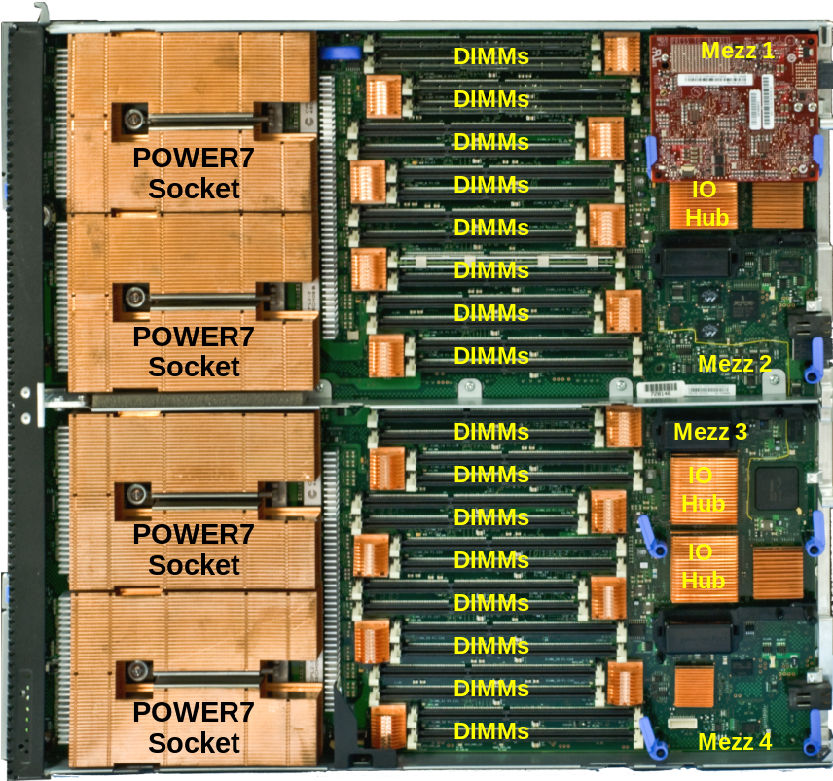
IBM Flex System p460
Compute
IBM Flex System p460
Power is Performance Redefined
The same 4-socket server technology behind Watson, is now enhanced and available on Power Compute Node for IBM Flex System
Full Width compute node
◊
4-socket POWER7®
◊
64-bit POWER7® processor
◊
32 core : 4 Socket x8 core
◊
32 DIMMs DDR3, 1066 MHz, 512GB Max
◊
Quad Mezz cards and IO Hubs
System infrastructure
*HDD or SSD – Mounted on cover (located over memory)
Notes:
25

Slide 26
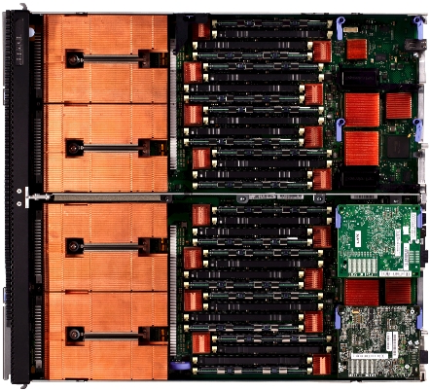
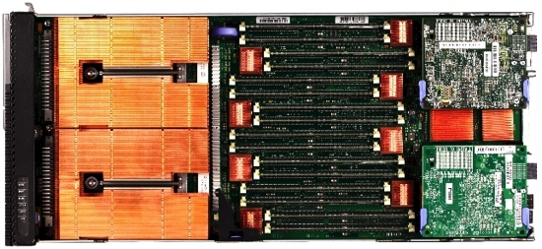
Integrated Power Compute Nodes
 | Flex System p260 | Flex System p24L | Flex System p460
CPU | 4/8c, 2s, POWER7+ | 6/8c, 2s, POWER7 | 4/8c, 4s, POWER7
Memory | 16 memory DIMMs Up to 512 GB | 16 memory DIMMs Up to 256 GB | 32 memory DIMMs Up to 512 GB
Disk | Up to 2 HDD or 2 SSD | Up to 2 HDD or 2 SSD | Up to 2 HDD or 2 SSD
I/O slots | 2 | 2 | 4
Dual VIOS | Yes* | Yes | Yes
OS Support | AIX, Linux, IBM i | Linux | AIX, Linux, IBM i
*RPQ required for limited FCoE support of SAN
c=core, s=socket

Slide 27
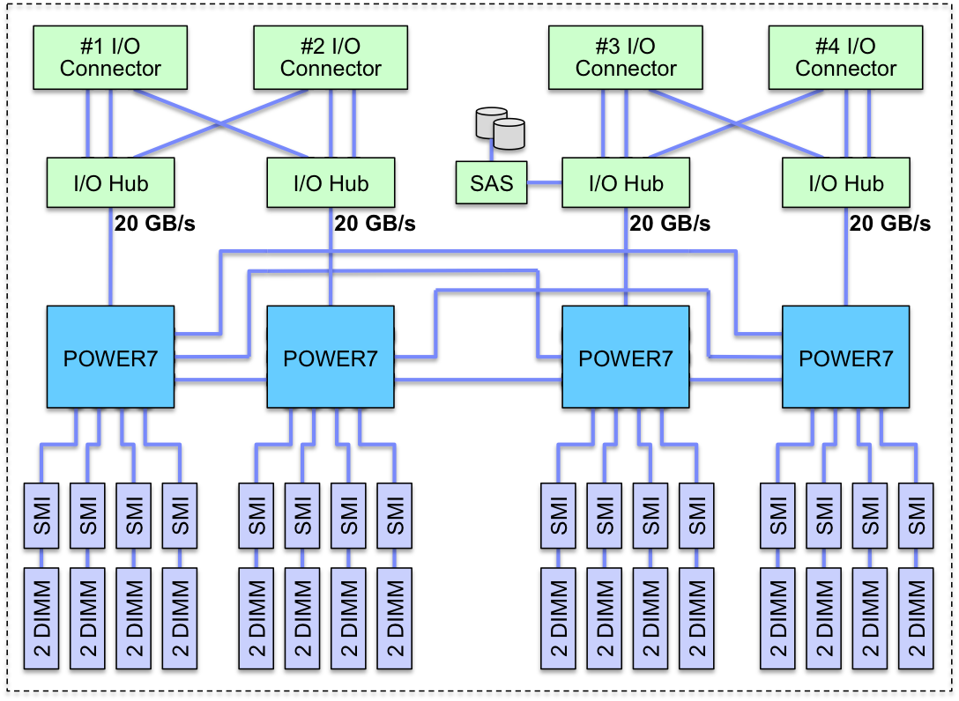
Flex System p460 POWER7 Compute Node

Slide 28
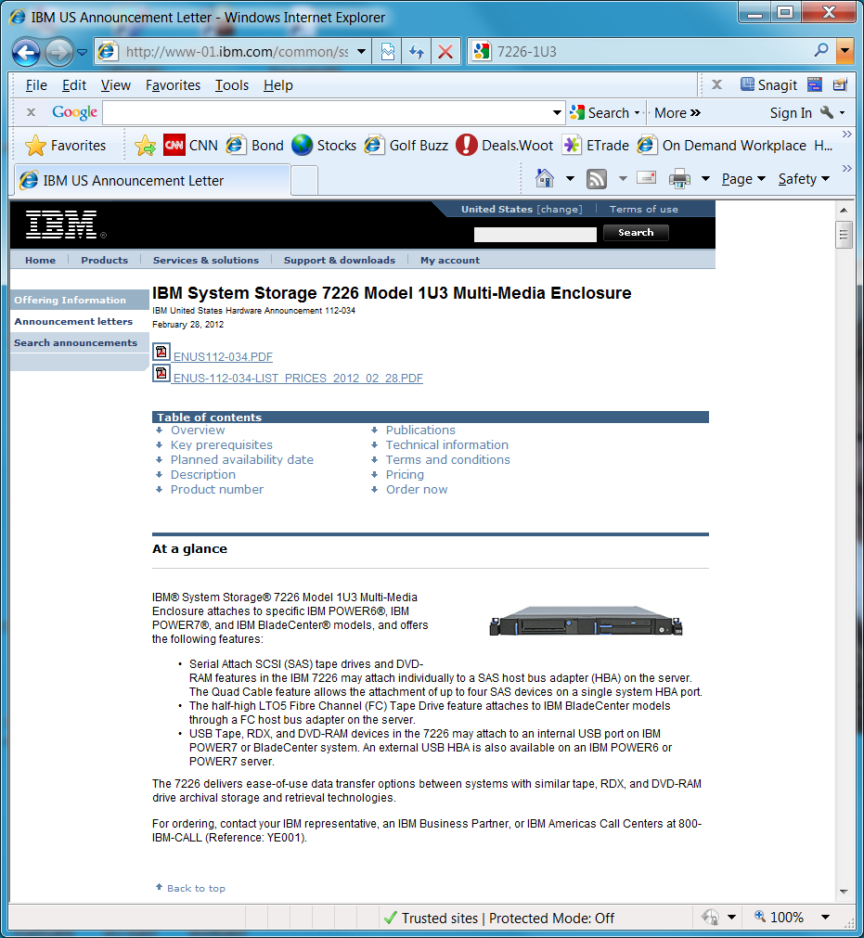
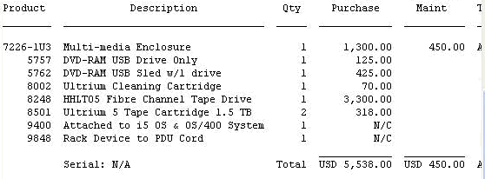
What about Tape or DVD?
7226 -1U3
Supports :
Half-High LTO™ Ultrium™ 5/6
1.5 TB SAS and FC Tape Drive
DVD-RAM (2 per side)
SAS and USB interface
Support of FC Tape Libraries
HH LTO3, HH LTO4, HH LTO5/6,
TS3100/3200, TS3310, TS3500
http://www-947.ibm.com/support/entry/portal/docdisplay?lndocid=flex-interop

Slide 29
Networking

Slide 30
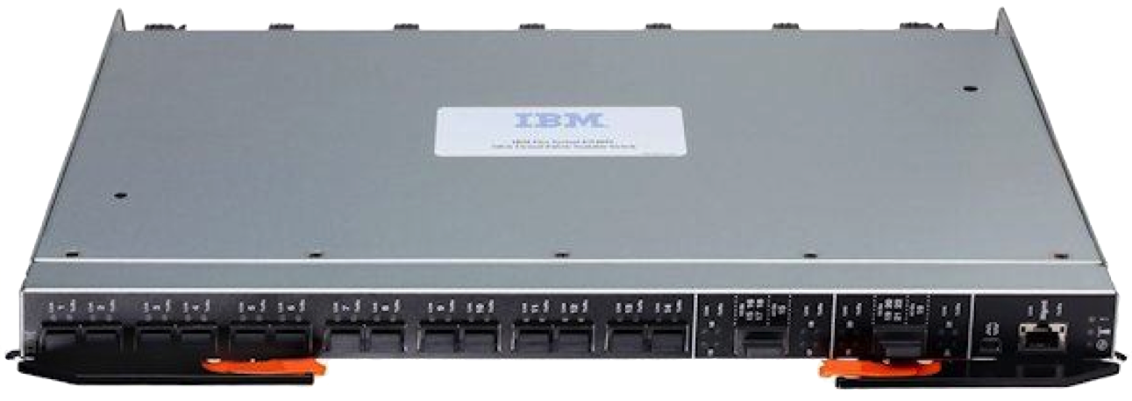


Choice in Connectivity
Ethernet
2, 4, 6 port 10 Gb
FCoE and RoCE
2, 4 port 1 Gb
Pass-thru
Fibre Channel
2 port 8 Gb
2 port 16 Gb
Pass-thru
InfiniBand
2 port 56 Gb FDR
2 port 40 Gb QDR

Slide 31
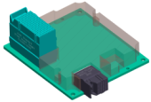

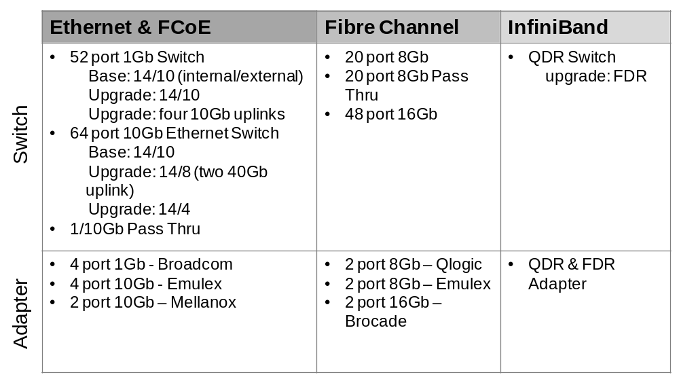
Full breadth of Networking offerings
Networking
IBM Networking Offerings
    Scalable Switch modules for the IBM Flex System chassis
    Four Scalable switches per chassis
    Capable to provide up to 16 virtual switch partitions per chassis
    Feature on Demand port upgrades for switches
Simplifies network deployment via integrated management
◊
Reduces network complexity via convergence and intelligent fabric monitoring
◊
Improves network performance via uncompromised IO throughput
◊
Fits with existing infrastructure and scales with Customer’s IO needs
System infrastructure
*Available at launch
Notes:
31

Slide 32
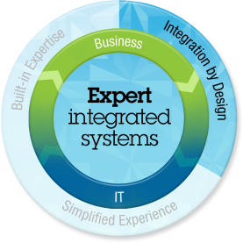
Intelligent, integrated and flexible network architecture that can fit with your existing or future environment
“Pay as you grow” scalability
Performance:
  Support 40Gb
  < 1ms latency
Designed for future:
  Hypervisor Virtual Switch optimized
  Built for VM Workload migration
  Full Convergence
Virtual Machine Mgmt./Virtual Switching
Automate network & server provisioning and failover (FSM)
VM-aware networking for easy management and tracking (VMready)
Software Defined Networking (SDN)
Manage as one system
Multiple switches within a POD managed as a single entity
Seamless interoperability
Standards based (Qbg, DCB, DOVE)
Optimized
Automated
Integrated
Flexible, Integrated, Standard-based
No Compromise Networking
Notes:
{DESCRIPTION}
This slide contains the topics that are covered by the narration written in the transcription of this slide.
But let’s start to dig a little deeper into the Ethernet based offerings because what you’re going to see is we deliver intelligence, integration and flexibility that works in your existing and future environments. And I believe our value really comes in 3 key areas: optimization, automation, and integration.
<Button Click>
So let’s start by first talking about what we deliver in PureFlex in the area of optimizing. First off, we provide you “pay as you grow” scalability. The ability to turn on additional ports down to the server or additional uplink ports, with the activation of a license key instead of a rip and replace. This really makes upgrades easy for our clients.
The PureFlex chassis was the first that supported 40Gb capabilities. This is going to be the first chassis in the marketplace capable of supporting 3 10Gb down link ports per switch (6 per node). We provide the lowest latency switches with sub-microsecond latency.
<Button Click>
From an automation standpoint, we can automate provisioning and failover. We can track security policies as VMs move around your environment with our VMReady technology. And we’re paving the way for Soffware Defined Networks, further simplifying and automating network management in the near future.
<Button Click>
We deliver seamless inoperability to your existing environment, whether that be 1GbE, 10GbE, 40GbE or FCoE. If you’re not at 10GbE yet, you can start with 1GbE and simply swap out the cables when you’re ready for 10GbE.
You’ll find that everything we do is based on standards like 802.1QBG.

Slide 33
High Bandwidth Mid-plane That is Ready for the Future
Node Bay 1
I/O
Switch
Bay 1
Ethernet
Mezzanine
Card
Base Ports
Feature on Demand
Feature on Demand *
I/O
Switch
Bay 2
Base Ports
Feature on Demand
Feature on Demand *
FC
Mezzanine
Card
I/O
Switch
Bay 3
Base Ports
I/O
Switch
Bay 4
Base Ports
Mid-plane
* The 8 port adapter is currently announced for Power only and is limited to 6 active switch ports with the EN4093

Slide 34
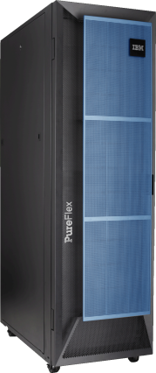



PureFlex Intra-Chassis Network Fabric Provides Outstanding Results In Low Latency Tests
PureFlex System (Intel)
2.4X
27.5
Microseconds latency per message
Microseconds latency due to network
Higher Throughput
LLM
1024 byte messages
9.4
Linux
LLM
Linux
18,803
Messages per second
Flex System x240 E5-2680 2s/16c (2.7GHz) Sandy Bridge
Coalition Competitor
63.0
Microseconds latency per message
Microseconds latency due to network
LLM
1024 byte messages
40.0
Linux
LLM
Linux
7,920
Messages per second
E5-2680 2s/16c (2.7GHz) Sandy Bridge
Notes:
34
34
34
One key distinction about how we implement networking versus some of our competitors, is that we allow you to keep the switching inside the chassis, instead of sending all server-to-server traffic up through a ToR switch.
A recent Garnter study indicated that with today’s achievable VM densities, upwards of 80% of server-to-server traffic never requires messages to leave a chassis environment. This is especially the case with the density that the IBM PureFlex chassis can provide. So why pass those communications up through a FEX chokepoint, just to bounce it back down through that same chokepoint, in order for two servers applications to talk to one another? Why not run the traffic over a high-speed backplane that provides full 10GbE from server to server?
And what does it mean in the real world?
<Button Click>
It means 240% higher throughput, in terms of messages passed per second. 240% better throughput… simply because the design is better.

Slide 35
Storage

Slide 36
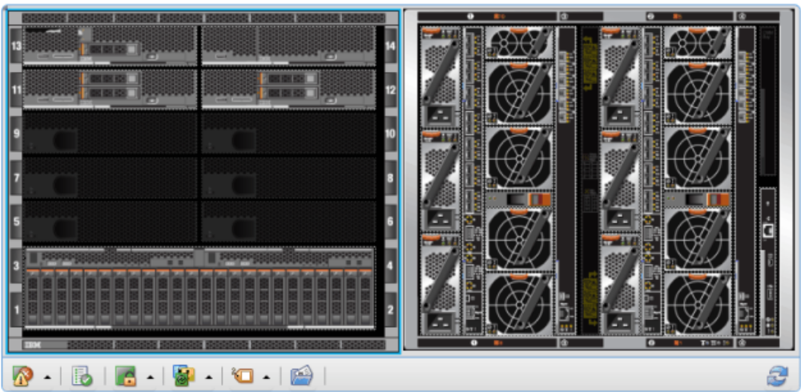

Flex System Storage Choice
Flex System V7000 Storage Node
Automatic discovery and credentials
Automated firmware updates
Call home support
Integrated into FSM chassis map
LUN creation and host mapping
FC, FCoE, and iSCSI
SAN attach external storage
DS8000, XIV, Storwize V7000 and V3700, DS5000, DS4000, DS3000, N Series
Virtualize external storage
Flex System V7000, Storwize V7000, SAN Volume Controller
Notes:
http://www-03.ibm.com/systems/info/x86servers/serverproven/compat/us/serverproven/indexf.html

Slide 37
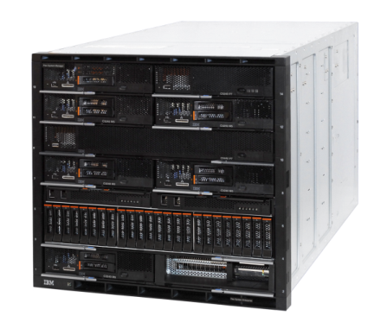
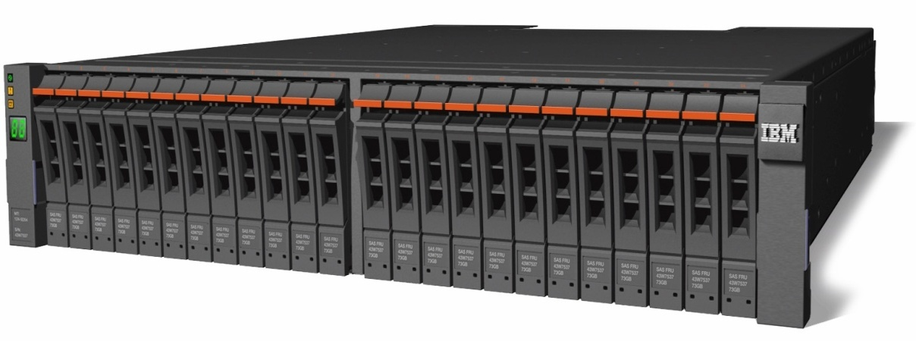

Storwize V7000 – Leverage Existing Storage, Easy-tiering
Modular Hardware Building Blocks
Simplifies storage administration with a single user interface and common CLI through a tightly integrated management console Virtualizes third-party storage with non-disruptive migration of the current storage infrastructure Balances high performance and costs for mixed workloads Protects data for business continuity and disaster recovery with built-in local and remote replication and snapshot functions
IBM
EMC
HP
Notes:
6/6/2013
IBM Confidential
37

Slide 38
Management

Slide 39
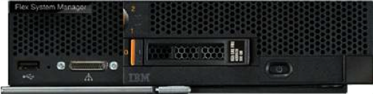
Integrated Comprehensive Platform Management
Flex System Manager
  Pre-installed management appliance
  Currently supports up to 4 managed chassis
  Single point of entry
Auto discovery of resources
Configuration wizards
Physical and virtual resource management
Chassis maps to visualize resources
Lights out remote console
Remote media
Network and storage management
Alerts, health status, call home
Integrated firmware management

Slide 40
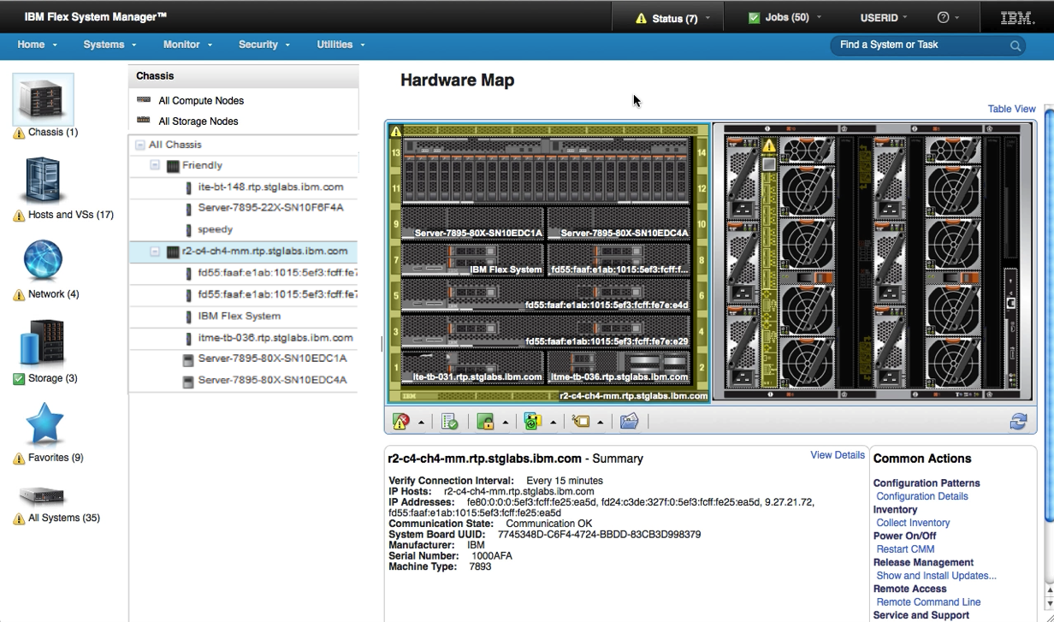
Visual Management is More Intuitive
Single management entry point
Visualize front and rear of chassis
Component drill downs
Context sensitive overlays

Slide 41
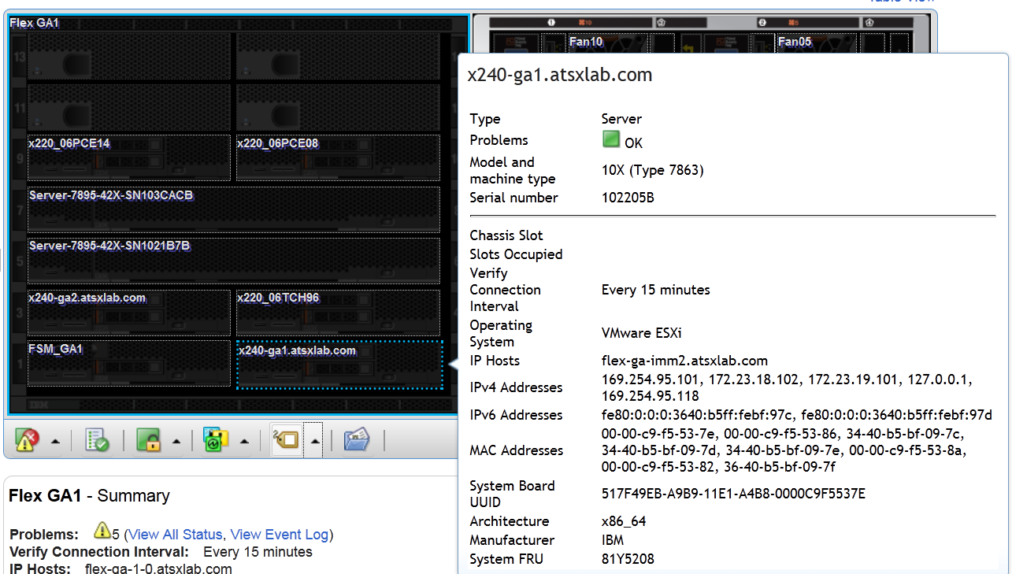
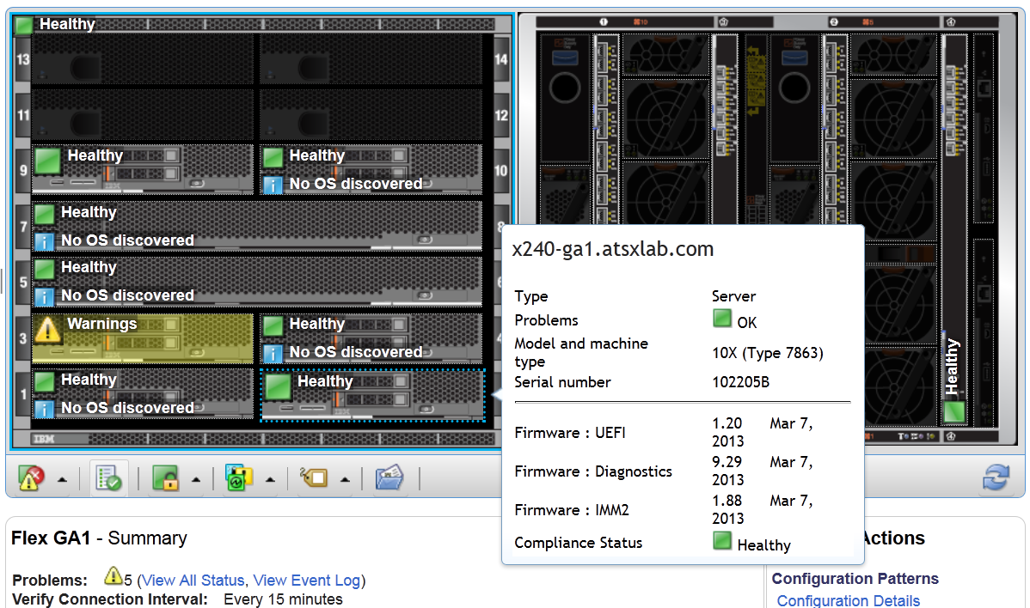
Overlays Allow Easy Access to Commonly Needed Information
Component Names and Properties
Six available
More to come
Compliance and Firmware

Slide 42
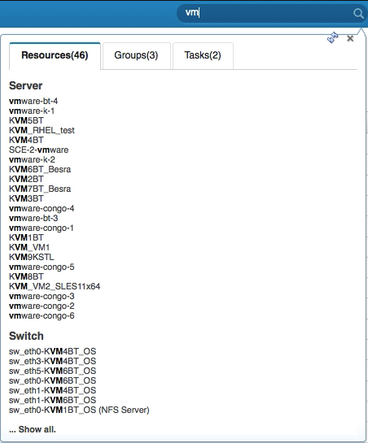
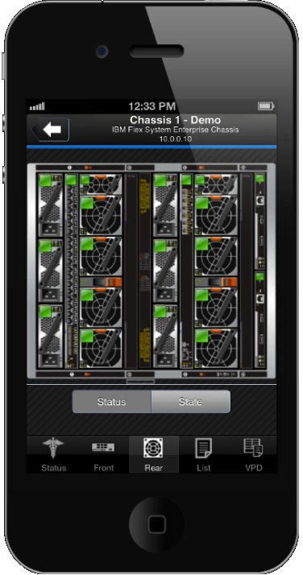
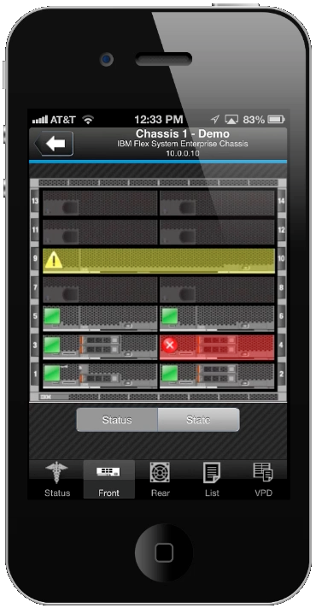
Tools Designed to Help Busy Administrators
Global find to simplify locating resources, groups, and tasks
iPhone, Android, Blackberry support

Slide 43




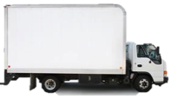
Choice in Virtualization Stacks
Create
Clone
Visualize
Relocate
Retire
Full VM life cycle management
Servers, storage, and network
VMware, KVM, Hyper-V, PowerVM
Visualize physical to virtual relationship
Bare metal Hypervisor deployment
Import virtual appliances
Manage pools of resources

Slide 44







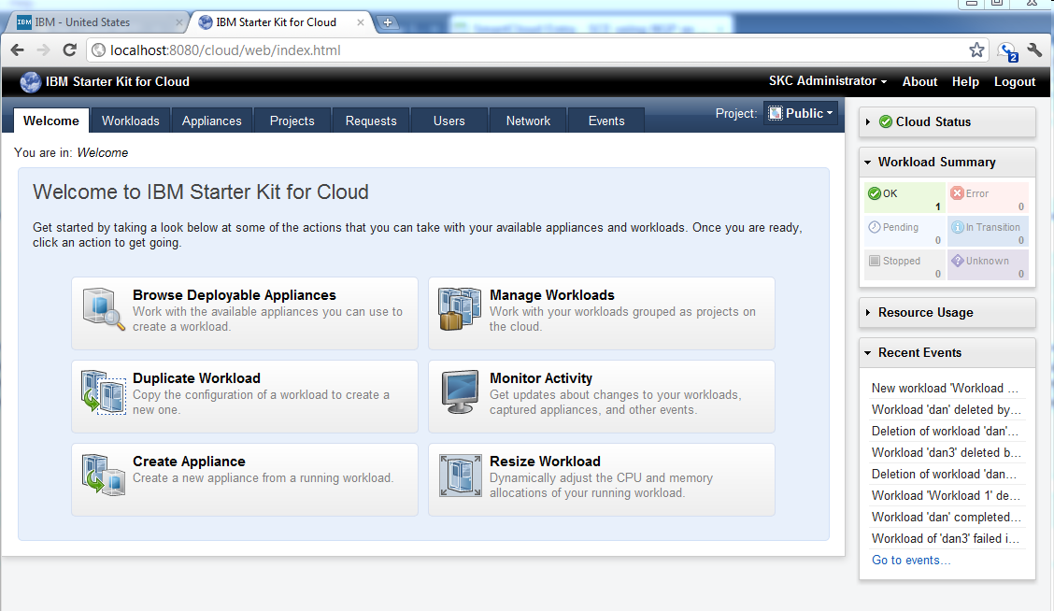
Deploy New Workloads with as Few as Four Clicks
Approve
De-provision
Monitor
Service Catalog
Provision
Meter / Bill
SmartCloud Entry
All essential cloud functions
Mix x86 and Power
Part of PureFlex Standard and Enterprise foundations

Slide 45
IBM PureSystems Family
Infrastructure Components
Beyond Blades
Integrated Infrastructure
Delivering Cloud
Infrastructure Services
Application Platform
Delivering Cloud Application
Platform Services
Data Platform
Delivering Big Data
Platform Services

Slide 46
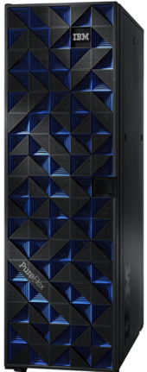
IBM PureFlex System
Integrated hardware
x86 and/or Power servers
Storage
Networking
Management
Integration services
Base hardware integrated at factory
On-site installation services
Choice
x86 and/or Power servers
Windows, Linux, AIX, IBM i
VMware, KVM, Hyper-V, PowerVM
SmartCloud Entry
Software included with Standard & Enterprise foundations

Slide 47
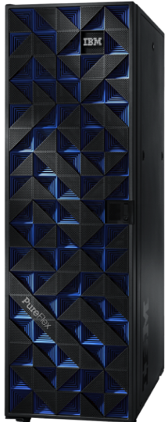
PureFlex – Infrastructure System
Configurations that ease acquisition experience and match your needs
Express
Standard
Enterprise
Starting point:
1 x Chassis
1 x 10Gb switch
1 x 8Gb or 16Gb FC switch
2 x Chassis Mgt Modules
1 x Flex System Manager
(Standard License)
1 x Flex System V7000
(2 SSD, 8 HDD)
1 x 42U Rack
* Lab Services (3 days)
Starting point:
1 x Chassis
1 x 10Gb switch
2 x 8Gb or 16Gb FC switch
2 x Chassis Mgt Modules
1 x Flex System Manager
(Advanced License)
(SmartCloud Entry)
1 x Flex System V7000
(2 SSD, 16 HDD,
4 HDD used for SCE)
1 x 42U Rack
* Lab Services (5 days)
Starting point:
1 x Chassis
2 x 10Gb switch
2 x 8Gb or 16Gb FC switch
2 x Chassis Mgt Modules
1 x Flex System Manager
(Advanced License)
(SmartCloud Entry)
1 x Flex System V7000
(4 SSD, 16 HDD,
4 HDD used for SCE)
1 x 42U Rack
1 x TOR (POWER only)
* Lab Services (7 days)
Choice of
POWER and/or x86
*defaulted – can be de-selected
Designed for Cloud - SmartCloud Entry included on Standard and Enterprise
Designed for choice of architectures: IBM POWER7 and/or Intel x86 processors within the same systems
Designed for choice of OS: AIX, IBM i, Microsoft Windows®, and Linux from Red Hat, SUSE
Designed for choice of hypervisors: PowerVM, KVM, VMware, or Microsoft HyperV

Slide 48








Software Integration for Power
Media Images preloaded, Software Installed & Configured
Software components integrated in our factory before system arrives at customer site
Media images provided
Operating System installed
Virtualization Configured
Ready for Cloud
Business Process as a Service
Software as a Service
Platform as a Service
Infrastructure as a Service
LPAR1
LPAR2
LPAR3
LPAR4
Design
Deploy
Consume
VIOS
VIOS
OS
for
SCE
SW
SW
SW
OS
OS
OS
Virtual Server
Virtual Server
Virtual Server
Storage
Virtualization
Networking
Compute
Storage
p460 example
Notes:
SW Integration for System x includes preloading VMWare ESXi hypervisor on USB key.
48

Slide 49

PureFlex Installation Services
Hardware pre-integrated at IBM
On-site services
Other services also available
PureFlex Extra
Chassis Add-on
(5 days)
PureFlex Cloud
(10 days)
Configure SmartCloud Entry
Basic External network integration
First Chassis configured 13 nodes
Configure up to 14 nodes within one Chassis
Up to 2 virtualization engines (ESXi, KVM or PowerVM)
PureFlex Enterprise
(7 days)
Advanced virtualization
Server pools or VMware cluster configured (VMware or VMControl)
Advanced virtualization
Server pools or VMware cluster configured (VMware or VMControl)
Configure up to 14 nodes within one chassis
Up to 2 virtualization engines (ESXi, KVM or PowerVM)
PureFlex Virtualized
(5 days)
Basic Virtualization (VMware, KVM, VMControl)
Up to four nodes, two switches
Basic Virtualization (VMware, KVM, VMControl)
Up to four nodes, two switches
Basic Virtualization (VMware, KVM, VMControl)
Up to four nodes, two switches
Configure up to 14 nodes within one chassis
Up to 2 virtualization engines (ESXi, KVM or PowerVM)
PureFlex Intro
(3 days)
One node, one switch configured
FSM Configuration
Discovery, Inventory
Review Internal Storage configuration
Skills Transfer
One node, one switch configured
FSM Configuration
Discovery, Inventory
Review Internal Storage configuration
Skills Transfer
One node, one switch configured
FSM Configuration
Discovery, Inventory
Review Internal Storage configuration
Skills Transfer
One node, one switch configured
FSM Configuration
Discovery, Inventory
Review Internal Storage configuration
Skills Transfer

Slide 50

Getting started with IBM i™ on an IBM Flex System™ compute node.
Latest version at: select attachment tab
https://www.ibm.com/developerworks/mydeveloperworks/wikis/home?lang=en#/wiki/IBM%20i%20Technology%20Updates/page/IBM%20i%20on%20a%20Flex%20Compute%20Node

Slide 51

Where Do I Start with Installing VIOS and IBM i on Power system?
Latest version at:
http://www.ibm.com/systems/resources/systems_i_Virtualization_Open_Storage.pdf

Slide 52
I/O Virtualization on POWER
IO Bus Virtualization
with Dedicated Adapters
IO Adapter Virtualization
with VIO Server
VIOS LPAR
LPAR A
LPAR B
LPAR A
LPAR B
Physical
Adapter
DevDrv
Physical
Adapter
DevDrv
Physical
Adapter
DevDrv
Increasing
Adapter BW
& LPAR
Density
per Slot
Virtual
Adapter
Server
Virtual
Adapter
Server
Virtual
Adapter
DevDrv
Virtual
Adapter
DevDrv
Hypervisor
Virtual Fabric
Hypervisor
Func
Func
PCI adapter
PCI adapter
Func
Port
Port
PCI adapter
Port
Fabric
Fabric

Slide 53
IBM i + VSCSI (Classic)
Source
System 1
VIOS
IBM i Client
(System 1)
IBM i Client
(System 2)
IBM i Client
(System 3)
System 2
FC HBA
System 3
6B22
Device Type
6B22
Device Type
6B22
Device Type
Assign storage to the physical HBA in the VIOS
Hostconnect is created as an open storage or AIX hosttype,
Requires 512 byte per sector LUNs to be assigned to the hostconnect
Cannot Migrate existing direct connect LUNs
Many Storage options supported
Hypervisor
POWER7 with IBM i 6.1.1 or Later

Slide 54

IBM i + VSCSI Optical
VIOS
IBM i Client
Storage is assigned to the VIOS partition
Within the VIOS you map physical tape or optical or file backed virtual optical to the vhost corresponding to the client partition
CD1
OPT01
vhostXXX
cd1
VSCSI SERVER
VSCSI Client
Hypervisor
POWER7 with IBM i 6.1.1 or Later

Slide 55
IBM i + NPIV ( Virtual Fiber Channel )
Source
System 1
VIOS
IBM i Client
(System 1)
IBM i Client
(System 1)
IBM i Client
(System 1)
System 2
8Gbs HBA
System 3
Hypervisor assigns 2 unique WWPNs to each Virtual fiber
Hostconnect is created as an iSeries hosttype,
Requires 520 byte per sector LUNs to be assigned to the iSeries hostconnect on DS8K
Can Migrate existing direct connect LUNS
Virtual address example C001234567890001
Hypervisor
POWER7 with IBM i 6.1.1 or Later
Note: an NPIV ( N_port ) capable switch is required to connect the VIOS to the DS8000 to use virtual fiber.

Slide 56
IBM PureSystems Family
Infrastructure Components
Beyond Blades
Integrated Infrastructure
Delivering Cloud
Infrastructure Services
Application Platform
Delivering Cloud Application
Platform Services
Data Platform
Delivering Big Data
Platform Services

Slide 57

IBM PureApplication System
Transactional workloads
WebSphere and DB2 workloads
x86 or Power models
Pre-Integrated by IBM
Pre-integrated hardware
Pre-configured and tuned
Pre-configured monitoring
Pre-configured security
Pre-integrated cloud
Pattern based deployments
Policy based scaling
Middleware-aware management
Virtual appliance, system, and application patterns

Slide 58
IBM PureSystems Family
Infrastructure Components
Beyond Blades
Integrated Infrastructure
Delivering Cloud
Infrastructure Services
Application Platform
Delivering Cloud Application
Platform Services
Data Platform
Delivering Big Data
Platform Services

Slide 59



IBM PureData System
Meeting Big Data Challenges – Fast and Easy!
For apps like E-commerce…
Database cluster services optimized for
transactional throughput and scalability
Similar to DB2 Data Sharing on the mainframe
System for Transactions
Powered by DB2 pureScale
For apps like Customer Analysis…
Data warehouse services optimized for
high-speed, peta-scale analytics and simplicity
System for Analytics
Next generation
Netezza appliance
For apps like Real-time Fraud Detection…
Operational data warehouse services optimized to balance high performance analytics and real-time operational throughput
System for Operational Analytics
Next generation
ISAS 7700 and 7710

Slide 60





Additional Information
New announcement videos
    IBM PureFlex System - announcement
    IBM Flex System - announcement
Flex System Manager Demo
  The Value of IBM Flex System Manager
3. Open Choice Video series
    Architecture - IBM PureFlex System Open Choice : VDI
    Storage - IBM PureFlex System Open Choice : Storage
    Operating Systems
      IBM PureFlex System Open Choice : AIX
      IBM PureFlex System Open Choice : IBM i
      IBM PureFlex System Open Choice : Linux
      IBM PureFlex System Open Choice : Microsoft Windows
    Hypervisors
      IBM PureFlex System Open Choice : PowerVM
      IBM PureFlex System Open Choice : Microsoft Hyper-V
      IBM PureFlex System Open Choice : VMware
      IBM PureFlex System Open Choice : KVM
    Networking - IBM PureFlex System Open Choice : Networking
Notes:
Speaker Note – Handle the distribution of additional information as you see fit.

Slide 61


Slide 62

PureData Systems for Transactions
Tuned for high volume OLTP
  Powered by DB2 pureScale
Simplicity
  100+ DBs per system
  Multiple DB versions
  Specify the cluster name, description, and topology patterns
Availability
  DB node recovery in seconds
  No planned downtime for firmware and OS upgrades or configuration expansion
Scalability
  Three sizes with up to 384 cores, 6 TB of memory, and 150 TB of raw storage
Smart
  Adaptive compression – up to 10x storage space savings
  Oracle database compatibility
  Easy Tier
Notes:
Topology patterns: These patterns are used to quickly and easily deploy database clusters. A cluster instance is a set of database nodes that work together to provide higher levels of scalability, availability and throughput. Using topology pat- terns, administrators can create database clusters in minutes, eliminating the time, effort and expertise required to do so manually. These patterns offer flexible options to create clusters of different sizes to best fit the application’s needs.
Database patterns: These patterns are used to quickly and easily deploy DB2 databases on the system. The system includes a default OLTP transactional database pattern that can be used to create databases that are pre-tuned and pre- configured specifically for high-performance transaction processing. IT departments can also create their own database patterns by cloning existing databases. In both cases, database patterns enable quick, simple and consistent database deployment as well as provide a user-friendly, self-service environment for application development.
Patterns help create a standardized infrastructure, reducing the risk of errors by encouraging optimized database configurations, reducing IT operational overhead and improving productivity for application developers.
Built-in database clustering
Software pre-installed in PureData System for Transactions provides automatic deployment, management and monitoring of database clusters, which supports fast, seamless failover. The system also delivers high scalability by enabling administrators to add more nodes with no application changes required. Plus, no database clustering skills are required to manage the system. Automatic workload balancing across the multiple servers in a cluster boosts throughput for optimum performance, and higher utilization is provided through shared resource management to help lower costs.
Built-in, automated storage tiering
The virtualized storage in PureData System for Transactions is designed for fast performance and to rapidly respond
to business needs, being powered by IBM Easy Tier® technology. The system automatically manages hot, warm and cold data to enhance performance and cost savings without sacrificing data accessibility.
Topology Patterns. Topology patterns will install all of the software required to run pureScale and create the pureScale instance on a number of compute nodes. You can deploy a topology pattern of 2, 4, or 6 nodes. The 2 node topology pattern consists of an instance of 2 members with a cluster caching facilities (CFs) co-located on each of two compute nodes. This is the smallest practical HA installation of Db2. The 4 nodes topology pattern consists of 2 members and 2 CFs on Ratings 0 separate compute nodes. The 6 node topology pattern is a 4 member cluster with 2 CFs on separate compute nodes. Of course the more nodes you deploy to the higher the performance and resilience.
Database Patterns. A database pattern is essentially a method of storing and reusing database configuration settings. Databases patterns are used to create and configure a database within the instance topology. PureData systems will come with an IBM transaction processing database pattern. You can also "roll your own".

Slide 63

PureData Systems for Analytics
Simplicity
  No database indexes
  No tuning
  No storage administration
Availability
  Dual-pathing between all related components
  Spare S-blade
Rich set of in-database analytics
Fast
  Data loads ready in hours
  Up to 100+ queries per second
Scalability
  Scales up to 10 racks
  Up to 300 TB of raw data with hardware compression to 1.2 PB
S-blade with built-in FPGA
  Filter 90-95% of irrelevant data
  In-memory temporary tables
Notes:
This is an overview of the PureData System for Analytics. While you can but PureData for Analytics in ¼ rack, ½ rack, full rack, and multi-rack configurations, each rack will look like this.
There are 8 SAS disk enclosures with a total of 96 1TB drives, two front end “hosts” using dual quad core processors and seven 146Gb drives each.
But the real work happens on the S-Blades. In a quarter rack configuration there are 4 S-Blades, in a half rack there are 7, and in a full rack there are 14. These S-Blades have two quad core CPUs and four dual core Field programmable gate arrays (FPGAs) along with 24GB of memory. The FPGAs act as an intelligent query filter -- automatically discarding the 90-95% of the data that is irrelevant to the query being run. The built in expertise of the The FPGA does more than that though… certain types of processing are pushed down to run inside the FPGA -- on the fly decompression, projections, restrictions, and visibility lists are all handled within the FPGA. This patented hardware acceleration layer is the secret sauce that provides the breathtaking performance expected from IBM PureSystems.
All of this adds up to a system that can handle up to 128GB of data in a full rack (Over a petabyte in a 10-rack system) that can scan data at 145TB per hour and load data at over 5TB per hour --- All without any need for indexes, storage management, or tuning.

Slide 64


PureData Systems for Operational Analytics
Simplicity
  Policy-based data placement and workload management
  Supports continuous data ingest
  Integrated ETL tooling
  Integrated monitoring
Availability
  All firmware and OS patches are integrated and tested together
Scalability
  Available in four sizes with up to a PB of data capacity
  Built on POWER7 740 and 730s
Fast
  1000+ concurrent operational queries
Smart
  Time Travel enables fast historical and trend queries
  Smart access controls for multi-tenant warehouses
  Adaptive compression

Slide 65
Legal Disclaimer
  © IBM Corporation 2011. All Rights Reserved.
  The information contained in this publication is provided for informational purposes only. While efforts were made to verify the completeness and accuracy of the information contained in this publication, it is provided AS IS without warranty of any kind, express or implied. In addition, this information is based on IBM’s current product plans and strategy, which are subject to change by IBM without notice. IBM shall not be responsible for any damages arising out of the use of, or otherwise related to, this publication or any other materials. Nothing contained in this publication is intended to, nor shall have the effect of, creating any warranties or representations from IBM or its suppliers or licensors, or altering the terms and conditions of the applicable license agreement governing the use of IBM software.
  References in this presentation to IBM products, programs, or services do not imply that they will be available in all countries in which IBM operates. Product release dates and/or capabilities referenced in this presentation may change at any time at IBM’s sole discretion based on market opportunities or other factors, and are not intended to be a commitment to future product or feature availability in any way. Nothing contained in these materials is intended to, nor shall have the effect of, stating or implying that any activities undertaken by you will result in any specific sales, revenue growth or other results.
  If the text contains performance statistics or references to benchmarks, insert the following language; otherwise delete:
  Performance is based on measurements and projections using standard IBM benchmarks in a controlled environment. The actual throughput or performance that any user will experience will vary depending upon many factors, including considerations such as the amount of multiprogramming in the user's job stream, the I/O configuration, the storage configuration, and the workload processed. Therefore, no assurance can be given that an individual user will achieve results similar to those stated here.
  If the text includes any customer examples, please confirm we have prior written approval from such customer and insert the following language; otherwise delete:
  All customer examples described are presented as illustrations of how those customers have used IBM products and the results they may have achieved. Actual environmental costs and performance characteristics may vary by customer.
  Please review text for proper trademark attribution of IBM products. At first use, each product name must be the full name and include appropriate trademark symbols (e.g., IBM Lotus® Sametime® Unyte™). Subsequent references can drop “IBM” but should include the proper branding (e.g., Lotus Sametime Gateway, or WebSphere Application Server). Please refer to http://www.ibm.com/legal/copytrade.shtml for guidance on which trademarks require the ® or ™ symbol. Do not use abbreviations for IBM product names in your presentation. All product names must be used as adjectives rather than nouns. Please list all of the trademarks that you use in your presentation as follows; delete any not included in your presentation. IBM, the IBM logo, Lotus, Lotus Notes, Notes, Domino, Quickr, Sametime, WebSphere, UC2, PartnerWorld and Lotusphere are trademarks of International Business Machines Corporation in the United States, other countries, or both. Unyte is a trademark of WebDialogs, Inc., in the United States, other countries, or both.
  If you reference Adobe® in the text, please mark the first use and include the following; otherwise delete:
  Adobe, the Adobe logo, PostScript, and the PostScript logo are either registered trademarks or trademarks of Adobe Systems Incorporated in the United States, and/or other countries.
  If you reference Java™ in the text, please mark the first use and include the following; otherwise delete:
  Java and all Java-based trademarks are trademarks of Sun Microsystems, Inc. in the United States, other countries, or both.
  If you reference Microsoft® and/or Windows® in the text, please mark the first use and include the following, as applicable; otherwise delete:
  Microsoft and Windows are trademarks of Microsoft Corporation in the United States, other countries, or both.
  If you reference Intel® and/or any of the following Intel products in the text, please mark the first use and include those that you use as follows; otherwise delete:
  Intel, Intel Centrino, Celeron, Intel Xeon, Intel SpeedStep, Itanium, and Pentium are trademarks or registered trademarks of Intel Corporation or its subsidiaries in the United States and other countries.
  If you reference UNIX® in the text, please mark the first use and include the following; otherwise delete:
  UNIX is a registered trademark of The Open Group in the United States and other countries.
  If you reference Linux® in your presentation, please mark the first use and include the following; otherwise delete:
  Linux is a registered trademark of Linus Torvalds in the United States, other countries, or both. Other company, product, or service names may be trademarks or service marks of others.
  If the text/graphics include screenshots, no actual IBM employee names may be used (even your own), if your screenshots include fictitious company names (e.g., Renovations, Zeta Bank, Acme) please update and insert the following; otherwise delete: All references to [insert fictitious company name] refer to a fictitious company and are used for illustration purposes only.

Slide 66
Backup Slides

Slide 67


Flex System and Virtual Desktop Infrastructure (VDI)
VDI business value
  Better security and compliance
  Lower management costs
  Rapid recovery
  Bring-your-own-device
Common building blocks
  Management cluster
  One/two scalable desktop pools
  Scale out file storage
Flex advantages
  Scale resources as needed
  Significant network bandwidth
  Choice in VDI software stacks
Stateless Desktops
Dedicated Desktops
Management Cluster
Storage

Slide 68
Integrated Networking: 10 Gb Ethernet Feature on Demand
Base
Switch
Base Switch:
14 internal 10 Gb ports (one to each server)
10 external 10 Gb ports
14
internal
ports
Base 10 x 10GbE SFP+
Upgrade
#1
1st Upgrade via Feature on Demand:
14 internal 10 Gb ports (one to each server)
2 external 40 Gb ports (or 8 10 Gb ports)
14
internal
ports
IBM 10Gb Virtual Fabric Switch
Pool of uplink ports
#2 = 4x10GbE
Upgrade
#2
2nd upgrade via Feature on Demand:
14 internal 10 Gb ports (one to each server)
4 external 10 Gb ports
#1 = 2x40GbE
14
internal
ports

Slide 69


Integrated Flex System Hardware
Chassis for the Next 10 Years
Larger power envelope
High speed passive Midplane
Integrated Connectivity
Choice in Ethernet, FC, FCoE, and InfiniBand
Pay-as-you-grow scalability
Flexible Compute Nodes
Choice of platform, OS, and Hypervisors
Support for large memory amounts
Scalable Virtualized Storage
Flex System V7000 storage node
Other storage options supported
Node Expansion Options
PCIe and Storage
Management Appliance
Flex System Manager

Slide 70





Example Use Cases
ERP
PureFlex
System
Apps
DEV
TEST
Oracle
Virtualize to Optimize!
SQL
DB2
Web Apps
QA
Stage
VDI
VMware
Consolidate
Optimize
Standardized HW and infrastructure
Limited or no migration
Reduced infrastructure and footprint costs
Unified management across entire infrastructure
Example: VDI and VMware farm
Share networking and storage resources and manage them all from one console
Simplify firmware and device driver updates
Improve agility
Example: ERP in a box

Slide 71



























































































Example Use Cases
VM’s
Innovate
Cloud
Ten’s of thousands applications and 100’s tuned and optimized for PureFlex
Faster time to value
Simplify procurement
Rapid deployment and development
SmartCloud Entry
Dynamic resource allocation eliminates time spent re-provisioning
Built in metering, billing, approvals
Improved agility, greater utilization

Slide 72
Integrated Compute Nodes
Flex System x86 Compute Nodes
Model | Sockets | Cores | Chip | Memory
x220 | 2,1 1 | 8,6,4 2 | E5-2400 E5-1403 | 12 memory DIMMs, up to 384 GB 6 memory DIMMs, up to 192 GB
x240 | 2,1 | 8,6,4 | E5-2600 | 24 memory DIMMs, up to 768 GB
x440 | 4,2,1 | 8,6,4 | E5-4600 | 48 memory DIMMs, up to 1.5 TB
Flex System POWER Compute Nodes
Model | Sockets | Cores | Chip | Memory
p260 | 2 | 8,4 | POWER7+ | 16 memory DIMMs, up to 512 GB
p24L (Linux only) | 2 | 8,6 | POWER7 | 16 memory DIMMs, up to 512 GB
p460 | 4 | 8,4 | POWER7 | 32 memory DIMMs, up to 1.0 TB

Slide 73

Flex System p260 POWER7 Compute Node

Slide 74

Flex System x240 Compute Node

Slide 75

Flex System x240 Compute Node (x86)
Base Configuration
2-socket, 16 cores, 32 threads
24 DDR3 RDIMMs, up to 768 GB
2 HDDs or up to 8 200 GB SSD
Reliability
Chipkill, memory mirroring, and memory rank sparing
Tool-less cover removal
Hot-swap disk drives
Light path diagnostics
RAID 0, 1, 5, 10, 50
PFA for processor, memory, disks
Manageability
Integrated Management Module II
Industry-standard UEFI
IBM Fabric Manager Support
Integration with FSM
Energy Efficiency
Intel Intelligent Power Capability
Low-voltage 1.35V memory
SSD - 80% lower than HDD
Calibrated vectored cooling
Power monitoring and capping
PureSystems Center
Online application store
Virtual appliances
Performance
Up to 80% > Westmere EP (5600)
PCIe 3.0

Slide 76

Flex System x440 Compute Node (x86)
Base Configuration
4-socket, 32 cores, 64 threads, E5-4600
48 DDR3 RDIMMs, up to 1.5 TB
2 HDDs or up to 8 200 GB SSD
Reliability
Chipkill, memory mirroring, and memory rank sparing
Tool-less cover removal
Hot-swap disk drives
Light path diagnostics
RAID 0, 1, 10, 5 & 50
PFA for processor, memory, disks
Manageability
Integrated Management Module II
Industry-standard UEFI
IBM Fabric Manager Support
Integration with FSM
Energy Efficiency
Intel Intelligent Power Capability
Low-voltage 1.35V memory
SSD - 80% lower than HDD
Calibrated vectored cooling
Power monitoring and capping
Performance
Intel AVX floating point performance improvements vs. Intel Xeon 5600 series
PCIe 3.0 x16

Slide 77

Flex System p260 Compute Node (POWER7)
Base Configuration
2-socket, 16 cores, 64 threads
16 DDR3 RDIMMs, up to 256 GB
2 HDD or 2 SSDs
Reliability
Chipkill, memory bit sparing
Tool-less cover removal
Light path diagnostics
RAID support via the OS
PFA for processor, memory, disks
Automatic server restart
Dynamic CPU de-allocation
Manageability
Integrated Flexible Service Processor
Integration with FSM
Integrated PowerVM
Energy Efficiency
IBM EnergyScale
SSD - 80% lower than HDD
Calibrated vectored cooling
Energy monitoring and capping
Performance
PCIe 2.0
I/O bus controller / mezzanine card
Active memory expansion support

Slide 78

Flex System p460 Compute Node (POWER7)
Base Configuration
4-socket, 32 cores, 128 threads
32 DDR3 RDIMMs, up to 512 GB
2 HDD or 2 SSDs
Reliability
Chipkill, memory bit sparing
Tool-less cover removal
Light path diagnostics
RAID support via the OS
PFA for processor, memory, disks
Automatic server restart
Dynamic CPU de-allocation
Dual VIO server support
Manageability
Integrated Flexible Service Processor
Integration with FSM
Integrated PowerVM
Energy Efficiency
IBM EnergyScale
SSD - 80% lower than HDD
Calibrated vectored cooling
Energy monitoring and capping
Performance
PCIe 2.0
I/O bus controller / mezzanine card
Active memory expansion support

Slide 79





Best Intel Compute Capabilities
 | Blade HS23 | Flex Node x240
Storage
Max HDD per system | 2 | 14
Max SSDs per system | 2 | 8
Max USB ports per system | 1 | 3
RAID 0, 1, 1E, 10 | ✔ | ✔
RAID 50, 60 |  | ✔
PCIe Expansion
PCIe Gen 3 full height/full length slots | 2 | 2
Low profile PCIe Gen 3 slots |  | 2
Memory Capabilities
Max DIMMs per system | 18 | 24
Max Memory per system | 512 GB | 768 GB
Networking Capabilities
High speed I/O lanes per system | 4 | 16
1 Gb Ethernet | ✔ | ✔
10 Gb Ethernet | ✔ | ✔
40 Gb Ethernet |  | ✔
8 Gb Fibre Channel | ✔ | ✔
16 Gb Fibre Channel |  | ✔
Predictive Failure Analysis
Processors | ✔ | ✔
Memory | ✔ | ✔
Hard disks | ✔ | ✔
Voltage regulator modules |  | ✔
PCIe slots |  | ✔
Expansion cards |  | ✔
System battery |  | ✔
All critical chassis components | ✔ | ✔
Flex System x240 Node
  Up to 14 HDDs/Node (ex. Hadoop)
  Supports Intel “Top Bin” Processors
  More PCIe Expansion
  50% MORE Memory
  40GbE and 16GbE Support Today
BladeCenter HS23 Blade
  Only 2 HDDs
  Does NOT Support Intel “Top Bin” Processors
  PCIe addition sacrifices I/O Connectivity
  50% LESS Memory
  Will NOT support I/O above 10GbE
  Will NOT support I/O above 8Gb FC
Flex System Interoperability

Slide 80
x86 System Feature Comparison
 | HS23E → x220 |  |  | HS23 → x240
Processors | 2-Socket Intel Sandy Bridge - EN | 2-Socket Intel Sandy Bridge - EN |  | 2-Socket Intel Sandy Bridge - EP | 2-Socket Intel Sandy Bridge - EP
Form Factor | 30 mm | Standard width Single height |  | 30 mm | Standard width Single height
# of DIMMs | 12 DIMMs / DDR3 VLP 192GB Max | 12 DIMMs / DDR3 LP 192GB Max (assuming 16GB) |  | 16 DIMMs / DDR3 VLP 256GB Max | 24 DIMMs / DDR3 LP 768GB Max (assuming 32GB)
# HDDs / Type | 2 x HS 2.5” (SAS/SATA/SSD) | 2 x HS 2.5” (SAS/SATA/SSD) |  | 2 x HS 2.5” (SAS/SATA/SSD) | 2 x HS 2.5” (SAS/SATA/SSD)
SAS Controller | - LSI SW SATA RAID - H1135 LSI2004 CIOv | -LSI SW SATA RAID - H1135 LSI2004 CIOv - M5115 Mezz |  | - LSI2004 (SATA & SAS) | - LSI2004 Down - M5115 Mezz
Embedded Hypervisor | 1x Flash Key ESXi | 2x Flash Key ESXi 1x Front Access USB Key |  | 1x Flash Key ESXi | 2x Flash Key ESXi 1x Front Access USB Key
Ethernet | Broadcom BCM5718 B0 Dual 1Gb | Broadcom BCM5718 B0 Dual 1Gb |  | Server Engines BE3 Dual 10Gb/1Gb | Server Engines BE3 Dualport 10Gb vNIC
I/O Expansion | 1x CIOv 1x CFFh | 2x Mezz (x8/x4 + x4) 1x ETE (x16) |  | 1x CIOv 1x CFFh/CFFL | 2x Mezz (x16 + x8) 1x ETE (x16)
Chassis Supported | BCH-R, BCS, BCHT, BCE-R* | Flex Chassis |  | BCH-R, BCS, BCHT, BCE-R* | Flex Chassis
Power | AEM (Pstate capping, Power Maximizer) | AEM (Pstate capping, Power Maximizer) |  | AEM (Pstate capping, Power Maximizer) | AEM (Pstate capping, Power Maximizer)
* Thermal Restrictions may apply

Slide 81

Best Infrastructure Management
Flex System management can be
  Hardware Only
  Workloads and Pools of Resources
  Multiple Chassis Management
  Virtualization Hypervisor Management
  Automated OS Deployment
BladeCenter
  Hardware only management
  No workload management
  No multiple chassis support
  No virtualization management
  No Automated OS deployment
IMM and CMM are standard
Add FSM capabilities when ready
 | BladeCenter |  |  | Flex System
 | IMM | AMM |  | IMM | CMM | FSM
Node power state | ✔ | ✔ |  | ✔ | ✔ | ✔
Update node firmware | ✔ |  |  | ✔ |  | ✔
Update chassis firmware |  | ✔ |  |  | ✔ | ✔
Gather event logs | ✔ | ✔ |  | ✔ | ✔ | ✔
Change UEFI (BIOS) settings | ✔ |  |  | ✔ |  | ✔
Set AMM/CMM IP |  | ✔ |  |  | ✔ | ✔
Set node IMM hostname | ✔ | ✔ |  | ✔ | ✔ | ✔
Set node IMM IP address | ✔ | ✔ |  | ✔ | ✔ | ✔
Manage node workload |  |  |  |  |  | ✔
Open remote console | ✔ | ✔ |  | ✔ | ✔ | ✔
View firmware status | ✔ | ✔ |  | ✔ | ✔ | ✔
View blade/node hardware | ✔ | ✔ |  | ✔ | ✔ | ✔
View chassis hardware |  | ✔ |  |  | ✔ | ✔
Set switch module IP address |  | ✔ |  |  | ✔ | ✔
Manage switch modules |  | ✔ |  |  | ✔ | ✔
Call home functionality |  | ✔ |  |  | ✔ | ✔
Storage management |  |  |  |  |  | ✔
Chassis maps |  |  |  |  |  | ✔
Configuration patterns |  |  |  |  |  | ✔
Mobile management |  |  |  |  |  | ✔
Bare metal OS deployment |  |  |  |  |  | ✔
Management of multiple chassis |  |  |  |  |  | ✔
Redundant management |  | ✔ |  |  | ✔
Virtualization management |  |  |  |  |  | ✔

Slide 82

x220 Planar Layout

Slide 83


x240 Compute Node Front View
Dongle Cable
2.5” HDD HS (Gen2) x 2
Dongle Cable Connector
RFID
NMI/Reset Button
Power Button
Location LED
System Info LED
Fault LED
USB

Slide 84


Chassis I/O Routing
I/O module bays are not wired to work with only specific Scalable Switch Element (ScSE)
The ScSE in an I/O module bay determines what kind of I/O is routed out of that bay
The adapter slot an I/O card is placed in determines which bay I/O is routed to
The adapter determines the number and type of links consumed
Multiport adapters mean one has to take into consideration the number of internal as well as external ports one has available on a ScSE.
ScSE 1
ScSE 3
ScSE 2
ScSE 4

Slide 85
IBM Flex System EN2092 1Gb Scalable Switch
Incremental Ports
Description | Part Number | 1Gb to Server | 1Gb Uplinks | 10Gb Uplinks
Base System | 49Y4294 | 14 | 10 | 0
Upgrade #1 - Additional | 90Y3562 | 14 | 10 | 0
Upgrade #2 - Additional | 49Y4298 | 0 | 0 | 4
Base + Upgrade #1 and #2 | N/A | 28 | 20 | 4
Base 10 x 1GbE ports
Notes
Pay-as-you-grow design
Can upgrade in any order
VM aware and VM mobility with VMready
Layer 2/3 design
Warranty & software upgrade licenses match the chassis
Add 10x1GbE
Add 4x10GbE

Slide 86
IBM Flex System EN4093R 10Gb Scalable Switch
Incremental Ports
Description | Part Number | 10 Gb to Server | 10 Gb Uplinks | 40 Gb Uplinks
Base System | 95Y3309 | 14 | 10 | 0
Upgrade #1 - Additional | 49Y4798 | 14 | 0 | 2
Upgrade #2 - Additional | 88Y6037 | 14 | 4 | 0
Base + Upgrade #1 and #2 | N/A | 42 | 14 | 2
Base 10 x 10GbE SFP+
#2 = 4x10GbE
Notes
64 10Gb pay-as-you-grow ports
Must upgrade in order
VM aware and VM mobility with VMready
Layer 2/3 design
Warranty & software upgrade licenses match the chassis
FCoE convergence support with Cisco Nexus 55XX
Stacking and UFP
Virtual Fabric – carve up virtual NIC’s and pipe
The two 40 Gb uplinks can be turned into 4 10 Gb uplinks with a dongle
#1 = 2x40GbE
1GbE Mgmt

Slide 87
IBM Flex System CN4093 10Gb Converged Switch
2X10Gb SFP+
Incremental Ports
Description | Part Number | 10 Gb to Server | 10 Gb Uplinks | 40 Gb Uplinks | Omni Ports
Base System | 00D5823 | 14 | 2 | 0 | 6
Upgrade #1 - Additional | 00D5845 | 14 | 0 | 2 | 0
Upgrade #2 - Additional | 00D5847 | 14 | 0 | 0 | 6
Base + Upgrade #1 and #2 | N/A | 42 | 2 | 2 | 12
#1 = 2x40GbE
6 10GbE Omni
Notes
64 10Gb pay-as-you-grow ports
Can upgrade in any order
VM aware and VM mobility with VMready
Layer 2/3 design
Warranty & software upgrade licenses are 1 year or will match the chassis
Can act as a full fabric FC/FCoE switch or as an integrated Fibre Channel Forwarder
Virtual Fabric – carve up virtual NIC’s and pipe
OmniPorts allow flexibility 10 GbE or 4/8 Gb FC
#2 = 6 10GbE Omni
1GbE Mgmt

Slide 88

IBM Flex System FC3171 8Gb SAN Switch
Switch Features
  20 FC ports (14 internal, 6 External) – no port upgrades
  Enhanced N_Port ID Virtualization (NPIV) capability
  Auto-StreamGuard to guarantee streaming data operations
  Auto-negotiates to supports 8/4/2 Gb HBA
  Call home e-mail notification
  Port Aggregation – combine ports to increase bandwidth
  San Doctor Functionality integrated into base SW
Transparent Pass-thru Module Features
  All the features of the full fabric switch without
    The “Fabric” mode
    The security features
  Presents N_ports directly to the fabric or storage
Full Fabric Switch can become pass-thru module
Pass-thru module cannot become Full Fabric Switch

Slide 89

IBM Flex System FC5022 16Gb SAN Switch
Description | Part Number | Upgrade 1 12 ports | Upgrade 2 24 Ports
FC5022 16 Gb 12-port Switch | 88Y6374 | Part 88Y6382 | Part 88Y6386
FC5022 16 Gb 24-port Switch | 00Y3324 | Included | Part 88Y6386
FC5022 16 Gb 24-port ESB Switch | 90Y9356 | Included | Part 88Y6386
Notes
Released with other Brocade 16Gb FC switch and adapter products
Ports licensed include any mix of internal and external ports
There are a total of 28 ports internal and 20 ports external
Upgrades must be done in order.
First 16Gbps embedded switch with up to 640Gb bandwidth
Investment protection; growth in ports and bandwidth
Superior scalability to allows greater intra-chassis connectivity
Encryption and Compression capable
Diagnostic Port (D-Port) for superior serviceability

Slide 90


Slide 91
Flex System High Level Network
Chassis Management Module Network
To Management
LAN
IMM
IMM
FSP
FSM
x86
Node
POWER
Node
Flex
V7000
I/O Bay #1
To Client
LAN
I/O Bay #2
I/O Bay #3
To Client
LAN or SAN
I/O Bay #4
Management
Nodes
Switches
Storage

Slide 92
VMready – Virtual Machine Aware Networking
VMready
  Hypervisor agnostic
  Dynamic VM provisioning
VMready 4.0 with IEEE 802.1Qbg
  Needs IEEE 802.1Qbg hypervisor
  IBM DVS 5000V for vSphere 5.0
VM 1
VM 2
VM X
VM 1
VM 1
VM 1
VM 1
Virtual Port
VLAN100
ACL filters
QoS
Migration
Virtual Switch
Virtual Switch
VMready Switch
VMready Switch

Slide 93


PureFlex Complements VMware Capabilities
Integrated Scalable Packaging
Future proof chassis
Network and storage integration
High bandwidth, low latency network
Hot add and removal of nodes
Extensive Platform Management
Discover and monitor components
Component configuration
Chassis visualization
Event management
Comprehensive PFA support
Centralized firmware updates
FC and MAC address virtualization
VMready Ethernet switches
Configuration patterns
Single point of vendor support
All PureFlex HW and SW
Centralized call home
VMware Storage Integration
vCenter Storage Plug-In
VAAI support
Storage replication adapter
PureSystems Center
Online application store
Virtual appliances
SmartCloud Entry
Simplified provisioning
Authorization
Billing and metering
Service catalog
+

Slide 94

Integrated InfiniBand Switch
Based upon Mellanox technology
Nine InfiniBand virtual lanes (8 data, 1 management)
Remote Direct Memory Access (RDMA) support
IBTA (InfiniBand Trade Association) 1.3 compliant
Less than 0.7 usec measured latency node to node (FDR)
Integrated FC Switches | Internal Ports | External Ports | Port Bandwidth | Available Port Speeds
IB6131 | 14 QDR | 18 QSFP | 40 Gbps QDR | 10, 20, 40 Gbps
IB6131 with Upgrade | 14 QDR | 18 QSFP | 56 Gbps FDR | 56 Gbps

Slide 95
Flex System Fabric Naming Conventions
EN4093
EN | 4 | 09 | 3
Protocol | Max Gbps | Vendor | Max Ports per Node
Ethernet | 10 | IBM | 3
ID | Protocol
FC | Fibre Channel
EN | Ethernet
CN | Converged Ethernet
IB | InfiniBand
ID | Gbps
2 | 1
3 | 8
4 | 10
5 | 16
6 | 40, 56
ID | Vendor
02 | Brocade
05 | Emulex
09 | IBM
13 | Mellanox
17 | QLogic
IBM Flex System Name | Protocol | Midplane Gbps | Vendor | Midplane Ports | External Ports
EN4093 10Gb Scalable Switch | Ethernet | 10 | IBM | 3x14 | 14x10Gb, 2x40Gb

Slide 96
Flex System Fabric Naming - Ethernet
IBM Flex System Name | Protocol | Midplane Gbps | Vendor | Midplane Ports | External Ports
EN4093 10Gb Scalable Switch | Ethernet | 10 | IBM | 3x14 | 14x10Gb, 2x40Gb
EN4093R 10Gb Scalable Switch | Ethernet | 10 | IBM | 3x14 | 14x10Gb, 2x40Gb
CN4093 10Gb Converged Scalable Switch | Converged | 10 | IBM | 3x14 | 2x10GbE, 2x40GbE, 12xOmni (10GbE or 8Gb FC)
EN4091 10Gb Ethernet Pass-Thru Module | Ethernet | 10 | IBM | 1x14 | 1x14x10Gb
EN2092 1Gb Ethernet Scalable Switch | Ethernet | 1 | IBM | 2x14 | 2x14x1Gb
CN4054 10Gb Virtual Fabric Adapter | Converged | 10 | Emulex | 4 | -
CN4058 10Gb Converged Network Adapter | Converged | 10 | Emulex | 8 | -
EN4054 4-port 10Gb Ethernet Adapter | Ethernet | 10 | Emulex | 4 | -
EN4132 2-port 10Gb Ethernet Adapter | Ethernet | 10 | Mellanox | 2 | -
EN4132 2-Port 10Gb RoCE Adapter | Ethernet | 10 | Mellanox | 2 | -
EN2024 4-port 1Gb Ethernet Adapter | Ethernet | 1 | Brocade | 4 | -

Slide 97
Flex System Fabric Naming – Fibre Channel and InfiniBand
IBM Flex System Name | Protocol | Midplane Gbps | Vendor | Midplane Ports | External Ports
FC5022 8/16Gb SAN Scalable Switch | Fibre Channel | 16 | Brocade | 2x14 | 20x16Gb
FC3171 8Gb SAN Switch | Fibre Channel | 8 | QLogic | 1x14 | 6x8Gb
FC3171 8Gb SAN Pass-Thru Module | Fibre Channel | 8 | QLogic | 1x14 | 6x8Gb
FC5022 2-port 16Gb Fibre Channel Adapter | Fibre Channel | 16 | Brocade | 2 | -
FC3052 2-port 8Gb Fibre Channel Adapter | Fibre Channel | 8 | Emulex | 2 | -
FC3172 2-port 8Gb Fibre Channel Adapter | Fibre Channel | 8 | QLogic | 2 | -
IB6131 InfiniBand Switch | Infiniband | 40,56 | Mellanox | 1x14 | 18x56Gb
IB6132 2-port FDR InfiniBand Adapter | Infiniband | 56 | Mellanox | 2 | -
IB6132 2-port QDR InfiniBand Adapter | Infiniband | 40 | Mellanox | 2 | -

Slide 98
High Bandwidth Midplane Ready for the Future Needs
Node Bay 1
Quad-Port
Ethernet
I/O
Bay 1
Partition 1 (Base)
Base Ports
High bandwidth, low latency
Flexible
  2/4 port 10Gb Ethernet
  2/4 port 1Gb Ethernet
  2 port 8Gb or 16Gb FC
  FC or Ethernet pass-thru
  InfiniBand (FDR/QDR)
  FCoE (SOD)
Pre-wired for the future
Feature Upgrade
Feature on Demand
Partition 3 (Optional)
Partition 4 (Optional)
I/O
Bay 2
Partition 1 (Base)
Base Ports
Feature Upgrade
Feature on Demand
Partition 3 (Optional)
Partition 4 (Optional)
Dual-Port
FC
I/O
Bay 3
Base Ports
I/O
Bay 4
Base Ports
Midplane
SOD = Planned Statement of Direction. IBM plans subject to change.

Slide 99
Integrated Networking: CN4054 Virtual Fabric Adapter
Node Bay 1
CN4054
EN4093
Bay 1
Partition 1 (Base)
Base Ports
Each of the (4) 10 Gb links can provide up to 4 vNICs
  0 – 10 Gb each
  100 Mb increments
  Can dynamically change increments
Dual independent ASICs for availability
Multi-tenancy (Q-in-Q)
x86 nodes only
Feature Upgrade
Feature on Demand
Partition 3 (Optional)
Partition 4 (Optional)
EN4093
Bay 2
Partition 1 (Base)
Base Ports
Feature Upgrade
Feature on Demand
Partition 3 (Optional)
Partition 4 (Optional)
I/O
Bay 3
Dual-Port
FC
Base Ports
I/O
Bay 4
Base Ports
Midplane
A non-virtual fabric dual-ASIC 4-port 10 Gb Mezzanine adapter is also available (EN4054) that supports Power environments

Slide 100
Special notices
This document was developed for IBM offerings in the United States as of the date of publication. IBM may not make these offerings available in other countries, and the information is subject to change without notice. Consult your local IBM business contact for information on the IBM offerings available in your area.
Information in this document concerning non-IBM products was obtained from the suppliers of these products or other public sources. Questions on the capabilities of non-IBM products should be addressed to the suppliers of those products.
IBM may have patents or pending patent applications covering subject matter in this document. The furnishing of this document does not give you any license to these patents. Send license inquires, in writing, to IBM Director of Licensing, IBM Corporation, New Castle Drive, Armonk, NY 10504-1785 USA.
All statements regarding IBM future direction and intent are subject to change or withdrawal without notice, and represent goals and objectives only.
The information contained in this document has not been submitted to any formal IBM test and is provided "AS IS" with no warranties or guarantees either expressed or implied.
IBM Plans subject to change.
All examples cited or described in this document are presented as illustrations of the manner in which some IBM products can be used and the results that may be achieved. Actual environmental costs and performance characteristics will vary depending on individual client configurations and conditions.
IBM Global Financing offerings are provided through IBM Credit Corporation in the United States and other IBM subsidiaries and divisions worldwide to qualified commercial and government clients. Rates are based on a client's credit rating, financing terms, offering type, equipment type and options, and may vary by country. Other restrictions may apply. Rates and offerings are subject to change, extension or withdrawal without notice.
IBM is not responsible for printing errors in this document that result in pricing or information inaccuracies.
All prices shown are IBM's United States suggested list prices and are subject to change without notice; reseller prices may vary.
IBM hardware products are manufactured from new parts, or new and serviceable used parts. Regardless, our warranty terms apply.
Any performance data contained in this document was determined in a controlled environment. Actual results may vary significantly and are dependent on many factors including system hardware configuration and software design and configuration. Some measurements quoted in this document may have been made on development-level systems. There is no guarantee these measurements will be the same on generally-available systems. Some measurements quoted in this document may have been estimated through extrapolation. Users of this document should verify the applicable data for their specific environment.
Revised September 26, 2006
Notes:
100

Slide 101
Special notices (cont.)
IBM, the IBM logo, ibm.com AIX, AIX (logo), AIX 6 (logo), AS/400, BladeCenter, Blue Gene, ClusterProven, DB2, ESCON, i5/OS, i5/OS (logo), IBM Business Partner (logo), IntelliStation, LoadLeveler, Lotus, Lotus Notes, Notes, Operating System/400, OS/400, PartnerLink, PartnerWorld, PowerPC, pSeries, Rational, RISC System/6000, RS/6000, THINK, Tivoli, Tivoli (logo), Tivoli Management Environment, WebSphere, xSeries, z/OS, zSeries, AIX 5L, Chiphopper, Chipkill, Cloudscape, DB2 Universal Database, DS4000, DS6000, DS8000, EnergyScale, Enterprise Workload Manager, General Purpose File System, , GPFS, HACMP, HACMP/6000, HASM, IBM Systems Director Active Energy Manager, iSeries, Micro-Partitioning, POWER, PowerExecutive, PowerVM, PowerVM (logo), PowerHA, Power Architecture, Power Everywhere, Power Family, POWER Hypervisor, Power Systems, Power Systems (logo), Power Systems Software, Power Systems Software (logo), POWER2, POWER3, POWER4, POWER4+, POWER5, POWER5+, POWER6, POWER7, System i, System p, System p5, System Storage, System z, Tivoli Enterprise, TME 10, Workload Partitions Manager and X-Architecture are trademarks or registered trademarks of International Business Machines Corporation in the United States, other countries, or both. If these and other IBM trademarked terms are marked on their first occurrence in this information with a trademark symbol (® or ™), these symbols indicate U.S. registered or common law trademarks owned by IBM at the time this information was published. Such trademarks may also be registered or common law trademarks in other countries. A current list of IBM trademarks is available on the Web at "Copyright and trademark information" at www.ibm.com/legal/copytrade.shtml
The Power Architecture and Power.org wordmarks and the Power and Power.org logos and related marks are trademarks and service marks licensed by Power.org.
UNIX is a registered trademark of The Open Group in the United States, other countries or both.
Linux is a registered trademark of Linus Torvalds in the United States, other countries or both.
Microsoft, Windows and the Windows logo are registered trademarks of Microsoft Corporation in the United States, other countries or both.
Intel, Itanium, Pentium are registered trademarks and Xeon is a trademark of Intel Corporation or its subsidiaries in the United States, other countries or both.
AMD Opteron is a trademark of Advanced Micro Devices, Inc.
Java and all Java-based trademarks and logos are trademarks of Sun Microsystems, Inc. in the United States, other countries or both.
TPC-C and TPC-H are trademarks of the Transaction Performance Processing Council (TPPC).
SPECint, SPECfp, SPECjbb, SPECweb, SPECjAppServer, SPEC OMP, SPECviewperf, SPECapc, SPEChpc, SPECjvm, SPECmail, SPECimap and SPECsfs are trademarks of the Standard Performance Evaluation Corp (SPEC).
NetBench is a registered trademark of Ziff Davis Media in the United States, other countries or both.
AltiVec is a trademark of Freescale Semiconductor, Inc.
Cell Broadband Engine is a trademark of Sony Computer Entertainment Inc.
InfiniBand, InfiniBand Trade Association and the InfiniBand design marks are trademarks and/or service marks of the InfiniBand Trade Association.
Other company, product and service names may be trademarks or service marks of others.
Revised April 24, 2008
Notes:
101

