Slide 1





VIOS 2.2.4
Shared Storage Pools Phase 5 with Tiers
and loads more
Nigel Griffiths
nag@uk.ibm.com

Slide 2
Marketing: VIOS Shared Storage Pools
Enormous reduction in storage man-power
Independence from underlying SAN technology & team!
Sub-second disk space allocate & connect
  lu command: create, map, unmap, remove
  snapshot: create/delete/rollback
Autonomic disk mirrors & resilver with zero VM effort
Live Partition Mobility ready by default
Simple Pool management:
pv & failgrp, lssp, alert, VIOS logs
DR capability to rebuild a VM quickly on a Remote Pool Copy
HMC GUI for fast SSP disk setup across dual VIOS
  No more: VIOS slot numbers, Cnn or vhosts

Slide 3

YouTube Videos
Shared Storage Pool (SSP) Intro 17 mins
Shared Storage Pools (SSP2) Getting Started 10 mins
Shared Storage Pools (SSP2) Thin Provisioning Alerts 17 mins
Shared Storage Pools (SSP3) New Features 24 mins
Looking Around a Shared Storage Pool SSP3 15 mins
Live Partition Mobility (LPM) with Shared Storage Pool SSP3 7 mins
SSP3 Recover a Crashed Machine's LPAR to Another Machine 25 mins
Migrating to Shared Storage Pool (SSP3) & then LPM 18 mins
Shared Storage Pool 4 (SSP4) Concepts 28 mins
Shared Storage Pools 4 (SSP4) Hands On 19 mins
PowerVC 1.2.1 with Shared Storage Pools 20 mins
Shared Storage Pool in 3 Commands in 3 Minutes 8 mins
Shared Storage Pools Repository is bullet proof 13 mins
Shared Storage Pool Remote Pool Copy Activation for Disaster 22 mins
PowerVM VUG 33 VIOS Shared Storage Pools Phase4 100 mins
11,500 views in total so far (Q4 2015)
YouTube search: Shared Storage Pools Nigel Griffiths

Slide 4

Recent new information: AIXpert Blog
https://www.ibm.com/developerworks/community/blogs/aixpert/
Look for entries with these titles:
SSP4 Best Practice & FAQ
  35 recommendations + 20 questions
SSP Hands-on Fun with LU by Example
  Rename a LU (offline)
  Backup & restore LU + Backup a snapshot
  Slim down a Thin LU (offline)
  Move a LU between SSPs
  Check if a LU is mapped across whole SSP cluster
  No Testing in Production (TIP) please!!!

Slide 5
New information: AIXpert Blog
https://www.ibm.com/developerworks/community/blogs/aixpert/
Look for entries with these titles:
SSP4 a better lu -list command
  Script to make the LUs in order + better format
SSP4 Pool Expansion
  Grow the LUNs and the pool grows
SSP4 Cheat Sheet
  Learn the commands by simple examples
How many SSP in the world?
  SSP = no charge option of VIOS so we don’t know
  I guess: SSP=1000’s, 10’s of TB & loads in production

Slide 6
Reminder

Slide 7
Readme from FixCentral for each VIOS release
Feature Min Max
Number of VIOS Nodes in Cluster 1 16
Number of LUNs in Pool 1 1024
Number of Virtual Disks (LUs) Pool 1 8192
Number of Client LPARs per VIOS node 1 200
Each LUN in Pool size 10GB 16TB
Total Pool size 10GB 512TB
Virtual Disk (LU) size from the Pool 1GB 4TB
Number of Repository Disks 1 1
Capacity of Repository Disk 512MB 1016GB
Nigel’s Recommendation
  8 LUN minimum
  LUNs of 128 GB in the pool up to 8 TB
  Larger LUN for large pools
  Repository LUN size 1 GB & spare repository LUN of 2 GB

Slide 8

SSP - Architecture
VIOS Client VM
virtual disks thin
or thick provisioned over vSCSI
Client
VM
Client
VM
Client
VM
vSCSI
VIOS
VIOS
Pool space allocation &
mapping to VM performed on
the VIOS’ & takes ~1 second
VIOS Cluster
concurrent access
to the pool LUNs
VIOS
Shared Storage Cluster
FibreChannel
Shared Storage Pool
create + zone LUNs
then add to the pool once
Pool & “chunk” level 1 MB
Pool LUN level 128 GB
SAN Hardware level V7000

Slide 9
SSP is simple – allocate some LUNs
VIOS
VIOS
silvervios1
orangevios1
FibreChannel
7
8
9
10
11
12
13
14
Two V7000 units
A
B

Slide 10
SSP is simple – Zone them to all VIOS’
VIOS
VIOS
silvervios1
orangevios1
FibreChannel
31
32
33
34
41
42
43
44
Two V7000 units
A
B

Slide 11
SSP is simple – Initialise the SSP on 1 VIOS
cluster -create -clustername stellar -spname stellar
-repopvs hdisk15 -sppvs hdisk7 hdisk8
-hostname orangevios1.domain.com
VIOS
VIOS
silvervios1
orangevios1
FibreChannel
Repository
15
7
8
9
10
11
12
13
14
Two V7000 units
A
B

Slide 12
SSP is simple – 1st VIOS SSP, next add another
VIOS
VIOS
silvervios1
orangevios1
Shared Storage Pool
FibreChannel
Two LUN sets
1 for each failgrp
Two V7000 units
7
8
9
10
11
12
13
14
A
B

Slide 13
SSP is simple – add more VIOS’s
cluster -addnode -clustername stellar
-hostname silvervios1.domain.com
VIOS
VIOS
silvervios1
orangevios1
Shared Storage Pool
FibreChannel
Two LUN sets
1 for each failgrp
Two V7000 units
7
8
9
10
11
12
13
14
A
B

Slide 14
SSP is simple - allocate + assign space to VM’s
lu -create -lu blue1 -size 64G -vadapter vhost3 [optional: -thick]
silver2
VM
orange2
VM
orange3
VM
VIOS
VIOS
silvervios1
orangevios1
Shared Storage Pool
FibreChannel
Mirrored chunks
→ SSP managed
Two LUN sets
1 for each failgrp
Two V7000 units
7
8
9
10
11
12
13
14
A
B

Slide 15
SSP is simple – add SSP mirror for all LU’s
failgrp -create -fg V7000b: hdisk11 hdisk12
silver2
VM
Mirrors need
zero VM
changes
VIOS SSP
does
re-silvering
after problems
orange2
VM
orange3
VM
VIOS
VIOS
silvervios1
orangevios1
Shared Storage Pool
FibreChannel
Mirrored chunks
→ SSP managed
Two LUN sets
1 for each failgrp
Two V7000 units
Mirror
7
8
9
10
11
12
13
14
A
B

Slide 16
SSP4 – is Simple and flexible
“pv” command
to add additional LUNs to the pool
to grow its size as space is used up
or to remove LUNs later
pv -add -fg a: hdisk10 b: hdisk14
silver2
VM
orange2
VM
orange3
VM
VIOS
VIOS
silvervios1
orangevios1
Shared Storage Pool
FibreChannel
Mirrored chunks
→ SSP managed
Two LUN sets
1 for each failgrp
Two V7000 units
7
8
9
10
11
12
13
14
A
B

Slide 17
SSP4 – is Simple and fast to operate
silver2
VM
orange2
VM
orange3
VM
VIOS
VIOS
VIOS
silvervios1
orangevios1
orangevios2
Shared Storage Pool
FibreChannel
Mirrored chunks
→ SSP managed
Two LUN sets
1 for each failgrp
Two V7000 units
lu -create -lu xyz -size 64G -vadapter vhost42
lu -map -lu xyz -vadapter vhost62
7
8
9
10
11
12
13
14
A
B

Slide 18
SSP4 Advanced Functions
Live Partition Mobility (LPM)
  The default with no more work
Migrate fixed / internal disks to SSP
  For high performance AND LPM
Simple manual server crash recovery
  “Get out of Jail FREE” card
  See net 3 charts . . .

Slide 19
Advanced Functions: Live Partition Mobility
4
SSP VIOS’s already have the LUNs online
→ no SAN zoning issues
Provided you have Virtual Ethernet & no physical adapters
→ you are LPM ready
→ default is LPM ready
→ no additional work
Assuming your machines have PowerVM Enterprise
= LPM
Client
VM
Client
VM
Client
VM
vSCSI
VIOS
VIOS
VIOS
Shared Storage Pool

Slide 20
Advanced Functions: Migrating to SSP
5
Got old local disks, VIOS LV or hdisk via vSCSI, NPIV but want to use SSP !!!
Actions:
Add VIOS to SSP
Add LU disks
With AIX
  migratepv live to SSP
  bosboot
  bootlist
  Remove old disks/adapters
  and you are LPM ready
Client
VM
Client
VM
Client
VM
vSCSI
VIOS
VIOS
VIOS
X
Shared Storage Pool

Slide 21
Advanced Functions: Box Crash Recovery
6
Total box lost!
  SSP will disks survive
Actions:
Make a new LPAR
Map in the SSP LU
Connect to right network
Set the bootlist
Reboot
and you are running again in, say, 2 minutes!
Client
VM
Client
VM
Client
VM
vSCSI
VIOS
VIOS
VIOS
Shared Storage Pool

Slide 22
New Stuff
To install Shared Storage Pool phase 5
Just upgrade/install VIOS 2.2.4 (or later)
Available 5th December 2015

Slide 23
VIOS 2.2.4
  SSP LU Resize (grow = saves admin time)
  Command: lu -list in alphabetical order
  Removing pointless -clustername -spname in commands
  SSP Tiers (multiple pools only better)
    10 tiers (think grouping not levels)
    Fast, medium, slow or IBM, HDS, EMC or prod, in-house, test
  SSP mirrored now at tier level (was whole SSP)
  Move a LU between tiers
  HMC GUI extended for tiers
  SSP Tier advanced features

Slide 24
1 SSP LU Resize
Why resize, when you can add a new LU virtual Disk?
  Answer: new LU = manual spread data across disks at OS
New option to the lu command: -resize
Example: lu -resize -lu myLU -size 35G [G = GB or M = MB]
LU shrink not possible – give you a polite error
No “add a bit” option (+4GB) → you state the new total size
Online = Live with the VM using the LU
  Actually, the VM will not notice more blocks at the end

Slide 25
1 SSP LU Resize on the VIOS
$ lu -list -attr lu_name=vm96boot
POOL_NAME: spiral
TIER_NAME: prod
LU_NAME SIZE(MB) UNUSED(MB) UDID
vm96boot 38912 36353 4634dca8b41654ddb39893177d61060e
$
$ lu -resize -lu vm96boot -size 40G
Logical unit vm96boot with udid '4634dca8b41654ddb39893177d61060e' has been successfully changed.
$ lu -list -attr lu_name=vm96boot
POOL_NAME: spiral
TIER_NAME: prod
LU_NAME SIZE(MB) UNUSED(MB) UDID
vm96boot 40960 38401 4634dca8b41654ddb39893177d61060e
$
Original Size
New Size

Slide 26
1 SSP LU Resize on the VM
OS level details
  AIX: chvg -g rootvg →AIX then finds the larger disk space
  AIX client has a VG PP size = minimum you need to grow
    32 GB rootvg has default PP size of 64 MB
  IBM i: Does not support LUN/LU resize → actually “dangerous!”
    For IBM i just give it a new LU – it knows what to do.
  Linux: depends on the volume manager & filesystem in use
    Good luck!

Slide 27
1 SSP LU Resize on the AIX VM
# lsvg rootvg | grep "PP SIZE"
VG STATE: active PP SIZE: 64 megabyte(s)
# lsvg rootvg | grep "TOTAL PP“
VG PERMISSION: read/write TOTAL PPs: 607 (38848 megabytes)
Resize on the VIOS here
# chvg -g rootvg
# lsvg rootvg | grep "TOTAL PP"
VG PERMISSION: read/write TOTAL PPs: 639 (40896 megabytes)
#
Have to grow at least this size & preferably a multiple
Or grow by GB’s
Pre-resize

Slide 28
2 lu -list in alphabetical order
Wow, about time, right!
I pointed out the random order in the beta testing ☺
Developers said “No way. Oh cumbs! We will get that fixed.”
And they have

Slide 29
2 lu -list
Spot the THREE user hostile features? IMHO
$ lu -list
POOL_NAME: spiral
TIER_NAME: test
LU_NAME SIZE(MB) UNUSED(MB) UDID
testa 32768 32770 0491ba1cd2bb7a41040f307689636d21
SNAPSHOTS
2015-09-30T11:26:32
testb 40960 40962 5c2ebbf20e7e4edac8d166cb6bec33c1
SNAPSHOTS
before-upgrade
after-upgrade
v234567890123456789012~ 8192 8192 ebffb84803e5ced5401ebf1ed7d6c2fc
vm97boot 38912 36352 a1ccdea9dac4ed18b4ea546de9a69bcc
vm97data 8256 8233 bb033473f8ec78752550ba0fbe940f27

Slide 30
2 lu -list
$ lu -list
POOL_NAME: spiral
TIER_NAME: test
LU_NAME SIZE(MB) UNUSED(MB) UDID
testa 32768 32770 0491ba1cd2bb7a41040f307689636d21
SNAPSHOTS
2015-09-30T11:26:32
testb 40960 40962 5c2ebbf20e7e4edac8d166cb6bec33c1
SNAPSHOTS
before-upgrade
after-upgrade
v234567890123456789012~ 8192 8192 ebffb84803e5ced5401ebf1ed7d6c2fc
vm97boot 38912 36352 a1ccdea9dac4ed18b4ea546de9a69bcc
vm97data 8256 8233 bb033473f8ec78752550ba0fbe940f27
(1) On what planet is that
useful in the default output?
32 hexadecimal digits
(2) Mixed in snapshot names = confusing
(3) Truncated LU name at 22 letters

Slide 31
2 lu -list
Trouble is, everyone has there own “perfect layout”
Fortunately, the SSP designers are very clever
The lu options allow you any format
      $ lu -list -field LU_SIZE LU_NAME -fmt :
      32768:testa
      40960:testb
      38912:vm97boot
      8256:vm97data
      8192:testc
      8192:v23456789012345678901234567890
      38912:vm96boot
      8256:vm96data
OK not pretty but nothing awk can’t sort out
In Tier then alphabetical order = actually makes sense
For a full list of
field names use:
lu -list -verbose

Slide 32
2 lu -list
echo "SizeMB UsedMB Used% Type Tier Name"
/usr/ios/cli/ioscli lu -list -fmt : \
-field LU_SIZE LU_USED_SPACE LU_USED_PERCENT \
LU_PROVISION_TYPE TIER_NAME LU_NAME \
| awk -F: '{ printf "%6d %6d %4d%% %5s %7s %s\n",$1,$2,$3,$4,$5,$6}‘
SizeMB UsedMB Used% Type Tier Name
32768 0 0% THIN SYSTEM testa
40960 0 0% THIN SYSTEM testb
38912 2562 6% THIN SYSTEM vm97boot
8256 23 0% THIN SYSTEM vm97data
8192 8192 100% THICK prod testc
8192 0 0% THIN prod v23456789012345678901234567890
38912 2561 6% THIN prod vm96boot
8256 26 0% THIN prod vm96data

Slide 33
2 nlu – download AIXpert blog
help()
{
echo $0 "Nigel's lu command with improved layout and column ordering"
echo $0 "[-sizemb | -usedmb | -used | -type | -tier | -name (default)]"
exit 0
}
if [[ $(whoami) == "padmin" ]]
then
command=$(whence $0)
# echo DEBUG I am padmin so restart $command again as the root user
echo "$command" $1 | oem_setup_env
else
# echo DEBUG now I am root
# lowercase the parameter with tr to avoid input case errors
case `echo $1 | tr "[A-Z]" "[a-z]" ` in
1 | -sizemb) COLUMN="-nk 1" ;;
2 | -usedmb) COLUMN="-nk 2" ;;
3 | -used | -used%) COLUMN="-nk 3" ;;
4 | -type) COLUMN="-k 4" ;;
5 | -tier) COLUMN="-k 5" ;;
6 | -name) COLUMN="-k 6" ;;
? | -?) help ;;
*) COLUMN="-k 6" ;;
esac
echo " SizeMB UsedMB Used% Type Tier Name"
/usr/ios/cli/ioscli \
lu -list -field LU_SIZE LU_USED_SPACE LU_USED_PERCENT LU_PROVISION_TYPE TIER_NAME LU_NAME -fmt : \
| awk -F: '{ printf "%7d %7d %4d%% %5s %5s %s\n", $1, $2, $3, $4, $5, $6 } ' \
| sort $COLUMN
fi
exit 0

Slide 34
2 nlu with sort by field name
$ nlu -usedmb
SizeMB UsedMB Used% Type Tier Name
8192 0 0% THIN prod v23456789012345678901234567890
32768 0 0% THIN test testa
40960 0 0% THIN test testb
8256 23 0% THIN test vm97data
8256 26 0% THIN prod vm96data
38912 2573 6% THIN prod vm97boot
40960 2579 6% THIN test vm96boot
39936 39936 100% THICK prod testc
$

Slide 35
3 Remove -clustername -spname
  Small item – more of a clean up change
  Only one cluster per VIOS AND one pool per VIOS
    The VIOS knows the only one possible name
    QED: don’t make the user type it all day
  Removed (optional) from most commands including:
  lu, failgrp, tier, pv, alert, snapshot
  Nigel’s recommendation
  KISS: make the cluster name & pool name the SAME

Slide 36
3 Remove -clustername -spname
Still needed for
  cluster -create -cluster XXX -sp YYY
  → to set the names later seen in command output
  NOTE: it was -spname and now is -sp
  Older “list storage pool” command lssp has it
  lssp -clustername XXX -sp YYY -bd
  → Same command used for local pool disks (rootvg LV’s)
  → Most people use the lu command instead via a script
  Note: was always -sp

Slide 37
4 Tiers

Slide 38
SSP5 – Multiple Pools verses Tiers
Regular question; I need multiple pools, WHEN?
  With the current version just one pool per VIOS and
  “hose it all about” policy – I can’t separate workloads
Different reasons:
  Two pools for high speed IBM SAN disks & older slower EMC ones ☺
  Different pools for FlashSystem 9000 (prod) & V7000 (test/dev)
  Policy to separate production data & “other” workload disks
  Have local speedy & remote FC “dark fibre” storage
  – need to set which VM gets which type
  By the way tiers can do all this

Slide 39
SSP5 – Multiple Pools verses Tiers
Regular question; I need multiple pools, WHEN?
  With the current version just one pool per VIOS and
  “hose it all about” policy – I can’t separate workloads
But multiple pools has inherit issues:
  Live moving a LU between pools is impossible to do safely
  What if you fill a pool and other is 95% empty
  Implement in the slow pool but urgently now need fast disks
  What if VIO Servers have different mixture of pools
    LPM could be messy & Zone complexity
    SSP is meant to reduce complexity and save people time

Slide 40
SSP5 – Multiple Pools verses Tiers
Conclusion:
What you wanted multiple pool for, can be done by tiers
Tiers can do more than multiple pools
Tiers keep everything simple & fast to operate
Regular expression: 1,$s/multiple pools/Tiers/g
  Over a beer, we could argue they are the same thing!
Tiers Win! – Hurray!

Slide 41
SSP5 – Tiers
Ten tiers inside the single shared storage pool
Tier made up of a set of LUN – giving you data separation
LUN can be from different disk units
Use Tiers any way you like:
    Speed: FAST, Medium, slow
    Vendor: IBM, HDS, EMC
    Importance: Critical, Prod, in-house, test, dev
    Isolation: customerA and customerB
    Isolation: marketing, sales, support and proper techies
    Location: Local, computer-room-C, across-campus
    Functionality: RDBMS, web-service, archive, video-collection
Can live / dynamically move an LU between tiers
  Due to one common set of meta data

Slide 42


SSP5 – Tiers
Misconception 1 Tiers do not imply layers = no top or bottom
Misconception 2 Move from a tier to any other tier
Misconception 3 There is no special tier*
Well there is a tier which has the meta data (SYSTEM) & the Default tier (changeable)

Slide 43
SSP5 – Tiers creation
A Tier is just a collection of LUNs
An SSP with one tier works exactly like SSP4
  The only is called SYSTEM includes the meta data and is the default
SSP create single first tier
  cluster -create -clustername FRED -repopvs hdisk20 -sp FRED
  -sppvs hdisk31 hdisk32 …
SSP create with two tier “starter pack”
  cluster -create -clustername SALLY -repopvs hdisk20 -sp SALLY
  -systier RED: hdisk30 hdisk31 …
  -usrtier GREEN: hdisk40 hdisk41 …
then you can add more tiers
SYSTEM
SYSTEM
RED
GREEN
SYSTEM
DEFAULT

Slide 44
SSP5 – Later Tier creation
Add one Tier at a time
tier -create -tier BLUE: hdisk50 hdisk51
Other Options follow SSP conventions
  tier –remove –tier NAME
  tier –modify –tier NAME –attr ATTR=VALUE
  tier –list [-fmt : | -field | verbose] …
or
DEFAULT
SYSTEM
SYSTEM
DEFAULT

Slide 45
SSP5 – Tiers LU allocation
One Tier is marked as “Default”
If you make a LU as before it goes in the Default Tier
$ lu -create -lu vm22boot –size 64G
Add options to allocate from your choice of Tier
$ lu -create -lu vm23boot \
–size 64G –tier RED
A LU is only in one Tier
IMHO: Makes sense for the LU’s of one VM to be in the same Tier
DEFAULT
Virtual
Machine
LU:
Boot
Data
backup

Slide 46
5 SSP5 – Tiers Mirrors
Mirrors (a second failgrp) are now at the Tier level
Same failgrp command but with a -tier parameter
failgrp -create -tier SALLY -fg SALLY2: hdisk60 hdisk61 …
As before you need a 2nd set of disks – on a different disk unit
So you can have mixed mirrored tiers & unmirrored tiers
  IMHO that would be unusual
Have to mirror each tier, of course
Default
Tier for:
“crash & burn” VMs
Or
backup / scratch space

Slide 47
SSP5 – Tiers Attributes
$ tier –list
POOL_NAME: testsp
TIER_NAME SIZE(MB) FREE_SPACE(MB) MIRROR_STATE
SYSTEM 10112 8000 NOT_MIRRORED
mytier 10110 8000 SYNCED
$ tier –list -verbose
POOL_NAME: testsp
TIER_NAME: SYSTEM
TIER_TYPE: COMINGLED
TIER_DEFAULT: NO
TIER_SIZE(MB): 10112
FREE_SPACE(MB): 8000
OVERCOMMIT_SIZE(MB): 0
TOTAL_LUS : 5
TOTAL_LU_SIZE: 2112
FG_COUNT : 1
MIRROR_STATE: NOT_MIRRORED
ERASURE_CODE: NONE
POOL_NAME: testsp
TIER_NAME : mytier
TIER_TYPE : USER
TIER_DEFAULT: YES
TIER_SIZE : 10110
FREE_SPACE : 8000
OVERCOMMIT_SIZE: 0
TOTAL_LUS : 3
TOTAL_LU_SIZE: 2110
FG_COUNT : 2
MIRROR_STATE: SYNCED
ERASURE_CODE: MIRROR2
SYSTEM tier no failgrp mirror
mytier has a failgrp mirror & mirrors in sync
COMMINGLED – system meta data & user data
Not Default tier for lu –create with no tier option
To change default:
$ tier -modify -attr TIER_DEFAULT=YES -tier mytier
‘mytier' has been set as default tier successfully.
Not mirrored
USER data only tier (no meta data)
Default Tier
Mirrors are in sync
Two copies

Slide 48
6 SSP5 – Tiers: LU Live move
Live storage migrate a LU’s blocks to a different Tier
With the LU client VM running
$ lu -move -lu vm42boot -dsttier bluetier
dst = destination = IMHO ghastly
Default
Default

Slide 49


SSP5 – Tiers: LU move
Effectively Live moving the LU data to a different disk set
For example:
  faster SAN disks like Flash
  more reliable SAN disks
  similar disks but different location
If the workload is disk bound then this is a non-disruptive way to tune the disks or even experiment
Some ghastly slow old
non-IBM SAN disk array
with small disk count
Default
Default
Shiny fast V7000 SAN disk array
with many more disks & caching

Slide 50
SSP5 – Tiers: LU attributes
$ lu -list -verbose
POOL_NAME:sp1
TIER_NAME:SYSTEM
TIER_RELATION:PRIMARY or “vacating”
ADDITIONAL_TIERS:N/A other tier name
LU_NAME:test
LU_UDID:4b9ab8ac36f99fc6d81720528a5dd64b
LU_SIZE(MB):10
LU_USED_PERCENT:0
LU_USED_SPACE(MB):0
LU_UNUSED_SPACE(MB):10
LU_PROVISION_TYPE:THIN
LU_UDID_DERIVED_FROM:N/A
LU_MOVE_STATUS:N/A
LU_SNAPSHOTS:N/A
There is no lu -modify
i.e. you can’t directly change anything

Slide 51
“tier” SSP virtual disk command / state map
tier -list
tier -list - verbose
tier -create
tier
failgrp -create
failgrp -remove
tier
tier -remove
tier -modify -attr
name=x
type=system |
comingled
default=x
tier
tier
lu -move -dsttier

Slide 52
SSP5
Worked Example

Slide 53
Shared Storage Pool phase 4
VIOS Client VM
LU virtual disks
vSCSI thin or thick provisioned
Client
VM
Client
VM
Client
VM
vSCSI
VIOS
VIOS
Pool space allocation &
mapping to VM performed on
the VIOS’ & takes ~1 second
VIOS Cluster
concurrent access
to the pool LUNs
VIOS
Shared Storage Cluster
FibreChannel
Shared Storage Pool
create LUNs+ zone
then add to the pool once
Pool &“chunk” level
Pool LUN level
Hardware level

Slide 54

Shared Storage Pool phase 4
VIOS Client VM
LU virtual disks
vSCSI thin or thick provisioned
s
P
s
Client
VM
Client
VM
Client
VM
vSCSI
VIOS
VIOS
Pool space allocation &
mapping to VM performed on
the VIOS’ & takes ~1 second
VIOS Cluster
concurrent access
to the pool LUNs
VIOS
Shared Storage Cluster
FibreChannel
Shared Storage Pool
Multiple Tiers
create LUNs+ zone
then add to the tier once
Slow Tier
Pool &
“chunk”
level
Prod Tier
S T
Y E
S I
T R
E
M
Pool LUN
level
Hardware
level
Flash900

Slide 55
SSP4 to SSP5 upgrade?
SSP4 = VIOS 2.2.3.x
SSP5 = VIOS 2.2.4.x
Online VIOS upgrade – business as usual
  Check dual path VIOS
  clstartstop -stop …
  updateios … plus a VIOS reboot
  clstartstop -start …
  Upgrade last VIOS → Tier functions work
Online:
  tier -create …
  lu -move …

Slide 56
7 SSP5
HMC Classic & Enhanced+
Need to recapture with HMC 840 as it has much more SSP support including Tiers our current HMC 840 has no SSP attached

Slide 57
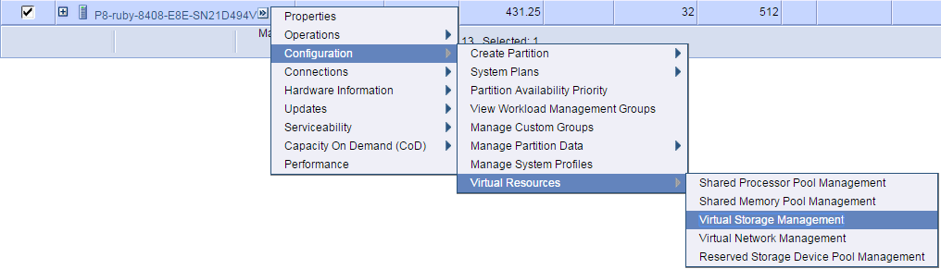
SSP5 – HMC Support Classic view

Slide 58
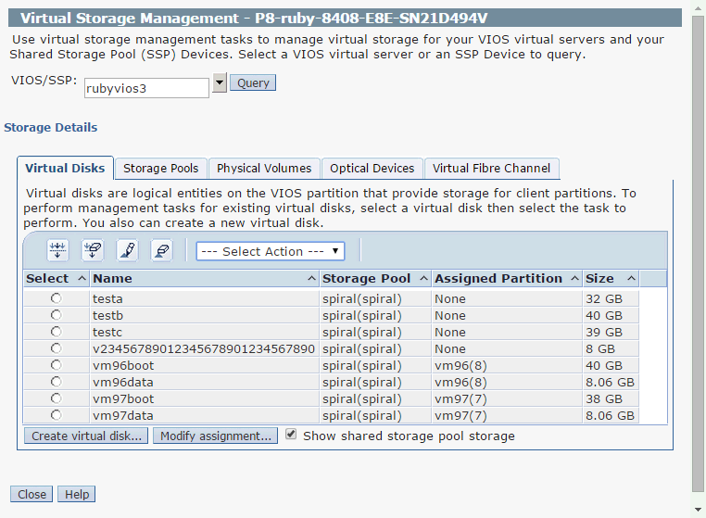
SSP5 – HMC Support Classic view

Slide 59
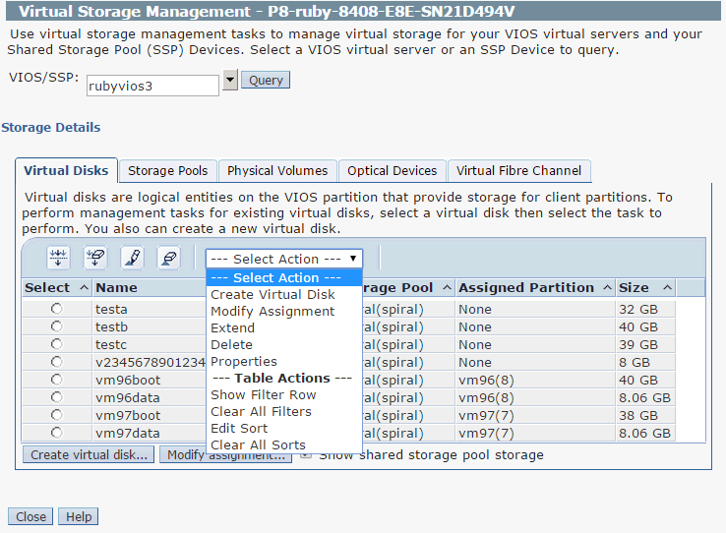
SSP5 – HMC Support Classic view

Slide 60
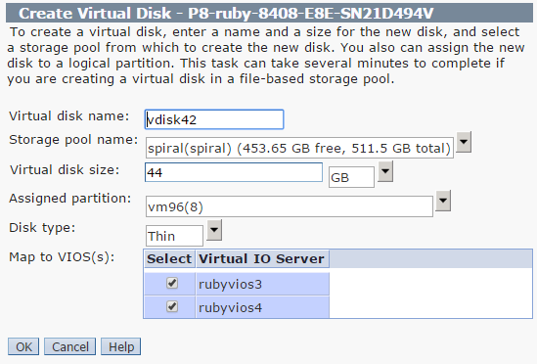
SSP5 – HMC Support Classic view

Slide 61
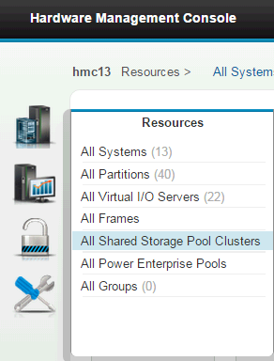
SSP5 – HMC Support Enhanced+ view

Slide 62
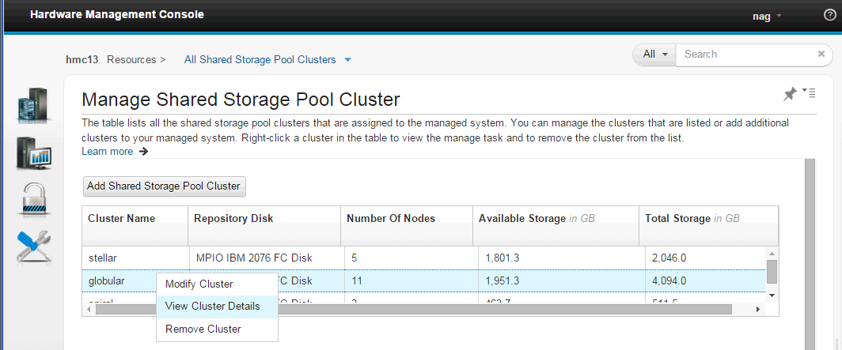
SSP5 – HMC Support Enhanced+ view
Right Click

Slide 63
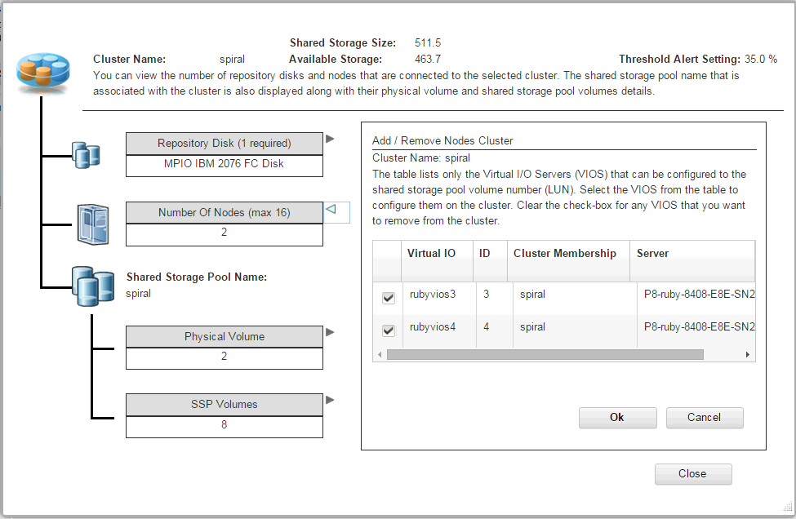
SSP5 – HMC Support Enhanced+ view
Click these for different information

Slide 64
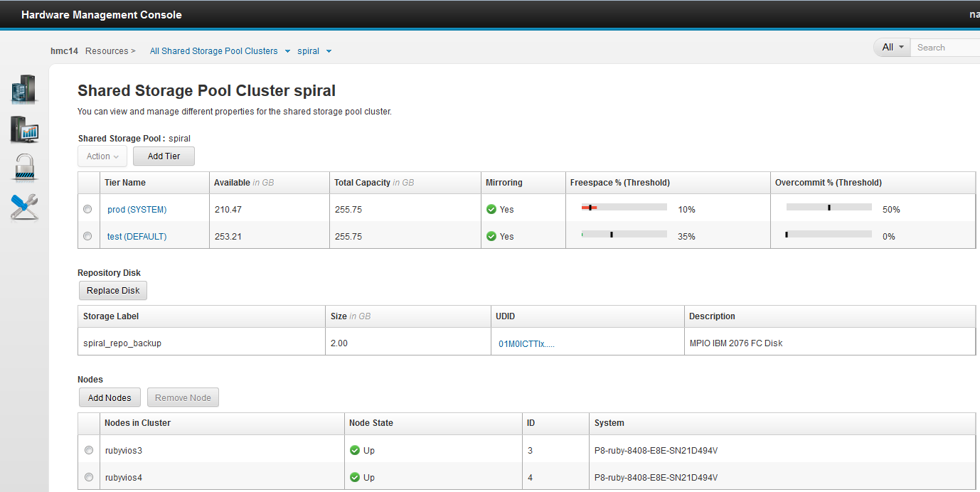
HMC 840 – with Tier support
Alert
Thresholds
Tiers
Add Tier
Mirrored?
Repository Disk
VIOS Nodes

Slide 65
8 SSP5 –Advanced
Tier modify options
Separate SYSTEM tier
lu -move -nonrecursive
Alert is tier based – warnings on SSP near full or grossly over-committed

Slide 66
SSP5 – Tier –modify name & Default tier attribute
Tier Name:
Change tier name (like lu & failgrp modify)
$ tier -modify -tier FRED -attr tier_name=BERT
Note: 1st tier is called “Default” but might not be the Default tier!
Default tier:
Use tier -list -verbose
And look for TIER_DEFAULT:YES
lu -create without -tier option go here
Only one tier can be the Default tier - set using
$ tier -modify -tier GREEN -attr default=yes
  Note: can use either default=yes or tier_default=yes

Slide 67
SSP5 – separate SYSTEM Tier
If your Shared Storage Pool is
  Large (10’s of TB)
  High rates of new or changing LUs
  High rates of Thin LU extending – dynamic space allocation
  High numbers of LU tier moves
Then SSP meta-data update I/O rate can be large = effecting performance
The SSP developers really like the idea of a separate SYSTEM tier disks
Separate the meta-data I/O to a different disk set
  To reduce latency i.e. meta-data I/O not queued behind data I/O
Turbo charge SYSTEM tier by using FC Flash storage

Slide 68
SSP5 – separate SYSTEM Tier
SYSTEM TIER “Rules of thumb”
When separate SYSTEM meta-data is recommended
→ If you have some fast LUNs and
much slower larger User tier LUNs
→ If you have access to limited Flash LUNs
The size of the SYSTEM tier needed
→ 0.3% of the User Tiers

Slide 69
SSP5 – SYSTEM Tier
Tier types:
SYSTEM ← SSP meta-data only
COMINGLED ← SSP meta-data and LUs
USER ← All other Tiers for LU data
1st tier has to be type SYSTEM or COMINGLED (only one)
Set Tier type “system” or “system comingled”
$ tier -modify -tier RED -attr type=system
$ tier -modify -tier RED -attr type=comingled
If Type SYSTEM
Can lu -move a LU from it ← used to remove LUs from this SYSTEM Tier
until no LUs left in it= only meta-data
Can’t lu -move a LU to it

Slide 70
SSP5 – SYSTEM Tier
Number of Tiers
1
2
2
many
Comingled =
(SYSTEM +
User LUs)
Default
cluster -create single tier
cluster -create two tier then add more tiers
Comingled =
(SYSTEM +
User)
User LUs
Default
User LUs
Default . . . .
SYSTEM
No user LUs
SSP metadata is much smaller than the LU data so a SYSTEM only tier could be smaller
User LUs
Default
SYSTEM
No user LUs
User LUs
Default
User LUs
User LUs
User LUs

Slide 71
SSP4 to SSP5 – adding a tier (new or reused LUNs)
With SSP4 this is all you have
1 tier, comingled and default
Comingled =
(SYSTEM +
User LUs)
Default
1 Add more LUNs for new tier -create …
Comingled
Completely new LUNs
for new tier
User LUs
Default
2 lu -move VM to new tier or create more LUs
OR
1 pv -remove LUNs from SYSTEM tier
2 tier -create with these released disks
Comingled
Reuse existing LUNs
for new tier
Assuming:
SSP has spare capacity
User LUs
Default
3 lu -move VM to new tier

Slide 72
Upgrading SYSTEM tier to Faster/Flash LUNs
You can’t directly move the SYSTEM tier
For example: to faster LUNs to gain performance
You have to rotate your disks (LUNs)
Scary the first time!!
Next is two ways to get this done . . .
SYSTEM Tier
User Tier
Fast
Disks

Slide 73
Upgrading SYSTEM tier to Faster/Flash LUNs
You can move the SYSTEM tier
  1 Add fast disks: pv -add -tier sys -fg san1: hdisk98 -fg san2: hdisk99
  2 Then remove slow: pv -remove -pv hdisk42 hdisk52
  3 Then add to User tier: pv -add -tier user -pv hdisk42 hdisk52
SYSTEM Tier
User Tier
Fast
Disks
SYSTEM Tier
User Tier
Fast
Disks
SYSTEM Tier
User Tier
Fast
Disks

Slide 74
Upgrading SYSTEM tier to Faster/Flash LUNs
You can move the SYSTEM tier
  1 One step Swap out: pv -replace -oldpv hdisk42 -newpv hdisk89
  pv -replace -oldpv hdisk52 -newpv hdisk99
  2 Then add to User tier: pv -add -tier user -pv hdisk42 hdisk52
SYSTEM Tier
User Tier
Fast
Disks
SYSTEM Tier
User Tier
SYSTEM Tier
User Tier

Slide 75
Fast/Flash System Tier in practice
Don’t worry – be happy!
Good to monitor SYSTEM meta-data disk I/O
ATS has a 128GB min LUN →128 / 0.3% = 39TB
  Result just one LUN (pair) for the tier = not good for I/O
  Flash is expensive → smaller LUN size so lots of LUNs
VIOS Advisor spots hot disks, small queue depth …
SYSTEM I/0 rate only an issue on
  Very large SSP and very busily changing SSP config
  High numbers of VIOS (future!)

Slide 76
SSP5 – Tiers: LU Advanced move with Clones
lu –move -lu vm42 -dsttier blue -nonrecursive
Background
SSP system admin can’t normally create LU clones
The commands are not documented → Ignoring “under the hood” fiddlers!
But System Director and PowerVC use clones & clones of clones
Then the clones can have snapshots or further clones
Master image 100%
Clones with x% difference
Clones of Clone with y% difference

Slide 77
SSP5 – Tiers: LU Recursive move (default)
Source Tier Target Tier

Slide 78
SSP5 – Tiers: LU Recursive move (default)
Source Tier Target Tier

Slide 79
SSP5 – Tiers: LU Recursive move (default)
Source Tier Target Tier
Could be a massive move of data
LU=100GB and clones ~50% difference
Could move 600GB & same space use
Could be a large-ish move of data
Could move 200GB
50 to 100 GB more space overall
Move 100GB as expected
Source gets more space + 50GB more target space

Slide 80
SSP5 – Tiers: LU Non-Recursive move (-nonrecursive)
Source Tier Target Tier

Slide 81
SSP5 – Tiers: LU Non-Recursive move (-nonrecursive)
Source Tier Target Tier
Note: 1 master images becomes 3!
Free space goes down

Slide 82
SSP5 – Tiers: LU Non-Recursive move (-nonrecursive)
Source Tier Target Tier
Source master clone gone space used goes up ~50GB
Will move 100GB + 100GB more target space
Source intermediate clone gone space used goes up ~100GB
Will move 100GB + 100GB more target space
Move as expected, source 50GB more space
Will move 100GB + 100GB more target space

Slide 83
SSP5 – Summary lu -move with clones
No clones = no complexity
With clone hierarchy it can get complex
  Probably a problem that you which I had never told you about ☺
It can result in
  higher than expected large data moves
  extra space on source and/or target
But it can be used to break a PowerVC clone away
  Example: clone AIX LU & then install Linux on it = no point being a clone
  lu -move -lu vm42 -dsttier blue -nonrecursive
  lu -move -lu vm42 -dsttier red ← Optional move back to original tier

Slide 84
alert -tier mandatory → Messaged sent to the HMC
By example - my tier is called “prod”
  alert -set -tier prod -type threshold -value 10
  alert -set -tier prod -type overcommit -value 50
  Threshold is the Pool “free space” getting low
  i.e. 10 means alert when Pool free space crosses to below the 10%
  Overcommit warns when you go “to far” & risk problems later on.
  50% might be accept on not busy VM’s but 500% is sure to bite you!
$ alert -list
    PoolName:spiral
    PoolId:0000000009893ED900000000560AA6E3
    TierName:prod
    ThresholdPercent:10
    OverCommitPercent:50
    PoolName:spiral
    PoolId:0000000009893ED900000000560AA6E3
    TierName:test
    ThresholdPercent:35
    OverCommitPercent:N/A
Nigel’s Recommendation:
Set alert values but monitor
in coming Alerts via HMC
(which every customer
should be watching) !!
The defaults

Slide 85
Summary VIOS 2.2.4 with SSP Tiers
  SSP LU Resize (grow = saves admin time)
  DIY lu -list
  SSP Tiers (multiple pools only better)
    10 tiers (think grouping not levels)
    Fast, medium, slow or IBM, HDS, EMC or prod, in-house, test
    lu -create -lu fred -size 32G -tier prod lu -move -lu fred -dsttier test
  SSP mirrored now at tier level (was whole pool)
  SSP LU move between tiers
  Possible separate SYSTEM tier LUNs
  HMC GUI Support

