Slide 1

Kieran Colville
Kenexa, an IBM Company
Dublin, 30 May

Slide 2


Slide 3
Sleepless nights at the C-Suite level…
Over 50% of company expenditure is people related but the return on this spend is rarely measured effectively
A lack of skills and capabilities is rated consistently as one of the biggest concerns of C-Suite Executives
66% of CEOs don’t rate succession planning as effective
77% of CEOs are reviewing their talent strategy in 2013
$13 billion spent by US companies on leadership development in 2012

Slide 4
Two overarching objectives
Hire more people like your best people
Maximise their performance and engagement

Slide 5
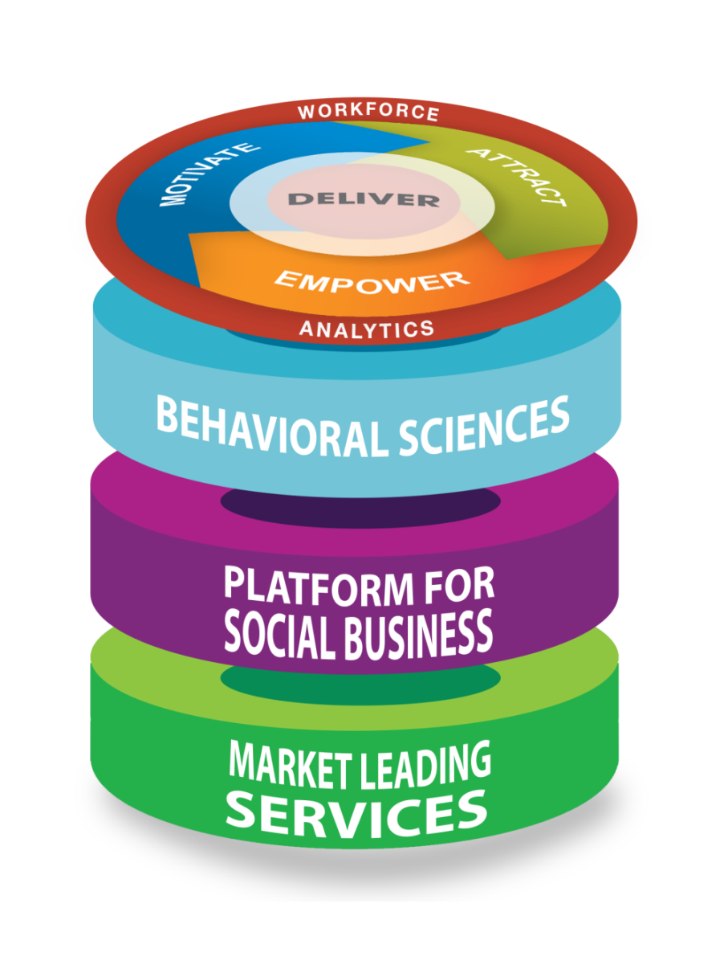
Introducing a new era of Smarter Workforce
World-class Talent Management technology
Science that makes it “smarter”
Social platform to drive adoption
Focused and scalable services

Slide 6
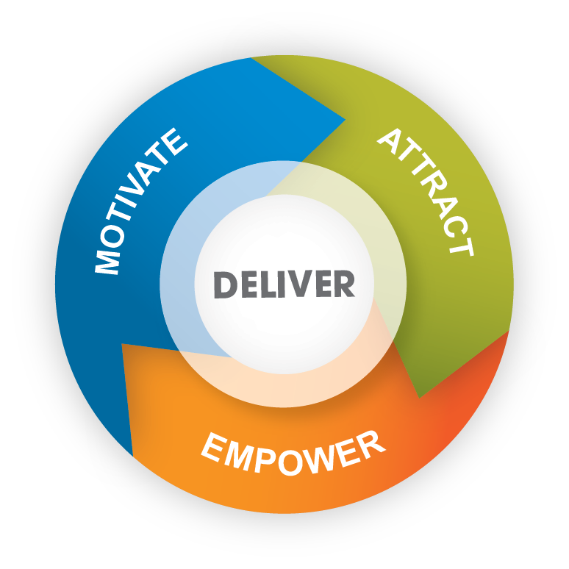
Organisational Surveys
Sourcing and Employer Branding
Measuring and improving organisational performance and employee engagement
Attracting the right talent
for the right job
Resourcing
Talent and Succession
Transforming organisations
one hire at a time
Identifying successors and high potentials to drive future performance
Selection for recruitment
Hiring the very best using predictive assessments
Building People
Capability
Equipping leaders and employees with the behaviours to drive higher levels of performance
Compensation benchmarking
Optimising investment and retaining key employees
Learning and Collaboration
Performance Management
Providing the technology and tools to create a culture of learning and sharing
Technology and skills to ensure employees have clear direction and the tools to do the job

Slide 7
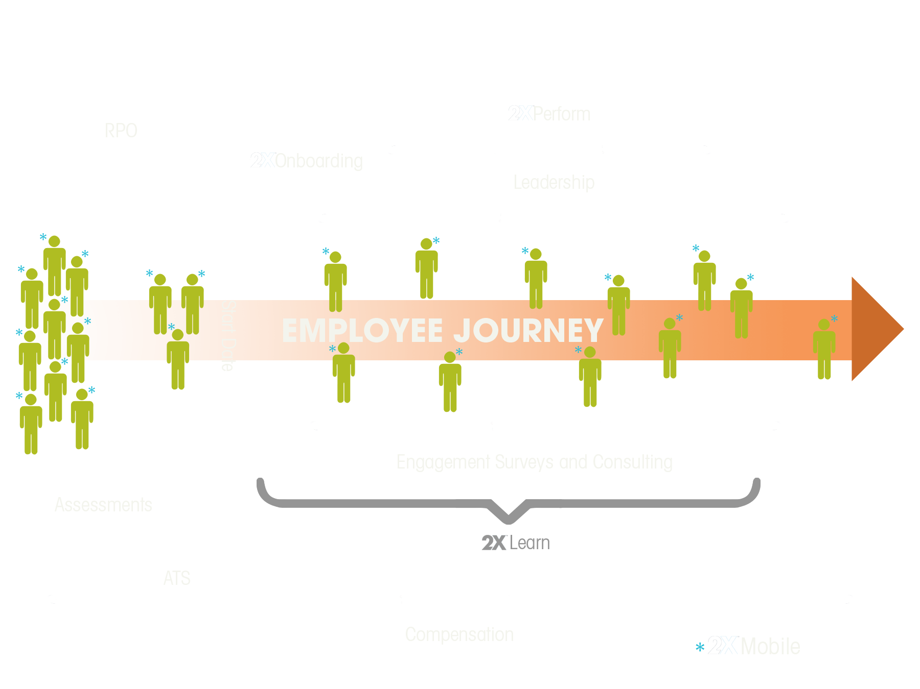
TALENT
LEADERSHIP
DEVELOPMENT
SUCCESSION
EXIT
EMPLOYEE JOURNEY
ENGAGEMENT
LEARNING
START DATE
PERFORMANCE
RECRUIT
ASSESS
ONBOARD
SALARY BENCHMARKING

Slide 8
Two overarching objectives
Hire more people like your best people
Maximise their performance and engagement

Slide 9
Business Metric
Customer Satisfaction Index | 2.76 points
Diluted Earnings Per Share | $1.05
Three Year Total Shareholder Return | 2.82%
Return on Assets | 1.18%

Slide 10
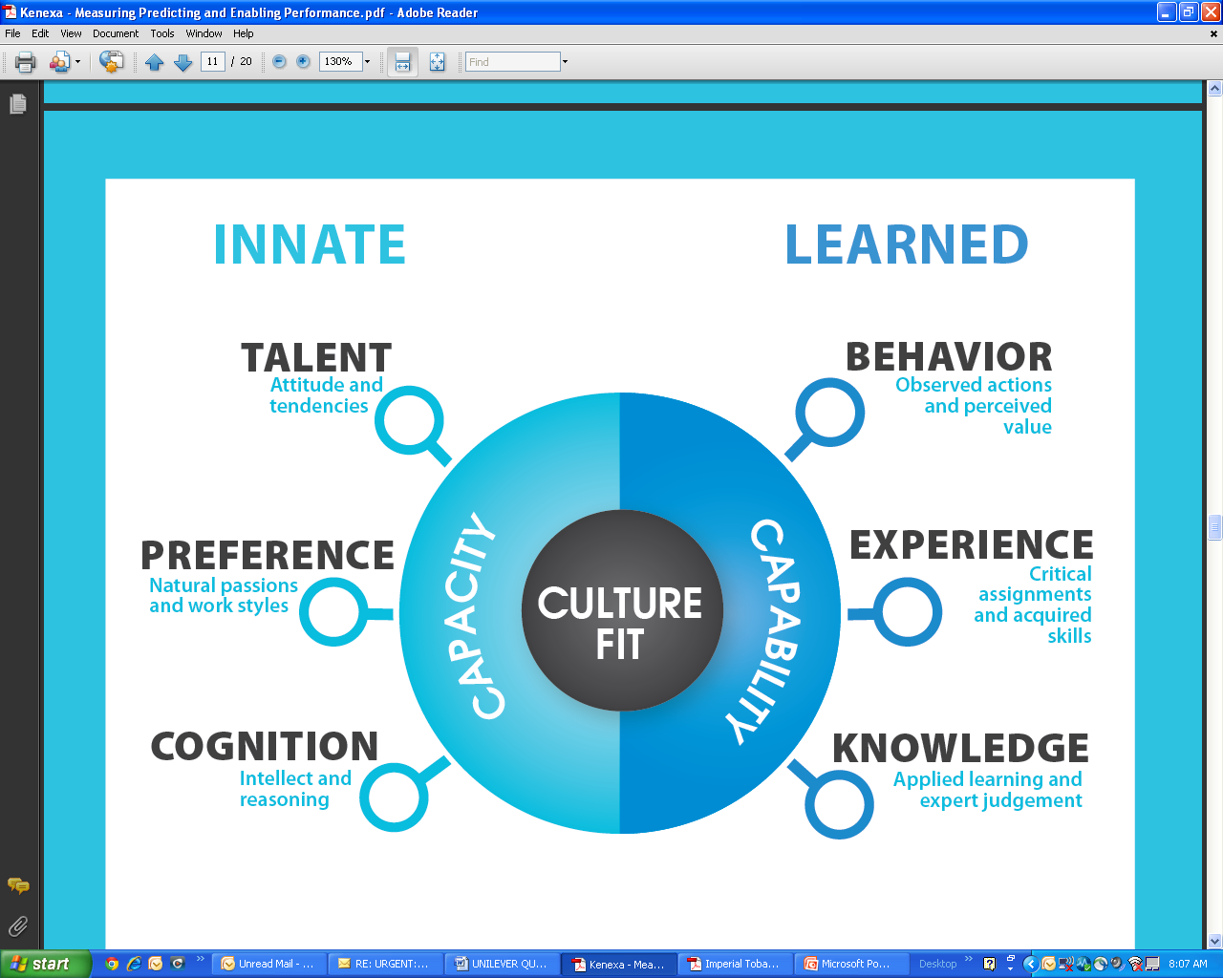

Slide 11
Applying the science to drive your business forward
SUCCESS
PROFITIBILITY
RECOMMEND
ASSESSMENTS
Critical Job Roles?
RETENTION
DEVELOPMENT
PRODUCTIVITY
ENGAGEMENT
1
2
3
4
CRITICAL JOB IDENTIFY INDIVIDUALS DEFINE SUCCESS RECOMMENDATIONS

Slide 12






Science enabled by world class technology
RECRUITMENT
TECHNOLOGY
PERFORMANCE
MANAGEMENT
LEARNING
COMPENSATION
MANAGEMENT
ASSESSMENTS
SURVEYS
ANALYTICS THAT DRIVES PERFORMANCE

Slide 13










The world’s best talent management technology
323 million candidates
1 million users per day
170 countries
36 languages
45 million applications per year
650+ deployments

Slide 14
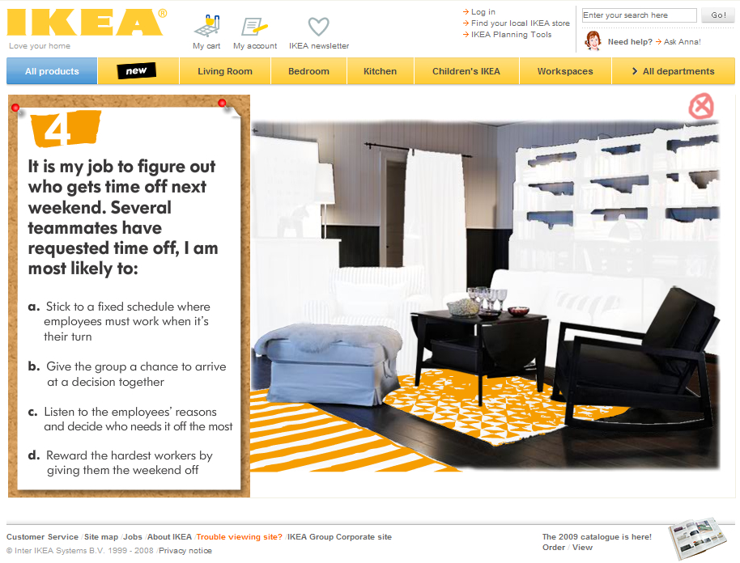

Slide 15















































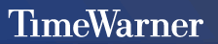




Financial Services
Manufacturing
Services
Insurance / Pharmaceuticals
Retail / Consumer
Other

Slide 16

Smarter Workforce in action: RBS
£500 million in operational savings
Greater customer focus
Higher employee engagement
HOW?
By creating and embedding a way for teams and leaders to make better decisions; solve live business problems; and drive effective collaboration

Slide 17

Smarter Workforce in action: Network Rail
A consistent improvement in train reliability and punctuality
Estimated £50,000 ROI per person
Employee engagement increasing by 9%
Enhanced leadership capability recognised by the European Foundation for Quality Management
HOW?
A culture change programme that combined leadership development, employee engagement, reward and performance management

Slide 18

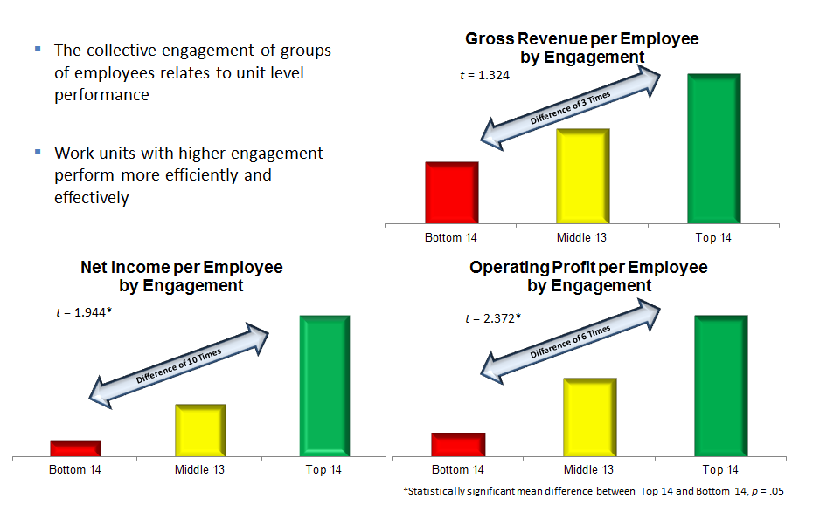
Smarter Workforce in action: Allianz
A global measure of workforce health that drives business performance
HOW?
An integrated organisational survey and behaviour change programme aimed at driving KPIs across the bank

Slide 19

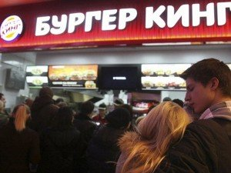
Smarter Workforce in action: Burger King Europe
New market entry
New revenues streams identified and monetized
HOW?
An assessment and talent development programme aligned to critical business projects

Slide 20
Two overarching outcomes
More people like your best people
Engaged employees who stay longer, work harder and perform better

