Slide 1
Virtualisation Challenges
IBM Smarter Storage Symposium – July 2012
Hardev Sanghera, Partner SE

Slide 2

Agenda
Virtualisation has many benefits such as cost savings and improved DR – but we don’t want them reduced by a different set of problems
In a virtualised infrastructure you need to make sure your storage is agile and enterprise class.
It’s arguably the most important building block in your virtualised infrastructure
www.freeimages.co.uk

Slide 3











VMware is the Customer Proven Market Leader
Company Overview
  FY ‘11 $3.77BN (27% growth)
  > $1 billion trailing q1 ‘12 revenue
    (25% growth)
  Over $5 billion in cash and equivalents
  Healthy Margins
  ~11,000 employees worldwide
  5th largest infrastructure software
  company in the world
Proven in the Trenches
  300,000+ VMware customers
  100% of Fortune 100
  100% of Fortune Global 100
  99% of Fortune 1000
  97% of Fortune Global 500
Notes:
So we have a strong well managed industry player – our key ratios (that’s finance talk!) are healthy – here are some key points – so we’re well run and have the management and financial momentum to enable virtualization.

Slide 4

Business and Market Pressures Weigh Heavy on Businesses
React quickly to changing market conditions
Contain costs and improve productivity
Improve quality of products and processes
Grow revenues
and customers
Continually innovate to beat competition
Sources: SMB Group 2011: Top 10 SMB Technology Market Trends; Zoomerang 2011 Study: SMB Business Perspectives; Forrester 2011
Notes:
SLIDE: Business and Market Pressures Weigh Heavy on SMBs
Today SMB customers face increasing business and market pressures that are weighing them down. They are looking to grow revenues and customers while controlling costs. They need to be nimble and react quickly to changing market conditions while improving quality of products and processes – avoiding the false choice between innovation and quality. With limited resources, they need the ability to scale but also remain nimble vs larger competitive forces, maintain profitability and stay in business.

Slide 5



New Technology, While Vital to SMB, Brings IT Challenges
More mobile devices and apps
More clouds
forecast
IT Challenges
1.1 billion
Cell phones shipped by 2015
>30 percent
SMBs have or plan to adopt cloud in the next year
300 million
Tablets shipped by 2015
Complexity of diverse IT environments
Seamless technology adoption
Availability and security of systems and applications
Streamlining processes
Demand for instant access
66 percent
Growth rate of cloud data traffic by 2015
85 percent
SMBs surveyed stating employees use personal devices for work.
Source: CompTIA Annual SMB Technology Adoption Trends Study; Gartner Survey Analysis: Midsize-Business Cloud Plans; Reuters 2011, Forrester 2011
Notes:
SLIDE: New Technology is Vital to SMB but Brings IT Challenges
Today, many small and mid-sized businesses are adopting new technology to strengthen their business, as was seen in the recent SMB technology adoption trends study by CompTIA (Computing Technology Industry Association, a non-profit trade association advancing the global interests of IT professionals and companies, we focus our programs on four main areas: education, certification, advocacy and philanthropy.)
Mobile devices and applications are increasing in the workplace with 85% stating that employees already use their personal devices and 40% who have or plan to adopt these solutions as a company. In addition, more cloud computing is forecasted with over 30% who have or plan to adopt cloud in the next year for storage/ backup, email, document management, and collaboration.
This trend while vital to SMB is putting pressure on IT and raising challenges with increasing demand for compute hardware, capacity and performance. There’s an increase need to keep the business up and running with no downtime. IT management and security is becoming more complex and costly and end-user productivity is becoming increasingly critical with the need to support various mobile devices.

Slide 6

You business is what matters
Real business value
Notes:
Your business is really what matters – doesn’t matter what I think – so if you’re going to make a technology ‘bet’ you need to be assured about the financial health and capability of the company. What we’re trying to fix is the 70/30 split – the split of your IT budget where as much as 70% of it is used to keep the light on and the other 30% is used to make your business more agile, competitive and support new projects. Like it or not you’re kinda in the software business – getting an app (home grown, Off the shelf or SaaS) quicker is a real bonus – look at Kodak vs Google(?) and Barnes & Noble and Amazon.
While were talking about money - here’s a picture of a really rubbish money launderer – hasn’t quite grasped the concept !

Slide 7
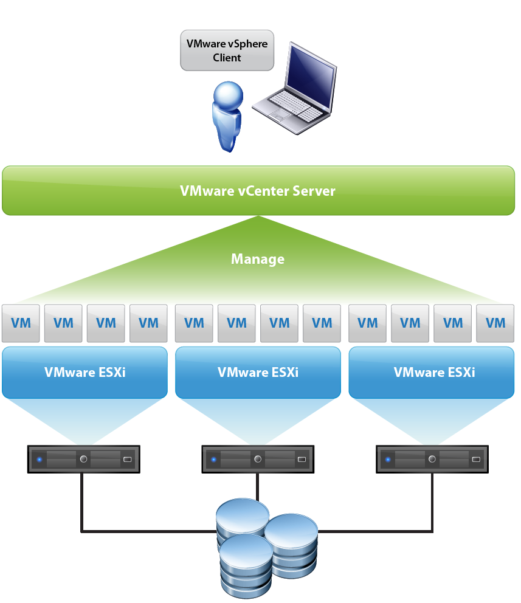
VMware vSphere Deployment Architecture
Management Layer
vCenter Operations Manager
vSphere Client
Virtualization Layer
vSphere
Hardware Layer
Storage
Server
Network
Notes:
SLIDE: VMware vSphere Deployment Architecture
A vSphere deployment consists of three layers: the hardware layer, the virtualization layer and the management layer.
The hardware layer includes your storage, server and network infrastructure.
The virtualization layer is comprised of the hypervisor, VMware ESXi and the virtual machines that run on top of the hypervisor.
The management layer consists of the vSphere client to manage the VMware hypervisor and vCenter Operations Management Suite, which controls all of the application services, such as availability, security and scalability.

Slide 8
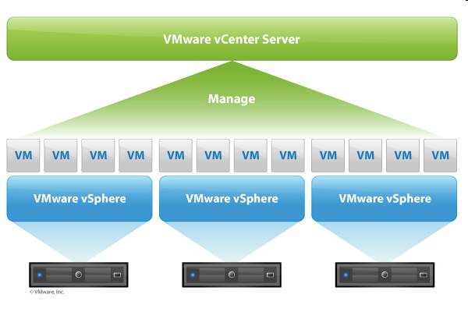
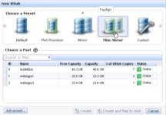






Virtualisation Built-In - Virtualise the ‘Complete Infrastructure’
Virtual Server Infrastructure
FREE Virtual Centre Plug-In for Storwize V7000
Manage
Storwize V7000
Storwize V7000
Virtual Storage Infrastructure
Tivoli Storage Productivity Center
Storage Virtualisation
Manage

Slide 9
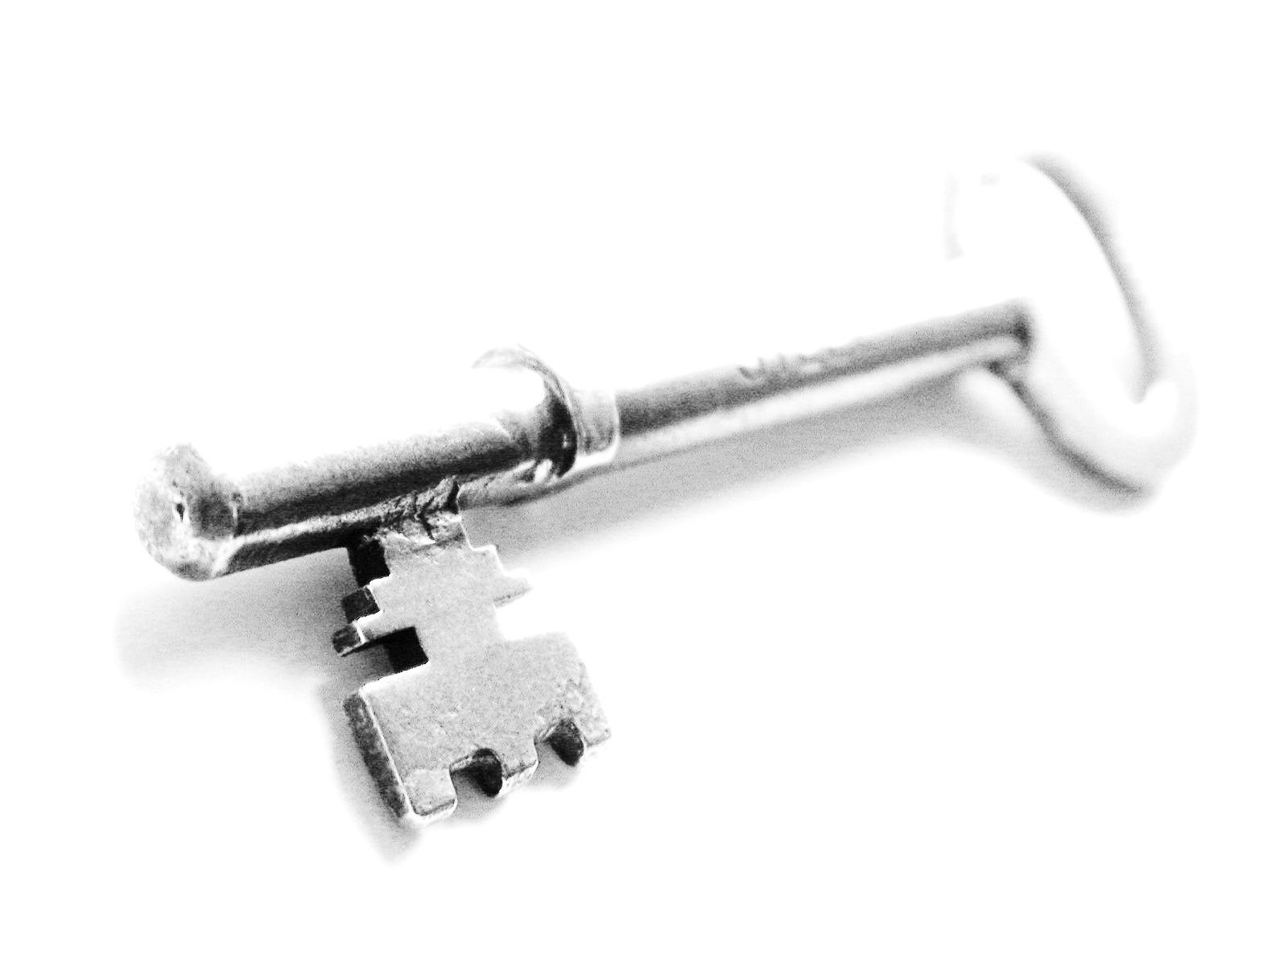
The Challenges
Storage is at the core of virtualised environment
  Manageability
  Utilisation
  Sprawl
  Changing application demands
  Performance
Requirements around storage
  Easy to manage
  Agile
  ‘Enterprise’ class
  Functionality
  Enhances Business Continuity
  Managed costs
www.freeimages.co.uk

Slide 10

VMware and IBM: Joint Innovation
Partnering for more than 13 years – more than 20,000 joint Customers
One of the largest number of dedicated 1,600 VMware certified professionals outside of vmware
IBM level 1 and level 2 support – single point of contact for hardware and software escalations.
VMware level 3 and 4 – best of both worlds.
Joint Development and Solutions
  Data Centre Consolidation
  Business Critical Applications
  Virtual Desktop and Mobility
  Business Continuity & Disaster recovery
  Private and Public Cloud Offerings
IBM x86 Virtualization:
First VMware system vendor
First VMware joint development partner
First to offer comprehensive VMware support
First blade to include VMware
First demonstrated VMware embedded hypervisor
First VMware managed desktop offering
First reference platform for vSphere scalability
10
Notes:
For nearly a decade, VMware and IBM have collaborated to deliver integrated virtualization solutions to over 10,000 customers. In fact, IBM was the first VMware system vendor, the first joint development partner, and the first to offer comprehensive VMware support. In addition, IBM was the first to include VMware integrated into a blade server and the first to demonstrate the embedded hypervisor. IBM won "Best of Show" at VMworld 2007 with this offering. Finally, IBM had the first VMware managed desktop offering. IBM was also the first OEM to leverage VMware's SDK to deliver IBM Virtual Machine Manager. This capability plugs into IBM Systems Director and enables our mutual customers to manage both their physical and virtual machines from a single pane of glass.
We continuously collaborate to bring customers solutions that solve real challenges and this IBM eX5 announcement continues the rich history of collaboration between IBM and VMware.

Slide 11


Thank You
Hardev Sanghera
Partner SE
@ hardev@vmware.com
07802 930373
www.flickr.com/photos/horiavarlan

