Slide 1
Expect More….
IBM Smarter Storage Symposium
A Client’s Perspective
London 5th July
Welcome
Notes:
Slide notes are distributed as separate document

Slide 2
Expect More….
IBM Smarter Storage Symposium
A Client’s Perspective
London 5th July
Paul Cameron
IBM UKI System Storage
Business Unit Executive
Notes:
Slide notes are distributed as separate document

Slide 3
Agenda
Time | Speaker | Support | Subject
15 mins | Paul Cameron |  | Welcome to the IBM System Storage Symposium
15 mins | Ian Shave |  | IBM - Smarter Storage
30 mins | David Rogers | Nick woods | Deloitte - Microsoft Exchange
30 mins | Hardev Sanghera | Dominic | VMware - Virtualisation
30 mins | Steve Uniack |  | IBM – Virtual Storage Center
30 mins | Richard Corrigan |  | Alliance
10 mins | Paul Cameron |  | Closing remarks and questions
Storage Solution Expo and Lunch
Voting System
Collateral Folders
Notes:
4/30
A zettabyte is 10 to the 21st power.
34% are considering cloud storage, InfoWeek State of Storage 2012
Up to 80% of data is unstructured
“IT labor costs will be 70% of IT spend by 2013” IDC data, report coming from Wikibon

Slide 4


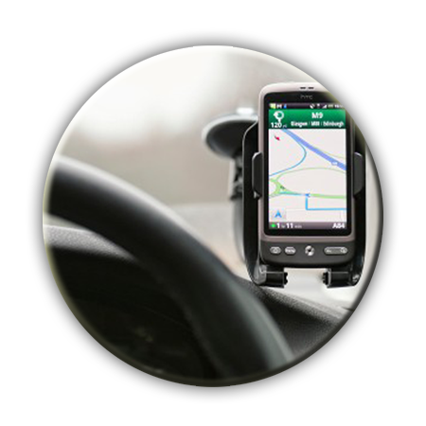



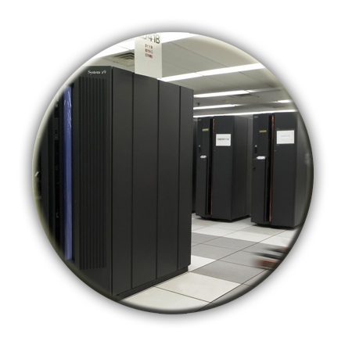
Efficient Access to Information Fuels Smarter Business
We face 40% - 60% annual growth in the volume of data vs 5% growth in global IT Spending (Big Data Analytics 2012)
90% of organizations expect to adopt or deploy a cloud model in the next 3 years (IBM Market Intelligence)
By 2020, IT departments will be looking after 10 x more servers and 50 x more data (IBM Market Intelligence)
Analytically savvy companies are 2x more likely to outperform
their industry peers (IBM Market Intelligence)
5 exabytes of data were created between the dawn of civilization and 2003. Today, that much information is created every two days. (Eric Schmidt, CEO, Google)
Labour costs will be 70% of IT spend by 2013 (IBM Market Intelligence)
Notes:
4/30
A zettabyte is 10 to the 21st power.
34% are considering cloud storage, InfoWeek State of Storage 2012
Up to 80% of data is unstructured
“IT labor costs will be 70% of IT spend by 2013” IDC data, report coming from Wikibon

Slide 5

IBM Storage is Key to Smarter Computing
Managed with
cloud technologies
Storage Virtualization enables a robust cloud deployment
Smarter
Computing
Storage Efficiency is essential to outpace data growth
Designed for data
Tuned to the task
Storage must adapt to changing information patterns
Source: IBM studies of CEOs and CIOs

Slide 6
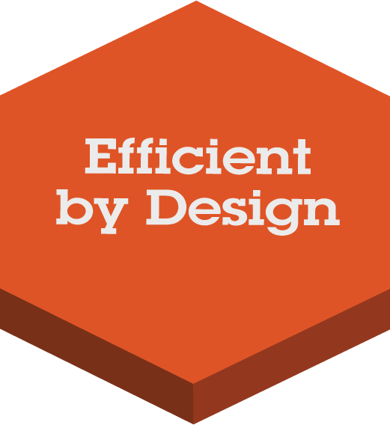


Introducing IBM Smarter Storage for Smarter Computing
Manage cost and capacity growth
Improve performance and productivity
Increase information access and improve ROI
Notes:
6
Smarter Computing is delivered through a combination of three characteristics of an IT infrastructure. The key point is that this is an IT infrastructure that actually enables a Smarter Planet. As clients want to seize the opportunities that are presented by a Smarter Planet they need to think differently about their infrastructure.
Why? Why do they need to design for the data, all the data that they need, not just the data that they traditionally use of new forms of information? Because companies are challenged to harness all this information. In fact 89% of CEOs actually say that they want better insight through business intelligence. This is a challenge of the IT department to design their infrastructure for all of this data.
Tuned to the task, this is really about leveraging optimized systems, systems that are optimized for specific workloads to drive greater performance and improve IT economics. Why? Because today we have the ability to reduce total cost per workload by up to 55% and drive tremendous savings by matching the right system to the workload, the applications that need to be supported, the data that needs to be used. It’s a tremendous opportunity.
Why do we need to manage with cloud technologies? Because cloud actually gives the opportunity to reinvent IT and transform service delivery. 60% of CIOs plan to use cloud technologies which is up almost two fold over a year ago. 55% of business executives believe that cloud can enable business transformation. The business is demanding a new approach to IT; they want it managed differently to be able to deliver service delivery, better quality the way they want to consume it.
So Smarter Computing is about designing an infrastructure that is ready for a Smarter Planet, that is able to harness the data that’s there, use the right system and manage your IT infrastructure in a much more cloud like fashion. We believe we are the only company in the industry who can partner with clients to help them build out an infrastructure that fits these requirements and reflects these three characteristics.
=====================
Sources:
Harness all available information - 89% of CEOs* want better insight via Business Intelligence and analytics
*IBM Global Chief Information Officer Study, May 2011
Drive greater performance and improve IT economics - total cost per workload can be reduced up to 55%* with optimized systems
* “How zEnterprise Drives Lower Cost for Workload Deployment,” Ray Jones, WW Vice President, z Software. Cumulative savings over 3 years (Total Cost per Workload comparison (Servers, Network, Power, Labor, Storage) – 2500 heavy I/O workloads, 500 heavy workloads, 7000 light workloads – Deployed on Intel ($62K / workload) vs. Best fit on zEnterprise ($28K / workload).
Reinvent IT - 60% of CIOs plan to use cloud technologies* and 55% of business executives** believe cloud enables business transformation
*IBM Global Chief Information Officer Study, May 2011
====================

Slide 7


Slide 8
Agenda covered this morning…
Paul Cameron | Welcome to the IBM System Storage Symposium
Ian Shave | IBM - Smarter Storage
David Rogers | Deloitte - Microsoft Exchange
Hardev Sanghera | VMware - Virtualisation
Steve Uniack | IBM – Virtual Storage Center
Richard Corrigan | Alliance
Paul Cameron | Closing remarks and questions
Storage Solution Expo and Lunch
Notes:
4/30
A zettabyte is 10 to the 21st power.
34% are considering cloud storage, InfoWeek State of Storage 2012
Up to 80% of data is unstructured
“IT labor costs will be 70% of IT spend by 2013” IDC data, report coming from Wikibon

