Slide 1
Designing IBM System Storage Solutions for Microsoft Exchange Server 2010
David Hartman, IBM
sEA01

Slide 2
A little about me…
Own the technical relationship between IBM System Storage™ & Microsoft. Responsible for:
  Driving technical enablement, i.e. feature support (SMI-S, VSS, ODX)
  Creating technical collateral (ESRP, whitepapers, Redguides)
  Creating joint solutions such as the Hyper-V Fast Track & SQL Server Data Warehouse reference architectures
  HW & staffing at the Microsoft campus & the IBM Center for Microsoft Technologies
  Defining technical goals and areas of collaboration between the companies
With IBM since 2004
20+ years hands-on IT from startups to enterprise
  Still have nightmares from on call pager duty
Notes:
A brief synopsis of my role & background.

Slide 3


What’s in a name?
Unfortunately, not affiliated with:
But tormented as a kid thanks to:

Slide 4
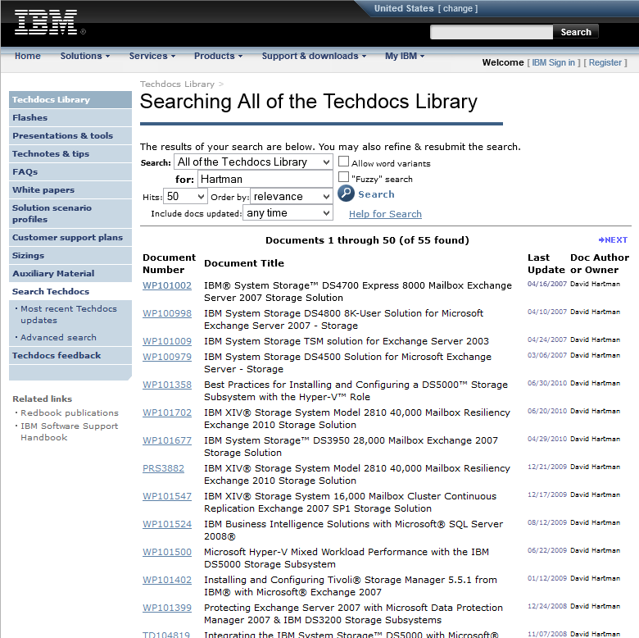
I’ve created some collateral…
Notes:
I have a great team of engineers and a project manager who love (for the most part) Microsoft technologies. Actually, my PM love schedules and timelines. He is largely ambivalent to Microsoft.

Slide 5
Session Objectives
At the conclusion of this session, participants should be able to:
  Intelligently discuss the key architectural design concepts of Microsoft Exchange Server 2010
  Understand Exchange performance characteristics and how they affect storage design and underlying hardware
  Be able to map IBM’s System Storage™ solutions to applicable Exchange scalability, performance and availability requirements
  Adapt best-practices from real-world Exchange deployments that can help to control storage cost and ease management burdens
  Understand work IBM has done to validate our products with Exchange, and where to go for additional resources

Slide 6

Question: What was the first official version of Exchange, and when was it released?
Notes:
Exchange v4.0, April 1996.

Slide 7



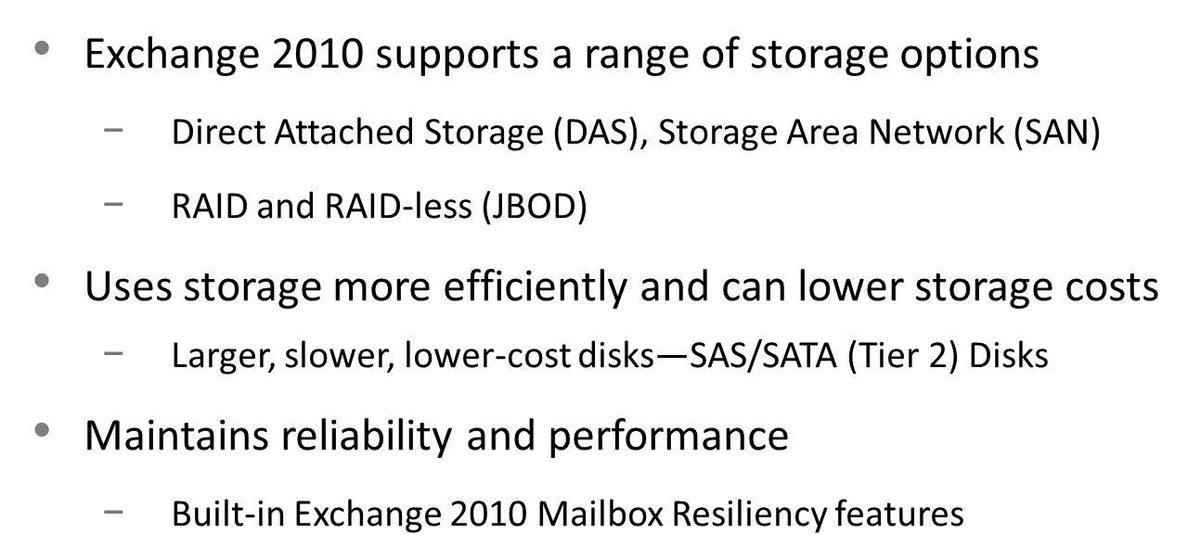
Design Drivers in Exchange Server 2010
Large Mailboxes at Low Cost
Notes:
OK, back to the topic at hand. The purpose of this slide is to emphasize what the key design objectives of Exchange Server 2010 were.
The key areas that affect storage are:
Enhancements to the I/O profile
HA design changes from CCR/SCR to Database Availability Groups

Slide 8




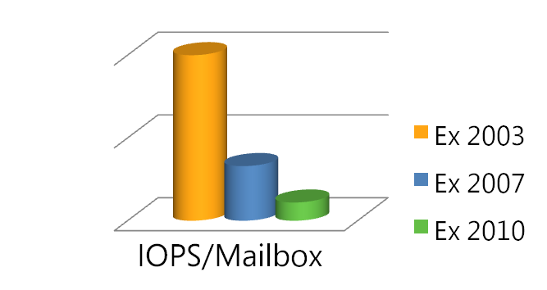
Storage Improvements
New options with performance enhancements
Choose from a range of storage technologies that can reduce costs without sacrificing system availability
Storage Area Network (SAN)
Direct Attached w/ SAS Disks
SATA Disks
JBOD
(RAID-less)
Exchange 2010 storage enhancements
90% reduction in IOPS from Exchange Server 2003
Smoother I/O patterns
Resilience against corruption
Notes:
Take a look at this chart and tell me what sort of messaging the Exchange Team is promoting regarding Exchange Storage?
I will answer that question shortly…

Slide 9

It is hereby pronounced that:
“The SAN is dead!”

Slide 10

This messaging has been received well by enterprise customers…

Slide 11


XIV – The Exchange Team’s ‘problem child’
As recently as Exchange Server 2007, XIV & the Exchange Team ‘butted heads’
  What was that about log & database spindle isolation?
  Cannot be physically achieved in a
  virtualized storage system
  No ESRP’s for XIV?!
  ‘Unsupported’ architecture?!
After much animated dialog
  Common sense prevailed in Redmond
  Microsoft actually loves XIV (and the SVC/V7000
  after their respective GUI updates)
Exchange is actually one of XIV’s top workloads…
Notes:
Oh boy…

