Slide 1

Storage Challenges
Client Conundrums
David RS Rogers \ 5th July 2012

Slide 2
Contents
Introduction
The growth of data – the promise of an unlimited mailbox
Data Assurance – who exactly do we need to put on WORM
Is email really critical – the operations manager’s dilemma
Closing thoughts

Slide 3

1. Introduction
Who am I
David Rogers
Been in IT consultancy for ... a while
Part of Deloitte’s Infrastructure practice
Leads infrastructure eCommerce
Works primarily with Retailers, but has worked in FSI, Public Sector and manufacturing.
Modular storage evangelist
Currently doing operational support for a large sporting event hosted in the east end of London

Slide 4
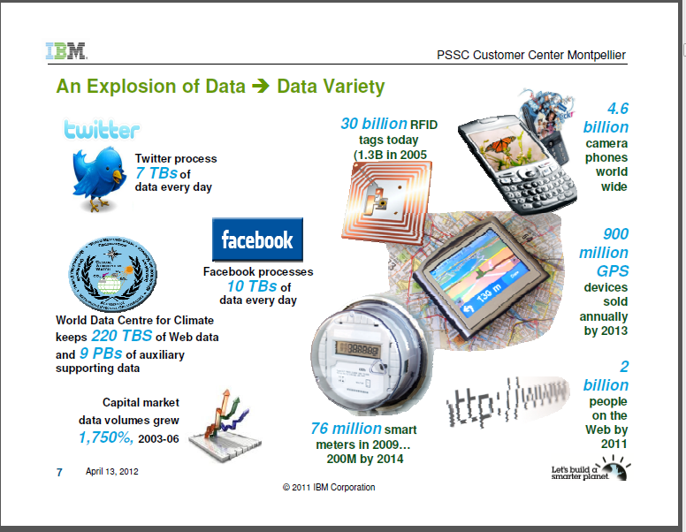
2. The growth of data
The promise of an unlimited mailbox
The Big data story?
Proliferation of data, both personal and business
Email archives cover several years, many systems and can be considerable hidden data requirements
PST ingestion, auto archive
Exchange 2010 promises move to low cost tier of storage
Translated into ‘we don’t need to worry about it because storage is cheap’
‘Every two days we now create as much information as we did from the dawn of civilisation up until 2003’
Eric Schmidt, CEO Google
Notes:
In a networked world, trust is the most important currency.
Eric Schmidt, University of Pennsylvania Commencement Address, 2009

Slide 5

3. Data Assurance
Who exactly do we need to put on WORM?
Perception of growing legislation to cover email.
Need to assure the authenticity of data for government and clients
Does not need to be all data
Technology is not a solution to poor data lifecycle management
Define the security model and implement it

Slide 6

4. Is email really business critical?
The operations manager’s dilemma
No
Unless you are Hotmail or Gmail then email should not be business critical.
However, what happens if the email system is down?
Low cost storage tier vs. Highly Available resilient architecture.

Slide 7
5. Some closing thoughts
New technologies in the Storage tier can improve your usage and ease of operation – SVC, modular storage.
Others such as compression, de-duplication will reduce your growth rate.
However the perception of storage becoming cheap has reset the end user’s expectations.
Technology is only a band aid to buy you time to implement a cohesive data lifecycle strategy.

Slide 8
Deloitte refers to one or more of Deloitte Touche Tohmatsu Limited (“DTTL”), a UK private company limited by guarantee, and its network of member firms, each of which is a legally separate and independent entity. Please see www.deloitte.co.uk/about for a detailed description of the legal structure of DTTL and its member firms.
Deloitte MCS Limited is a subsidiary of Deloitte LLP, the United Kingdom member firm of DTTL.
This publication has been written in general terms and therefore cannot be relied on to cover specific situations; application of the principles set out will depend upon the particular circumstances involved and we recommend that you obtain professional advice before acting or refraining from acting on any of the contents of this publication. Deloitte MCS Limited would be pleased to advise readers on how to apply the principles set out in this publication to their specific circumstances. Deloitte MCS Limited accepts no duty of care or liability for any loss occasioned to any person acting or refraining from action as a result of any material in this publication.
Registered office: Hill House, 1 Little New Street, London EC4A 3TR, United Kingdom. Registered in England No 3311052.
© 2012 Deloitte MCS Limited. All rights reserved.
Member of Deloitte Touche Tohmatsu Limited

