Slide 1
Smarter Process for Government
Smarter Process for Government

Slide 2

Change
2
Notes:
One of the key trends in improving business operations is the “consumerization of change”. This trend is enabling business users to own more and more of the small operational changes that occur continuously. Since new tools are now more accessible and require very little training or unique skills, IT can empower the business to own operational aspects of systems while maintaining strict governance of deployments.

Slide 3






Dynamic Challenges Exist at All Levels of Government
ACCELERATING GLOBALISATION
Countries and societies are becoming more economically interdependent across social, political and cultural boundaries, as illustrated by current economic conditions.
EVOLVING SOCIETAL RELATIONSHIPS
Today, governments are expected to deliver results and value through secure, private services that are available anywhere at any time.
EXPANDING IMPACT OF TECHNOLOGY
  The adoption of the Internet is remaking the landscapes of business, healthcare and government.
  CHANGING DEMOGRAPHICS
  Median ages are rising in the developed countries of Italy, Germany and Japan,
  but dropping in developing ones such
  as India.
  RISING ENVIRONMENTAL CONCERNS
Societies and governments are becoming more attuned to what the earth can provide and what it can tolerate.
  GROWING THREATS TO SOCIAL STABILITY AND ORDER
  From terrorism to armed conflict to pandemics to natural disasters, the character of threats is changing.
Source: “Government 2020 and the perpetual collaboration mandate”
IBM Institute for Business Value
3
Notes:
3
For governments, this means taking a stronger leadership role in leading in the face of complex challenges, of which many have global implications, and making the world a better place and smarter planet. As government leaders look to develop strategies for change… those strategies must align with existing realities… drivers (listed on chart), constraints, aspirations… that were identified through a recent Government 2020 Research Report… and the call for a new imperative… ‘Managing within the current global financial and economic crisis in a way that begins to solve the above challenges and lay a foundation to build a better future.’
Why must we get smarter? Because we can: the technology is both available and affordable. Because we must: the shocks we’ve seen to so many systems show that the current approaches aren’t sustainable. And because we want to. IBM is starting a conversation with our government clients and with the world because we think now is the time to make changes for the better.
ACCELERATING GLOBALIZATION
Countries and societies are becoming more economically interdependent across social, political and cultural boundaries, as illustrated by current economic conditions.
Korea Customs Service is a great example
EVOLVING SOCIETAL RELATIONSHIPS
Today, governments are expected to deliver results and value through secure, private services that are available anywhere at any time.
District of Columbia: This is our classic story of better services to citizens delivered through web portals and 24h access to social services website with automated eligibility determination and benefits calculation assisted by dynamic questionnaires powered by our BRMS. Veterans Health Administration is another example. State of CA another one. Just be mindful that none of these stories is an actual reference.
EXPANDING IMPACT OF TECHNOLOGY
The adoption of the Internet is remaking the landscapes of business, healthcare and government.
You can speak about better fraud management, particularly in the context of taxes (governments look for ways to reduce costs). SAT Mexico and Shandong Taxation Bureau are good examples.
CHANGING DEMOGRAPHICS
Median ages are rising in the developed countries of Italy, Germany and Japan, but dropping in developing ones such as India.
It is a good time to give a ITS example (Intelligent Transportation System). My favorite: City of Stockholm
Pilot showed 20 to 25 % reduction in traffic volume in the city center
Significant reduction in economic costs associated with traffic congestion
Generation of an estimated €50 Million per year to be channeled into further reducing congestion–making the initiative virtually self-sustaining
RISING ENVIRONMENTAL CONCERNS
Societies and governments are becoming more attuned to what the earth can provide and what it can tolerate. Water management is a big thing. You can take the example of city of Rotterdam
GROWING THREATS TO SOCIAL STABILITY AND ORDER
From terrorism to armed conflict to pandemics to natural disasters, the character of threats is changing.
U.K. Border Agency: It is a very strong story that shows the depth and breath of IBM's solutions (not just products)

Slide 4
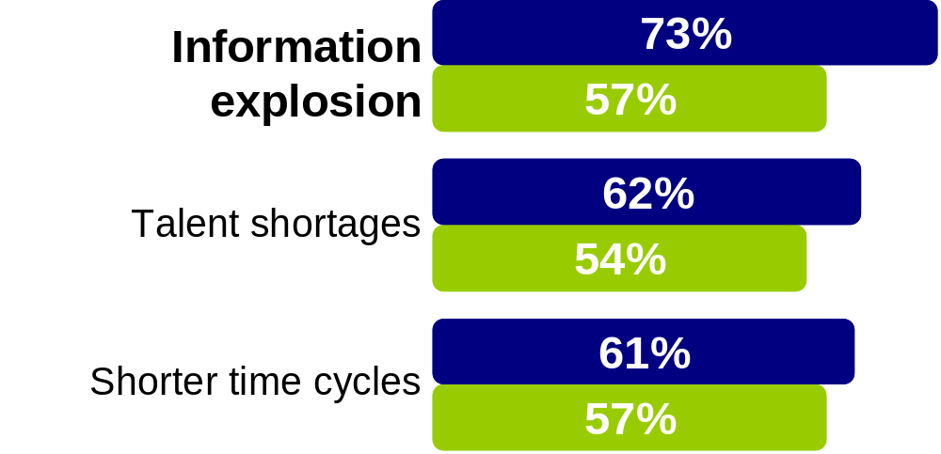
Open Government is struggling with three factors …
Source: Global CEO Study, “Insights from global public sector CEOs”
IBM Institute for Business Value
Information
explosion
■ Public sector
■ Private sector
Talent
shortages
Shorter time
cycles
Increasing budget pressure
Notes:
Open government goals
Government-as-platform
Better collective problem solving
Transformed government and governance

Slide 5

“If government is to serve the needs of its citizens in the 21st century, it must reconfigure itself — to shift the boundaries of who does what and, even more important, how its work gets done”.
Donald F. Kettl,
Dean School of Public Policy
University of Maryland

Slide 6

Government needs to …
Translate policy into reality – dynamically and consistently
Increase speed and accuracy of service delivery
Reduce the burden of administration
Ensure proof of operations – visibility, audit and compliance
Work
Optimisation, the key goal is to increase the volume of
throughput or work completed
System intensive integration
Transactional integrity is a critical requirement
Runners
High emphasis on Human to Human interaction
Activities are well understood and the flow is structured
Requires visibility and measurement of human activities
Repeaters
Unstructured or structured events (triggers)
Relies on people (sometimes specific expertise)
Activities require collaboration
Path is often undetermined (but not always)
Unstructured content (Paper/Image, fax, electronic
document … digital image, voice, video …)
Knowledge intensive, requires deep analysis capability
Persistence (System of Record and lifecycle)
Rarities

Slide 7
Five Typical Entry Points of execution …
Industry Expertise and Solutions
Business Discovery & Understanding
Work
Process
Automation
&
Management
Policy And Decisions
Management
Business Events & Rules
Advanced Case Handling
Business Visibility & Measurement
Master Data Management
Integration
Analytics
Enterprise Content Management

Slide 8


Slide 9
Government
Use Cases and Examples
Smarter Process for Government

Slide 10
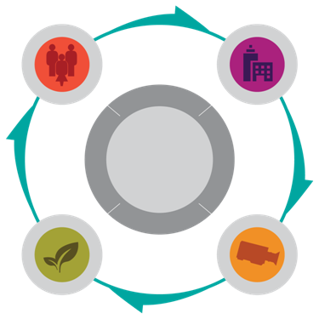
To ensure the economic health, welfare and security of their citizens, smart governments are working toward…
IMPROVE CITIZEN AND BUSINESS SERVICES
Connecting people
to programs based on individual needs—
achieving sustainable outcomes while reducing operational costs and maximising taxpayer value.
MANAGE RESOURCES EFFECTIVELY
Leveraging business intelligence and planning to improve insight and elevate performance with visibility
and control.
GOVERNMENT
ENSURE A SUSTAINABLE ENVIRONMENT
Deploying environmentally responsible operations,
from energy efficiency and conservation to transportation management and the pursuit
of renewable resources.
STRENGTHEN NATIONAL SECURITY AND PUBLIC SAFETY
Enabling defense and law enforcement organisations
to achieve situational awareness, increased
speed of command and combat superiority.
Notes:
The Fiscal crisis is causing previously unmentionable change in Government IT buying:
Opening for new technology strategies: shared services, alternative delivery models (cloud) and transaction-based contracts
Heavy focus for IT investments on projects that reduce operating costs and increase program effectiveness
Shift away from large-scale, single-award contracts to a larger number of small opportunities
Focus on services that offer alternatives to new capital investment and longer term IT value
Government Priorities:
Prioritizing services and managing their budget in a very constrained financial environment
Stimulating the economy to restore job growth after the recession
Meeting the increased demand for citizen services caused be the recent recession
Maintaining public safety in the face of ongoing or increasing terrorist threats and challenging crime trends
Managing resources more effectively, including physical resources such as energy and water, and IT infrastructure
What is Smarter Government?
A smarter government assesses the needs of its society, uses analytics to improve insight, and makes collaborative decisions to improve the economic health, welfare and security of its citizens.
We help governments become smarter in their mission of improving the economic health, welfare and security
That leads us to the need for and VALUE of ‘A Smarter Government.’ A smarter government leads by setting agendas based on the needs of your citizens and businesses in the global economy. Through priority initiatives focused on: 1) citizen-centered experiences, 2) government accountability, 3) green solutions and 4) sense and respond (national and public safety) initiatives. Government at the core of ensuring the economic health, welfare and security of citizens and societies... demonstrating Smarter Governments.

Slide 11


Smart Government:
Improving citizen and business services.
SMART IS
Putting the citizen first by organising
agency services around client needs.
Sharing client information and collaborating with integrated
service providers.
SMART IS
Maximising the value to taxpayers
by reducing costs and streamlining business processes.
Moving away from a transaction-
based system to an ongoing client relationship model
A State Government in Brazil: Multiple state agencies in the remote Brazilian rainforest unite for one-stop service to constituents–and gain actionable new insights to help shape the area’s future–when the state implements a single, shared view of each citizen’s data.
Hiroshima Prefectural Office: A government office in Japan improves data interfaces, increases operational efficiency and exceeds its cost reduction target by adopting SOA principles, standardised interfaces and shared business processes.
Notes:
Improving citizen and business services…. ‘Smart is’ for government nations and organizations represents all of these statements and more…
Ultimately, it is… connecting people to programs and services based on individual needs, achieving sustainable client outcomes, while reducing the operational costs of delivering services and maximizing value to taxpayers.

Slide 12

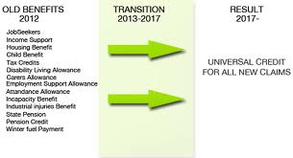
21st Century Welfare
DISCOVER > MODEL > IMPACT ANALYSIS > AUTOMATE
MONITOR

Slide 13
University College London Hospitals (UCLH)
IBM Software
Business challenge:
Implement a management system to meet Government standards
Track 500,000 patients annually
Model patient treatment pathways
Interact with huge amounts of data from a number of existing databases
Solution:
A Patient Tracking System (PTS) with IBM BPM at its core
Alerts signal when a patient is delayed in their treatment pathway before they go over the 18wkRTT
Patient details entered once on to the system rather than multiple entries
“A vital part of the PTS, is the business process management platform which provides the real-time tracking, enables parameters to be set and creates the notifications and alerts allowing us to know what stage the patient is at in their pathway and how long they have been at that stage.”
— James Thomas,
IT Director of University College London Hospitals NHS Foundation Trust.
Benefits:
Able to manage and demonstrate how they are meeting the 18wkRTT mandates
Greater insight into resource planning
Fewer patient delays
Reduction in patient complaints
Solution components:
IBM IBM BPM
IBM Blueworks Live
WSP14245-USEN-00

Slide 14
Operational Decision Management Yields Significant Benefits
300%
  improvement
WorkSafe Victoria sees 300% improvement in payment times to workers compensation treatment providers
85% straight-through processing; Over 2,000 complex rules
Notes:
3x faster rule changes - Visa
14

Slide 15

Smart Government:
Managing resources effectively and efficiently.
SMART IS
Implementing
tighter fiscal management controls.
Integrating budget planning with performance objectives to measure
and manage for results.
SMART IS
Consolidating and streamlining complex financial processes to ensure successful compliance and regulatory management practices.
Moving beyond physical records retention to electronic history, reporting, analysis and planning to increase return on budget while managing risk.
New York Tax Agency: This state tax department increases tax revenue by 7% in one year and recovers $83 million in delinquent taxes by using predictive modelling and patterns of data to flag and prioritise suspicious tax returns and refund claims to maximise the effectiveness of its auditors
Australian Government: Significantly reduce the reporting burden for businesses, saving around $800M a year by implementing a streamlined movement of financial information along the entire reporting chain.
Notes:
Managing resources effectively and efficiently… societal demands drive the need for organizational accountability and effectiveness in the use of government resources. Governments who leverage business intelligence and planning solutions will improve insight and elevate performance with visibility and control. ‘Smart is’ statements… highlight how governments can successfully embrace accountability and transparency.

Slide 16


Smart is: delivering services more effectively
Industry context: regional government
Value driver: faster delivery, improve compliance
Solution: process and business rules
Castilla y León Social Services Agency
"By combining the strengths of IBM Software and services, we are dramatically reducing the time to process benefits, allowing the staff to put more focus on handling exceptional cases..”
— José María Molina, Project Director, IT Department Social Services, Social Services Management, Family and Equal Opportunity Council, Junta de Castilla y León
Business Challenge
Spain’s recent passage of a law promoting care and autonomy for dependent people compelled the agency to reengineer its IT systems to comply with new regulations as well as provide better service to citizens.
What’s Smart?
Implementation of a centralized process-oriented management system for granting benefits, automating the agency’s work and shortening services delivery. The system has allowed the agency to adapt quickly to the new regulatory framework, and provides greater flexibility for implementing future policy changes.
Smarter Business Outcomes
Provide better service, comply with new and changing regulation more rapidly, access to rules which govern the process closer to the business giving improved control, understanding of business impact and audit history
Notes:
The regional government of Castilla y León, one of Spain’s 17 autonomous regions, administers a broad range of social programs through its Social Services agency. More than 50,000 people benefit from the agency’s social assistance programs for the disabled, elderly and younger, and child protection. For more information on the agency, please visit www.jcyl.es.
Challenge
Spain’s recent passage of a law promoting care and autonomy for dependent people, including the elderly and disabled compelled the agency to reengineer its IT systems for implementing programs, The law not only introduced new social benefits, but backed them with precisely defined eligibility criteria. The agency launched the project, called Social Services Unified Access System (SAUSS), to comply with the new complex regulations, and more generally, provide better service. Solution The SAUSS project involved putting in place a new organization as a single point of contact for citizens and implementing a centralized process-oriented management system for granting benefits, automating the agency’s work and shortening services delivery. For this, the agency is relying on IBM FileNet Business Process Manager as its BPM system, Microstrategy for statistics and scorecard balancing, and IBM WebSphere ILOG JRules to facilitate the development, deployment and maintenance of the business rules governing the complex decisions to be taken in the process. For instance, a rule-based decision service is used to score applications and assess eligibility. Social Services’ IT department no longer has to recode applications associated with SAUSS to implement new policies and regulations. All the business rules governing the new system are stored in a central repository. The agency’s policy managers can access the repository through a Web-based interface to review, modify, test and redeploy rules to implement changes directly. Furthermore, as the decision logic is managed separately from business processes, policy changes have no impact on business processes themselves. The new system has greatly improved the productivity of approximately 600 agency personnel. It lets them handle the greater number of cases resulting from the introduction of the new law. The system automates the processing of most of the paperwork, allowing the agency’s staff to focus on handling exceptional cases. Even though the number of cases has increased significantly, each application is processed much faster, enabling the agency to deliver services in far less time on average. The SAUSS system was assembled by Thales, a system integrator and IBM Business Partner. Two people—one from Thales and the other from the agency—were primarily responsible for developing the system. They prepared for the project by attending an IBM WebSphere ILOG JRules training course given by IBM Software Education Services. In all, the project lasted one year. The system was developed to run in a Java environment with Microsoft® Windows 2000. Benefits The agency has gained significant benefits from the new system: Faster delivery of social benefits through a clear process that requires less interaction between the citizen and the administration Transparent and fair decisions through consistent scoring and application of eligibility criteria across all the agency’s centers Empowerment of policy managers with a powerful, user-friendly interface that allows them to review, validate and maintain policies directly Flexibility to adapt faster to new and changing regulations Ease of integration with the IBM FileNet P8 Platform for developing custom enterprise systems Better management of business processes, which are impacted less by policy changes

Slide 17
UK Government Agency: Example Logical View
End to End Solution with Rules, BPM, Case Management, ESB and Monitoring
Business Monitor
Instruction Error
Web
Straight Through Processing
R
Paper
Input
Channels
Form
Data
R
Output
Channels
B2B
R
ESB
Complete
Execution
Complex
instruction
SoR
Execution
A
Forms
Case
Case Management
D
E
Systems of Record
R
R
BPM
C
IBM Forms
B
Form Template/Doc
Asset
Citizen
Documents
A
Validation (R), Documents (RW)
B
Form (RW)
Rules [R]
IBM Decision Management
C
Data (R), Documents (RW)
IBM BPM
D
Data (R), Documents (RW)
Business Process Management [BPM]
Data (RW)
Enterprise Service Bus [ESB]
IBM Message Broker
E

Slide 18



Agile tax collection Transforms Insight into Action
drives down exceptions and processing time for tax returns
  Client Pains
  Slow, expensive, paper-intensive, manual processes
  Lengthy exception processing times
  Real Results
  80% reduction exception backlogs
  80% reduction in average age of work queue, avoiding extra interest cost
18
18
18
Notes:
18
18

Slide 19

State of Alaska, Dept. of Natural Resources
The Department of Natural Resources is responsible for authorizing use of state owned land. Permits are required for any use of state owned land.
Problem: Paper-based process provided poor visibility into permit process, resulting in backlogs in authorization
Opportunity: Expedite authorizations to increase revenue.
Solution Components: Process Automaton, Discovery, Quick Win Pilot
IBM BPM v7.5 IBM Blueworks Live
Expected Results: 50% Increase in Revenue, 30% Reduction in Cycle Time
Contributing Success Factors:
Blueworks Live for process discovery
Getting to Line of Business early
  customer-led playbacks
IBM Methodology: Keep it focused on business value
Next Steps:
Extend Land Permit Process to mobile
IBM BPM v8 (Aug / Sept)
Operational Decision Management (2013)
Scale solution to other processes (Leases and Easements / Water Rights
“I’ve seen more progress in these 14 weeks than in the previous 10 years”
- Commissioner, Scott McCowen
Notes:
Dept. of Natural Resources is under state legislator (reporting to tax payer). To do anything on that land, somebody must apply for authorization (permit). For example, an oil company could purchase to drill, easement to build temporary road, prospect for gold, recreational (cross country travel, snowmobile, etc.). These authorizations work like any typical case management process. Request to the state what you want to do, describe what you want to do (activity, and where), then the state determines if it is approved. The state wants to get to “yes”, because it yields revenue. This often requires modifying or changing part of the ‘requirements’. They need to take into account adjoining properties, future building projects, etc.
Problem: For 15 – 20 years there have been backlogs in authorizations (for example, there were requests from 1972 to heard 5 cattle). They had a visibility problem (paper process that didn’t give mgmt. view of where things were at or if they were completed).
Opportunity: Expediting these authorizations leads to more revenue. So if you are a resident of Alaska, this is revenue. 90% of all public sector activities are paid by Dept. of State Resources. There is no liquor tax, income tax, property tax, etc. Each person with a social security number gets about $1,400 per person (family of 5 would get about $7K). Improving the process by which corporations and individuals can access land is a huge opportunity.
19

Slide 20

UK Fire and Rescue Services
Background
Business Issues & Challenges
Government initiative to provide 9 Regional Control Centres (RCC)
2009: DCLG tasked with providing integration strategy for 46 FRS
2010: investigation into possible providers
IBM already engaged in PoC with CFRS demonstrating Business Value
Government scrap RCC programme
Feb 2011: DCLG fail to reach procurement decision
CFRS take control and form consortia
IBM chosen May 2011
First contracts signed Sept 2011
Massive pressure to reduce costs/FTE – Political/Unions
FRS’s operate independently from each other
  Variations - Fire Tenders/IT Platforms/Uniforms
Government spending review
  Expected 20 - 25% overall budget reduction
  Need to utilise
  technology to
  manage change and
  meet objectives
Government directive
to increase
collaboration to achieve
savings
  Localisation

Slide 21
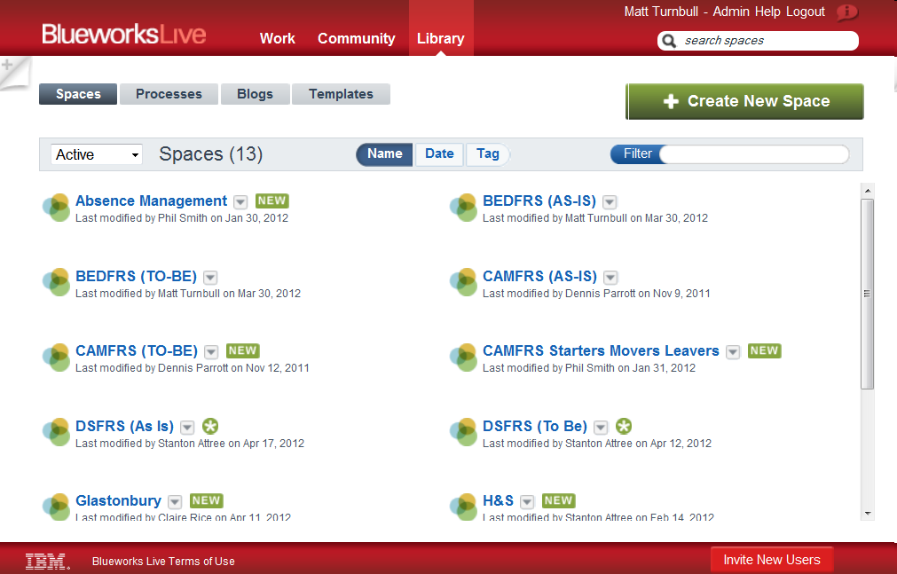
UK Fire and Rescue Services
Capturing Process Requirements with IBM Blueworks Live

Slide 22
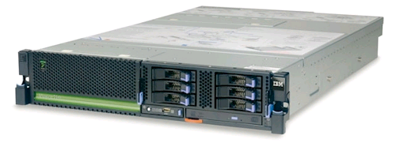
UK Fire and Rescue Services
IBM Process Improvement Appliance
An appliance that provides capabilities to:
  Improve your manual processes
  Integrate information between existing systems
The appliance plugs in to your site:
  Ready to go, pre-loaded with software
  Low maintenance
  Secure, reliable hardware

Slide 23
UK Fire and Rescue Services
IBM Proposition
Components
  WebSphere Message Broker
  IBM BPM
  Blueworks Live
  DB2
  Power 710 device
Services
  Installation & Commissioning
  Bundle of Assistance Services
S&S Multi-year support
  2nd to 5th year support
Agreed procurement model
  OGC framework
  Negates need for tender
  Negates need for OJEU
Proven IBM Technologies
  Reliable
  Sustainable
  Scalable
23
Notes:
23

Slide 24




Other
organisations
Business Process Management
Integration
Availability System
Rostering System
Staff Directory
/Email
Incident Reporting System
Mobilisation System
Competency System
Premises System
FSEC / MOSAIC

Slide 25

UK Fire and Rescue Services
Who’s using it?
Cambridgeshire
  Retained fire fighter recruitment
  Sickness
Devon & Somerset
  Asset maintenance
Bedfordshire & Luton
  Incident reporting
Tyne & Wear
  Resource management
  proof of concept
Tyne & Wear
Cambridgeshire
Bedfordshire & Luton
Devon & Somerset

Slide 26


Smart Government:
Strengthening national security and public safety.
SMART IS
Increasing informed decision-making
by creating interoperability within and
among groups.
Facilitating travel and promoting commerce while maintaining
border integrity.
SMART IS
Improving crime prevention by enabling
law enforcement to better understand
criminal patterns.
Increasing speed of command and success in the field through network-centric operations.
Korean Customs: Increases detection of fraudulent import activity with a system that can accommodate changes to information sources, risk factors, risk thresholds, profile composition, alert processing and routing to external agencies. Empowers business specialist to drive detection profiling with simple, rapid changes exclusive of IT involvement.
Law Enforcement Data Hub: Federal Government Agency links together information from law enforcement jurisdictions across Australia, delivering relevant up-to-date crime data in the preferred format of the user to a variety of different devices.
Notes:
Strengthening national security and public safety: …. facilitating information gathering, analysis and sharing of critical data. Defense organizations achieving situational awareness, increased speed of command and increased combat superiority. Law Enforcement agencies protecting communities.

Slide 27
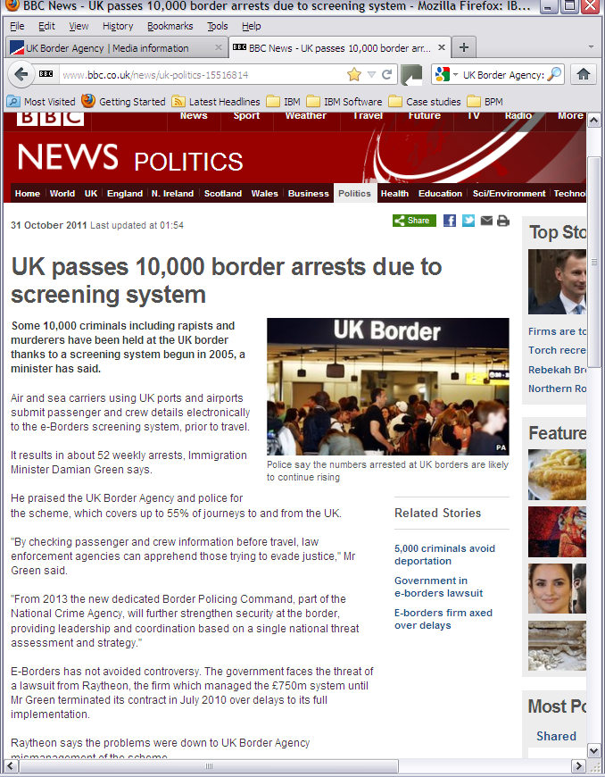
UK Border Agency
Stronger border security with business rules
Client Pains
Growing threats: organised crime, illegal immigration and terrorism
Long waiting times at airports to go through security
Frequent law changes
Cumbersome system for tax payers
Solution
Integrated secure border
Advanced Passenger Analysis
Real Results
Enhanced security at airports
Better traveller experience: screening happens before passengers arrive at boarder
Real-time risk scoring and response to threats

Slide 28
Operational Decision Management Yields Significant Benefits
  96%
  straight-through processing
Swiss Customs achieves 96.5% straight-through processing
to validate electronic customs declarations
200,000 declarations daily; Over 700 business rules
Notes:
3x faster rule changes - Visa
28

Slide 29

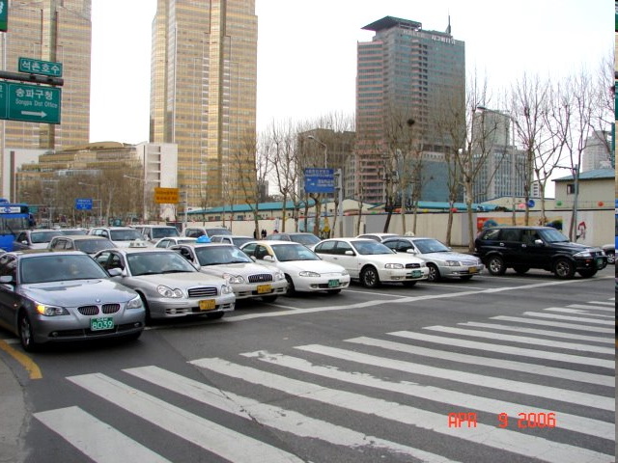
Smart Government:
Ensuring a sustainable environment.
SMART IS
Improving transit experience by reducing traffic congestion and encouraging a modal shift among users.
Generating new sources of revenue to support capital improvements to the transit network.
SMART IS
Understanding how reducing carbon footprints can help to lower operational costs and conserve energy.
Using the right tools to optimize water consumption, monitor quality and model past and future basin behaviors.
Stockholm, Sweden: An intelligent toll system in the city center resulted in 20% less traffic, 40% lower emissions and 40,000 additional users of the public transportation system.
Becheon City, Korea: Using intelligent video analytics to provide real-time traffic information resulting in increased accuracy of traffic volume data from 50% (or less) to 90% and increased
speed of data collection by over 1,200%.
Notes:
Ensuring a sustainable environment: deploying environmentally responsible operations. From energy efficiency and conservation, to transportation management and recycling, to pursuit of renewable resources—realizing the economic benefits. Smart is….

Slide 30


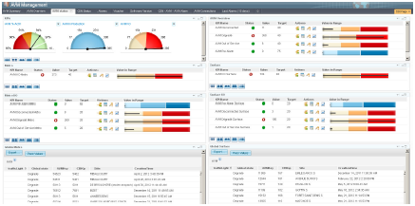
Société des Transports Intercommunaux de Bruxelles
The first Belgian urban public transport company
It is responsible for an integrated network of +/- 700 km
6,500+ employees, of which 3,000 drivers
4 metro lines, 18 tram lines, 50 bus lines, 11 night bus lines
A territory of 242 km².
Provides mobility solutions to over half a million inhabitants of Brussels and commuters every day.
Business & Technical Challenges
Financial – Management
No SLA / Penalties management with third-parties
No visibility on the end-to-end Business Process
Human Resources
Not enough resources to manage the volume and the complexity of the alerts
Technical
Volume and complexity of alerts too important to be managed and analysed without an IT application
Solution - Business Activity Monitoring
Monitoring of business activities based on defined business needs
Real Time information for optimized reaction time and forecasting
Graphical visualisation and presentation

Slide 31
Société des Transports Intercommunaux de Bruxelles
Business Benefits
Automatic alerts creation and closing in real time
Improved reaction time and repair time for the people working on the incidents.
Improved qualification of the incidents
Time Reduction in IM-PM : time spent before to capture the data is now spent to the resolution
Detailed and correct monthly reporting: communication to the management
Rapid and correct calculation for SLA’s and penalties: communication to the suppliers
One single application to monitor all the activities and the lifecycle of potentially all the equipment managed by InfoTech

Slide 32

National Assembly for Wales
  Increase payment speed & accuracy, meet regulation, reduce admin burden
Industry context: government
Value driver: productivity, cost & compliance
Solution: rules, process & case
The need
The European Union Common Agricultural Policy provides annual subsidies of more than £250 million for the 19,000 farmers in Wales. The previous process management was based on paper-based applications and a bespoke legacy computer system. The legacy system was slow to change, difficult to use and each scheme was implemented separately, based on a different manual process.
The solution
Fully automated request capture and submission with standardized business processes throughout all line of subsidies
Agile exception handling with collaborative case management
Abstracted and flexible management of rules
Automated best practices
The benefits
Improved customer service--on the first day of payment, more than 75 percent of Single Payment Applicants had received their payments instead of waiting weeks with the previous system. Wales was one of the first countries in Europe to make these payments in 2005.
Greater flexibility and ability to modify business policies in hours rather than weeks
Business process and business rules traceability and auditability

Slide 33
Government
Why, What, How and Homework
Smarter Process for Government

Slide 34




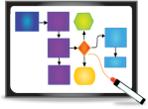

So … why do agencies buy process and decision management?
IT
LoB
C-Level
IT Automation and Optimisation
Process Automation and Optimisation
Enterprise Performance Optimisation
Time to value
Total cost of ownership
Prebuilt assets
Reuse
IT standards
Automate a manual process
Visibility and ROI
Quicker, better, cheaper
Operational Compliance
Target operating model
Innovation
Go to market
Citizen centricity
Service flexibility
European and UK Government standards
System
Agility
Process
Agility
Agency
Agility
Notes:
34

Slide 35
IBM Smarter Process portfolio address those entry points …
Industry Expertise and Solutions
IBM Blueworks Live
IBM
Business
Process
Manager
IBM
Operational
Decision
Management
IBM
Case Manager
IBM Business Monitor
Master Data Management
Integration
Analytics
Enterprise Content Management

Slide 36
Value Tree for Smarter Process
Client Examples
Personalisation – citizen centricity
Better citizen experience
Increase Revenue
70% faster on or off-boarding business partners or products onto the platform and achieving new revenue streams
Product and go-to- market flexibility
Faster time to value
Compared to traditional approaches
20-50% faster for initial delivery
45-60% faster for on-going maintenance
Return
On
Investment
Increase Straight Through Processing %
Reduce FTE by 25-75%
Faster process cycle times
Automation / business productivity
Reduce
Costs
Reduce policies required for review/audit by 53% Save €0.5m p.a thru reduced fines
Process consistency and faster compliance
3yr ROI: 150-450%
Breakeven < 1 yr
Resolve exceptions better, reduce errors and fraud
Save €3m pa by identifying unnecessary work
Lower
IT Costs
Lower Total Cost of
Ownership
30-50% reduction in TCO
40% saved in professional services
Agile applications
80% saved through reuse of artifacts
Notes:
Increase Visibility & Mitigate Risk
Cut Costs & Increase Efficiencies
Efficiency
Eliminate Manual Data Entry
e.g Reduction in time to add a new employee record into the HR system from 9 hours to 10 minutes.
Reduce Process Cycle Time
Eg. Reduction in compensation processing timing for 12,000 sales reps from 33 days down to 7.
Reduce Manual Analysis/Routing
E.g Elimination of 80 percent of the manual work previously required to route invoice exceptions to the appropriate resolution teams.
Effectiveness
Handle Exceptions Faster and Better
E.g Evolve process from saving 5 percent of distressed shipments to saving 70 percent—yielding 2 million U.S. dollars per quarter in saved revenues.
Make Better Decisions
E.g. Better review process results in 3 million U.S. dollars saved in billing dispute write-offs that would formerly just been processed because the process was poorly controlled.
Consistent Execution
E.g Customer satisfaction improvement to 92 percent based on proactive tasks that help ensure the home loan process executes better and faster.
Agility
Faster Regulatory Compliance
E.g. Change customs related processes after 11 September 2001 within 90 days to comply with new federal regulations for better shipping visibility.
Support New Business Models
E.g Ability to change shipping partners within 10 minutes in core process allows manufacturer to change primary shipper every quarter—based on best bid provided.

Slide 37

and the Journey looks like this …
Transformation
Start Here
Deliver
Develop Capabilities
Over Time
Program
Transform across the enterprise
Infuse a culture of process across the organization
Establish a Program
Project
Mentoring
Establish CoE
Optimize
established projects
Extend to new projects
Succeed with an Initial Project
Identify Business Challenge & Value
Quick Win Pilot
Discovery Workshop
Notes:
08/16/11
37
Main Point: Process improvement can seem challenging in the face of a complex and dynamic business network, but the right approach can get you there. Today we’ll take a look at how you can get started improving processes.
Speaker Notes:
With all the complexity of a dynamic business network, starting down the road of process improvement can seem challenging. The key to success is to use the right approach, and approach that starts with careful analysis that is focused on business value, and then expands slowly leveraging incremental successes along the way.
Start with business value
Successful process improvement initiatives all start with and are driven by business value. This means that organizations must understand the business goals and strategy that are driving the process improvement initiative, and analyze their current processes to identify the “low-hanging fruit”, the processes that when improved will deliver the greatest return on investment. Only after the processes projects have been identified and prioritized should organizations begin working on an initial project.
Begin with a short-term, initial project
Business analysis is an important first step on the road to process improvement, but organizations should also caution against over analysis. Process improvement initiatives, like all IT projects must be able to deliver some quantifiable successes or stakeholder commitment and, most importantly, funding for the initiative can dry up. The best approach is to begin with an initial project that can be implemented quickly. By starting with a manageable project you can development process improvement skills, and deliver value to the business quickly, ensuring commitment, funding, and success of subsequent projects.
Extend process improvements across the business
Once you have successfully completed an initial project, then you can start expanding to additional projects, leveraging and sharing your expertise along the way to truly build a process improvement program within your business.
IBM is here to help you with your roadmap to process improvement. We have assisted 1000s of clients with their process improvement projects. Today we’ll take a look the process improvement journeys of a couple of these clients – one that focused on process automation, and another that focused on improving operational decisions. We’ll also take a look at some new products and service offerings that can help you along the way.
What do you need for successful BPM?
How can you get this kind of success?
You need the right technology
You need the right expertise (training, approach)
Services / Education
Start out with your first project (S Curve)
As you go up the curve, you need more technology / capabilities
As you go up the curve, you will become more self-sufficient (On-Demand consulting)
As you go up the curve, you need a platform that can scale
After project 1, you need services
Last phase, you just need on-demand services
Project (turn-key services), Program (solution mentoring), Transformation (On-Demand)

Slide 38
Homework
Key Questions
Can you prove that your processes are doing what you think they are / claim they are / actually currently need?
Do you have business processes that extend to suppliers, partners, or customers? What are the revenue & cost impacts of inefficient linkages?
How flexible is policy and decision logic?
How do you recognize process bottlenecks & inefficiencies? How do you remove them?
How do you manage process exceptions?
Could you gain revenue by focusing talent on business value rather than repetitive tasks?
When you need to create change, how long does it typically take IT to deliver on it?
Are you able to make timely changes to your business when required by market, competitive, or regulatory conditions?
Can you make smart business decisions in real-time, based on real information (structured or unstructured)?
Are processes/decisions visible to you, end to end?
Would you like insight into how much duplication of effort or manual steps make up that process?
How interested are you in reducing team's redundant, time-consuming administrative or non-customer-related responsibilities?
Typical Process Issues
Current operational “fire”
One Sigma quality .. a 32% error rate
Individual or group heroics make the process work
Poorly understood end-to-end process within LOB
Process workflows operating over e-mail, with spreadsheets etc.
Process Models documented in static “diagramming” and “modelling” tools
Failure to “actualise” the process/decisions as documented
Policy, Process and Rule Volatility – with changes required many many times per year
Investment in existing process and decision technologies and formal methodologies like “Lean Six Sigma” not yielding anticipated results
No governance or process/decision lifecycle management

Slide 39



Change
39
Notes:
One of the key trends in improving business operations is the “consumerization of change”. This trend is enabling business users to own more and more of the small operational changes that occur continuously. Since new tools are now more accessible and require very little training or unique skills, IT can empower the business to own operational aspects of systems while maintaining strict governance of deployments.

Slide 40

Thank You

