Slide 1
IBM X-Force: The Emerging Threat Landscape
Michael P. Hamelin
Lead X-Force Security Architect
IBM Security Systems

Slide 2
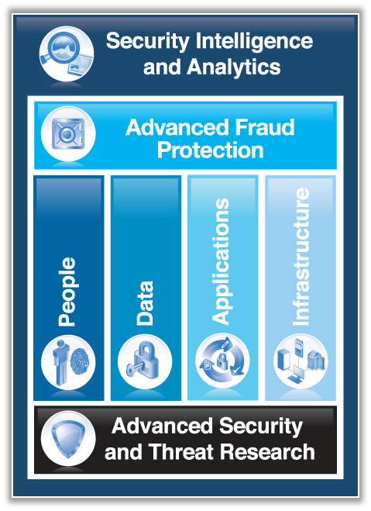
IBM X-Force is the foundation for advanced security and threat research across the IBM Security Framework.
Notes:
Advanced Security and Threat Research, which includes the X-Force team, is the foundation for many of the pillars in the security product portfolio.
As the team tasked with staying on top of the latest threats and vulnerabilities, the information it provides is a critical aspect of providing protection to the other parts of the framework.
2

Slide 3

The mission of X-Force is to:
Monitor and evaluate the rapidly changing
threat landscape
Research new attack techniques and develop protection
for tomorrow’s security challenges
Educate our customers and the general public
Integrate and distribute Threat Intelligence through IBM Solutions and directly to our customers
The mission of X-Force is to…
Monitor and evaluate the rapidly changing
threat landscape
Research new attack techniques and develop protection
for tomorrow’s security challenges
Educate our customers and the general public
Integrate and distribute Threat Protection and Intelligence to make IBM solutions smarter
Vulnerability Protection | Reverse engineering and protection against more than 76K vulnerabilities and 400 application protocols housed in the X-Force Database
IP Reputation | Categorization more than 800K suspect IP addresses into different categories including malware hosts, botnets, spam sources, and anonymous proxies
Malware Analysis | Analysis and defense of malware targeting financial institutions and customers leveraging a network of 30M endpoints across the globe
Web Application Control | Identify and manage the capabilities of more than 2000 web and client applications (e.g. Gmail or Skype)
Web Application Protection | Able to assess and remediate vulnerabilities in mission critical web applications
URL/Web Filtering | One of the world’s largest URL databases containing categorized information on more than 22 billion URLs
Anti-Spam | Detect spam using known signatures, discover new spam types automatically, 99.9% accurate, near 0% over-blocking; monitoring of more than 7M spam & phishing attacks daily.
Notes:
IBM X-Force has a long standing history as one of the best known commercial security research and development groups in the world
Can leverage security expertise across IBM to better understand what is happening in security
Work closely with IBM managed security services group
Monitor over 15B security events every day from nearly 4,000 security clients in over 133 countries
Have numerous intelligence sources:
Global web crawler, probably biggest in world behind Google and Bing
Spam traps around the work
database of more than 73k security vulnerability – monitored every day
International spam collectors
All of this is done to stay ahead of continuing threats for our customers
Web crawler is particularly interested in files, images, or pages that contain malicious links or content.
The team in Kassel Germany who builds our web crawler also developed an anti spam product
We have spam traps around the world, receive large amounts of spam so that we can analyze and understand the different types so that we can preemptively block that spam
Our work covers 4 key areas:
Research
Engines
Content Deliver
Industry/Customer deliverables – such as this X-Force report, blogs, articles, presentations and speaking engagements

Slide 4

IBM X-Force Threat Intelligence is a key differentiator for IBM Security Systems.
Coverage
Depth
20,000+ devices
under contract
3,700+ managed
clients worldwide
15B+ events
managed per day
133 monitored
countries (MSS)
1,000+ security
related patents
22B analyzed
web pages & images
7M spam &
phishing attacks daily
73K documented vulnerabilities
Billions of intrusion attempts daily
Millions of unique malware samples
Notes:
IBM X-Force has a long standing history as one of the best known commercial security research and development groups in the world
Can leverage security expertise across IBM to better understand what is happening in security
Work closely with IBM managed security services group
Monitor over 15B security events every day from nearly 4,000 security clients in over 133 countries
Have numerous intelligence sources:
Global web crawler, probably biggest in world behind Google and Bing
Spam traps around the work
database of more than 73k security vulnerability – monitored every day
International spam collectors
All of this is done to stay ahead of continuing threats for our customers
Web crawler is particularly interested in files, images, or pages that contain malicious links or content.
The team in Kassel Germany who builds our web crawler also developed an anti spam product
We have spam traps around the world, receive large amounts of spam so that we can analyze and understand the different types so that we can preemptively block that spam
Our work covers 4 key areas:
Research
Engines
Content Deliver
Industry/Customer deliverables – such as this X-Force report, blogs, articles, presentations and speaking engagements

Slide 5
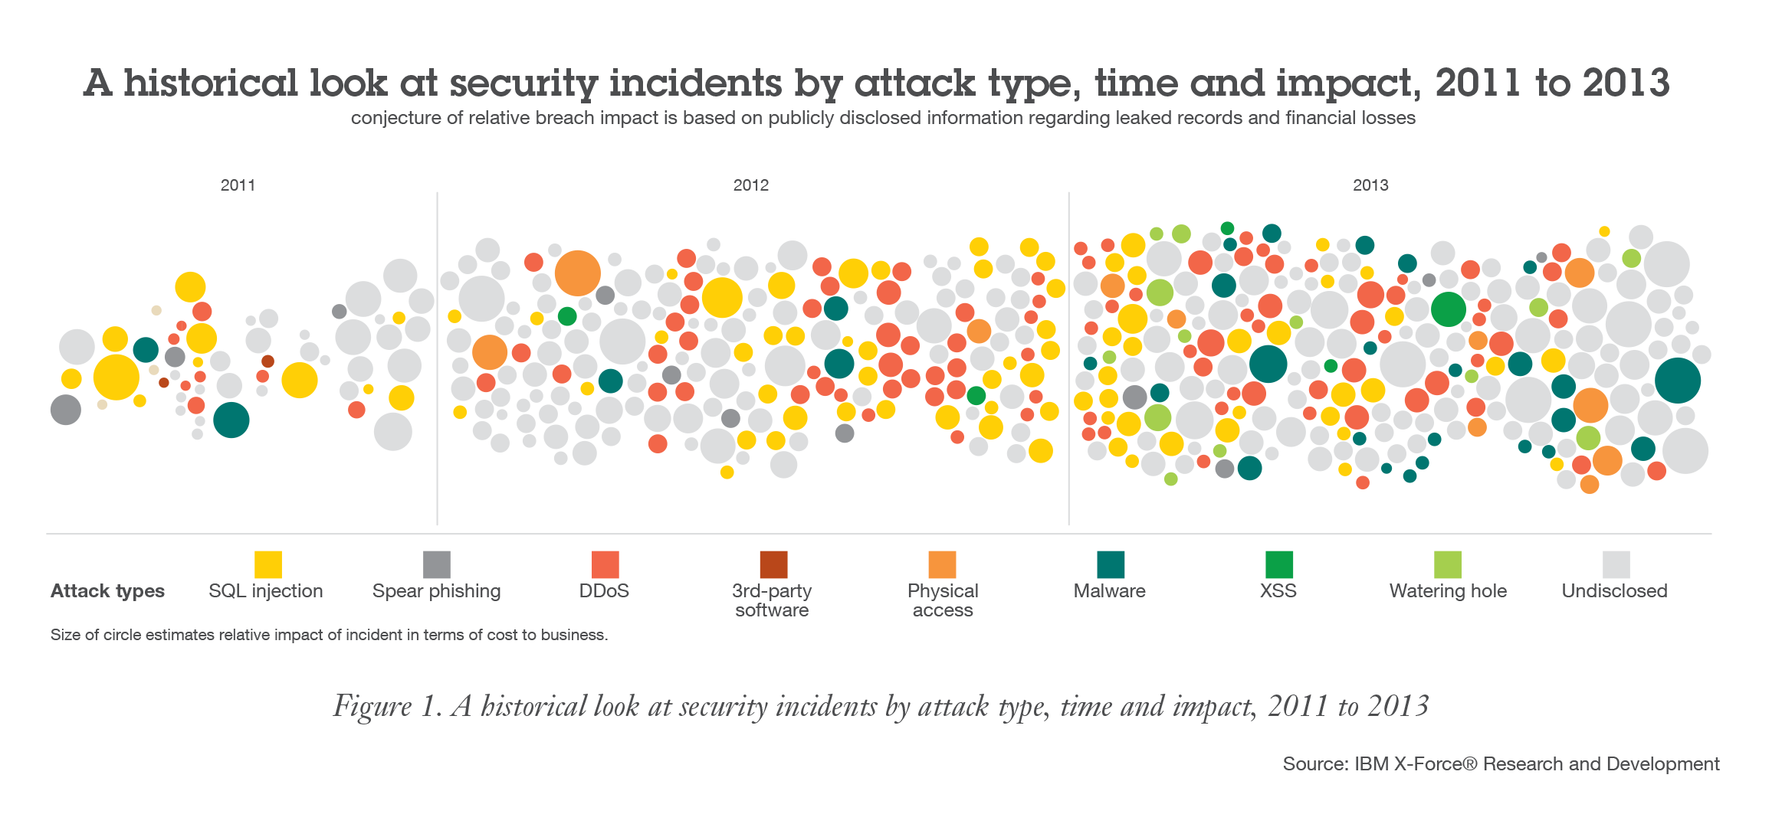
More than
half a billion records
of personally identifiable information (PII) were leaked in 2013.
Notes:
5

Slide 6
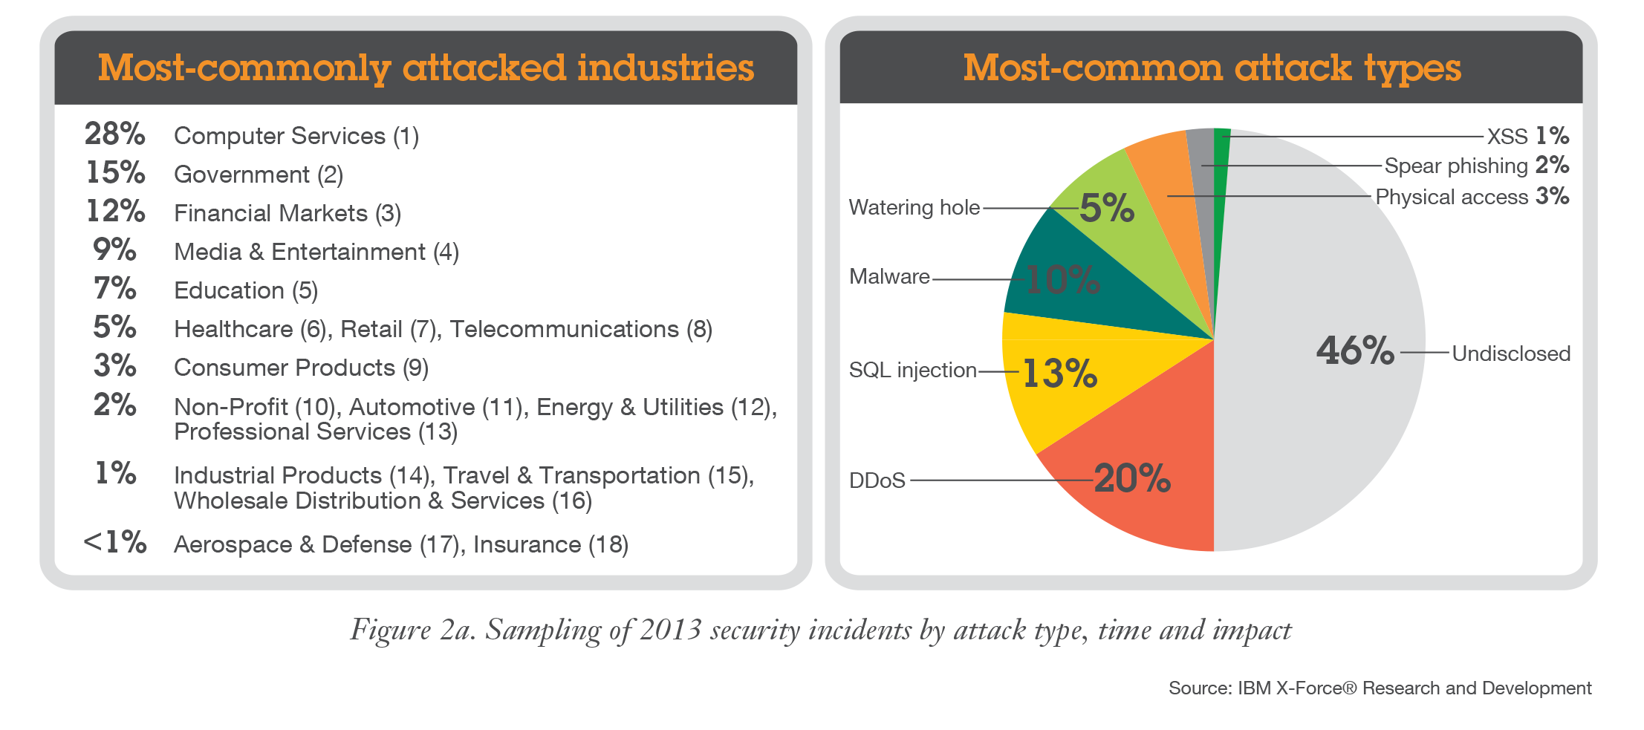
Computer services, government and financial markets were the most attacked industries as
attackers focused on central strategic targets.

Slide 7
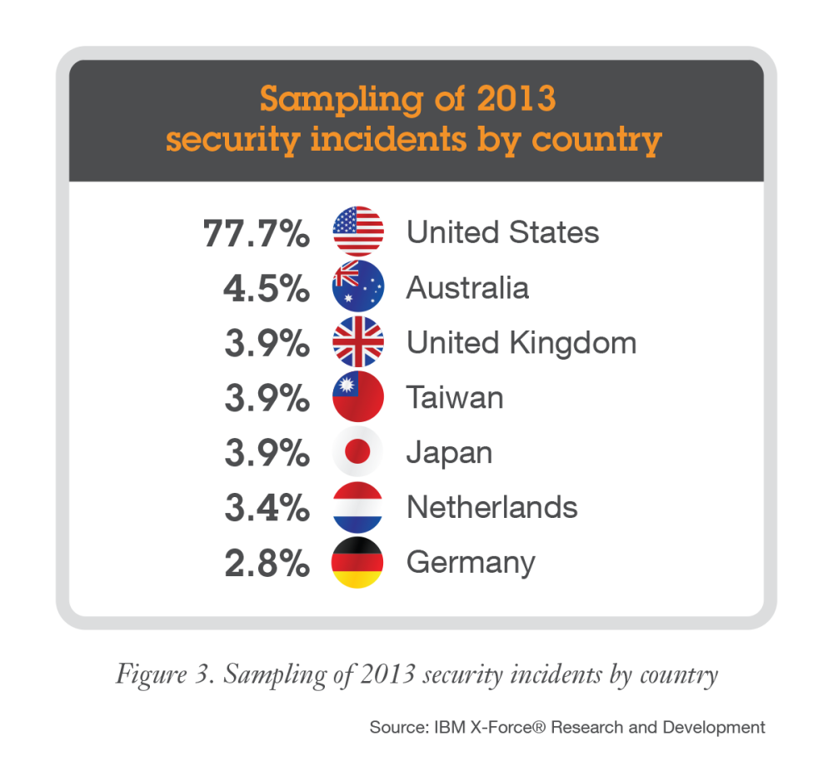
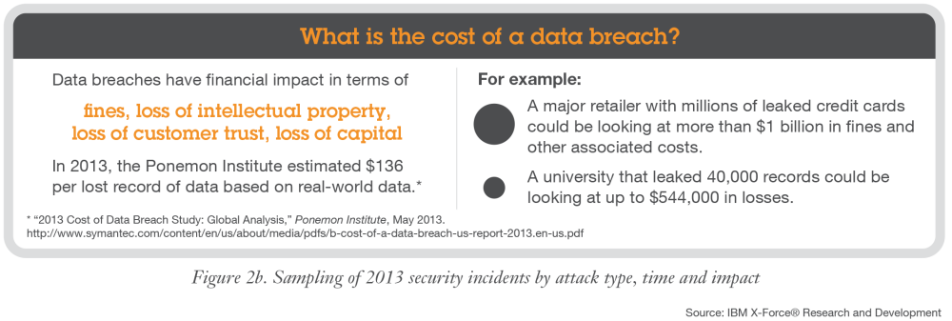
Aside from hard dollar value losses in fines and capital, breached companies will also suffer from a
loss of intellectual property and customer trust.
Notes:
Figure 3 illustrates the possible financial impact of a data breach in terms of fines, loss of intellectual property, loss of customer trust, and loss of capital, etc. that an organization of any size might face.
Additionally, of the sampling of security incidents reported by X-Force in 2013, in terms of the country where the attack target was located, more than three quarters of those continue to occur in the United States. This could be based on the fact that many websites are operated from the United States, or possibly that it is more common that U.S. companies and websites are disclosing publicly.

Slide 8
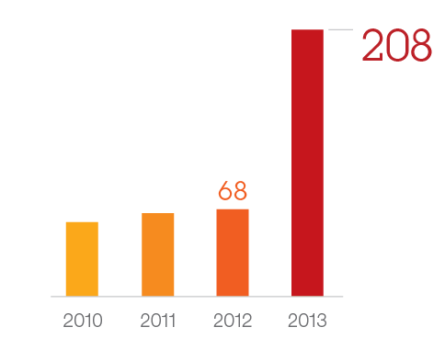
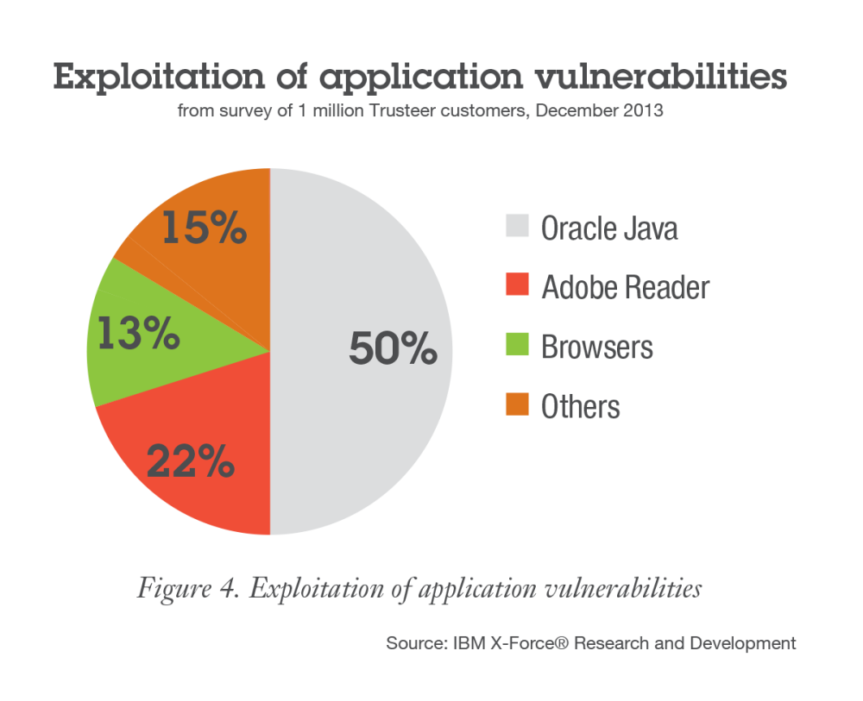
Oracle Java™ Technology Edition is used in nearly every enterprise. Explosive growth of Java vulnerabilities…
Java vulnerability disclosures growth by year, 2010 to 2013
Originating in either the core Oracle Java or in IBM Runtime Environment, Java™ Technology Edition SDKs
Source: IBM X-Force Research & Development
… combined with a presence in every enterprise makes Java the top target for exploits.
Notes:
Java is a widely deployed high risk application that exposes organizations to advanced attacks. The number of Java vulnerabilities has continued to rise over the years, and 2013 was no exception. The number of reported Java vulnerabilities jumped significantly between 2012 and 2013, more than tripling.

Slide 9
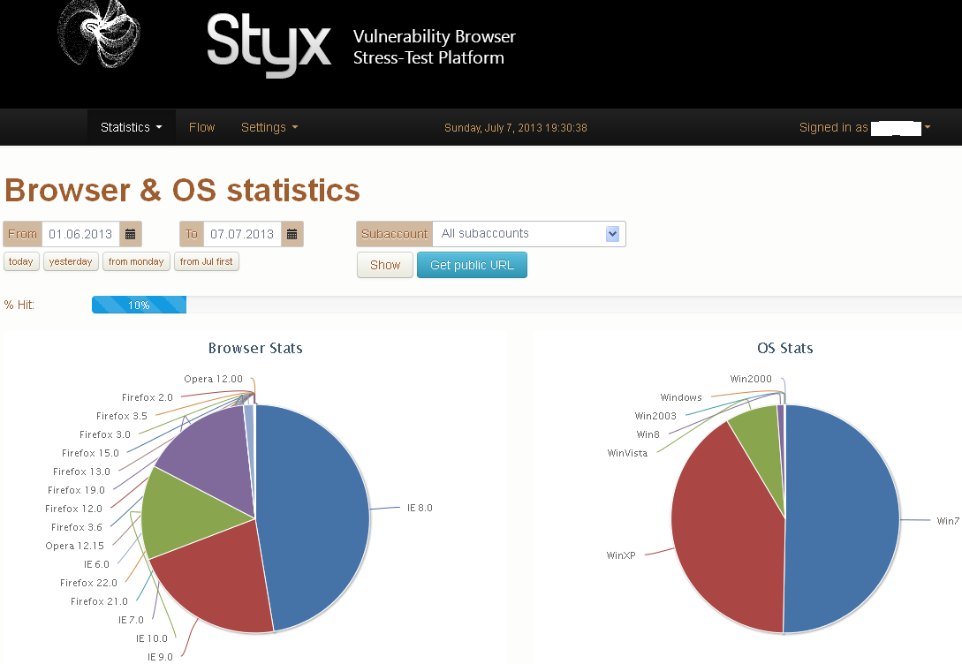

Attackers are using exploit kits to deliver payloads.
The Blackhole Exploit Kit was the most popular in 2013. The creator was arrested in October.
The Styx Exploit Kit is rising in popularity, successful in exploiting IE and Firefox on Windows platforms.

Slide 10





Attackers are effectively targeting end users with more sophisticated attacks.
Watering Hole
Malvertising
Attacker injects malware on special interest website
Vulnerable niche users exploited
Attacker injects malware on ad network
Malicious ad embedded on legitimate websites
Vulnerable users exploited

Slide 11
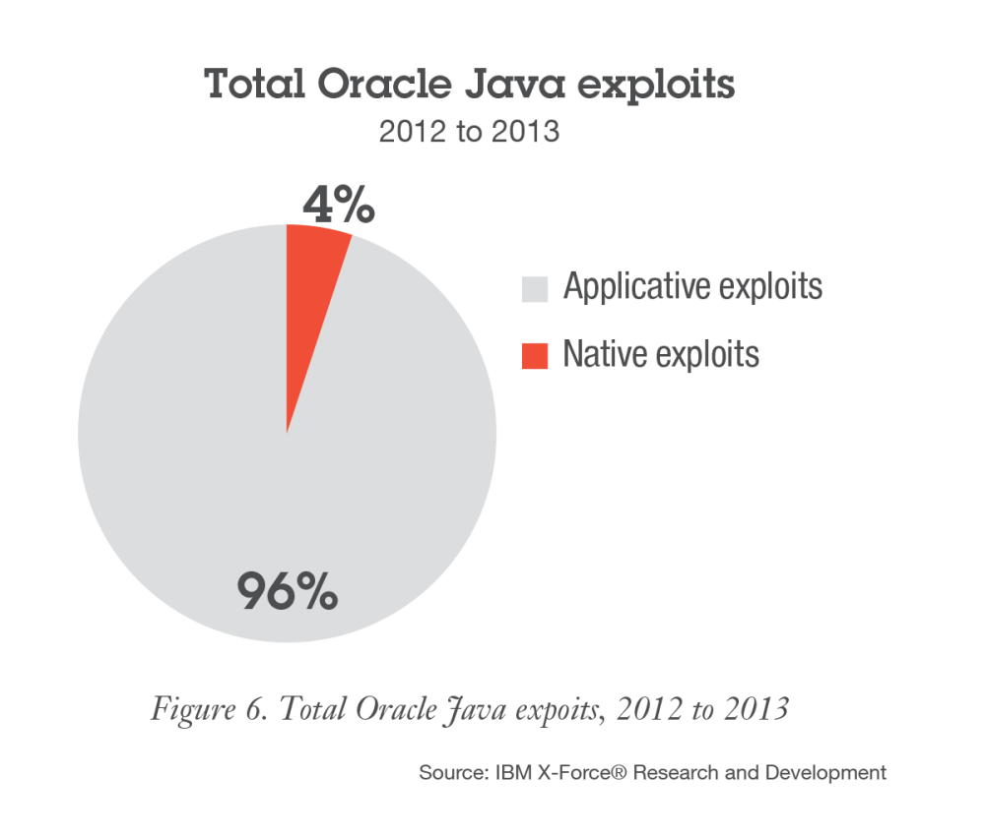
Most successful Java exploits are applicative, exploiting vulnerabilities related to the Java security manager and bypassing native OS-level protections.
Applicative exploits
Difficult to defend
Gain unrestricted privileges
Bypass native OS-level protections
Native exploits
Buffer Overflow
Illegal memory use
Use-after-free
Notes:
Java applicative exploits are more difficult to defend against because they allow the applet to gain unrestricted privileges— which makes malicious activities seem legitimate at the OS level. This means that, unlike native exploits, Java applicative exploits completely bypass native OS-level protections. Plus, Java applicative exploits don’t generate buffer overflow, and hence are not prevented by methods such as DEP, ASLR, SEHOP and others.
A native exploit results in running native shell code. This type of exploit is accomplished by techniques that include buffer overflow, use-after-free and more.

Slide 12
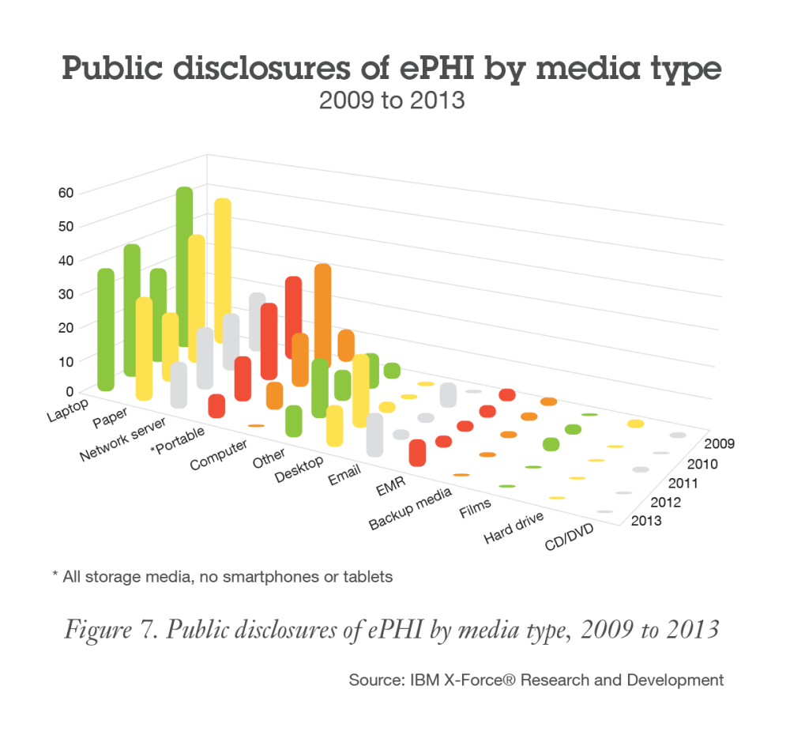
The biggest risk to the enterprise isn’t the data contained on mobile devices - it’s the credentials.
The real threats:
  Compromised credentials
  Personal information to further compromise social media accounts
  Rogue apps that are cracked and re-distributed
Notes:
Despite worry by executives that bring-your-own-device (BYOD) programs risk exposing enterprise data through loss or theft of smartphones and tablet computers, IBM X-Force hasn’t seen significant incidents in public disclosures to corroborate this concern. Virtually all incidents involve laptops, USB drives, or secure digital (SD) cards.
While mobile malware continues to mature and target both Android and Apple iOS, we are not yet seeing large scale compromise of enterprise data.
IBM X-Force research shows that enterprise mobile applications that access organizational data generally don’t store a significant amount of records on the mobile device. Instead, the data is stored in the cloud behind publicly accessible portals, while the mobile app provides the user interface, interacting with one record at a time, or small batches cached for performance.
The real threat: The bottom line is that while some organizational information may be present on mobile devices, IBM X-Force found that the biggest risk to the enterprise isn’t the data contained on these devices—it’s the credentials.
Attackers who compromise the credentials can target the mobile app portal directly, which is more efficient than attacking hundreds of individual smartphones and tablets and trying to tease out a comprehensive set of sensitive data.
In addition, mobile devices also contain a trove of personal information, which can allow for further social engineering to mount new or deeper attacks into the enterprise.
The other major threat on mobile are rogue applications that have been cracked and re-distributed thru rogue app stores.

Slide 13
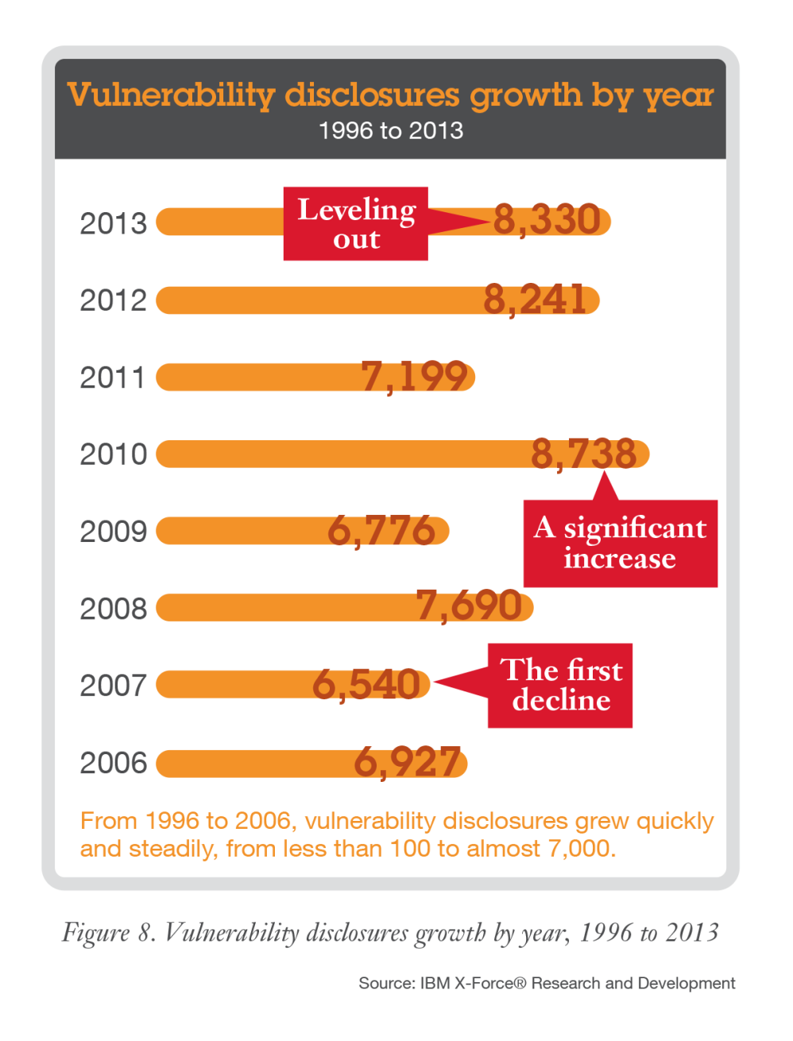
Vulnerability disclosures leveled out in 2013, but attackers have plenty of older, unpatched systems to exploit.
Notes:
MH note:
maybe hint we still didn't reach 10K vulnerabilities in a year, even though we modified the CVE number scheme to handle it, just thinking of interesting things to talk about.

Slide 14
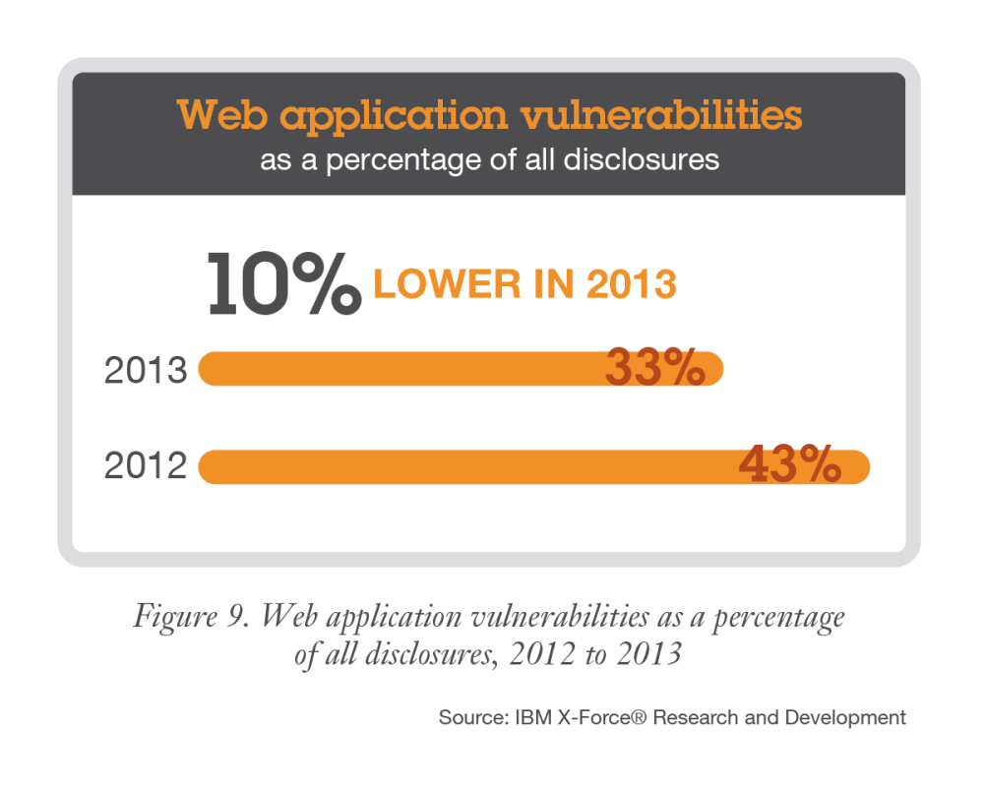
Declines in web application vulnerabilities could indicate improvements in app authoring or patching practices.
Possible reasons:
  Software authors are doing a better job at writing secure web applications.
  CMS systems & plugins are maturing as older vulnerabilities are patched.
And yet… XSS and SQLi exploitation is still observed in high numbers.
Notes:
However, vulnerabilities in key reporting areas such as Web application, Cross-Site Scripting, and SQL injection all demonstrated downward trends in 2013. Overall web application vulnerabilities accounted for 33 percent of those publically reported, down from 43 percent in 2012.
The declines in vulnerabilities demonstrated at the end of 2013 in both XSS and SQL injection could indicate that developers are doing a better job at writing secure web applications or possibly that traditional targets like CMS systems and plugins are maturing as older vulnerabilities have been patched. As noted, XSS and SQL injection exploitation continue to be observed in high numbers, indicating there are still legacy systems or other unpatched web applications which remain vulnerable. This is expected considering there are many thousands of blogs and other websites operated by individuals who may not have the skills or awareness to update to later versions of their platform or framework.

Slide 15
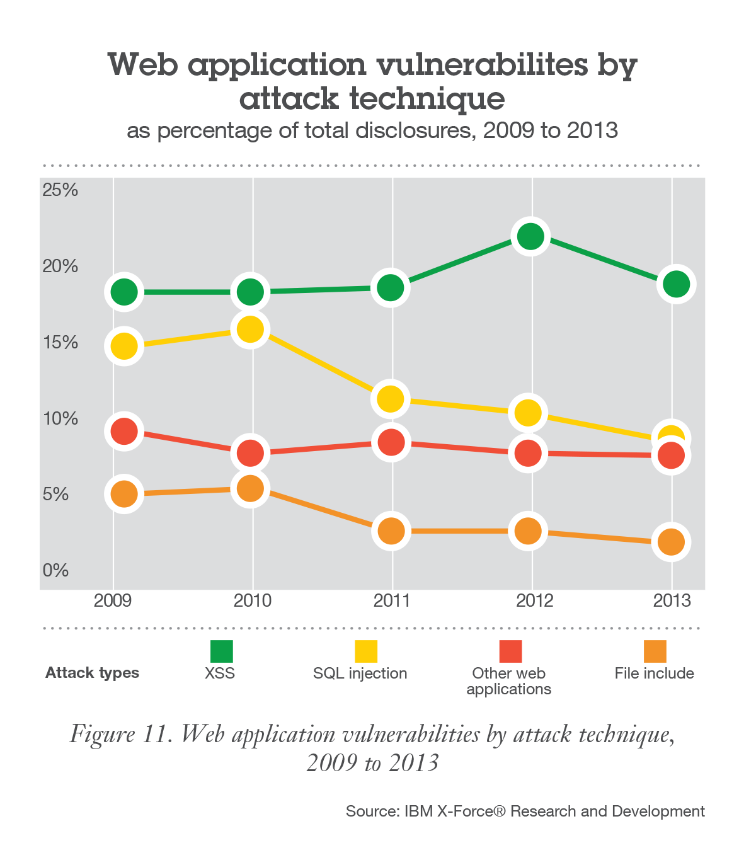
Although declining as a portion of the total,
XSS and SQLi attacks will continue until the many thousands of websites running unpatched versions of their platform or framework are patched.
Applications in Development
In-house development
Outsourced development
Production Applications
Developed in house
Acquired
Off-the-shelf commercial apps
Notes:
The declines in vulnerabilities demonstrated at the end of 2013 in both XSS and SQL injection, shown in Figure 11, could
indicate that developers are doing a better job at writing secure web applications, or possibly that traditional targets like content management systems (CMSs) and plug-ins are maturing as older vulnerabilities have been patched.
As noted previously, XSS and SQL injection exploitation continue to be observed in high numbers, indicating there are still legacy systems or other unpatched web applications that remain vulnerable. This is expected, considering there are many thousands of blogs and other websites run by individuals who may not have the skills or awareness to update to later versions of their platform or framework.

Slide 16
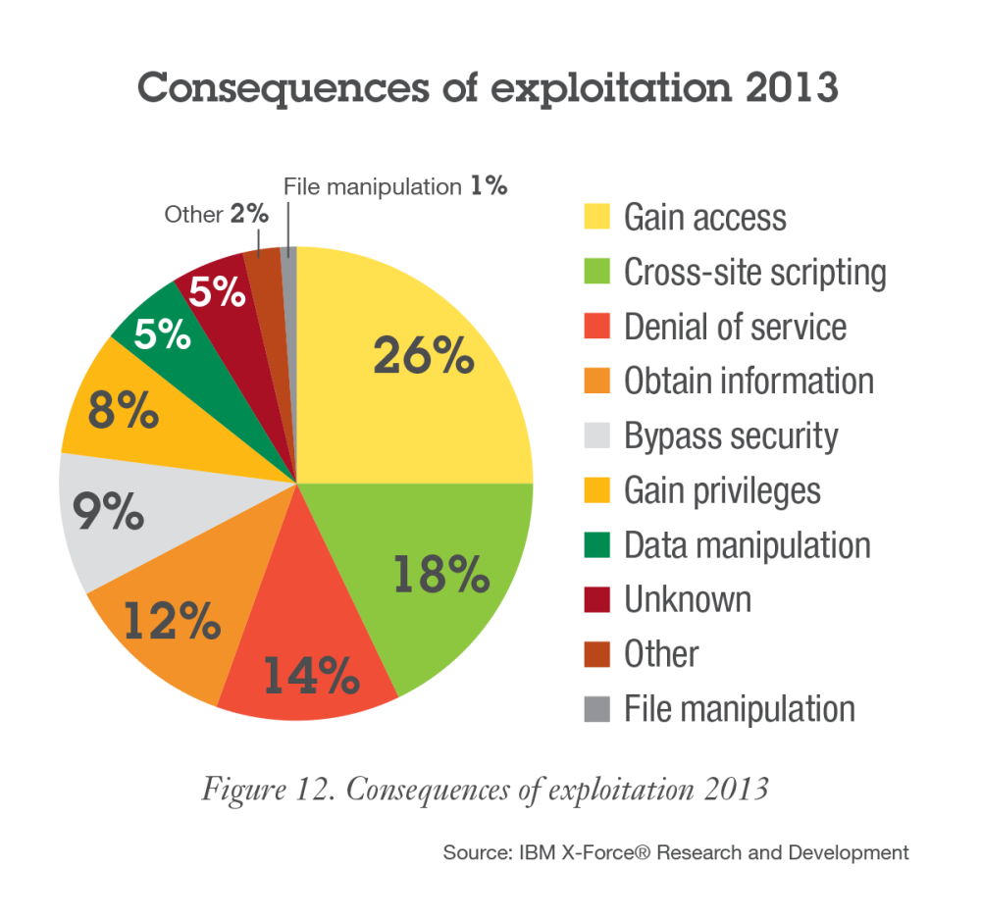
The top intended consequence for exploits was gaining additional or unauthorized access.
Notes:
The most prevalent consequence of vulnerability exploitation was "Gain Access" at 26% of all vulnerabilities reported in 2013. Cross-Site Scripting was the second most prevalent consequence at 18% and typically involves attacks against Web applications.

Slide 17
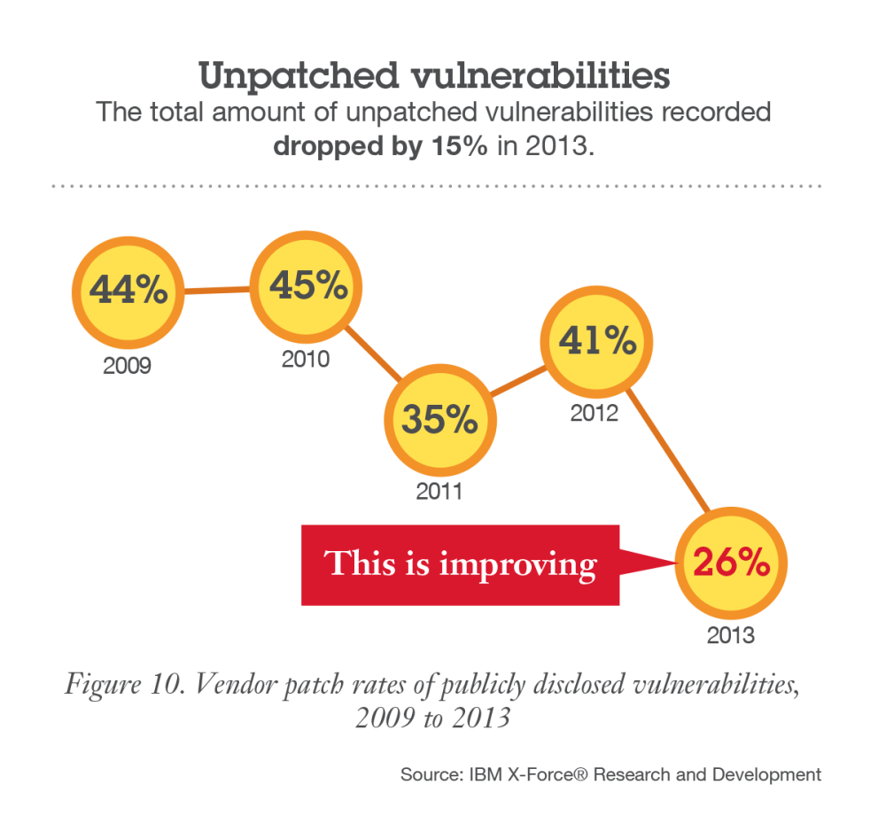
Major vendors continue to improve patching, so that the total amount of unpatched vulnerabilities dropped 15% last year.
Notes:
In addition, vendor patch rates of publicly disclosed vulnerabilities have reached some of the highest rates we’ve
seen since X-Force began tracking this data. In 2013, we found that only 26 percent of publicly disclosed vulnerabilities remain unpatched—this shows improvement!

Slide 18
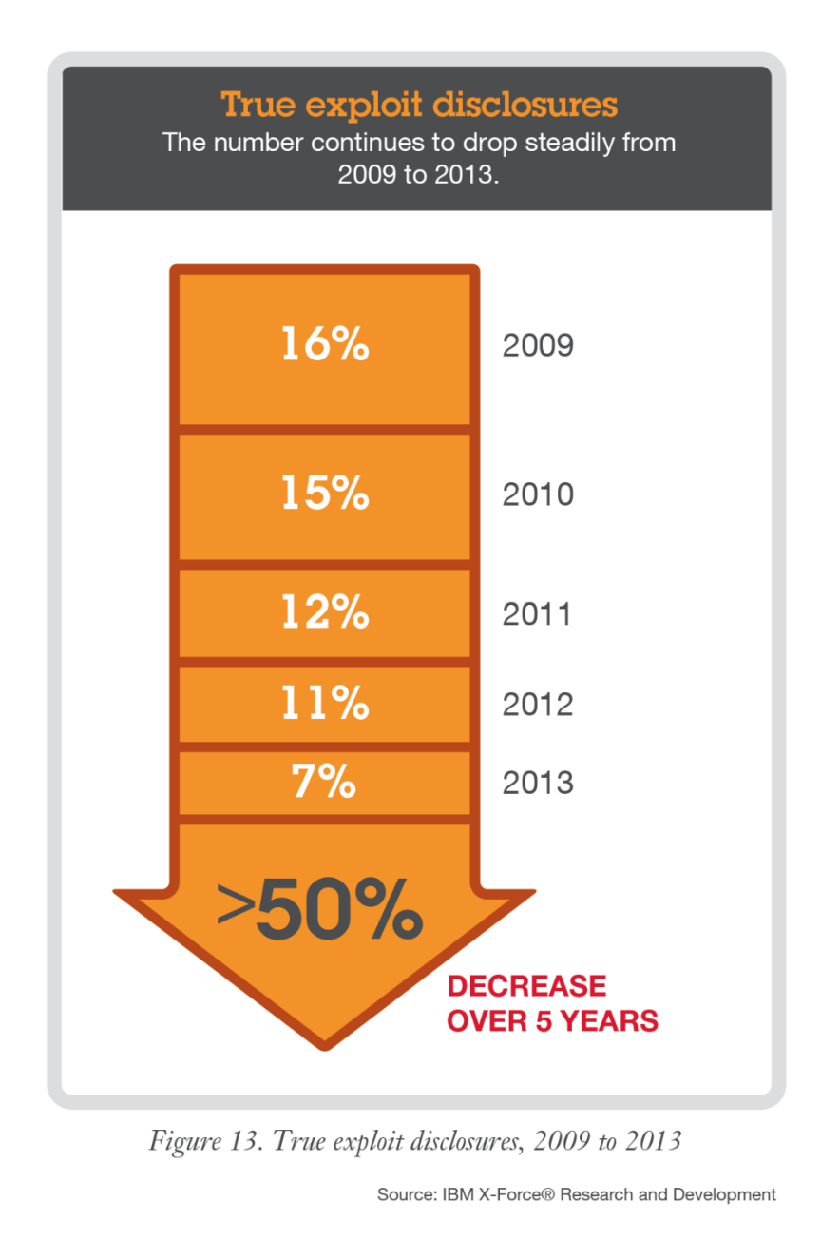
Reports of true exploits declined to the lowest level in the past 5 years.
Two categories of exploits are tracked:
  Exploits: Proof-of-concept code
  True Exploits: Fully functional programs capable of attacks
Notes:
X-Force catalogs two categories of exploit: exploit and true exploit. Simple snippets with proof-of-concept code are
counted as exploits, while fully functional programs capable of standalone attacks are categorized separately as true exploits.
Publicly available and disclosed true exploits have continued to decrease over the past five years to the lowest levels we’ve seen since 2006. At the end of 2012 we reported that total true exploits were still down overall and at the end of 2013, we seethis trend continue.

Slide 19



Connect with IBM X-Force Research & Development
Follow us at @ibmsecurity and @ibmxforce
Download IBM X-Force Threat Intelligence Quarterly Reports http://www.ibm.com/security/xforce/
IBM X-Force Security Insights blog at www.SecurityIntelligence.com/x-force

Slide 20
Notes:
Mandatory Thank You Slide (available in English only).

