Slide 1
Tivoli Talk:
Gemalto Strong User Authentication for TAM E-SSO & TAMeb
E.K. Koh, IBM
Thomas Fylnn, Gemalto
3rd June, 2010

Slide 2
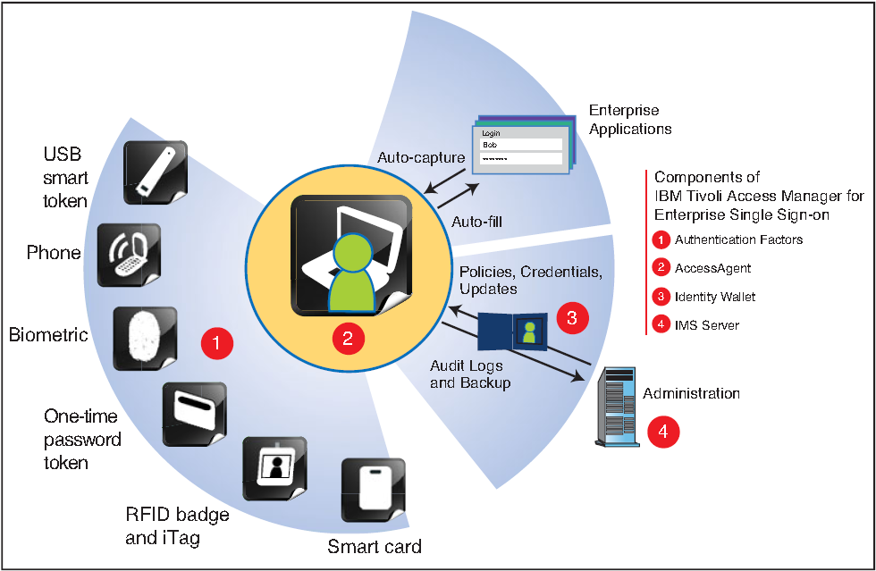
TAM E-SSO v8.1 Solution Overview
Single sign-on
Supports strong authentication
Kiosk sharing
Password self service
Web-based administration
Browser-based remote access
User access tracking & audit
No change to the infrastructure
TAM E-SSO enables visibility into user activity, control over access to business assets, and automation of the sign-on process in order to drive value for our clients.
2
Notes:
TAM E-SSO offers the support variety and flexibility that is needed in an Enterprise SSO tool, to securely facilitate logon, password change, and logoff to all Enterprise applications.
First, we support fingerprint biometrics from Upek and Digital Persona as well as smart cards in USB token form factor.
Second, it allows the user to connect from a different set of client devices, including web server, remote desktops, desktops, terminal workstations, and pervasive devices. The user wallet, which contains all the credentials for the user, is managed and distributed by the central IMS server. This wallet can be used in a direct connection to the IMS server, or in disconnected mode. The TAM E-SSO agent that sits on the client workstation retrieves the user wallet and uses it to automatically log the user to each application requested. TAM E-SSO uses profiles on the client to identify how to interact with each particular application. There is support for hundreds of application profiles out of the box.
Besides facilitating the SSO function, TAM E-SSO also ensures that all activity is tracked for auditing and compliance purposes.

Slide 3
Tivoli Unified Single Sign-on
  Web (TAMeb)
  Enterprise (TAM E-SSO)
  Federated (TFIM)
Tivoli Unified Single Sign-On enables visibility into user activity, control over access to business assets, and automation of the sign-on process in order to drive value for our clients.

Slide 4
Gemalto & IBM TAM E-SSO and TAMeB
“Protecting Access for the Enterprise”
Thomas Flynn
Director Sales & Marketing
Gemalto Enterprise Security

Slide 5
Agenda
Gemalto at a glance
The case for stronger authentication
Customer motivation
Extending Tivoli to support Trusted Identities
Meeting the customer needs together

Slide 6
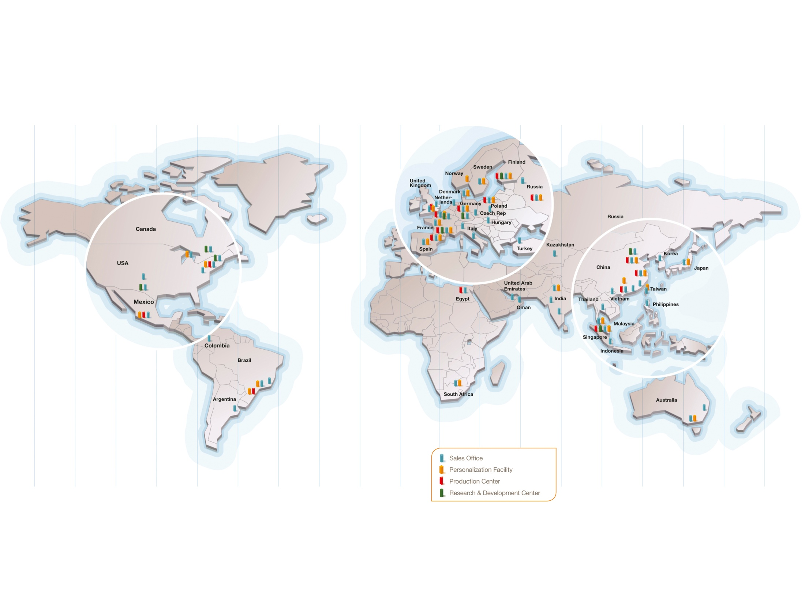
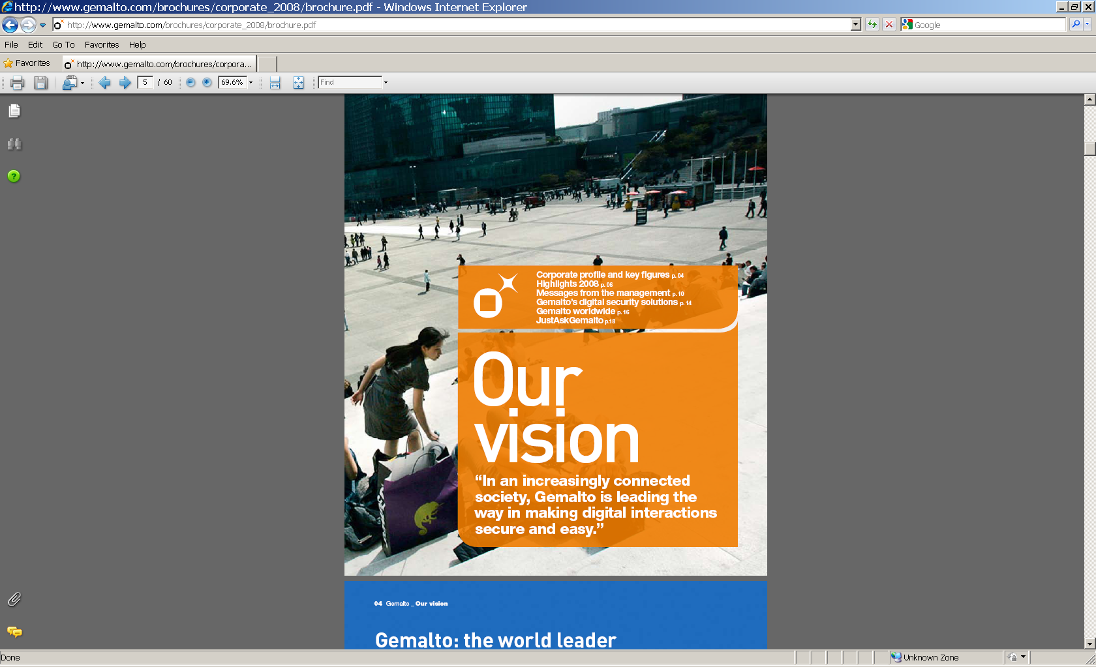
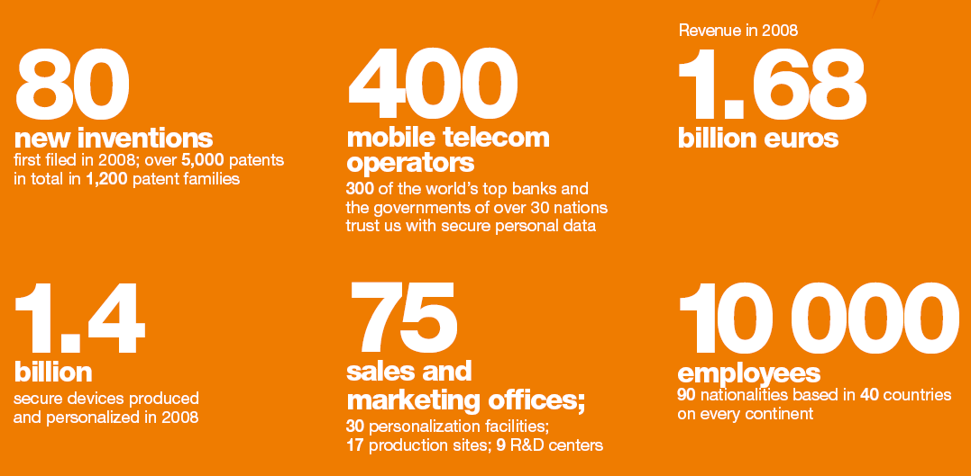

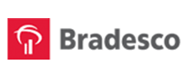
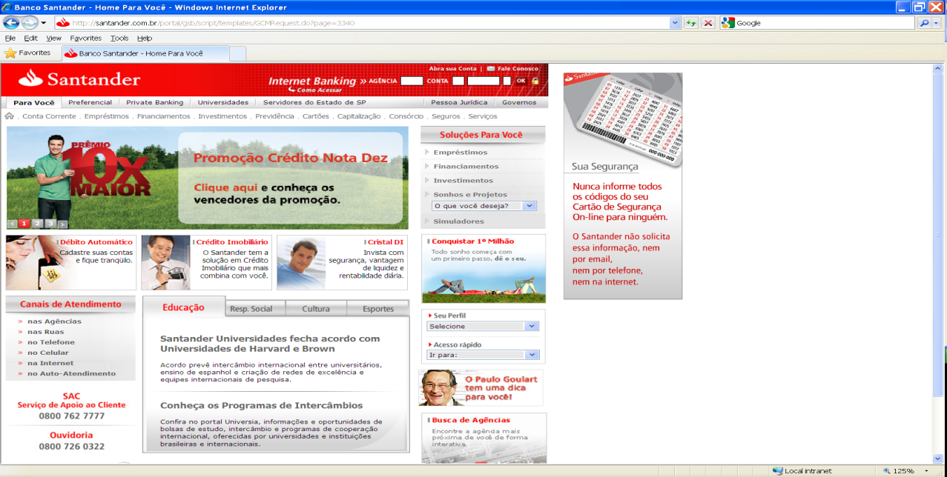



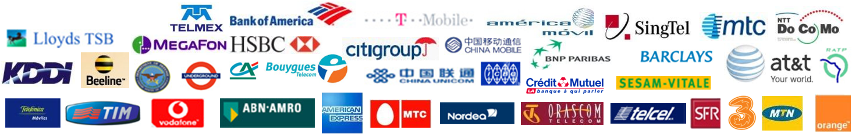
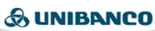
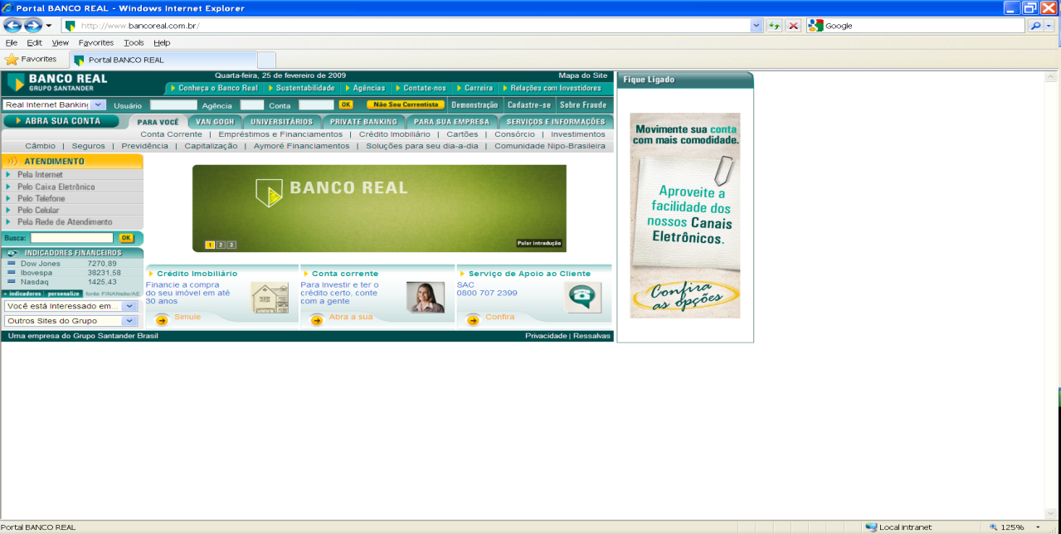
Gemalto's Worldwide Presence
Revenue
$2.4Bn
  30 personalization facilities
  17 production centers
  9 R&D sites
Notes:
How many people are familiar with Gemalto?
We are a company that strives at making digital interactions secure and easy
We are a global company – over 2 billion users are already carrying a Gemalto product of some kind
If you have a cell phone with a SIM chip in it, or a credit card, you are using one of our products now.
The digital revolution is transforming people’s everyday lives and the business of our customers; we help them by making digital interactions more convenient, secure and enjoyable
We are part of a large and fast developing market, in which we have chosen to expand our activities throughout the broader value chain, to provide our clients with solutions that are more comprehensive and useful
Smart cards have come to represent only partly what Gemalto can do, and our expertise and experience in developing secure personal devices, software and related services enable the company to become a leader and to thrive in this market

Slide 7
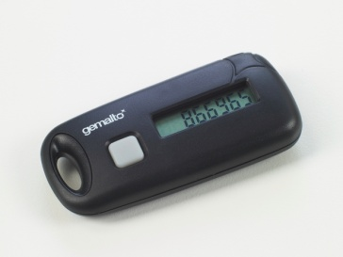
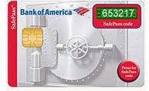
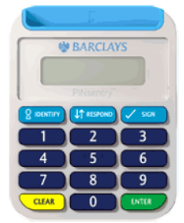
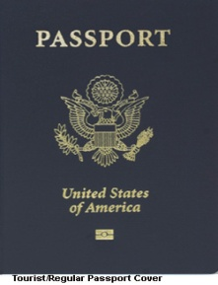
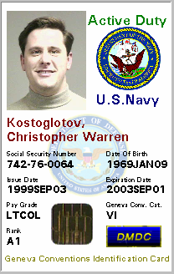
Customer Confidence in Gemalto’s Solutions
Amazon Web Services OTP Token
SAAS customers of AWS leverage
Gemalto’s OTP service to secure access
Bank of America SafePass
BofA chose Gemalto’s Ezio Display Card
for OTP-enabled online banking
Barclays PINsentry
2.5 million Barclays users take advantage
of our cryptographic smart card for online banking
U.S. State Department ePassport
The U.S. State Department has issued over 10 million ePassports
using Gemalto’s contactless smart card
Department of Defense Common Access Card
Gemalto provides millions of smart cards
each year for the Department of Defense

Slide 8









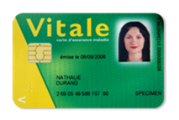


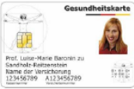


Trusted by Governments and Fortune 500 Companies
  Gemalto produced and securely personalized 1.4 billion devices in 2008
  Every day more than 10 million people in the world securely access their premises and sensitive data thanks to our strong authentication solutions
  Smart Enterprise Guardian, winner of 2008 Info Security Products Guide Award: “Tomorrow's Technology Today”
Notes:
8

Slide 9
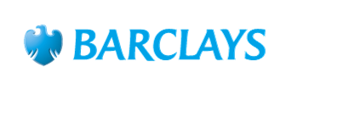
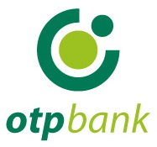







Trusted by the World’s Top 100 Banks
  Gemalto delivers secure solutions to more than 900 banks in the world
  800 million people use Gemalto banking cards
  World leader in smart card readers (Frost & Sullivan)
  10 million online banking customers use Gemalto’s eBanking solutions
Notes:
9

Slide 10
Agenda
Gemalto at a glance
The case for strong authentication
Customer motivation
Extending Tivoli to support Trusted Identities
Meeting the customer needs together

Slide 11

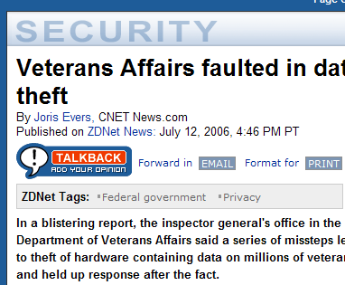
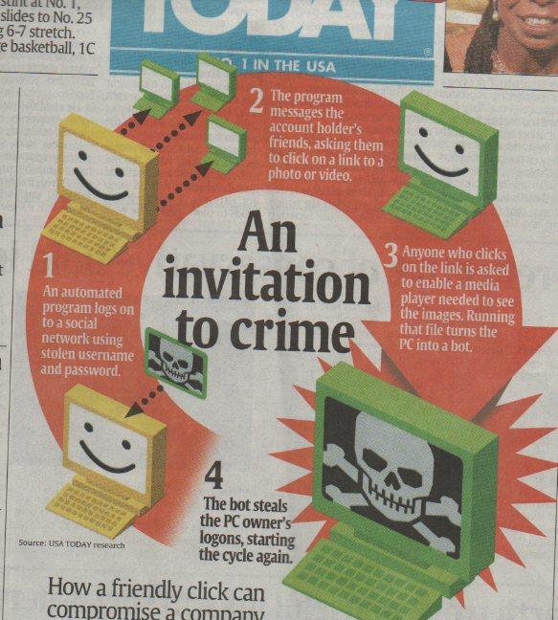
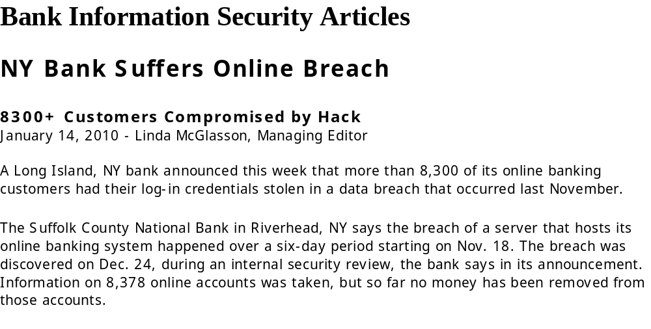
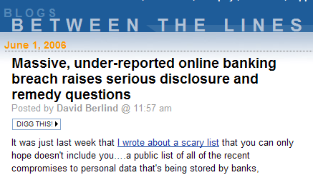
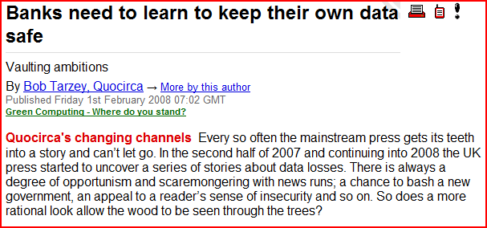
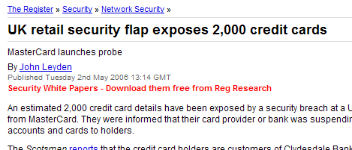
The Challenge for Compliance:
Sophisticated Cybercrime
Veterans Affairs faulted
in data theft
Banks need to learn to keep their own data safe
©Microsoft Confidential 2005 All rights reserved
Notes:
First example newspaper headline lost laptop exposes customer data
Second example customers database breach to do to weak passwords
Look for an example around soxs or hippa
11

Slide 12


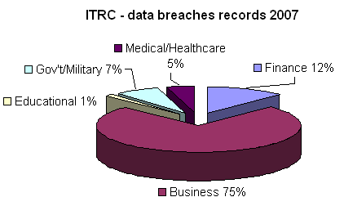

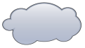
Organization’s Data Security Challenges:
From portable to mobile to network
Portable Data
52 percent of enterprises have reported loss of USB drives in last 2 years (survey by Government Technology magazine)
Mobile Data
The Computer Science Institute found the average theft of a laptop to cost a company $89,000
Network Data
251 data breaches identified by the Identity Theft Resource Center as of August 2007; 74,782,417 records exposed
Notes:
12

Slide 13
Information Loss is Costly
Whether it is theft or accidental, it creates several impacts…
The U.S. Dept of Justice estimates that intellectual property theft cost enterprises $250 billion in 2004
Loss of revenue, loss of e-business opportunities market capitalization, and competitive advantage
Financial
Increasing regulation: Sarbanes-Oxley Act, Health Insurance Portability & Accountability Act, Gramm-Leach Bliley Act and EU Directive
Non-compliance can lead to significant legal fees, fines and/or settlements
Regulatory
Compliance
Image &
Credibility
Leaked executive e-mails can be embarrassing
Unintended forwarding of sensitive information can adversely impact the company’s image and/or credibility
Decreasing confidence into e-banking & e-commerce services
Notes:
13

Slide 14


Strong Authentication – Combining Security, Efficiency, and Effectiveness
The more factors, the stronger the authentication
  Something I know, a PIN or password
  Something I have, a smart card or token
  Something I am, i.e. biometrics
I Know
I Have
Do more with less
Make fewer mistakes
Do it more quickly
I am
Better controls
Better transparency
Notes:
14

Slide 15
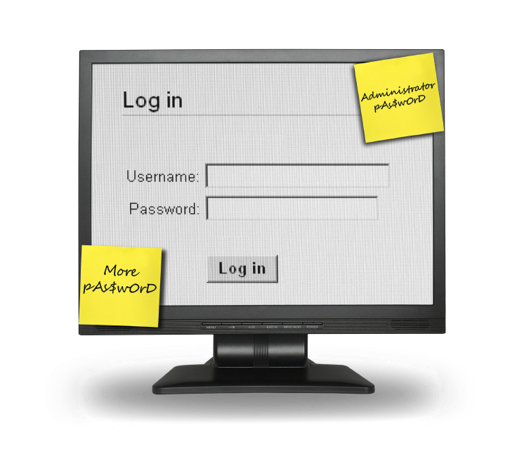
Value of Two Factor Authentication & SSO
Ease of Use and Reduced Cost:
No more user frustration and complaints due to password and security complexity
No longer wasting employee time with password management activities
High password-related user support costs
Security:
Weakened security due to poor password selection and management
Confidently securing access to application base
Integrated security to protect “keys to the kingdom”
Regulatory:
Protect access to confidential data (HIPAA, GLBA)
Track access to sensitive data (SOX)
User36
Passwors1
User36
12#$5p
USR44
PaxxWrk2
User36
Passwors1
User36
PaLLwors1
User36
Passwors1
PaulaM
PP*sn1
User36
Passwors1
User36
P*&^hkk
Notes:
Every enterprise and every individual should be able to relate to the typical problems caused by network and application sign-on
[select those that are appropriate for the customer presentation]
The frustration users experience when juggling an increasing number of passwords that need to be unique and follow individual selection rules to make them secure
Then inevitably when one’s forgotten the time users waste while getting a reset and the interruption to getting work done
The resets add up and with them the costs … for the typical enterprise according to Gartner between 40% and 60% of help desk calls at an avg of $25/call
Otherwise users simplify the process and pick weak passwords or write them down and stick them to their monitor
Making it very difficult to confidently secure critical applications
To lock those critical applications down, passwords are made more complex further exasperating the problem and it’s very difficult to integrate more secure advanced authentication
Unfortunately it’s not an option as regulations seek to protect consumer data and track all user access

Slide 16
Agenda
Gemalto at a glance
The case for stronger authentication
Customer motivation
Extending Tivoli to support Trusted Identities
Meeting the customer needs together

Slide 17
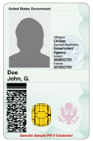
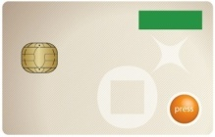
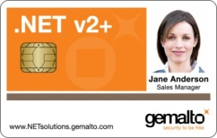

Why do customers deploy Trusted Identities solutions?
Stepping to the highest level of trust in Identity Management
  Government agencies (PIV mandate, Police forces, Contractors)
  Financial and insurance sectors employees
  Critical infrastructure industries (Utilities, Oil and Gas, Healthcare)
Streamlining business processes with digital signature
  Pharmaceuticals & life sciences (SAFE Bio-Pharma)
  Retail & distribution
Retiring proprietary 2-factor authentication systems
  Future-proof and open standards-based infrastructure
  Multiple form factors to match enterprise use cases
  Compliance with the relevant infrastructure standards
Securing customer identities and transactions
  Compliance with regulatory standards (e.g., FFIEC)
  Identity theft avoidance
  E-service adoption, “stickiness”

Slide 18

Large Swiss Bank, Switzerland
Secure the access to its IT infrastructure
Data integrity and accountability are key requirements for the bank’s operations
Solution implemented: PKI-based solution providing strong authentication, secure access to terminals, email encryption and digital signature of documents.
Over 40,000 bank employees use Gemalto’s solution daily to access the Bank’s network, validate transactions, encrypt and sign sensitive documents.
Benefits:
  Effective authentication of all users
  Security policy enforcement
  Cost savings
Notes:
Confidential: Credit Suisse required a secure network access to protect its sensitive information and a full and accurate record of all users accessing its corporate resources to ensure both accountability and the integrity of all types of information.
Stringent legal and regulatory requirements govern the access to and the storage of information for financial institutions.
Credit Suisse needed security capabilities that would provide an effective means of authenticating users and ensuring accountability and confidentiality. User accountability and privacy of the confidential financial information handled by its employees and IT systems were of the utmost importance to Credit Suisse
Ensuring that users are properly identified and authenticated to applications is therefore a critical issue. When examining possible new solutions for its authentication requirements, Credit Suisse identified the following solutions: smart cards and a security infrastructure that would enable authentication, authorization, encryption and digital signatures. (Entrust is the certification authority)
Use
The employees of the Bank use their card daily to reach the network of the company and make their operations. Certain validation passes by electronic signature and numbers of sensitive documents are encrypted by the card.
Benefits
Perfect balance between cost security and end-user convenience.
As the Bank explained at time of implementation, this solution allowed an economy about 30 % on all the others. The investment granted for the complete system answers security imperatives of and secret that in the implementation of the new banking standards
Credit Suisse Group has reduced the cost of administering tokens and resetting passwords for internal users. It has also increased the speed with which new applications can be developed by leveraging a central authentication infrastructure instead of incorporating it in each individual application.

Slide 19


Leading French Retailer
Situation:
  More than 490,000 employees worldwide
  30 brands and 15,000 stores
  Implement trusted identity infrastructure to enforce business controls and streamline processes
Challenges:
  Integrate the logical access with the legacy physical access infrastructure
  Enhance the trust in a distributed environment while simplifying user’s day to day life.
  Part of the company internal branding
Solution:
  Integrate open standards public key infrastructure with Tivoli IDMS
  Converged physical/logical access employee badge
  Integration with enterprise single sign-on.
Benefits:
  Improved corporate image
  Good user acceptance through esso convenience
  Enabling transaction trust and non-repudiation

Slide 20

Pfizer, USA
Enhanced overall security for physical and logical access with two-factor authentication
Productivity enhanced with single ID badge for building access and secure logon to corporate networks and applications
Preserved Pfizer’s security infrastructure investments through integration with legacy systems
Achieved substantial ROI through the elimination of paper document submittals to the FDA
Significantly reduced support costs associated with password resets handled by help desks
Notes:
The leading pharmaceutical group Pfizer is deploying a smart card-based integrated badge system, to provide employees with physical access badge, single sign on access to internal information systems and digital signature for business transaction based on Identrus certificates. Gemalto has supplied several key component of the global system, including over 100,000 smart card modules, middleware and smart card readers
The solution delivered to Pfizer consists of:
• Smart cards
• Desktop readers
• Desktop middleware
• Services and consulting
Gemalto provides the card and the cryptographic client needed to sign digitally the paper work submitted to the FDA.
Compliant with Identrust standard for signature
How does it work?
Gemalto is embedding 64Kb smart chips pre-loaded with a secure authentication applet onto Pfizer's existing employee proximity (HID) badges. The badge is now equipped with both a contactless antenna and a contact microprocessor chip. The contactless antenna is used for access to restricted locations by swiping the card in front of a contactless reader, while the contact chip is accessed by inserting the card into a reader connected to the desktop.
With the smart chip Pfizer employees can perform a broad range of logical security functions such as:
Secure PC logon
Strong PKI-based network authentication
Digital signatures
Remote employee access to VPNs
Access to buildings and offices in Pfizer's facilities,
Other applications include:
Tracking training classes attendance
Cafeteria payments
Benefits:
ROI is fully driven by the reduction of the wet signature:
Pfizer disappeared form the top 10 customer of Fedex after implementation
The cost of one signature is equivalent to that of one converged badge.
As of 2006, Pfizer had completed the integration work and issued smart badges to 80,000 users. In the coming years Pfizer, along with other
pharmaceutical companies, plan to use smartcard based devices with SAFE for the high assurance of digitally signed documents to
clinical trial participants which support the pharmaceutical industry.
.

Slide 21
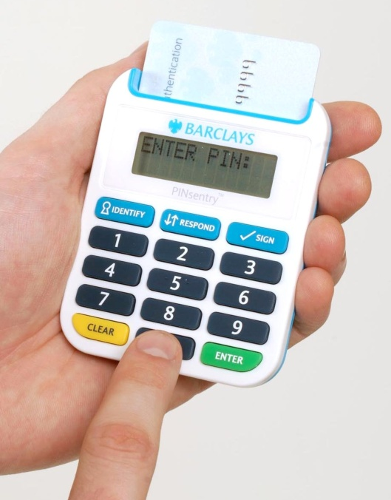
Over 3 Million Barclays users today hold a Gemalto reader
Fraud decrease: not one PINsentry customer has suffered an Online fraud since its implementation in summer 2007
After the intial launch, Barclays observed that:
  Acceptance of the solution by the users was higher than anticipated
  The satisfaction rate was a record high on 95%
  Not one PINsentry customer has suffered an online fraud since its implementation
  The number of calls to the Call Center and their duration was in line with expectations
  New online users asked for the device
  New Barclays clients were asking for online access and the device up front
In December 2007, Barclays decided to go ahead with the next phase of the program and …
  Promote it to their entire user base
  Activate new users and target a growth of 40% of the online channel penetration
  Insource again the helpdesk into Barclays call center

Slide 22

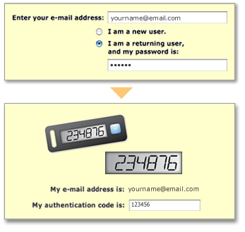
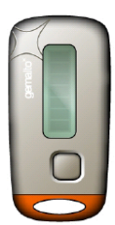
Amazon Web Services (USA)
Situation:
  Since early 2006, Amazon Web Services (AWS) has provided companies of all sizes with an infrastructure web services platform in the cloud. (computer power, storage, and other services)
Challenge:
  Ensuring only authorized users are accessing their AWS account.
Solution:
  Ezio Time Token: guarantees two-factor authentication and provides a one-time password (OTP) for secure login
Benefits:
  Secure – Provides an additional, opt-in layer of security.
  Simple – Easy and secure account access from anywhere at any time with any type of terminal
  Easy to set up
  Creates confidence: Companies of any size with these authentication devices can ensure authorized access to account information.
Notes:
Situation:
Amazon Web Services provides highly scalable computing infrastructure that enables organizations around the world to requisition compute power, storage, and other application services in the cloud. These services are available on demand so a customer doesn't need to think about controlling them, maintaining them or even where they are located. Customers access the services when they need them and pay for only what they use.
Challenge:
Cloud computing and Web services are designed for convenient access to online resources and are experiencing strong adoption within enterprise accounts. This makes it essential to ensure only appropriate users are gaining access to these online services and resources
Solution:
Ezio Time Token: is a small, lightweight, long lasting device that provides a unique six digit one-time password (OTP). The user simply presses a button on the device and the OTP is displayed. The generated password is only good for one access attempt within a short time interval. The Multi-Factor Authentication feature allows users to combine something they know, their email address and password, with something they have, the Gemalto Ezio device, to ensure only authorized users are accessing their AWS account.
Allynis™ Managed ID suite of services for direct fulfillment of the Ezio Time Tokens to AWS users. Allynis Managed ID allows organizations, often overburdened with issuing employee badges and tokens, to take advantage of Gemalto’s 20+ years of experience for all of their personalization, inventory management and fulfillment needs.
Benefits:
Secure – Provides an additional, opt-in layer of security. even greater protection for AWS account, including extra protection of sensitive information such as AWS access identifiers and critical actions such as changing AWS infrastructure service subscriptions. AWS resources, such as Amazon Elastic Compute Cloud (Amazon EC2) instances or Amazon CloudFront distributions, cannot be modified without multi-factor authentication.
Simple – Easy and secure account access from anywhere at any time with any type of terminal
easy to set up
Creating confidence: make sure business users are confident with the level of security AWS offers and multi-factor authentication is a big step in the right direction. Companies of any size can buy these authentication devices and ensure employees are the ones accessing the account. If the device is stolen it is useless without the username and password. If someone really wants to access an account they shouldn’t then it’s going to be a lot harder than stealing a username and password or a Time Token – they have to get all three.
Cost Effective – Once purchased your authentication device, there is no fee for using AWS MFA.

Slide 23






Strong Authentication is
at the Core of Multiple IT Security Concerns
Identity Security
Identity Administration
  Provisioning
  Role & Entitlement Management
  Privileged-User & Password Management
Identity Data Infrastructure
Data Security
Encryption
Scanning
Monitoring
Data at Rest
Data in Use
Data in Motion
Federation
Data
Encryption
(DLP)
ESSO
Web SSO
Core Authentication Market
Converged
Badge
Fraud
Detection
Network Security
Threat Management
Secure Content Management
Security & Vulnerability Management
Intrusion, Detection & Prevention
Building Security
Security equipment (doors, video, access card, readers,…)
Software Management
Ebanking & ecommerce
Transaction Security
Signature (web and document)
Web transaction
Fast and automated signature circuit
Audit
Notary service (i.e. timestamp)

Slide 24
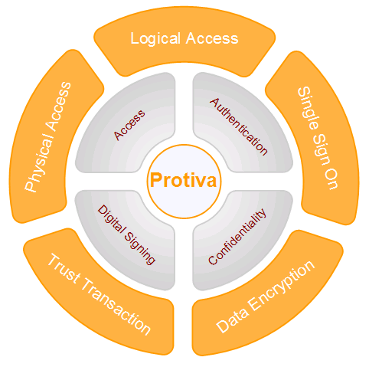
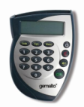

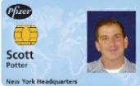
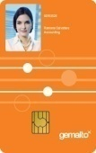

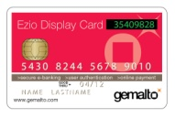


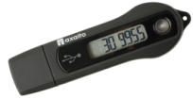
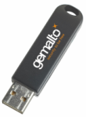

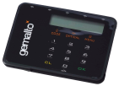



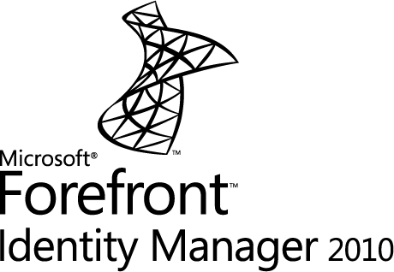





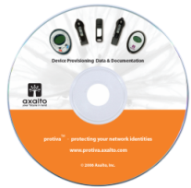


Complete Solution
Readers
Cards & Tokens
Services, Fulfillment and Support
Operated Services
Drivers, applications and authentication servers
Issuance and Lifecycle Management
24
Notes:
24

Slide 25
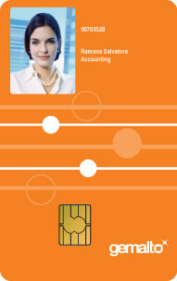




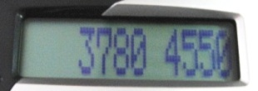
Handheld Digital security
Photos
PKI Certificates
NT Login
rparris
letmein
SAP
richardp
x4Lo19b
Physical and logical access control
C. Schwab
richparr
echo2
Finance
RP1
echo1
Passwords and PINs
Biometric recognition
OTP calculation and display
25
Notes:
25
25

Slide 26
Agenda
Gemalto at a glance
The case for stronger authentication
Customer motivation
Extending Tivoli to support Trusted Identities
Meeting the customer needs together

Slide 27
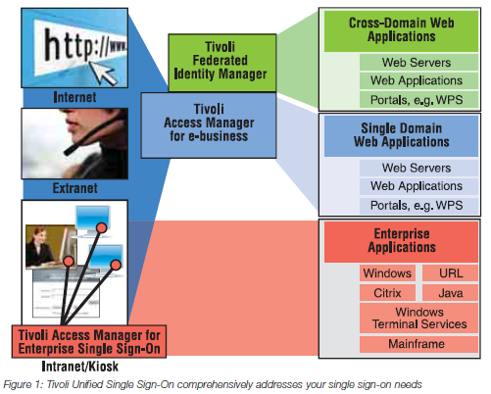
Integrated Two-Factor Authentication
Ease of Use
Reduced Cost
Robust Security
Compliance
“Trusted Identity Initiative”

Slide 28
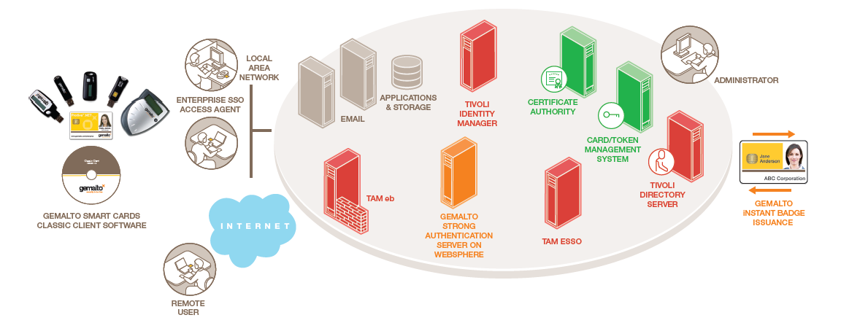
High Level Enterprise Architecture and Integration
Notes:
Jerome, be sure to highlight required 3rd party
components here: eg CA, CMS

Slide 29

Gemalto Protiva configurations are Ready for Tivoli Certified
 | Use case | TAM ESSO Ready?* | Configuratiion | OTP Support? | PAC Support? | USB form factor?
TPC Classic | Flexible enterprise platform | Yes | TPC IS (applet v1) TPC IM (applet v2) with Classic Client 5.2.0 | On Request | Yes | Yes
.NET | Flexible enterprise platform | Yes | .NET V2+ with Msft Base CSP | Yes | Yes | Yes
PIV card | Compliance with USA FIPS 201 mandate | Yes | Tested with ActivIdentity middleware | No | On Request | No
IAS TPC | Compliance with European IAS standard | Yes** | Generic European Citizen Card with Classic Client for IAS | On Request | Yes | Yes
Access TPC | Corporate badge for existing customers | Yes | Access Client with TPC CY2 card | No | Yes | No
* Reported by Gemalto. Please check with vendor for details
** Requires selection of the authentication container
IBM OPAL: http://www.ibm.com/software/tivoli/opal?NavCode=1TW10AMBT

Slide 30
Agenda
Gemalto at a glance
The case for stronger authentication
Customer motivation
Extending Tivoli to support Trusted Identities
Meeting the customer needs together

Slide 31
Gemalto Extends Tivoli’s Trust Solutions
Gemalto extends the value of TAM E-SSO and TAM eb
  TAM E-SSO provides easy entry into the enterprise while Gemalto Protiva enhances security
  For consumer portals, TAM eb provides the access control while Gemalto provides the consumer authentication
Identity Management implementations are linked to larger changes
  Implementation of cloud computing / outsourcing
  Extranet and B2B cooperation
Opportunity for consulting and expanded services
  Policy and objective setting for infrastructure roll-out
    Scope definition, project management
    Security objective and policy updates
  System integration and production enablement
  Full IDMS architecture definition
  Secure implementation of Certificate Authority and Card Management System

Slide 32
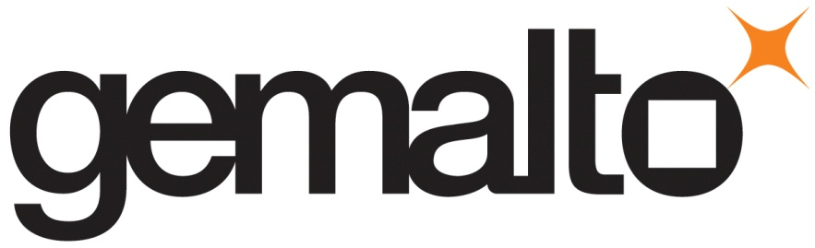
Why Gemalto?
Worldwide industry leader & reliable company
Gemalto produced and securely personalized 1.4 billion devices in 2008
EMV & CAP/DPA specialist
Gemalto co-develops and promotes standards
Complete end-to-end solution provider
Notes:
32

Slide 33
Useful Information
More information can be found at the following links:
IBM OPAL Listing
Gemalto Strong Authentication Devices
Protiva Enterprise Security Solutions for Tivoli
IBM Contacts: E.K. Koh (ekoh@us.ibm.com) or Gino Maa (gmaa@us.ibm.com)
Gemalto Contacts: Bill Cashel – Western Regional Manager (william.cashel@gemalto.com);
Brad Rouse – Central & Eastern Regional Manager (brad.rouse@gemalto.com)
01/06/2010
33
Notes:
33
33

