Slide 1

Competitive Selling
with BigFix
Jim Katz – WW Tivoli Sales Enablement
Mark Ehr – Product Marketing, BigFix
Mark Phinick – Account Executive, BigFix

Slide 2
Statement Of Direction And Intent
All statements describing future direction or intent are provided for planning purposes only and are subject to change or withdrawal without notice
  This presentation represents our current goals and objectives
  Our development teams are engaging to further define our product plans
  We are listening to customers’ views on the future directions of our solutions
  IBM reserves the right to change product plans, features, and delivery schedules according to business needs and requirements
Notes:
Please ask your manager for any compensation-related questions” and see the July 26 Tivoli Talk for further information.

Slide 3
Agenda
Introduction – Jim Katz
BigFix Competitive Overview – Mark Ehr
Real-world BigFix Competitive Win – Mark Phinick
Questions - Team

Slide 4
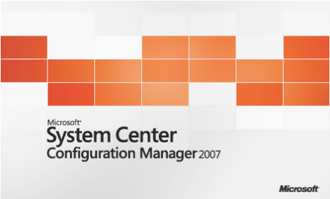

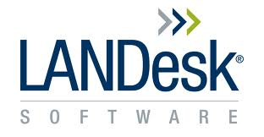
Key Competitors
Microsoft Systems Center
Configuration Manager (SCCM)
Symantec/Altiris
LANDesk
…and scores of others
Notes:
In addition to the “usual suspects,” including SCCM, Altiris and LANDesk, there are literally scores of other players in the endpoint management market, particularly when you factor in all of the segments in which BigFix competes (system lifecycle management, security configuration and vulnerability management, plus endpoint protection). Other common competitors include Patchlink/Lumension, Shavlik, and Kace/Dell.
It is very important to understand that regardless of which competitor you’re facing, the most successful BigFix reps don’t get wrapped around the axle focusing on specific kill points against a specific competitor. Instead, focus on the overall value of the BigFix platform and solution, and show the customer that value, and you’ll win every time.
Some people may be asking “but what about security?” The reality is that selling the security aspects of the BigFix solution are really a corollary to the primary BigFix advantages, with patch management leading the way. When it comes to anti-virus, BigFix sells an OEM of Trend Micro, but we can also manage any vendor’s AV solution including distributing AV signature files and updates.

Slide 5

Sample Global Management Company – Before BigFix
“We deployed only 40,000 out of 90,000 devices in 8 months”
“We use 15 configuration management tools to manage our entire IT environment”
“Of 40,000 devices deployed, we’ve only achieved an 80% patch management success rate, and we don’t have real-time visibility into the process”
Notes:
This is a typical situation that BigFix prospects experience with other tools. In this case, which is a large global management company, they attempted to deploy Altiris. After eight months, they had managed to deploy less than half of their 90K endpoints, they were forced to use 15 different tools to support all of the operating systems and platforms in their environment, and of the devices they had managed to deploy, they had only been able to reach an 80% patch application success rate. Even worse, they had no real-time visibility into the status of their environment, increasing the risk from machines that were not in compliance with policy.

Slide 6

Sample Global Management Company - After BigFix
“We deployed over 90,000 devices in 5 days”
“We reduced our agent-based management technologies by 50%”
“We now have a 95%+ patch success rate with real-time visibility”
Notes:
50% of their agents thanks to the BigFix Unified Management Platform, and they increased their patch success rate to over 95%. They were also delighted to be able to visualize and report on their IT environment in real-time.

Slide 7

Sales Challenges
Every BigFix deal is competitive
  There are virtually no “green field” opportunities outside of SMB
  Complement or displace
Virtually every competitive deal is similar
  Regardless of competitor
  Find the pain, conduct a POC to show value, close the deal
Many prospects have “free”
tools installed
  Free is not free!
Notes:
Virtually every enterprise and government agency over a certain size (perhaps as low as 5K endpoints) already has some sort of patch management product in place. It could be something as simple as Windows Server Update Services (WSUS), or it could be any of the competitors listed in slide 4. The reality is that there are virtually no “green field” opportunities, and as such, every BigFix deal will be competitive. Fortunately, there are many opportunities for BigFix to either complement existing tools or replace existing tools (and often, one leads to the other!).
That said, virtually every competitive deal is similar, regardless of the incumbent tool in place. The key concept, regardless of competitor, is to find the pain, convince the customer to do a proof-of-concept, and once installed, IT will not want to give BigFix up. It’s the classic “tip of the spear” approach.
One of the key objections that you will run into is the prevalence of “free” tools. While these tools are not technically free, they are typically provided as a part of an enterprise license deal (hence the perception that they are free to use—in other words, for no incremental cost). This perception is completely and totally wrong. For more details on how to fight a battle against a “free” product, refer to the BigFix “Free is not Free” white paper.

Slide 8
Customer Challenges
 | Competitors | BigFix
Multiple Platform Support | Varies | Win, Mac, UNIX, Linux, POS, Mobile
First-pass Patch Success Rate | 50 - 80% | 95% +
Real-time Inventory, Status, Reports | No | Yes
Agent Overhead | Up to 100% | Less than 2%
Roaming Device Support | Difficult | Easy
Out-of-band Patches / Zero-Day Events | Labor Intensive, Slow | Simple, Quick
Management Tool TCO | 5 - 10x+ | 1x
Tools / agents/ consoles | Many | One
Published Patch Content | Limited Third-Party Apps | O/S + Third-Party Apps
Notes:
This chart summarizes many of the challenges that BigFix customers experience with other tools, and why BigFix is superior.
Multiple Platform Support
Competitors only offer a subset of the platforms that BigFix supports. This means that they will have to deploy yet another tool (or BigFix!) in order to gain support for the missing platforms.
First-pass Patch Success Rate
This is the percentage of patches that are successfully applied in the first attempt. Competitive solutions report only 50-80% first-pass success rate, which means that IT admins have to schedule re-applications over and over until they “take”. Another issue is ensuring that once a patch is installed, it remains installed. BigFix customers consistently report 95%+ first-pass success rate, and BigFix also continuously assesses endpoint compliance, guaranteeing that patches stay installed.
Real-time Inventory, Status, Reports
All BigFix competitors use an antiquated, slow, scan-based architecture to obtain inventory, configuration, and status information from endpoints. Scans can take days or weeks to complete, making real-time decisions and risk determinations (e.g. during a zero-day event) impossible. BigFix’s unique architecture provides this data continuously, in real-time. Queries and reports take seconds to complete, and data is accurate.
Agent Overhead
Many IT organizations believe that “agent” is a bad word. This is because many management agents are resource intensive and unwieldy to support. BigFix competitors not only require large, cumbersome agents, some require multiple agents and many open ports in order to function. BigFix relies on a single, lightweight agent that consumes less than 2% of the machine’s resources.
Roaming Device Support
Roaming devices are those that are mobile and function outside of the corporate network—like a laptop, for example. Maintaining endpoint compliance for roaming devices is very difficult, expensive, or impossible for many BigFix competitors. BigFix not only supports roaming devices, but thanks to bandwidth throttling and other policies, it functions very well over slow, highly latent network connections. Competitors can’t touch this.
Out-of-band Patches and Zero-Day Events
OOB patches that those that are released outside of a scheduled update cycle, such as Microsoft Patch Tuesdays. Zero-day events are often the cause of OOB patches, as they result from a severe security vulnerability being disclosed that must be patched ASAP in order to ensure endpoint viability. In some causes, remediation of zero-day attacks may be as simple as a configuration change, and BigFix excels at rapid distribution of patches or configuration changes. BigFix’s real-time architecture also allows customers to instantly determine their risk exposure to a zero-day attack by determining which machines are at risk—and launching remediation in minutes.
Management Tool Total Cost of Ownership (TCO)
TCO of competitive solutions can range from five to ten times (or more) of BigFix’s TCO. Even so-called “free” tools suffer from high TCO due to substantial deployment, capital expenditure and ongoing maintenance costs. BigFix deploys in days or weeks with a single server.
Tools / agents / consoles required
Competitive tools have very complex architectures that often incorporate tools that were obtained via acquisition. These tools are generally not well integrated, resulting in multiple tools, agents and consoles. BigFix works with a single platform, console and agent.
Published Patch Content
When patches are released by vendors, they must be tested, packaged and deployed to endpoints throughout the organization. BigFix tests and delivers patch content for a wide variety of vendors, including Microsoft, Adobe, Apple, Java, and Real Networks. Many BigFix competitors deliver only Microsoft patches or only one or two additional.

Slide 9

Objection Killers
Does your tool…
Update endpoints in minutes?
Validate successful remediation and continually enforce policy compliance?
Provide coverage for Windows, Linux, UNIX, Mac plus third-party apps?

Slide 10

Objection Killers
Does your tool…
Manage roaming devices even when not connected to a network?
Use less than 2% of endpoint resources?
Provide real-time risk and compliance data?

Slide 11

Objection Killers
Does your tool…
Automatically quarantine, remediate and confirm patches before removing from quarantine?
Manage up to 250K endpoints with a single server and console?

Slide 12



BigFix Ease of Use
Forklift upgrade
from v6 to v7
CMS v7 incompatible w/Asset Mgr v7
Most configs require manual installation post-upgrade (weeks -> months)
Huge investment in PS just to get it to function
“Side-by-side” upgrade
for SMS -> SCCM
Manual steps include:
  Verify all objects have migrated
  Configure Site Settings
  Migrate Folders and folder membership
  Make Software distribution functional in new site without boundaries
  Optional: Modify package source path
  Migrate hardware inventory customizations (SMS_def.mof)
  Export / Import queries
  Export / Import reports
  Configure security rights
  Non-Replicating Software Metering Rules
“One-click” Upgrade Agility. Fixlets and Forget it.
Server and Consoles, then Relays, then Agents.
Typical upgrade timeframe for a mid-large enterprise? A few hours.
Notes:
Real-world example of how easy it is to upgrade BigFix:
We released BigFix version 8.0 on Monday August 16th
12 hours later, 36 customers had already upgraded, including one that had already upgraded 2,225 seats
Note that we always upgrade smaller customers first, so this number will actually accelerate considerably over the next few days and weeks

Slide 13

Identifying Competitive Opportunities
Prospect is unhappy with
incumbent solution
  Highly typical
  Push for POC / pilot to prove value and expand
Compelling events
  Zero-day scenarios
  Power management projects
  Compliance audit failures
Look for co-existence as well as displacement opportunities
  e.g. SCCM + BigFix

Slide 14



Competitive Kill points

Slide 15
Kill Points: Microsoft SCCM
Windows-only support (platform and patch targets)
Horrible scalability, long deployments, army of FTEs to maintain
  50,000 endpoints = 40+ servers
Out-of-control TCO
  BigFix is orders of magnitude less expensive than “free” SCCM
Slow patch cycles

Slide 16
Kill Points: Symantec/Altiris
Altiris v7 is unproven
  Released November 2008; still no public large enterprise references
  CMS v7 portfolio is still incomplete
Painful upgrades / installations
Costly, server-heavy architecture
  1 server per 5K endpoints
Slow inventory scans = inaccurate data
Brittle patch management lacks
broad coverage
  No third-party support other than Adobe; no support for
  out-of-band or offline patching

Slide 17
Kill Points: LANDesk
Parent company (Emerson/Avocent) desperately trying to sell LANDesk
  “…the LANDesk business unit of Avocent is not a strategic fit and it is expected to be sold within six months. Therefore, the results of LANDesk are being reported as discontinued operations.”
  (Emerson 1Q’10 Financial Results Announcement)
Uncertain future = rich FUD opportunities
Slow, complicated deployments
Large agent footprint
Data collection / remediation
slow, resource intensive

Slide 18
Real-world BigFix competitive win
Mark Phinick

Slide 19
Customer Pain Points
Visibility: lack of a singular view into all end point hardware and software assets.
  Asset Discovery
  Installed software and usage of software
  Hardware inventory and specifications
Manageability: lack of an effective centralized method of pushing patches, updates, and software applications to endpoints.
  Patch Management
  Power Management
  Software Distribution
  Anti-Virus Updates
Result
Risk: unable to effectively identify/remediate end point configuration issues. As a result risk is created in the following areas:
  Software License Compliance (over purchase or under purchase of software)
  Virus, Malware and Spyware threats (esp. response to Zero Day Attack)
  Non-Standard computer configurations
Lack of Visibility + Lack of Manageability = Risk

Slide 20
Customer Evaluation Process
Products Evaluated
Why BigFix Won
Symantec Altiris
BigFix
Microsoft SCCM with Quest Software’s QMX agents
Dell Kace Systems Management Appliance
TriActive Systems Management on Demand
BigFix POC proved it performed as advertised – in customer’s network
IT staff felt most comfortable with BigFix
Strong references
Competitors could not demonstrate they could work in their production network.

Slide 21
BigFix Cost Savings… Sealed the Deal
Power Management
  $180K savings/year across the enterprise using BigFix to manage desk power settings
Risk Avoidance
  Software license compliance: potential costs associated with software piracy
  As much as $150K per infraction plus damages to copyright owner
  Company reputation and public Image
  Prevent domino effect of software audits if a single department fails an audit
Potential Savings
  Software over-purchase: eliminate wasted licenses from deployed software not being used

Slide 22

Key Take-aways
BigFix helps IT staff reduce the cost and complexity of systems and security management.
Addressing and overcoming the customer’s fear of switching is a necessary part of our competitive strategy.
Against every competitor, our key differentiators remain the same:
  High performance
  Unified approach
  Cost-effective scalability
  Breadth of coverage
  Speed & ease of deployment

Slide 23
Questions?

Slide 24
Key BigFix Contacts and Resources
Sandy Hawke – Senior Director, Product Marketing
sandy_hawke@bigfix.com / 510-501-4107 (mobile)
Mark Ehr – Senior Manager, Product Marketing
mark_ehr@bigfix.com / 720-984-1347 (mobile/office)
Kimber Spradlin – Senior Manager, Product Marketing
kimber_spradlin@bigfix.com / 720-210-4077 (mobile)
Jim Katz - WW Tivoli Sales Enablement
jakatz@us.ibm.com / 916-768-4945 (mobile)
Angela Reese - Tivoli Marketing Manager
afreese@us.ibm.com / 512-286-2484 (office)
Jinfang Chen – Tivoli Competitive Action Team
jichen@us.ibm.com / 512-286-3133 (office)
BigFix Sales Kit: http://w3-103.ibm.com/software/xl/portal/content?synKey=L816829E10129E56#assets

Slide 25
BACKUP SLIDES

Slide 26
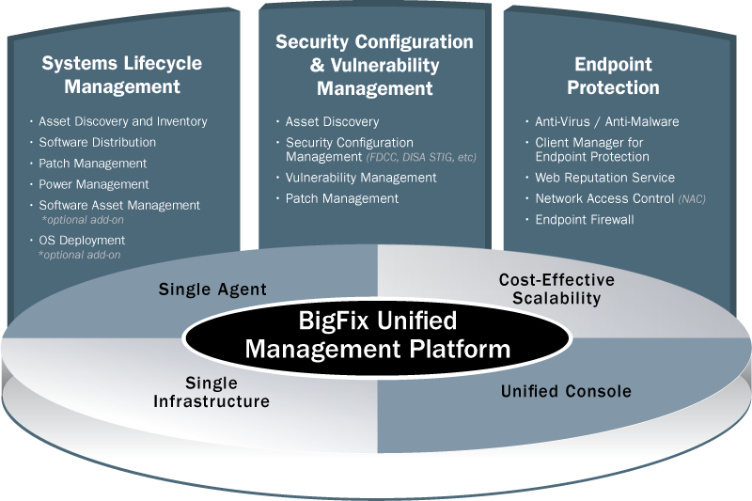
BigFix Product Portfolio
26
Notes:
26

Slide 27
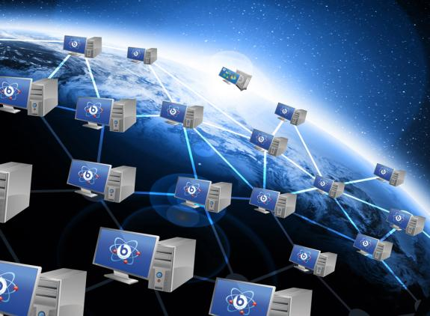
BigFix Systems Lifecycle Management
Comprehensive solution for end-to-end systems management which includes:
Asset Discovery and Inventory Management
Patch Management / Software Distribution
Software Asset Management
Power Management
OS Deployment
Remote Control
Features and Benefits
Dramatically reduced patch cycles and
increased first-pass success rates
Massive scalability and support for remote
and intermittently connected devices
Detection and resolution of corrupted patches
Closed loop validation in real-time
Multi-platform support (*nix, Win, Mac)
Coverage for legacy platforms
27
Notes:
27

Slide 28



BigFix Patch Management
BigFix Patch Management is a comprehensive solution for delivering Microsoft, UNIX, Linux, and Mac patches, as well as third-party application patches, through a single console.
Features and Benefits
Patch capabilities for multiple platforms: Windows, Linux, UNIX, Mac
Coverage for a variety of software vendors, such as Adobe, Mozilla, RealNetworks, Apple, and Java
Real-time reporting that provides information on which patches were deployed, when they were deployed, who deployed them, and to which endpoints
Scalability—manage more than 250,000 endpoints from a single server
No loss of functionality over low-bandwidth or globally distributed networks
Patch
KB123456

Slide 29

BigFix Power Management
BigFix Power Management allows IT organizations to enforce conservation policies across the enterprise, while providing granularity that enables application of those policies to a single computer.
Features and Benefits
Saves up to $50 per year per BigFix-managed device depending on local electricity costs and net energy savings achieve
Centralized, policy-driven power management of distributed computers scalable from individual machines to entire global enterprises
Fine-grained controls for hibernation/standby, subsystem-only shutdown, and save-work-before-shutdown options
Wake-on-LAN support synchronizes systems maintenance processes with power conservation
Opt-in programs encourage end-user participation as well as Wake-on-Web feature to allow for end-users to remotely connect and turn on their own systems

Slide 30
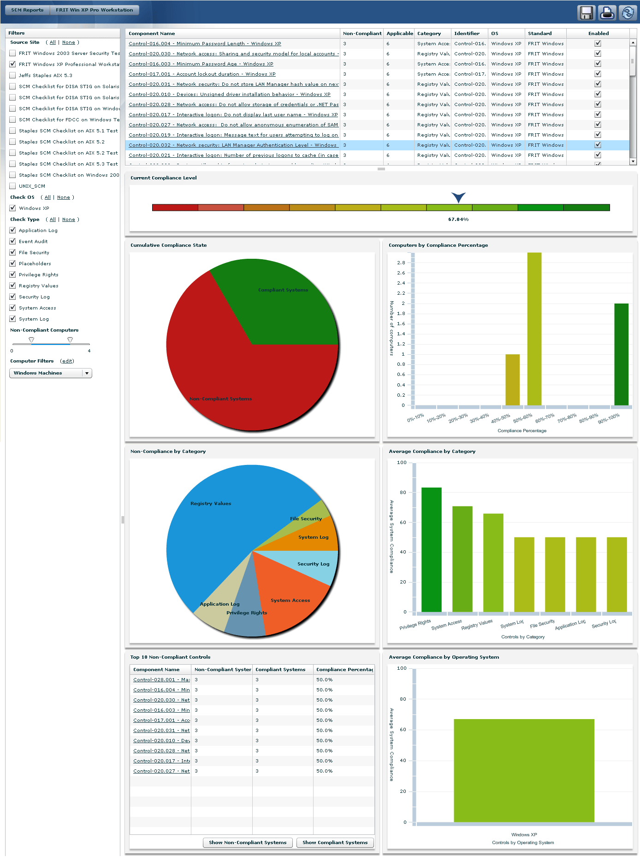
BigFix Security Configuration & Vulnerability Management
Comprehensive solution for end-to-end security management which includes:
Asset Discovery
Patch Management
Security Configuration Management
Vulnerability Management
Features and Benefits
Continuous enforcement of security policies,
regardless of network connection status
Host-based vulnerability assessment with
severity scoring and a 99.9% accuracy rate
Define and assess client compliance to security
configuration baselines
SCAP certified for FDCC
Heterogeneous platform support:
Windows, UNI X, Linux, and Macintosh

Slide 31
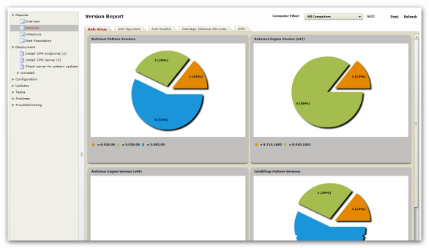
BigFix Endpoint Protection
Integrated Endpoint Protection modules include:
Anti-Virus
Anti-Malware
Endpoint Firewall
Web Protection
Client Manager for
Endpoint Protection
Network Access Control (NAC)
Features and Benefits
Prevent infection, identity theft,
data loss, network downtime, lost productivity, and compliance violations
Eliminate security gap with real-time threat intelligence
Achieve unparalleled visibility into complete enterprise protection
Combine endpoint protection, security configuration, patch management, and systems lifecycle management tools

Slide 32
Strengths against Microsoft SCCM
Key Differentiators | BigFix Strengths | MS SCCM Weaknesses
Significantly lower total cost of ownership (TCO) | Low cost with single server required; no PKI between server and client required; only 10% of labor needed for deployment, comparing to SCCM; & 1 FTE can manage up to 10,000 endpoints | “Free” with high hidden costs, including many SCCM infrastructure servers hardware, OS and software; PKI cost between server and clients; SCCM management server licenses; & high labor to plan, deploy and maintain
Quick Time to Value (TTV) | Quick deployment within weeks for 50,000 endpoints | Can take 1 year for 50,000 endpoint deployment
Heterogeneous env mgmt | Windows, MAC, Linux, Solaris, HP-UX, ESX and AIX | Windows only
Minimum endpoint impact | < 2% CPU usage with bandwidth throttling Single multi-purpose agent | Up to 85% CPU usage, no throttling 8-10 agents to provide different capabilities
Unbeatable Scalability | Scales to 250,000 endpoints with 1 server No additional hw/sw required for remote site implementation | Costly: 65,000 endpoints requires 4 primary and 44 secondary SCCM servers Primary site duplicated for remote site implementation
Accurate and real-time data | Real-time visibility High accuracy with intelligent agent and real-time reports | 1-2 weeks old depending on scan cycle Not accurate: stale data and lack of validation
Automatic remediation | Policy-based automatic remediation | Not supported

Slide 33
Strengths against Symantec Altiris
Key Differentiators | BigFix Strengths | Symantec Weaknesses
Quick Time to Value | Quick deployment within weeks for 50,000 endpoints | Complex and time consuming, requiring hierarchy and replication to achieve scalability
Simple server infrastructure | 1 server supports 250,000 endpoints | 5-10 servers required to support 50,000 endpoints based on use case
Minimum endpoint impact | Single multi-purpose agent < 2% CPU usage with bandwidth throttling ~ 7 Mb memory usage for given single process | 1 master agent with 14+ sub agents 100% endpoint CPU usage during inventory and processing cycle Minimum10 MB memory usage during idle; expands during processing
Accurate and real-time data | Real-time visibility High accuracy with intelligent agent and real-time report | No real-time capability; depends on time intervals between multiple agents posting data Contradicting data as different agents post data on different schedules
Advanced security configuration management | Comprehensive capability Single console and platform Automated assessment and remediation | Symantec Control Compliance Suite is not integrated with Altiris Lack of essential features required by federal customers
Comprehensive patch management | Short patch cycle with high 1st try success rate Real-time detection and remediation Broader application patching support | Scheduled patch installation No automated Unix patch management Limited application patching support on Adobe only
Notes:
BigFix application patching support: Adobe, Mozilla, RealNetworkd, Apple, Skype, Winzip and Java

Slide 34
Strengths against LANDesk
Key Differentiators | BigFix Strengths | LANDesk Weaknesses
Quick Time to Value | Quick deployment within weeks for 50,000 endpoints | Unintuitive agent deployment process takes weeks to implement 10,000 nodes; requires channel partners to complete Problematic license activation
Simple server infrastructure with scalability | 1 server supports 250,000 endpoints | Separate installation per 10,000 endpoints Hard to manage centrally with separate installations required 5-10 servers required to support 50,000 endpoints depending on use case
Lightweight, fast endpoint management solution | Real-time visibility and control Strength in highly distributed env Minimum impact to endpoints | Cumbersome infrastructure with high network and endpoint impact Scan- and query-based data updates
Minimum endpoint impact | Single multi-purpose agent < 2% CPU usage with bandwidth throttling | 3-5 distinct agents requires many separate open ports, running as separate processes/services
Accurate and real-time data | Real-time visibility High accuracy with intelligent agent and real-time reports | No real-time capability; query-based solution High network and client impact
Notes:
BigFix application patching support: Adobe, Mozilla, RealNetworkd, Apple, Skype, Winzip and Java

