Slide 1

The Turkey Threat Landscape
Understand What You Need to Protect and Why ?
Dr. Tamer Aboualy
Security Practice Lead
IBM Security MEA

Slide 2

Introduction: Dr. Tamer Aboualy
Qualifications
Over 19 years of experience in IT and Security.
Currently responsible for leading the IBM Security Practice for MEA & Turkey.
Board of advisors for NYIT Abu Dhabi
Previous IBM Canada’s Security Services CTO, responsible for leading Canada.
Previous technical lead for Canada’s crypto and security methods for financial payment systems.
Various security patents (Intrusion protection, cloud security, others)
Expert speaker at security conferences (ISACA, Gartner, Forrester, GOVTECH, VISA, CLOUD, IDC, Canadian Bankers Association, and many others).
Education:
  Bachelors of Information Systems (Ryerson University Toronto Canada)
  Masters of Science in Telecommunications and Networks (Syracuse University, New York, USA)
  Ph.D. in Information Systems (Nova Southeaster University, Florida, USA)
Tamer Aboualy, Ph.D
Security Practice Lead
IBM Security MEA

Slide 3
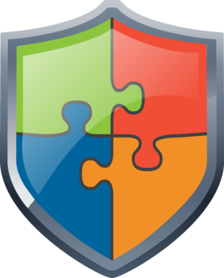





Agenda
X-Force Global Threat Research
The evolving Turkish threat landscape
Know your critical data and protect it
Notes:
I’d like to address four areas:
1. Today's security attacks are getting more sophisticated The complexities in which we conduct today's business. CISO challenges.
2. The importance of strategy before implementation
Security challenges are a complex, four-dimensional puzzle
Visibility and Security Intelligence Integrate controls across domains to eliminate silos
Gain expertise and insights <should include research, expertise, and services>
3. How IBM Security can help
Optimize your security maturity IBM Security: Helping clients optimize IT security
Framework applied to megatrends
IBM offers a comprehensive portfolio of security solutions
4. Why Choose IBM?
Resources, capabilities, success stories, thought leadership

Slide 4
X-Force Global Threat Research
Ibm.com/security

Slide 5
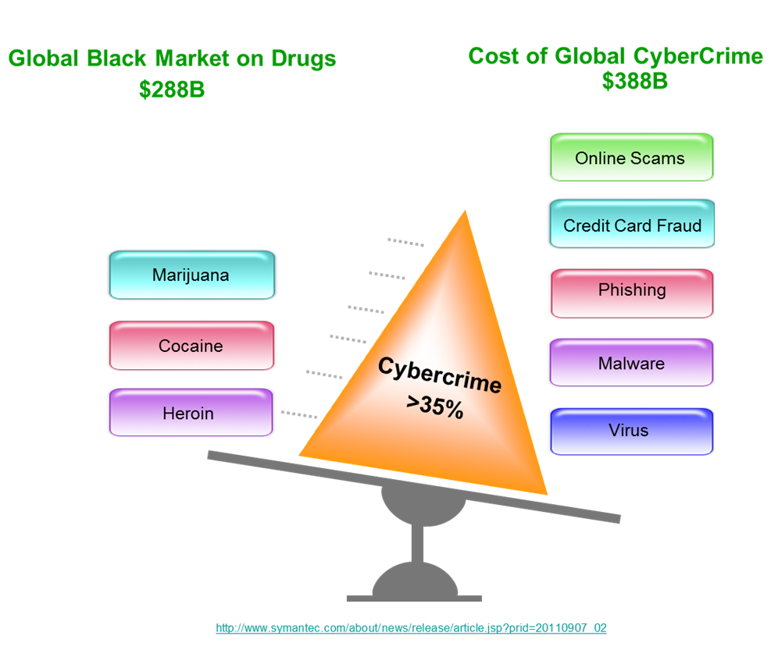
Today’s criminals are learning the Cybercrime business
.... its a work at home job that pays well!

Slide 6
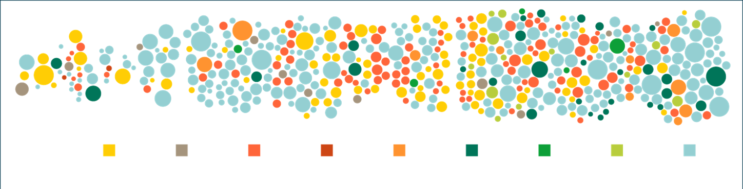
Business Impact – Increased attacks every day
2011
Year of the breach
2012
40% increase
2013
500,000,000+ records breached
Attack types
SQL injection
Spear phishing
DDoS
Third-party software
Physical access
Malware
XSS
Watering hole
Undisclosed
Note: Size of circle estimates relative impact of incident in terms of cost to business
Source: IBM X-Force® Threat Intelligence Quarterly – 1Q 2014
61%
of organizations say
data theft and cybercrime are their greatest threats
2012 IBM Global Reputational Risk & IT Study
$3.5M⁺
average cost
of a data breach
2014 Cost of Data Breach, Ponemon Institute

Slide 7

The new security landscape - Sophisticated attackers are a primary concern
Threat | Profile Type | Share of Incidents | Attack Type
Advanced threat / mercenary | National governments Terrorist cells Crime Cartels | 23% | Espionage Intellectual property theft Systems disruption Financial Crime
Malicious Insiders | Employees Contractors Outsourcers | 15% | Financial Crime Intellectual Property Theft Unauthorized Access/
Hacktivist | Social Activists | 7% | Systems disruption Web defacement Information Disclosure
Opportunist | Worm and virus writers “Script Kiddies” | 49% | Malware propagation Unauthorized Access Web defacement
Potential Impact
Source: Government Accountability Office, Department of Homeland Security's Role in Critical Infrastructure Protection Cybersecurity, GAO-05-434; IBM CyberSecurity Intelligence & Response Team, September 2012
Notes:
- UK Gamma Group Finfisher or FinSpy. Weaponsized software for Espionage
Anonymous Group
- Cutting Sord of Justice
7

Slide 8

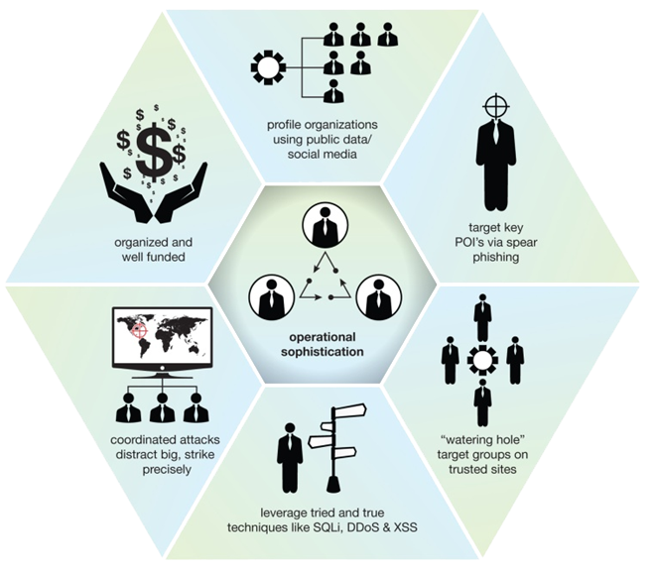
Exploiting trust is one example of attackers becoming more operationally sophisticated to
breach targets
Many breaches
are not the result of
custom malware
and zero-day exploits, attackers look for paths of least resistance
Notes:
What we are attempting to demonstrate in this graphic are the types of “Operational Sophistication” that is being utilized in many of these recent breaches and security incidents. It doesn’t mean there is not technical sophistication, because there can be ,but we see are attackers organizing strongly to create return on their development investments – getting, if you will – “the biggest bang for the buck!”
They often look first for the path of least resistance.
Some examples seen are:
- attackers are organized and well funded (maintenance of botnets and ability to evolve techniques)
- attackers are using social media and other public info to target key individuals (persons of interest)
- spear phishing still a common point of entry to get a foothold
- They are using "watering hole" techniques where they are scoping out where potential targets might congregate (like putting a Java vuln on the Mobile Dev site that resulted in infection of Apple and Facebook developers)
- other "tried and true" techniques like XSS to target individuals and SQLi to breach web servers
- using layered approach - for example... vulnerable CMS systems easily taken over to install malware/bots which are then used to DDoS other targets

Slide 9

Business impact of compromise and data breaches
CEO
CFO/COO
CIO
CHRO
CMO
Loss of market share and reputation
Legal exposure
Audit failure
Fines and criminal charges
Financial loss
Loss of data confidentiality, integrity and/or availability
Violation of employee privacy
Loss of
customer trust
Loss of brand reputation
Your Board demands a strategy

Slide 10

Turkey Threat Landscape

Slide 11
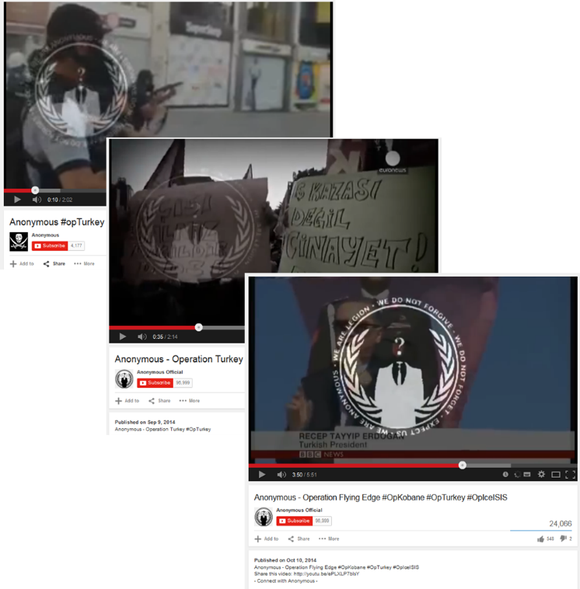
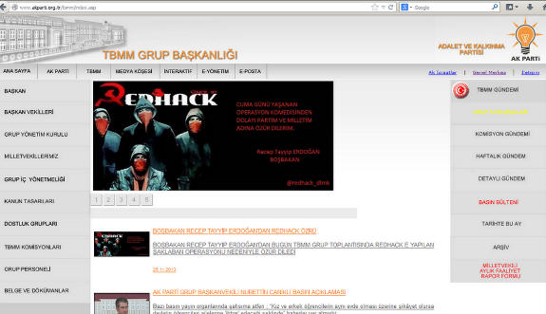
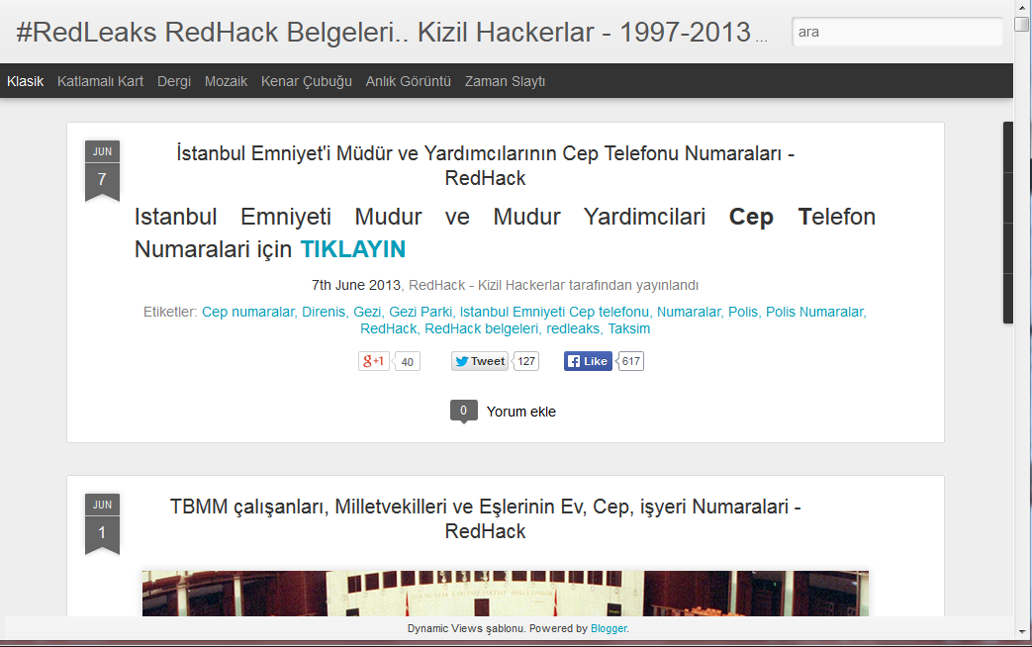
Turkey is the target of advanced threats and Hacktivism
Notes:
DOHA Press October 19th .
The infamous group of hackers that supports embattled Syrian President Bashar al-Assad has apparently taken control of Qatar’s .QA domain name and shut down numerous high-profile websites.
Starting at about 1.54am local time, the Syrian Electronic Army shared this message on Twitter: QATAR #Down
Following that, they went about switching off government and private websites using the .QA extension, including Ministry of Interior, the Supreme Education Council, the Emiri Diwan, and even Google.com.qa:

Slide 12
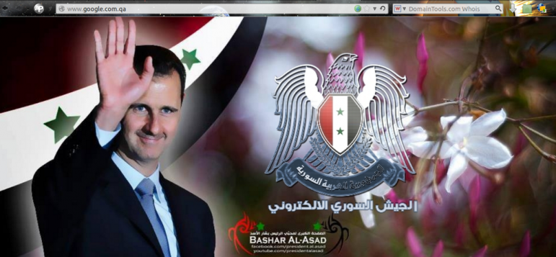
Syrian Electronic Army (SEA)

Slide 13
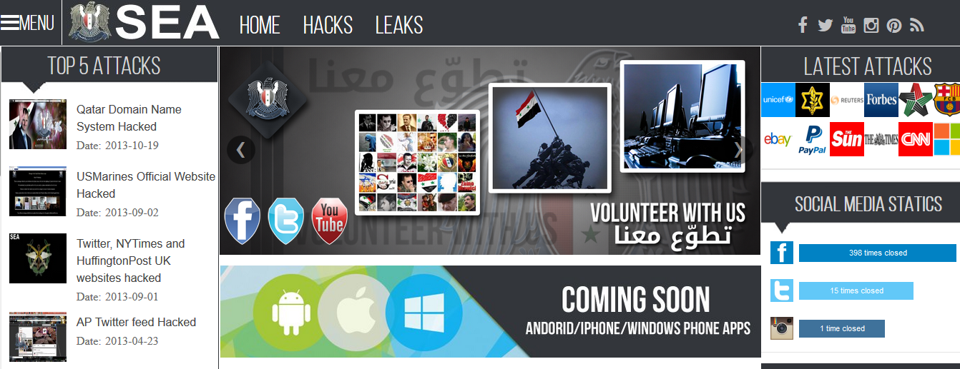

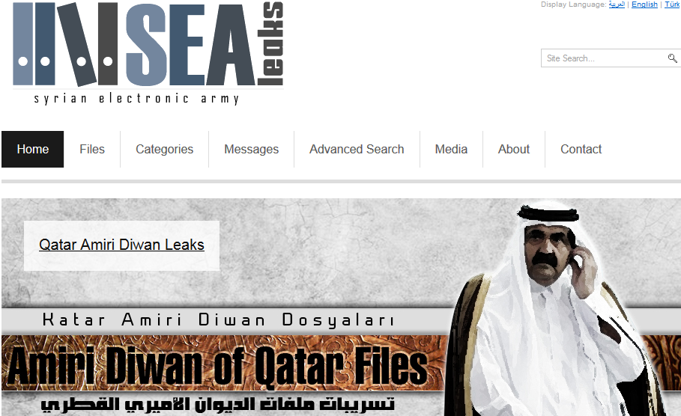
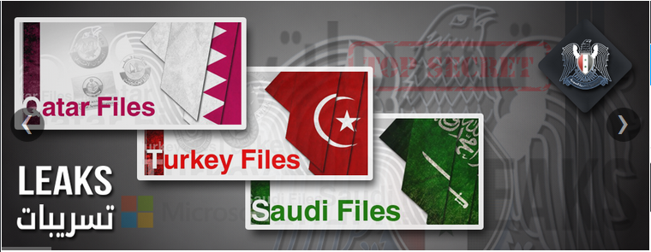
Profiling the Syrian Electronic Army

Slide 14
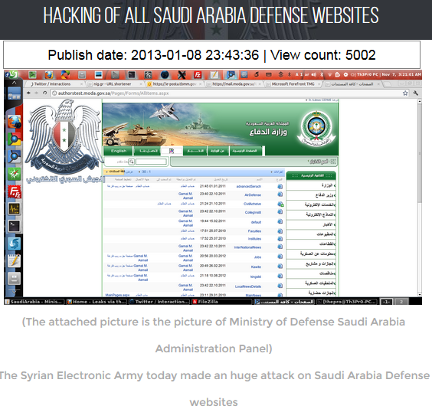
The Hacked Website's :
1 - The Saudi Ministry of Defense
Website: http://moda.gov.sa
2 - Saudi Arabia Defense Industries
Website: mic.gov.sa
3 - Admission gate of the Armed Forces
Website: afca.gov.sa
4 - Saudi government site
Website: csc.edu.sa
5 - General Directorate of Military Works
Website: gdmw.gov.sa
6 - General Directorate of Military Survey
Website: gdms.gov.sa
7 - a Saudi government site
Website: psmpq.org.sa
7 - a Saudi government site
Website: safous.gov.sa
8- Royal Saudi Land Forces
Website link : rslf.gov.sa
9- Royal Saudi Navy Foces
Website link : rsnf.gov.sa
10- http://mic.org.sa

Slide 15



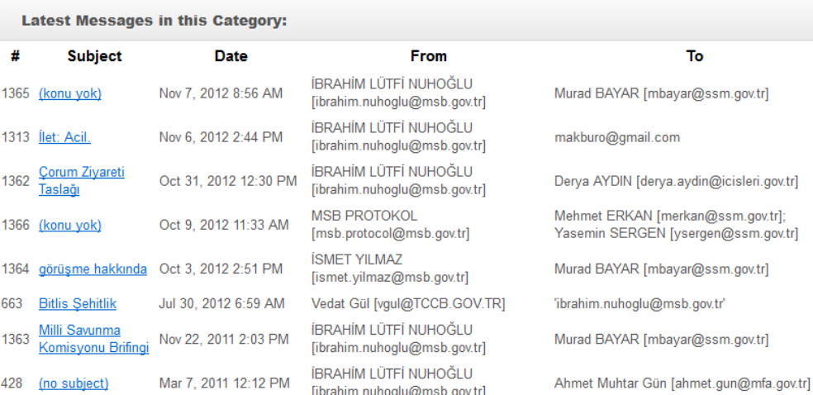
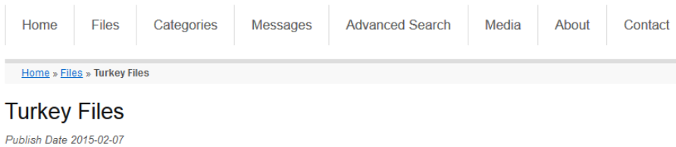
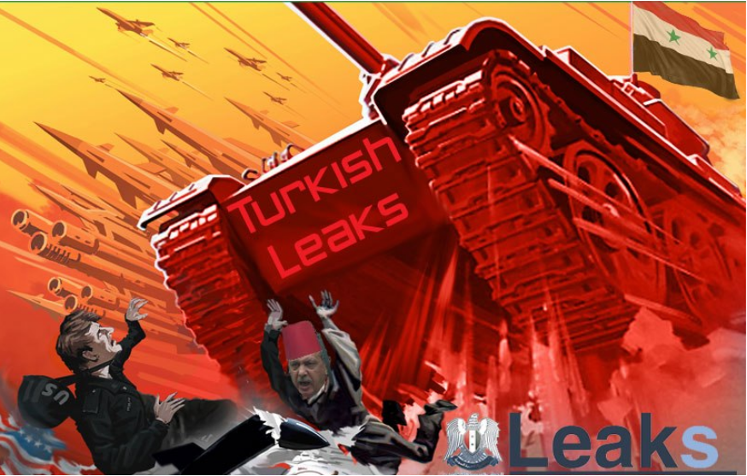
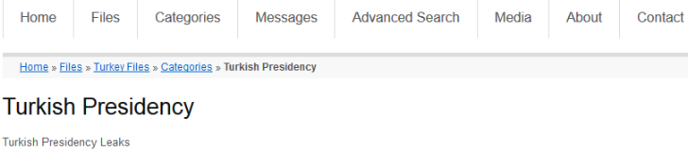

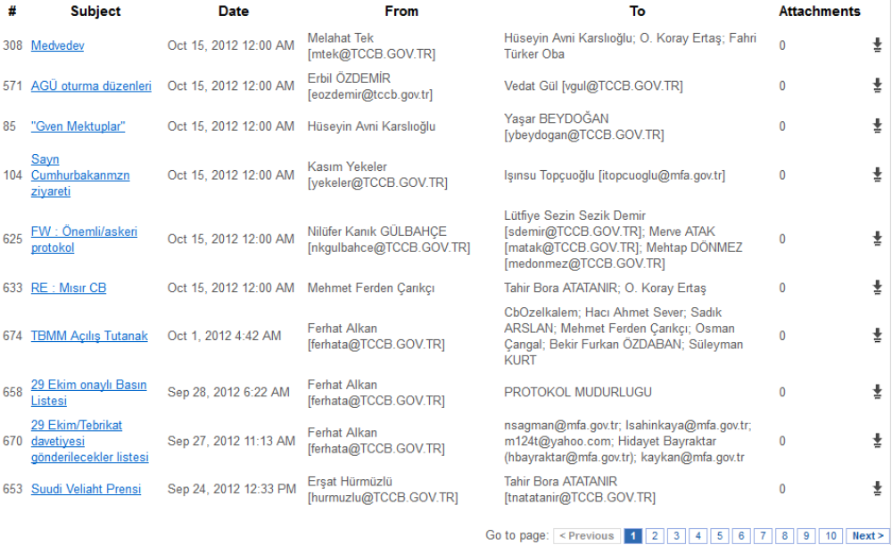
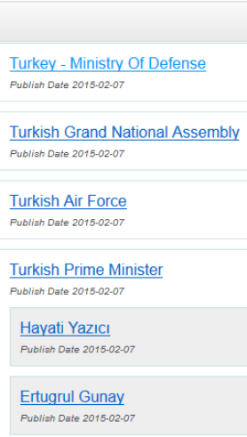
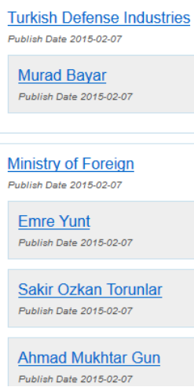
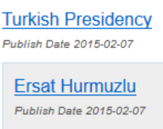

Slide 16
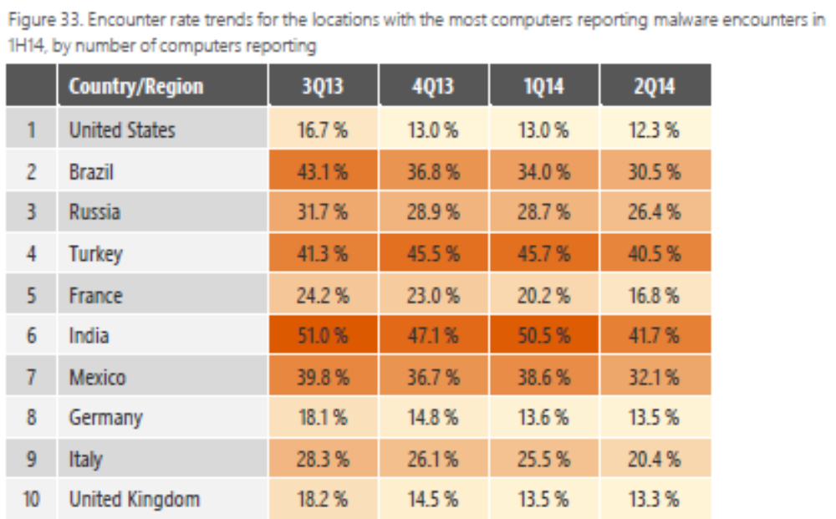
1H 2014 Global Malware Encounter Rate – Turkey ranked #2
The telemetry data generated by Microsoft security products from computers whose administrators or users choose to opt in to provide data to Microsoft includes information about the location of the computer, as determined by IP geolocation.
Locations are ordered by the number of computers reporting detections in 1H14.
Source: www.microsoft.com/sir
Microsoft Regional Security Intelligence Report
Notes:
The telemetry data generated by Microsoft security products from computers whose administrators or users choose to opt in to provide data to Microsoft includes information about the location of the computer, as determined by IP geolocation. This data makes it possible to compare infection and encounter rates, patterns, and trends in different locations around the world

Slide 17
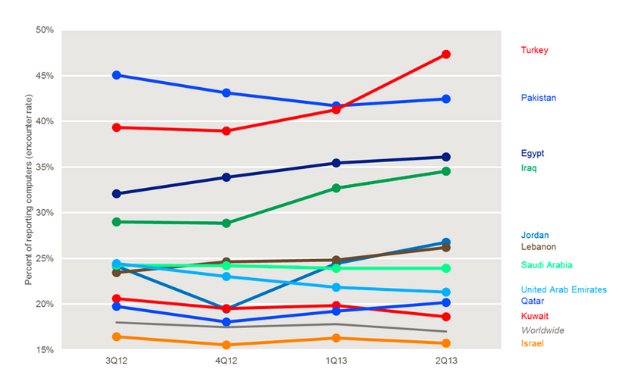
Malware Encounter Rates – Middle East – 3Q12 to 2Q13
Source: www.microsoft.com/sir
Microsoft Regional Security Intelligence Report
Notes:
For more information about malware in many of these countries/regions, see “The Threat Landscape in the Middle East and Southwest Asia,” a five-part series on the Microsoft Cyber Trust blog (blogs.microsoft.com/cybertrust):

Slide 18
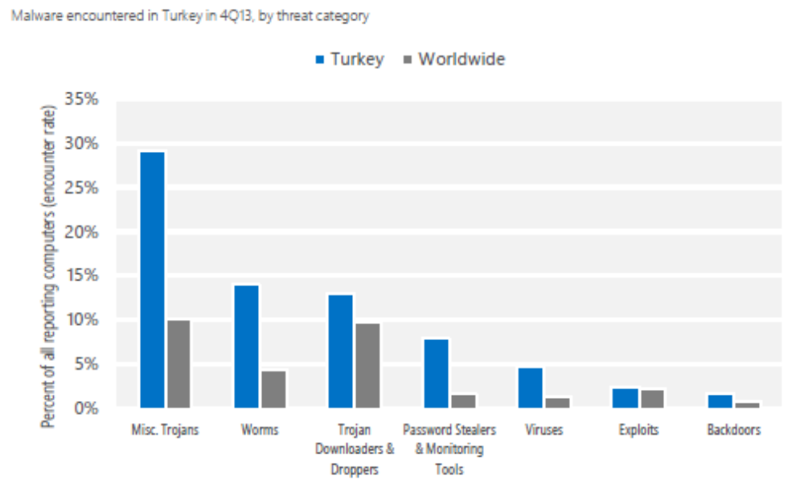
Malware encountered in Turkey - by threat category
Source: www.microsoft.com/sir
Microsoft Regional Security Intelligence Report

Slide 19
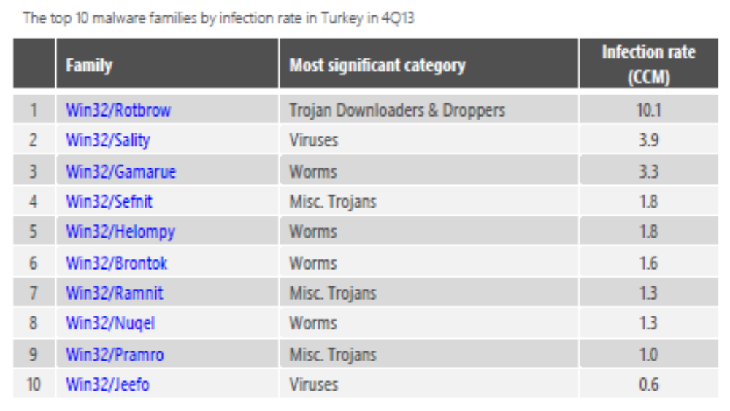
Top 10 Unwanted Software & Malware on Turkey Computers
Source: www.microsoft.com/sir
Microsoft Regional Security Intelligence Report

Slide 20
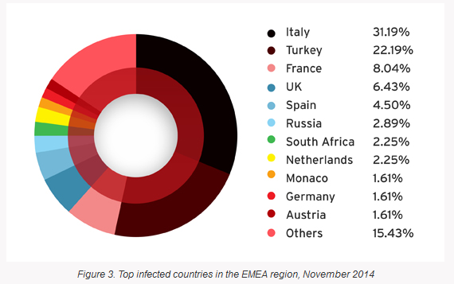
Crypto-ransomware attacks in the EMEA
Based on feedback collected via the Trend Micro Smart Protection Network
Source: trendmicro.com
Crypto-Ransomware Goes Local in EMEA Region

Slide 21
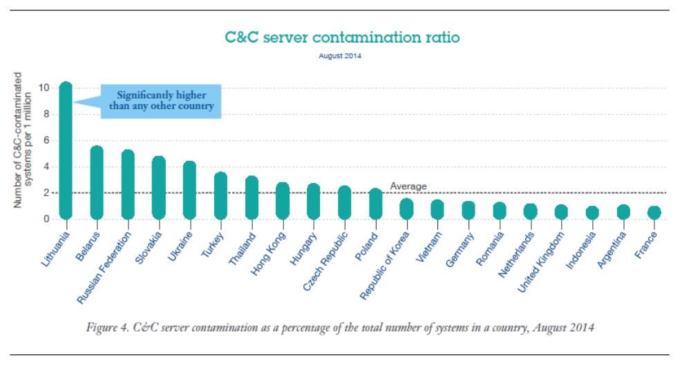
Command & Control Server Contamination Ratio
Source: http://www-03.ibm.com/security/xforce/
IBM X-Force Threat Intelligence Quarterly, 4Q 2014

Slide 22
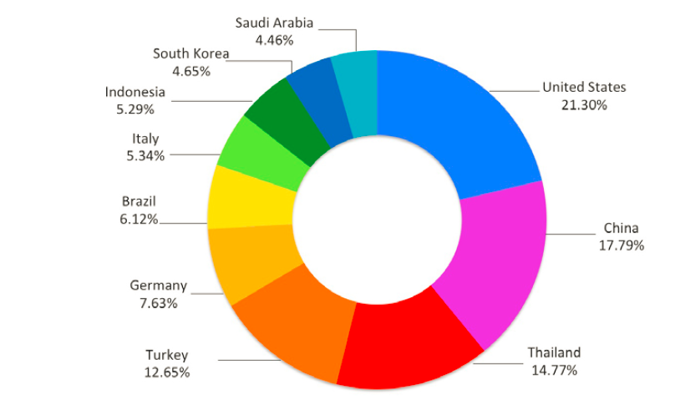
Distributed Denial of Service Attacks.
Turkey is in the top 5
Top 10 sources of malicious, non-spoofed DDoS traffic in Q1 2014
Prolexic Quarterly Global DDoS Attack Report Q1 2014

Slide 23
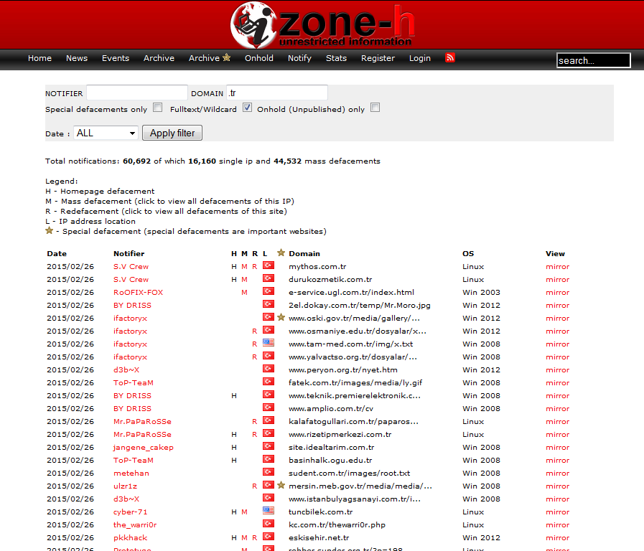
Turkey - Website defacements cause reputation impact
Zone-H reported more then 60,692 defacements for the .tr domain
8,145 gov.tr defacements
100+ defacements in 2015 alone

Slide 24
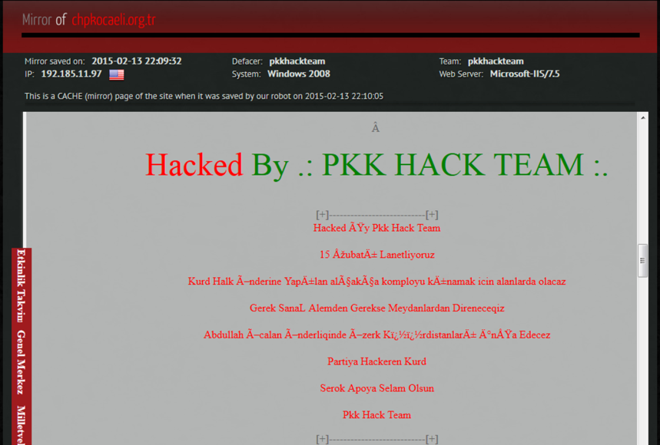
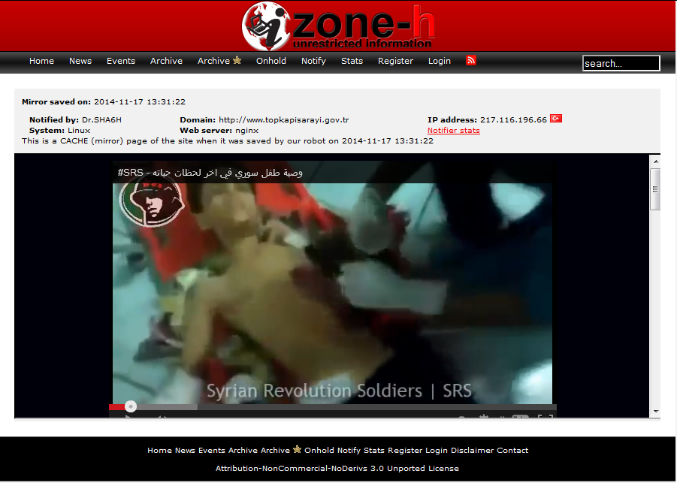
Various Turkish websites have been publically defaced
Main opposition party web site is defaced by fans of terrorist group
topkapisarayi.gov.tr
http://www.hack-mirror.com/222352.html
http://www.zone-h.org/mirror/id/23275496

Slide 25
Establishing a Critical Data Protection Program
Understand What You Need to Protect and Why ?

Slide 26



















Ten essential steps to creating an intelligent security management program
Understand Security Essentials
3 Secure collaboration in social and mobile workplace
4 Develop secure products, by design
5 Manage IT and OT hygienically
6 Create a secure and resilient network
GOAL:
INTELLIGENT CYBER THREAT PROTECTION AND RISK MANAGEMENT
1 Build a risk aware culture and management system
2 Establish intelligent security operations and rapid threat response
7 Address security complexity of cloud and virtualization
8 Manage third party security compliance
9 Assure data security and privacy
10 Manage the digital identity lifecycle

Slide 27

Why is it important to know and protect critical data?
Because breaches occur in minutes and take weeks/months to discover!
Time span of events by percent of breaches¹
Seconds
Minutes
Hours
Days
Weeks
Months
Years
Initial attack to initial compromise
Initial compromise to data exfiltration
Initial compromise to discovery
Discovery to containment / restoration
It can take only minutes to get in…
10%
75%
12%
2%
0%
1%
0%
8%
38%
14%
25%
8%
8%
0%
…but months to discover and recover
0%
0%
2%
13%
29%
54%+
2%
0%
1%
9%
32%
38%
17%
4%
98%
of compromises take days or more to discover, and 59% take weeks or more to contain¹
¹2012 Verizon Data Breach Investigations report, http://www.verizonenterprise.com/resources/reports/rp_data-breach-investigations-report-2012_en_xg.pdf

Slide 28
Industry focus has evolved from focusing on “T” to the “I” of IT
Business Context
T
I
I
T

Slide 29
Data-Centric Maturity Model
We even know where our valuable data is when it’s in motion
Structured Data
We have protected our data in proportion to its value
Maturity
We actually know where all of our data is
Our data’s protected even for Mobile
We use best practices in protecting our data
We’ve protected our most valuable data
We protect our structured data, don’t we?
We’ve figured out which data is valuable
We’ve got whole-disk encryption for laptops
We’ll get to our unstructured data later
Unstructured Data
Time

Slide 30
Data-Centric Maturity Model
Data Governance
Categories ranked by value and treated accordingly
Crown Jewels approach implemented
Threats & Vulnerabilities are well understood
Standard taxonomy & categories, business owners identified
We even know where our valuable data is when it’s in motion
Maturity
We have protected our data in proportion to its value
All data is treated equally, business owners unclear, no standard taxonomy
Structured Data
We actually know where all of our data is
We use best practices in protecting our data
Our data’s protected even for Mobile
We protect our structured data, don’t we?
We’ve protected our most valuable data
Unstructured Data
We’ve figured out which data is valuable
We’ve got whole-disk encryption for laptops
We’ll get to our unstructured data later
Time

Slide 31
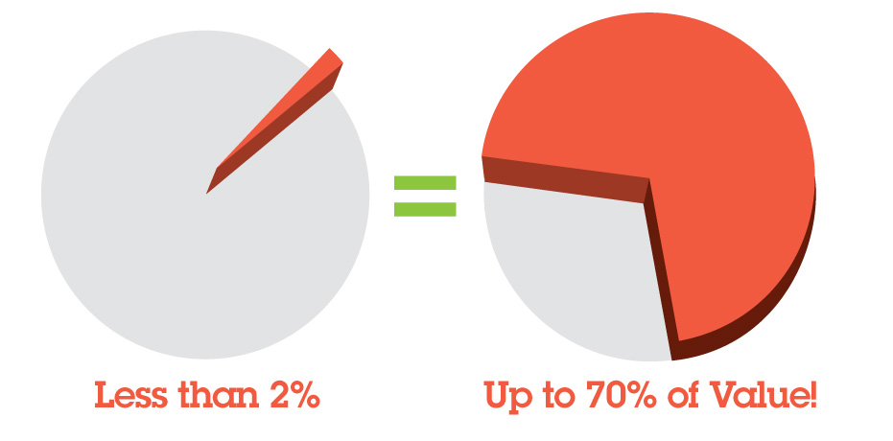
Source: U.S. President’s 2006 Economic Report to Congress
Notes:
Secure less than 2% of your data landscape and protect 70% of your value

Slide 32
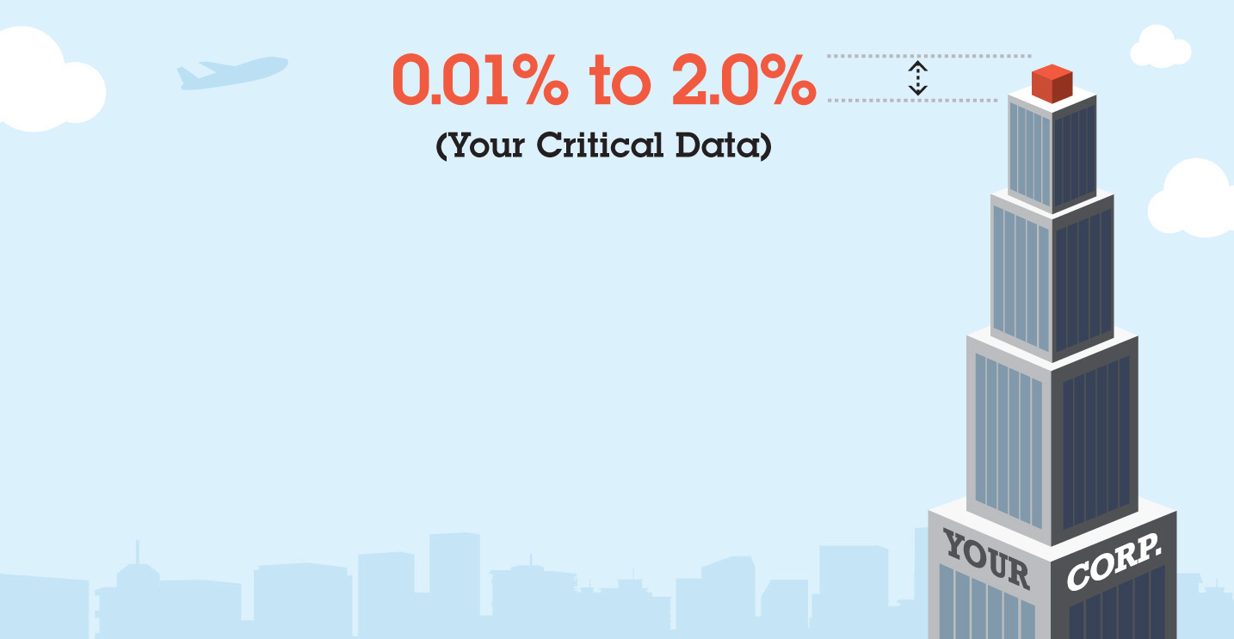
Do you know what and where your organizations most critical data assets are?
For most organizations, the most critical data –
the “Crown Jewels” – amount to between 0.01% and 2.0% of total sensitive data¹
The theft, misuse or corruption of this critical data can:
    cripple operations
    severely damage brand reputation
    dramatically reduce shareholder value
Source: U.S. President’s 2006 Economic Report to Congress

Slide 33
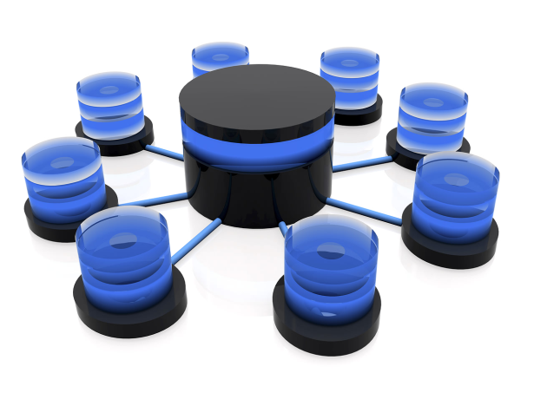
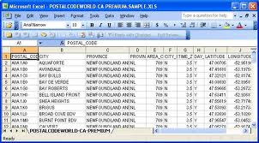
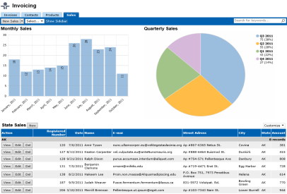
What information is most valuable to your organisation?
- where is it stored, who uses it, how is it protected?
Databases and transaction systems
- “lifeblood of the company”
Customer and sales data
Manufacturing resource planning
Financial and accounts
Engineering specifications – CAD / CAM
Product specifications
Personal and HR data
Critical decision documents
- small number but very sensitive
Board Papers
Merger and Acquisition research
“C level” recruitment decisions
Investment cases
Strategy papers
Structured data
and applications
DB2, Oracle, SAP,
Catia, Salesforce
Siebel
Unstructured files,
Email and messages
Microsoft Office,
Google Docs
Outlook,
Adobe

Slide 34
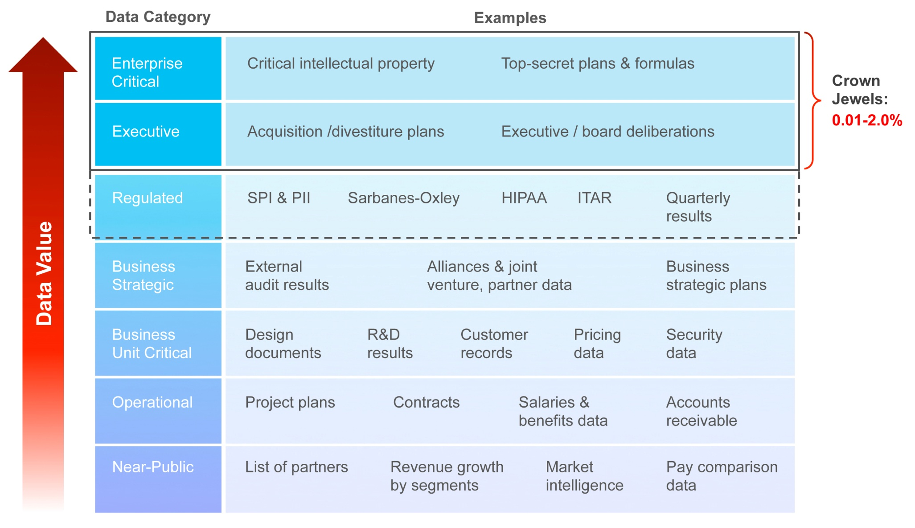
Critical Data – Crown Jewels – IBM as an Example
What are your organizations data categories, types, & criticality/value?

Slide 35

Identify Value of Different Categories of Data to the Enterprise
Rank
Relative Sensitivity
2 | Acquisition plans | x
3 | Divestiture plans | y
5 | Secret formulas or other trade secrets | z
SME Interviews
89 | Market Intelligence | 1
100 | Delivery Plans | 1
104 | Market Growth Projections | 1
Data Taxonomy
In IBM, we interviewed 30 executives (SMEs) from across our business to determine the relative sensitivity of 104 different categories
Consensus Ranking
Notes:
Organizations can define data categories that can be scored and ranked to represent the value of the data assets to the organization. We first create what is called the data Taxonomy for structured and unsturcred data.
The most valuable assets will be identified and adequacy of existing controls can be reviewed
Providing this type of value ranking increases awareness of the need to protect critical assets.
This categorization and ranking is accomplished by discovering sensitive assets, analzing what type of data exists in the environment, defining data categories, and ranking the data categories with business leaders to arrive at an ordered list representing the most valuable assets. This helps prioritize controls reviews and applications of enhanced controls.

Slide 36
Example Mapping of Data Value and Security
Security
% of Sensitive Data
Data Type
Enterprise Critical
Secure Communication, Separate Network, Backup Security, Physical Isolation, Real-time Response to 100% of Incidents, Insider Monitoring
0.01-0.1%
Secure Communication, Separate Network, Backup Security, Physical Isolation, Real-time Response to 100% of Incidents
Executive
0.1 - 2%
Regulated
Physical Isolation, Real-time Response to “Significant” Incidents, Insider Monitoring, Privacy
1-50%
Business Strategic
Physical Isolation, Real-time Response to “Significant” Incidents, Insider Monitoring
1-5%
Business Unit Critical
Near-Real-time Response to “Significant” Incidents, Insider Monitoring
10-20%
Operational
Best Efforts Response to “Significant” Incidents
20-80%
Near-Public
Event Response if Available Only
10-80%
Notes:
A ranking and categorization of data assets enables application of proper controls for each level of sensitivity
Controls can be differentiated based on the value of the assets.
Greater controls are applied to the higher value assets.

Slide 37
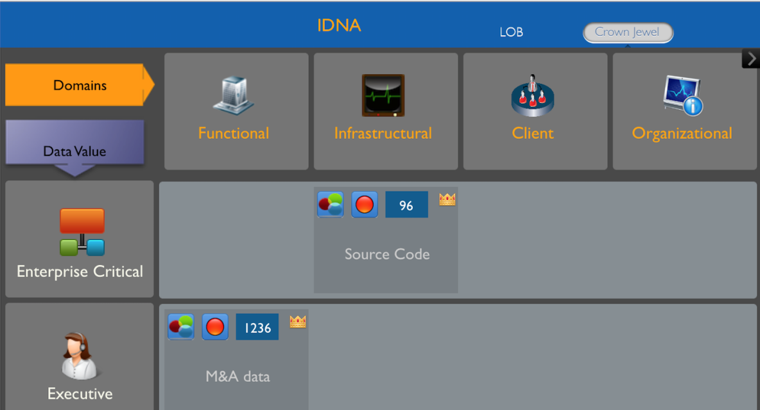
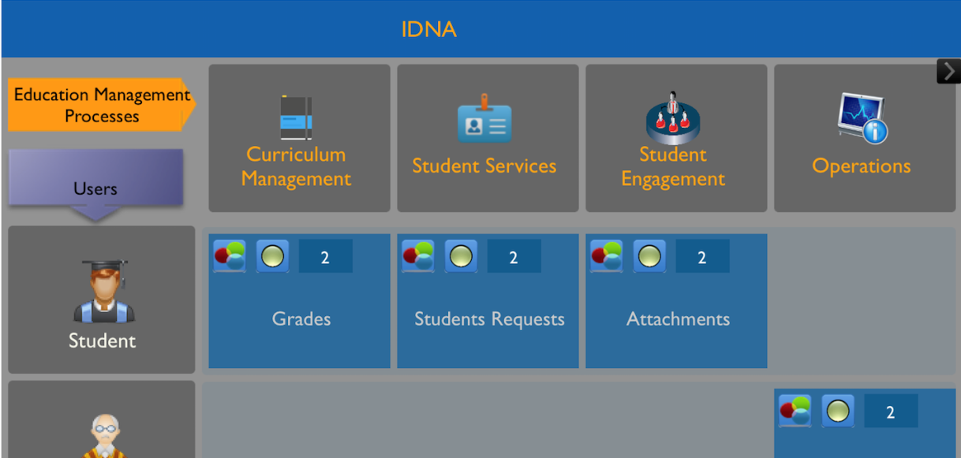
Visualizing The Data.
Identify, control and manage specific and high-value business information assets “Crown-Jewels”
Proactively measure and mitigate risks to safeguard vital assets and avoid loses
Provide early visibility into risks that may affect sensitive business assets
These assets, that may include "Crown Jewels" data, are inclusive of customer information, intellectual property, product designs, financial information, and more. Achieve information asset visibility through the prism of Line of Business, Sensitivity, Business Processes or other built-in taxonomies.
Utilizing rich visualization techniques delivering a intuitive interface depicting valuable business information assets at risk.
Graphic illustration of risks, information assets at risk, affected business processes, drill down capabilities to view hidden technical capabilities, and micro-icon based views for cross-references and dependencies

Slide 38





Tack
ευχαριστώ
Hindi
Swedish
Greek
Спасибо
Asante sana
Thai
Gracias
Russian
Swahili
Spanish
Thank You
Obrigado
Arabic
Portuguese
Dankie
Danke
Grazie
Merci
Afrikaans
German
Italian
French
Hvala
Slovenian
Simplified Chinese
Köszönöm
Korean
Hungarian
Japanese
Notes:
38
38

Slide 39
We have an extensive services portfolio today for you to leverage
IBM Security Services Portfolio
Strategy, Risk & Compliance
Security Essentials and Maturity Consulting | Security Strategy and Planning | Security Architecture and Program Design | Security Framework and Risk Assessments | Critical Infrastructure Security | PCI Compliance Advisory Services | Cloud Security Strategy
Cybersecurity Assessment & Response
Emergency Response Service | Incident Response Planning | Active Threat Assessment | Penetration Testing
Security Intelligence and Operations Consulting
Security Operations Consulting | SIEM Design and Deploy | Managed SIEM | Security Intelligence Analyst
Identity and Access Management | Data | Applications
Identity and Access Strategy and Assessment | Critical Data Protection Program | Application Source Code Security Assessment
Access Mgmt Design and Deploy | Data Security Strategy and Architecture
 |  | Smart and Embedded Device Security
Multi-factor Authentication Design and Deploy | Data Discovery and Classification
Identity and Access Solution Migration |  | Application Security Assessment
Cloud Identity | Encryption and DLP
Managed Security |  | Cloud Security
Firewall Management | Managed Server Protection | Hosted E-mail and Web Security | Managed Web Defense
Unified Threat Management | Secure Web Gateway Management | Hosted Vulnerability Management | Hosted Security Event and Log Management
Intrusion Detection and Prevention System Management |  | IBM X-Force Hosted Threat Analysis Service | Hosted Application Security Management
Notes:
39

