Slide 1
IBM Security
A New Era of Security for a New Era of Computing
Pelin Konakcı
IBM Security Software Sales Leader
Notes:
IBM Security: A New Era of Security for a New Era of Computing

Slide 2
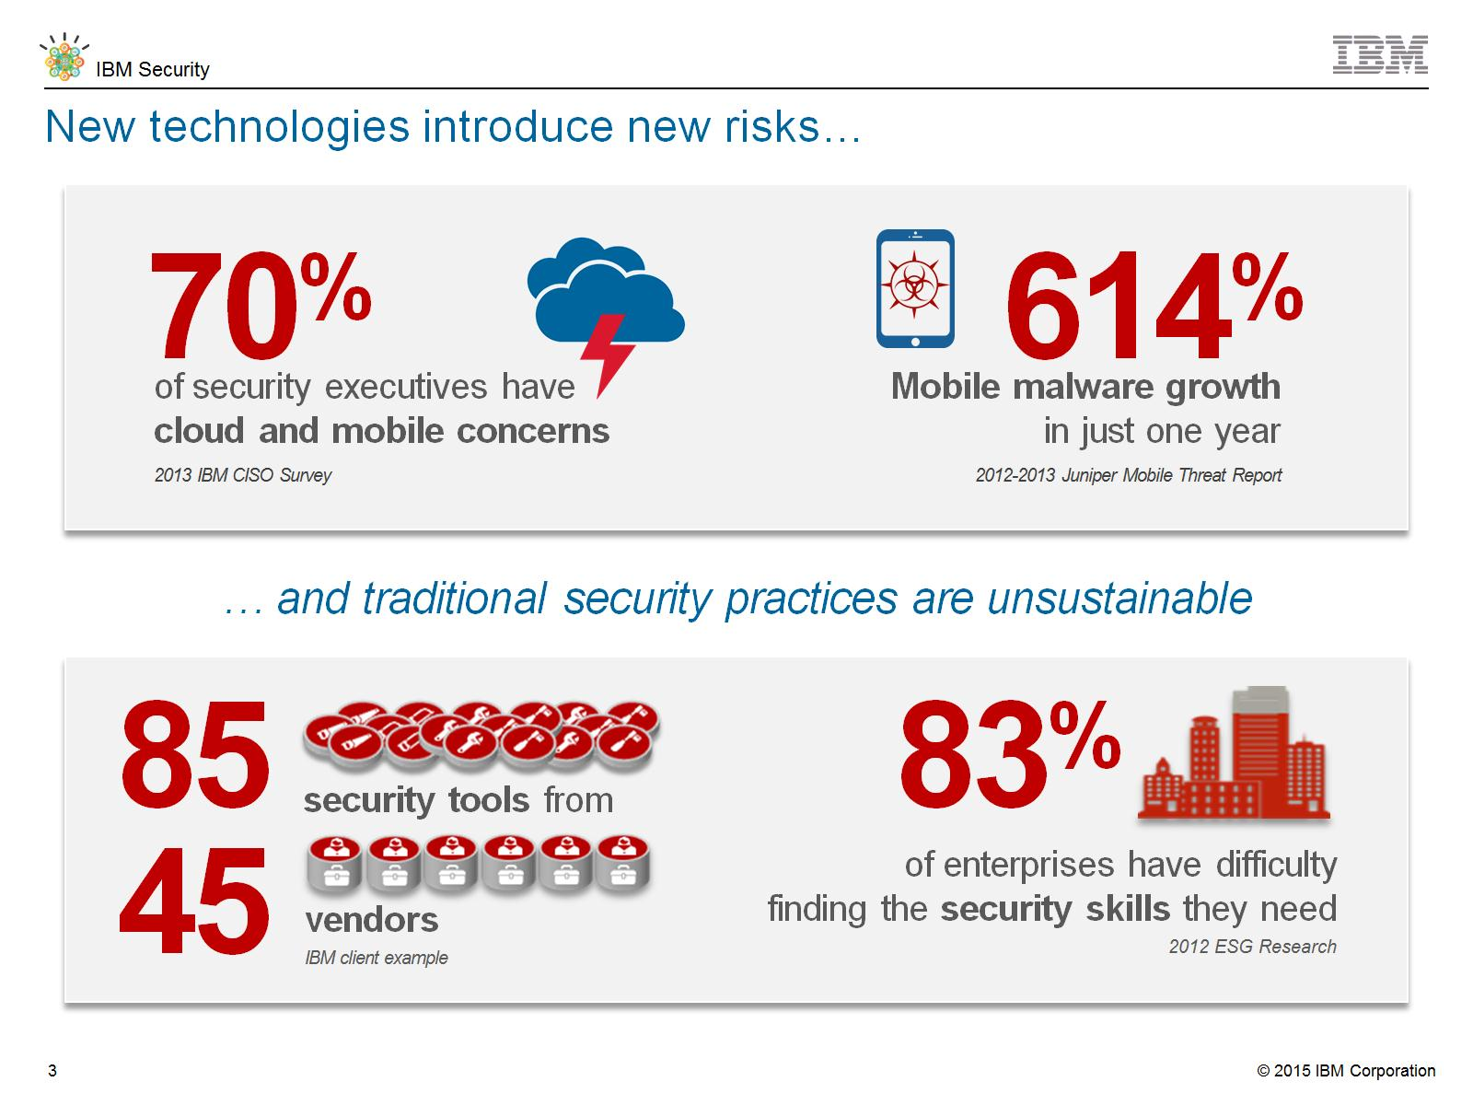
New technologies introduce new risks…
Notes:
New technologies introduce new risks, in fact, businesses are adopting cloud and mobile technologies at unprecedented rates. This influx of new innovation, technologies, and end-points push more and more business transactions outside company walls and completely transform enterprise security as we know it. As the traditional network perimeter around the data center permanently dissolves, it is more difficult to defend company data from the increasing gaps in security, and to verify that users accessing data are protected.
In one study, 70% of security executives expressed concern about cloud and mobile security. (2013 CISO Survey, IBM) Theft or loss of mobile devices, privacy concerns associated with cloud, and accidental sharing of sensitive data are some of the key fears. (2013 Juniper Mobile Threat Report) Without dynamic protection, an organization may spend more time recovering from attacks than it does preventing them. And those who do not prepare for change are leaving their companies dangerously exposed.
…and traditional security practices are unsustainable
Until recently, organizations have responded to security concerns by deploying a new tool to address each new risk. We’ve observed one company was using 85 tools from 45 different software vendors! Now they have to install, configure, manage, patch, upgrade, and pay for dozens of non-integrated solutions with limited views of the landscape. Costly and complex, these fragmented security capabilities do not provide the visibility and coordination needed to stop today’s sophisticated attacks.
Moreover, the skills and expertise needed to keep up with a constant stream of new threats is not always available. In fact, 83% of enterprises report having difficulty finding the security skills they need (2012 ESG Research).
As new risks emerge, the environment will grow more complex and the skills gap will grow even wider.

Slide 3
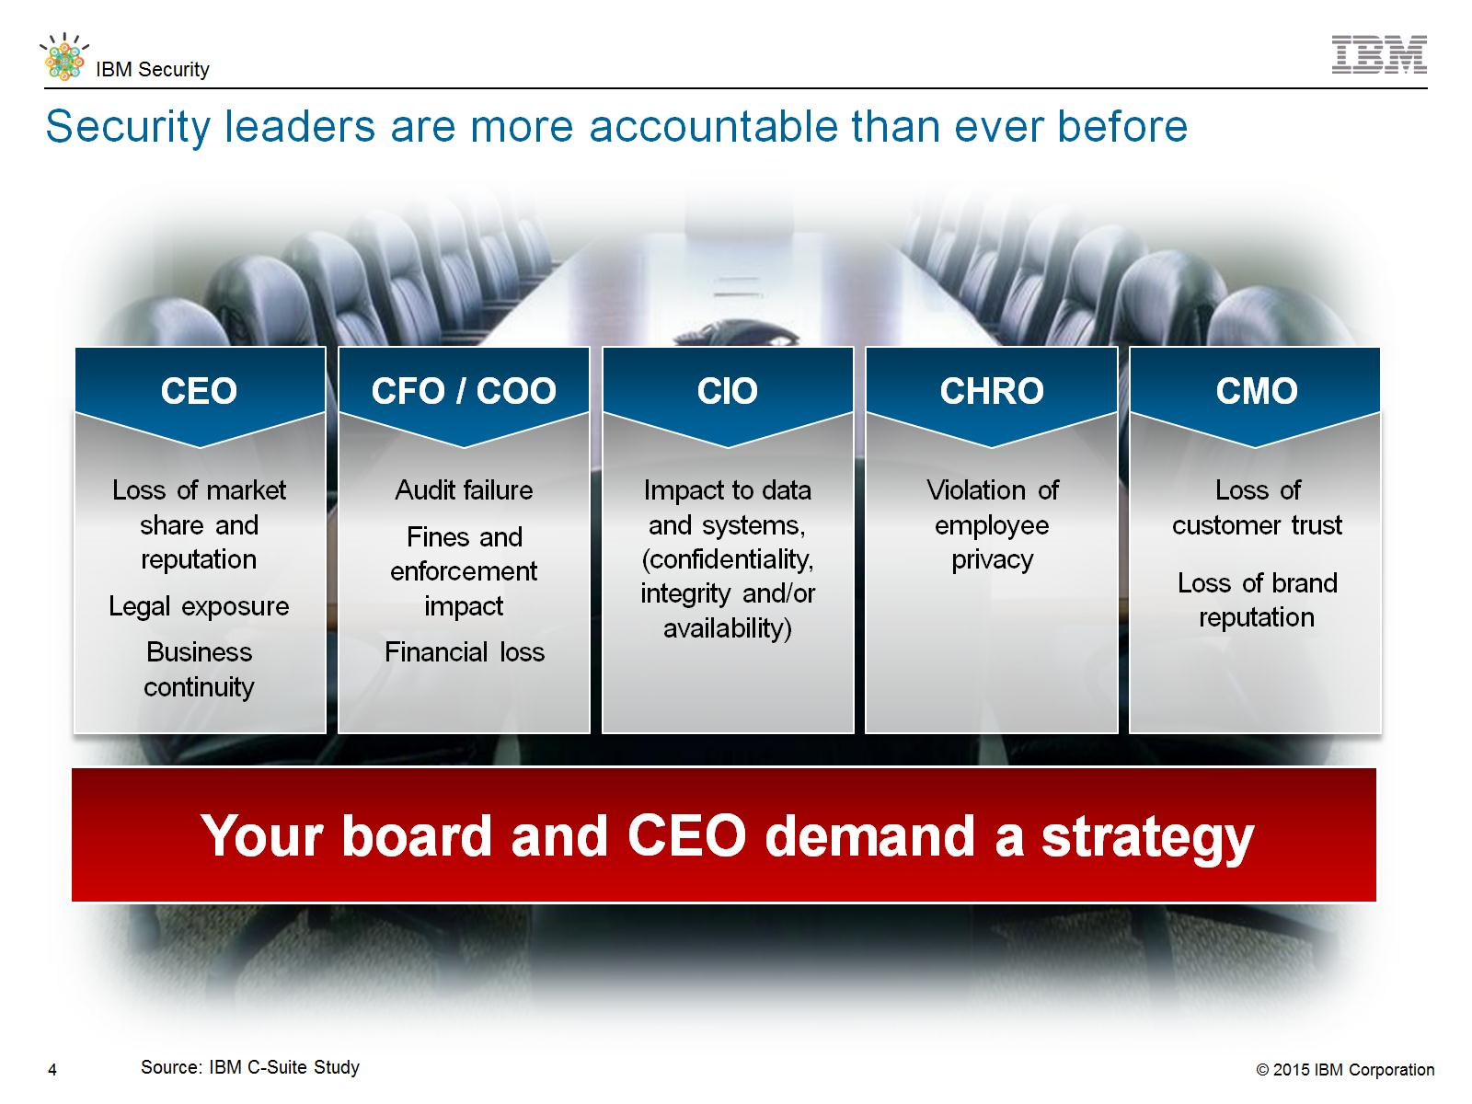
Security leaders are more accountable than ever before
Notes:
We know security has long been a top priority for CISOs and CIOs. Increasingly sophisticated and costly advanced attacks, along with deteriorating security perimeters have raised the issue to the view of CEOs and Boards. The adoption of cloud, mobile and big data technologies has increased the potential attack surface. These trends combine to create an acute, growing need for comprehensive, integrated security solutions.
13,000 C-Suite executive were included in the IBM study.

Slide 4
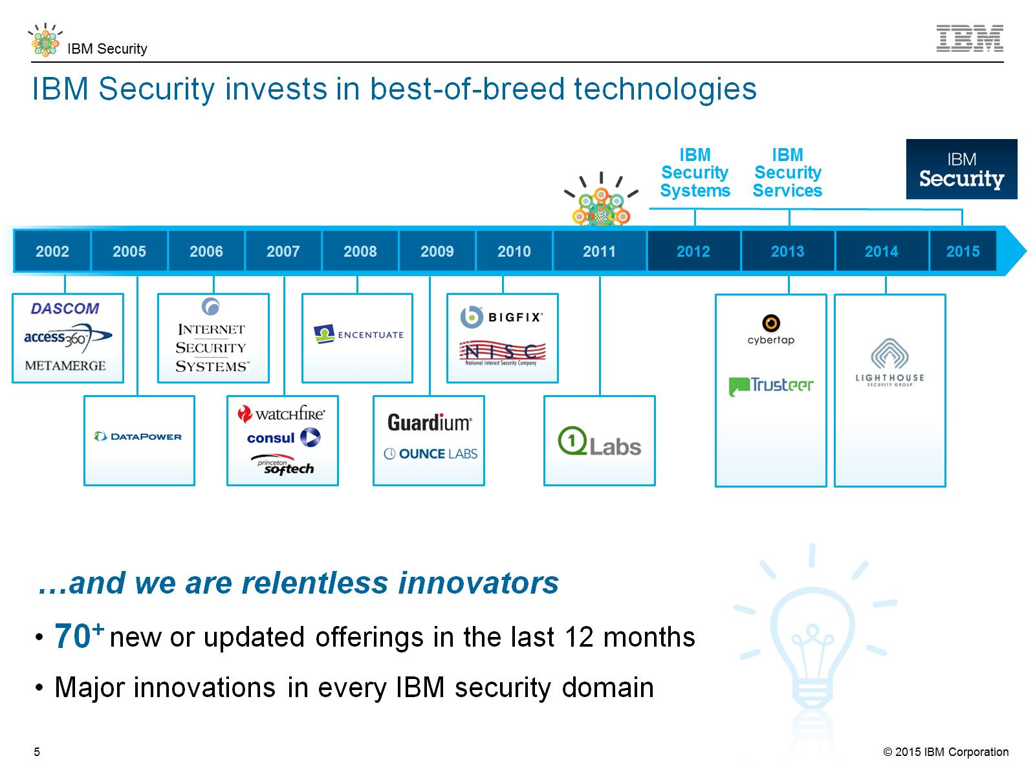
IBM Security invests in best-of-breed technologies
Notes:
For over 50 years, since the introduction of the mainframe, in 1970s, IBM has been committed to providing comprehensive security that meets evolving technological needs. We have invested substantially in inorganic growth to supplement and enhance our organically developed security solutions to build a comprehensive portfolio that can help clients move up the maturity model from basic to proficient to advanced.
This progression was formalized in 2012 with the creation of the IBM Security Systems Division that brought the multiple solutions together to increase the focus and help drive long term strategy for the organization. In 2015, IBM Security Systems Division became a primary Business Unit of IBM, called “IBM Security”.
2013 continued to be an active year for acquisitions with the announcement that IBM acquired Trusteer and Fiberlink Maas360.
And in 2014, IBM announced its intent to acquire CrossIdeas for its identity governance capabilities and also Lighthouse Security Group for their cloud-enabled identity management services.
<PRESENTER: See below for a more detailed background…>
1976
IBM introduces Resource Access Control Facility (RACF), to provides access control and auditing functionality for applications on the mainframe eliminating the need for each application to imbed security
1977
The IBM develops Data Encryption Standard (DES), a cryptographic algorithm, adopted as the national standard by the US National Bureau of Standards
1978
IBM announces the 3624 automatic teller machine, utilizing DES
1995
IBM starts contributing to Java Security technologies
1996
IBM launches Cryptolope containers to seal intellectual property in a digital package so that content transactions are secured over the Internet
IBM launches the SecureWay Key Management Framework, a collection of applications, services and cryptographic engines that help make the Internet safe for e-commerce
IBM begins pilot program with MasterCard using Secure Electronic Transaction (SET) technology which secures credit card transactions over the Internet
IBM develops and certifies the IBM Secure Crypto Co-processor (4758) at FIPS 104-1 Level 4, the highest level of FIPS
IBM releases its first enterprise-grade LDAP Directory Server (now known as Directory Server)
1998
IBM extends Secure Electronic Transaction (SET) standard support which secures payments over the Internet and is largely based on technology developed at IBM Research and adopted by major credit card companies
1999
IBM acquires Dascom, the basis for IBM's Access Manager portfolio
IBM Research's breakthrough paper on Side Channel Cryptanalysis Attacks and Countermeasures (1999 – 2004)
2000
IBM patents a system and method for alerting computer users to digital security intrusions
IBM appoints Harriet Pearson its first Chief Privacy Officer
2002
IBM acquires Access 360, the basis for IBM's Identity Manager portfolio
IBM acquires MetaMerge for meta-directory and directory synch capability (now known as Directory Integrator)
2005
IBM debuts the first ThinkPad with an integrated fingerprint reader, at the time offering an unmatched level of data protection through a new biometric capability and embedded security subsystem
2006
IBM acquires Internet Security Systems, Inc, the basis for today’s IBM X-Force® IT security research team and the IBM network protection product family
Smart cards, highly efficient JavaCard™ technology developed at IBM Research – Zurich, is licensed by a leading smart card manufacturer for secure multi-application smart cards and is used in many JavaCard™ projects The technology is used today in 10s of millions of VISA credit cards
2007
IBM acquires Consul, to help accelerate data and governance strategy
2008
IBM patents a secure system and method for enforcement of privacy policy and protection of confidentiality
IBM acquires Encentuate, the basis for 'IBMs Enterprise Single-sign-on (ESSO) product
Zone Trusted Information Channel: Plugs into the USB port of any computer and creates a direct, secure channel to a bank’s online transaction server, bypassing the PC which could be infected by malicious software (malware) or susceptible to hacker attacks
2009
IBM acquires Ounce Labs, a provider of software that analyzes software code for security vulnerabilities, today’s AppScan family
IBM acquires Guardium, a market leader in real-time enterprise database monitoring and protection
Pioneers the use of Big Data analytics to cybersecurity problems (FAA, USAF)
2010
IBM acquires Big Fix, helping organizations extend security and compliance to endpoints, today Endpoint Manager
IBM Research’s breakthrough on Fully Homomorphic Encryption
2011
IBM Security Systems division is created
IBM acquires Q1 Labs, with its QRadar security intelligence portfolio, to strengthen its offerings around advanced security analytics
IBM launches Cloud-based Mobile Security Services, IBM Hosted Mobile Device Security Management
2012
IBM delivers next-gen Intrusion system, new access appliance and privileged identity technology
IBM announces 25 new product releases in security, a record year of innovation
IBM extends its market leading static application security testing (IBM Security AppScan) to native Android applications, which allows clients to conduct their own testing for mobile applications
2013
IBM announces breakthrough with combination of Security Intelligence and Big Data
IBM acquired Cybertap for their incident forensics technology.
IBM announces new QRadar Vulnerability Manager software to help organizations identify and predict security risk
IBM announces MobileFirst security software (IBM AppScan Source 87 for iOS) to improve security quality without sacrificing time-to-market of mobile app projects
IBM announces acquiring Trusteer for mobile and application security, counter-fraud and malware detection
IBM announced acquiring Fiberlink. Fiberlink’s MaaS360 offering expands IBM MobileFirst solutions with new cloud-based capabilities to deliver a comprehensive mobile management and security solution for global organizations of all sizes. This acquisition supports IBM’s expanding vision for enterprise mobility management, which encompasses secure transactions between businesses, partners and customers.
2014
IBM announces the acquisition of Lighthouse Security Group and CrossIdeas
2015
In an IBM reorganization, IBM Security Systems Division advances to become an IBM business unit called IBM Security.

Slide 5
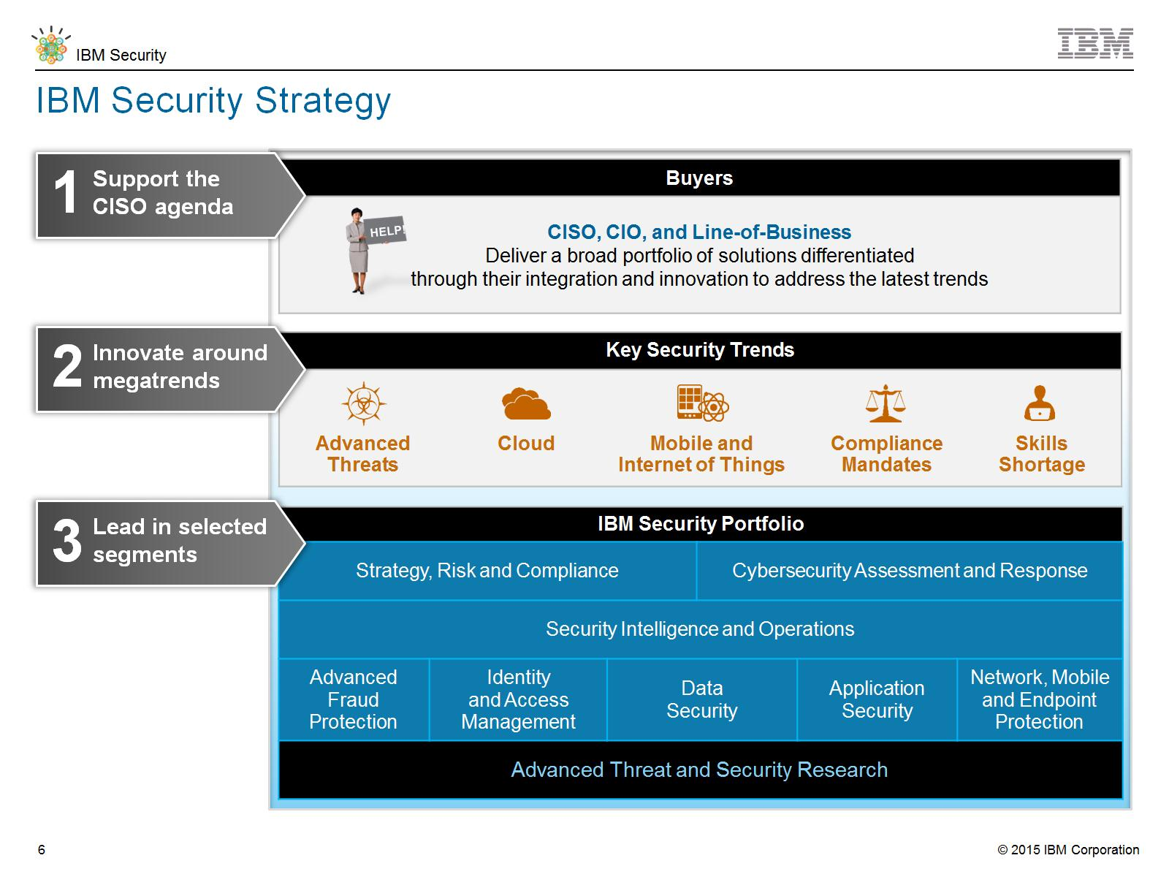
IBM Security Strategy
Notes:
In support of the critical role of the CISO, IBM offers integrated security intelligence and industry-leading experience enabled by the IBM Security Porfolio. All of the IBM Security offerings are backed by an extensive business partner ecosystem which consists of industry-leading technology, sales and service partners.

Slide 6
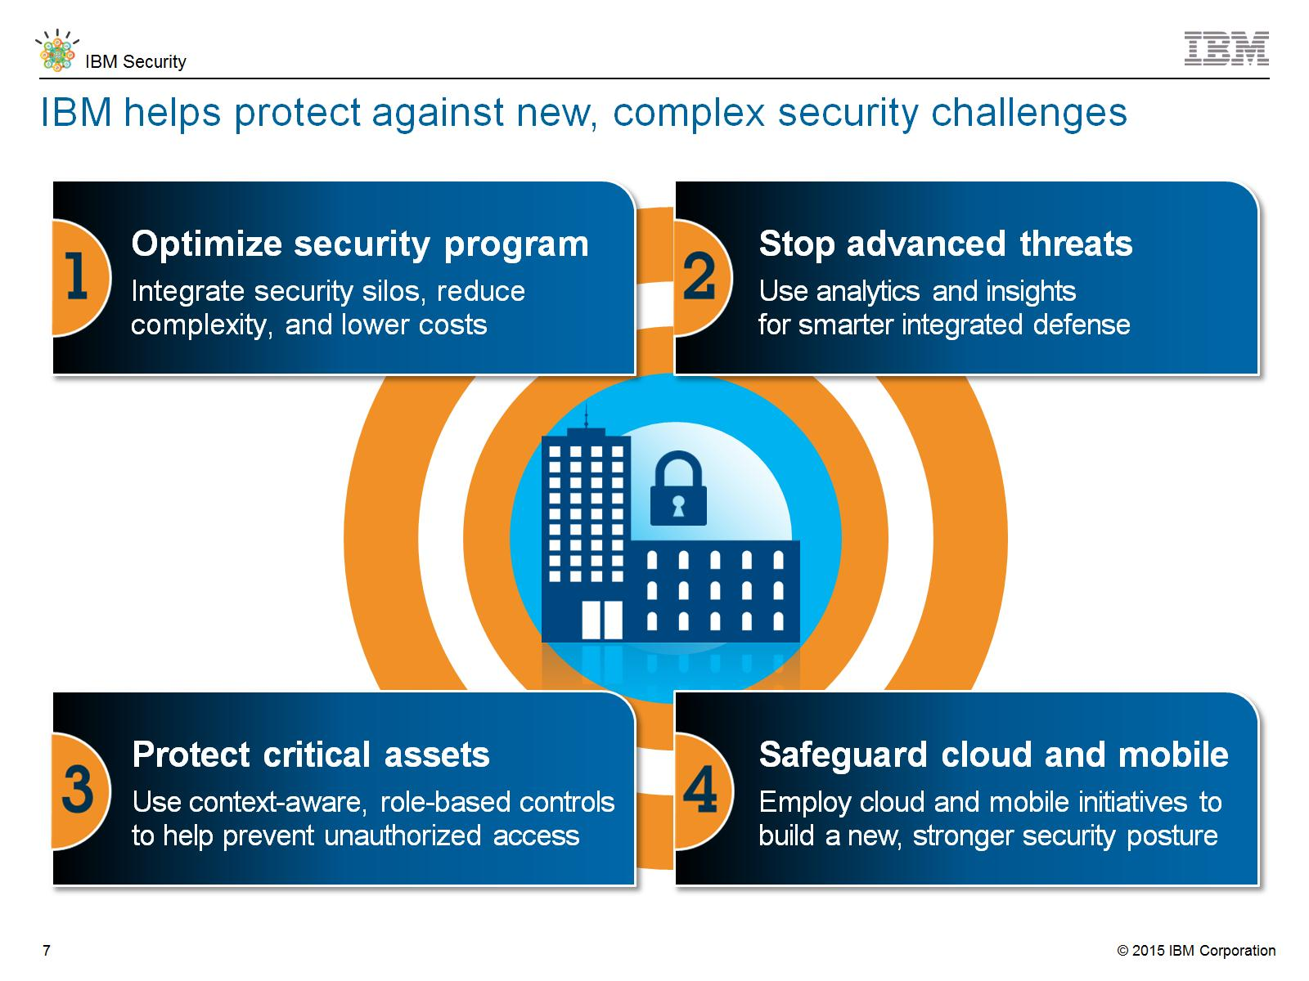
IBM helps protect against new, complex security challenges
Notes:
IBM helps protect against new, complex security challenges…

Slide 7
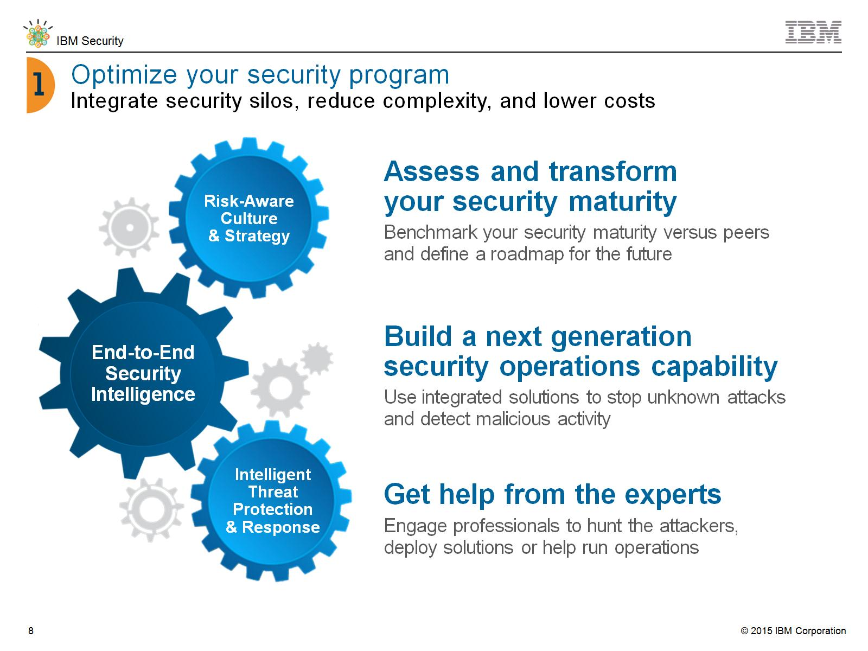
Optimize your security program
Integrate security silos, reduce complexity, and lower costs
Notes:
As a security professional, as a CISO, you may be asked to meet with senior execs and / or the Board to discuss, especially if a breach occurs in your industry or with a competitor. The Board isn’t looking for architecture, they want a strategy. They want to understand the current posture of your organization.
Assessing your current state of maturity is the first step to building a roadmap for the future. That path is very much a journey.
Some of the challenge relates to people and building a risk aware culture in your organization. Help employees, contractors, partners, and customers understand how important security is and what role they play.
Realities of budgets and resources will play into your plan. Working with a trusted partner that has thousands of security clients and manages billions of security events per day for those clients, is a clear way forward for many organizations. Augment your own resources with security experts and threat research that you don’t have in house.

Slide 8
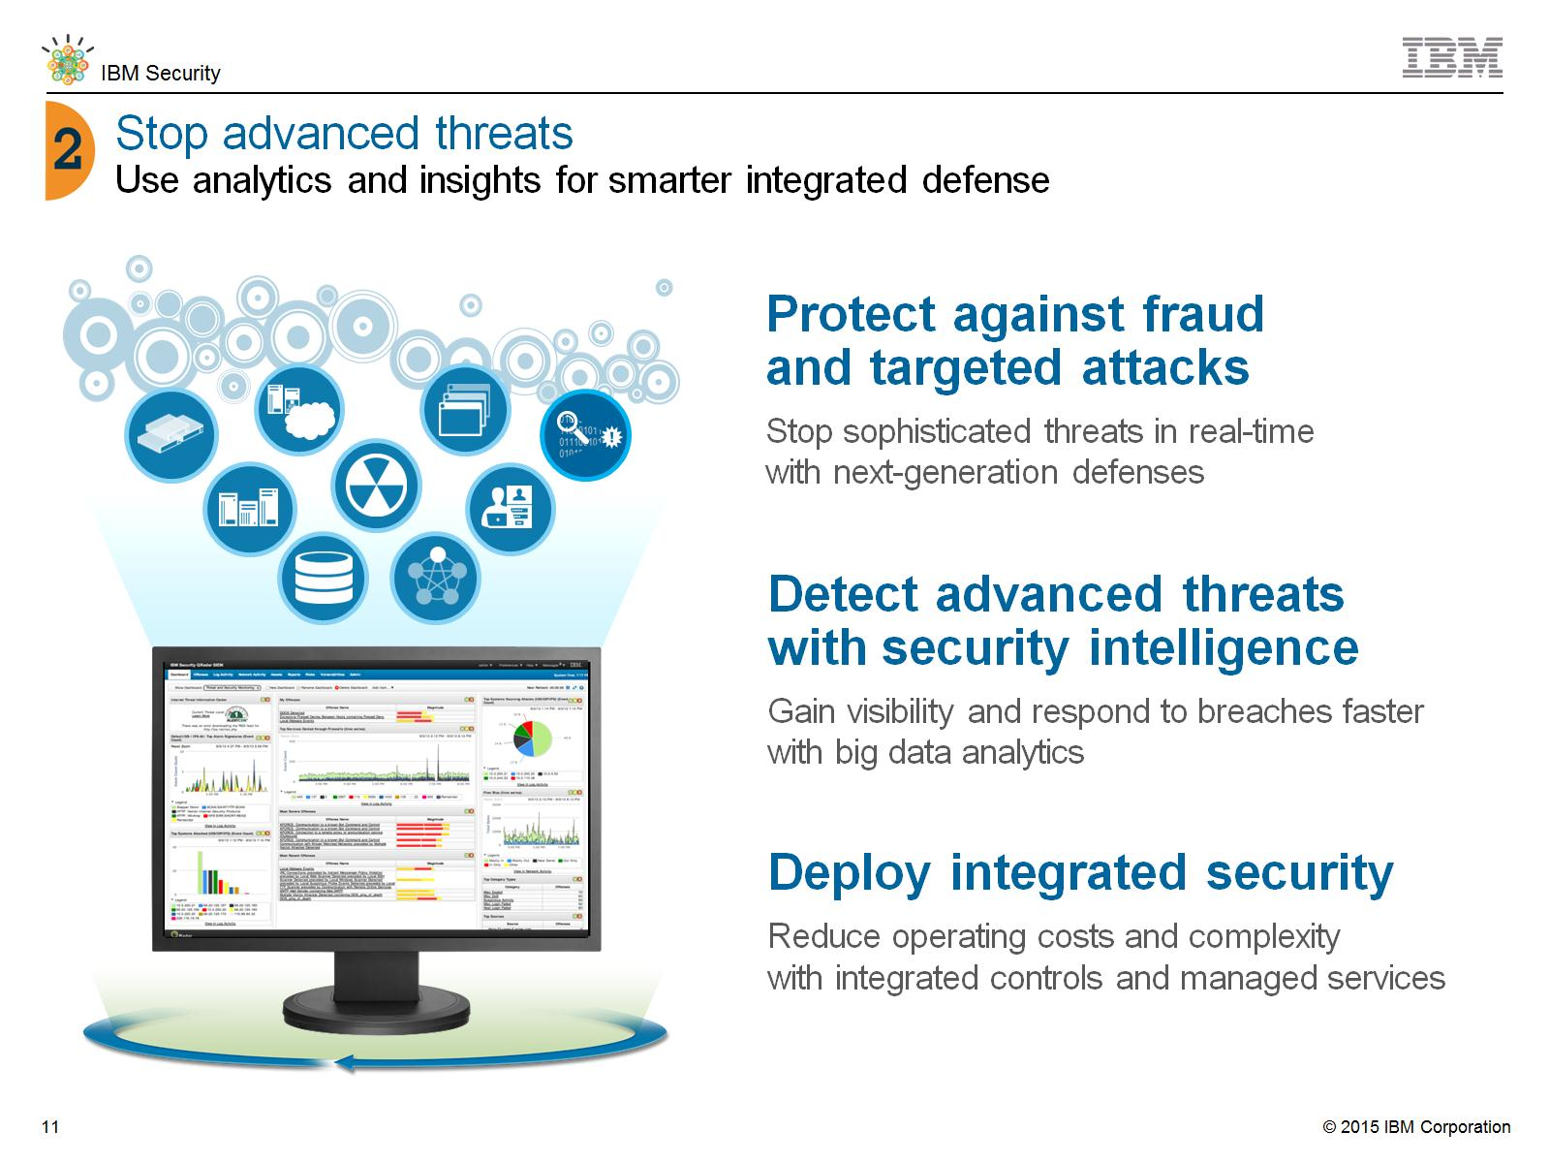
Stop advanced threats
Use analytics and insights for smarter integrated defense
Notes:
How can advanced attacks be prevented? An integrated platform of capabilities can help detect threats by providing network and endpoint protection that identifies unusual activity.
Behavior based analysis can understand what the user and application should be doing and compare that to what is happening on the network and endpoint and then alert the security team to unusual activity.
Passing this information on to an advanced security intelligence platform provides correlation and analytics to help detect and understand the threat. Advanced threat research from IBM’s global database helps stay ahead of the threat.
And deploying forensic capabilities and emergency response services when an attack happens can help remediate the situation more quickly. Integration of all of these capabilities and expertise provides value beyond what is gained from individual point products.

Slide 9
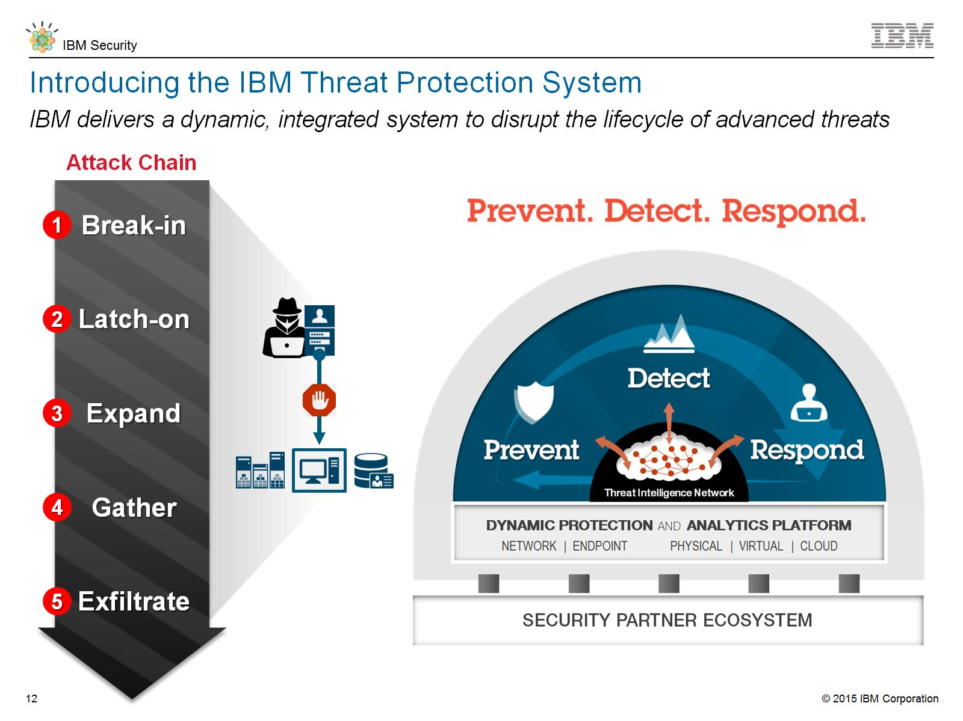
Introducing the IBM Threat Protection System
Notes:
IBM delivers a dynamic, integrated system to disrupt the lifecycle of advanced threats through the IBM Threat Protection System…

Slide 10
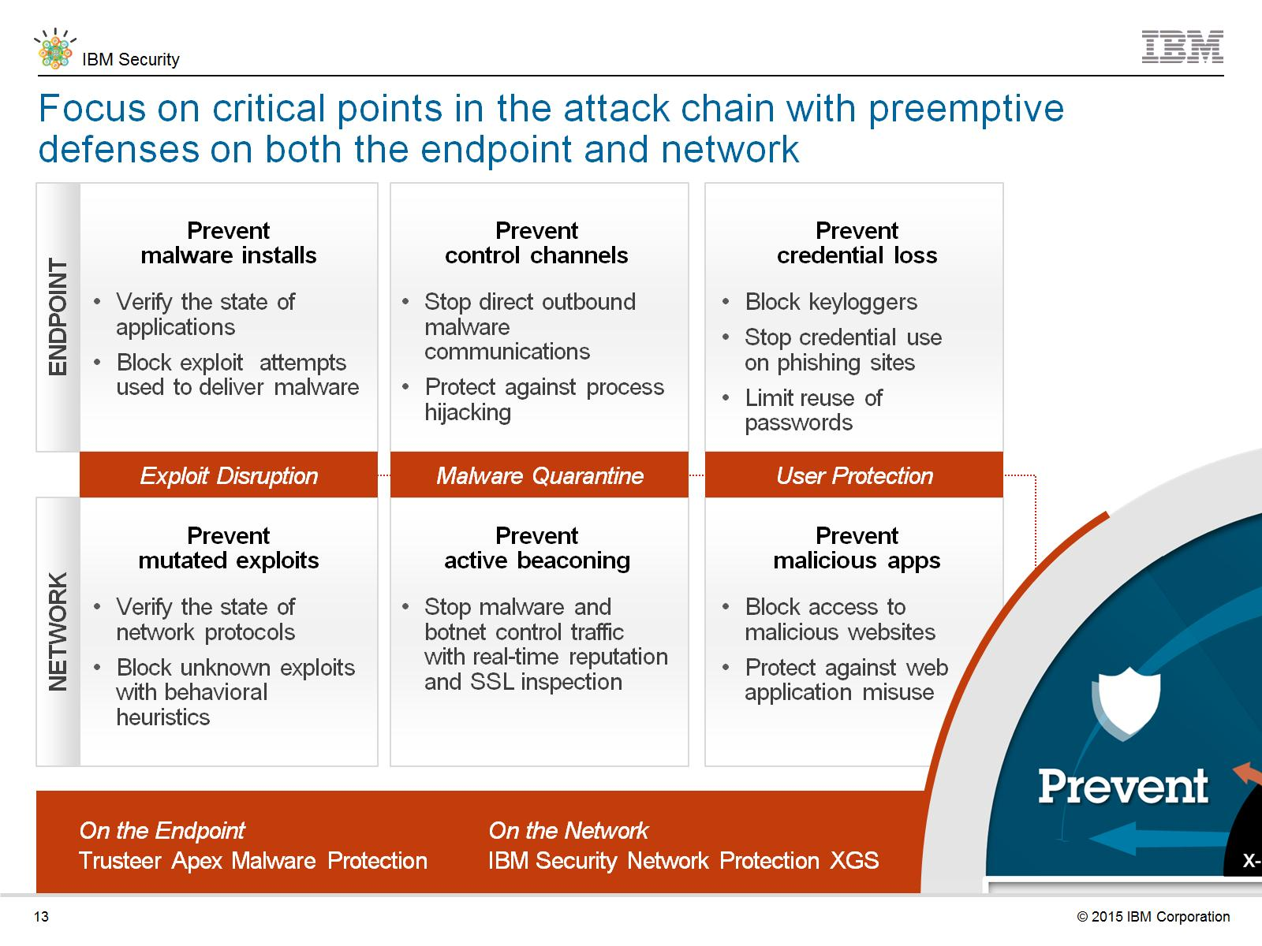
Focus on critical points in the attack chain with preemptive defenses on both the endpoint and network
Notes:
Focus on critical points in the attack chain with preemptive defenses on both the endpoint and network…

Slide 11
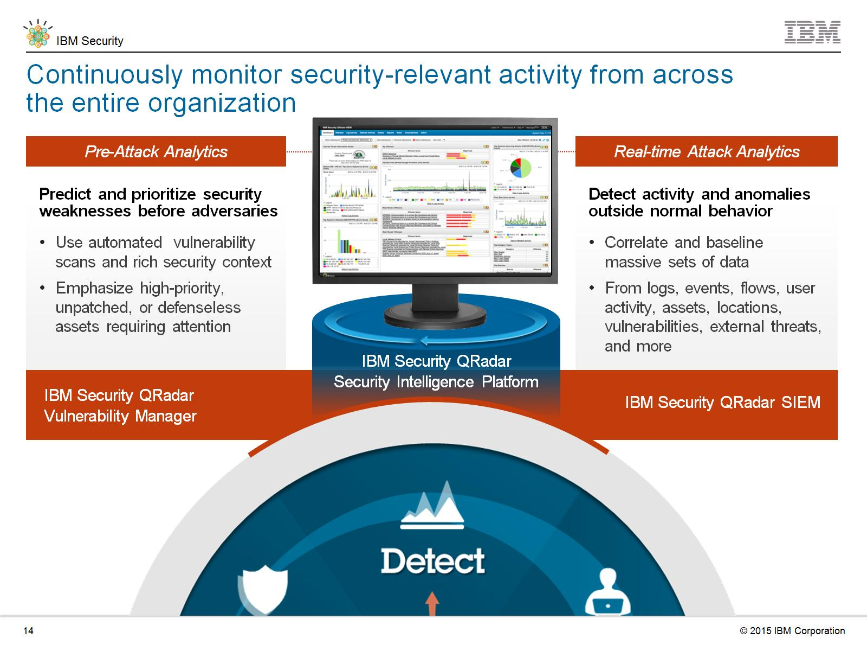
Continuously monitor security-relevant activity from across the entire organization
Notes:
Continuously monitor security-relevant activity from across the entire organization…

Slide 12
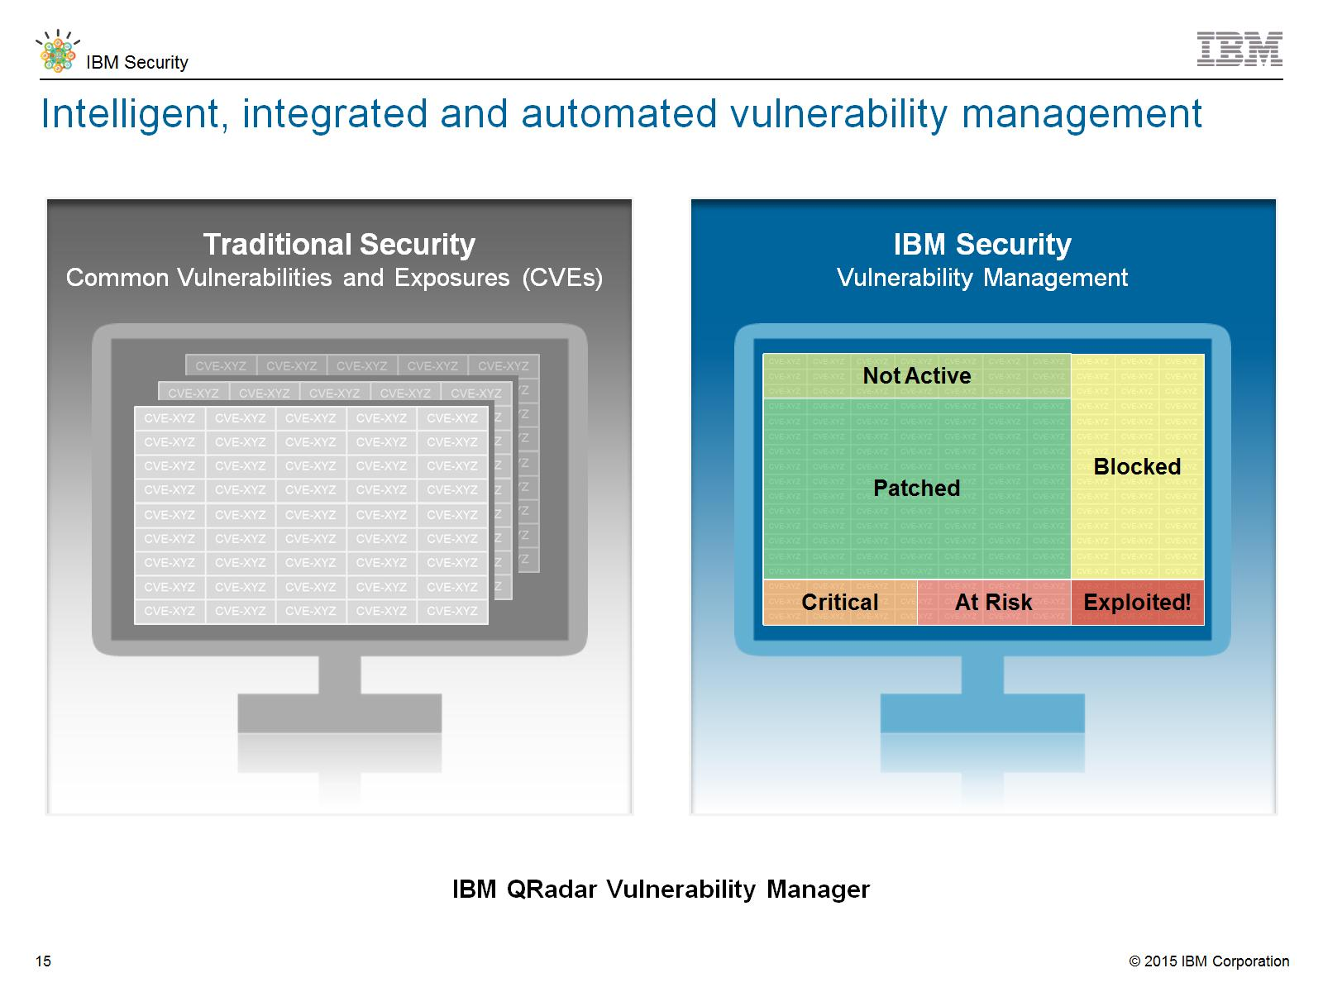
Intelligent, integrated and automated vulnerability management
Notes:
Intelligent, integrated and automated vulnerability management with QRadar Vulnerability Manager…

Slide 13
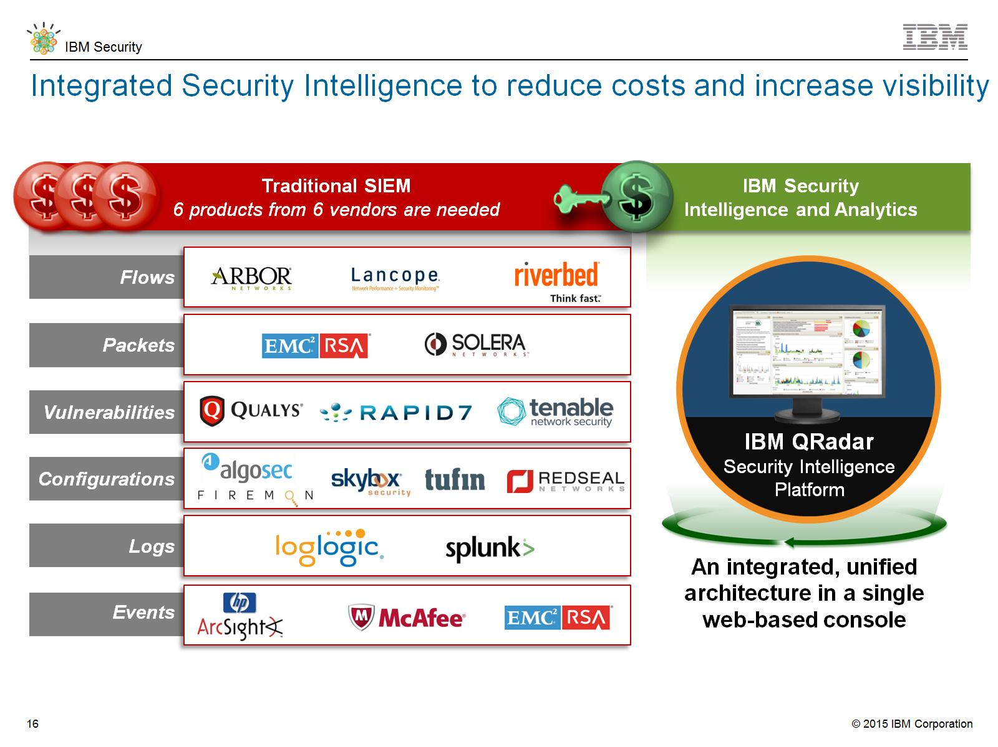
Notes:
Traditional SIEM
As many as 6 products from 6 different vendors are needed
IBM Security Intelligence and Analytics
An integrated, unified architecture in a single web-based console

Slide 14
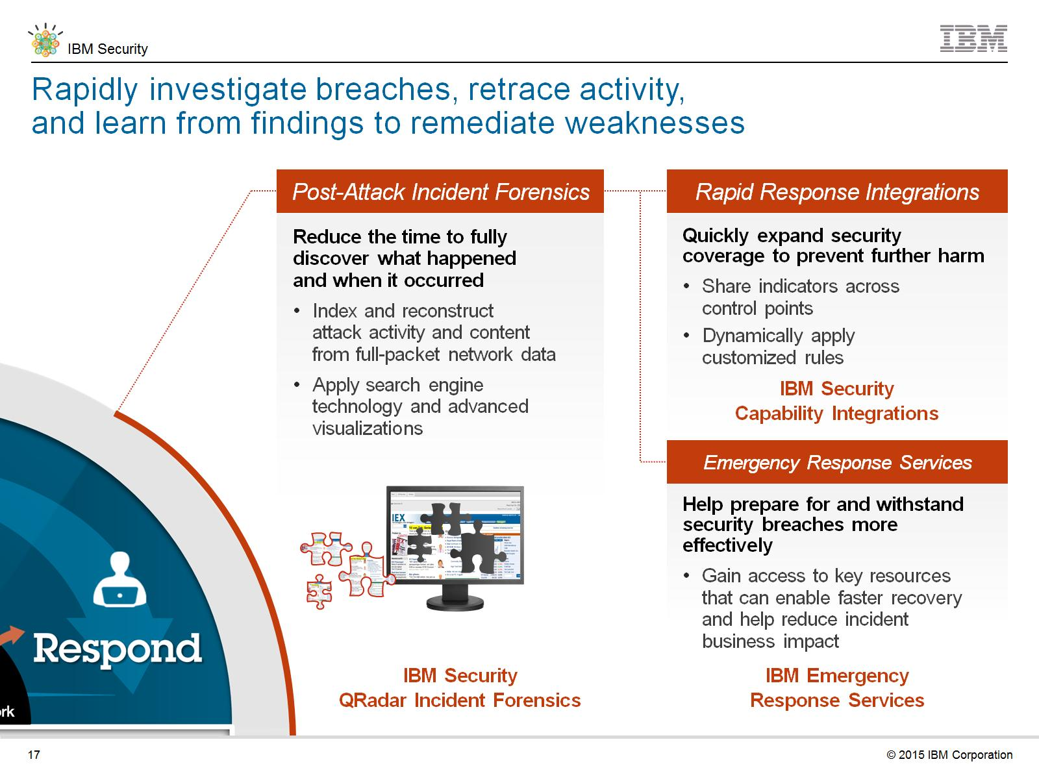
Rapidly investigate breaches, retrace activity, and learn from findings to remediate weaknesses
Notes:
Rapidly investigate breaches, retrace activity, and learn from findings to remediate weaknesses…

Slide 15
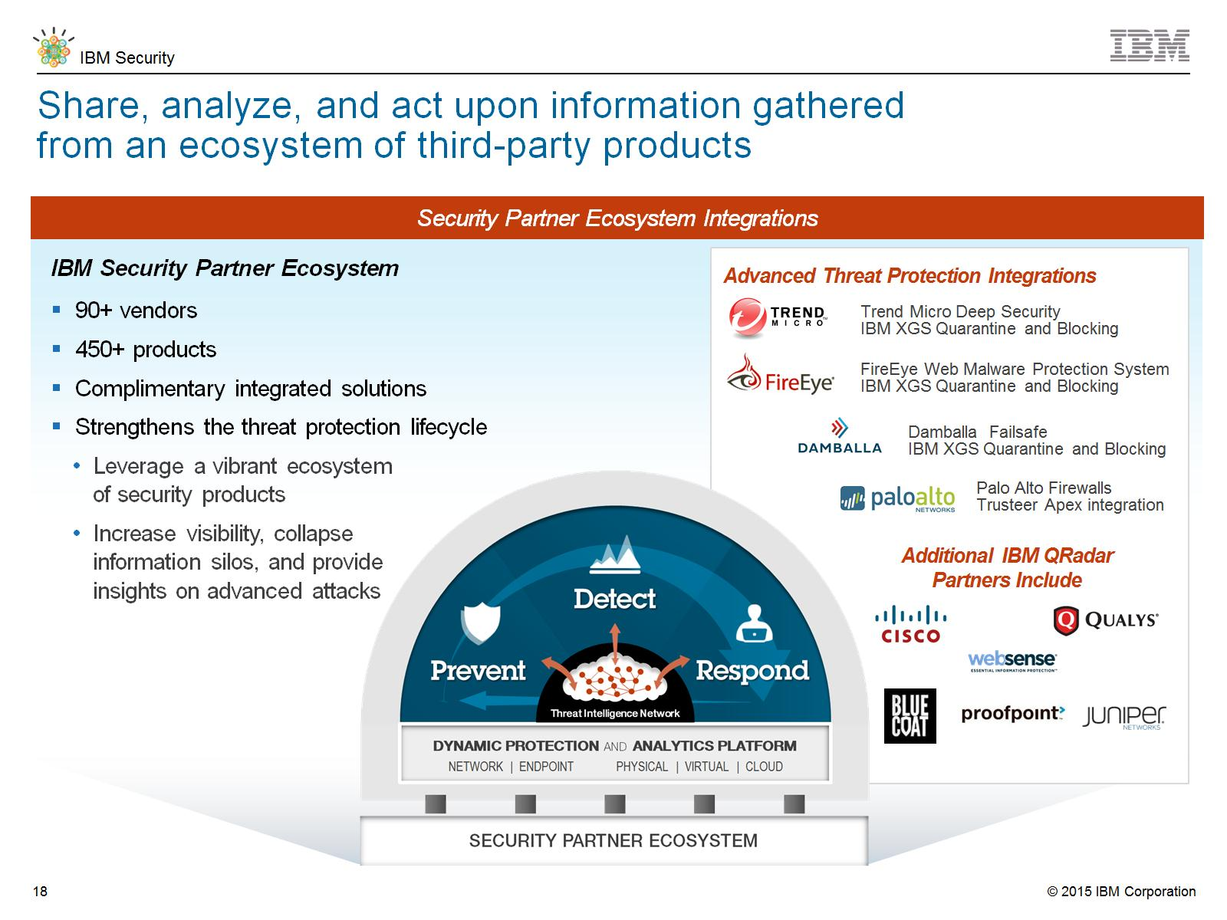
Share, analyze, and act upon information gathered from an ecosystem of third-party products
Notes:
IBM works with a broad set of technology vendors who provide complementary solutions and are integrated with our security products

Slide 16
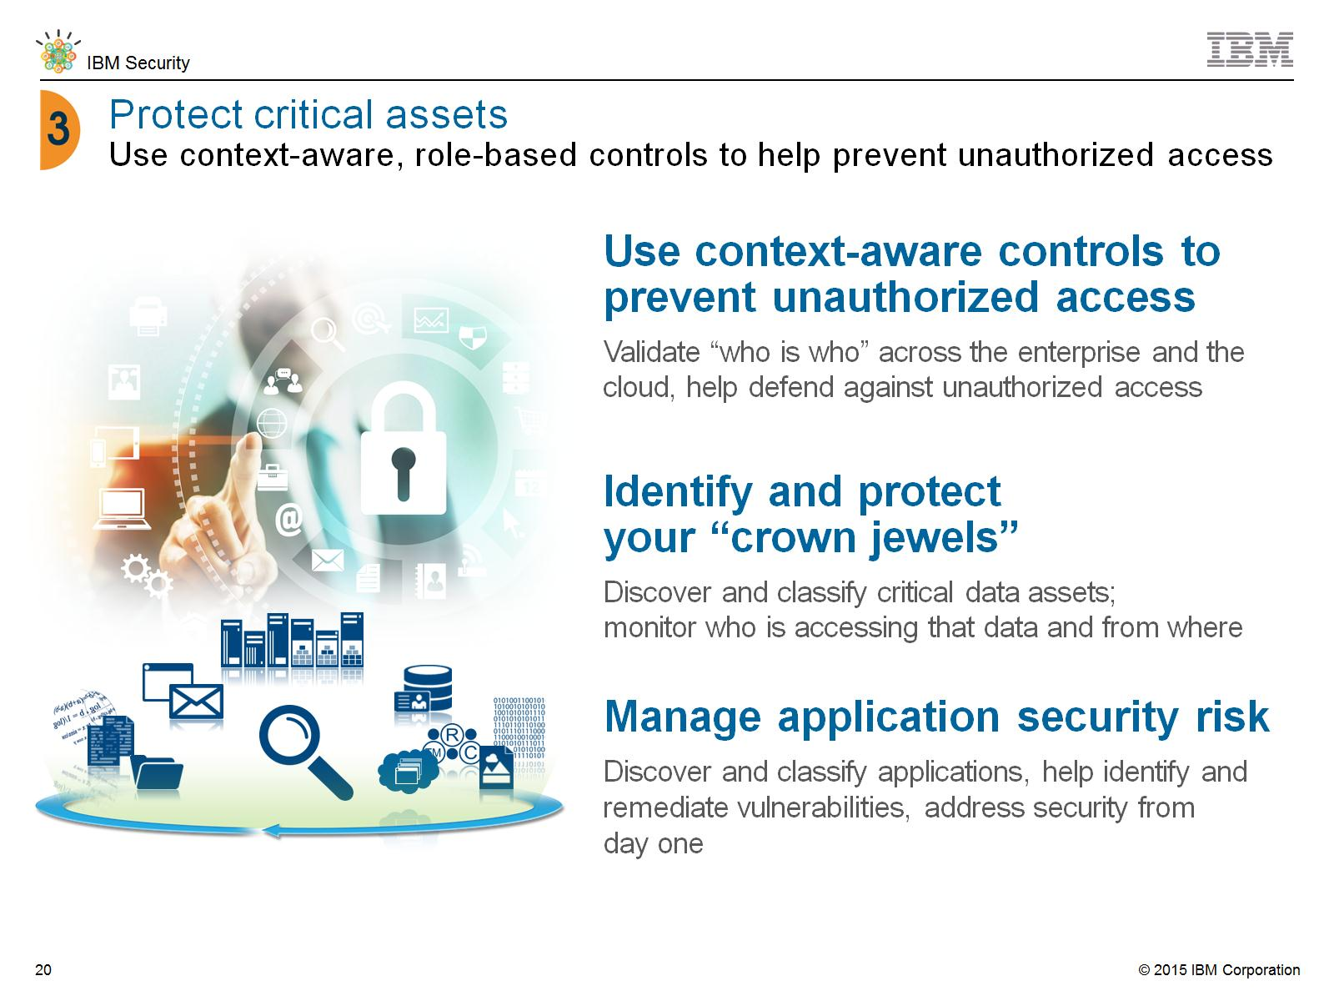
Protect critical assets
Use context-aware, role-based controls to help prevent unauthorized access
Notes:
Not so long ago, an organization need only worry about employees accessing a few, highly controlled and contained applications on the mainframe. Fast forward a few years and now you have potentially millions of users coming into your systems to access their records, users who are not employees, but customers, partners, contractors, and so on.
The data they are using has increased exponentially, and the rate of new applications being developed in the world of mobile apps, is astonishing compared to the 2-year development cycle of just a few years ago.
This velocity and volume requires a different approach to security, a risk-based approach. You need automated and role-based access controls that are smart enough to know where the user is located, what they want to do, and what normal behavior is before letting them in the door.
You need to discover your most critical data and monitor who accesses it, what they do, and who controls the encryption keys and privileged user rights.
And, finally, applications need to be checked for vulnerabilities before they go into production to avoid the costs of fixing them later and the potential damages from remediating victims’ losses. Heartbleed and the recent Bash bug are evidence that security flaws can be around and exploited for years before they are discovered.

Slide 17
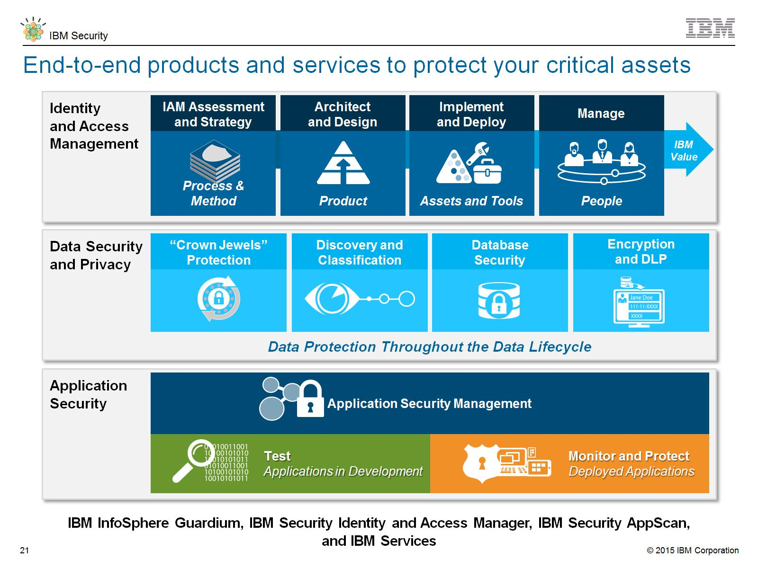
End-to-end products and services to protect your critical assets
Notes:
End-to-end products and services to protect your critical assets…

Slide 18
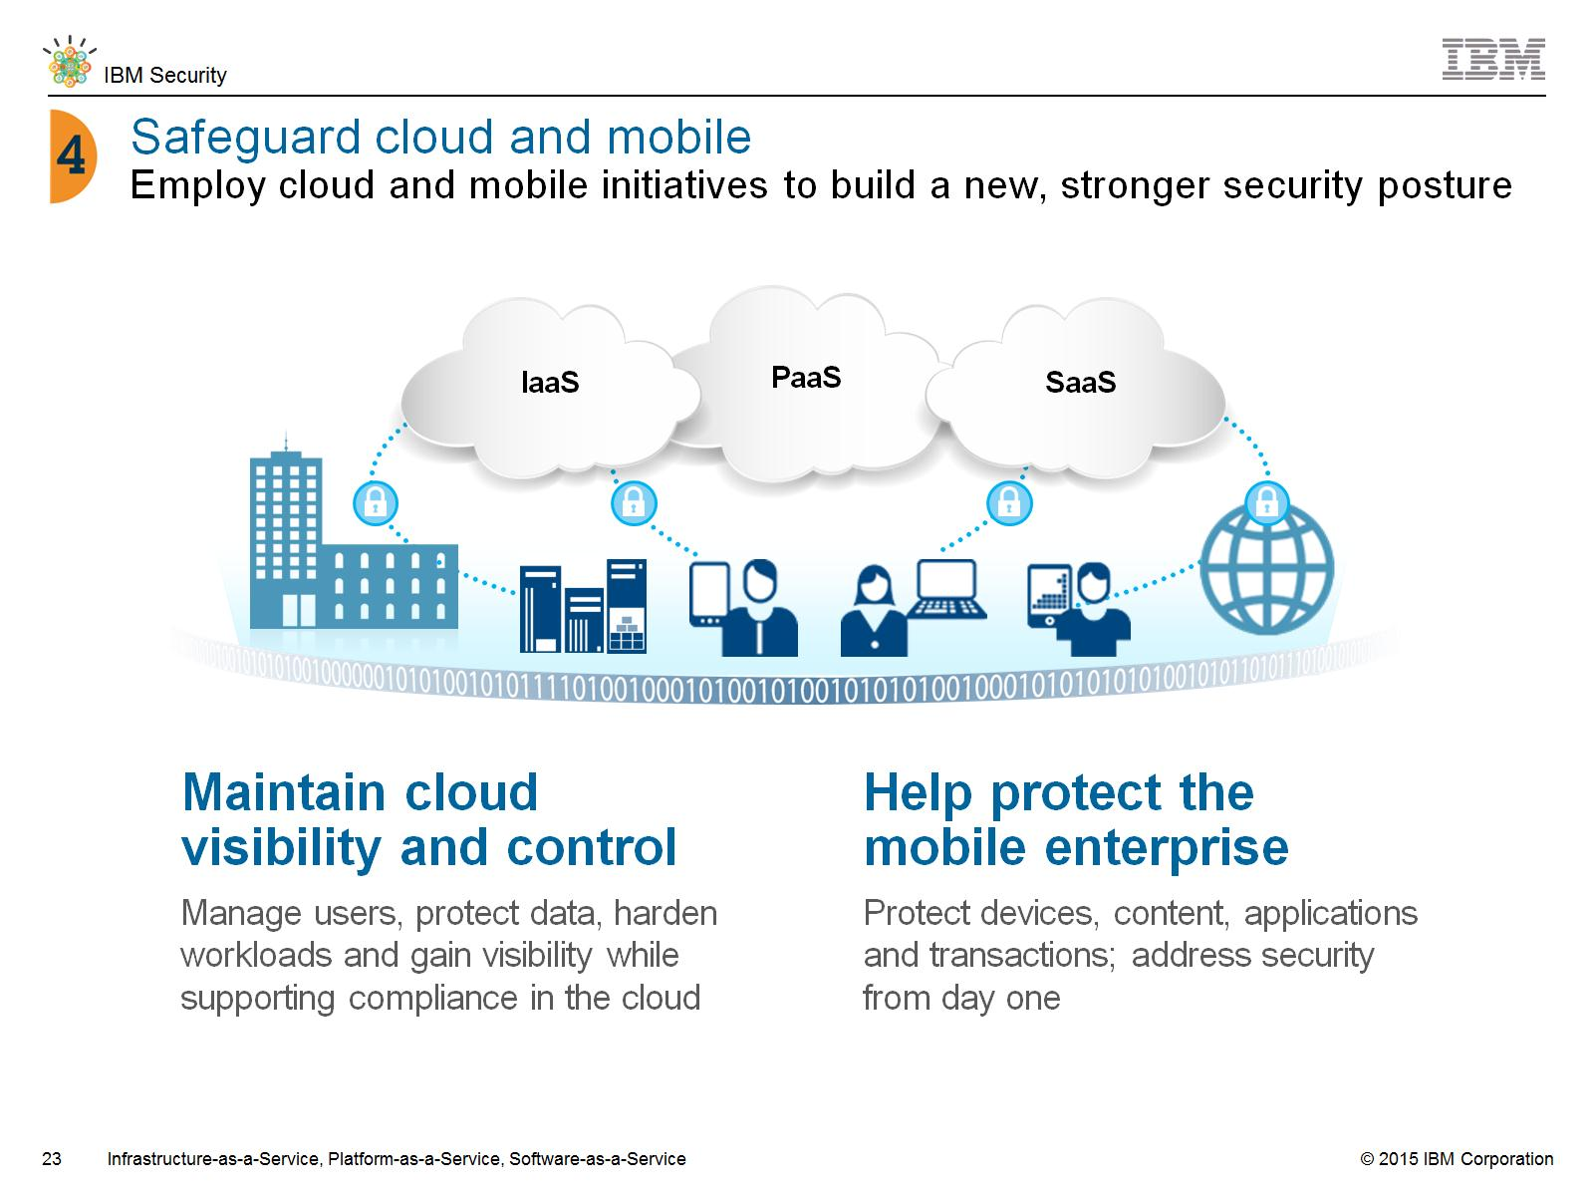
Notes:
IBM is one of the largest cloud providers in the industry, with thousands of customers using cloud products. We offer managed cloud security services for organizations that want to take advantage of the flexibility and scalability of cloud but that do not have the skills in house to manage the security for their clouds.
IBM’s portfolio of security products is “cloud ready”, meaning that we help protect clients’ people, data, applications and infrastructure as they build their private clouds.
We also work with many of the largest cloud service providers and telecommunications companies in the world to help them build security into their cloud offerings.
Customers are looking at Bring Your Own Device and other mobile initiatives to engage with their employees and customers in new ways.
IBM can help make the mobile environment more secure than the traditional environment by addressing from day one the security of the device, the content, the applications and the transactions.
IBM solutions provide a layered approach to strong authentication, device management, anti-fraud and other mobile security concerns.
IBM also offers cloud-based security and services that can help fight fraud, manage user access fight advanced threats.

Slide 19
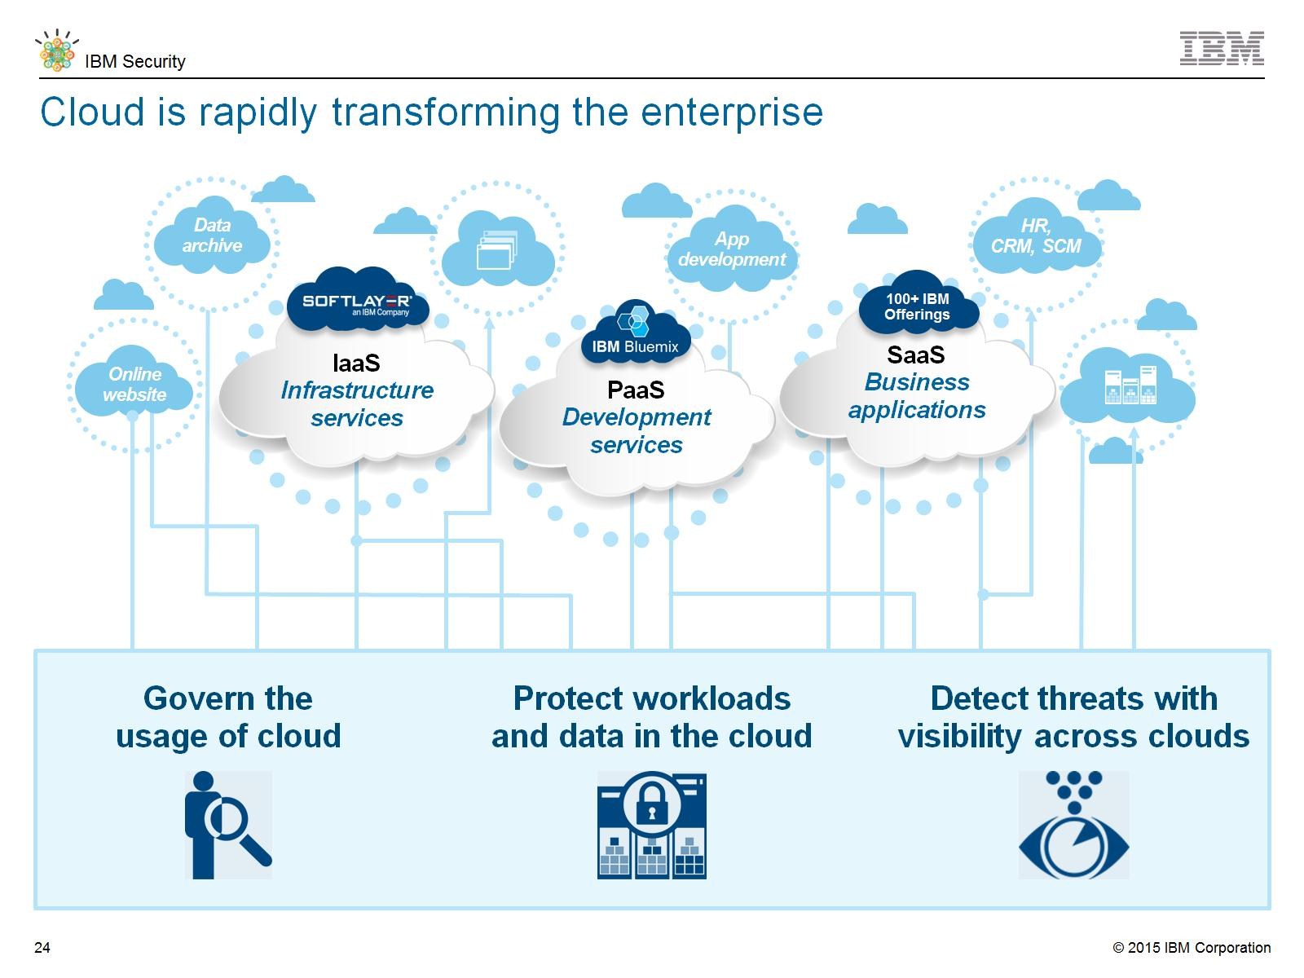
Cloud is rapidly transforming the enterprise
Notes:
Cloud is rapidly transforming the enterprise…

Slide 20
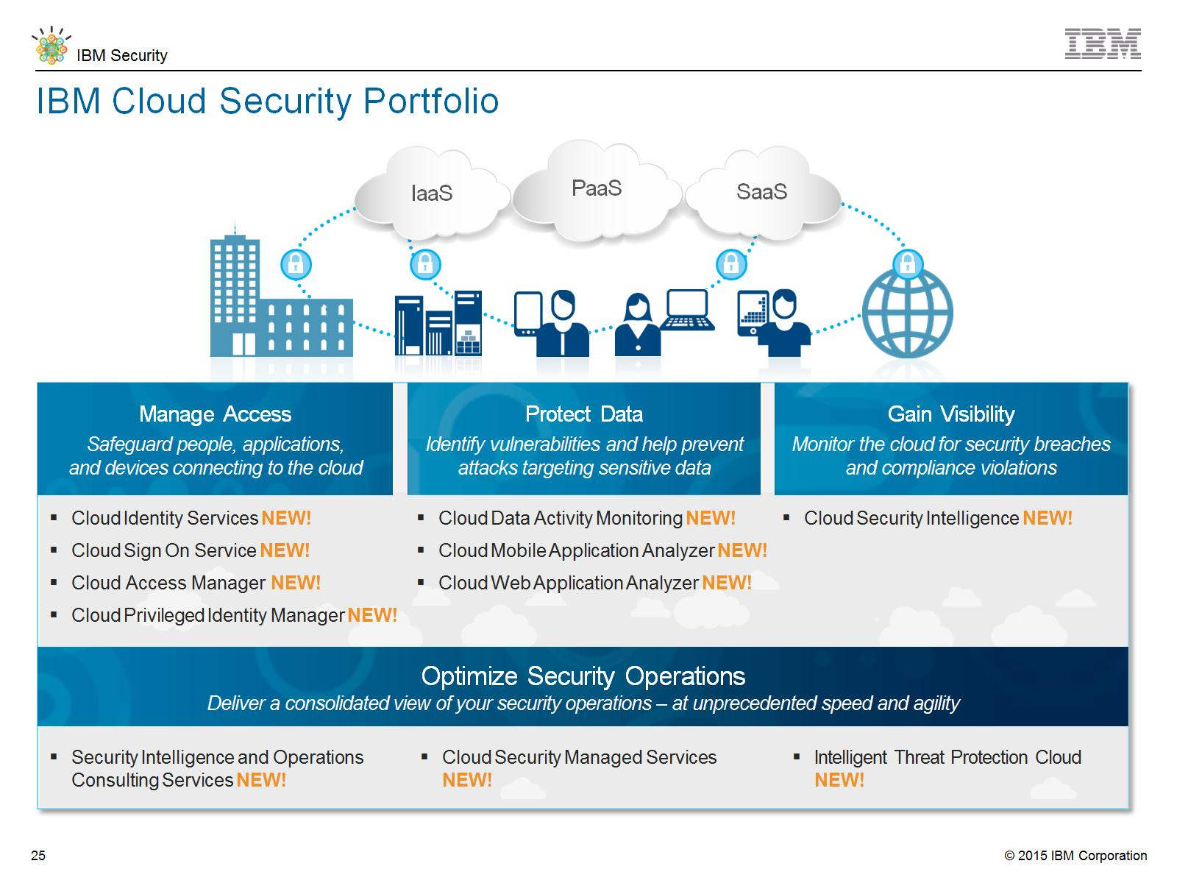
IBM Cloud Security Portfolio
Notes:
IBM Cloud Security Portfolio…

Slide 21
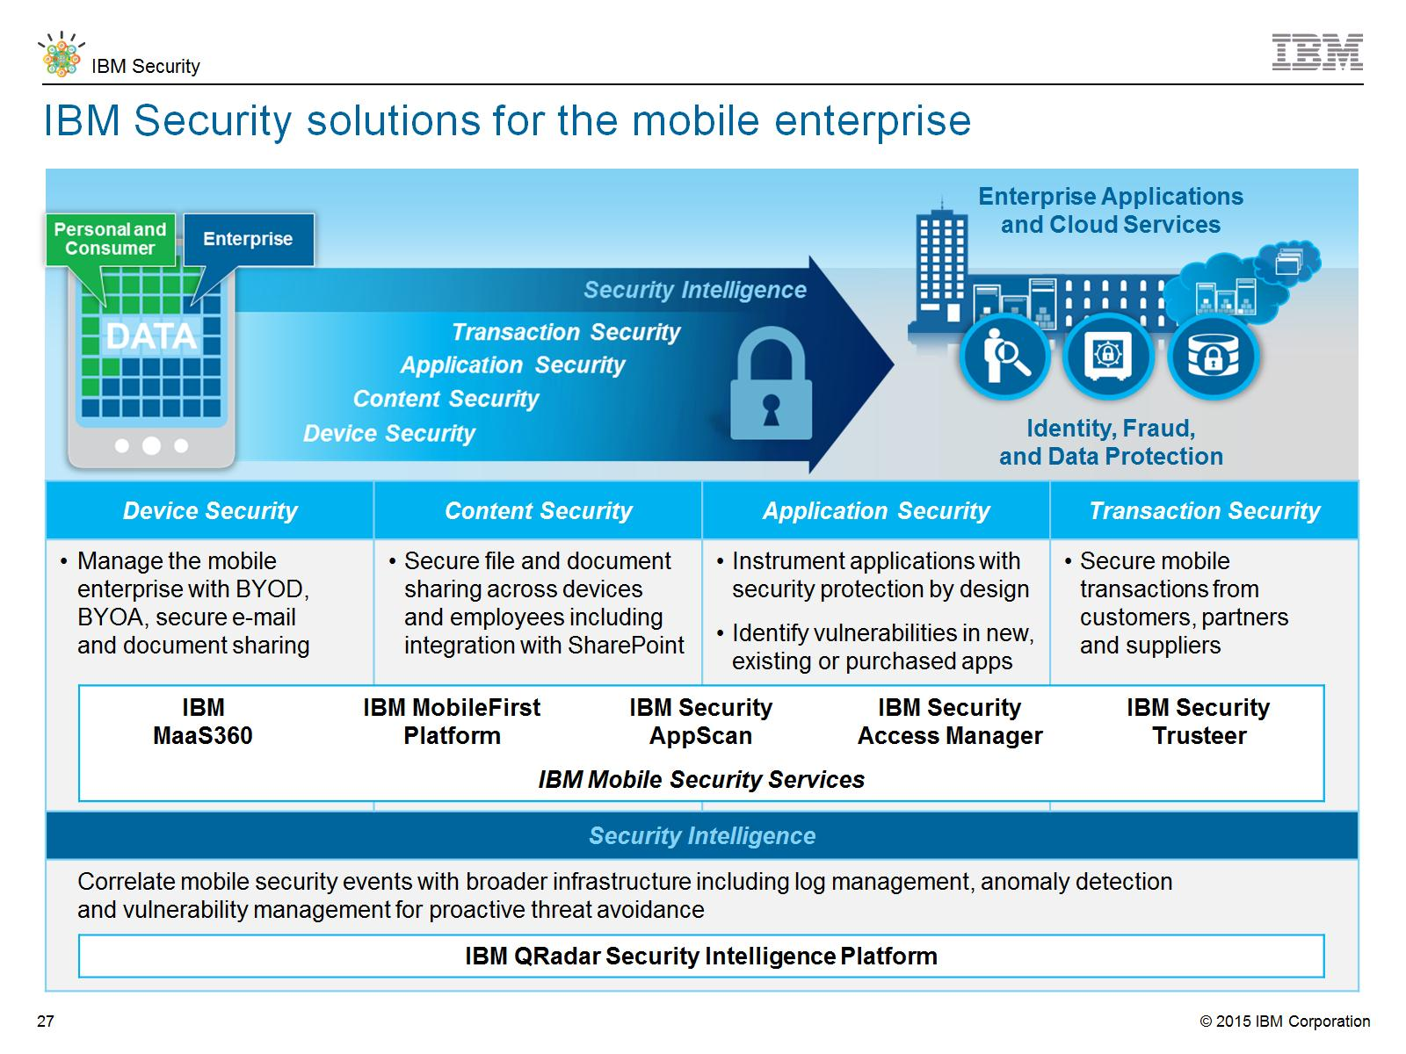
IBM Security solutions for the mobile enterprise
Notes:
IBM Managed Security Services
IBM Smart and Embedded Device Security
Mobile Application Dynamic Assessment
Mobile Application Source Code Review
IBM Hosted Application Security Management
Secure SDLC with Threat Modeling
Identity and Access Management Assessment and Strategy
IBM Secure Web Gateway Management
IBM Penetration Testing
IBM Application Security Assessment for Web Apps

Slide 22
The IBM Security Portfolio
Services
Products
Cybersecurity Assessment and Response
Threat Intelligence Advisory | X-Force Threat Analysis | Penetration Testing | Incident Preparation | Emergency Response
Strategy, Risk and Compliance
Security Maturity Benchmarking | Security Strategy and Roadmap Development | Security Risk Assessment and Program Design | Industrial Controls (NIST, SCADA) | Payment Card Advisory (PCI)
Security Intelligence and Analytics
Emergency Response | Managed SIEM | Incident Planning | Cyber Threat Intel | Security Operations Center Design Services
QRadar SIEM | QRadar Log Manager | QRadar Risk Mgr | QRadar Vulnerability Mgr | QRadar Incident Forensics
Advanced Fraud Protection
Trusteer Rapport | Trusteer Pinpoint Malware Detection | Trusteer Pinpoint ATO Detection | Trusteer Mobile Risk Engine
People | Data | Applications | Network | Infrastructure |  | Endpoint
Identity Strategy and Assessment | Data Security and Assessment | Embedded Device Testing | Firewall / IDPS / UTM Management
 |  |  | Web Protection and Managed DDoS
User Provisioning and Access Mgmt | Encryption | Penetration Testing | Hosted Web, E-mail and Vulnerability Management
 |  |  | Deployment and Migration
Total Authentication Solution | Data Loss Prevention | Application Security Assessment | Staff Augmentation
Managed and Cloud Identity |  | Mobile Application Testing
Identity and Access Governance | Guardium Data Security | AppScan Source | Network Intrusion Prevention | Trusteer Apex
Identity and Access Management | Guardium Database Vulnerability Mgmt | AppScan Dynamic | Next Generation Network Protection | Mobile & Endpoint Management
Privileged Identity Management | Guardium / Optim Data Masking | DataPower SOA Security | SiteProtector Threat Management | Virtualization and Server Security
Federated Access and SSO | Key Lifecycle Manager | Security Policy Manager | Network Anomaly Detection | Mainframe Security
IBM X-Force and Trusteer Threat Intelligence

Slide 23
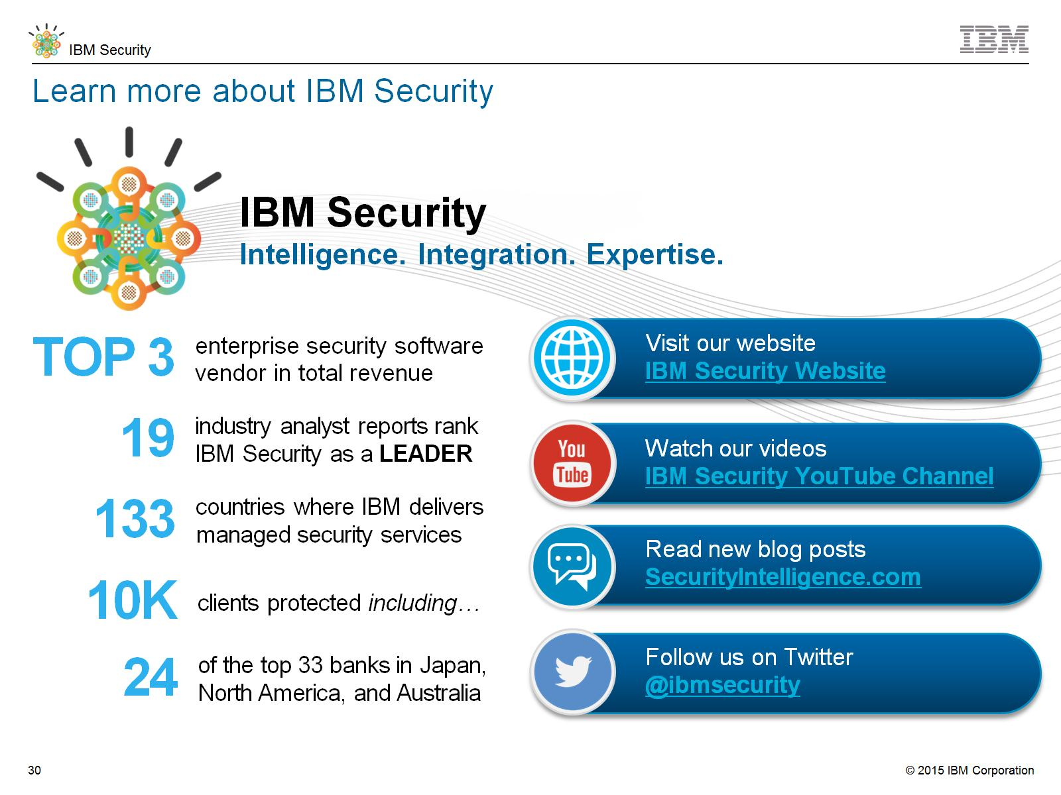
Learn more about IBM Security

Slide 24
