Slide 1
Delivering Security Improvements
Enterprise-wide approach to help build a stronger security posture
Kris Lovejoy
General Manager
IBM Security
20th February, 2015

Slide 2



Thinking like a security expert
Security risk exists when …
Threat
Vulnerability
Impact
Can exploit
And cause
(Actor)
(Weakness)
(Loss)
Security Risk Management is the application of control to detect and block the threat, to detect and fix a vulnerability, or to respond to incidents (impacts) when all else fails.
Notes:
The more the environment changes, the more the opportunities exist for risk.
Technology is rapidly changing and the world we live in is becoming more digitized and interconnected. In order to keep up and stay competitive, chief executive officers need to be able to embrace new technology through the use of cloud, mobility and Big Data, but at the same time they need to consider the risks of potential threats and vulnerabilities in order to reduce the impact of a breach.
Security risk management is a key component to consider when adopting new technology to help ensure that security is built in.
From a risk perspective, new technology raises the level of a potential threat, which means that new investments needs to be made in protecting your company.

Slide 3

While threat actors are more sophisticated, insiders are an “unwitting” accomplice in 95% of incidents
Who’s attacking
Who’s letting them in
Combination
95%
22%
“…over
of all incidents investigated recognize “human error” as a contributing factor.”
Malicious insiders
Outsiders
17%
56%
Inadvertent actor
5%
Source: IBM Security Services 2014 CyberSecurity Intelligence Index
Notes:
Who’s behind these attacks? Although this index data and report are not focused on who specifically is responsible for all these attacks, it can provide some insight into the types of attackers behind them. Although most attacks originate outside a company’s network, it’s important not to dismiss the role played by inadvertent actors, despite the fact that they comprise such a small percentage of the attacker population. As members of your own company who are unwittingly “recruited” to aid the cause of others with malicious intent, they can become key players in carrying out a highly damaging—and potentially prolonged—attack without arousing any suspicion.
Opportunistic attacks are those that take advantage of existing vulnerabilities without any specific motivation. They’re simply aimed at damage or disruption. In our experience—through service engagements and attack investigations—we’ve seen that nearly half of attackers are typically motivated by sheer. Due to their typical lack of sophistication, they’re generally easy to detect, which means that those organizations able to reduce opportunistic threats can potentially make better use of their time and resources to detect and respond to targeted and sophisticated attacks. Nonetheless, because opportunistic attacks occur so frequently, it’s important to not let down your guard against them.

Slide 4
Here are the top 10 reasons why insiders make compromise so easy…
End users
Systems Admins/Developers
Double-clicking “on anything”
Disabling endpoint security settings when they get in the way
Using vulnerable, legacy software and hardware
Failing to install security patches
Disabling anti-virus
Failing to report lost or stolen device
Connecting endpoints to a network from an insecure access point (such Café Nero)
Using a second access point (such as AirCard), creating a bypass
Using a weak or default passwords, or using business passwords for personal use
Using anyone’s USB
Connecting systems and virtual images to the Internet before hardening them
Connecting test systems to the Internet with
default accounts or passwords
Failing to update or patch systems/applications on a timely basis.
Failing to run/update virus detection software
Using legacy or end-of-life software and hardware
Running unnecessary services
Using insecure back-end management software
Failing to remove old/unused user accounts
Implementing firewalls with rules that don't stop malicious incoming or outgoing traffic
Failing to segment network and/or adequately monitor/block malicious traffic
Notes:
The Ponemon Institute found that 39 percent of employees lost or “misplaced” an unencrypted data-bearing device (such as Universal Serial Bus, or Universal Serial Bus (USB) drive, smart phone, laptop computer); 74 percent of those employees did not report the loss immediately, either because they were embarrassed, worried about losing their job, or thought they just misplaced the device and would find it soon.

Slide 5

Security reality – we have all been compromised
1,764,121
only 1
out of 100
Represents the number of security events the average organization of 15K employees will capture weekly
security compromises are ever detected
of these events represent actual attacks, per week
324
2.1
of these attacks will result in an incident, per week, – a 22% annual increase
General Keith Alexander, Head of U.S. Cyber Command, in a speech to the American Enterprise Institute
2014 IBM Cybersecurity Intelligence Index
Notes:
5

Slide 6










Anatomy of a targeted attack
Privileged user
Suppliers
Hacker/activist
People
Employees
Customers
Endpoints
Applications
Web applications
System applications
Mobile apps
Infrastructure
Customer environment
Data
Structured
Unstructured
At rest
In motion
Adversary compromises endpoint used by privileged user with undetectable malware
Keystroke logger capture credentials and command & control capability is gained
Adversary acts as systems administrator
Data is stolen and/or production systems are compromised
Notes:
6

Slide 7
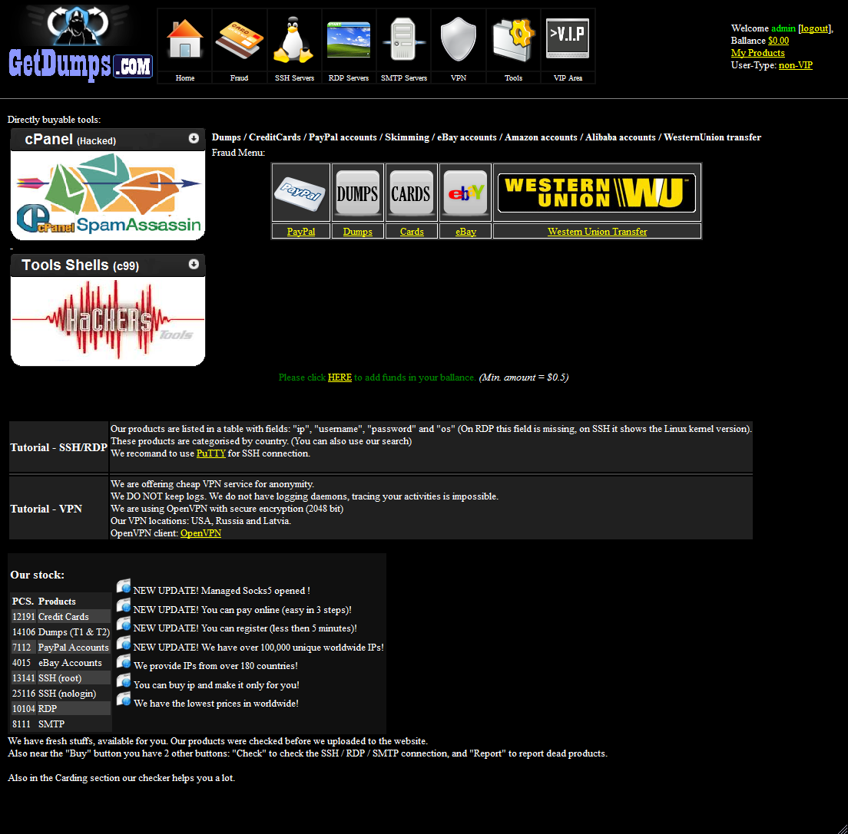
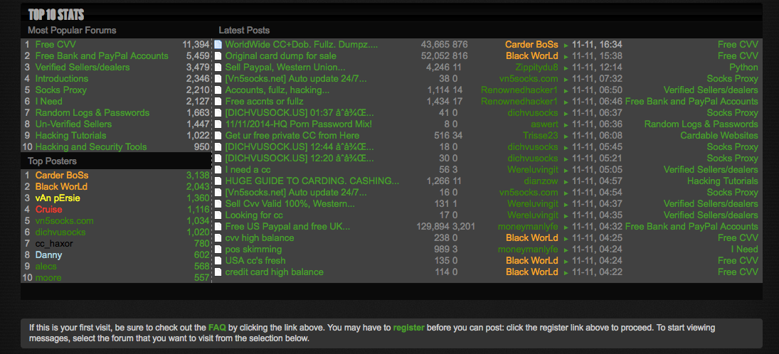
Data is bought an sold in “carding forums”

Slide 8
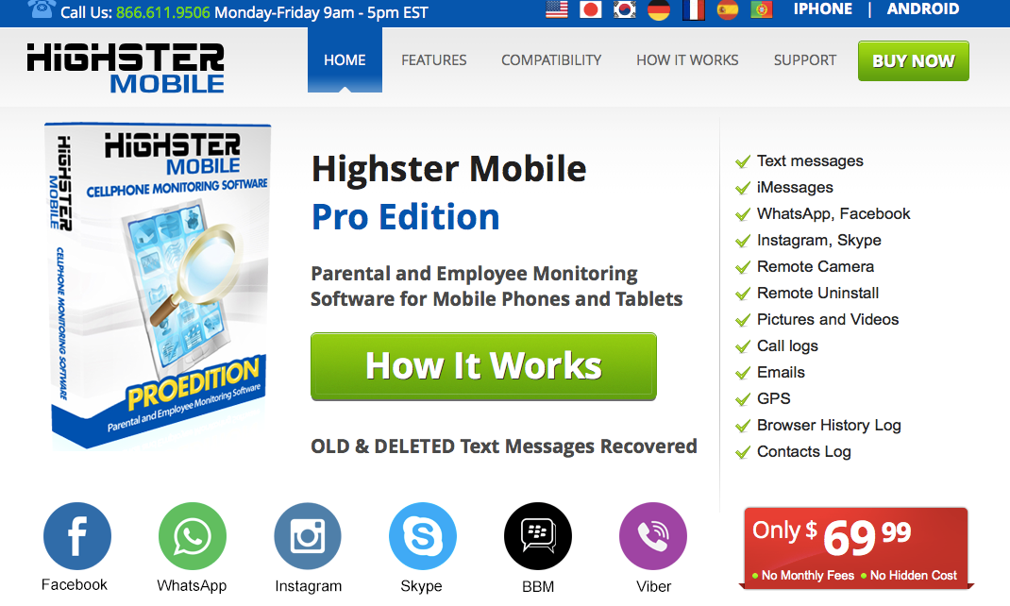

Slide 9
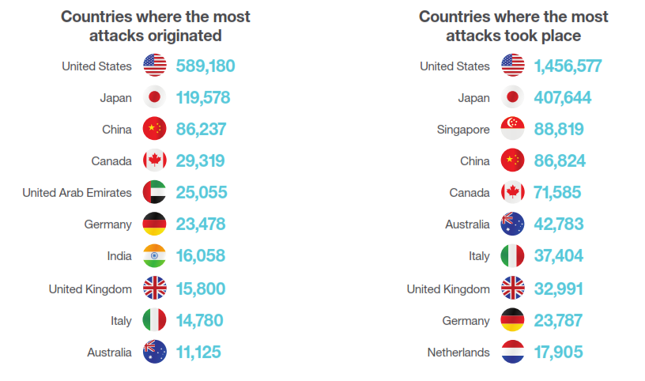
No country is immune from cybercrime
Countries where the most
attacks originated
Countries where the most
attacks took place
United States
589,180
United States
1,456,577
Japan
119,578
Japan
407,644
China
86,237
Singapore
88,819
Canada
29,319
China
86,824
United Arab Emirates
25,055
Canada
71.585
Germany
23,478
Australia
42,783
India
16,058
Italy
37,404
United Kingdom
15,800
United Kingdom
32,991
Italy
14,780
Germany
23,787
Australia
11,125
Netherlands
17,905
Source: IBM Security Services 2014 CyberSecurity Intelligence Index
Notes:
A new addition to the threat index shows us where these attacks originate. But let’s be clear about what this information means. For example, when considering the list of the top 10 countries responsible for the attacks we detected in 2013, we need to take into account the size of the country and the availability of bandwidth within each.
That goes a long way toward explaining why more than half of the attacks we saw in 2013 originated in the United States. And for many of the same reasons, the United States was also the most attacked country in 2013.

Slide 10
Over 75% of incidents target the same five industries
Incident rates across monitored industries
Finance and
insurance
23.8%
Manufacturing
21.7%
Information and
communication
Finance and insurance companies tend to offer attackers the most significant potential payoff
18.6%
Retail and
wholesale
6.2%
Health and
5.8%
social services
Source: IBM Security Services 2014 CyberSecurity Intelligence Index
Notes:
Two industries are targeted in nearly 50 percent of all incidents. Here’s a look at the five industries where we’ve seen 77 percent of these incidents taking place over the past year. Not surprisingly, the top two—which account for nearly half of the year’s security incidents among our data sets—are the ones that offer attackers significant potential payoff. It’s easy to imagine how accessing financial data or blocking online banking services could result in massive cash losses and major business disruption. And think about what could be gained by uncovering proprietary manufacturing processes or product formulas.
3/4/15
SK4_Security_Kristin_Lovejoy
10
Pulse 2013

Slide 11





















Based on our extensive experience, we recommend 10 essential practices for a stronger security posture
Security Essentials
3 Secure collaboration in social and mobile workplace
4 Develop security-rich products, by design
5 Manage IT hygienically
6 Create a security-rich and resilient network
1 Build a risk-aware culture and management system
2 Establish intelligent security operations and rapid threat response
7 Address security complexity of cloud and virtualization
8 Manage third-party security compliance
9 Assure data security and privacy
10 Manage the digital identity lifecycle

Slide 12
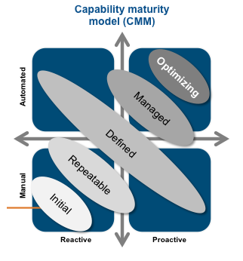

Building a risk-aware culture involves identifying the risks and goals, and spreading the word about them
1
Essential practice 1
Build a risk-aware culture and management system
What does it mean?
Management of IT and security risk across the company
Risk process identification and remediation
Continuous communication and education
Implementation of policies, measurements and tools
Key IBM offerings
IBM Security Essentials and Maturity Consulting
Security Training & Awareness Services (available soon)
Management must push this change relentlessly from the top down, while also implementing tools to track progress
Notes:
Essential practice 1 – Build a risk-aware culture and management system
Expand the mission of enterprise security from the IT shop, to managing IT risk across the company, driven by a leader with a strategic enterprise-wide purview
Design an organization structure and governance model that enables proactive identification and management of risks
Communicate and educate organization to raise awareness of potential cyber risks
Build a management system enabled by digestible policies, measurements and tools
Essential practice 2 – Build an intelligent threat protection and response center
Build a skilled incident management process and response team with sufficient resources to conduct the forensics required
Develop a unified incident handling policy and process
Leverage consistent tools and security intelligence for incident management and investigative forensics
Develop a security information event management (SIEM) capability to capture and track all security events
Define security operations roles and responsibilities

Slide 13
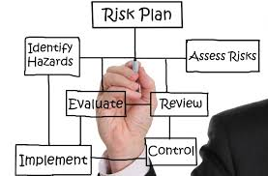
A company-wide effort to implement intelligent analytics and automated response capabilities is essential
2
Essential practice 2
Establish intelligent security operations and rapid threat response
What does it mean?
Build a skilled incident management and response team with sufficient resources to conduct the forensics required
Leverage consistent tools and security intelligence for incident management and investigative forensics
Develop a unified incident handling policy and process
Key IBM offerings
IBM Security Intelligence & Operations Consulting
IBM Managed SIEM
Threat Insight Platform (available soon)
APT Survival Kit (available soon)
C
Creating an automated and unified system will enable an enterprise to monitor its operations — and respond quickly
Notes:
Essential practice 1 – Build a risk-aware culture and management system
Expand the mission of enterprise security from the IT shop, to managing IT risk across the company, driven by a leader with a strategic enterprise-wide purview
Design an organization structure and governance model that enables proactive identification and management of risks
Communicate and educate organization to raise awareness of potential cyber risks
Build a management system enabled by digestible policies, measurements and tools
Essential practice 2 – Build an intelligent threat protection and response center
Build a skilled incident management process and response team with sufficient resources to conduct the forensics required
Develop a unified incident handling policy and process
Leverage consistent tools and security intelligence for incident management and investigative forensics
Develop a security information event management (SIEM) capability to capture and track all security events
Define security operations roles and responsibilities

Slide 14
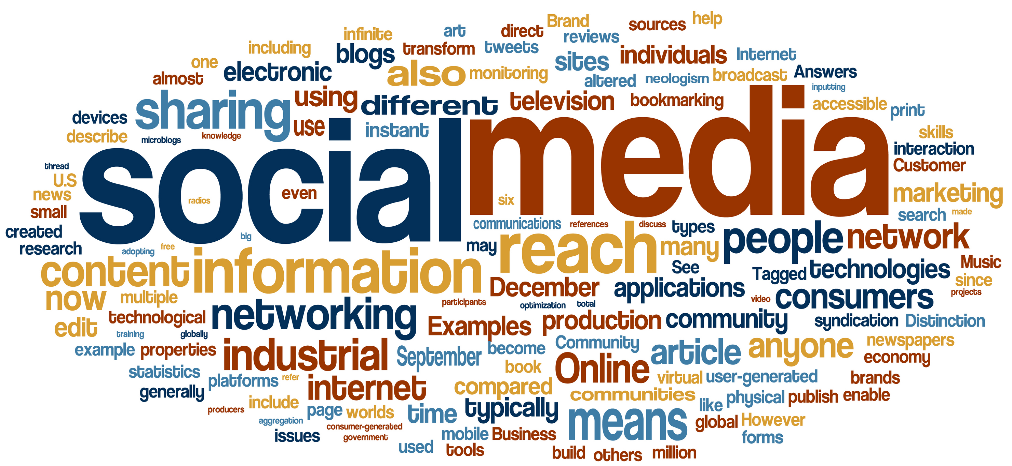
Securing the workforce promotes the right balance between openness and risk management
3
Essential practice 3
Secure collaboration in mobile and social workplace
What does it mean?
BYOD and use of social media with ability to segment business and personal data
Secure end-user computing platforms
Endpoint security across all workstations, laptops and smart devices
Business, client and personal data isolation and protection
Key IBM offerings
Smart and Embedded Device Security
Executive Protection (available soon)
70% of mobile professionals will conduct their work on personal smart devices by 2018²
Bring Your Own Device¹ Gartner Report 2013²
Notes:
Essential practice 1 – Build a risk-aware culture and management system
Expand the mission of enterprise security from the IT shop, to managing IT risk across the company, driven by a leader with a strategic enterprise-wide purview
Design an organization structure and governance model that enables proactive identification and management of risks
Communicate and educate organization to raise awareness of potential cyber risks
Build a management system enabled by digestible policies, measurements and tools
Essential practice 2 – Build an intelligent threat protection and response center
Build a skilled incident management process and response team with sufficient resources to conduct the forensics required
Develop a unified incident handling policy and process
Leverage consistent tools and security intelligence for incident management and investigative forensics
Develop a security information event management (SIEM) capability to capture and track all security events
Define security operations roles and responsibilities

Slide 15

The best solution is to build in security from the beginning, and carry out regular automated tests to track compliance
4
Essential practice 4
Develop security-rich products, by design
What does it mean?
SDLC¹ security policy and governance
Embedded security in the design process
Ethical hacking and penetration testing of applications
Implement secure interfaces and COTS² solutions
Key IBM offerings
IBM Secure Engineering and Application Security Services
80% of development costs are spent identifying and correcting defects!³
¹Software development life cycle (SDLC); ³Commercial off the shelf (COTS); ³National Institute of Standards and Technology
Notes:
Essential practice 1 – Build a risk-aware culture and management system
Expand the mission of enterprise security from the IT shop, to managing IT risk across the company, driven by a leader with a strategic enterprise-wide purview
Design an organization structure and governance model that enables proactive identification and management of risks
Communicate and educate organization to raise awareness of potential cyber risks
Build a management system enabled by digestible policies, measurements and tools
Essential practice 2 – Build an intelligent threat protection and response center
Build a skilled incident management process and response team with sufficient resources to conduct the forensics required
Develop a unified incident handling policy and process
Leverage consistent tools and security intelligence for incident management and investigative forensics
Develop a security information event management (SIEM) capability to capture and track all security events
Define security operations roles and responsibilities

Slide 16

With a hygienic, security-rich system, administrators can keep track of every program that is running
5
Essential practice 5
Manage IT hygienically
What does it mean?
Register all IT infrastructure components in centralized inventory and retire legacy components
Integrate compliance data for end-to-end visibility
Data integration compliance and patch management compliance
Routine health checks
Key IBM offerings
IBM Security Strategy, Risk and Compliance Services
In a secure system, administrators have a comprehensive system in place to install updates and patches as they’re released
Notes:
Essential practice 1 – Build a risk-aware culture and management system
Expand the mission of enterprise security from the IT shop, to managing IT risk across the company, driven by a leader with a strategic enterprise-wide purview
Design an organization structure and governance model that enables proactive identification and management of risks
Communicate and educate organization to raise awareness of potential cyber risks
Build a management system enabled by digestible policies, measurements and tools
Essential practice 2 – Build an intelligent threat protection and response center
Build a skilled incident management process and response team with sufficient resources to conduct the forensics required
Develop a unified incident handling policy and process
Leverage consistent tools and security intelligence for incident management and investigative forensics
Develop a security information event management (SIEM) capability to capture and track all security events
Define security operations roles and responsibilities

Slide 17
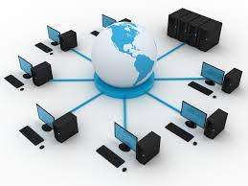
Companies that channel registered data through monitored access points will have a far easier time spotting and isolating malware
6
Essential practice 6
Create a security-rich and resilient network
What does it mean?
Network threat protection
Malicious network activity detection
Filtering, logging, monitoring and advanced analytics solutions
Network infrastructure optimization
Key IBM offerings
IBM Managed Security Services
IBM Managed Network Security Services
Network security tools provide organizations with a way to control access to the “rooms” where confidential data and critical systems are stored
Notes:
Essential practice 1 – Build a risk-aware culture and management system
Expand the mission of enterprise security from the IT shop, to managing IT risk across the company, driven by a leader with a strategic enterprise-wide purview
Design an organization structure and governance model that enables proactive identification and management of risks
Communicate and educate organization to raise awareness of potential cyber risks
Build a management system enabled by digestible policies, measurements and tools
Essential practice 2 – Build an intelligent threat protection and response center
Build a skilled incident management process and response team with sufficient resources to conduct the forensics required
Develop a unified incident handling policy and process
Leverage consistent tools and security intelligence for incident management and investigative forensics
Develop a security information event management (SIEM) capability to capture and track all security events
Define security operations roles and responsibilities

Slide 18

Despite what you might have heard, it is possible to embrace cloud technology while reducing risk
7
Essential practice 7
Address security complexity of cloud and virtualization
What does it mean?
Better secure cloud services
Security controls of cloud providers
Vulnerabilities of cloud architecture, policies and practices
Defined cloud security objectives
Key IBM offerings
IBM Cloud Security Strategy Consulting Services
IBM Cloud Managed Security Services
To thrive in a cloud environment, organizations must have the tools and
procedures to isolate and protect themselves, and to monitor potential threats
Notes:
Essential practice 1 – Build a risk-aware culture and management system
Expand the mission of enterprise security from the IT shop, to managing IT risk across the company, driven by a leader with a strategic enterprise-wide purview
Design an organization structure and governance model that enables proactive identification and management of risks
Communicate and educate organization to raise awareness of potential cyber risks
Build a management system enabled by digestible policies, measurements and tools
Essential practice 2 – Build an intelligent threat protection and response center
Build a skilled incident management process and response team with sufficient resources to conduct the forensics required
Develop a unified incident handling policy and process
Leverage consistent tools and security intelligence for incident management and investigative forensics
Develop a security information event management (SIEM) capability to capture and track all security events
Define security operations roles and responsibilities

Slide 19

An enterprise’s culture of security must establish best practices among its contractors and suppliers
8
Essential practice 8
Manage third-party security compliance
What does it mean?
Integrate security as a part of mergers and acquisitions
Education on 3rd-party compliance policies and processes
Education on incident handling and reporting
Vendor conformance with requirements and regulations
Manage vendor and contractor risk lifecycle
Key IBM offerings
IBM PCI Compliance Advisory Services
Security, like excellence, should be infused in the entire partner
ecosystem
Notes:
Essential practice 1 – Build a risk-aware culture and management system
Expand the mission of enterprise security from the IT shop, to managing IT risk across the company, driven by a leader with a strategic enterprise-wide purview
Design an organization structure and governance model that enables proactive identification and management of risks
Communicate and educate organization to raise awareness of potential cyber risks
Build a management system enabled by digestible policies, measurements and tools
Essential practice 2 – Build an intelligent threat protection and response center
Build a skilled incident management process and response team with sufficient resources to conduct the forensics required
Develop a unified incident handling policy and process
Leverage consistent tools and security intelligence for incident management and investigative forensics
Develop a security information event management (SIEM) capability to capture and track all security events
Define security operations roles and responsibilities

Slide 20

Every company has critical data, and it’s vitally important to improve the protection of your data
9
Essential practice 9
Assure data security and privacy
What does it mean?
Identify the value of your confidential data and the business impact of loss
Assess gaps and define a data protection strategy that manages data loss risk and meets governmental and customer requirements
Design a robust data management architecture that protects sensitive information
Deploy and manage leading data protection technologies
Key IBM offerings
IBM Critical Data Protection Program
Critical data should be guarded, tracked and encrypted as if the company’s survival hinged on it
Notes:
Essential practice 1 – Build a risk-aware culture and management system
Expand the mission of enterprise security from the IT shop, to managing IT risk across the company, driven by a leader with a strategic enterprise-wide purview
Design an organization structure and governance model that enables proactive identification and management of risks
Communicate and educate organization to raise awareness of potential cyber risks
Build a management system enabled by digestible policies, measurements and tools
Essential practice 2 – Build an intelligent threat protection and response center
Build a skilled incident management process and response team with sufficient resources to conduct the forensics required
Develop a unified incident handling policy and process
Leverage consistent tools and security intelligence for incident management and investigative forensics
Develop a security information event management (SIEM) capability to capture and track all security events
Define security operations roles and responsibilities

Slide 21
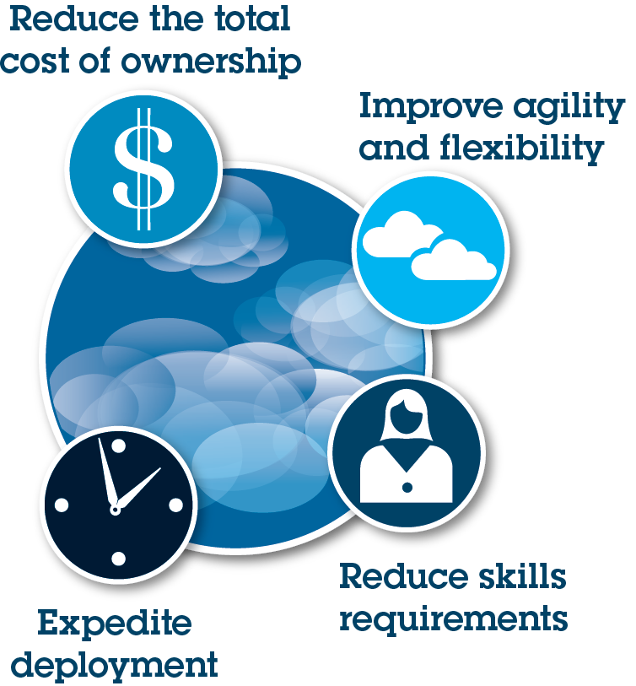
Managing who has access to critical data is essential element of security
10
Essential practice 10
Manage the digital identity lifecycle
What does it mean?
Identity and access management
Standard, policy based control mechanisms
Intelligent monitoring
Separation of duties management
Single-sign-on
Key IBM offerings
IBM Identity and Access Management Services
IBM Cloud Identity Services
Companies that mismanage the identity and access of users are making themselves vulnerable to intrusions
Notes:
Essential practice 1 – Build a risk-aware culture and management system
Expand the mission of enterprise security from the IT shop, to managing IT risk across the company, driven by a leader with a strategic enterprise-wide purview
Design an organization structure and governance model that enables proactive identification and management of risks
Communicate and educate organization to raise awareness of potential cyber risks
Build a management system enabled by digestible policies, measurements and tools
Essential practice 2 – Build an intelligent threat protection and response center
Build a skilled incident management process and response team with sufficient resources to conduct the forensics required
Develop a unified incident handling policy and process
Leverage consistent tools and security intelligence for incident management and investigative forensics
Develop a security information event management (SIEM) capability to capture and track all security events
Define security operations roles and responsibilities

Slide 22






Learn more about IBM Security
IBM Security Services
Intelligence. Integration. Expertise.
Visit our website
IBM Security Website
Watch our videos
IBM Security YouTube Channel
Read new blog posts
SecurityIntelligence.com
Follow us on Twitter
@ibmsecurity
Notes:
Graphic illustration: Depicts our logo and explains how clients can stay in contact with IBM through various channels

Slide 23
Case studies
Notes:
Optional Divider slide

Slide 24


Largest Bank in Canada improves security by establishing SOC & implementing monitoring tools and processes
Cloud-delivered Identity and Access Management (IAM)
Clients served by this Largest
Bank in Canada, 3rd
largest in North America, top 10 globally
18M
Help secure access for
all employees
of the bank
80,100
Business Challenge
Lack of any SOC model and strategy roadmap
There were no trained SOC Operations team or staff
No Security monitoring tool or processes for security incidents
IBM Security Solution Benefits
Reduced risks & costs associated with security incidents and data breaches
Addressed compliance issues by establishing clear audit trails for incident response
Improved security posture with enterprise-wide security intelligence correlating events from IT & business critical systems/applications.

Slide 25



A global bank enables security-rich mobile access for millions of users
Safeguard Mobile Deployments
North American entity protects user access to mobile and web channels for
10,000
internal users
Mobile Devices
Mobile Users
Web and Mobile Apps
Business Challenge
Protect employee and contractor access to web and mobile applications
Roll out new application to customers and help protect access for mobile devices
IBM Security Solution Benefits
Centralized user access control across web and mobile channels
Reduced IT cost with self-care, single sign-on and session management
Introduced risk-based access and multi-factor authentication for 10M+ customers

Slide 26
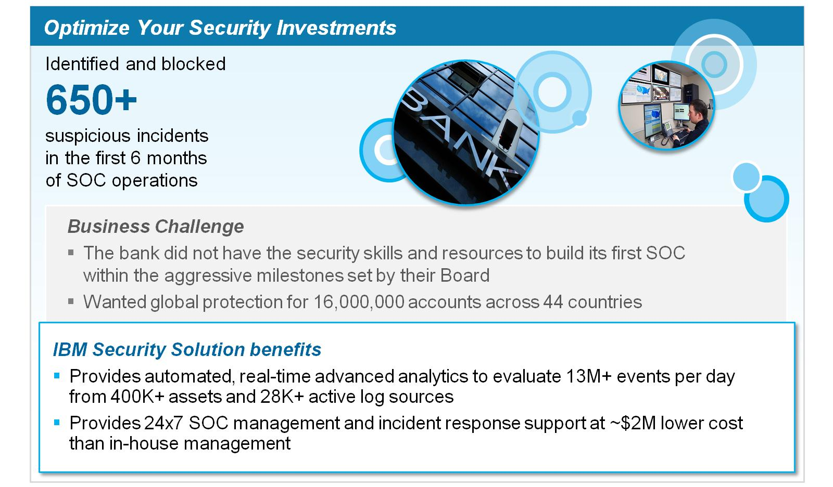
A financial services firm teams with IBM to build its first SOC
A financial services firm teams with IBM to build its first SOC

Slide 27
Appendix
Notes:
Optional Divider slide

Slide 28


















IBM Security invests in best-of-breed technologies
Cloud-enabled
identity management
Identity
governance
Advanced
fraud
protection
Mobile security and management
IBM Security
is created
Security
intelligence
1976 | 1999 | 2002 | 2005 | 2006 | 2007 | 2008 | 2009 | 2010 | 2011 | 2012 | 2013 | 2014
Mainframe
and server security
Identity management
Directory integration
Security services
and network security
Enterprise
single-sign-on
Endpoint management
and security
Information
and analytics
management
IBM Security Investment
6,000+ IBM Security experts worldwide
3,000+ IBM Security patents
4,000+ IBM Managed Security Services clients worldwide
25 IBM Security labs worldwide
Access management
Service oriented architecture (SOA) management
and security
Application security
Risk management
Data management
Database monitoring
and protection
Application
security
Notes:
For over 50 years, since the introduction of the mainframe, in 1970s, IBM has been committed to providing comprehensive security that meets evolving technological needs. We have invested substantially in inorganic growth to supplement and enhance our organically developed security solutions to build a comprehensive portfolio that can help clients move up the maturity model from basic to proficient to advanced.
This progression was formalized in 2012 with the creation of the IBM Security Systems Division that brought the multiple solutions together to increase the focus and help drive long term strategy for the organization.
2013 continued to be an active year for acquisitions with the announcement that IBM acquired Trusteer and Fiberlink Maas360.
And this year, IBM announced its intent to acquire CrossIdeas for its identity governance capabilities and also Lighthouse Security Group for their cloud-enabled identity management services.
<PRESENTER: See below for a more detailed background…>
1976
IBM introduces Resource Access Control Facility (RACF), to provides access control and auditing functionality for applications on the mainframe eliminating the need for each application to imbed security
1977
The IBM develops Data Encryption Standard (DES), a cryptographic algorithm, adopted as the national standard by the US National Bureau of Standards
1978
IBM announces the 3624 automatic teller machine, utilizing DES
1995
IBM starts contributing to Java Security technologies
1996
IBM launches Cryptolope containers to seal intellectual property in a digital package to help secure content transactions over the Internet
IBM launches the SecureWay Key Management Framework, a collection of applications, services and cryptographic engines that help make the Internet safe for e-commerce
IBM begins pilot program with MasterCard using Secure Electronic Transaction (SET) technology which helps secure credit card transactions over the Internet
IBM develops and certifies the IBM Secure Crypto Co-processor (4758) at FIPS 104-1 Level 4, the highest level of FIPS
IBM releases its first enterprise-grade LDAP Directory Server (now known as Directory Server)
1998
IBM extends Secure Electronic Transaction (SET) standard support which helps secure payments over the Internet and is largely based on technology developed at IBM Research and adopted by major credit card companies
1999
IBM acquires Dascom, the basis for IBM's Access Manager portfolio
IBM Research's breakthrough paper on Side Channel Cryptanalysis Attacks and Countermeasures (1999 – 2004)
2000
IBM patents a system and method for alerting computer users to digital security intrusions
IBM appoints Harriet Pearson its first Chief Privacy Officer
2002
IBM acquires Access 360, the basis for IBM's Identity Manager portfolio
IBM acquires MetaMerge for meta-directory and directory synch capability (now known as Directory Integrator)
2005
IBM debuts the first ThinkPad with an integrated fingerprint reader, at the time offering an unmatched level of data protection through a new biometric capability and embedded security subsystem
2006
IBM acquires Internet Security Systems, Inc, the basis for today’s IBM X-Force® IT security research team and the IBM network protection product family
Smart cards, highly efficient JavaCard™ technology developed at IBM Research – Zurich, is licensed by a leading smart card manufacturer to help secure multi-application smart cards and is used in many JavaCard™ projects The technology is used today in 10s of millions of VISA credit cards
2007
IBM acquires Consul, to help accelerate data and governance strategy
2008
IBM patents a system and method for enforcement of privacy policy and protection of confidentiality
IBM acquires Encentuate, the basis for 'IBMs Enterprise Single-sign-on (ESSO) product
Zone Trusted Information Channel: Plugs into the USB port of any computer and creates a direct, protected channel to a bank’s online transaction server, bypassing the PC which could be infected by malicious software (malware) or susceptible to hacker attacks
2009
IBM acquires Ounce Labs, a provider of software that analyzes software code for security vulnerabilities, today’s AppScan family
IBM acquires Guardium, a market leader in real-time enterprise database monitoring and protection
Pioneers the use of Big Data analytics to cybersecurity problems (FAA, USAF)
2010
IBM acquires Big Fix, helping organizations extend security and compliance to endpoints, today Endpoint Manager
IBM Research’s breakthrough on Fully Homomorphic Encryption
2011
IBM Security Systems division is created
IBM acquires Q1 Labs, with its QRadar security intelligence portfolio, to strengthen its offerings around advanced security analytics
IBM launches Cloud-based Mobile Security Services, IBM Hosted Mobile Device Security Management
2012
IBM delivers next-gen Intrusion system, new access appliance and privileged identity technology
IBM announces 25 new product releases in security, a record year of innovation
IBM extends its market leading static application security testing (IBM Security AppScan) to native Android applications, which allows clients to conduct their own testing for mobile applications
2013
IBM announces breakthrough with combination of Security Intelligence and Big Data
IBM announces new QRadar Vulnerability Manager software to help organizations identify and predict security risk
IBM announces MobileFirst security software (IBM AppScan Source 87 for iOS) to improve security quality without sacrificing time-to-market of mobile app projects
IBM announces acquiring Trusteer for mobile and application security, counter-fraud and malware detection
IBM announced acquiring Fiberlink. Fiberlink’s MaaS360 offering expands IBM MobileFirst solutions with new cloud-based capabilities to deliver a comprehensive mobile management and security solution for global organizations of all sizes. This acquisition supports IBM’s expanding vision for enterprise mobility management, which encompasses protected transactions between businesses, partners and customers.

Slide 29
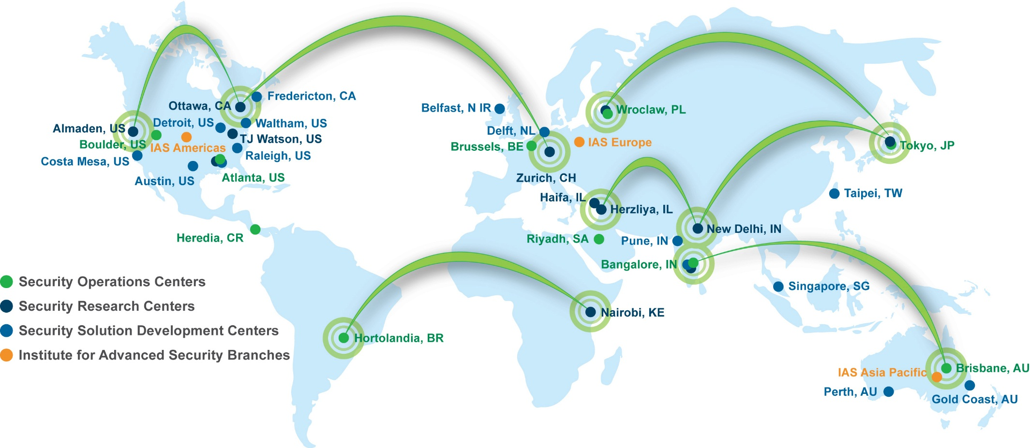





IBM Security has global reach
IBM Security by the Numbers
+
devices under contract
+
+
monitored countries (MSS)
endpoints protected
+
+
service delivery experts
events managed per day
Notes:
IBM operates one of the broadest enterprise security research, development and delivery organizations in the world. This powerful combination of expertise is made up of the award-winning IBM X-Force research and development team—with one of the largest vulnerability databases in the industry.
…and includes 10 security operations centers, 10 security research centers, 15 software security development labs, and 3 IBM Institute for Advanced Security Chapters in the United States, Europe and the Asia Pacific region. All totaling 38 IBM Security locations worldwide.

