Slide 1
Smarter Analytics
22 maj Waterfront

Slide 2
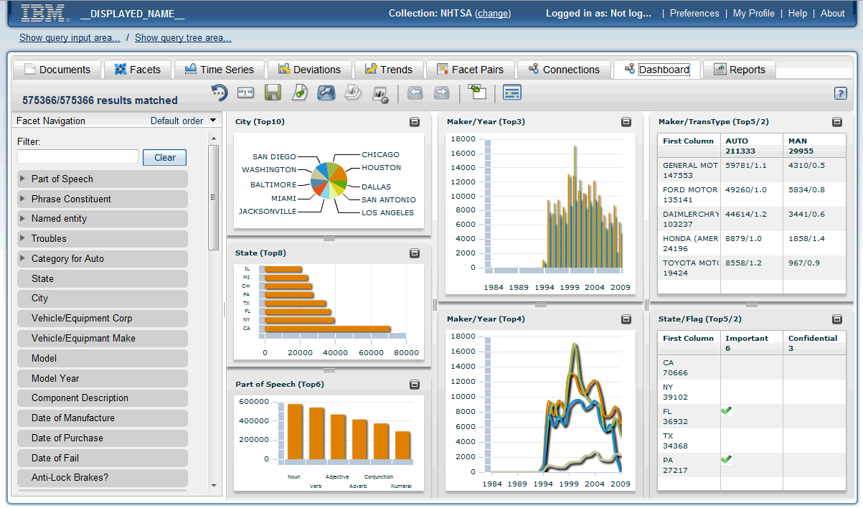
Är det idag möjligt att bygga rapporter med information från textdokument, Sociala medier, FAQ, Kundenkäter osv?
Notes:
C:\OEE-ICAviewlets\DashboardView\dashboardview.exe

Slide 3
Tillbakablick
Vi har haft BI/DW i många år, vi har räknat ut…..
  Försäljningsbelopp
  Basketanalyser
  Resultat och Balansräkningar
  Antal produkter sålda i ett distrikt för en viss säljare …..
Det finns Cognos, Oracle, Netezza, Teradata, Qlick view
Men 20% av alla information är strukturerad och passar in här!
80% är resten – kan vi gör automatisk BI på detta?
Kommer växa 40 gånger närmaste 10 åren

Slide 4









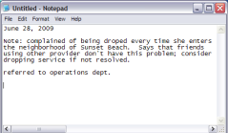
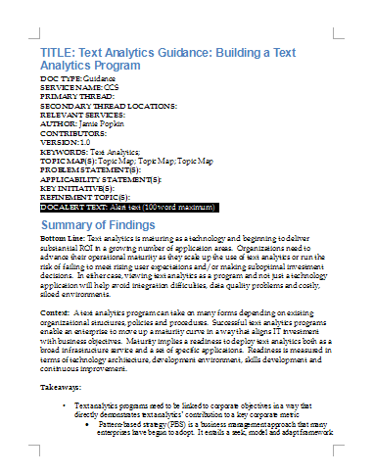
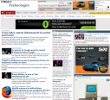
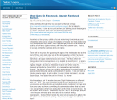

Business Intelligence till 100%
Customer
Service
Product
Management
Enterprise
Search
Business
Intelligence
DW
Service
Management
Content Analytics
Sales
Text
Analytics
Marketing
Suppliers
Market Research
CSR Logs
Email
Industry Reports
Internal Docs and Reports
Web
Blogs
4

Slide 5
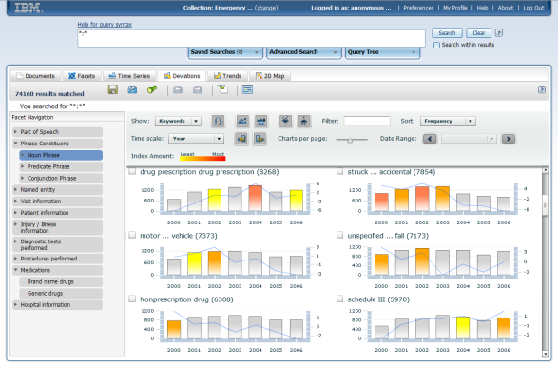
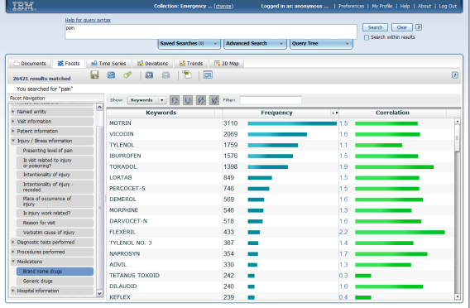
Ok vad är Content analytics ? ”Att omvandla ostrukturerad information till strukturer”
What is Text Analytics?
Text Analytics (NLP*) describes a set of linguistic, statistical, and machine learning techniques that allow text to be analysed and key information extraction for business integration.
March 13, 2012
13:23
I charged my Smart 4G through out the night and when I took it out of the charger it was at full. I only made 7 short calls today. But, it runs out of battery in 3 hours. It is annoying. How do I preserve the battery life?
Date | March 13, 2012
Time | 13:23
Product _Type | Smart 4G
Product_Component1 | charger
Product_Component2 | battery
Problem | runs out
Question | How do I preserve the battery life?
Experience | annoying
What is Content Analytics?
Content Analytics (Text Analytics + Mining) refers to the text analytics process plus the ability to visually identify and explore trends, patterns, and statistically relevant facts found in various types of content spread across internal and external content sources.
* Natural Language Processing
Notes:
5
5
Text Analytics analyzes text – an essential component. Content Analytics goes further, providing UI to visually explore the data.

Slide 6

Kundfall
6

Slide 7

Det är smart att analysera hur kundnöjdheten utvecklas
Business Challenge
Företaget behövde förbättra sin förståelse för kundenkäter,
Nästa all information var inlåsta en systemet för kundenkäter
Lokala chefer läste och kategoriserade kommentarer manuellt
“Hertz vill få hävstång på sin satsning inom content analytics på ett strategiskt plan men också på en lokalnivå, allt för att ytterligare ligga I topp gällande kundnöjdhet”
8000 stationer
Rykte om mycket stor kundnöjdhet
100,000+ enkäter per månad
7
Notes:
Segmentation: Deep Insight, Content Analytics Solutions
(Hertz)
As the world’s largest airport car rental brand with more than 8,300 locations in 146 countries, this company continually receives feedback from customers. To retain its competitive edge, the feedback is analyzed so that real-time identification of issues and rapid problem solving solutions can be deployed.
This company gathers an amazing amount of customer insight daily, including thousands of comments from web surveys, emails and text messages. The company wanted to leverage this insight at both the strategic level and the local level to drive operational improvements. With Content Analytics, the customer is able to better focus on improvements that their customers care about while removing a time-consuming burden from their location managers. This has greatly improved the effectiveness of their ‘Voice of the Customer’ program and has helped build on their reputation for delivering superior customer service.
IBM content analytics software has improved the accuracy and speed of the tagging and analyzing process, almost double what had been achieved manually, setting the stage for more reliable analytics. Free from manually tagging comments, the company’s field managers can now focus attention on performing deep-dive analysis on the information, quickly identifying trends or issues and adjusting operational service levels accordingly.
For more information: http://www-03.ibm.com/press/us/en/pressrelease/32859.wss

Slide 8
Content Analytics on customer survey
Not only was the pick-up line at the counter very long, but I waited 30 minutes just to talk to a rude representative who gave me a car that smelled like smoke, had stained floor mats, a dented fender, and only half a tank of gas.
very long
waited 30 minutes
pick-up line
rude representative
a car
smelled like smoke
Date
stained floor mats
Region
dented fender
half a tank of
₈

Slide 9
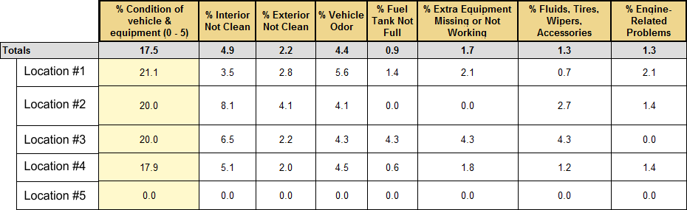
Monitoring Case Study: Hertz
“Hertz …wanted to leverage [customer] insight at both the strategic level and the local level to drive operational improvements”
“This has greatly improved the effectiveness of our ‘Voice of the Customer’ program and has helped build on our reputation for delivering superior customer service.”
- Joe Eckroth, Hertz CIO
Benefits:
  Automated a tedious process
  Improved consistency and accuracy
  Brand and location level analytics
  Search/navigation for operational improvement
₉
Notes:
CA is “hot” for reasons beyond a recent game show… it can provide a significant competitive advantage

Slide 10
Demo av IBM Content analytics
Mark Rice from IBM Netherlands
Notes:
Take off the discs:
Leave Text Miner, Search UI and
Add a box to support export to other systems
Foundation for everything he will see
Make the point that there are multiple technolgoies that aren’t compatible inside of IBM.
Add second chart that briefly explains.
How we extract stuff and populate the facet box. Make the comment. Autonomy now uses the search and hope model. No control of the accuracy of the facets that are created. We can have fine grain control over the entities that are created.
How Facets are created. Show you 4 different instantiation. Entities are entified and extracted
2 slide introduce to technology: What’s happening under the covers. So mike can apply each demo.
Talk about Search
Talk about Content Analytics
Talk about eDiscovery
Core way we process information.
One thing in common process information, NLP, and
1 core process powers Search, Content Analytics, eDiscovery.
ECM has a strategy and a common way to leverage these technologies and

