Slide 1
IBM Webcast:
Driving Innovation — Anytime,
Anywhere with Mobile and Cloud
Based Collaboration

Slide 2


Follow us on Join the conversation: #IBM #SocBiz
IBM Moderator
Randy Frink, IBM Worldwide Business Unit Executive, Social Software
Randy Frink serves has an IBM Worldwide Business Unit Executive for Social Software. As an IBM Social Business pioneer and evangelist he has been in the trenches selling social solutions to clients representing about every industry, customer segment and job function. Randy has worked within the IT industry for 30 years. Randy’s career spans indirect channel management, sales, marketing, business development and
sales management responsibilities. In his current role he is responsible for the IBM Social Business
solutions supporting clients making Social Software and Social Compliance solution decisions Worldwide.
Connect with Randy on Twitter @RDFrink and LinkedIn.
© 2015 IBM Corporation
Notes:
05/02/11
Copyright©2008 SugarCRM, Inc. All rights reserved.
2
2
I'd like to start by talking briefly about some of the broader changes we see happening in the world around us. The world we live in today is very different from the world of just a few years ago...By now I'm sure you're familiar with IBM's vision for a smarter planet- how technology, globalization, and a confluence of social tools and social changes have effectively altered the game for good. But perhaps most remarkable of all has been the application of this same vision to people themselves.
As the internet has evolved from content to commerce, it's also evolved from information to people. Now, people and processes are becoming interconnected. The meteoric rise of social technology, which now accounts for 22 percent of people's time spent online, has connected nearly every individual on earth.
Instrumentation, in the form of smartphones, has put unprecedented power -- literally -- in people's hands, anywhere they go. By instrumenting these- and other connections- bringing them into the enterprise- companies can gain real, meaningful business advantage.
The emergence of social analytics means not only are individual people intelligent, but networks of people have become intelligent as well -- and are able to learn from interactions and associations to deliver recommendations and take action. By connecting networks, processes and information, changing the way we mine data and use information, we can now collaborate more efficiently, adapt more quickly, and become more agile- becoming more intelligent businesses.

Slide 3

Follow us on Join the conversation: #IBM #SocBiz
IBM Panelist
Christopher C. Crummey, World Wide Executive Director of Sales, Social Business & Exceptional Digital Experience
Christopher leads a global team of thought leaders in the areas of Social Business & Exceptional Digital Experience. He works with the most successful customer deployments and communicates their “Best Practices” to a global customer base. This business generates $450M in revenue to IBM annually, and represents some of the fastest growing and most profitable segments of IBM's software business. His extended team consists of more than 450 sales specialists who interface with existing and prospective IBM customers to grow IBM's revenue and share in the middleware market, while maintaining a high level of customer satisfaction.
Previously, Christopher acted as the World Wide Business Unit Executive and the “Lead Evangelist" for Social Business, which covered the entire collaboration technology platform. With 21 years of collaboration experience, Christopher is one of the most sought after and popular speakers at IBM and he has worldwide responsibility for all of the products that make up our customer solutions. Christopher joined Lotus in 1991 as a customer support representative. During his 21 years at Lotus & IBM, he has held multiple positions which have focused on the technical and customer aspects of the products. Mr. Crummey is extensively involved in all major IBM & Lotus productions, such as Lotusphere, DNUG event and the Developer's Conferences. Mr. Crummey holds a Bachelor’s degree in psychology from Hobart College.
Connect with Christopher on Twitter @Ccrummey and LinkedIn.
© 2015 IBM Corporation
Notes:
05/02/11
Copyright©2008 SugarCRM, Inc. All rights reserved.
3
3
I'd like to start by talking briefly about some of the broader changes we see happening in the world around us. The world we live in today is very different from the world of just a few years ago...By now I'm sure you're familiar with IBM's vision for a smarter planet- how technology, globalization, and a confluence of social tools and social changes have effectively altered the game for good. But perhaps most remarkable of all has been the application of this same vision to people themselves.
As the internet has evolved from content to commerce, it's also evolved from information to people. Now, people and processes are becoming interconnected. The meteoric rise of social technology, which now accounts for 22 percent of people's time spent online, has connected nearly every individual on earth.
Instrumentation, in the form of smartphones, has put unprecedented power -- literally -- in people's hands, anywhere they go. By instrumenting these- and other connections- bringing them into the enterprise- companies can gain real, meaningful business advantage.
The emergence of social analytics means not only are individual people intelligent, but networks of people have become intelligent as well -- and are able to learn from interactions and associations to deliver recommendations and take action. By connecting networks, processes and information, changing the way we mine data and use information, we can now collaborate more efficiently, adapt more quickly, and become more agile- becoming more intelligent businesses.

Slide 4

Follow us on Join the conversation: #IBM #SocBiz
Special Guest Panelist
Jacob Morgan, Author, The Future of Work, Speaker, Futurist
Jacob is an Author, speaker and futurist. His latest book, The Future of Work: Attract New Talent, Build Better Leaders, and Create a Competitive Organization, explores how the workplace is changing and was endorsed by business leaders such as the Chairman of KPMG, CEO of Whirlpool, CEO of Intuit, CEO of SAP, CEO of Schneider Electric, Gary Hamel, and many others. Jacob also co-founded the FOW Community which is a network of the world’s most forward thinking organizations who come together to explore the future of work. He frequently speaks at conferences and events all over the world and contributes to media publications such as Forbes, the WSJ, USA Today, INC Magazine, CNN, and many others. You can learn more about Jacob and get access to his blog, podcast, and video series by visiting TheFutureOrganization.com.
Connect with Jacob on Twitter @JacobM or email him Jacob@TheFutureOrganization.com.
© 2015 IBM Corporation
Notes:
05/02/11
Copyright©2008 SugarCRM, Inc. All rights reserved.
4
4
I'd like to start by talking briefly about some of the broader changes we see happening in the world around us. The world we live in today is very different from the world of just a few years ago...By now I'm sure you're familiar with IBM's vision for a smarter planet- how technology, globalization, and a confluence of social tools and social changes have effectively altered the game for good. But perhaps most remarkable of all has been the application of this same vision to people themselves.
As the internet has evolved from content to commerce, it's also evolved from information to people. Now, people and processes are becoming interconnected. The meteoric rise of social technology, which now accounts for 22 percent of people's time spent online, has connected nearly every individual on earth.
Instrumentation, in the form of smartphones, has put unprecedented power -- literally -- in people's hands, anywhere they go. By instrumenting these- and other connections- bringing them into the enterprise- companies can gain real, meaningful business advantage.
The emergence of social analytics means not only are individual people intelligent, but networks of people have become intelligent as well -- and are able to learn from interactions and associations to deliver recommendations and take action. By connecting networks, processes and information, changing the way we mine data and use information, we can now collaborate more efficiently, adapt more quickly, and become more agile- becoming more intelligent businesses.

Slide 5
IBM Webcast:
Driving Innovation — Anytime,
Anywhere with Mobile and Cloud
Based Collaboration

Slide 6

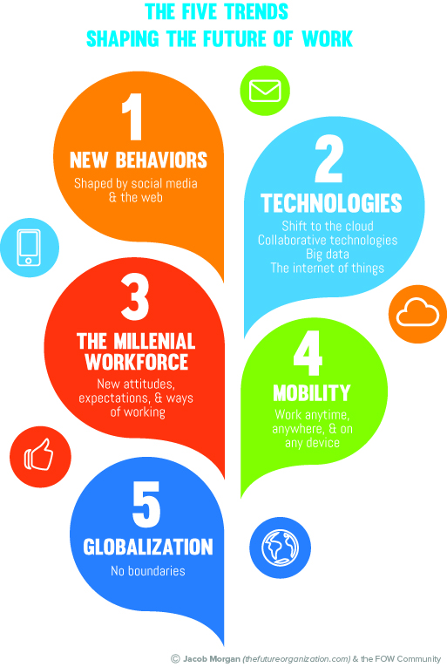
The Five Trends Shaping the
Future of Work
© 2015 IBM Corporation

Slide 7

New IBM Office
Acquisitions
Open Computing Model
Attract & Engage Gen X,Y,& Z
Communications
Brand Awareness Marketing
Future of Work
© 2015 IBM Corporation

Slide 8

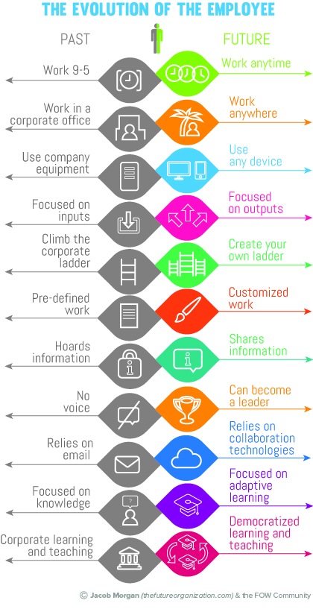
The Evolution of the Employee
© 2015 IBM Corporation

Slide 9

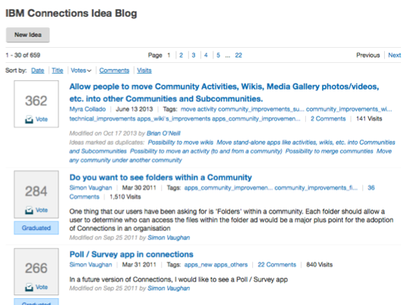
Idea Stacking & Innovation
© 2015 IBM Corporation

Slide 10

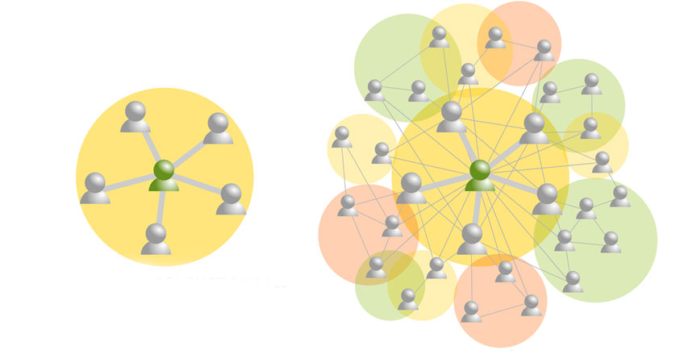
CONNECTIONS THROUGH STRONG TIES
CONNECTIONS THROUGH WEAK TIES
The Strength of Weak Ties
© 2015 IBM Corporation

Slide 11

Today’s Innovation
© 2015 IBM Corporation

Slide 12
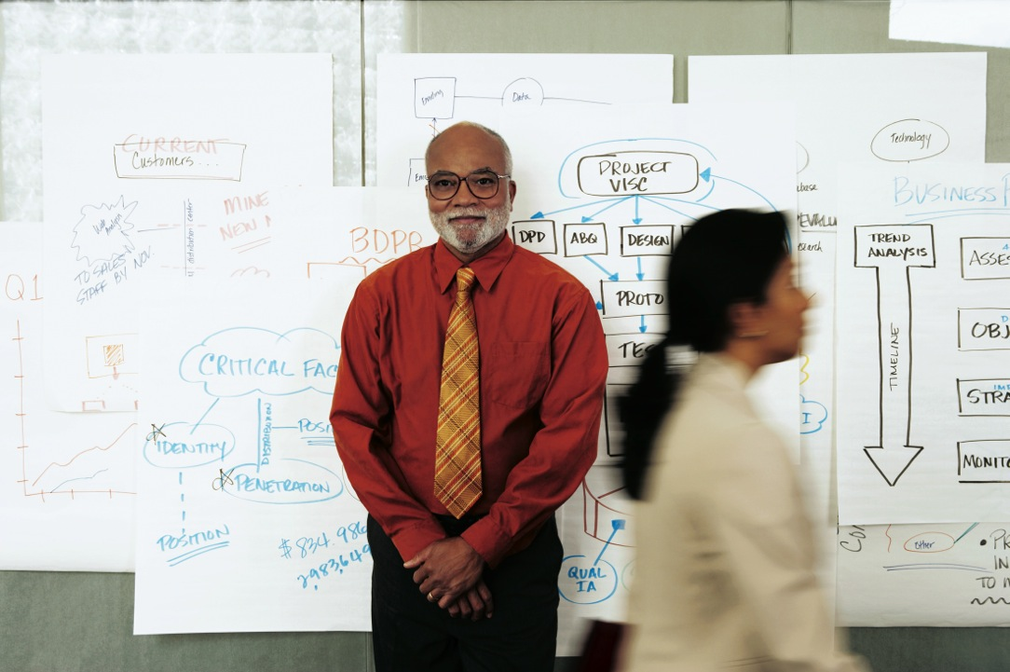
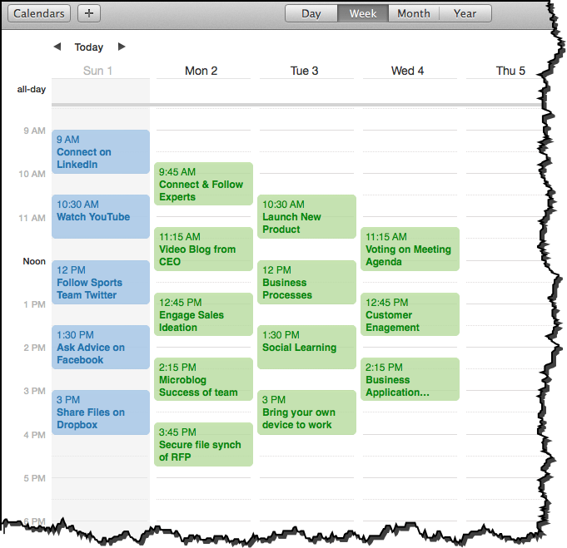

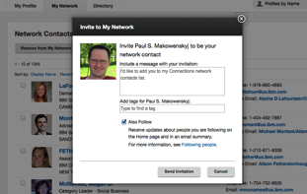

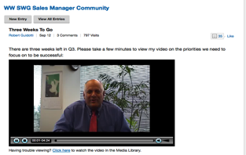

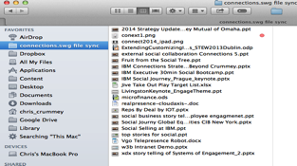
Sunday Night to Monday Morning
© 2015 IBM Corporation

Slide 13
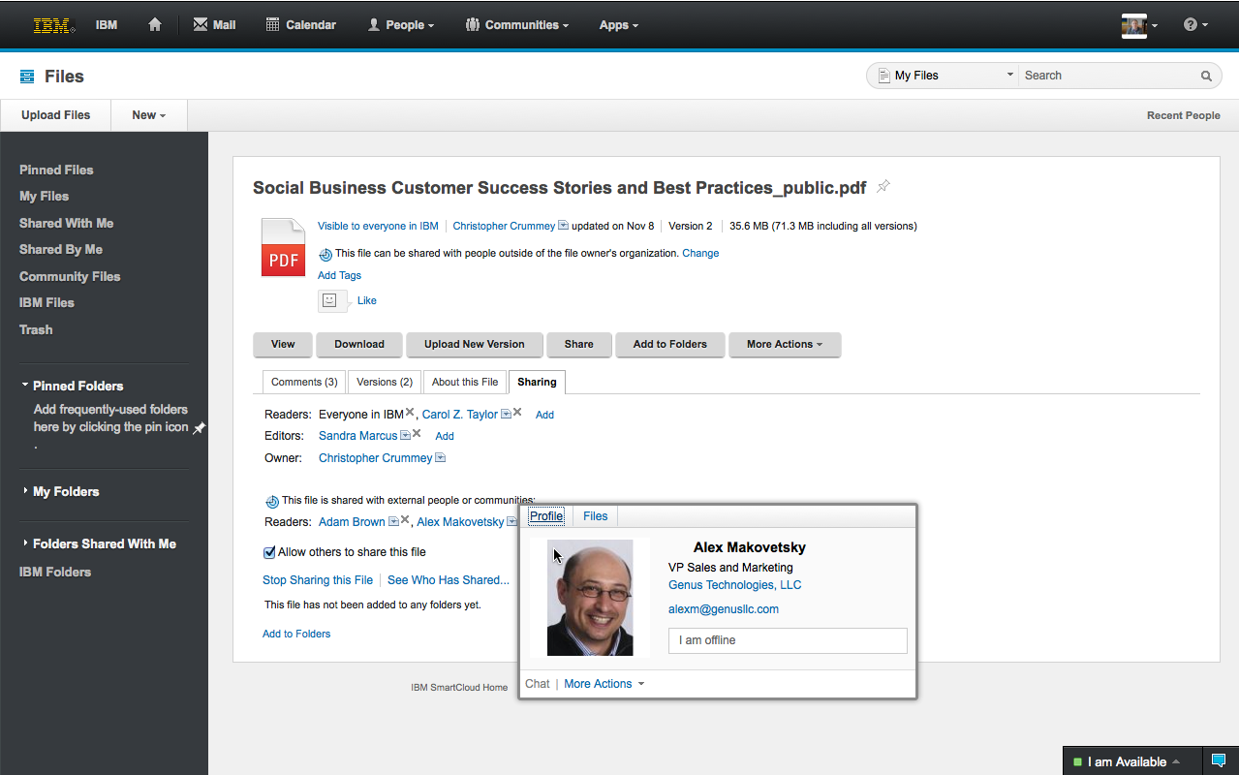
Collaborate in Ecosystems
in 60 Seconds
© 2015 IBM Corporation

Slide 14

Connecting Anytime, Anywhere
© 2015 IBM Corporation

Slide 15

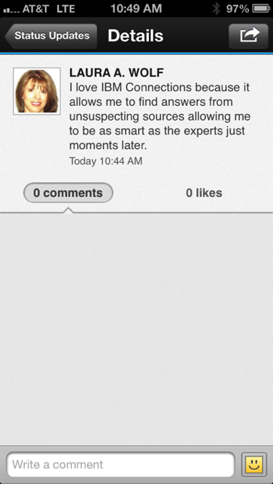
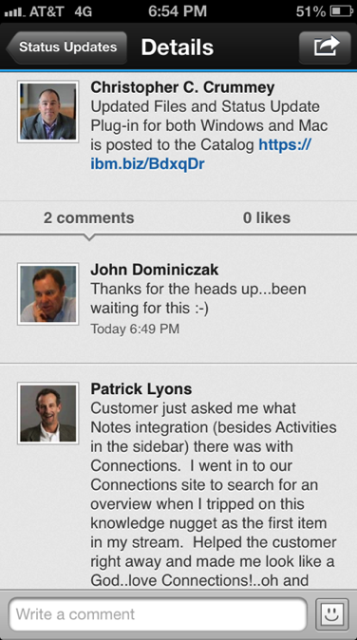
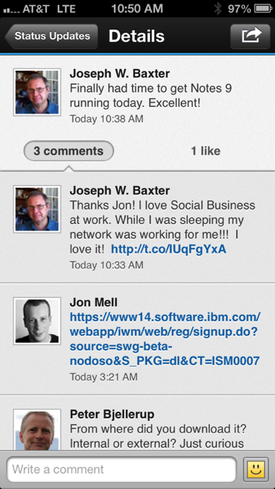
“tripped on this knowledge nugget”
“Helped the customer right away and made me look like a God”
“as smart as the experts but 5 min later”
“While I was sleeping my network was working for me!!!”
Expertise, Knowledge Nuggets
& Power of Networks
© 2015 IBM Corporation

Slide 16

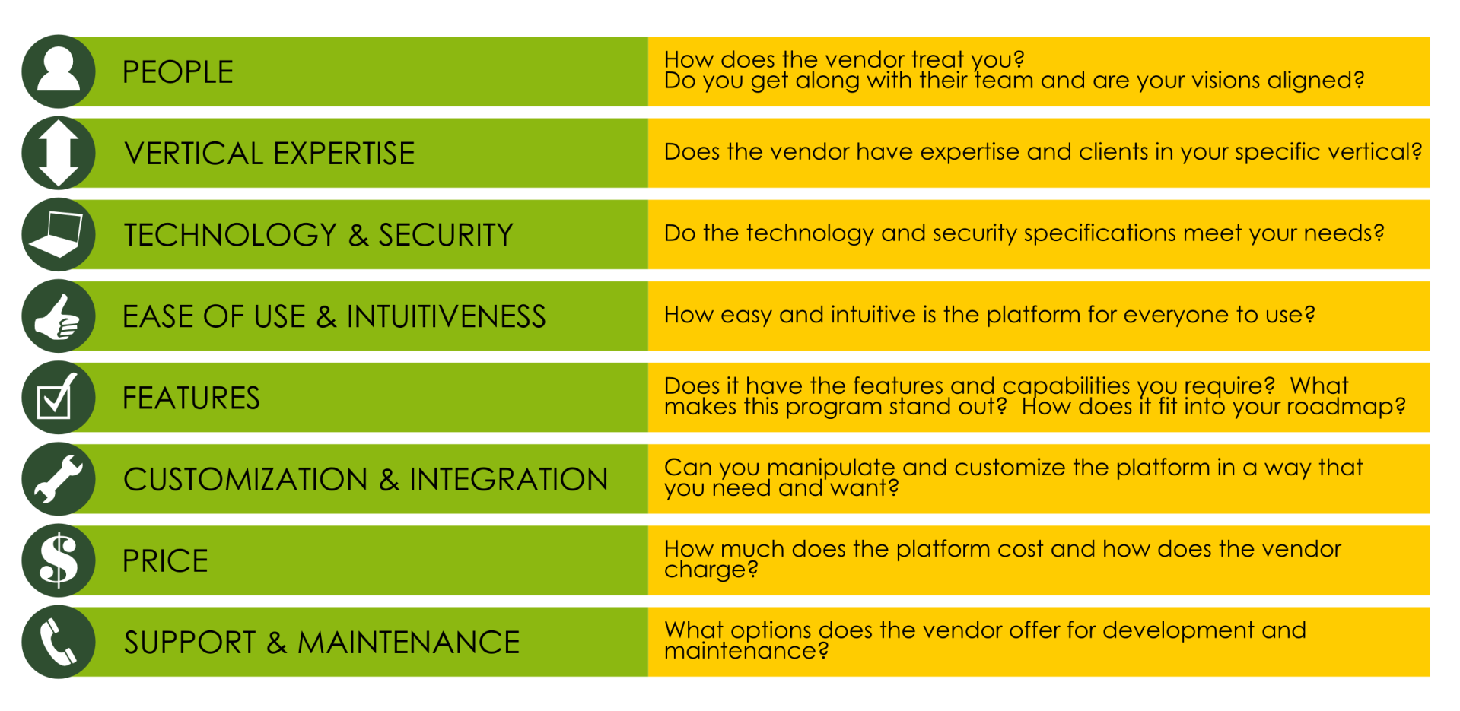
Eight Collaboration
Vendor Variables
© 2015 IBM Corporation

Slide 17
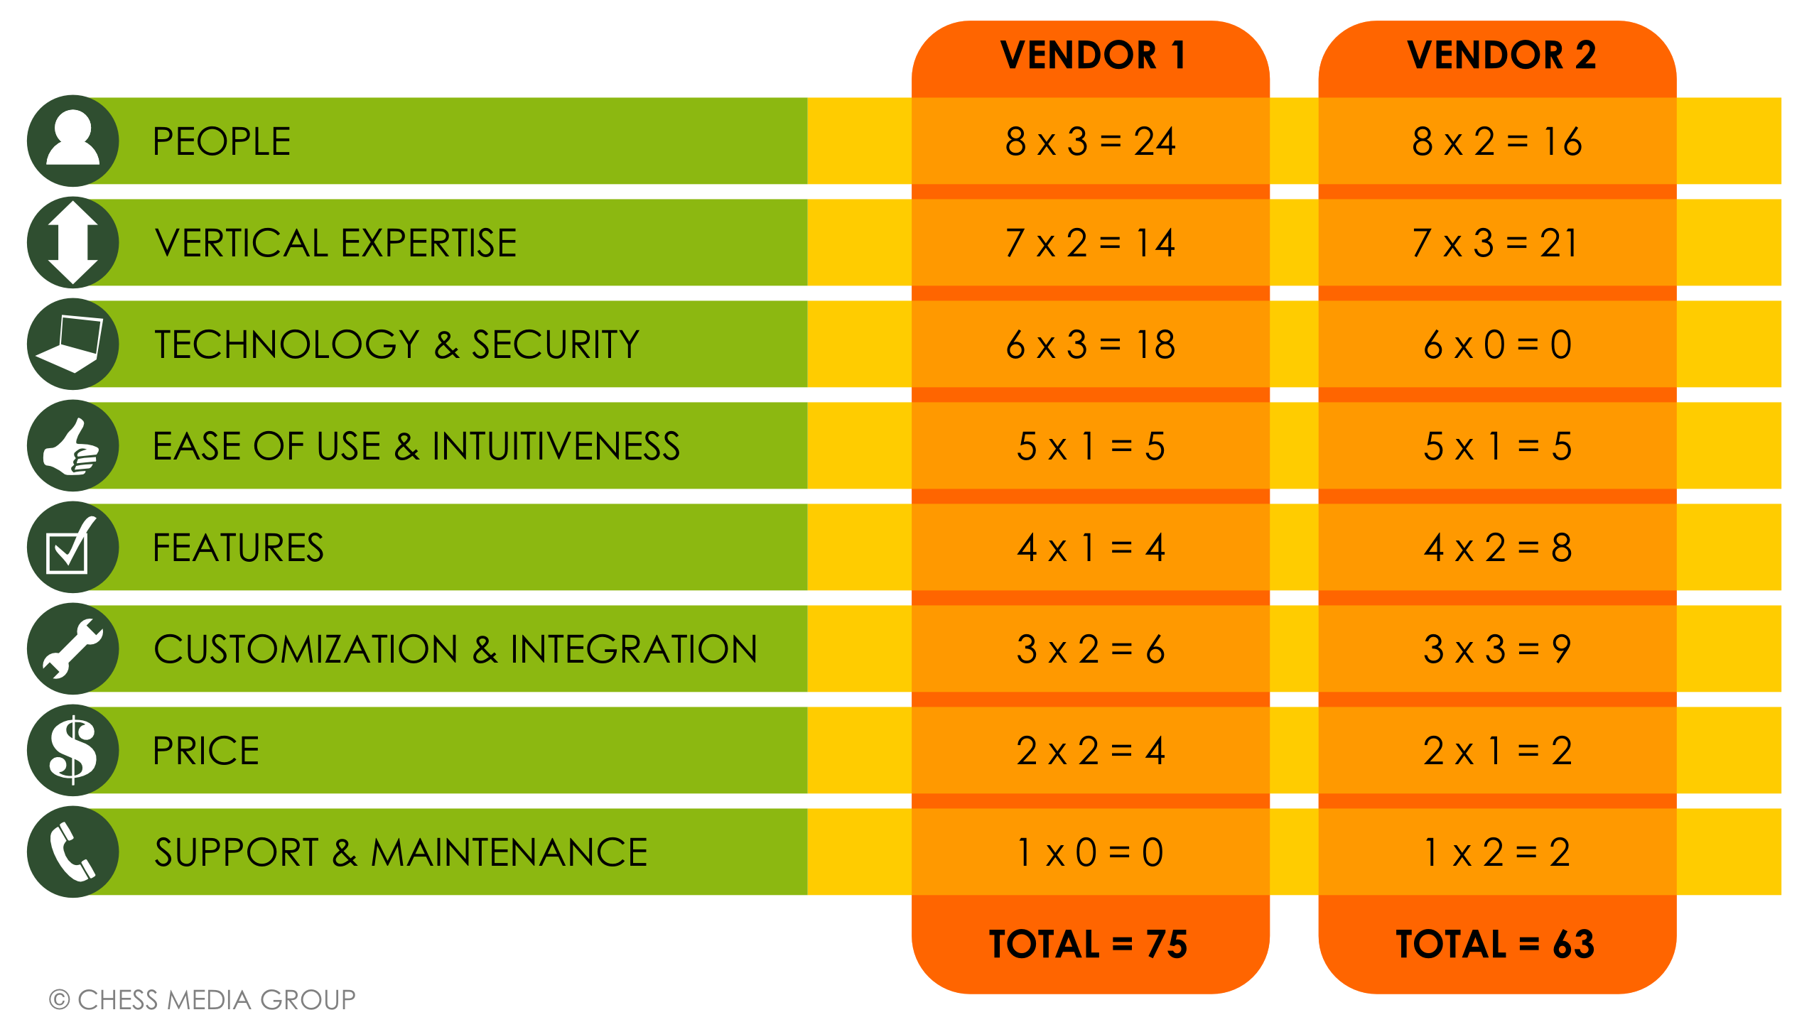
a
Sample Vendor Scoring
© 2015 IBM Corporation

Slide 18
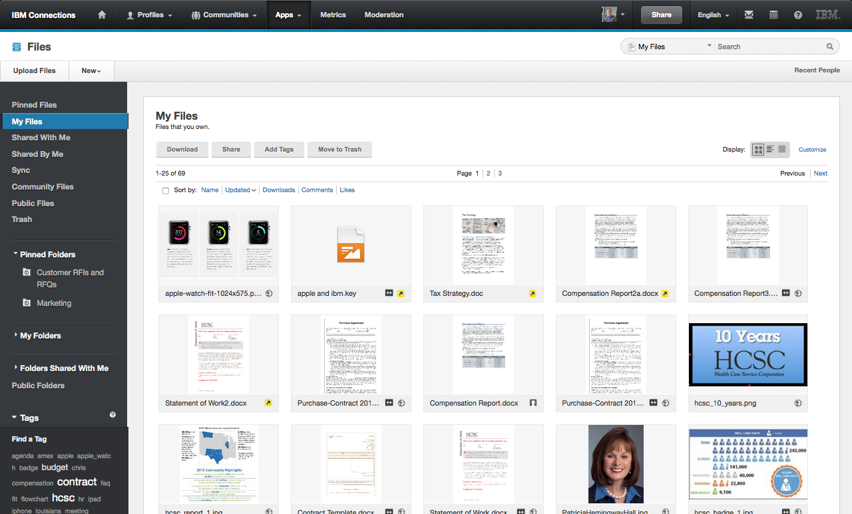

Public
Named Access
Private Draft
External File
File Sync
Collaborating Across the
Ecosystem Securely
© 2015 IBM Corporation

Slide 19
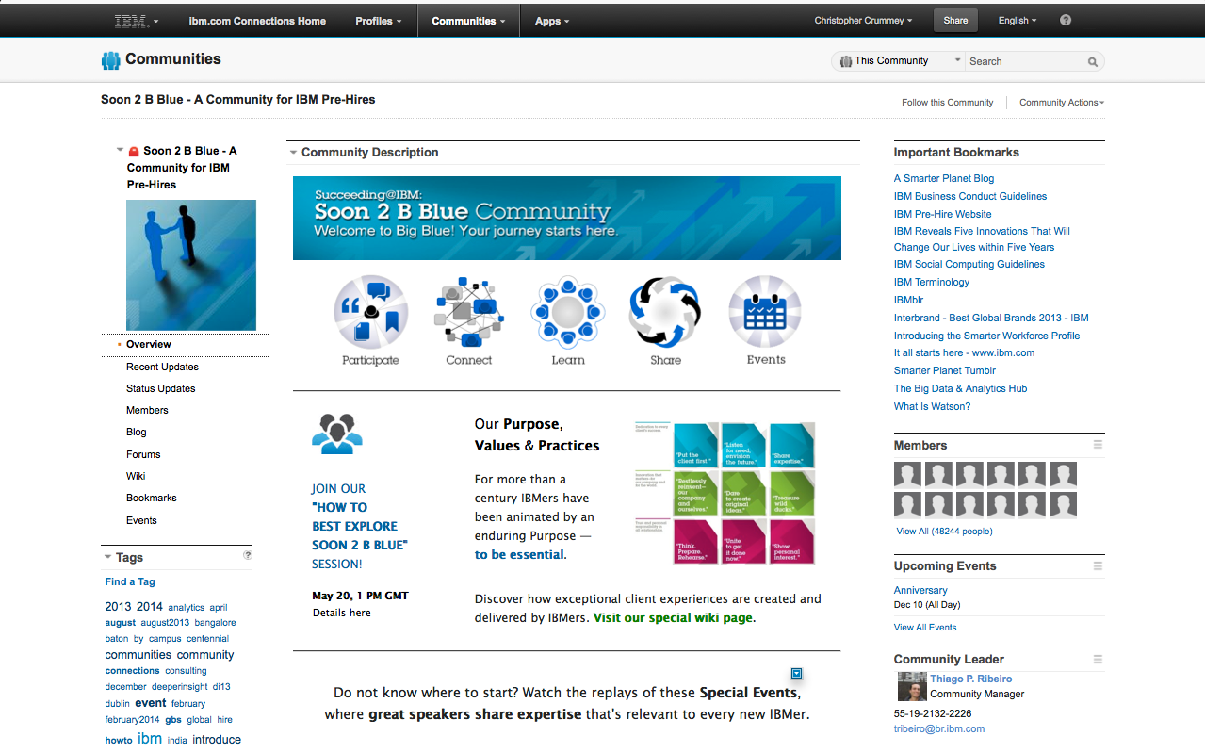
External Engagement
with Pre-Hires
© 2015 IBM Corporation

Slide 20
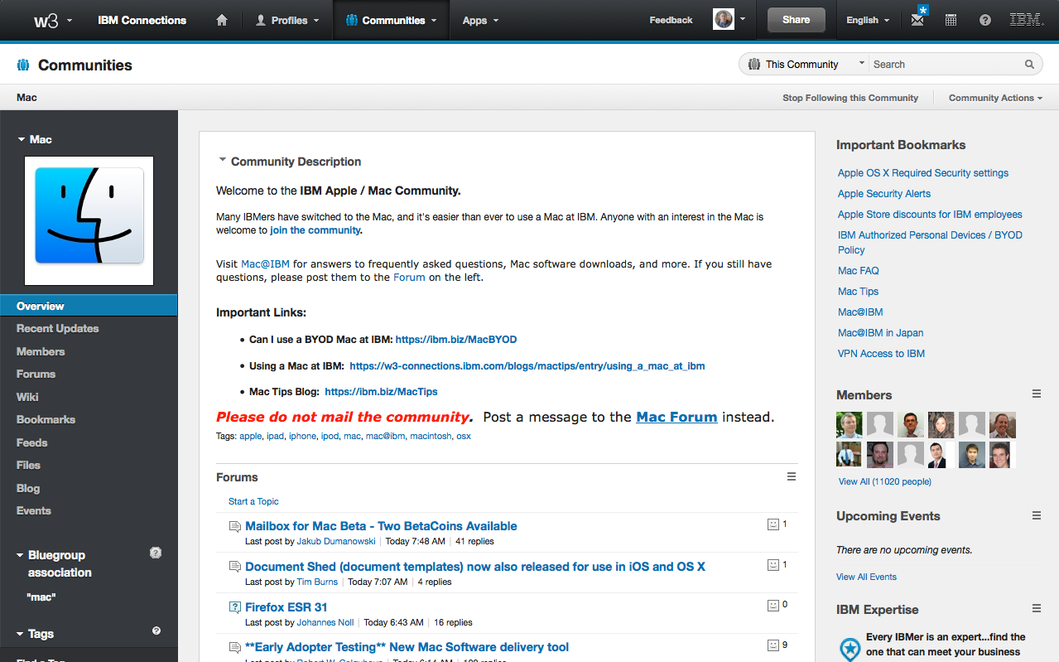
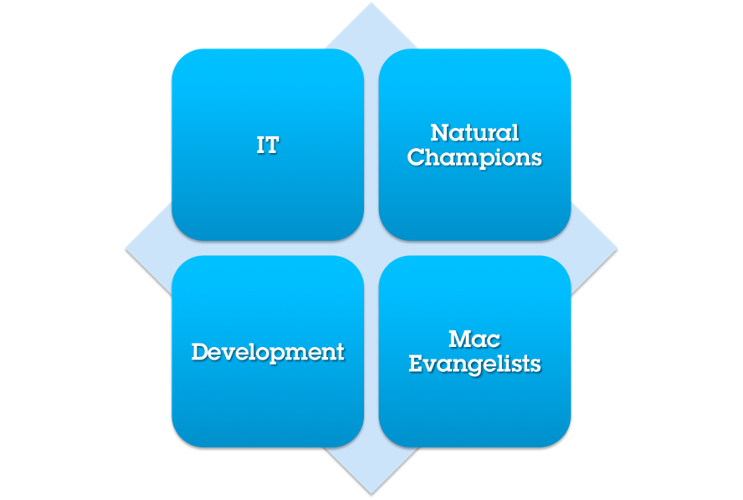
IT
Natural Champions
Technical Support Cost Savings
© 2015 IBM Corporation

Slide 21




Technology Evangelists & Champions
© 2015 IBM Corporation

Slide 22

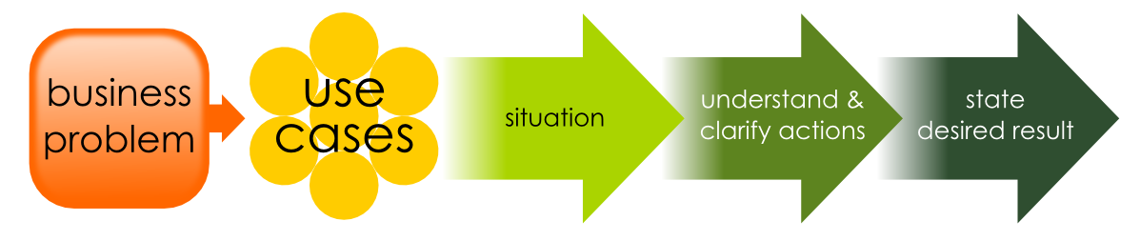
Solution Mapping Process
© 2015 IBM Corporation

Slide 23


Living Corporate Brain
Network Behavior
Corporate Think
Tank
Business Network
Share Economy
Everything is just 3 clicks away
Cocktail Napkin Vision
© 2015 IBM Corporation

Slide 24





Keys to Adoption
© 2015 IBM Corporation

Slide 25
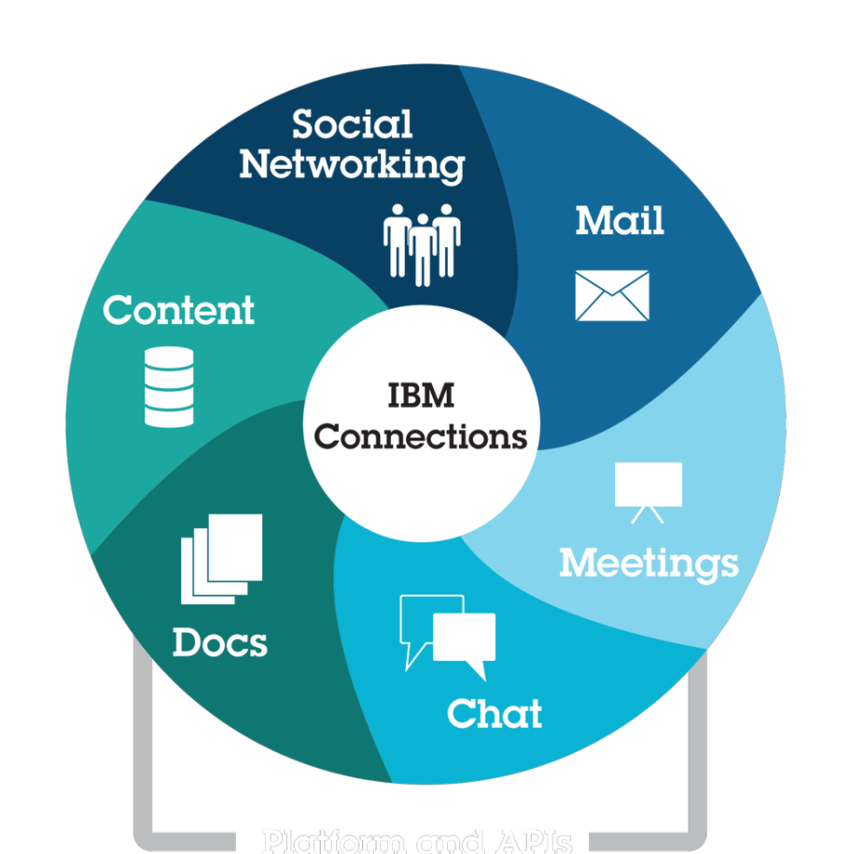
Award-winning industry leadership
Deep technical, cultural, business process, and adoption expertise
Rich, vibrant ecosystem
25 years creating people-centric work places
© 2015 IBM Corporation
IBM & IBM Connections
Your Trusted Partner – Your Solution of Choice
Notes:
25

Slide 26

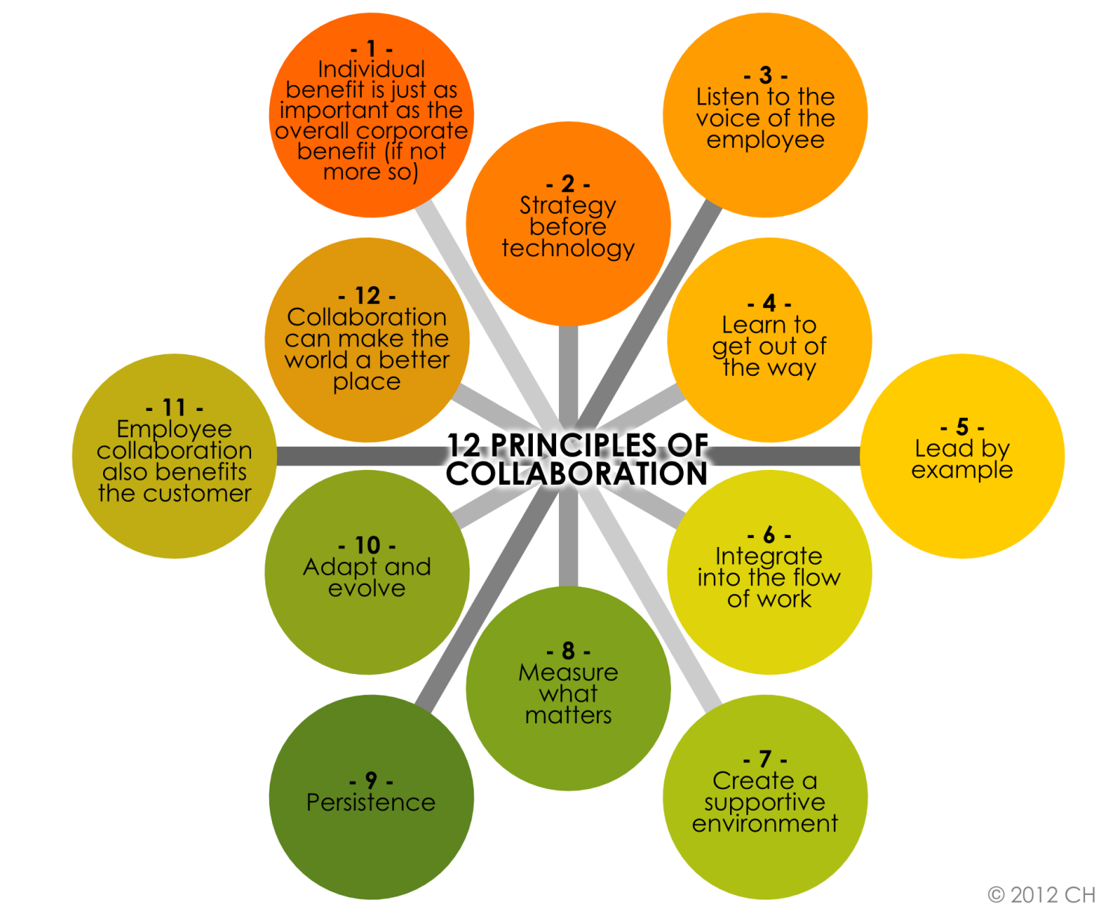
12 Principles of Collaboration
© 2015 IBM Corporation

Slide 27

Questions
© 2015 IBM Corporation

Slide 28

IBM Social Business Website http://www.ibm.com/social-business/us/en/explore-solutions.html
Jacob Morgan’s Website http://www.thefutureorganization.com/
IBM Connections Mobile Website bit.ly/IBMMobileCollab
Video: How-To: Collaborate with People External to Your Business http://bit.ly/1A03ZPT
Video: The Importance of Weak Ties (Not Strong Ties) in the Workplace -Jacob Morgan http://bit.ly/1LA3bTU
For more information, please visit:
Follow us on Twitter! @IBMSocialBiz @IBMCollabSol
© 2015 IBM Corporation

