Slide 1
Building the Right Path: A look into how studying your customers journey can improve your overall business
Zachary Betack
08/26/2015

Slide 2
Agenda
Clickstream Reporting Deep Dive
Overview
Benefits of Clickstream
Creating Clickstreams
Analyzing Clickstream Data
Report Features
KPIs
Use Cases
TruePath Reporting Deep Dive
Overview
Benefits of TruePath
Getting Started
Analyzing TruePath Data
KPIs
Report Features
Use Cases
Q&A

Slide 3
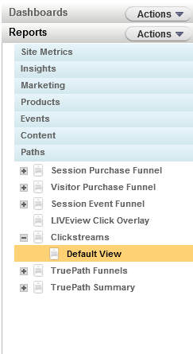
Clickstream Reporting
Clickstream reports are open ended pathing reports that help analyze popular paths your visitors are taking
These reports can reveal trends in visitor behavior and help you to determine which paths are most successful in leading to conversions.
To locate Clickstream Reporting, log into Digital Analytics<<Reports<<Paths<<Clickstream

Slide 4
Benefits of Clickstream Reporting
Clickstream reports allow you to analyze paths your customers take through your website either before or after they visit a specific page
Clickstream reports allow you to compare up to three different paths
Additionally you are able to view the top five most popular paths
You can further refine your results by using a profile segment/product segmentation
  Narrows in on a specific clientele's behavior
  Narrow in on customers that have purchased a specific product

Slide 5
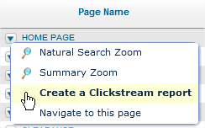
Building a New Clickstream Report
Click ‘Create New Report’ in the Clickstream list page
Click ‘Create a Clickstream Report’ in the drop-down menu under Pages

Slide 6
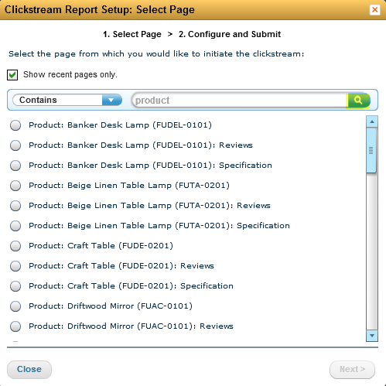

Creating a Clickstream Report: Step 1
Select the page you want use
You can enter a search string and click the search icon
Select the radio button next to the page name
Click Next to reach Step 2

Slide 7
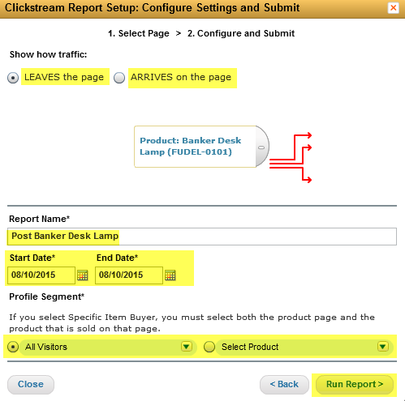
Creating a Clickstream Report: Step 2
Choose Clickstream direction
Name the Clickstream
Input a date range
Optionally, apply a Profile Segment/Specify a specific product
Click Run Report

Slide 8
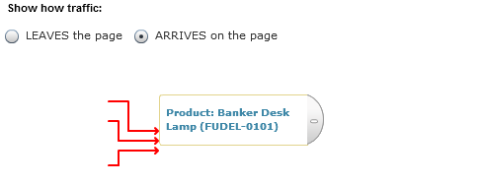
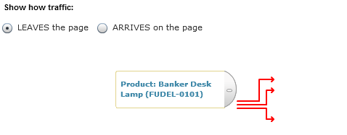
Backward vs Forward Clickstreams
When creating a Clickstream report, you can choose to create a Backward or Forward looking report
A backward looking Clickstream report will show you the most popular paths that customers use to arrive on the page.
A forward looking Clickstream report will show you the most popular paths that customers use to depart from the page.

Slide 9
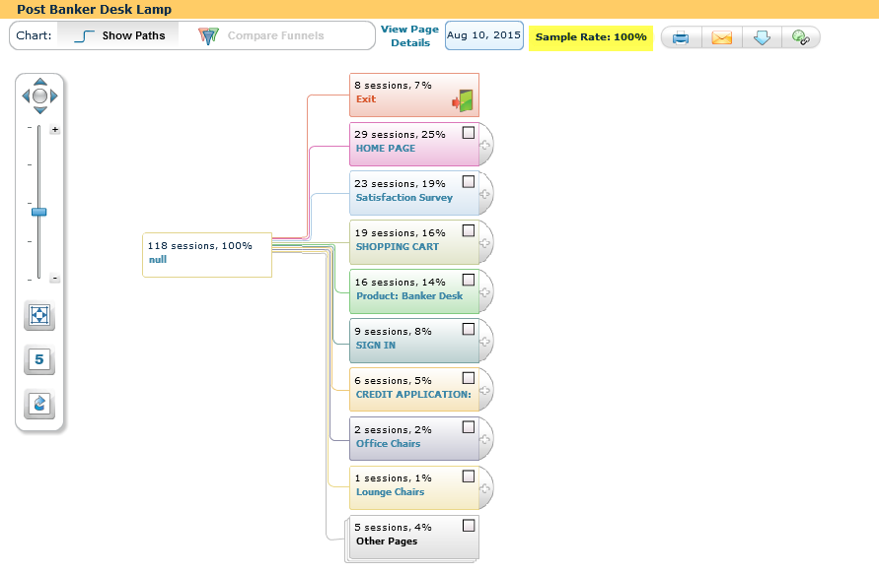
Sampling in Clickstream Reporting
Digital Analytics uses sampling to generate Clickstream reports for web pages that have page views from more than 20,000 sessions
IE: For a page that had 40,000 unique sessions during the specified time period, a random sample of 50% (20,000/40,000) of the total sessions are used

Slide 10
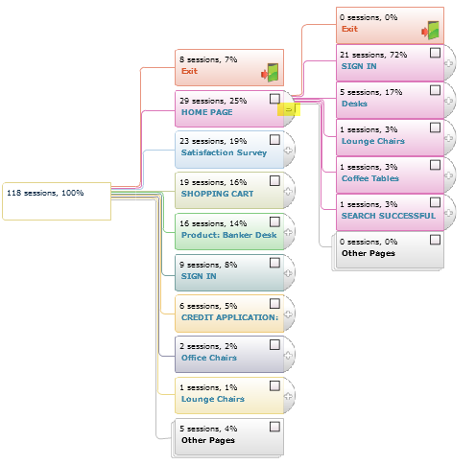
Path Expansion
To expand the paths, click the plus sign (+) at the end of each box.
Each expansion will reveal the top eight next pages viewed, how many visitors exited the path or went to pages beyond the top eight.

Slide 11




Pathing Illumination
By clicking on one of the boxes, the path will illuminate and you will see an associated funnel.
Use the zoom controls on the left to zoom in or out. Click the Fit to Page icon ( ) to resize the Clickstream to your screen.
Click the five icon ( ) to view the top five click paths.
Click the restore icon ( ) to collapse the tree.

Slide 12
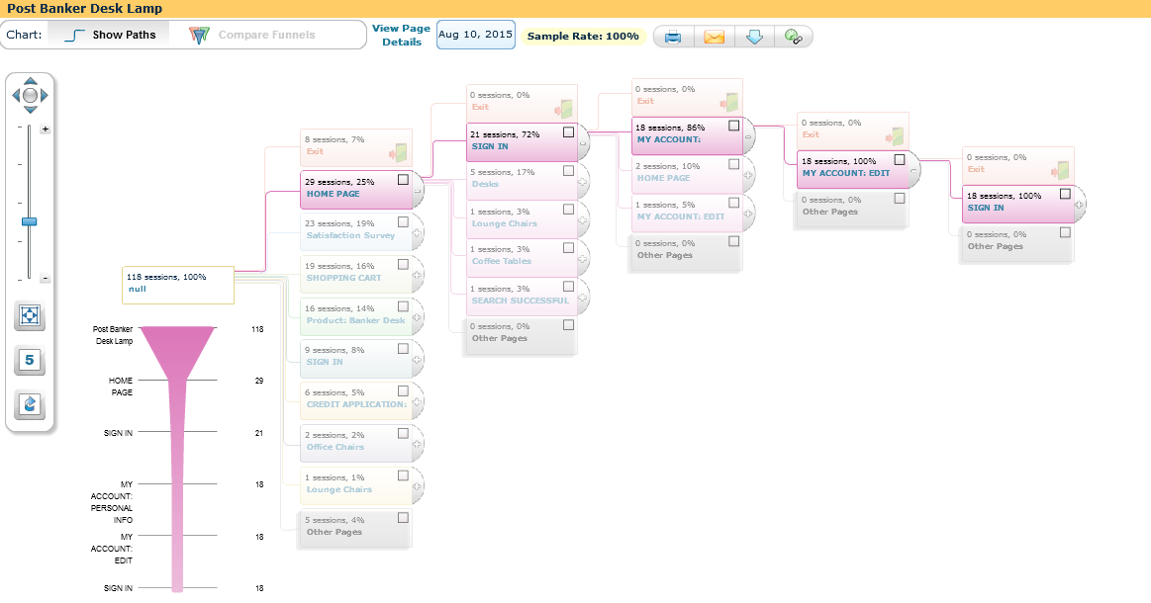
Top 5 Paths

Slide 13
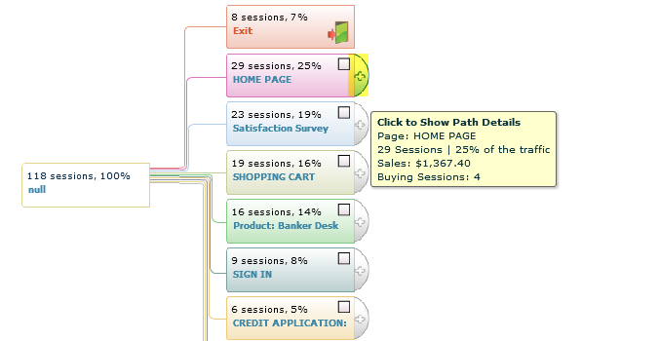
Clickstream KPIS
Sessions: The number of sessions that match the path criteria during the specified time period.
Buying sessions: The number of sessions following each path that resulted in a purchase, which occurred during the session.
Sales: Revenue from the buying sessions during the specified time period.
Exit: Sessions that leave the website immediately after viewing the specified page.
Enter: Sessions that arrive to the website on the specified page.

Slide 14

Page Detail
To view Page Details in a Table format, click on View Page Details from the top menu bar.
To view all data, click the downward arrow icon to Download the data. You will be able to see all pages grouped under “Other Pages”.

Slide 15
Clickstream Use Cases
Analyzing top paths for a website
Track landing page performance
Improving onsite search design
Investigate path and site abandonment for specific pages
Tracking activity of visitors to personalize your homepage

Slide 16
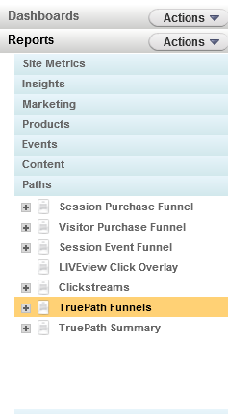
TruePath Reporting
TruePath reporting is a closed-ended pathing report that is used to analyze visitor behavior over user defined paths within a web site.
To locate Clickstream Reporting, log into Digital Analytics<<Reports<<Paths<<TruePath Funnels

Slide 17
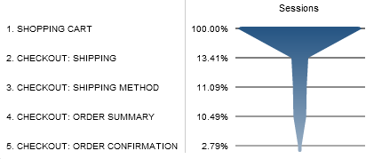
Benefits of TruePath Reporting
Flexibility in required and optional steps
Ability to back-process data 90 days historically
Report processes every day moving forward
Multiple criteria for a step
Ability to easily analyze path completion and departure rate
Flexibility in specification of pages

Slide 18
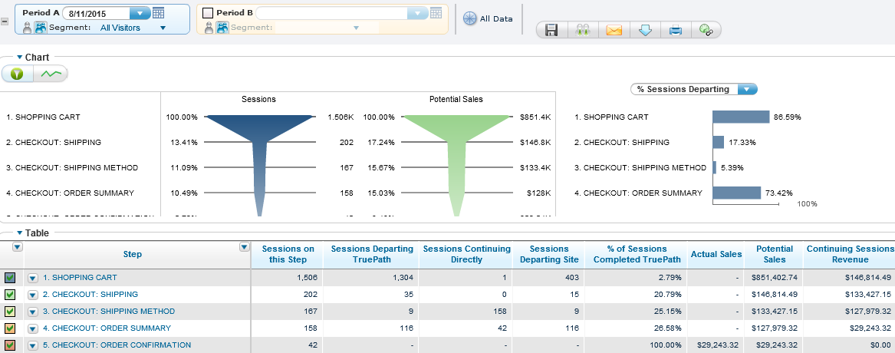
TruePath Report

Slide 19
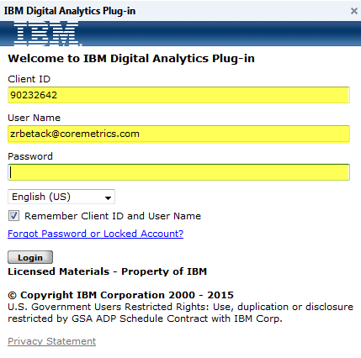
Getting Started with TruePath Reporting
Install the Digital Analytics Tools Plug-in
Go to a page on your site that has a Digital Analytics tags and click on the Digital Analytics Tools Plug-in icon that is located in the top of your browser window
Enter in the Client ID and the log in information that is used to access Analytics

Slide 20
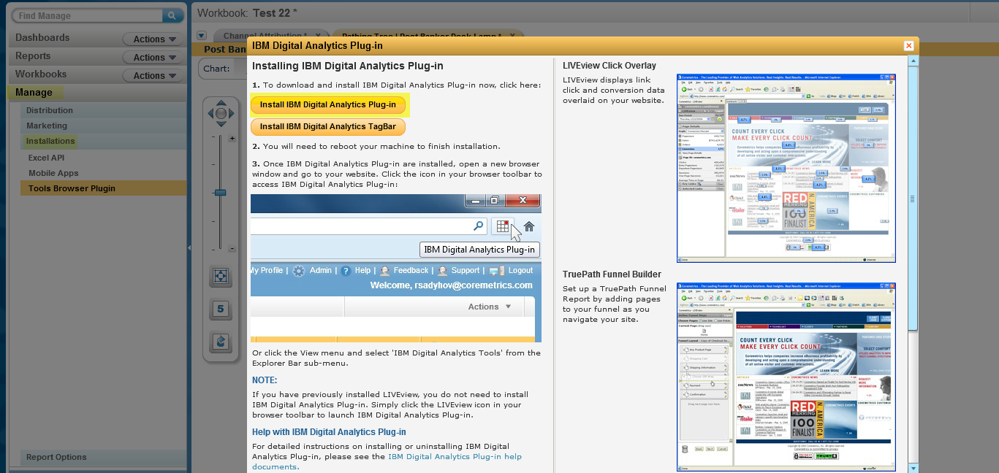
Digital Analytics Tool Plug In

Slide 21
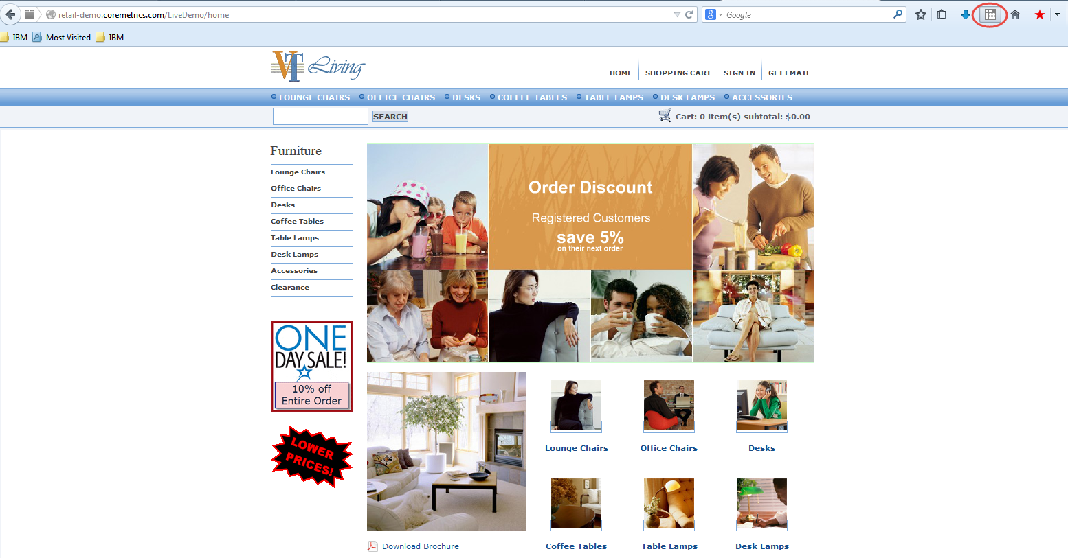


Digital Analytics Tool Plug In

Slide 22
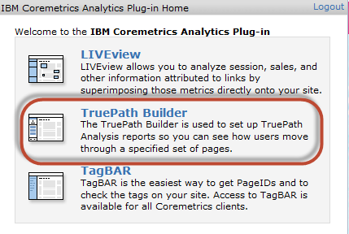
Getting Started with TruePath
After you log in click on the TruePath Builder

Slide 23
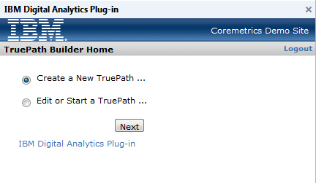
Getting Started with TruePath
Select “Create New TruePath”
Use the Page Picker to select the page you want

Slide 24
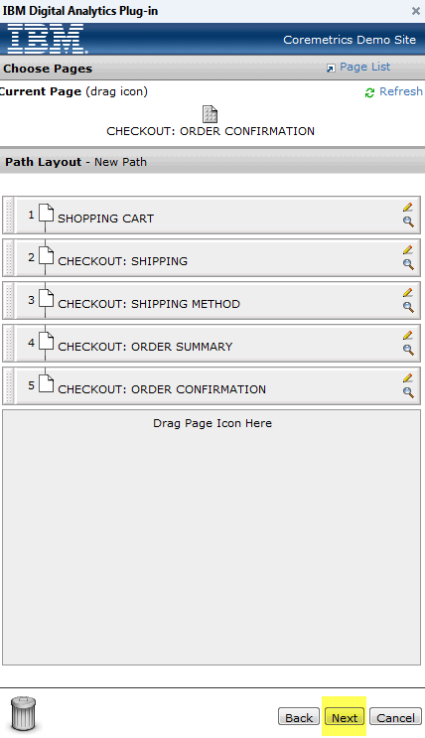
Creating a TruePath

Slide 25
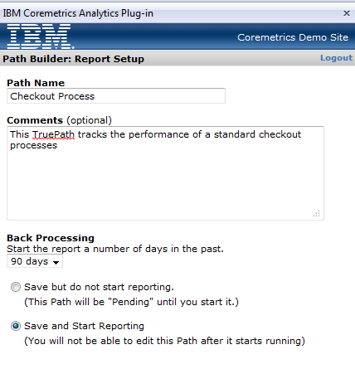
Submitting a TruePath
Options
7 days
14 days
21 days
30 days
60 days
90 days

Slide 26
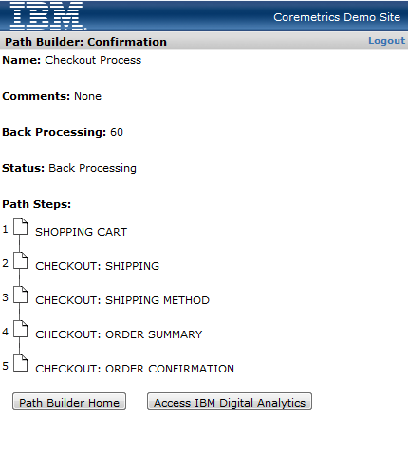
Submitting a TruePath

Slide 27
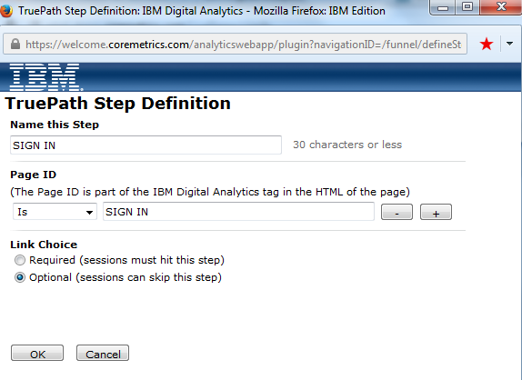
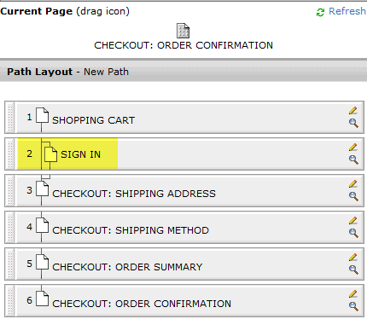
TruePath Optional Steps

Slide 28
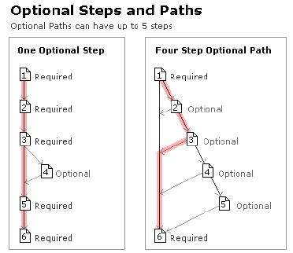
TruePath Optional Steps
You can incorporate optional steps in your TruePath
Optional steps are still required to be linear.
Example
  Path Completing: 1-2-6
  Path Not Completing: 1-2-4-6 (cannot skip 3)

Slide 29
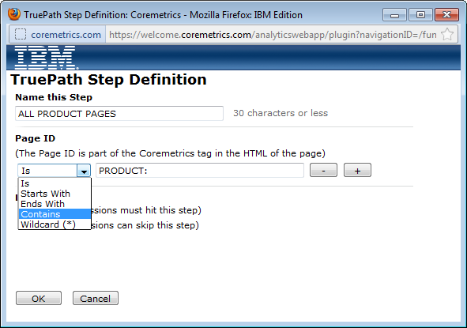
TruePath Page Options

Slide 30
TruePath Page Options
Is : This means Page ID value is an exact match
  Example: Page ID Is homepage
Starts With: This means grab all Page IDs that begin with X.
  Example: Page ID Starts With “Product” would likely grab all product view page ids.
Ends With: This means grab all Page IDs that end with X.
  Example: Page ID Ends With “Landing Page’ would likely grab all landing page ids
Contains: This means grab all Page IDs that contain X.
  Example: Page ID Contains “Product” meaning it would grab all page ids with “Product” in it.
Wildcard: This means it could be one word then anything and then another word in the Page ID.
  Example: Use *Product* to mean any page id that has “Anything” Product ”Anything” in a Page ID.

Slide 31
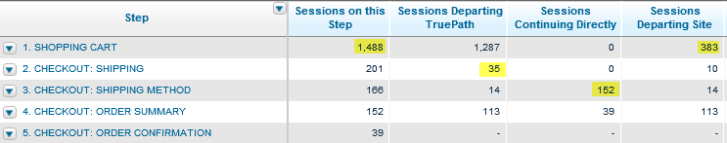
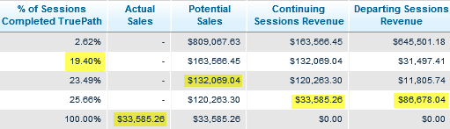
TruePath KPIs

Slide 32
TruePath Actions
For steps with a higher percentage of sessions completing the path than comparable steps
Represent the patterns that are likely to convert a customer
Implement methods to funnel visitors to these paths, so you can capitalize on the high
conversion rate
For steps with a high number of sessions departing the path
Review these pages to identify flaws with page design that deter movement
through the process
Use Clickstream reporting to determine where visitors are trafficking and pinpoint opportunities to limit access to these areas or implement a process that leads them back to the path.
For steps with a high number of sessions departing the site
Indication of visitor frustration at a certain point of the process
Use Form Analysis to identify the problem fields within the pages that might be contributing to the page abandonment.

Slide 33
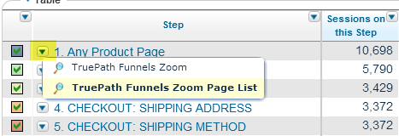
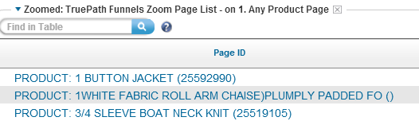

TruePath Features
Page Zoom
TruePath Sample Rate

Slide 34
TruePath Use Cases
Checkout Processes
Application Processes (ex-credit card application)
Booking Process (ex - Travel)
Registration Process (ex-creating account)
Newsletter or Email Sign Up Process
Landing Page to Order Confirmation Path
Onsite Search Results Path
AB Testing Comparisons Path

Slide 35
Q&A
The Customer Support team is available to provide support via the following channels:
  E -mail: Sunday 8:00pm - Friday, 7:00 PM U.S. Central
  Phone: Sunday 8:00pm - Friday, 7:00 PM U.S. Central
  US: 1-866-493-2673
  cm_support@us.ibm.com
Live Chat (for Business Support only): Sunday-Friday, 8:00 PM – 6:00 PM U.S. Central
  Live Chat is available from the home page of the IBM Client Success Portal
  https://support.coremetrics.com
IBM Client Success Portal: 24 x 7
Next Webinar: September 30th, 2015 OnSite Search Best Practices Suzanne Azulay

