Slide 1
Gain a Deeper Insight into your Data through Advanced Reporting: An Introduction to Explore
Tara Zandy
October 28, 2015
Notes:
Thank you. Again, Welcome everyone, my name is Tara Zandy and today we will be covering an introduction to Explore.
The goal of this webinar is to empower you to utilize the Explore tool so you can build customized reports for a deeper analysis of your data.

Slide 2
Agenda
Understanding Explore
  Overview
  When to use Explore vs Digital Analytics
How to utilize Best Practice Reports and Create Dashboards
Building a report
  Report types
  One-time vs frequency reports
  Sample reports vs full data set
Effectively using Relational Zooms, Segmentation and Filtering
  Adding a relational zoom to a report
  Segments vs filters
Tag Attributes
Explore Report Credits
  What are report credits?
  Credit Allocation and Report Credit Usage
Notes:
During this webinar, you will gain an understanding of Explore, know when to use Explore versus Analytics, learn how to utilize the standard best practices reports and create a dashboard, become familiar with building a report and the different report types and features available including relational zooms, segmentation and filtering, obtain an understanding of tag attributes and become familiar with report credits and how they are allocated

Slide 3

Explore Overview
Allows for flexible report creation
In depth segmentation and segment
comparison
Cross-session segmentation
Ties data from a session
together to allow for a more
holistic view
How are mobile visitors using
our site?
How do I isolate relevant data
for my business group?
Can I report on characteristics such as brand?
Notes:
Explore is a tool that allows the analyst to build ad hoc reports combining different tag type fields to understand the visitor’s entire journey.
When using Explore a deeper analysis can be obtained through in depth segmentation and segment comparison as well as cross session segmentation.
Explore allows you to tie data from a session together to create a holistic view. An example would be to create a report showing visitors from an email campaign and the pages they viewed during their session.

Slide 4
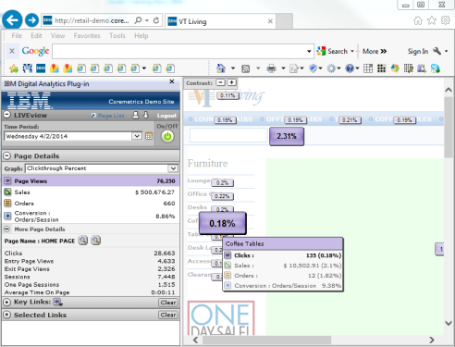
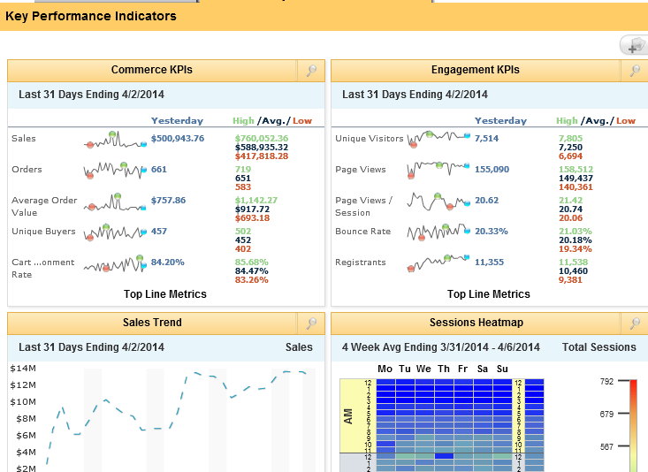
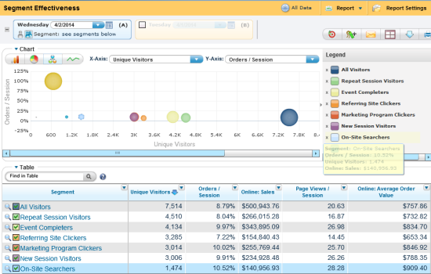
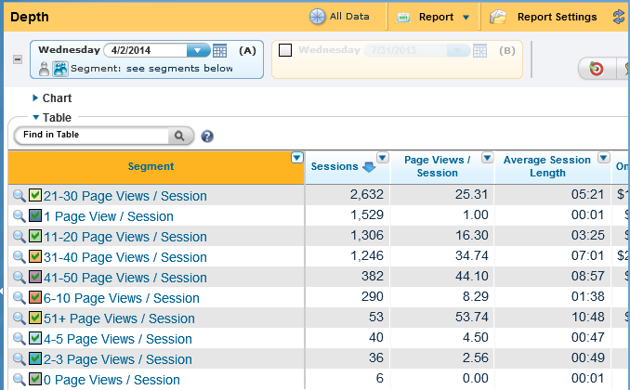
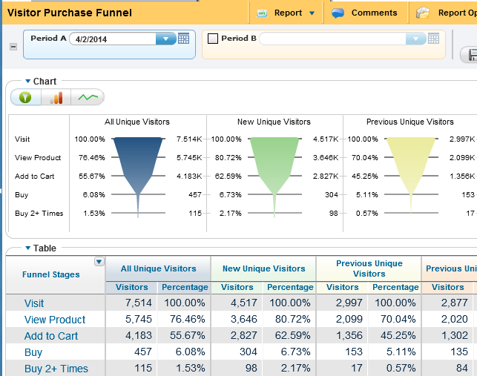
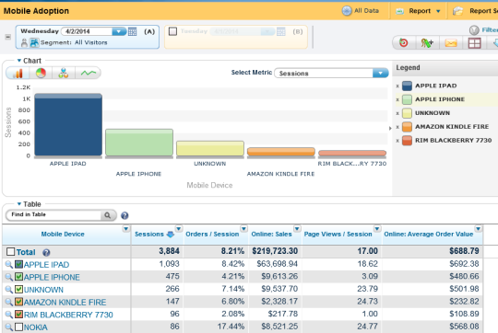
Explore vs. Digital Analytics
Digital Analytics
Explore
Best Practice Report Templates
Action Ready Reports
Path Analysis
Site Wide Statistics
TBD
  TBD
Ad hoc analysis and report building
Attribute Analysis
Filter and Segment Compare reports
Broader segmentation time frames
TBD
  TBD
Notes:
It is important to understand the difference between Digital Analytics and Explore and when to use each tool. Digital Analytics provides out of the box best practice reports, site wide key performance indicators, pathing analysis and executive level workbooks.
Explore allows for ad hoc analysis through reporting, segment comparison, more flexible segmentation features and time frames and attribute analysis, which we will discuss later in this presentation.
Explore by default will have a data retention limit of 400 days unless other wise contracted.
When you are unable to pull or combine the information in Digital Analytics, you should use Explore. The two tools should be used in conjunction with one another to provide a complete analysis of your site.

Slide 5
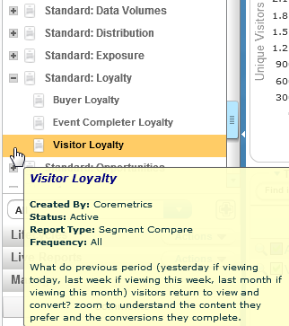
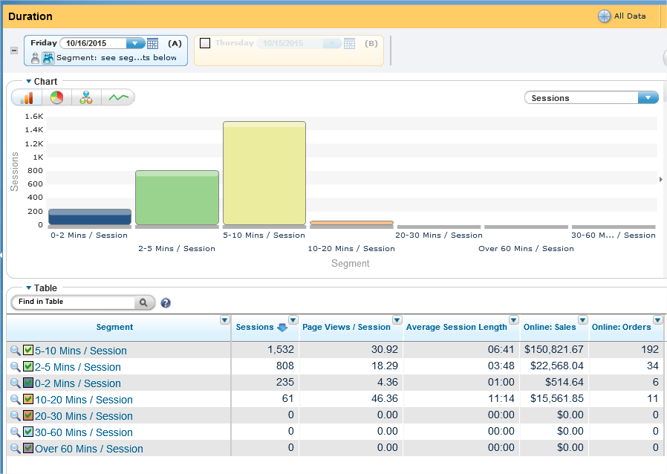
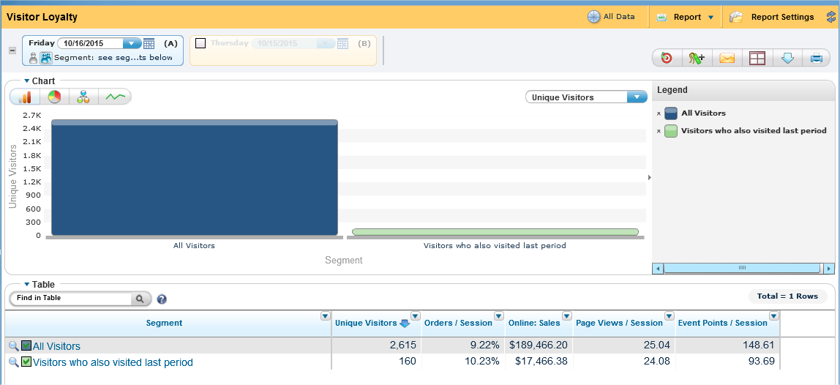
Utilizing Best Practice Reports
Provide immediate value by offering suggested reporting and analysis.
  View content, event and product affinities
  Understand the marketing channels driving visitors to your site
  Discover visitor and buyer loyalty
  Group together and compare visitors based on a set of criteria such as average order value, site duration, number of pages viewed, searching sessions, etc.
Notes:
Similar to Digital Analytics, Explore provides a set of standard Best Practice Reports which can be used in an analysis and can provide value by offering suggested reporting.
There are content, event and product affinity reports. Reports to help you track the marketing channels driving visitors to your site. You can view reports that group together and compare visitors based on sets of criteria. If you find a standard report you want to customize you can create a copy and add/ remove criteria and save the report with a new name.
These reports are located under the report category in the left navigation pane of the interface. Best practice reports are group under categories prefixed with the word ‘Standard’. These reports will be available in any instance of Explore.

Slide 6
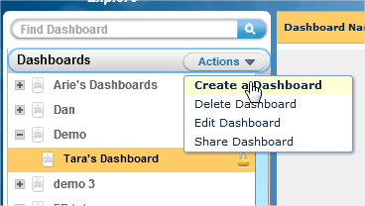
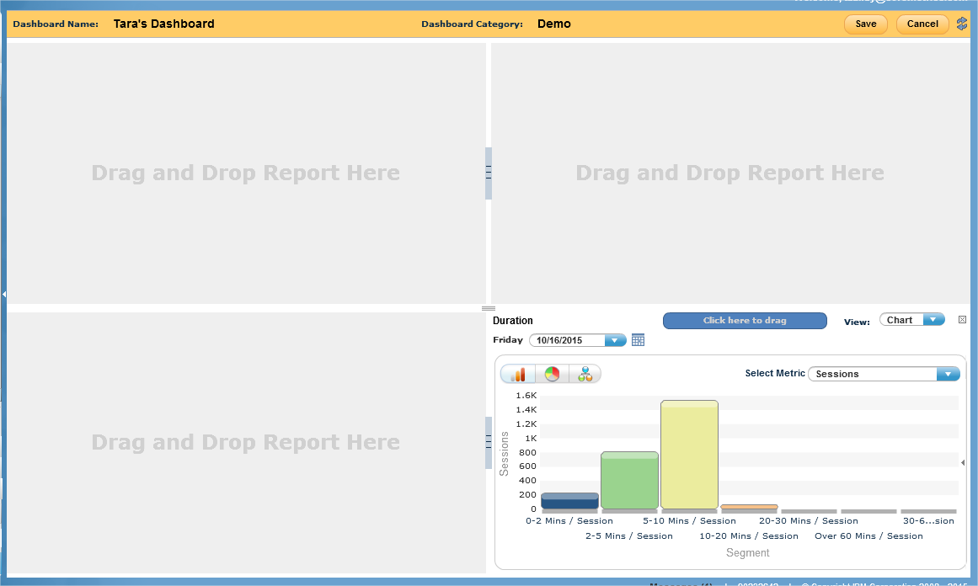
Creating a Dashboard
Create, edit and share a dashboard to relevant departments
Review and compare a combination of up to four Explore reports
Notes:
Explore allows you to create, edit and share a dashboard containing up to 4 custom reports.
Once you create reports based on business goals, it is beneficial to set up dashboards in order to spot trends to begin a deeper anlaysis. Dashboards are located in the left navigation pane of the Explore interface. Once trends are spotted through a dashboard, you can click on the dashboard to navigate to the report for more insight.

Slide 7
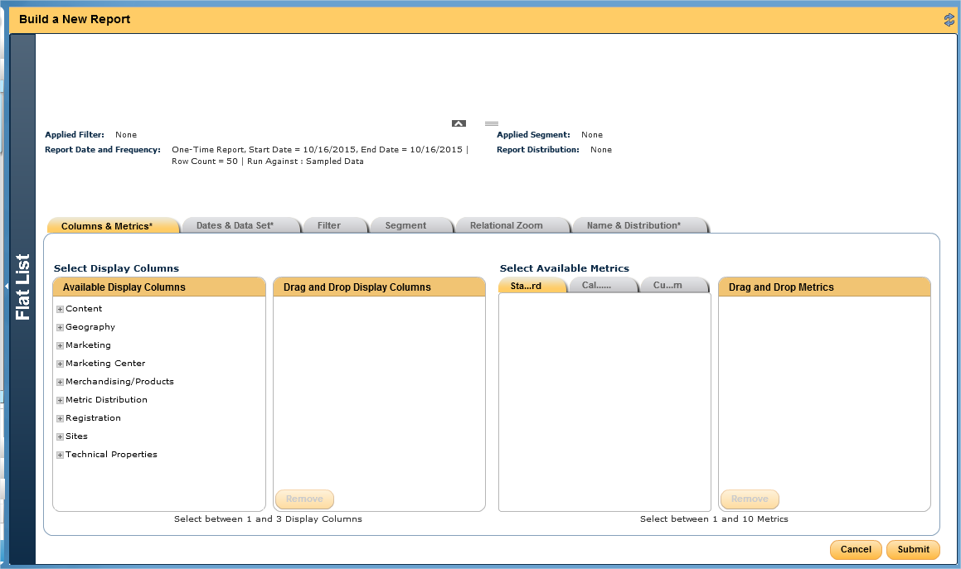
Building a Report
Choose your report type
Select appropriate tag fields
Add key performance indicators and metrics based on site goals
Choose an appropriate report time frame
Create and add a filter, segment or relational zoom (optional)
Notes:
We are now going to discuss how to build a report. When building a report in Explore, you will first choose a report type, select appropriate tag fields, such as page, marketing channel, entry page, product name, etc., add key performance indicators based on site goals or management needs, choose an appropriate time frame and create and add a filter, segment or relational zoom.
Adding a filter, segment or relational zoom is optional.
Each task in the report build is separated into tabs. Navigate through each tab customizing the criteria prior to saving the report.

Slide 8
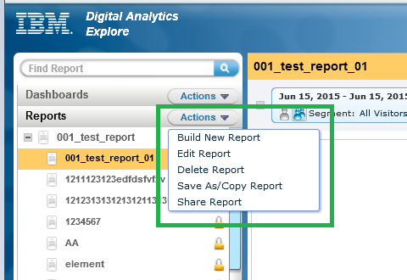
Building a Report: Actions
Explore allows you to build, edit, delete, copy and share a report
Since reports cost credits, the edit option will only allow you to update the name of the report, add a relational zoom, update the distribution list and add comments.
Any other edits will involve first creating a copy of the report by selecting ‘Save as/Copy Report’ and saving the report with a new name
Notes:
Within the Explore tool, you can build, edit, delete, copy and share a report.
The edit option will only allow you to update the name of the report, add a relational zoom, update the distribution list and add comments. To truly edit a report, you must create a copy of the report and save the report with a new name. The new report will consume report credits.

Slide 9
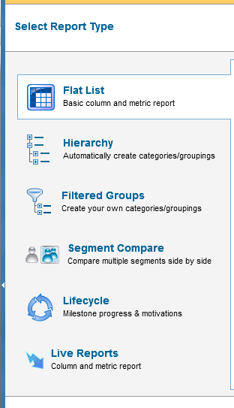
Report Types
There are 4 types of reports you can select
  Flat List
  Hierarchy
  Segment Compare
  Filtered Groups
Two additional Report types based on contract
  Lifecycle
  Explore LIVE
Notes:
There are 4 standard report types you can chose from when building your report. The flat list report, Hierarchy, Segment Compare and Filtered Groups report. There are two additional report types that are only available if the Explore instance is contracted for them. We will cover each of these report types in detail in the next few slides.

Slide 10
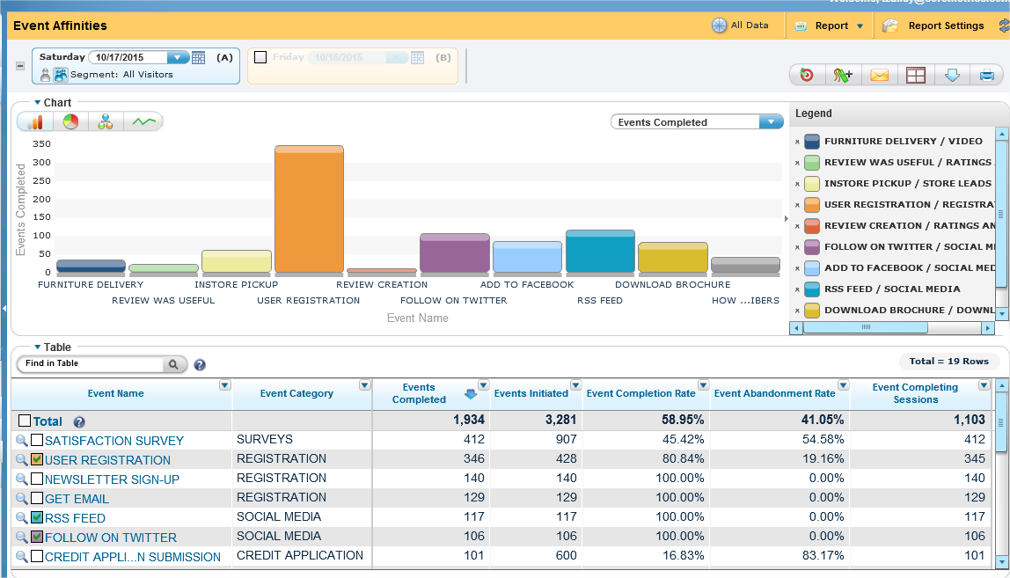
Flat List Report
Analyze large datasets in a simplified, non-hierarchical view
Add up to 3 data fields and 10 metrics
Pull up to 50,000 rows in one report
Use the extended CSV option to pull up to 1 million rows
  The extended CSV download will be available for up to 7 days
Notes:
The flat list report is the most commonly used report type. This report type allows you to analyze large data sets in a non-hierarchical view. Data fields will be displayed in adjacent columns, as shown in the screen shot.
The flat list report allows you to connect up to 3 data fields and select up to 10 metrics. Through the flat list report, you can pull up to 50,000 rows. This is the only report type that has an option for an extended CSV file which will allow you to download up to 1 million rows. The download will be available for up to 7 days.

Slide 11
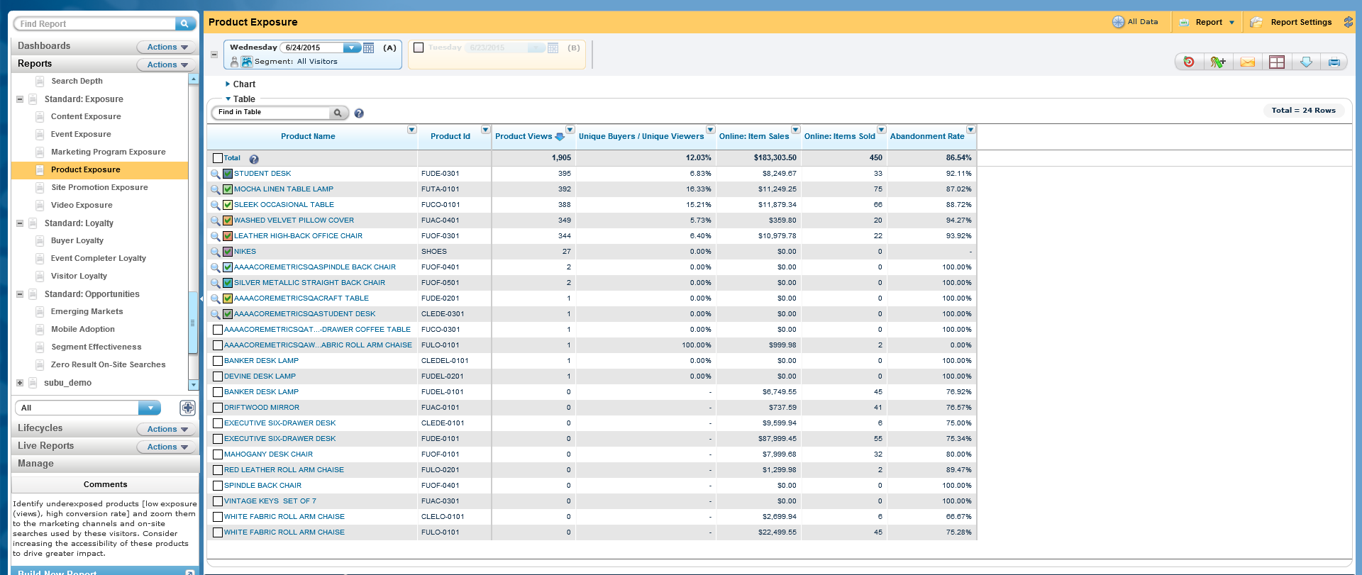
Flat List Report Example
Notes:
Now we will take a look at a few examples of flat list reports. In the example report shown in the screen shot, we are pulling the two data fields, Product Name and product ID. As you can see, the information is displayed in adjacent columns. The second column is tied to the first column displaying the product IDs for each of the product names listed.

Slide 12
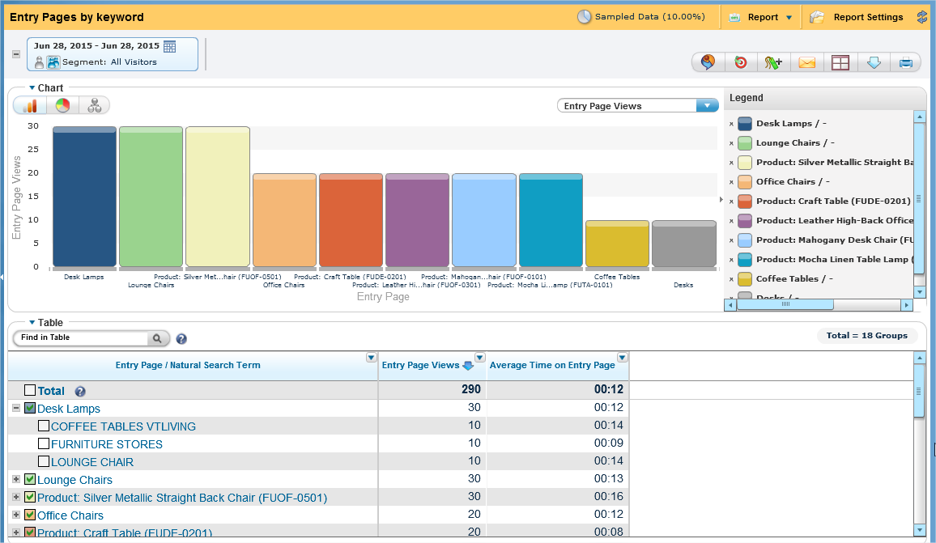
Hierarchy Report
Organize and analyze data fields in a hierarchical format
Select up to 5 levels (data fields) and 10 metrics
Pull up to 100 rows
Notes:
The hierarchy report allows you to display and organize data in an expandable hierarchy format. Through this report you can obtain aggregate metrics at each point in the hierarchy.
The hierarchy can be up to 5 levels deep, 100 rows and you can select up to 10 metrics. Each point in the hierarchy, minus the lowest level, can be expanded to display the data rolled up underneath.
Let’s take a look at the example of the hierarchy report more closely.

Slide 13
Hierarchy Report Example
Notes:
In this example, we are correlating the entry page with the natural search term used to access the entry page.
Using the first row, you can see that the entry page ‘Desk lamps’ had 30 entry page views. When we expand the desk lamp page, we can see the search terms used to access the page and how many page views out of the 30 were captured for each term.

Slide 14
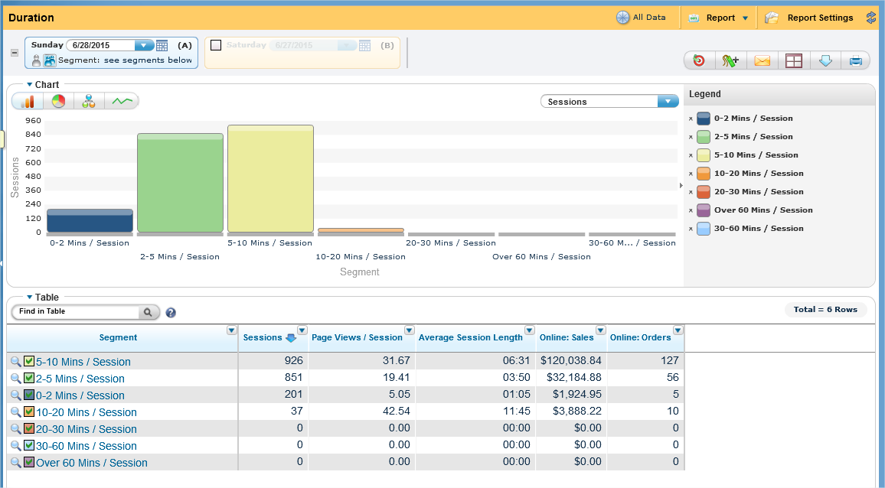
Segment Compare Report
Analyze and compare up to 10 segments side by side
Segment visitors based on specific criteria
Discovery actionable segments
Notes:
The next report type is called the segment compare report. It is important to understand different types of visitor groups who navigate your site but great insight can be discovered by comparing the actions of these unique visitor groups.
Through the segment compare report, you can analyze up to 10 segments side by side and discovery which segments are actionable.
We will now take a closer look at the segment compare example.

Slide 15
Segment Compare Report Example
Notes:
In this example, the segment criteria is session length. Looking at the data above, we can see the majority of the sessions on the site last between 5-10 minutes.

Slide 16
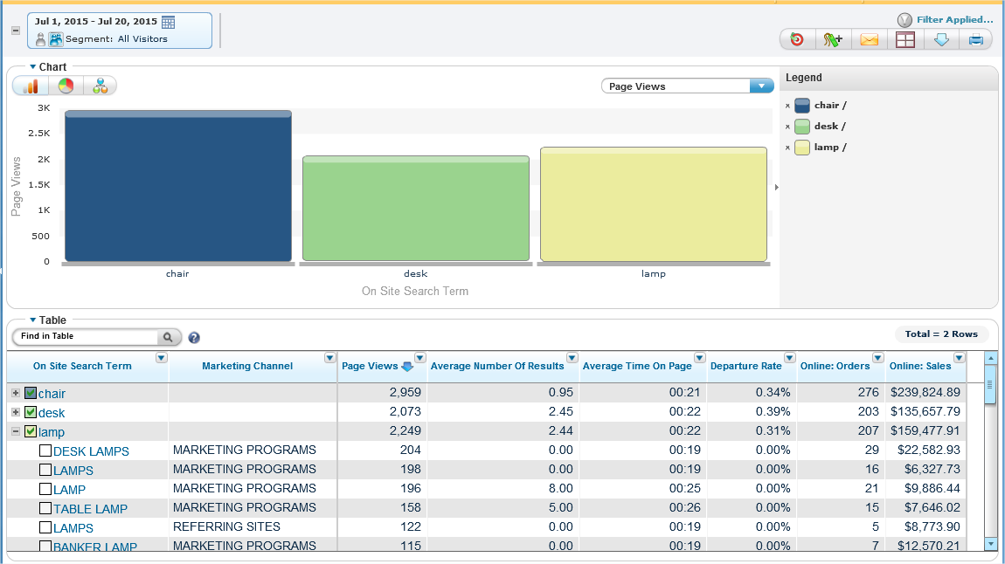
Filtered Groups Report
Create and view data groups and expand into these groups to reveal further details
View up to 100 categories side by side
Notes:
The filtered groups report displays data groups that can be expanded to reveal further data fields.
In this report type, you can view up to 100 groups side by side.

Slide 17
Filtered Groups Example
Notes:
The groups in this report are based on search term groups. Terms that contain the word lamp for example. Then we can see the corresponding Marketing Channel the visitor used to enter the site.

Slide 18
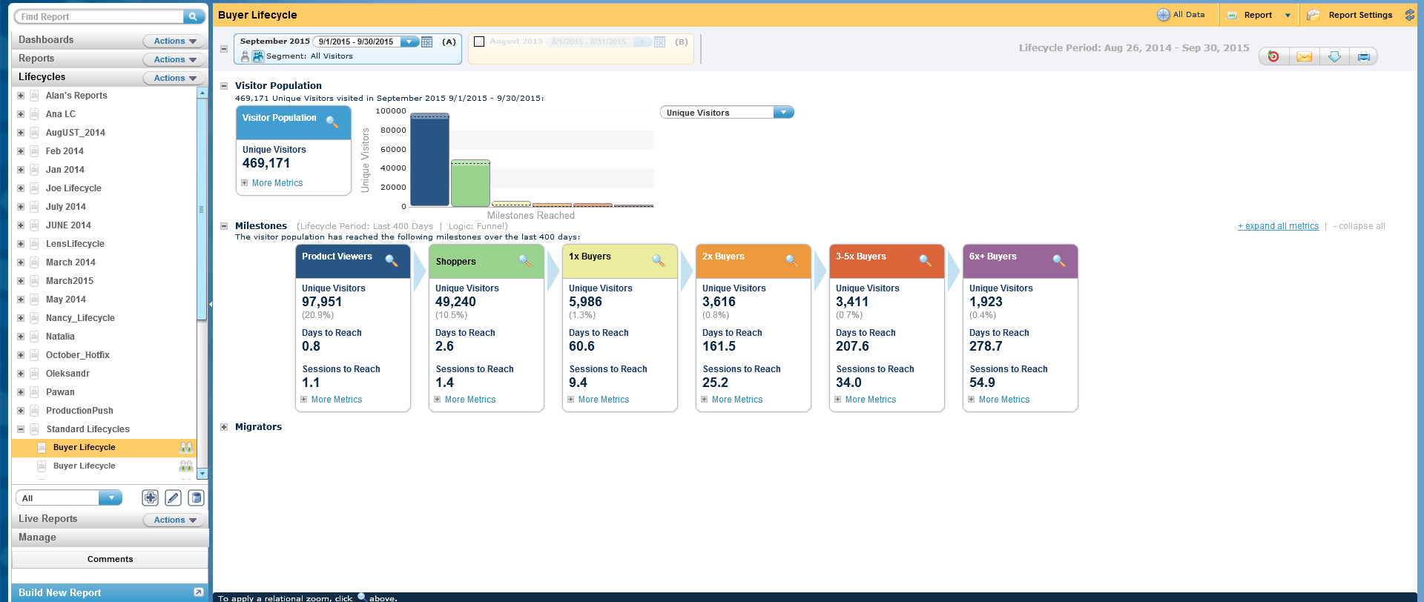
Lifecycle
Tailor marketing and site content to the preferences of your lifecycle segments
Discover insights that encourages customers to advance to the next milestone
Notes:
Lifecycle is report type that delivers an understanding of a customer
Lifecycle on your site and what motivates the customer to progress to the next milestone.
Lifecycle helps you understand which milestones your visitors reached and what
are the campaigns, products, and content that advance customers through the
lifecycle. You can then target these visitors to trigger advancement. Moving
customers along their path faster, leads to improved business results.

Slide 19
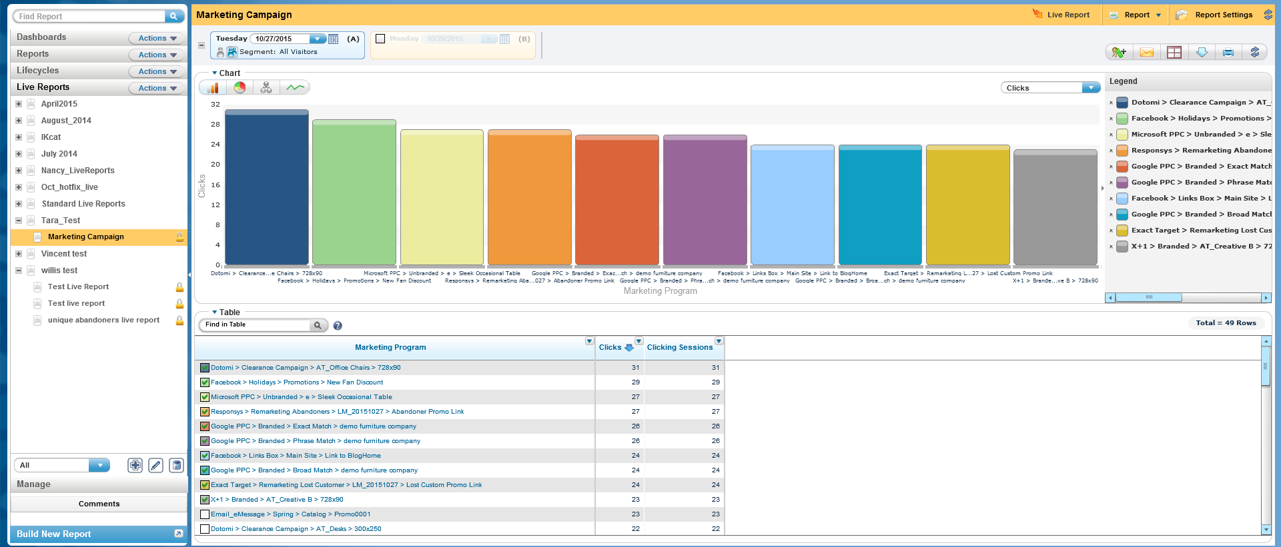
Explore Live
Real time reports
Update every 5 minutes
Notes:
Live reports are flat-list reports that update data in real time with hourly granularity. Live reports are used to see the most current data on your site and to
analyze hourly trends.
Live report data updates every 5 minutes and is retained up to 8 days.

Slide 20
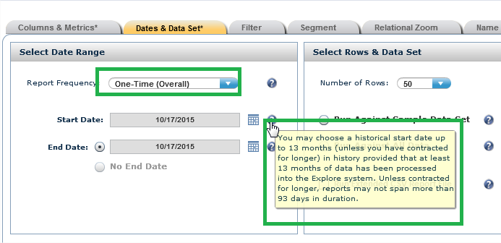
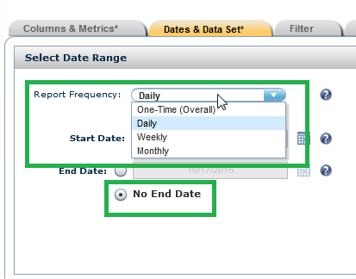
One-time vs Frequency Reports
One-time Reports
  Time based
  Date range can be 93 days
  Processed one time for the selected date range
  Can be sent to a distribution list via email
  Consumed report credits will be returned the following month
Frequency Reports
  Daily, Weekly or Monthly
  Report credits will be consumed automatically each month
  Can be sent to a distribution list via email
Notes:
When choosing a time frame, you also have the ability to select a one-time report or select a frequency.
One-time reports are time bound and have a maximum report date range of 93 days. The report processes one time for the report date range selected. Reports can be an aggregate of the entire date range or broken up into days, weeks or months. All consumed credits for a one-time report will be replenished in the next month.
Frequency reports can be processed daily, weekly and montly. Report credits will be consumed at the time of processing and will continue to be consumed automatically every month until the report is stopped.
Both report types can be emailed to a distribution list.

Slide 21
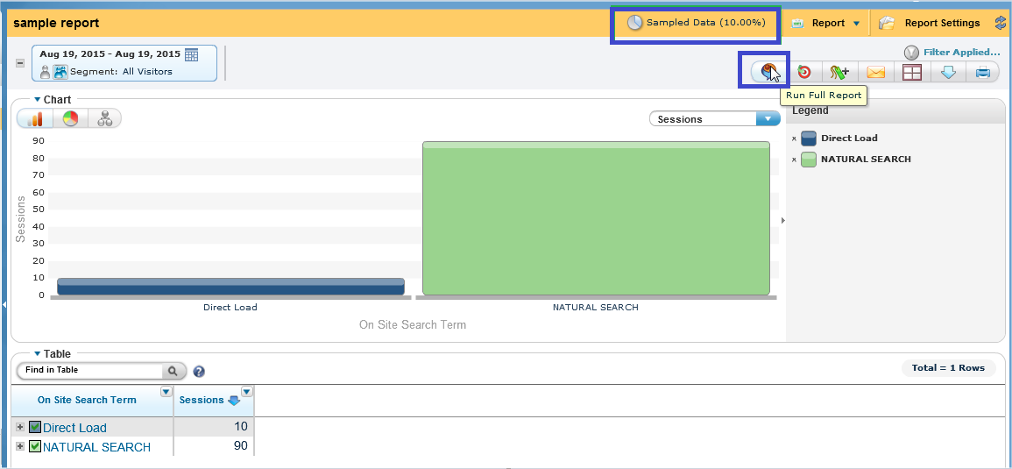
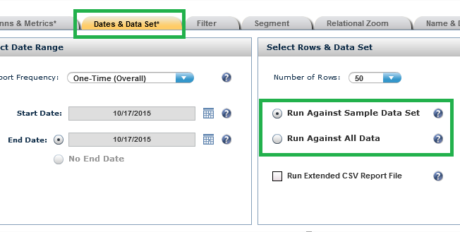
Sample vs Full Data Set Reports
Sample Reports
  Creates a test report
  Processes quicker than a full data set report
  Should not be used for analysis
  You can turn a sample report into a full data set report
Full Data Set Reports
  Returns full data captured
  Used for analysis
Notes:
Explore allows you to create sample reports and full data set reports. Sample reports use sample report credits and allow you to create a test report to ensure the report displays in the correct format for your business needs. Since the sample only uses a portion of the full data set, it processes quickly. The sample report should not be used for anlaysis.
Once you confirm the sample report displays in the manner in which you need, you can turn a sample report into a full data report to be used in your analysis.

Slide 22
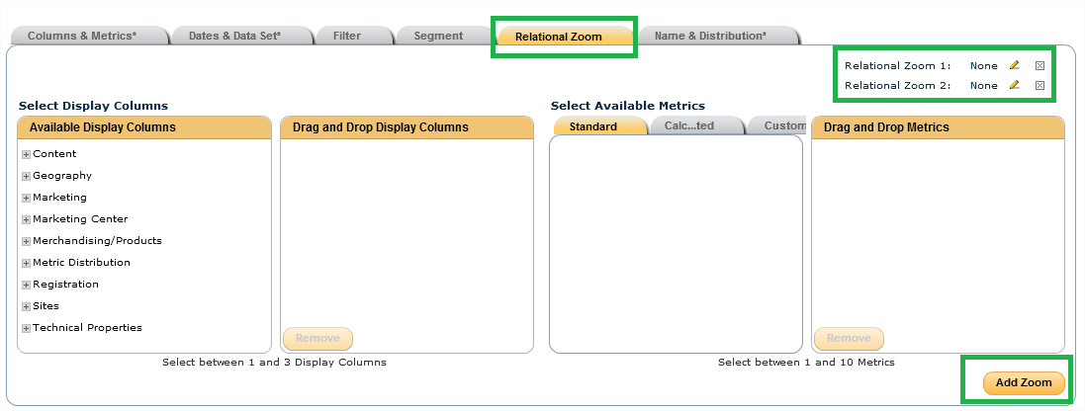
Adding a Relational Zoom
Correlate one set of data to one or two other sets of data for additional insight.
Only available within the Flat List Report type
Notes:
When you build a flat list report, you have the option to add a relational zoom to the data fields you selected. A relational zoom correlates one set of data to one or two other sets of data for additional insight.
Each relational zoom can have up to 3 data fields and up to 10 metrics.
A maximum of two zooms can be added to a report and the zoom will be available to the first 20 data fields.
The relational zoom is only available in the flat list report type.

Slide 23
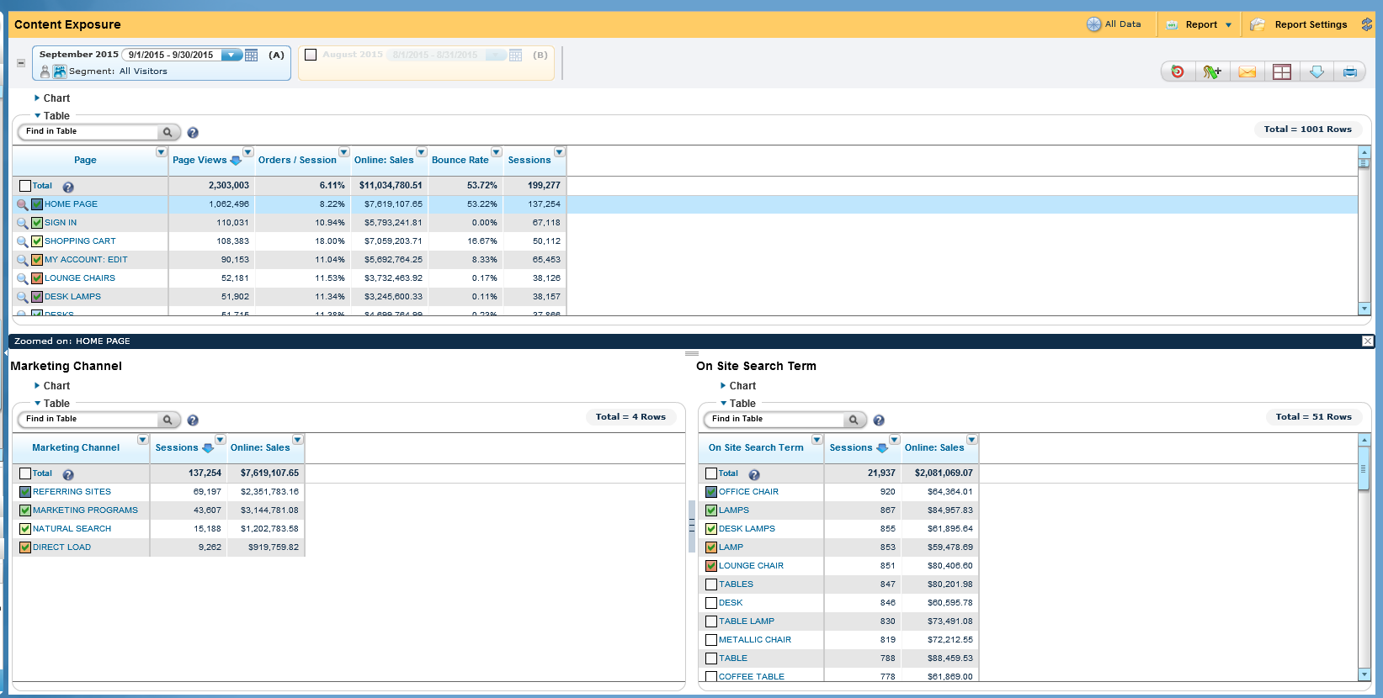
Relational Zoom Example
Notes:
This screen shot shows an example of two relational Zooms. We zoomed in on the home page and what the first zoom shows are the marketing channels that started a session on your site that viewed the home page. The second zoom shows the on-site search terms visitors searched in sessions that viewed the homepage.

Slide 24
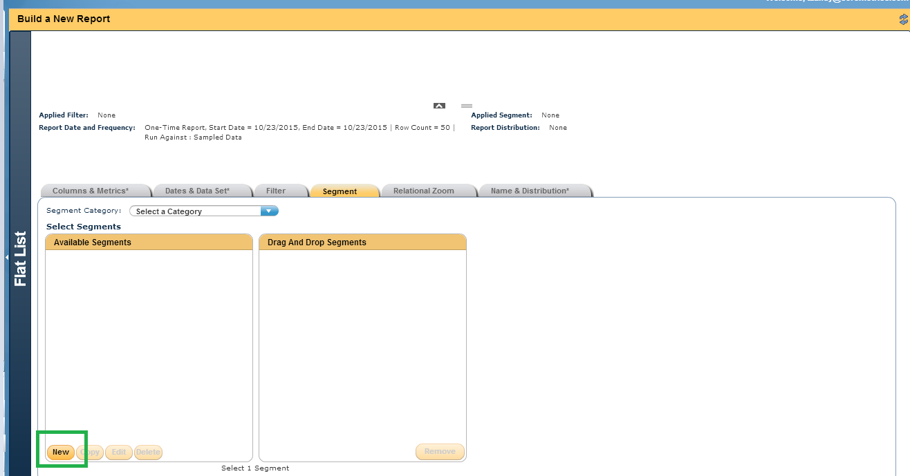
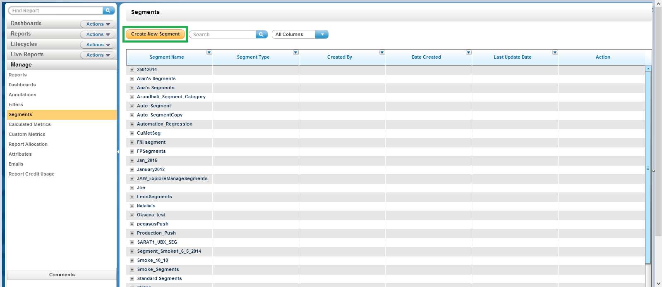
Segments
Segment limits your report to just the sessions that match your criteria
Create a segment under the segment tab or under Manage>Segments
Notes:
Another optional step within a report is adding a segment. As you know, segments will limit your report to only those sessions that meet the criteria of your segement.
There are two places in Explore to build a segment. When you are in the report build screen, you will need to click on the segment ab and select ‘new’. You can also manage segments within the manage screen in the left navigation pane. Through this section, you can create, edit and delete any segment.
If you want to edit a segment you will select the pencil icon next to the segment you want to edit. Be mindful of the frequency reports utilizing a segement as editing the segment will have an effect on these report moving forward.

Slide 25
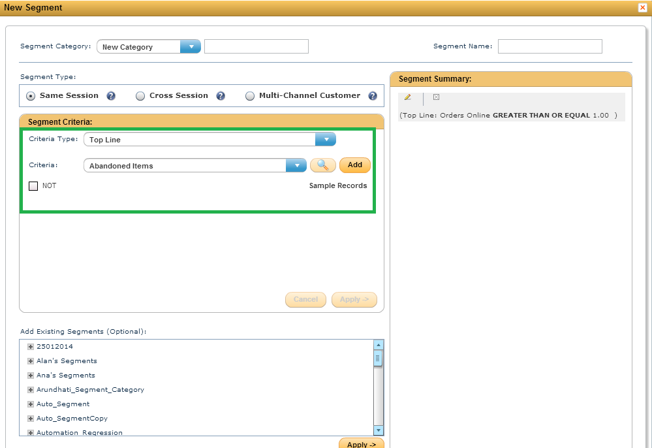
Steps to Build a Segment
Select the criteria type (topline, marketing, merchandising/products, content, etc.)
Select specific criteria (orders>= 1, page views between 1-10, etc)
Layer your criteria for more complex segmentation using AND/OR statements
Notes:
Building a segment is easy and can be done all in one screen. The first step is to select the criteria type for your segment. The criteria type is broken out into categories such as topline, marketing, merchandising/products, content, demographics, etc. The breakout is similar to the breakout found in Digital Analytics.
The next step is to select the specific criteria, orders> or equal to 1, page views between 1-10. You can also choose to layer your criteria for more complex segmentation using AND/OR statements.
Unlike Digital Analytics, segments in Explore are not time bound. You can use a segment for date ranges spanning the 400 days of data stored within Explore.

Slide 26
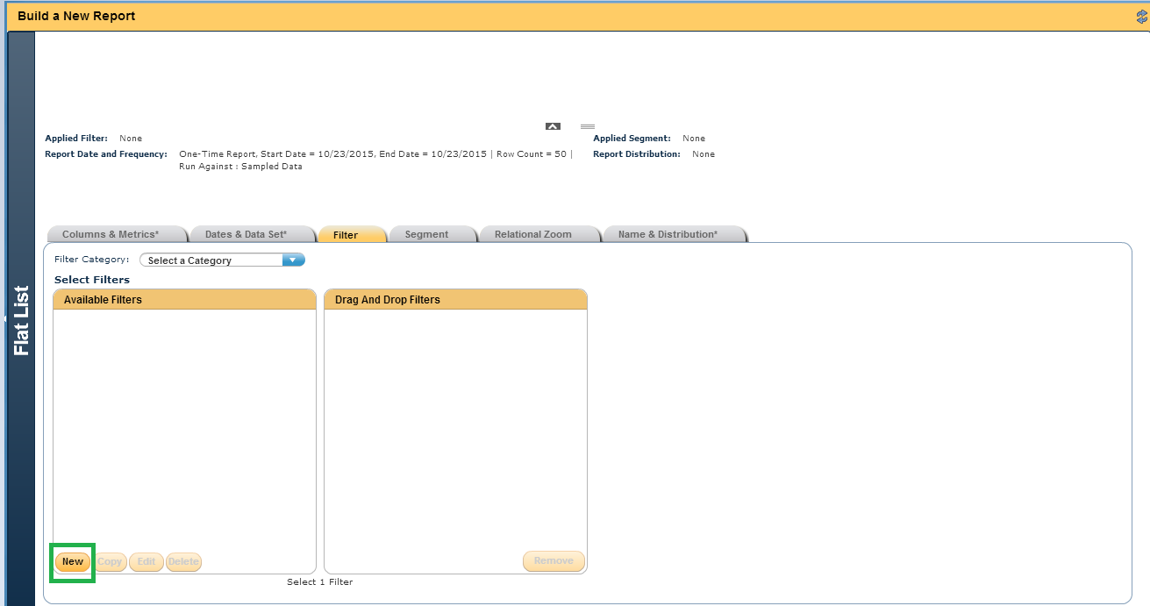
Filters
A filter narrows the report to just those rows that exactly match your criteria
You can build a filter in the report build screen by selecting the ‘filter’ tab and selecting ‘New’
Notes:
Filters are the third optional item you can add to a report. A filter will narrow down the report to show only those rows that exactly match the criteria selected for the filter. To help you understand a filter, you can think of how a filter works in Excel. You first pull the data field types into your report and then narrow down those data types to show only the items you want to view. An example would be the select pages as your data field and then filter the report to only show commerce pages. Another example would be to select marketing channels but filter the report to only show the natural search channel.
You can create a filter in the filter tab while building a report. Filters can be edited and deleted under manage in the left navigation pane.
If you want to edit a filter you can select the pencil icon next to the filter you want to edit.

Slide 27
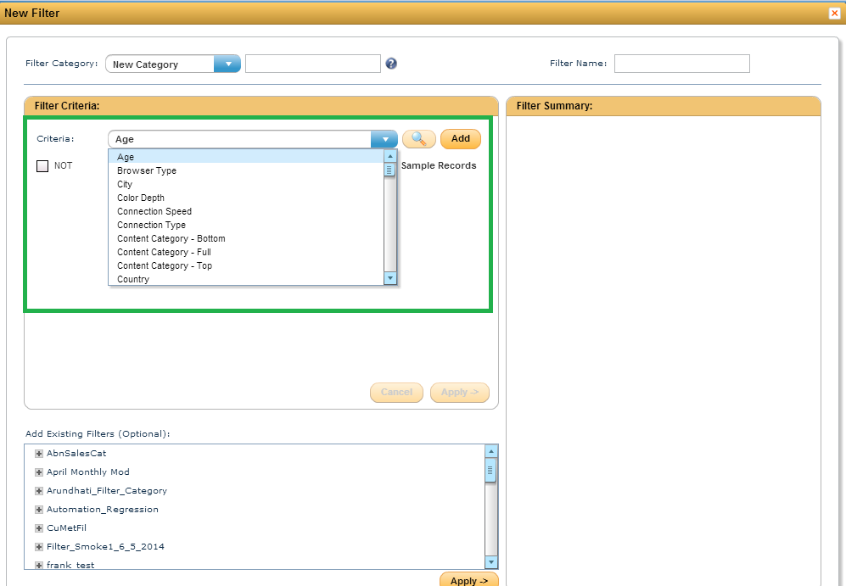
Steps to Build a Filter
Select specific criteria (Is mobile device IS Mobile, Browser type IS Firefox 38.0, etc)
Layer your criteria for more complex filtering using AND/OR statements
Notes:
The first step to building a filter is to select the criteria. You can use the magnifying glass located next to the criteria drop down to help ensure you enter criteria in the appropriate format.
Similar to a segment, you can layer criteria using AND/OR statements for more complex filters.

Slide 28
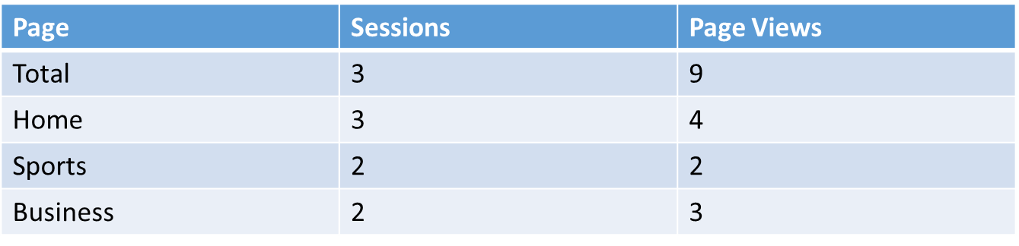
Segments vs Filters
Let’s look at an example of using a filter versus a segment!
Session 1 visited HOME, then SPORTS, then HOME and exited
Session 2 visited HOME, then BUSINESS, then SPORTS, then BUSINESS and exited
Session 3 visited HOME, then BUSINESS and exited
Report without a filter or segment
Notes:
Understanding the difference between a segment and a filter is a common question asked. We are going to look at an example to help clarify when to use a filter versus a segment.
In our example, 3 visits, also known as sessions, occurred on your site. The details for each session are displayed above. In the first session, the visitor viewed the home page, sports page and the home page again being exited the site. In the second session the visitor viewed the home page the business page, then the sports page, the business page again, then they exited the site. In the third session, the visitor viewed the home page and the business page before exiting the site.
If no segment or filter are added, the report will display as shown. There are 3 total sessions and 9 total page views. The three pages viewed within the session, home page, sports page and business page are shown as well.

Slide 29
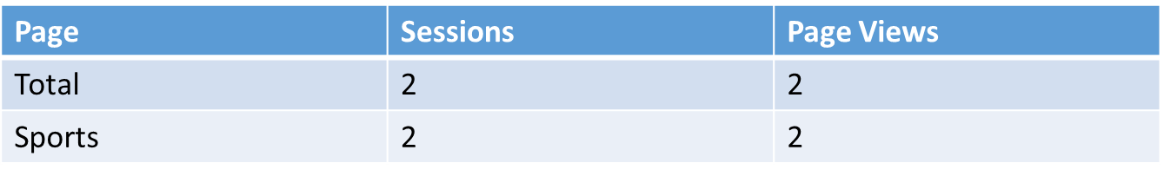
Segments vs Filters: Filter Example
If you create and apply a filter with the criteria
  Page Contains Sports
Below shows the data the report will displace once processed
Notes:
Now let’s take a look at what the report would look like if we added a filter. The criteria of our filter is going to be page contains sports. Now if we take a look at the report, we can see we have now narrowed the report to only display metrics for pages containing sports. Since there were only two sessions, that viewed the sports page, only those two sessions are shown.

Slide 30
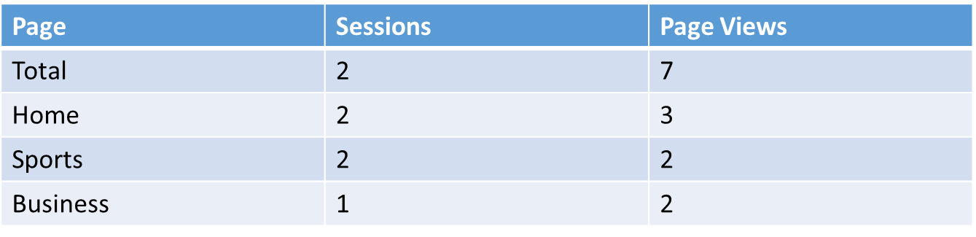
Segments vs Filters: Segment Example
If you create and apply a segment with the criteria
  Page Contains Sports
The report will consider all sessions matching your criteria and get results from session 1 and session 2, since both sessions involved a page view for the sports page
Below shows the data the report will displace once processed
Notes:
Now let’s take a look at how the report would be displayed if we add a segment. Our segment is going to have the same criteria, page contains sports. Now instead of seeing only the sports page displayed like we saw in the report with the filter, we now will see what pages were viewed by sessions that contained a sports page.
There were two sessions that contained the page sports, within those sessions the visitor also viewed the home page, sports page and business page. Therefore you will see all these pages displayed within the report.

Slide 31
Tag Attributes
Each tag type has fields to collect specific pieces of information plus 50 extra fields to collect additional pieces of information based on business goals
These 50 extra fields are called attributes
Reports can be built in Explore to pull data collected via attribute information
Attributes must be aliased prior to being utilized within a report
These fields can be aliased via admin>explore attributes
Notes:
Earlier in this presentation we mentioned one of the features of Explore was to pull reporting on tag attributes. We will now discuss what a tag attribute is and how you can utilized tag attributes in reports.
Every tag type has set fields collecting specific pieces of information. Any additional pieces of information that don’t fit the criteria for the standard fields can be collected through attributes.
An example of an attribute is if you are interested in collected a refinement of an on-site search via the page view tag. You can collect inventory status and the number of product ratings through the product view tag and date of birth and gender through the registration tag.
Once you are collecting attributes, you can create reports based on these attributes. Attributes are not reported on in Digital Analytics.
Each tag type can collect up to 50 attributes. Once attributes are being collected via the tag, they must be aliased within the Admin screen in order to be used within reports.

Slide 32
Report Credits
In order to process a report in Explore, you must have available report credits.
Two types of report credits
  Sample credits
  Full Data Set credits
Notes:
In order to process a report in Explore, you must have available report credits.
The number of credits available to an organization is expressed via the client contract.
In order to increase report credit allotment, please contact your account representative
One report credit will be used for date ranges selected up to a month (day, week and 1 month)
For a report spanning several months, one report credit will be used for each month selected within the report.
One-time reports will use report credits within the current month the report is processed and will be returned in the following month
Frequency reports will continue to consume report credits each month until the report is stopped

Slide 33
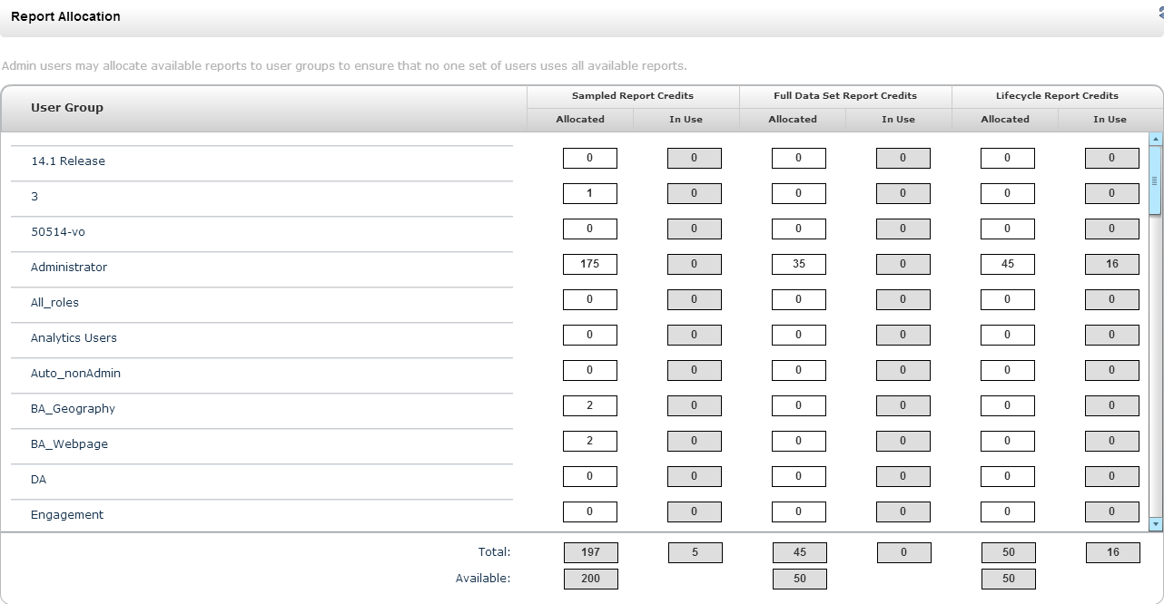
Report Credit Allocation
Reports are allocated first by client ID
More information on the steps to take allocate credits to different user groups and client Ids can be found under the ‘Help’ icon in the Explore interface
Notes:
Once a client ID has an allotment of credits, these credits can be dispersed to different user groups
Report allocation by user group can be found under Manage>Report allocation in the left navigation pane.
You can manage the amount of credits allocated to each user group based on the level of usage each group requires.

Slide 34
Report Credit Usage
It is important to monitor the reports using credits
Under Manage>Report Credit Usage, you can see all frequency reports by name/report category, the number of credits being used and the creator of the report
Clean up and stop all reports not being used in order to maintain report credit allocation for useful reports
Notes:
It is important to understand how your report credits are being used. Through the report credit usage screen, you can observe which reports have used or are using report credits each month.
You will want to clean up you instance of Explore and stop the frequency reports no longer being used.

Slide 35
Explore Resources
Explore User Guide-located under ‘Help’ icon in the top right hand corner of the Explore Interface
Videos: located under the ‘Help’ icon in the top right hand corner of the interface
  Building a Segment Compare Report
  Re-allocating Explore Credits
  Creating a Filtered Groups Report
  Building a Flat List Report
  Building a Hierarchy Report
  Building a Lifecycle Report
Web based training-IBM Digital Analytics Explore-located on the support site
Notes:
There are several resources you can use to further understand how to Use Explore.
I will read through each of the above resources.

Slide 36
Q&A
The Customer Support team is available to provide support via the following channels:
  E -mail: Sunday 8:00pm - Friday, 7:00 PM U.S. Central
  Phone: Sunday 8:00pm - Friday, 7:00 PM U.S. Central
  US: 1-866-493-2673
  cm_support@us.ibm.com
Live Chat (for Business Support only): Sunday-Friday, 8:00 PM – 6:00 PM U.S. Central
  Live Chat is available from the home page of the IBM Client Success Portal
  https://support.coremetrics.com
IBM Client Success Portal: 24 x 7

