Slide 1
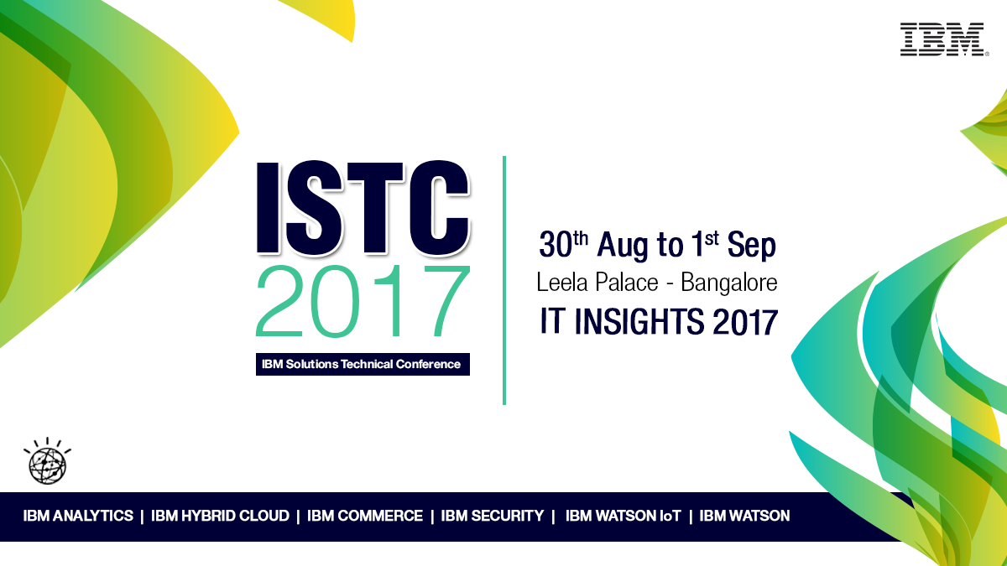

Slide 2
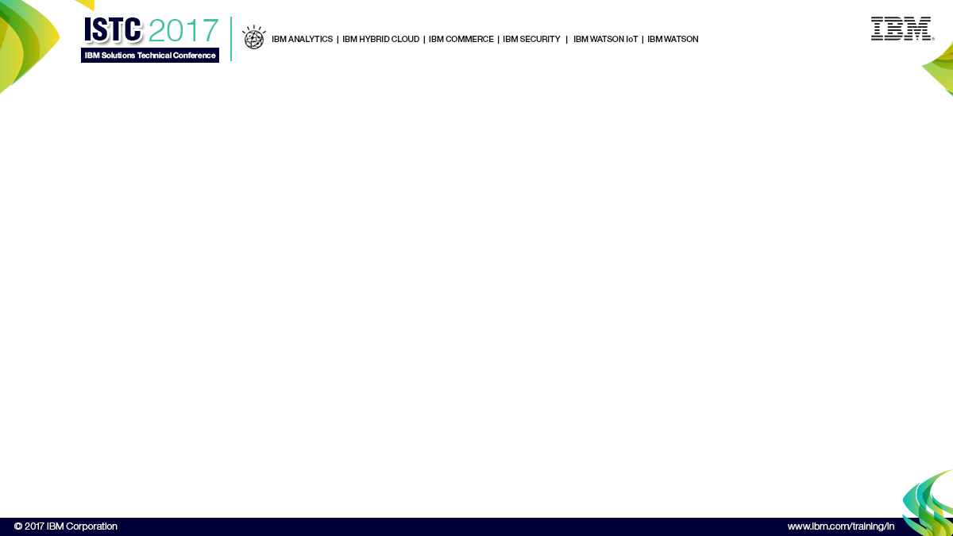
Integrating IBM Campaign 10 and IBM Watson Campaign Automation
Dinkar Kale(IBM Watson Campaign Automation Technical Support)
Sujit Shet(Senior consultant, Watson Marketing)

Slide 3
Agenda
Why & What this integration enables?
Integration components.
Configuration required in IBM Campaign v10 with WCA Integration.
Setting up Watson Campaign Automation.
Configuring UBX toolkit.
Key things to remember.
Integration Scenario.
Watson Campaign automation Program feature.

Slide 4
Why ?
Bring together the best of capabilities between IBM Campaign and WCA.
IBM Campaign 10 – On Premise, Multiple Database support, Rich Segmentation for targeted marketing campaigns.
IBM Watson Campaign Automation – Cloud based, messaging capabilities & deliverability, supporting multichannels like email, sms, mobile push, social media.
Combine IBM Campaign with WCA for Campaign segmentation power with the messaging capabilities of Watson Campaign Automation.

Slide 5

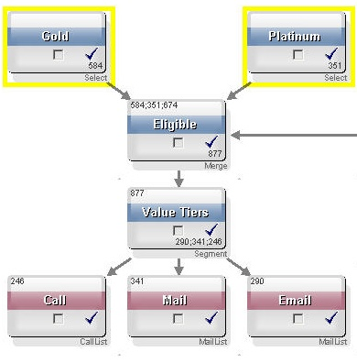

IBM Campaign Capabilities
  Used to plan, design, execute, measure and analyze personalized marketing campaigns
  Capable of managing all types of large-scale, multi-wave and cross-channel campaigns
  Creates a “marketing system of record” for offers, segments and interaction history
  Recognized best-of-breed functionality, scalability and record of customer success
  Serves as integration hub for add-on modules:
    Email marketing
    Contact optimization
    Real-time interactions
    Distributed marketing

Slide 6
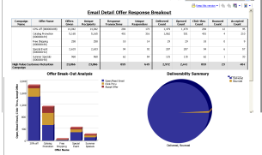
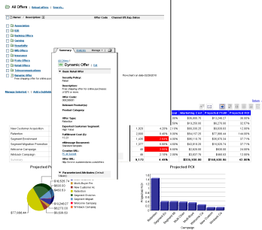
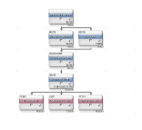
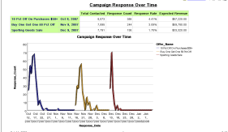
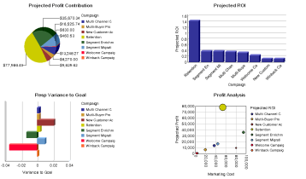
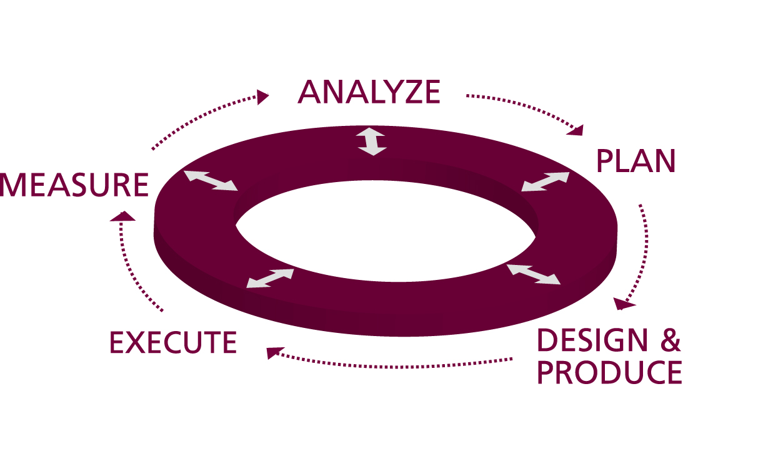

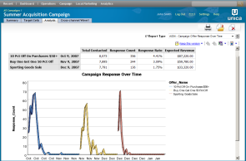
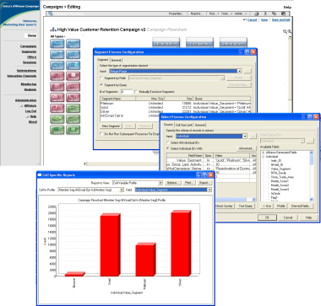

Supports the End-to-End Campaign Management Cycle
Campaign performance
Offer performance
ROI analysis
Response attribution
Response history
Offer management
Strategic segments
Target cell spreadsheet
Sizing
Suppressions
Contact
history
Logic
Offers
Response
history
Segments
Multiwave scheduling
List generation
Contact history
Segmentation & targeting
Offer & channel assignment
Output formatting
Campaign validation

Slide 7
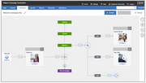
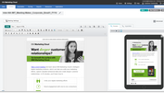
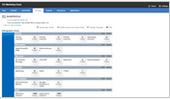
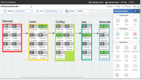
Watson Campaign Automation Capabilities
IBM Watson Campaign Automation
Campaign Automation
Email, mobile, social, marketing
Lead management
Journey design

Slide 8
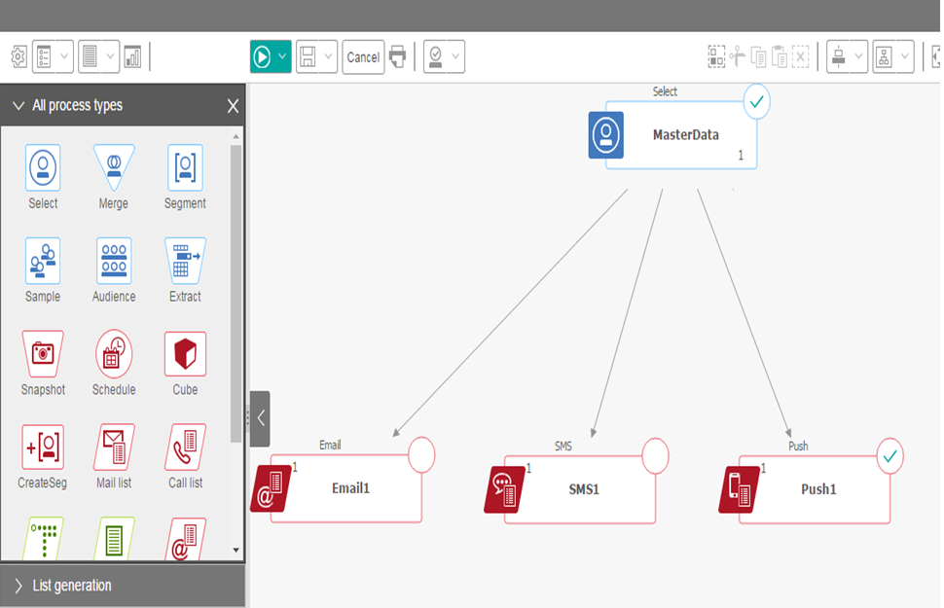


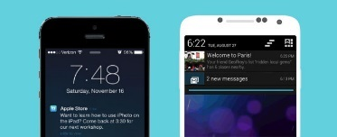
What this integration enables ?
Email
SMS
This enables Marketers to designs a single flowchart to select and segment master data and send marketing messages to various channels
Mobile Push

Slide 9
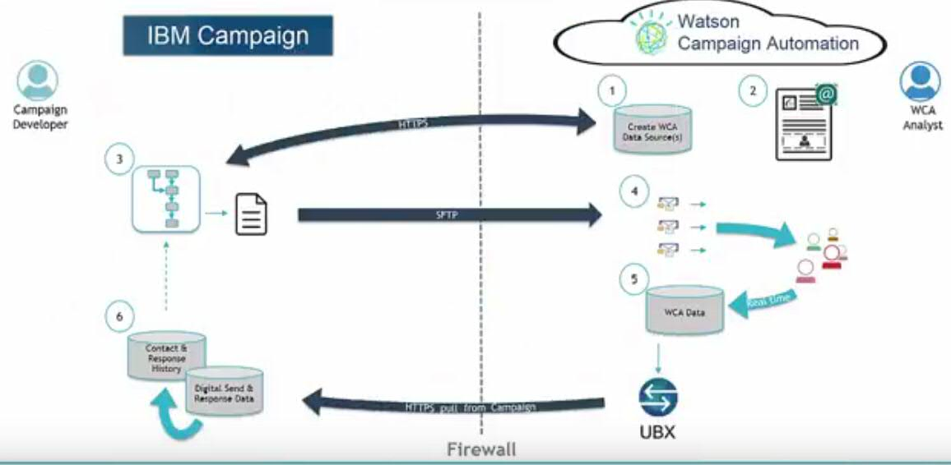





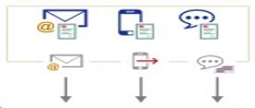





Integration components
1
Select recipients in a flowchart and exports to TSV file
1
2
IBM Watson Campaign Automation
2
Triggers integration to upload data to WCA via FTP/SFTP
IBM Campaign
3
WCA updates database and contact lists
4
4
WCA creates messages with uploaded data for Email/SMS/Push channel
3
5
5
WCA sends out Email/SMS/Push messages
6
Recipients receive the messages and respond
7
Responses received by WCA and sent to UBX
8
7
6
User responses
8
Campaign download response data with the integration or UBX toolkit
Contact and Response

Slide 10

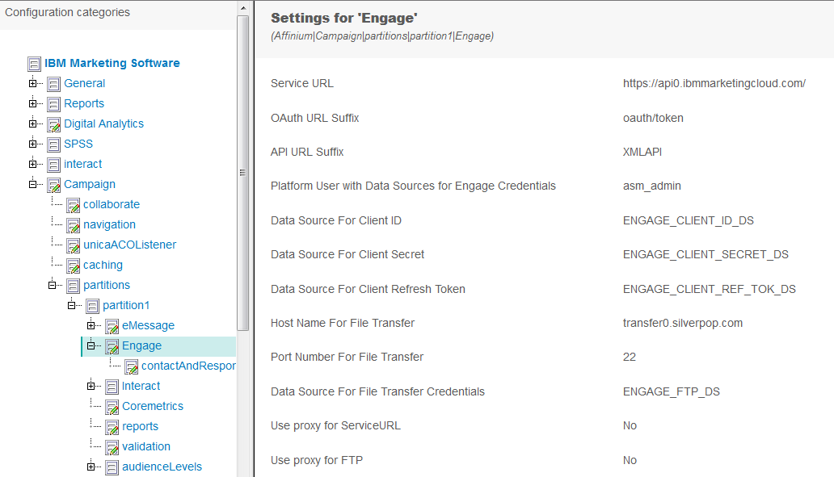
Campaign configurations

Slide 11
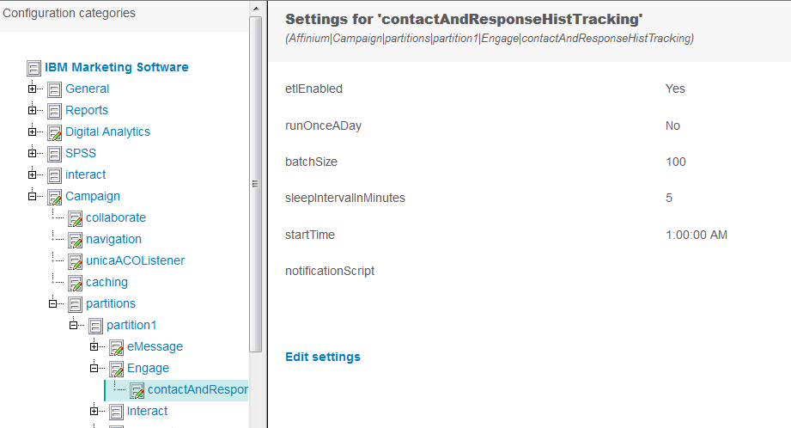
Campaign configurations
Campaign configurations

Slide 12
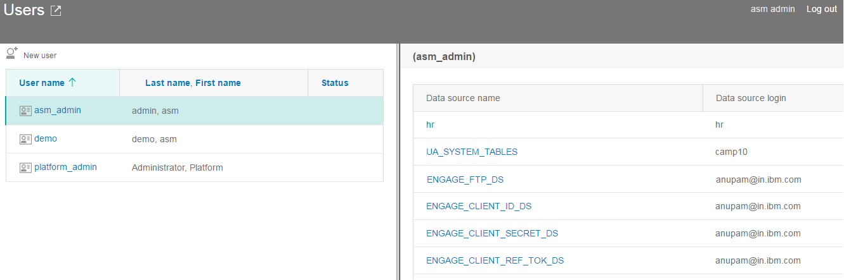
Campaign configurations
Campaign configurations

Slide 13
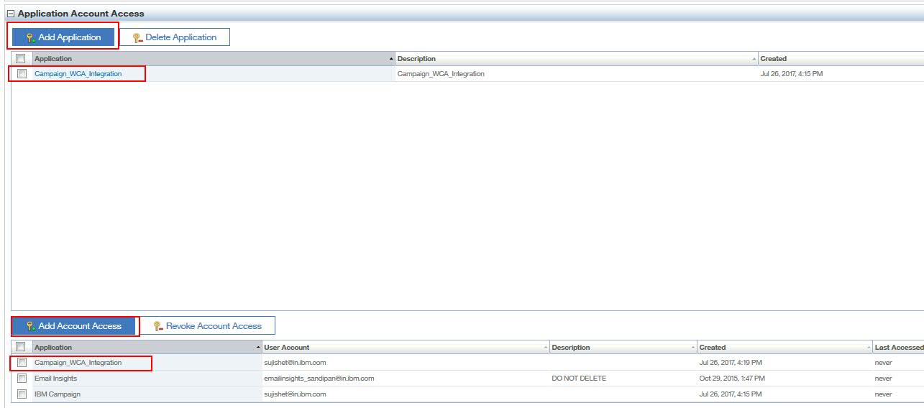
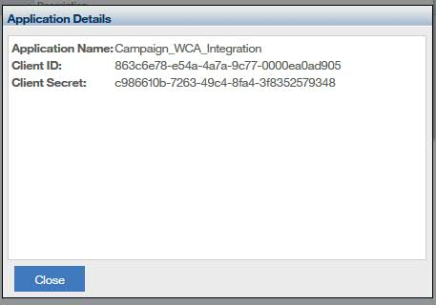
Watson Campaign Automation configurations

Slide 14
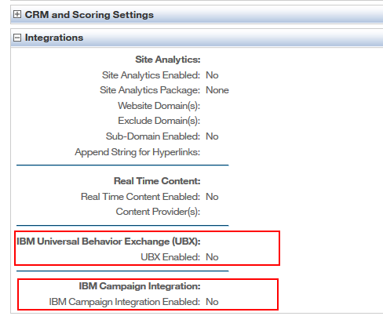
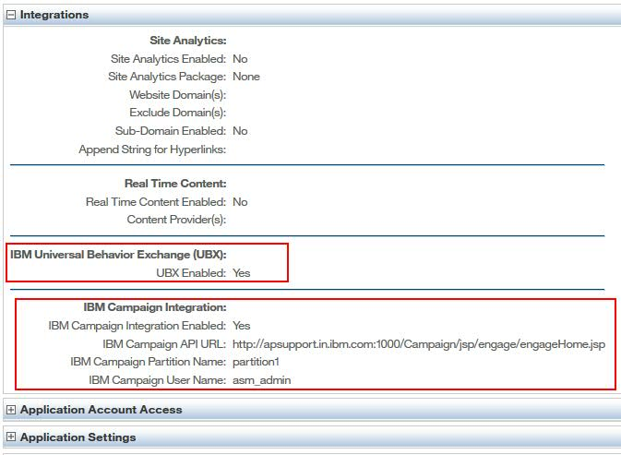
Watson Campaign Automation configurations

Slide 15
IBM UBX: Universal Behavior Exchange
Real Time, Cloud Based Data Integration Service from IBM.
Exchange data about customers/users and their behavior.
Provides a framework to selectively exchange events and audience data between IBM and/or Partner applications.
Avoids the need to develop complicated point to point integration between applications.

Slide 16



IBM UBX Toolkit for IBM Campaign
The UBX Toolkit provides a way for locally installed applications/On Premise applications like IBM Campaign, to interact with IBM UBX.
IBM Campaign

Slide 17
IBM UBX Toolkit for IBM Campaign
Download the UBX Toolkit from IBM Developer Works as a compressed file archive.
Extract the archive to a directory on a local server.
Modify UBX Toolkit environment files( properties, xml) to reflect paths in your local environment.
Register UBX endpoints in the UBX user interface, updating UBX toolkit configuration properties, and running the endpoint registration script.
(Optional) Encrypt the configuration settings for enhanced security, as required by your business security policy.

Slide 18
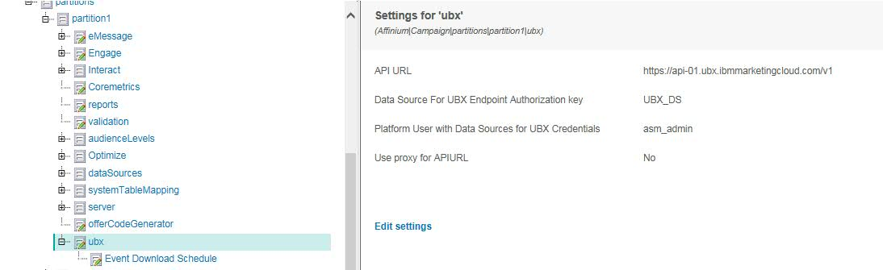
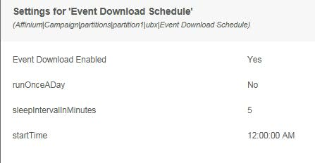
IBM Campaign UBX settings

Slide 19
IBM UBX configurations
IBM Watson Campaign Automation

Slide 20
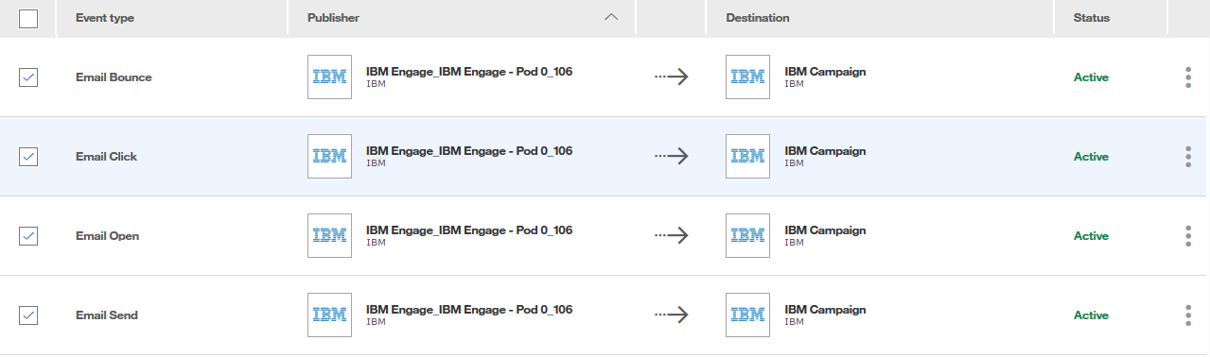
IBM UBX Configuration
Events configured to capture the Email responses from Watson Campaign automation as Source.
Captured Event data send to IBM Campaign Destination table landing on IBM Campaign Database.
Using ETL function in IBM Campaign transfer the UBX data to IBM Campaign Database table.

Slide 21
Key things to remember
User related:
Standard User with no password expiration
Needs permissions for Data access, Add/Remove Contacts from Contact Lists, Edit Queries, Upload Content
Generate OAUTH credentials (client id, client secret, refresh token) for script API access
Configuration related:
The datasource which is added under asm_admin user should have same names as configured under Engage node of Campaign > partitions > partition[n]
The user for the datasources added under asm_admin should be the IMC user and password should be according to the datasource
For example, the datasource names ENGAGE_CLIENT_REF_TOK_DS should have the password as actual refresh token generated for the user and not the IMC login password

Slide 22
Key things to remember …continued
SMS related:
Each organization can have only one SMS-enabled database.
If your organization is also Mobile Push Notification-enabled, the organization can have one SMS database and one Mobile Push database or one database that is enabled for both SMS and Mobile Push Notification.
Once you enable a database for SMS, you cannot choose to use another database. Please keep this in mind when you decide which database you want to use for SMS.
Single opt-in database, flexible database (with no unique identifier).
Add the SMS Phone Number type field.
The contact data that you provide for sending SMS messages must include a consent field that provides the CONSENT_STATUS_CODE. The only allowed values for CONSENT_CODE are OPTED-IN or OPTED-OUT. The values must be in uppercase and written in the exact phrase. Engage can send SMS messages only to recipients whose record is marked OPTED-IN.

Slide 23
Integration Use Case Scenario
Collect the data in one location to perform segmentation, sampling on data to fetch relevant customers.
Send personalized message to segmented contacts using various channels like Email, SMS, Push in single run of flowchart.
Collect the response data from Engage to IBM Campaign using UBX for further analysis.

Slide 24
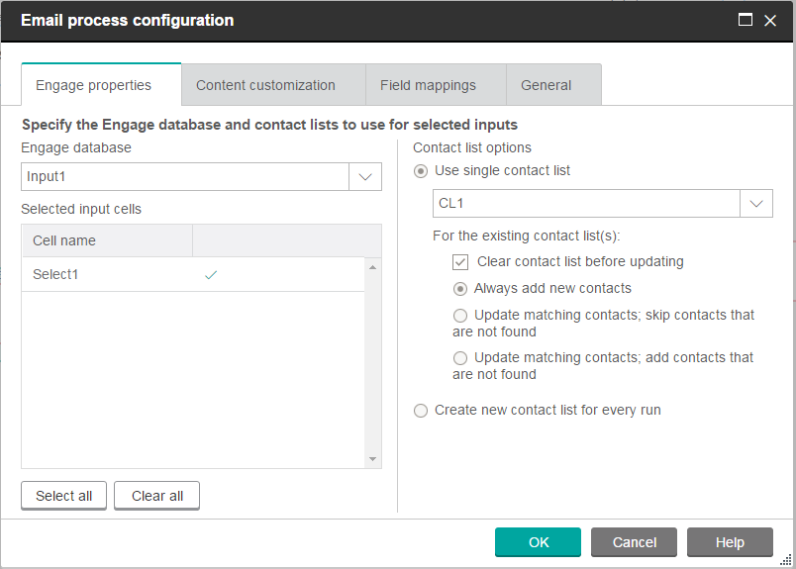
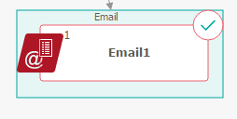
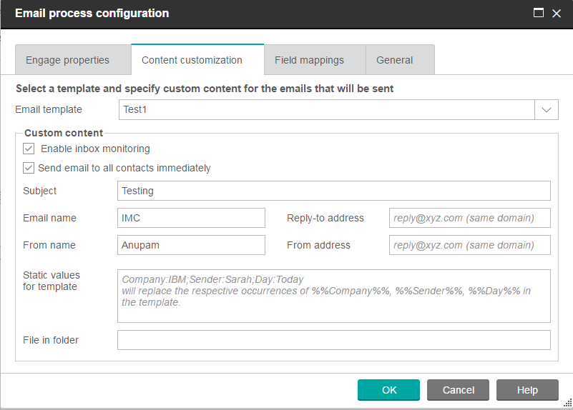
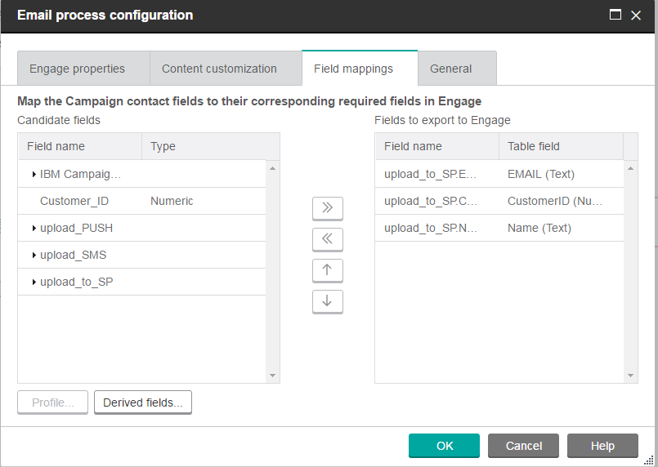
Campaign:
Setting up Email

Slide 25
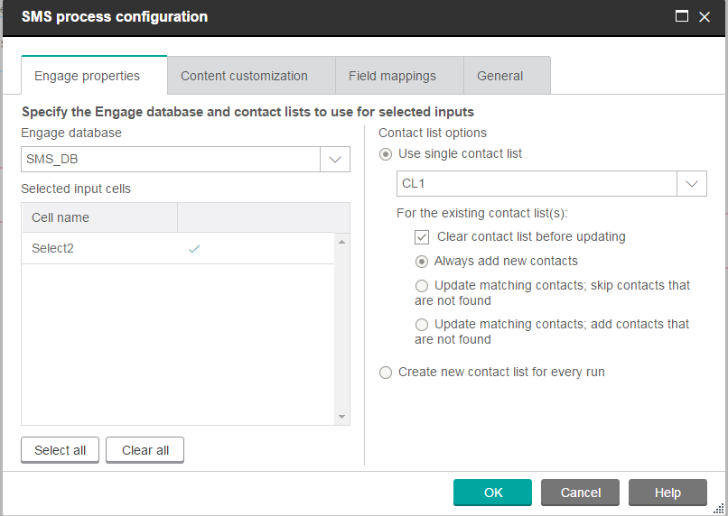
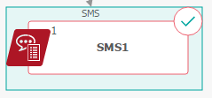
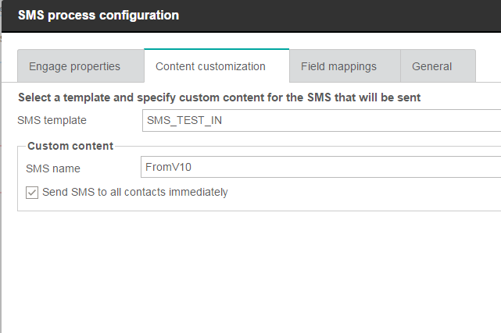
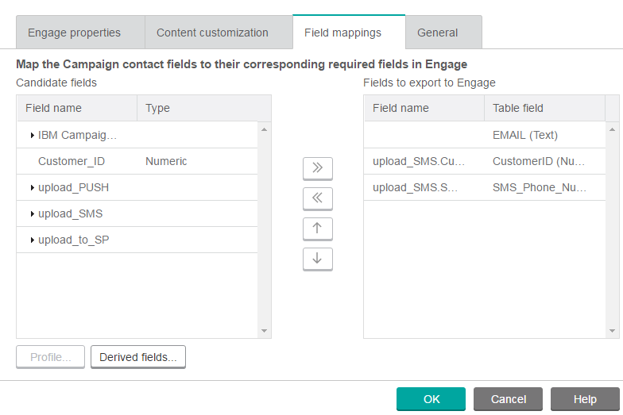
Campaign:
Setting up SMS

Slide 26

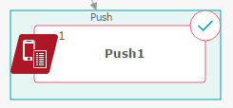
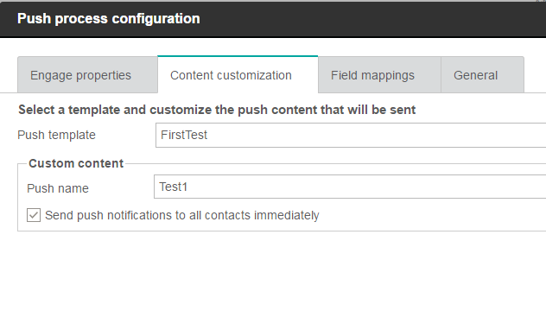
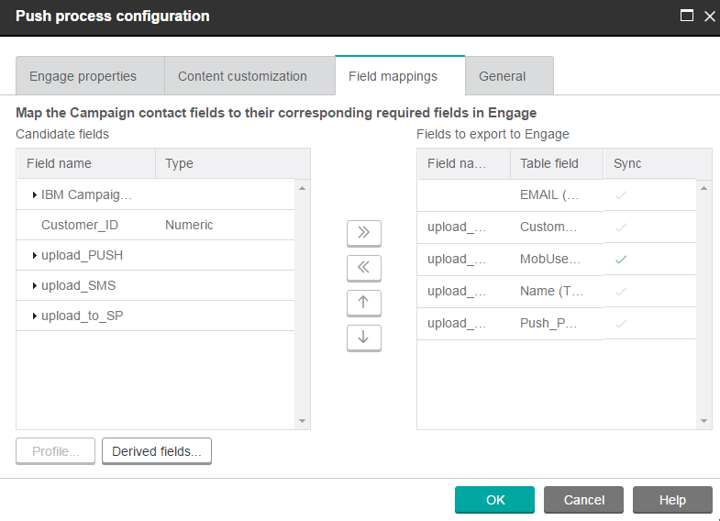
Campaign:
Setting up Push

Slide 27
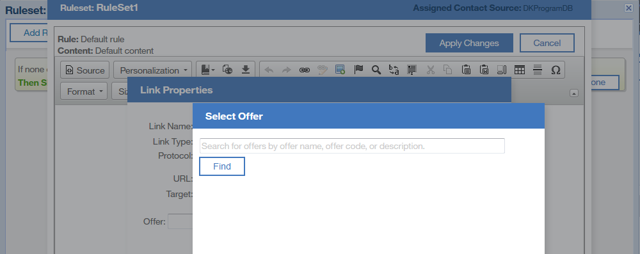
IBM Campaign Offers availability in Watson Campaign automation.
Offers from Campaign can be made available to Watson Campaign Automation to be assigned to images or links in an email message.
Establishing this relationship adds tracking codes to the contact and responses events Engage publishes to UBX.
Published events data enables contact and response history to be automatically created in Campaign and natively analyzed in Campaign’s Cognos-based performance reports.

Slide 28
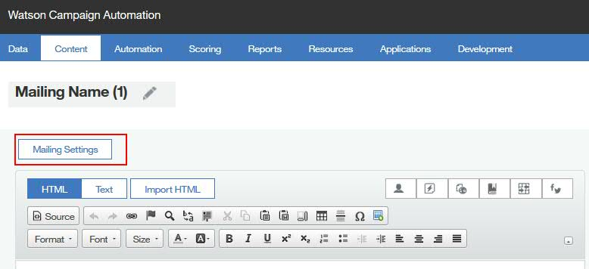
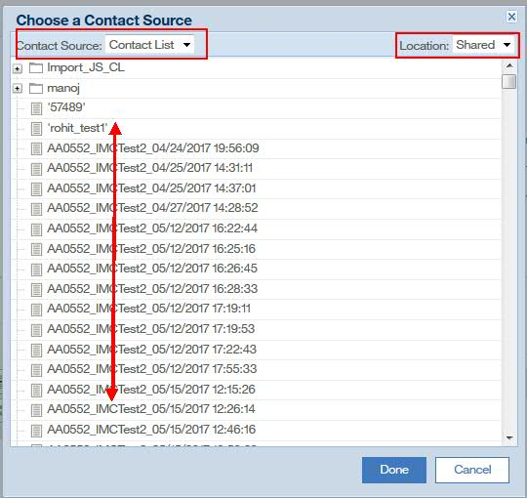
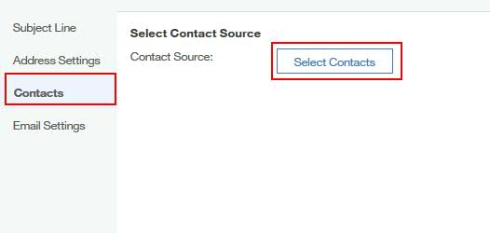
Send Mailings from Watson Campaign Automation
Select the campaign contact list in the WCA Mailing template.
The Contact List from Campaign will be available in WCA at shared location.

Slide 29
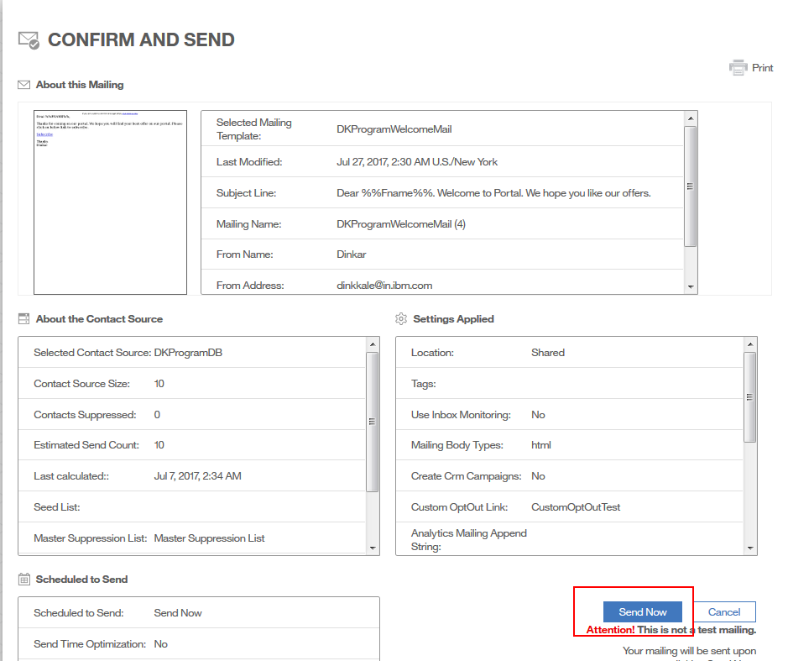
Watson Campaign Automation Send Page

Slide 30
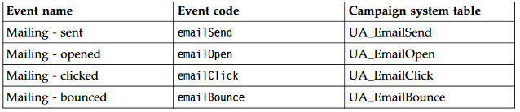
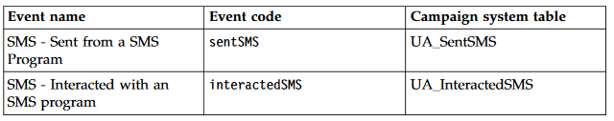
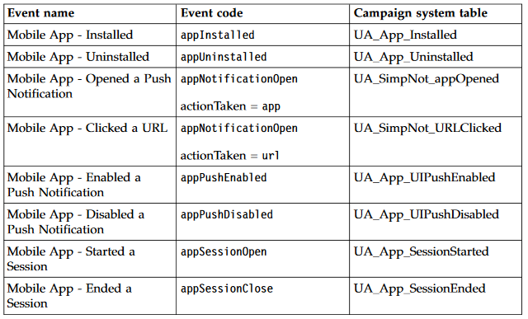
User Event data
Event data: Stored in Campaign DB
User Event data: Clicks/Open
IBM WCA
IBM Campaign

Slide 31
Important feature in Watson Campaign Automation : Program
A program is a multi-channel behavioral marketing module that allows a user to create a virtual conversation with a contact by sending the right message and the right time.
Build it and forget it, after the program has been activated it moves your contacts though the steps making decisions, and responding based on the contacts behaviors.
A Program gives you the ability to visualize and organize your campaign so you know what and when a piece of communication is being sent to contacts.
Programs also give the user more flexibility in creating a truly interactive marketing campaign.

Slide 32
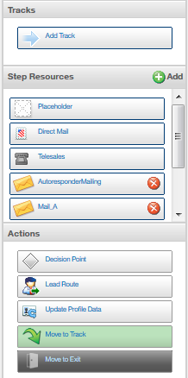
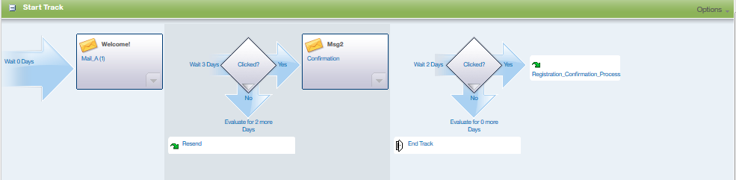
Programs in Watson Campaign Automation

Slide 33

Programs in Watson Campaign Automation

Slide 34

Programs in Watson Campaign Automation

Slide 35

Programs in Watson Campaign Automation

Slide 36

Q&A

Slide 37
Thank you very much.

Slide 38
Disclaimer
The information contained in this presentation is provided for informational purposes only.
While efforts were made to verify the completeness and accuracy of the information contained in this presentation, it is provided “As Is”, without warranty of any kind, express or implied.
In addition, this information is based on IBM’s current product plans and strategy, which are subject to change by IBM without notice.
IBM shall not be responsible for any damages arising out of the use of, or otherwise related to, this presentation or any other documentation.
Nothing contained in this presentation is intended to, or shall have the effect of:
Creating any warranty or representation from IBM (or its affiliates or its or their supplies and/or licensors); or
Altering the terms and conditions of the applicable license agreement governing the use of IBM software.

