Slide 1
Digital Health Check

Slide 2
Session Agenda
Purpose: Provide a basic understanding and the importance of doing a digital health check of your Digital Analytics Page Tags.
Objectives: At the end participants will be able to:
  Better understand the importance of validation in their page tags
  Provide a digital pulse of how their page tags are performing, easy fixes, and what steps are needed to bring their tags back to life.

Slide 3
Why check your heartbeat?

Slide 4


Heart Arrhythmias
Bradycardia
Atrial Tachycardia
© 2015 IBM Corporation

Slide 5


Why Check Page Tags?
Validate your data
Consistency in data collection
Human’s make mistakes
It’s healthy
Notes:
- Doing things like this client or that client

Slide 6
How Can I View Tags!

Slide 7
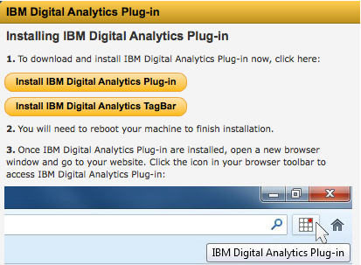
How Can I View Tags?
Digital Analytics Plug-in > TagBar
  Manage > Installation > Tools Browser Plugin

Slide 8
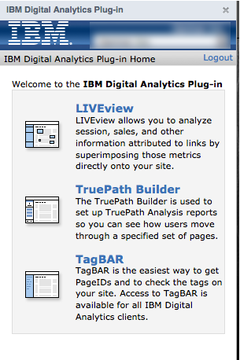
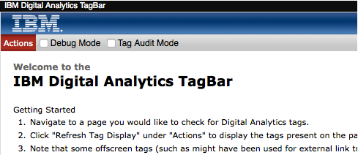
Plugin vs. TagBAR
Plugin
  Must be logged in to use it
  Provides additional features (e.g. LIVEview, TruePath Builder)
TagBAR
  Standalone TagBAR
  No login required

Slide 9
TagBAR Options
Debug Mode
Tag Audit Mode

Slide 10
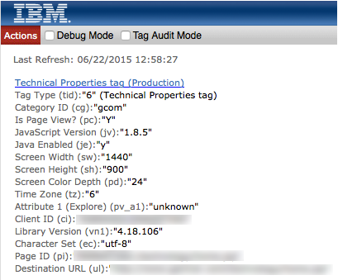
TagBAR Options
Debug Mode: Hidden IBM-generated parameter data (e.g. Page Start Time (st), Random (rnd), and any applicable (cj*) Client Managed 1st Party cookie parameters. Event-generated Tags, such as Link Click tag, Link Impression tag and Form Action tag.
Debug Mode Off

Slide 11
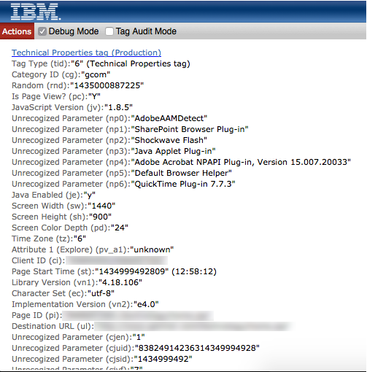
TagBAR Options
Debug Mode: Hidden IBM-generated parameter data (e.g. Page Start Time (st), Random (rnd), and any applicable (cj*) Client Managed 1st Party cookie parameters. Event-generated Tags, such as Link Click tag, Link Impression tag and Form Action tag.
Debug Mode On

Slide 12
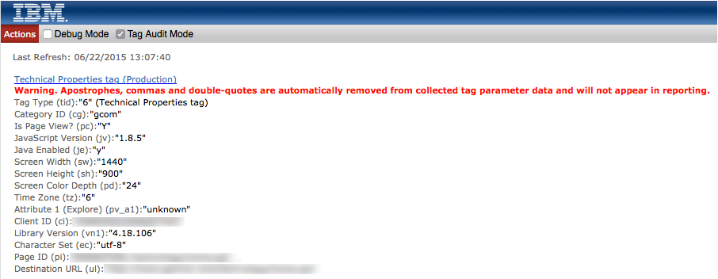
TagBAR Options
Tag Audit Mode: Checks tags and tag properties to ensure validity as well as informative information.

Slide 13
Consistency

Slide 14
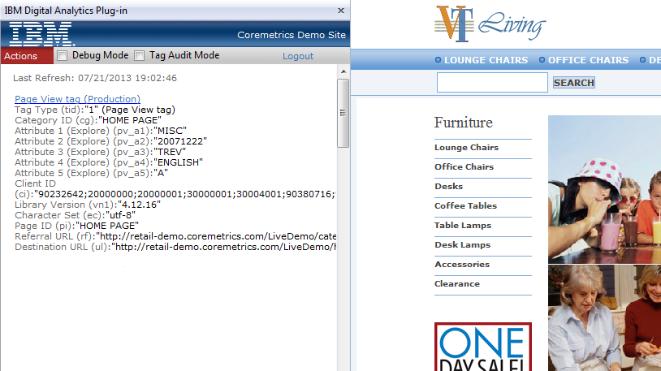
Consistency
Page View Tags
  Is every page tagged
  Only one page view tag per page

Slide 15
Consistency in Categories
Content Category ID
  Are they defined on every page and following your organization’s structure
Product Category ID
  Is every single product offered assigned with a Product Category ID
  Page Category ID & Product Category ID should have the same value

Slide 16
Category Definition File
The Category Definition File maps every category ID sent in tags to a display name and a parent category. The file should be uploaded to Digital Analytics through the https://import.coremetrics.com Import GUI, or the FTP account that is configured and managed through the GUI.
The Category Definition File is a comma separated values (CSV) file. Each line describes a category in the hierarchy. Each line has four values:
  Client ID
  Category ID
  Category Name
  Parent Category ID.

Slide 17
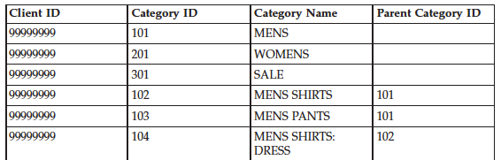
CDF Structure
Category ID, Category Name, and Parent Category columns (2-4) values can be in uppercase, lowercase, or mixed case for character sets having multiple case values. All CDF column values are converted to uppercase upon import to Digital Analytics.

Slide 18
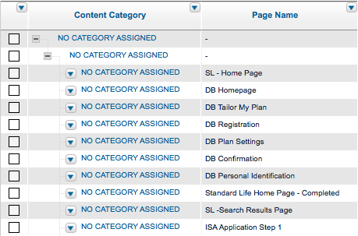
No Category Assigned
Top Level “No Category Assigned”
  Page tags contain category ID, but the category ID is missing from the CDF file.
Subcategory “No Category Assigned”
  Page tags do not send category ID information when page tags fire.

Slide 19
Successful Search Terms
Successful searches should populate the Onsite Search Word(se) parameter.
Successful searches should also include the number of results found.

Slide 20
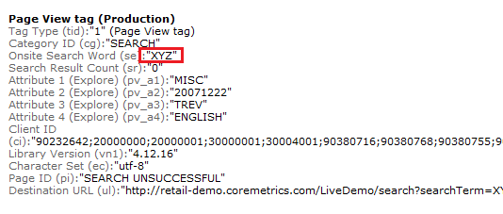
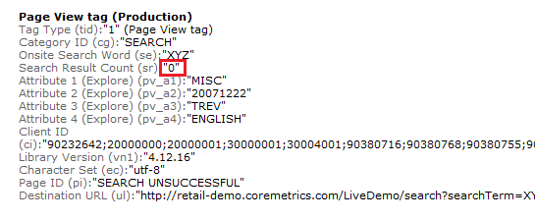
Unsuccessful Search Terms
Unsuccessful searches should populate the Onsite Search Word(se) parameter.
Unsuccessful searches should also include the number of results found.

Slide 21
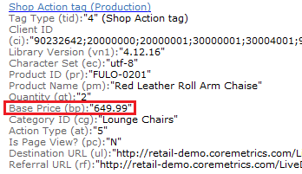
Shop Tags
All price fields are numbers only
No currency Symbols
No thousand separators
Dot used as decimal point

Slide 22
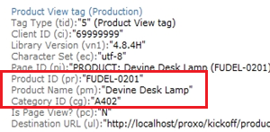
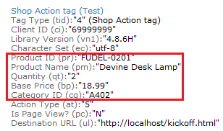
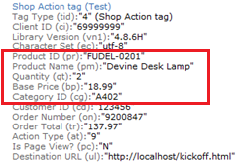
Shop Tag Consistency
    The same values are used for product ID, product name, and category ID in product view, shop5 and shop9 tags and base Price in Shop 5 and Shop 9 tags for the same product matches.
    - Base Price in Shop tags does not include tax/shipping/etc

Slide 23
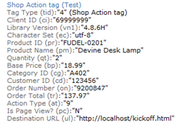
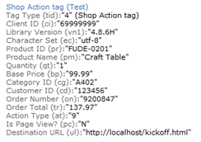
Order Tag
    Page View Tag is triggered
    Order Tag is triggered with all required values
      Order ID
      Order Subtotal
      Order Shipping
      Registration ID
    Shop Action 9 is sent for each item

Slide 24
Q&A

Slide 25
Tag Audit
Need a tag audit or further questions?
  Brandon Madsen – bmadsen@us.ibm.com

