Slide 1
Tagging For Business Users
Matthew Erstad
April 29, 2015
Notes:
Again, welcome – My name is Matthew Erstad and today we will be covering Tagging for Business Users.
The purpose of this webinar & training is to help you understand how we collect data from your site and how that data is mapped back to your reporting.
Knowing this will provide you with the expertise needed in identifying where and how your site data lives within the Digital Analytics suite. Reason this is important is not only for your day-to-day report monitoring of that data – but also to make sure the appropriate tags are implemented on your site to capture the necessary information to track your current and future marketing efforts.

Slide 2
Agenda
What are tags?
Why is understanding tagging important?
How can I view tags?
What are the standard tag types?
How do tags map to Analytics reporting?
Additional Resources
Conclusion
Q&A
Notes:
Today’s agenda will cover:
What are tags
Why is it important to understand tagging
How can you view the active tags on your site
What are the set standard tag types
How we take those tags and map them to the reporting
And cover where you can get additional resources on this topic

Slide 3
What are tags?
JavaScript function calls = “tags”
Data collected at browser level when “tagged” page rendered
Data parameters, or tag fields, in the tag communicate information about pages and visitor activities
IBM Digital Analytics defines the fields in the tags in which data will be passed
Values passed in tags fields is defined client side
There can be several methods or tag types that can be used for tracking a site feature
  Different pages will have different tags
  One page can have multiple tag types
Notes:
Digital Analytics collects data at the client browser level using javascript function calls we refer to as tags. Data from these tags is collected when a tagged page is rendered on the visitors browser.
data parameters, or tag fields, communicate information about pages; visitor activities such as carting a product, completing a purchase, registering an account, or interacting with a particular page element. Each tag type for Digital Analytics has a set of required and optional parameters used to further illustrate the visitor experience.
The parameter values we see passed within these tag fields is defined by your internal development team. Even though we outline some standards – there is flexibility with how and what you may use in tracking the pages and features unique to your site and business.
For that reason – pages on your site will not always house the same set of tags.

Slide 4
Why is understanding tagging important?
Vital to understanding how Digital Analytics collects data and what reports are telling you about your site
Identify tags Know What & Where Data is Collected
Answer Reporting Questions with Ease
Identify Data Gaps for Improved Data Collection
Notes:
Understanding the individual tags is vital to understanding how we’re using the tags to build your reports which then translates into the story of how visitors are interacting with your site. If you can identify tags on your site you can then map the information you’re seeing in the tags back to your reporting.
If you’re charged with reporting on a particular function or a new campaign for your site – knowing the basics of tagging allows you to easily determine if your site is collecting that data and later which reports you will use for analysis.

Slide 5
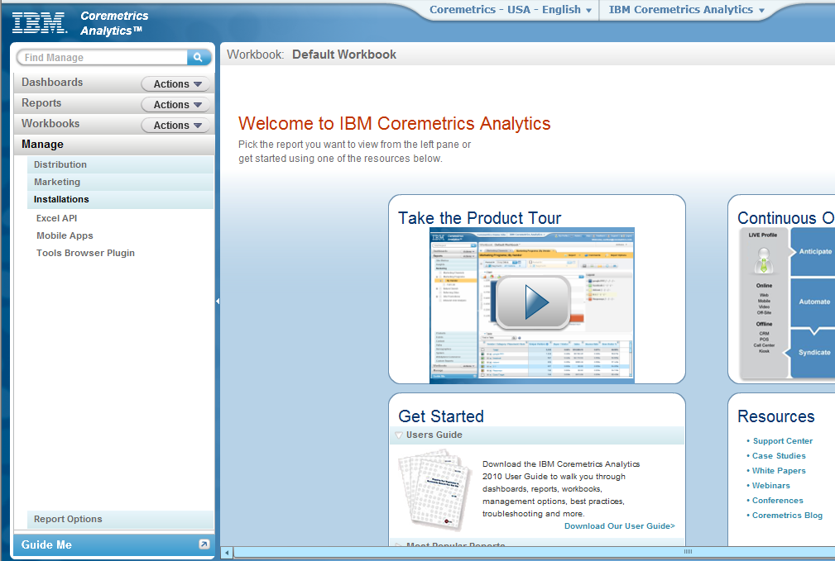
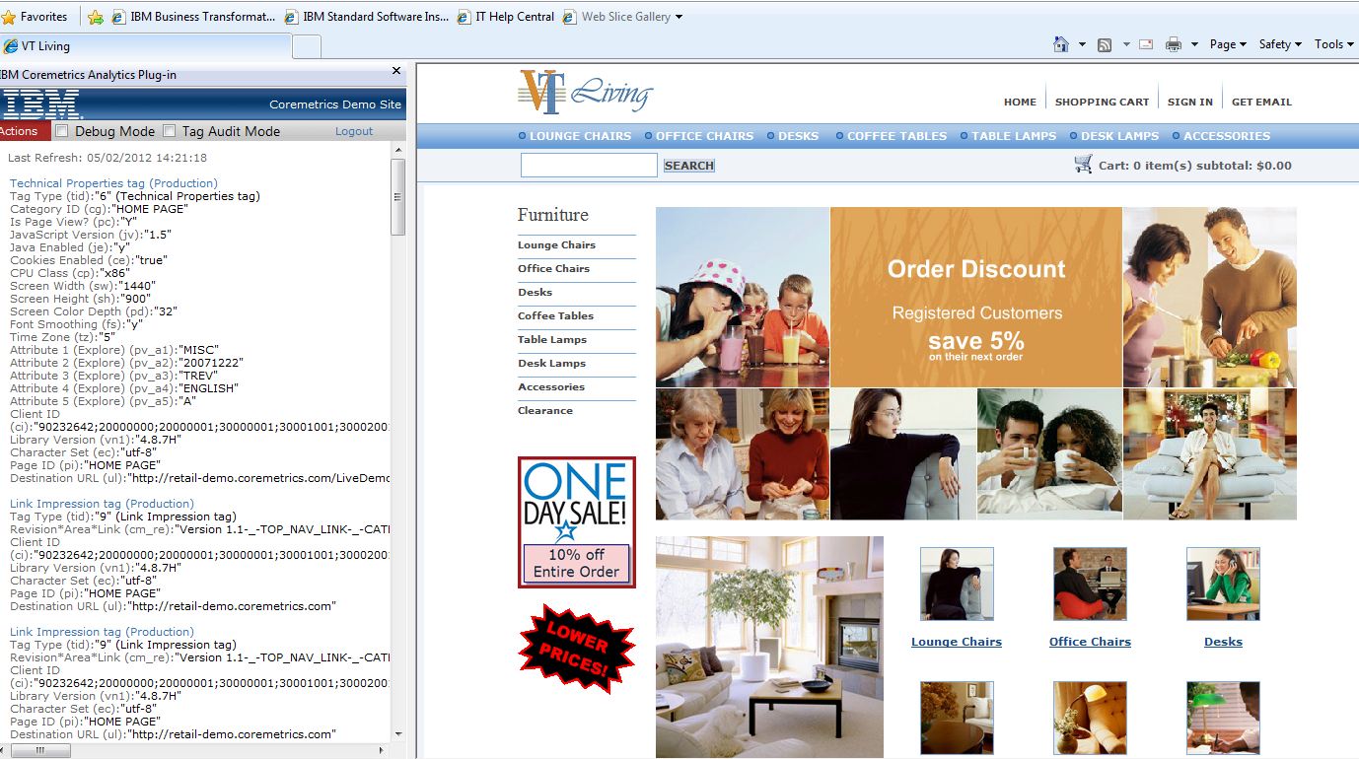
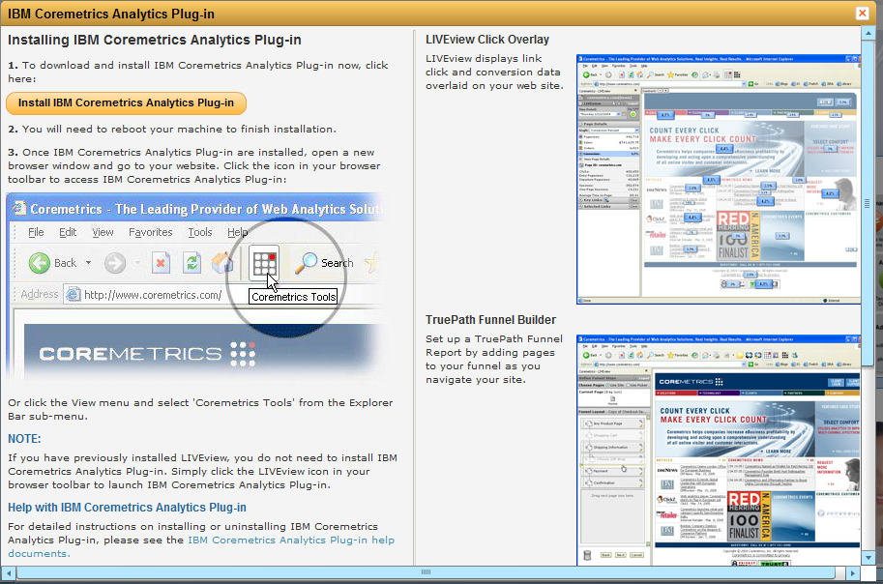
How Can I View Tags?
IBM Digital Analyitcs Plug-in > TagBar
Notes:
Since its important for not only Developers, but also Business users, to confirm tags and its parameters on your site – we’ve created the TagBar. TagBar is a feature within the Digital Analytics Plug-in that operates as a javascript whisperer. As you recall, our “tags” are simply javascript function calls. So the TagBar is reading these functions as they render on your site.
And as they fire, TagBar will populate those tags in sequence, along with outlining all of the tag parameters.
This plugin can be downloaded directly from Digital Analytics. Using the left navigation you will expand Manage – expand Installations – then choose browser plugin. WE currently only offer the download through IE and FF. This plugin also includes 2 other features - Truepath Builder and LIVEview.
((((go to next slide))))
So for this example we see a Technical Properties tag fire within TagBar. From TagBar you can determine vital parameters such as Page ID and Category ID which we use in mapping to your reports. More on that later. Again you can see each individual tag parameter…Everything that is passed in the javascript function call for your tags will be populated in TagBar. As you progress through your site, and new content renders, TagBar clears out the old and reloads with the current tags.
We also provide a standalone TagBar you can find from the Support Site Knowledge Base. Simply search for “tagbar” – all 1 word. There is a chrome extension – but not currently for download from our application suite. You can find this by searching the Google Chrome web store and search for IBM Digital Analytics TagBar.

Slide 6
What are the Standard Tag Types?
Content Tags
  Page View
  Technical Properties
  Conversion Event
  Element
Transaction Tag
  Order
“Automatic” Tags
  Link Click
  Form Action
  Link Impression
Commerce Tags
  Product View
  Shop Action 5
  Shop Action 9
User Profile Tag
  Registration
Tag Fields for “Customized” Data Collection
  Explore Attributes > 50 per tag type
Notes:
Standard Tags.
Digital Analytics has 12 standard tags. Each of these tags include required and optional parameters your team is taxed with populating. In addition – you’re allotted 50 explore attributes per tag. We will talk more about attributes towards the end of this session.
The page view, technical properties, conversion events, and element are all tags that capture data about the physical content of your site. Commerce Tags include Product View tag, and the Shop Action 5 and 9 tags. Each are representing interaction with products sold on your site. Order tags, although similar to commerce tags, are categorized as transactional tags. These tags capture visitor purchases or subscriptions.
User Profile data of your registrant or loyal visitors is captured by the Registration Tag . And then we have our “automatic” tags for Link Click, Link Impression, and Form Action tags. These automatic tags are precoded into the Digital Analytics eluminate.js library found on every page of your site.

Slide 7
How do tags map to Analytics Reports?

Slide 8
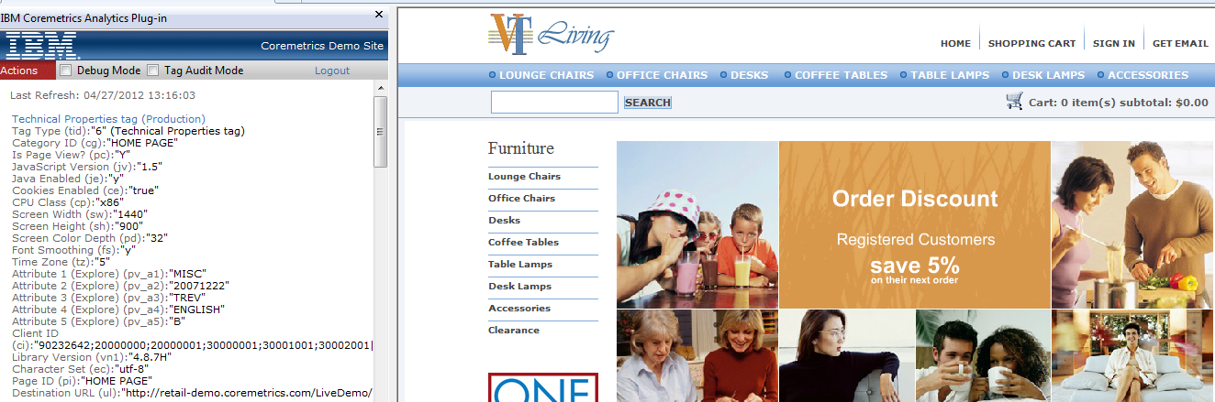
Page View Tags Page Categories Report
Page ID tag field = Page Name
Captures Onsite Search Word & Number of Results = maps to Onsite Search Report
Pathing reporting powered by Page View tags
Use CDF to understand Category ID to Category Name mapping
Technical Properties tag functions as a Page View
Notes:
The Page View tag will carry over data into your Page Categories reports. When we look at the technical piece of the tag parameters…we see a Page ID passed in the tag. Digital Analytics will map that Page ID into your reporting as the Page Name. You’ll see that when expanding Page Category by Category, Page Category by Page or Page Category Full List report.
Expand on the CDF – what it is
For the Page Categories reports to work appropriately, you need to not only pass correct Category IDs in the tags – but also supply us with a Category Definition File. This file defines the content hierarchy we use in mapping 1 category ID to another for parent-child relationship. This gives us that full hierarchy you see when drilling into categories from your Content reports.
Several other parameters in the Pageview tag are used to populate other Content reports. For instance – if a visitor uses your on-site search feature and is taken to a new page. The new PageView tag will carry over that search term into the parameters. You can also include number of search results. Taking those values in the parameters we will report into the Onsite Search Report.
Pathing reports make use of timestamp data from the Page View tag. As we see sequences of Page View tags fire in a session, we capture the timestamp of when this occurs. With the timestamp we can create that path from 1 page to the next. Making use all page view tags and sequences from sessions within a given time period - we can see how many visitors and sessions progressed on your site a certain way.

Slide 9
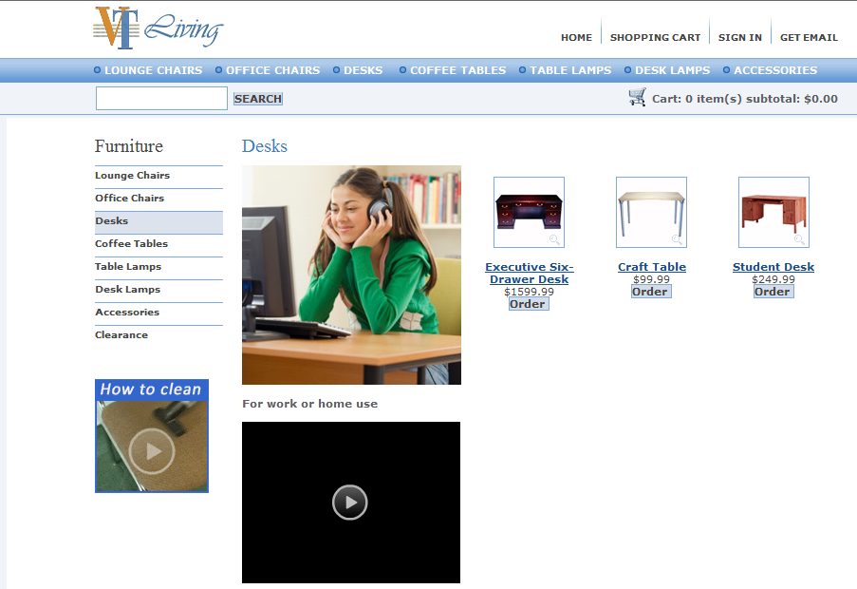
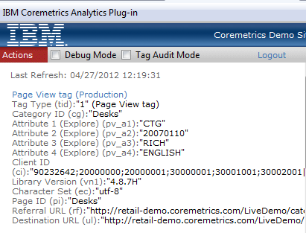
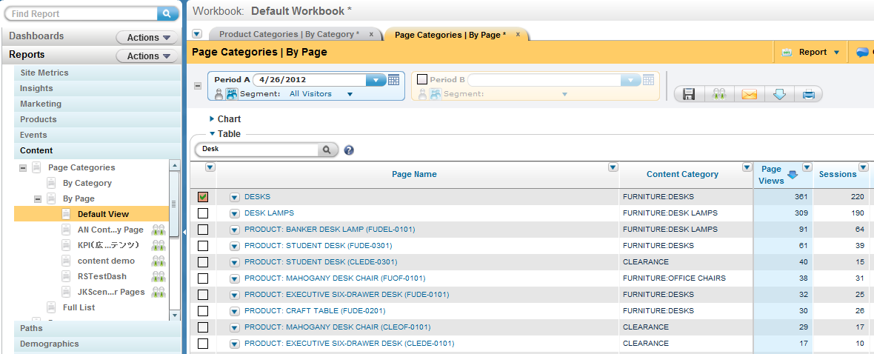
Page View Tags Page Categories Report
Notes:
In this illustration we show how parameters from your tag are reflected into the Reports.
((((take a 5 second break))))

Slide 10
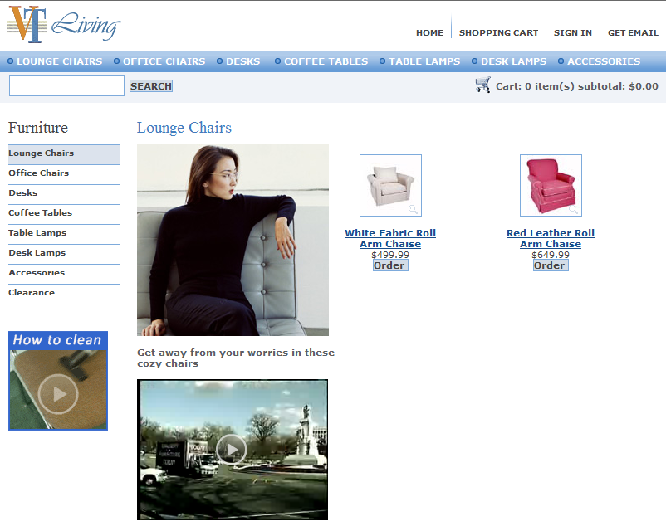
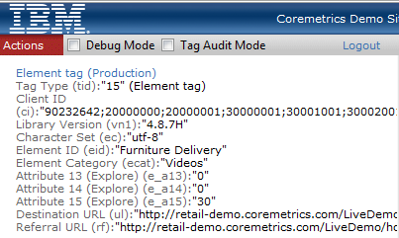
Element Tags Elements Report
Used for tracking intra-page content
Element ID tag field = Element Name
Element Category ID tag field = Element Category Name
Notes:
Element tags are used to track intra-page content on your site.
Some common use cases would be to track videos, PDF downloads, and dynamic page content such as filter boxes or feature selectors. Retail sites will also typically track the “quick view” interaction of a product. That way you’re still collecting important product interaction data should a visitor not quick get to the product detail page.
You can also make use of the various parameters to cover the entire visitor story – for instance tracking the start and stop of a video on your site and how many seconds have passed on that video when those occur.

Slide 11
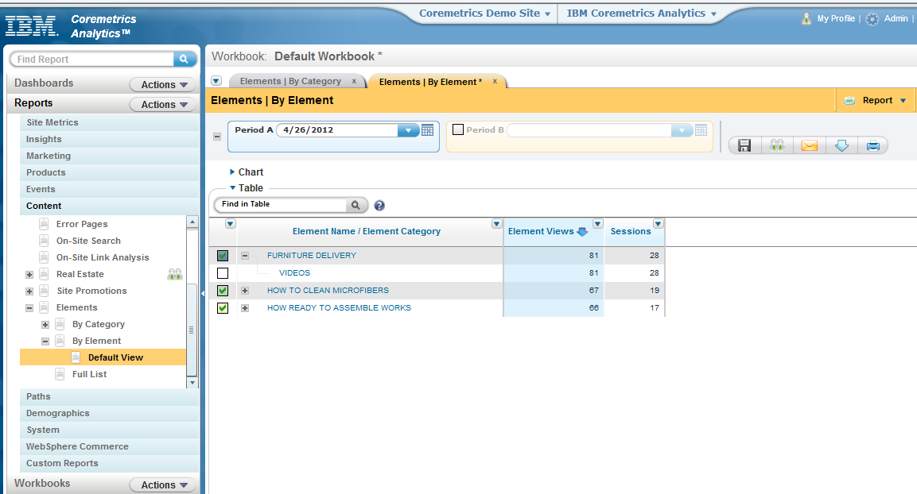
Element Tags Elements Report
Notes:
Similar to how the Page ID represents the Page Name from the Pageview tag – the Element ID will represent the Element name in your Element reports and the element category ID being the Element category Name.
((((5 second break))))

Slide 12
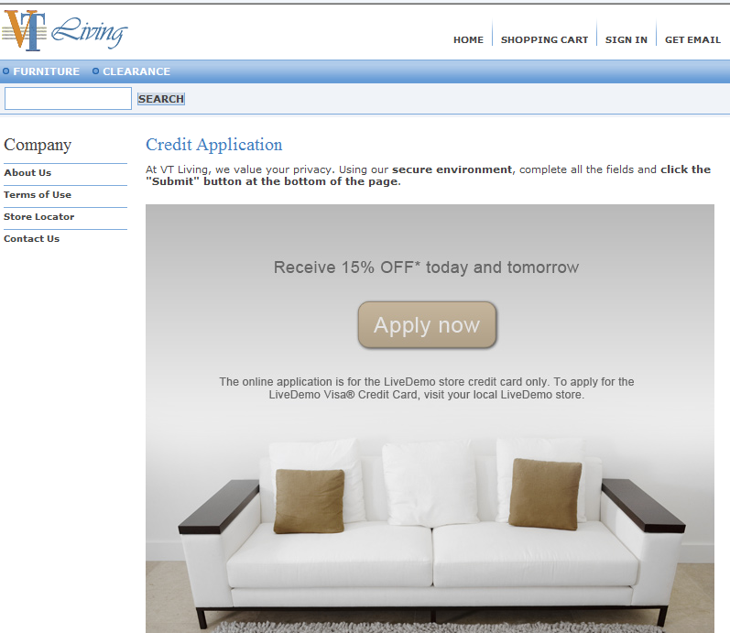
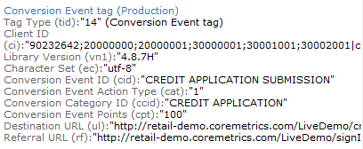
Conversion Event Tags Events Report
Used for non-commerce conversion events
Event ID tag field = Event Name
Event Category ID tag field = Event Category Name
Action 1 = Event Initiated, Action 2 = Event Completed Metric
Conversion Event Points = Event Points Metric
Notes:
With Conversion Event tags – we’re looking to track any interaction with your site that is a non-commerce conversion. This would be things like signing up for a newsletter, making use of a store locator, use of a comparison tool , or visitors registering for a webinar such as this one. The Conversion Event will begin with Action type tags 1 and 2. These represent initiated and completed events. So if I click a link to register for a webinar Event Action Type 1 fires. I am then brought to a page providing further details of this webinar. But I have not yet converted until I provided my information and decide to register – clicking that final button to register should fire the 2nd conversion event tag but this time with an Action type 2.
The event points are an optional parameter within the tags – providing an arbitrary “value” for a conversion. The point value allows relative weighting of an Event's 'initiation' and 'completion'. For example, a visitor initiating a low value event might be worth 5 points, whereas a visitor completing a high value event might be worth 50 points.

Slide 13
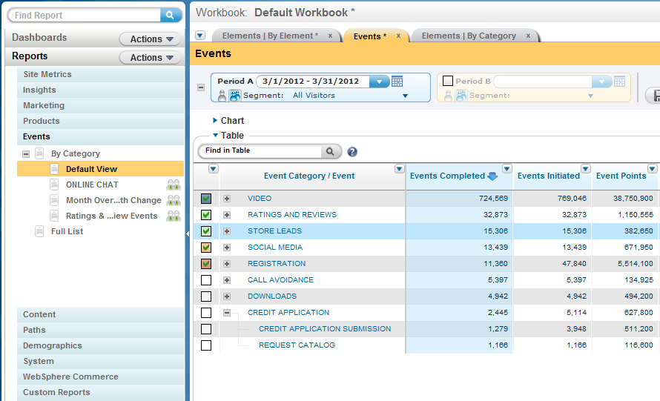
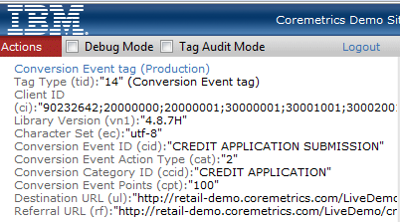
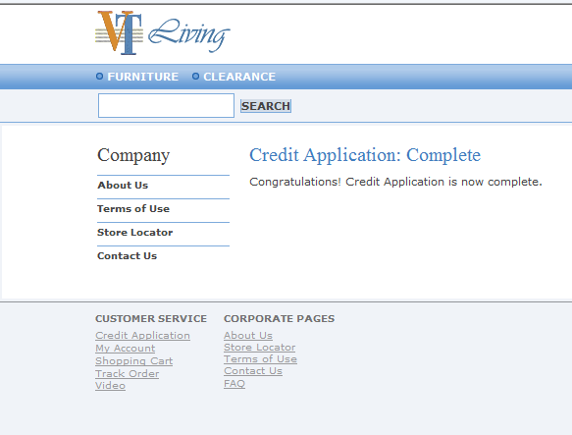
Conversion Event Tags Events Report
Notes:
Conversion Event tags will populate data into your Events reports. As you can see from this illustration of the report and tag – each parameter is carried into the report as either a column or metric.
((((5 second break))))

Slide 14
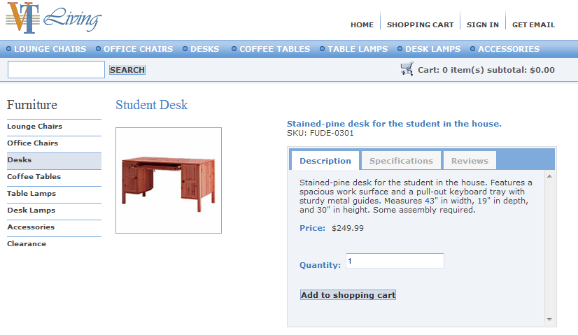
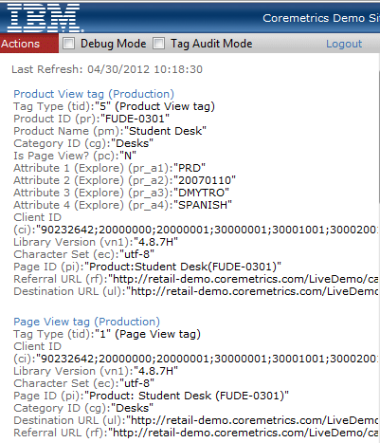
Product View Tags Product Reports
Product View Tag = Product View Metric
Product Name and Product ID fields map directly to Products Report
Used to calculate Product Views & Viewing Sessions metrics
Notes:
FIX THIS SENTENCE Similar to the Pageview tags – product view tags are providing us data related to the product name and category we use in populating your Products report.
The Product Name, Product ID, and Category ID parameters passed in the product view tag all reflect directly into the report as you describe it in the tag.
Again, the Category Definition File will be used to interpret The Category ID you pass in the parameter – so that we can generate the correct reporting hierarchy within the Products by Category report. By ensuring the Category Definition File is not missing any category in the hierarchy, and ensuring correct Category IDs are passed in the tags – you can avoid any No Category Assigned issues in either the Product or Page Category reports.

Slide 15
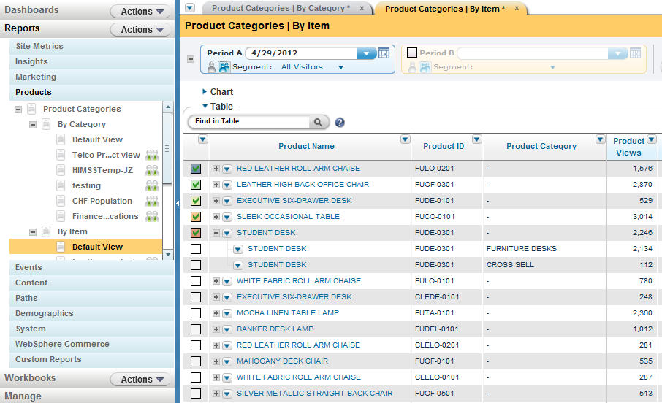
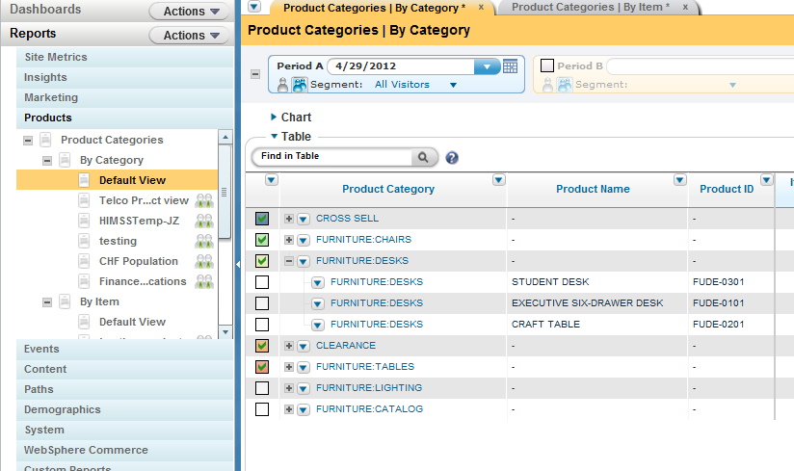
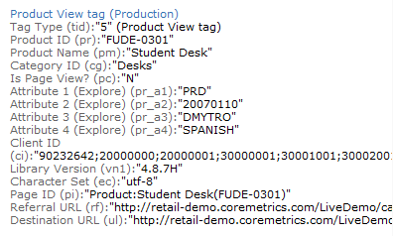
Product View Tags Products Categories
Notes:
In this report example we see each parameter being represented within the columns and hierarchy of the report.
Whether you’re looking within the Product by Item report
((((click to next slide)))))
or the Product by Category report.
((((5 second break))))

Slide 16
Shop Action Tags Product Categories
Shop Action 5 Tags captures Add to Cart and fired on Cart Page
Shop 5/ 9 fired for each unique item added/ purchased
Shop Action 9 Tags captures Items Sold & Item Sales and fired on Order Confirmation page
Both tags used to calculate Item Abandonment
Product Name and Product ID fields map directly to Products reports
Category ID, Product Name, and Product ID in tags must be persisted from Product View to Shop 5 to Shop 9 tags
Quantity and Base Price tag fields used to calculate sales and units sold for each item
Notes:
For transactions on your site we require 2 Shop tags. Shop action 5 represents a product being added to a cart and Shop 9 reflects a product being purchased.
The Shop 5 tag will fire as a visitor clicks an “add to cart” button as well as well a visitor views the cart page while products are present. For each unique product being added or purchased – there should be a corresponding unique shop tag. Quantity is a required parameter – so if a visitor is adding 3 of the same product you should only see 1 Shop 5 tag but with a quantity of 3.
Shop 9 tag will only fire after an order completion. Typically alongside the Order tag on the Order Confirmation page.
So that we can offer the appropriate analysis with these 2 tag types – we do require the Category ID, Product Name, and Product ID be persisted across the Product View, Shop 5, and Shop 9 tags. If one of these parameters is not the same as the others – we may see issues within metrics not making sense – think high product views but no sales and then high sales but no product views. If you come across this for any product in your Products report – this is likely the cause and you should contact Technical Support to review.

Slide 17
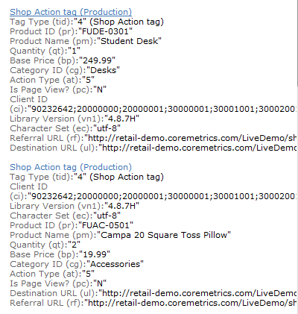
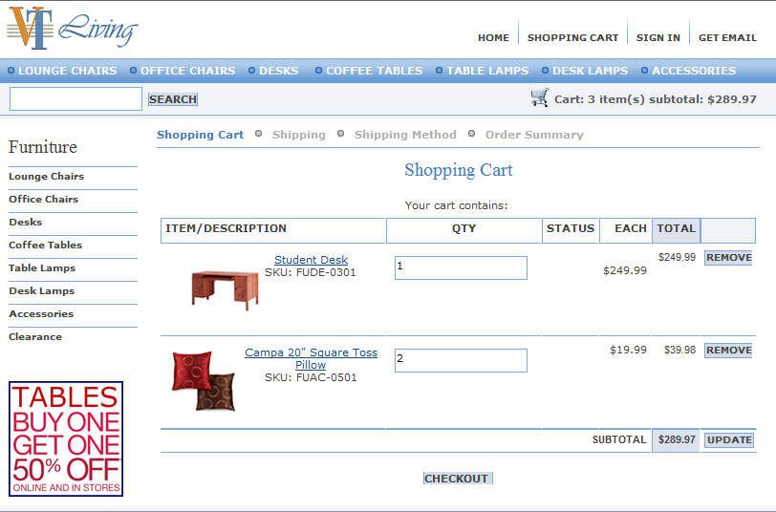
Shop Action Tags Product Categories
Notes:
For analysis purposes we use these 2 tags and their parameters within to generate a wide range of metrics for your reports such as the sales and cart abandonment.

Slide 18
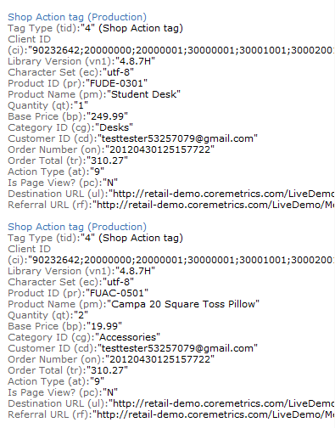
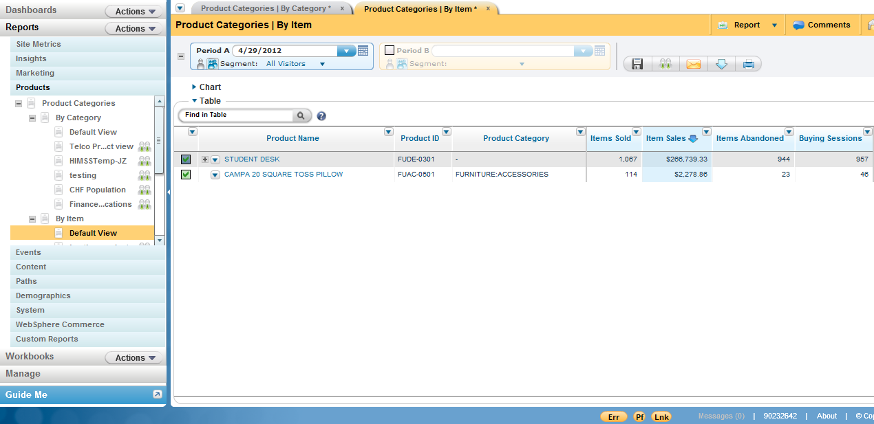
Shop Action Tags Product Categories
Notes:
Ensuring the correct Product ID and Category ID will keep your Products report aligned with the Category Definition File you submit.
((((5 second break))))

Slide 19
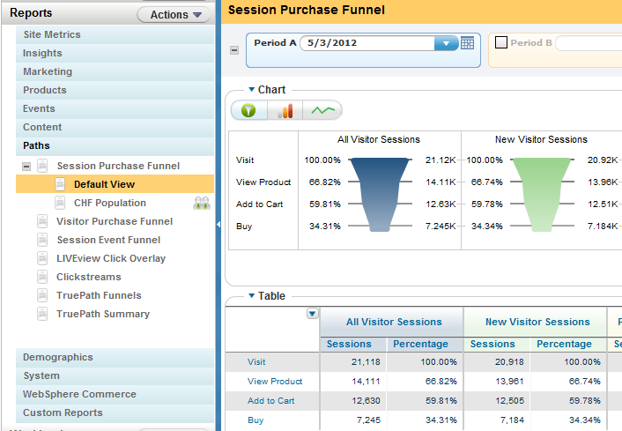
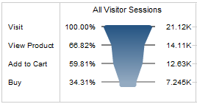
Session Purchase Funnel
Page View
Product View
Shop 5
Shop 9
Notes:
Taking a look at the last few tag types – we can now view these as a sequence of events. This sequence will illustrate your purchasing funnel from All Visitors and then trimming down to a full visitor conversion.
We calculate All Visits based on the overall unique visitors from the collected PageView tags. Those that fire a Product View tag in a session will then be pooled into the View Product group of the funnel. Both Shop tags close up the last 2 checkpoints in the funnel for Adding to Cart and finally conversion or Buy.

Slide 20
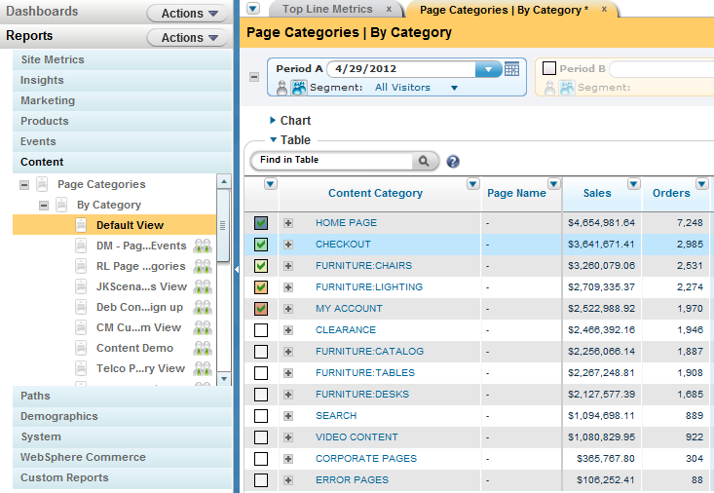
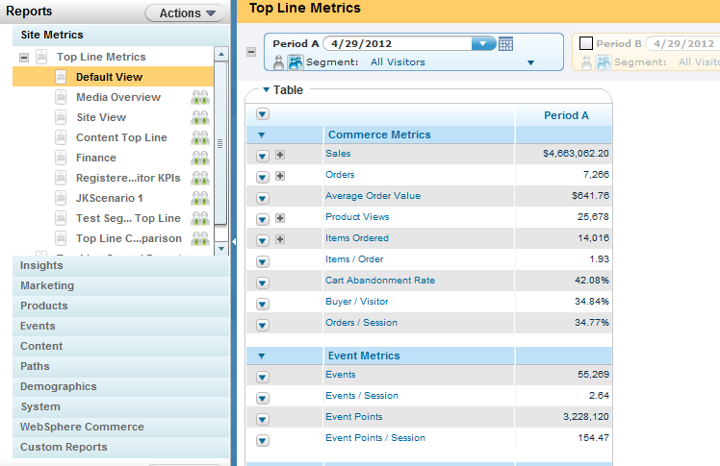
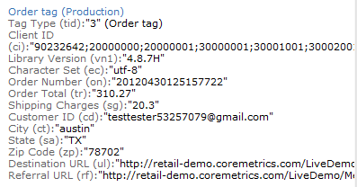
Order Tags Top Line & Content Metrics
Order Tag captures entire transaction
Fired on Order Confirmation page
Use to calculate Order and Sales in Top Line Metric and Content Reports
Notes:
Order tags should only be included once in the session and “fired” on the Order Confirmation Page. The parameters in this tag should describe the overall transaction details such as the order total, the order number your backend provides and tracks, any shipping charges, and relevant customer details you wish to include like the Customer ID which reflects in the registration tag.
We use this tag for providing metrics in the Top Line and Content reports for sales, orders, etc.
(((((CLICK…CLICK-----PAUSE slightly)))))

Slide 21
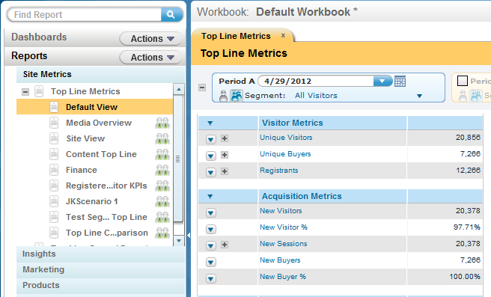
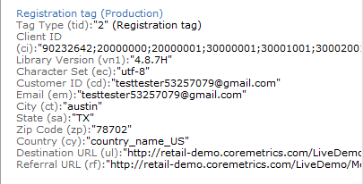
Registration Tags Registrant Metrics
Registration Tag captures user profile information
Fired on Account Setup, Account Login, Account Changes, Email Sign-ups, and Order Confirmation
Used to calculate any Registrant metric across reports
Notes:
There are several instances you can fire the Registration tag within a session. Commonly, we see these for Account creation, Account Login, Account changes, providing email to sign up for email deliveries, and finally Orders. The information in the Registration tag should include specific visitor profile data you wish to collect such as name, address, and email.
Digital Analytics will use this tag data to build various Registrant metrics such as repeat buyers or registered visitors.

Slide 22
Automatic Tags & Explore Attributes
Link Click Tags Live View, Site Promotions, & Real Estate Reports
Link Impression Tags Live View, Site Promotions, & Real Estate Reports
Form Action Tags Form Analysis Reports
Explore Attributes Explore Reports after Aliasing in Admin
Notes:
Both the Link Click and Link Impression tags will be used to populate data within your Site Promotions and Real Estate reports. Site Promotion and Real Estate reports will further rely on those Link Click tags to include the appropriate onsite marketing parameters within the Target HREF.
Next month’s webinar will cover more about these onsite marketing links.
We also offer reporting from the LIVEview click overlay. This is a feature within the same tool we discussed earlier where you can find the TagBar. LIVEview is a dynamic view of a specific page that is rendered on your browser when the tool is open. It will show basic page data for the page you’re on – including the number of clicks triggered on that page during the given time period. You can further see what the specific number of clicks for each individual link on that page.
Form action tags also automatically fire and will generate your data within the Form Analysis report.
Explore Attributes are not automatic, nor are they tags. But they are worth noting.

Slide 23
Explore Attributes
Passed as Parameters in Tags
  All standard tags
  Up to 50 Explore Attributes per tag
  Max 256 characters
  Can also be imported
Supplement standard parameters
  Helps further describe interaction with your site/content
  Examples – product inventory, how one arrived on a page, size, review ratings, promo code, shipping
Use within Explore reports
  Must be aliased prior to use(Admin)
Notes:
Explore attributes are additional Parameters within each of your tags. You are allowed up to 50 attributes per tag. These parameters do not have to be the same across all of your tags. Meaning, you can have 1 set for your Pageview tags – and a whole new set for your Shop or Order tags.
It will all depend on what relevant data you’re looking to supplement your tags with. Once you have added the Explore attributes to your tags – you must alias them within Admin before you’re able to work with them in Explore.

Slide 24
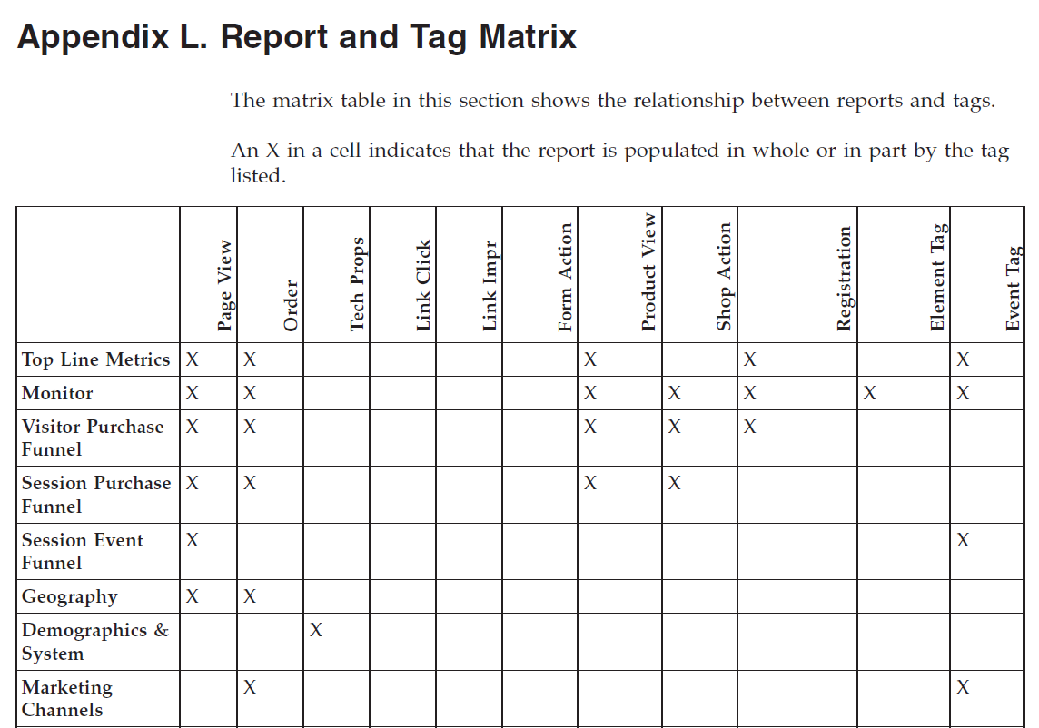
Report Matrix
Notes:
As we wrap up what tag types populate the various Analytics reports I want to make note of the Report Matrix. This matrix can be found and the end of the Implementation Guide. By taking a row from the chart you see, based on the check marks, which tags populate data to that report. So for instance you will see that Top Line Metrics gets its data from a combination of tags such as the Pageview, order, product, registration, and event tag. But not the Shop tags. If you ever are curious what tag is generating the report your looking at – cross-reference it to the Report Matrix.

Slide 25
Additional Resources
Search for the following resources on the IBM Support Site
  IBM Digital Analytics Implementation Guide
  IBM Digital Analytics Best Practices Guide
  Form Analysis Report – Best Practices
  LIVEview Tactical Workshop
  Explore User Guide
Notes:
The implementation guide can be found within the Support Site. There are other great resources within the Support Site such as User Guides, Best Practice Resources, and Fact Sheets for various workshops and engagements our team offers.
((((((CLICK))))))

Slide 26
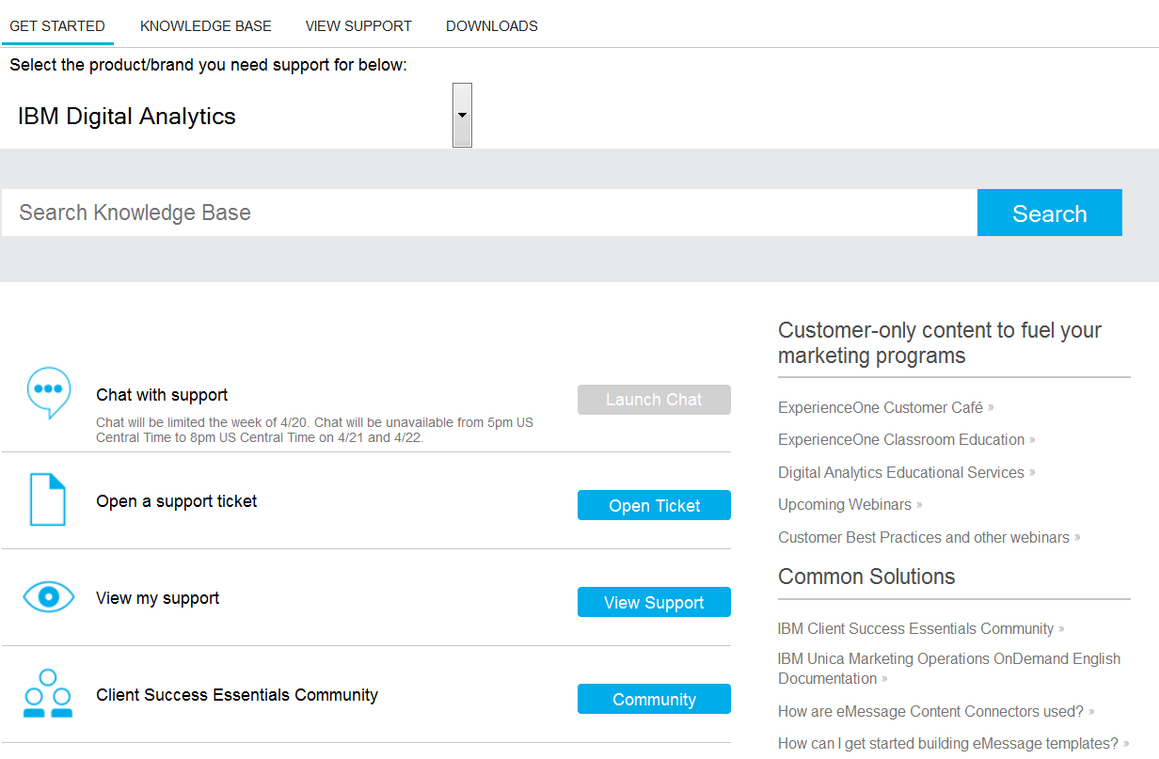
Additional Resources
Notes:
From the home page of the Support Site – we also offer links to Customer Café, and the Client Success Essentials Community – the latter being where you registered for this session and where we will post the recording from today.

Slide 27

Conclusion
Tags collect data for pages, products, elements, and events on your site
Tags can be seen in the Digital Analytics TagBar
Data collected in tags and tag fields can be mapped to reports and metrics
Understanding standard tags and tag fields empowers you to better interpret your reporting and data collection
Notes:
In conclusion – tags are constantly collecting data for your pages, products, elements, events and relatively all landscapes of your website. Being equipped in knowing which tags capture which data can help you as business users translate your need to the technical side where your Developers can implement the necessary function calls.
Without needing to know how to read javascript code – you can use the IBM Digital Analytics TagBar for seeing what tags are firing on your site. This is great for testing out new content or confirming the appropriate tags are present before attempting to report on activity.
Each tag and its associated fields can be mapped to 1 or more specific reports and metrics. Knowing what goes where will make you a more efficient user and strengthens your ability to interpret your reporting and data collection.

Slide 28
For more information on tagging…
Business Support
  Digital Analytics Consultant via chat or ticket
Premium Enablement
  Problems/Use Cases
    Client’s site is believed to be tagged in a fashion that does not properly address business requirements
  Deliverables
    Workshop meetings conducted via web conference and email
    Document containing images of each page type and the relevant tagging recommendations
    40 Hours over a 90 day period
  Interest in this
    Email your Account Rep and copy - ccsprt@us.ibm.com
    Fact Sheet posted to Support Site Knowledge Base
Notes:
Additionally – should anyone in attendance be looking for more information on tagging - myself and my colleagues who make up our Business Support team are always available on chat or through tickets. Whether it be to brainstorm tagging strategies for an upcoming campaign – or a new approach passed down from management and you’re looking to use the reports to answer these questions – we’re here to help.
Finally, we do also offer a paid Premium Enablement where our Analysts go through your site and business strategies to ensure the site is properly tagged, collecting what is needed, and work with you to get that in place. This is a paid engagement where we will offer 40 contracted hours from an Analyst over a 90 day period. Any interest in this – please reference the Premium Enablement Fact Sheet – which can be found on the Support Portal by searching “Fact Sheet” from the Knowledge Base.

Slide 29
Q&A
The Customer Support team is available to provide support via the following channels:
  E -mail: Sunday 8:00pm - Friday, 7:00 PM U.S. Central
  Phone: Sunday 8:00pm - Friday, 7:00 PM U.S. Central
  US: 1-866-493-2673
  cm_support@us.ibm.com
Live Chat (for Business Support only): Sunday-Friday, 8:00 PM – 6:00 PM U.S. Central
  Live Chat is available from the home page of the IBM Client Success Portal
  https://support.coremetrics.com
IBM Client Success Portal: 24 x 7
Next Webinar: May 27, 2015
Tracking offsite and onsite links - MMC, Site Promotions, Real Estate Best Practices
Notes:
That wraps up today’s presentation. At this time I’d like to request that any questions be sent via the chat feature of our web meeting.
Examples of questions:
On my product detail page I only see product view tags. Should I be including a pageview tag as well?
How can we retain a copy of our most recent CDF?
How can we go about testing tags if the page is not yet in production?

