Slide 1
Understanding a store associate's journey by integrating Tealeaf CX with IBM Store Engagement
Hansraj Mali – Advisory Software Engineer- Tealeaf Support
Murali J Iyengar- Advisory software Engineer- Commerce Application

Slide 2
What is IBM Store Engagement?
What?
A user friendly application which runs on various devices like mobile, tabs, desktop etc. across various platforms like IOS, Android , Windows etc.
Why?
Transforms traditional brick and mortar store to a digital store.
Provides better understanding of customer interests by analyzing digital data and enable Store Associates to take meaningful action in responsive and real-time fashion.
How do we achieve it?
Supporting each retailer in their unique journey to bring their store value proposition to life.
Provide step by step instruction to each and every persona using the application.

Slide 3
Store Personas

Slide 4

Personas-Store Associate
Associates who interact with the customer at the store frontend or billing counter.

Slide 5

Personas-Back of the Store Associate
Associates who perform back of the store operations like fulfilling BOPIS and BOSFS orders, inventory management etc.

Slide 6

Personas-Store Manager
  Associates who will monitor different store operations day in and day out.

Slide 7
Why Integrate Store with Tealeaf ?
In their day to day activities, the store associate or the back of the store associate performs various UI operations.
Some operations may be simple, while others may be time consuming.
  UI operations which takes more time can be due to various factors. For example, A new associate may take more time than a regular store associate to create an order or to perform any UI operation. In few scenarios, even an experienced associate can take more time to complete an UI operation due to some unforeseen errors or due to some incorrect configurations.
More number of time consuming operations hampers the day to day activities and results in loss of business and revenue for the store.
By integrating with Tealeaf, the store administrator can view the recorded sessions and identify the root cause of the issue by analyzing the data capture patterns.
Store administrators can also use events framework for further analysis of data.

Slide 8
How to Integrate Store with Tealeaf ?
Create a Tealeaf SaaS account for IBM Store Engagement application.
Using Tealeaf SaaS Wizard, generate the tealeaf.js file by selecting all the required components required for application.
Download the generated tealeaf.js file and include it in all the JSPs of the Store Engagement application.

Slide 9
IBM Tealeaf SaaS (Tealeaf Customer Experience on Cloud)
IBM Tealeaf Customer Experience on Cloud is a robust analytics platform that gives companies insight as to what their customers are actually doing on their websites and mobile applications.
Understand Experience
Identify Struggle
Isolate Problems
Notes:
What is Tealeaf – an Analytics platform that allows you to see exactly what your customer(s) are actually doing on their websites and mobile applications.
It allows you to understand the customer experience at a level that you’ve never seen before. It allows you to truly understand your customers experiences on your web site or mobile application
Identify Struggle – not just identify when someone receives an error code once but understand when a customer is entering the same information multiple times.
Isolate Problems – not just identify what page their following off or what form field but realy what are entering into a certain field. What error message are they seeing?

Slide 10



IBM Tealeaf Bridges the Gap
IBM Tealeaf
Actions
Interactions
Issues
Traditional Analytics
Site and application performance
Technical health monitoring
Web analytics
Business Intelligence
Customer Voice
Email, Surveys
Customer Service
App store ratings
Notes:
What is Tealeaf – an Analytics platform that allows you to see exactly what your customer(s) are actually doing on their websites and mobile applications.
It allows you to understand the customer experience at a level that you’ve never seen before. It allows you to truly understand your customers experiences on your web site or mobile application
Identify Struggle – not just identify when someone receives an error code once but understand when a customer is entering the same information multiple times.
Isolate Problems – not just identify what page their following off or what form field but realy what are entering into a certain field. What error message are they seeing?

Slide 11




The power of understanding why…
Without understanding WHY and fixing the problem, all other services and solutions are either ineffective or inefficient
Notes:
With traditional analytics solutions you can see at what point a customer is falling off or how many customers are falling but what you don’t get is WHY they’re falling off.
Without the why you’re only guessing on how to fix the problem.
Each department in an organization has tools to monitor effectiveness; it only makes sense to have a tool that monitors your website to discover the why.

Slide 12

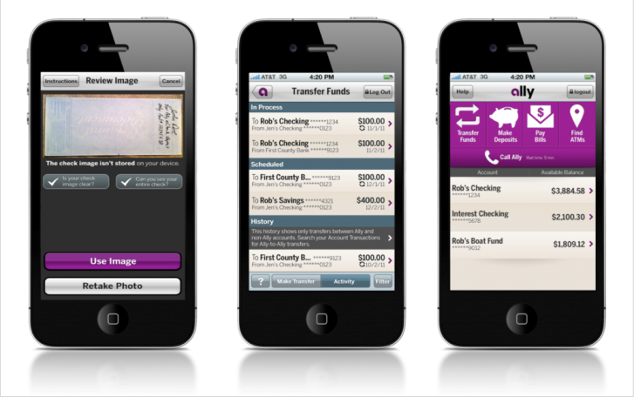

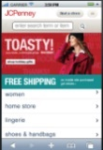
Tealeaf Customer Experience on Cloud
Capture Data
Tealeaf on Cloud
Web and mobile applications
Each interaction for each customer
Understand your user base
Identify issues or opportunities
Part of IBM Customer Analytics SaaS platform
User Interactions
Business Data
Environmental Data
Contextual Information
Notes:
A SaaS based solution leveraging IBM’s SoftLayer to bring you a true SaaS solution. What does this mean for you?
No investment in hardware and software. No need to worry about purchasing and configuring HW, SW, firmware networking etc. No need to have an operations or IT team own and manager this, we do that for you. No need to worry about maintenance costs or software upgrades/downgrades and eventually obsolete hardware.
Ease of deployment. We collect our data from 3 sources (3 SDKS) depending on what solution you’re looking we implement one or more SDKs to help you send data to our TL datacenter. Implementation and provisioning takes days instead of weeks to get the customer up and running.
Lower cost of entry: Allows the customer to get up and running without a lot of overhead costs and investment. The only investment is investing in the power of Tealeaf.
Brand new UI and workflow. We listened to our customers and listened to the pain points. Through a new IBM Design thinking process we’re completely reworked the UI and workflow.
Using a monthly cadence we’re able to deliver key features and functionality to you more often. We can listen to our customer’s requests and turn them around quicker. Faster Evolution.
Capture Data – what do you get?
User interactions:
Environmental Data
Contextual Information:
TL SaaS Solution: Ultimately what do you get a
A powerful analytics platform for web and mobile apps
Part of the IBM Customer Analytics Solution: DA, Journey Analytics.

Slide 13

Tealeaf Covers Web and Mobile Applications
Desktop Web App
Mobile Web
Native App
Hybrid App
Web Browser
Web Code
Mobile Browser
Native Application
Native Container
<html>
</body>
</head>
Web Code
Web Code
010101001101010100101010101010101001010
<html>
</body>
</head>
<html>
</body>
</head>
Device APIs
Device APIs
Web1.0
Web2.0 (RIA)
Single Page Applications
Responsive Web Design (RWD)
HTML5
iOS
Android
Worklight
PhoneGap
Notes:
Tealeaf CBA on Cloud – Works with desktop web, mobile web, native apps (iOS and Android) and hybrid apps.
Mobile Web
Tealeaf can capture visitor sessions to your web application initiated from mobile web browsers through the UI Capture for Ajax solution. (UIC Framework). It also works with desktop websites via the same UIC Framework.
Native Application
Tealeaf can capture user interaction data for a native application when the appropriate Tealeaf Logging Framework (iOS or Android) is instrumented in the application.
The following logging frameworks are available:
•Android
•iOS
Once the Tealeaf Logging Framework is deployed, it uses the Session identifer that is provided by the web server. User interaction data is collected and periodically POSTed (sent back) to a placeholder page on SoftLayer. Tealeaf can to capture and process this data using the onCloud system.
Hybrid Mobile (Web and Native Application combination)
A hybrid app is a native app that uses the device’s browser engine to access the web. Like native apps, hybrid apps use the session identifier provided by Softlayer. Mobile data is captured through both the mobile web and through the Tealeaf UIC Logging Framework.

Slide 14
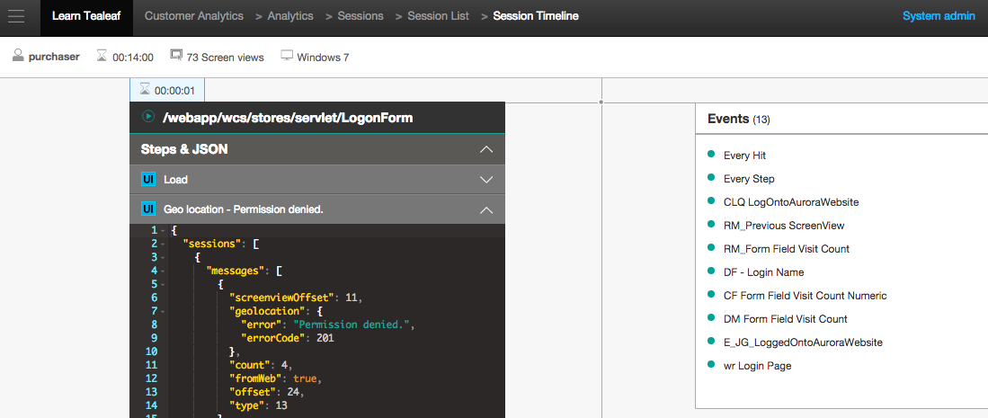
Session Timeline
Step by step actions within a user’s individual session

Slide 15
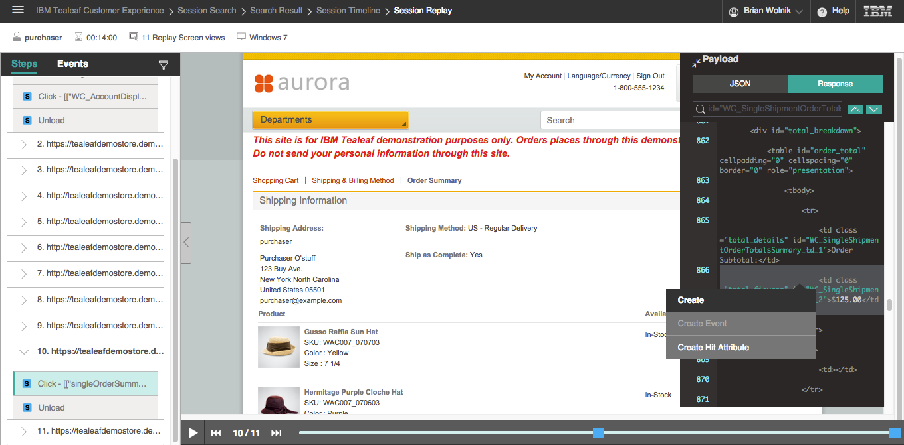
Session Replay
DOM Capture replay

Slide 16
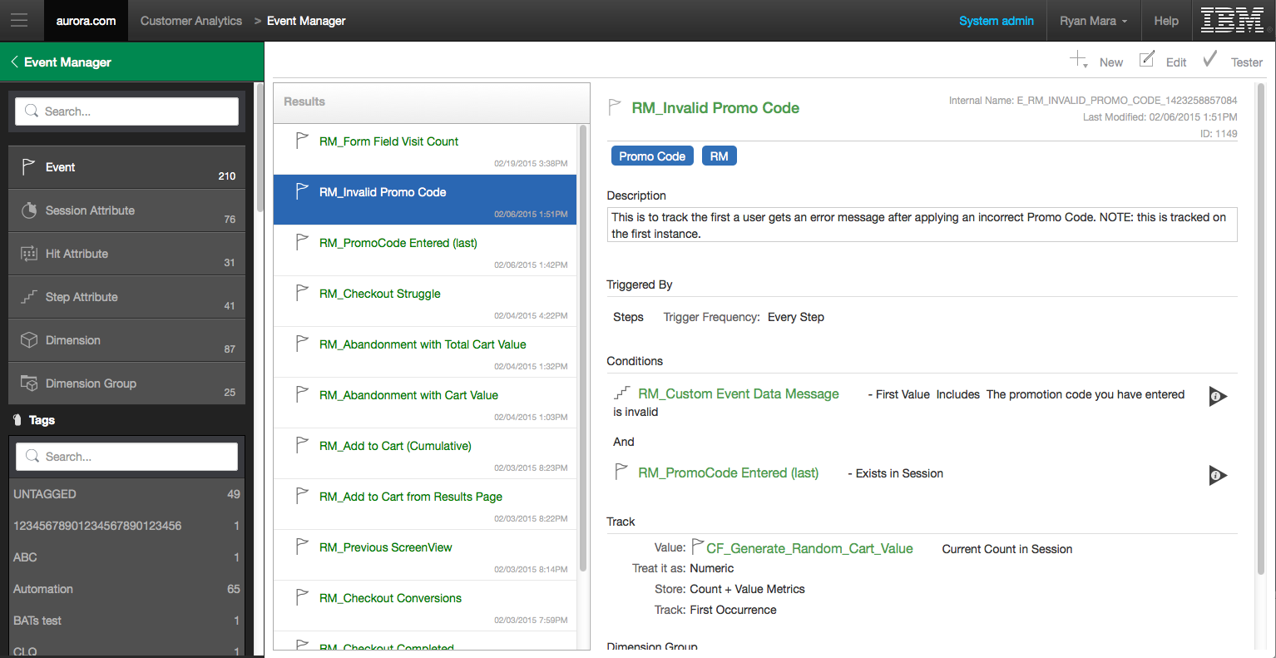
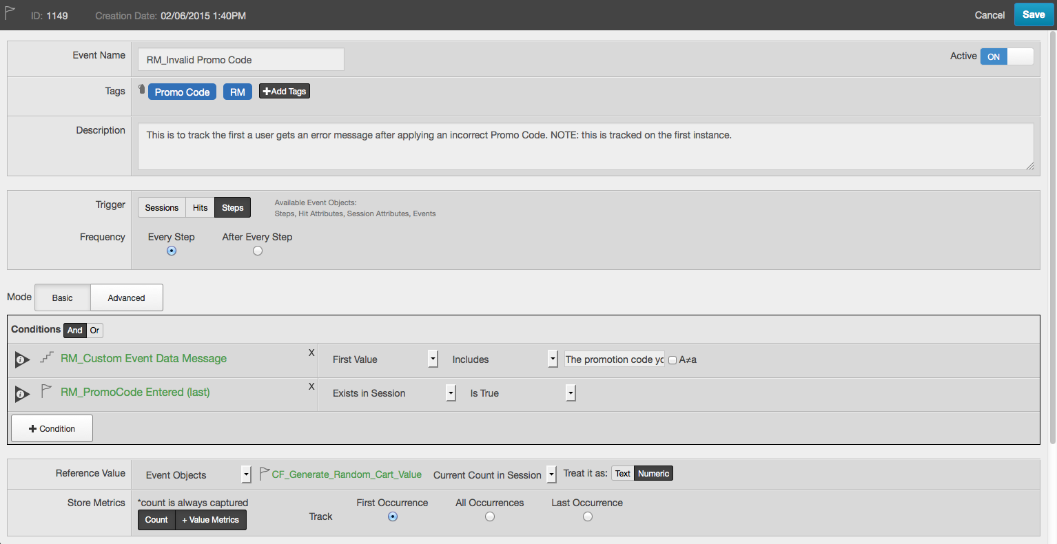
Event Manager
Create custom events to understand the user experience
Understand WHY

Slide 17
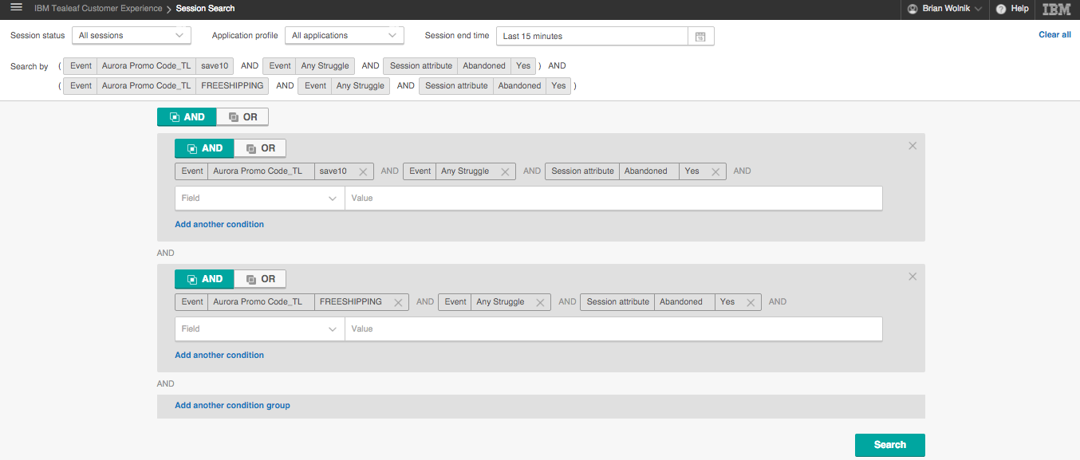
Session Search
Perform complex searches based on any criteria available

Slide 18
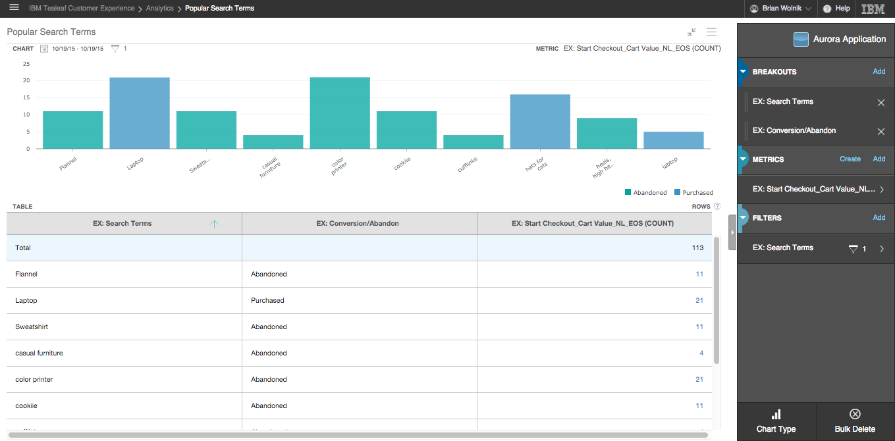
Report Builder
Easily configure reports that fit your business need
Refine your report with dimensions and filtering

Slide 19
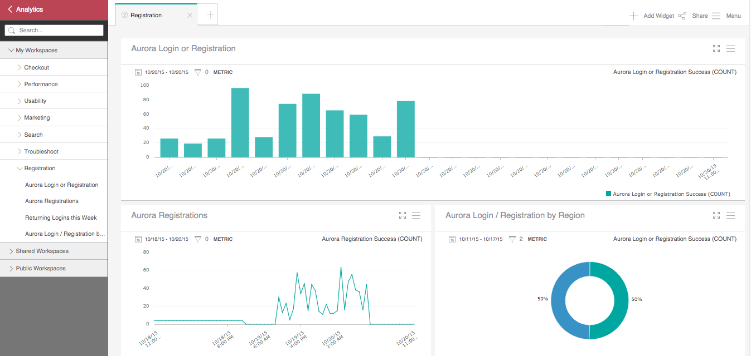
Workspaces
Customizable widgets to monitor report data
Shareable workspaces

Slide 20
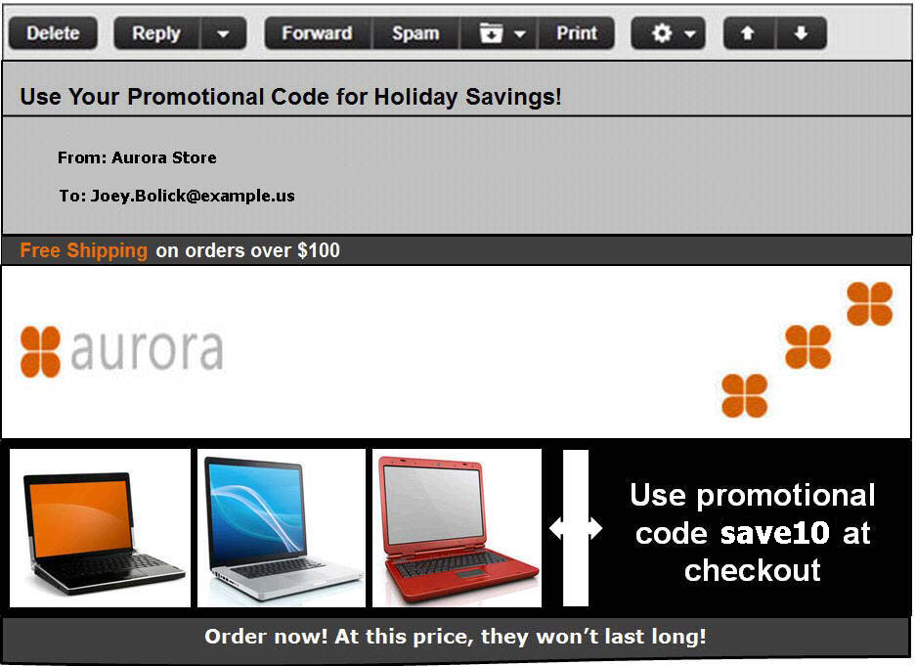
DEMO: Use Tealeaf for Issue Analysis
Notes:
Demonstration Scenario:
The Aurora marketing group sent out an email with a promotional code. They neglected to activate the code.
The number of visitors who experience promo code failure issues has increased beyond expected levels.
Perform a search by the Session Attribute Promo Code with a value of save10.
Analyze Session List data. Segment and filter data.
Create a new View to include user Duration, User Login ID, Promo Code, and Mini Cart Value

Slide 21
Disclaimer
The information contained in this presentation is provided for informational purposes only.
While efforts were made to verify the completeness and accuracy of the information contained in this presentation, it is provided “As Is”, without warranty of any kind, express or implied.
In addition, this information is based on IBM’s current product plans and strategy, which are subject to change by IBM without notice.
IBM shall not be responsible for any damages arising out of the use of, or otherwise related to, this presentation or any other documentation.
Nothing contained in this presentation is intended to, or shall have the effect of:
Creating any warranty or representation from IBM (or its affiliates or its or their supplies and/or licensors); or
Altering the terms and conditions of the applicable license agreement governing the use of IBM software.

