Slide 1


Gen-AI x IBM Z
Kelly Paesano kapaesan@us.ibm.com
Product Manager, IBM Z Software

Slide 2
Important
disclaimers
© IBM Corporation 2025.
All Rights Reserved.
IBM’s statements regarding its plans, directions and intent are subject to change or withdrawal without notice at IBM’s sole discretion. Information regarding potential future products is intended to outline our general product direction and it should not be relied on in making a purchasing decision. The information mentioned regarding potential future products is not a commitment, promise, or legal obligation to deliver any material, code or functionality. Information about potential future products may not be incorporated into any contract. The development, release, and timing of any future features or functionality described for our products remains at our sole discretion.
References in this presentation to IBM products, programs, or services do not imply that they will be available in all countries in which IBM operates.
Product release dates and/or capabilities referenced in this presentation may change at any time at IBM’s sole discretion based on market opportunities or other factors and are not intended to be a commitment
to future product or feature availability
in any way. Nothing contained in these materials is intended to, nor shall have
the effect of, stating or implying that any activities undertaken by you will result
in any specific sales, revenue growth,
or other results.
All client examples described are presented as illustrations of how those clients have used IBM products and the results they
may have achieved. Actual environmental costs and performance characteristics
may vary by client.

Slide 3
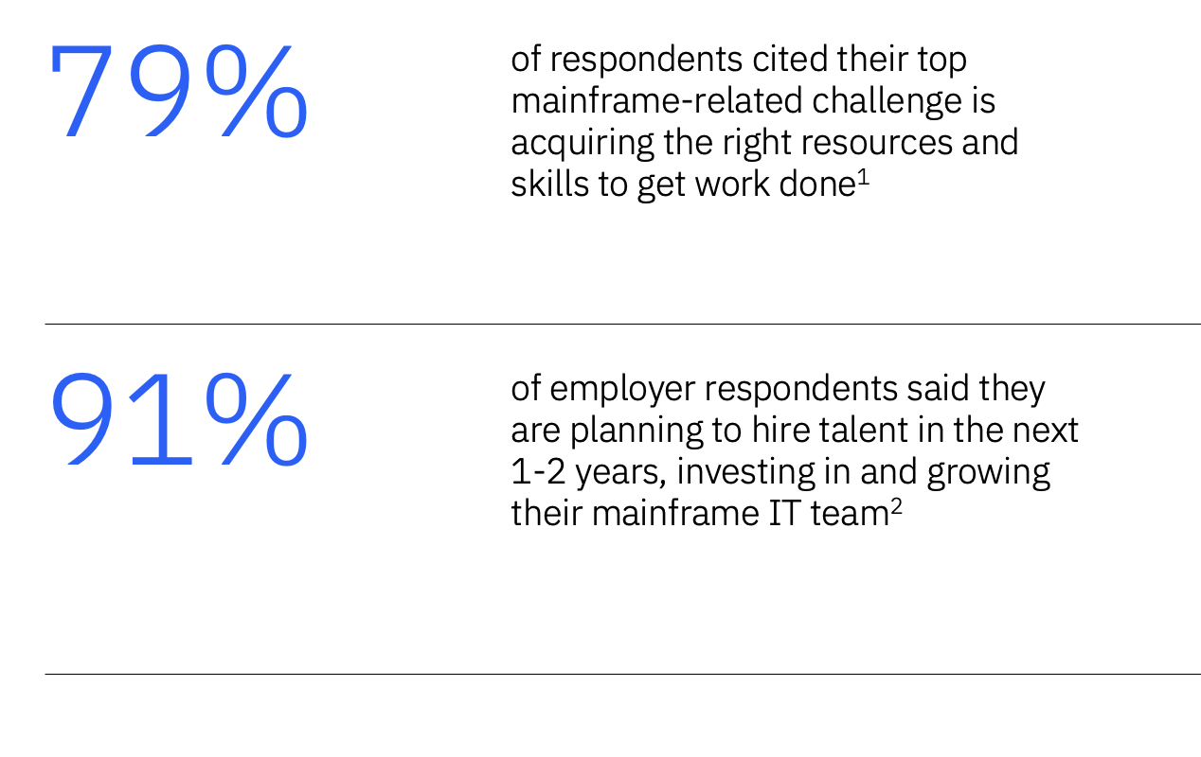
Addressing mainframe skills is a top priority
Gartner recommends the use of Gen AI-infused tools to augment human capabilities in understanding complex issues to reduce skills gap³
To address the key concern of lack of mainframe skills
1. Forrester Consulting Study conducted by Forrester Consulting on behalf of Deloitte
2. Challenging the Negative Narrative of the Mainframe Skills Landscape
3. The State of IBM Mainframe at 60 https://www.gartner.com/doc/reprints?id=1-2H9FEZE7&ct=240411&st=sb

Slide 4
What is the opportunity and impact of generative AI?
Massive early adoption
Broad-reaching and deep impact
Critical focus of AI activity and investment
Up to
80%
of enterprises are
working with or planning
to leverage foundation
models and adopt
generative AI ⁽¹⁾
Generative AI could
raise global GDP by
7%
within 10 years ⁽²⁾
Generative AI
expected to represent
30%
of overall market
by 2025 ⁽³⁾
The speed,
scope, and scale
of generative
AI impact is unprecedented
¹Scale Zeitgeist: AI Readiness Report, a survey of more than 1,600 executives and ML practitioners
²Goldman Sacks on generative AI could raise global GDP by 7%
³Boston Consulting Group (BCG)

Slide 5
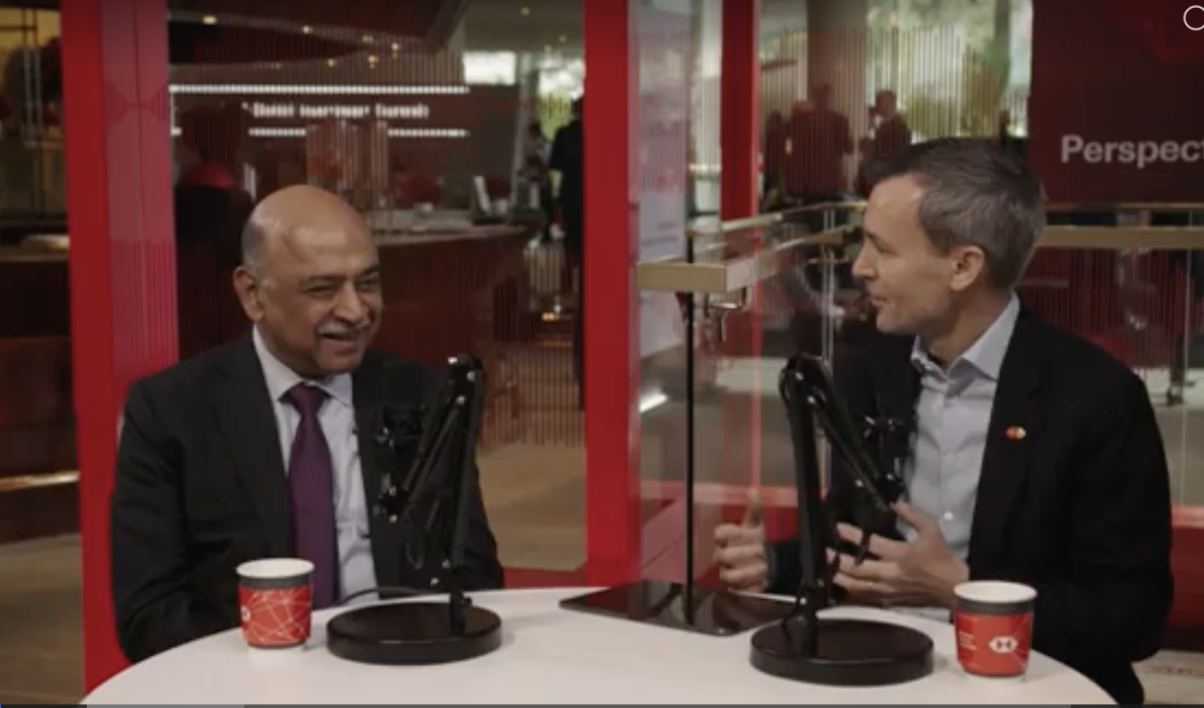
Is it living up to all the hype?
In technology we “tend to overestimate the short term, and underestimate the long term”
HSBC Perspectives Podcast: Scaling AI (April 14, 2025)
Arvind Krishna, Chairman and CEO of IBM and Stuart Riley, Group Chief Information Officer, HSBC.
.
Link to Source
The developer productivity gain at IBM using Gen-AI code assistants is around 6% today
The value of Gen-AI is growing, and the real game-changer is when it is purpose built to solve business problems at scale.
Gen-AI can be the catalyst to enable us to solve the mainframe skills challenges by upskilling faster, having less reliance on SMEs and increasing productivity.
And we can expect that to grow to
25-30% in the next few years, and possibly even more for targeted use cases.

Slide 6
Gen-AI x IBM Z
The IBM watsonx portfolio, built for IBM Z
For IBM Z Development
IBM watsonx Assistants deliver enterprise-ready AI solutions to address skills gaps and increase productivity for targeted, business use cases.
For all IBM Z
watsonx Assistant for Z
watsonx Code Assistant
watsonx Code Assistant for Z
Transform engagement and interaction with the mainframe.
Accelerate development for multiple programming languages
Accelerate mainframe modernization, across the application lifecycle

Slide 7


IBM watsonx
Assistant for Z
Transform engagement and interaction with the mainframe.

Slide 8
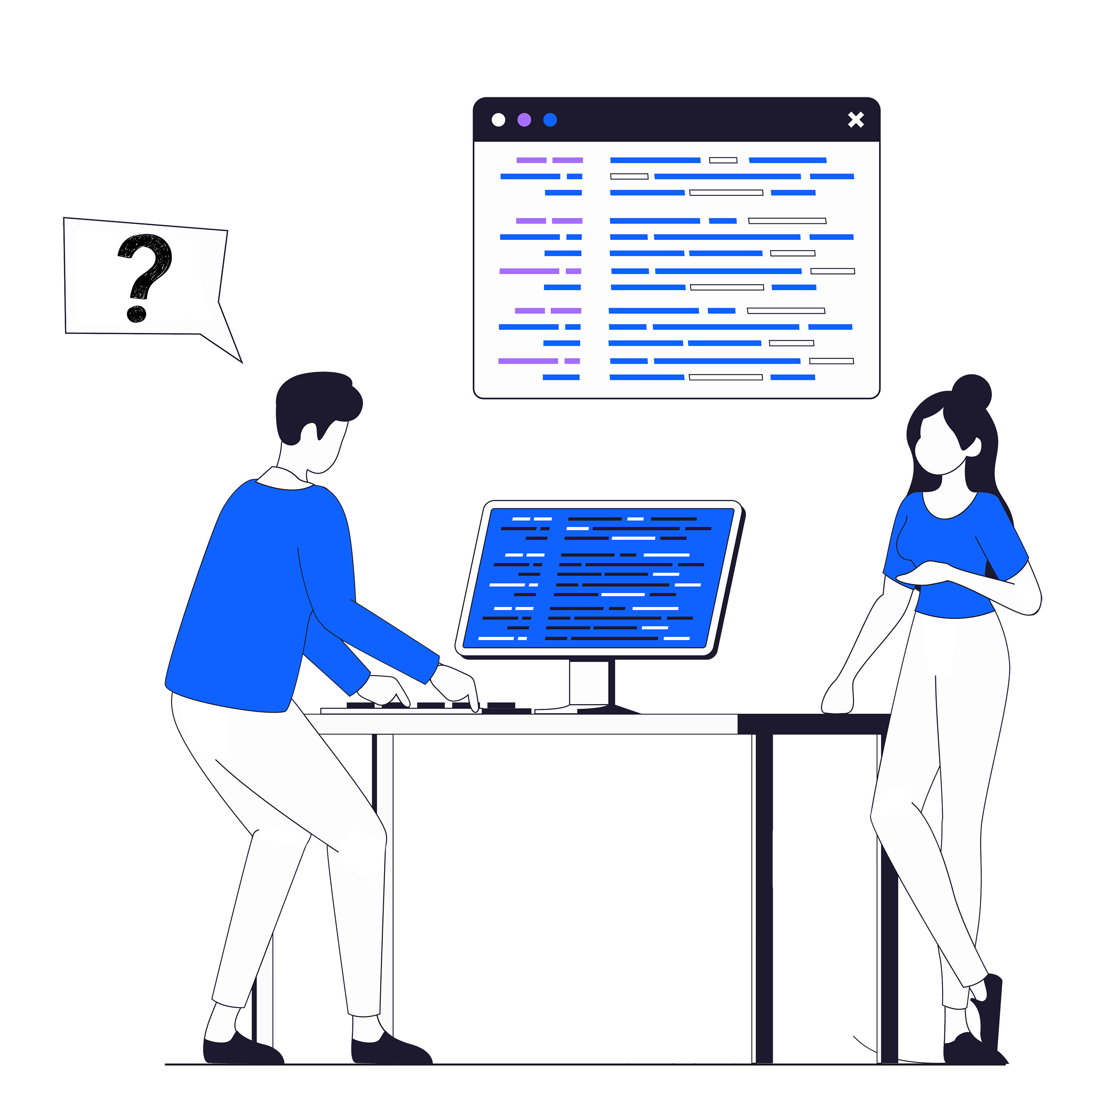



Mainframe users need to find the right information and perform tasks confidently
Spend hours trying to find the right information
Need help from experts to interpret and resolve problems
Perform manual tasks that can require switching between tools and screens
Afraid of causing errors with consequences
User journey
IBM watsonx Assistant for Z | © 2025 IBM Corporation

Slide 9
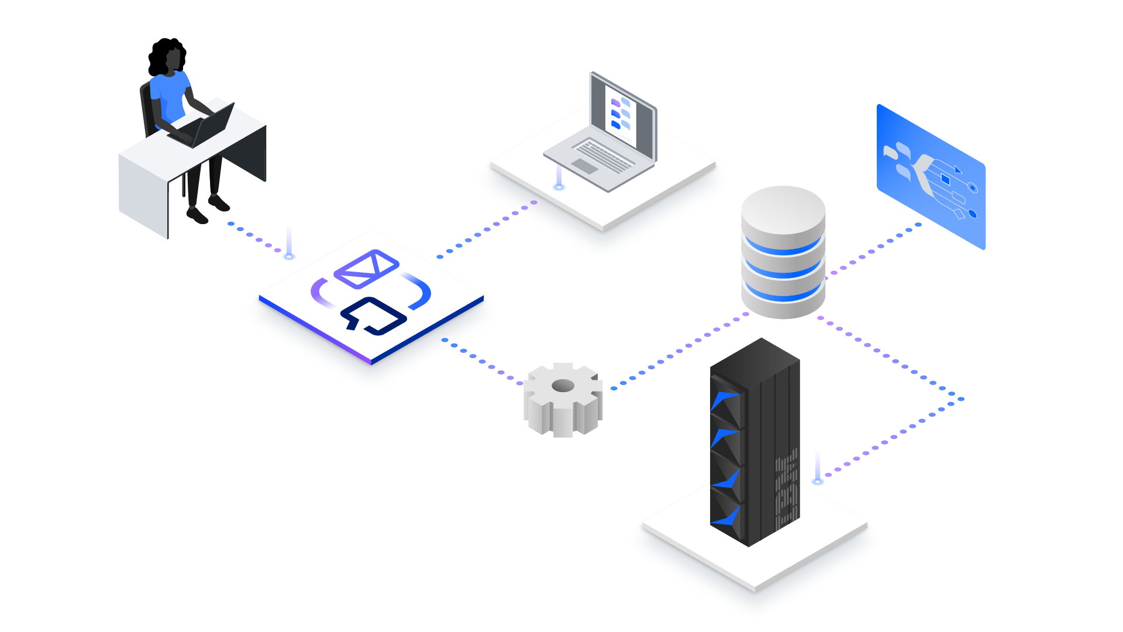
IBM watsonx Assistant for Z
Mainframe experience, reimagined.
Generative AI solution, transforming and simplifying the way Z users of all experience levels engage and interact with the mainframe to be more productive.
Conversational AI with real-time context driven actions
Quick and accurate answers to questions that leverage IBM Z domain-specific and your own documentation. Augment the conversation with real-time system insights and execute context driven automations.
Pre-built and custom automations
Low code approach to confidently build and deploy both routine and complex tasks with pre-built and custom skills.
Configurable Assistant
Personalize based on business process and job roles.
Seamlessly integrate your own documentation, processes and best practices to answer proprietary questions and relevant automation.
Benefits: | Reduce learning curve | Increase productivity | Increase efficiency | Reduce errors
IBM watsonx Assistant for Z | © 2025 IBM Corporation

Slide 10



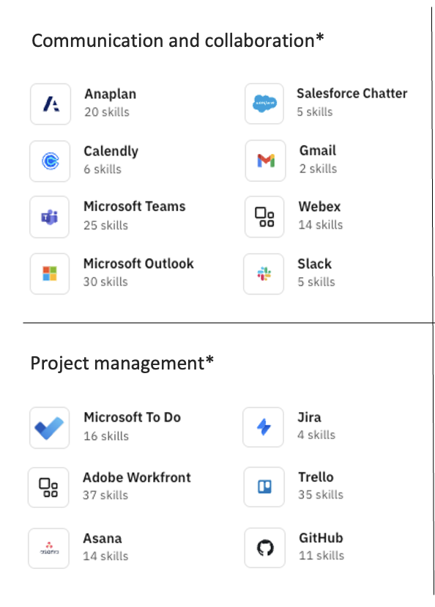
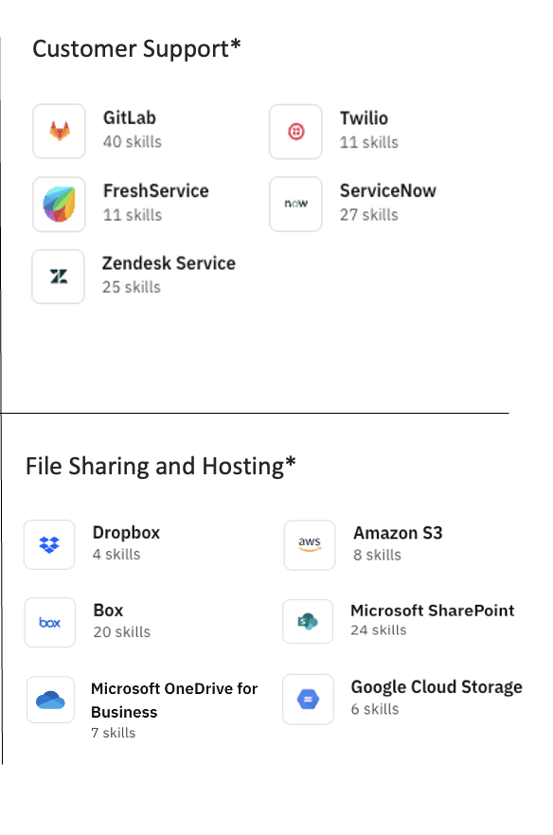
How is IBM watsonx Assistant for Z different?
Generative AI responses for IBM Z
  Provides accurate and current information that leverages all IBM Z domain-specific knowledge.
  Is meticulously trained with an extensive dataset of over 12 trillion tokens, including IBM Z-specific content.
  Leverages a RAG* to ground responses with both IBM Z* and your enterprise knowledge.
  If we don’t know, we don’t guess.
Integrated Automation
  Access libraries of pre-built automation across common tools and use a low-code skill builder to create your own process automation.
  Discover automation during an AI conversation (with the option to execute)
  Leverage IBM Z-specific automation and insights: use pre-built Z skills and obtain system insights in real-time for IBM Z**
Configurable Assistant
  Customize by persona, team and /
  or experience
  Seamlessly integrate your own documentation, processes and best practices to answer proprietary questions.
  Create simple or robust automations effortlessly through a low-code approach.
Include only the automation intended for an audience’s specific business needs.
↓
Fast, current, Z context-aware, automated, secure, and on-prem
*Retrieval-augmented generation (RAG) Link. Pre-ingested documents and Redbooks covering over 200 IBM Z products
  **Z-specific automation and insights available today for z/OS
IBM watsonx Assistant for Z | © 2025 IBM Corporation

Slide 11



Examples of personalized assistants
New to Z Assistant
Operations Assistant
Application Assistant
  Early-tenure professional
  Early-tenure IT Ops
  Developers
Up to 30 assistants can be created – personalize by persona, department, function, application, project, organization, etc.
Trusted companion to provide curated answers to any questions on IBM Z and your business.
Ask anything, any time, without hesitation.
Use cases:
Onboarding
Q&A on any IBM Z software product
Open a service ticket
  Simplifies access to operational insights and more on IBM Z, eliminating the need for specialized skills and switching between tools.
Use cases:
Operational Insights
Troubleshooting
Incident analysis
System patching
Provide curated answers on proprietary documentation, processes and procedures.*
Option to trigger automation, as appropriate.
Use cases with BYOD*:
Learn development processes
Understand code standards
Troubleshoot application environment
*Seamlessly integrate your own documentation, processes and best practices to answer proprietary questions.
IBM watsonx Assistant for Z | © 2025 IBM Corporation

Slide 12
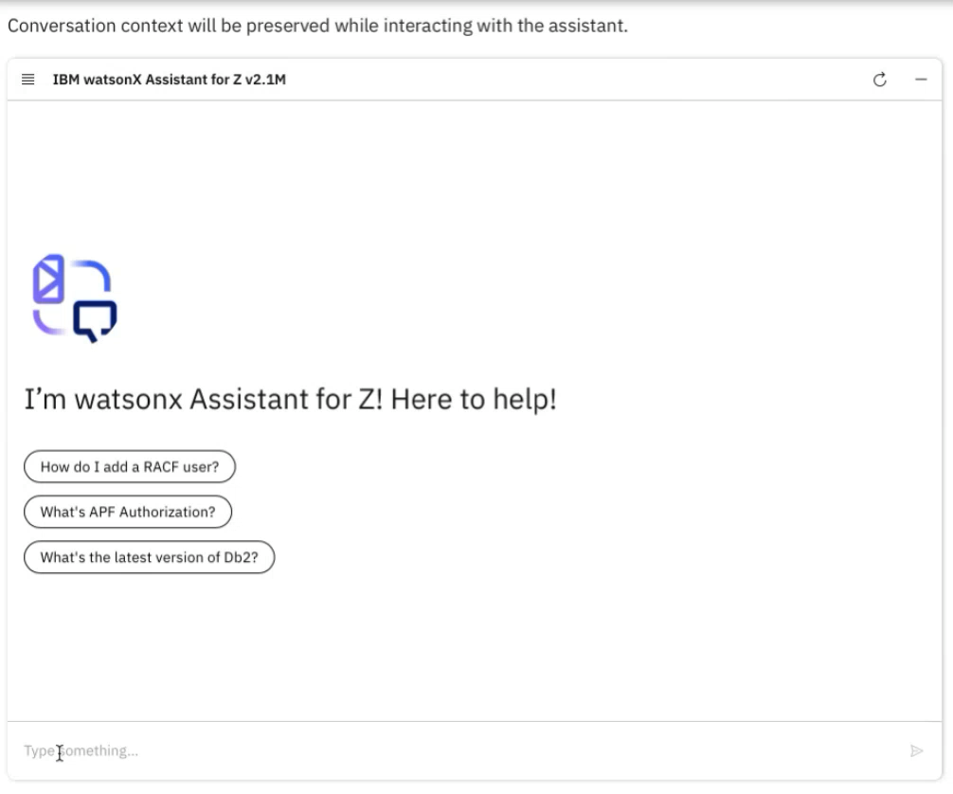
Steve
I’m an early tenure z/TPF application developer. I need to add a new feature to an existing application.
IBM watsonx Assistant for Z user experience
STEVE
Today’s experience
Unable to find the right documentation in support of a requested task
Unsure who to ask for help
“It takes me hours to research and find the right answer”
–Steve
with watsonx Assistant for Z
  “I can go to one place to get answers to any question, on demand”
IBM watsonx Assistant for Z | © 2025 IBM Corporation

Slide 13

IBM CIO Office
Boosting mainframe operations experience & productivity for new Z users
Today
End of 2025
  Need
The key goal of IBM CIO team office is to reduce the skill level required to run their IBM Z environment
Solution
Implemented IBM watsonx™ Assistant for Z in production and leveraged pre-built skills including ServiceNow and Ansible integration.
Initial cases
IBM Z Q&A support for operations staff
ServiceNow incident analysis
Patching Db2 subsystems
Solution components
IBM watsonx™ Assistant for Z
Ansible Automation Platform - RedHat
Concept to value in ~ 4 weeks
8%
30%
Initial learning time saved, optimizing SME usage.
10%
30%
Decrease in time for incident resolution.
50%
75%
Hours reduction to patch Db2 systems*
*Assumes a single patch per year with no rollbacks
*Grey text – outcome today; Blue– aspirational outcome by year end (2025)
Case study-> https://www.ibm.com/case-studies/watsonx-assistant-for-z
IBM watsonx Assistant for Z | © 2025 IBM Corporation

Slide 14
Change the way you engage and interact with IBM Z using IBM watsonx Assistant for Z
Engage in a context-aware conversation and find curated answers quickly
Trigger and perform tasks with guided assistance and automation
Successfully complete tasks autonomously
User journey
with AI assistant
“I can go to one place to get answers to any question, on demand” – IT Professional
IBM watsonx Assistant for Z | © 2025 IBM Corporation
Notes:
14

Slide 15


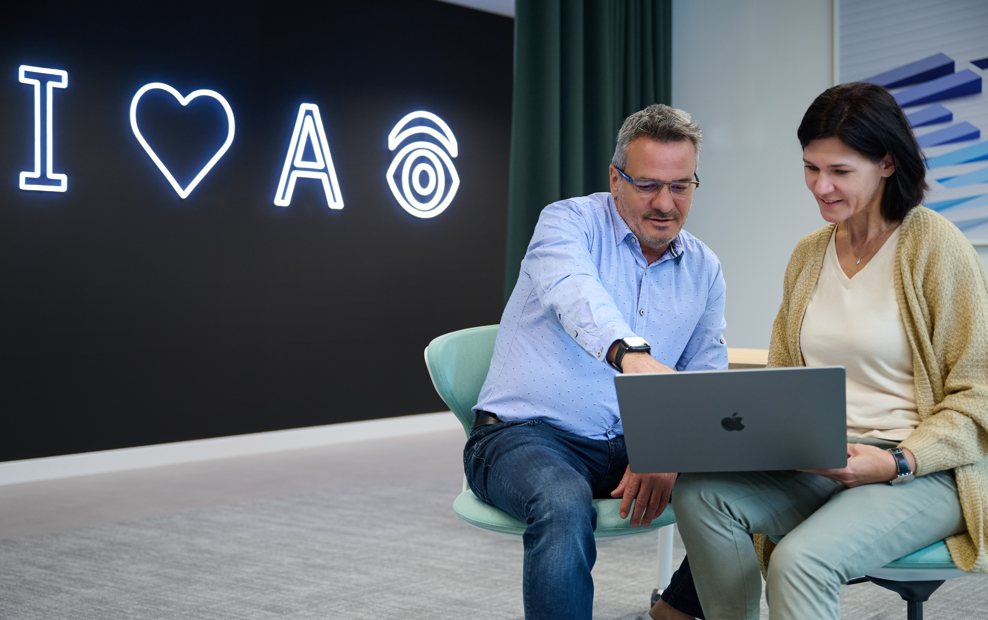


IBM watsonx Assistant for Z
Mainframe experience, reimagined.
Generative AI solution, transforming and simplifying the way Z users of all experience levels engage and interact with the mainframe to be more productive.
Reduce learning curve
Ask anything, any time, as many times as you need.
Increase productivity
Simplify and automate complex processes, save time and effort.
Increase efficiency
Save hours looking for answers and completing manual tasks without SME supervision.
Reduce errors
Increase work quality and accuracy with curated content and automation.
IBM watsonx Assistant for Z | © 2025 IBM Corporation

Slide 16
IBM watsonx
Code Assistant
Accelerate development for multiple programming languages

Slide 17








IBM watsonx Code Assistant
AI-powered
coding tasks
Code generation, explanation, unit test creation, AI-derived code documentation, and more.
Enhanced prompt
engineering
Pre-built chat commands with optimized prompts for specific tasks.
Enterprise-ready AI for code solutions to address skills gaps and increase productivity for targeted, business use cases.
↗ Supported languages: C, C++, Java, Python, Go, JavaScript, TypeScript, and more.
Integrated directly
into IDEs
Available directly within VS Code, integrating seamlessly with your workflow.
Chat for Code
integrated UI
Free-form AI conversational chat for planning applications
and writing code.
Trust, transparency,
and privacy
Code similarity checks,
IP protections, deploy either via SaaS on cloud or on-premises.
Enterprise Java modernization
Generative AI and automation-assisted modernization for Java enterprise applications.

Slide 18

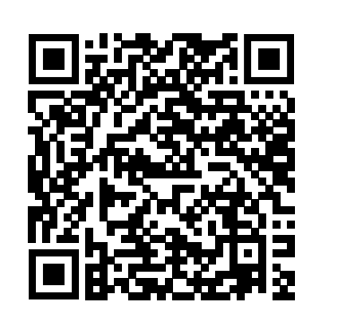
Core features and capabilities ↷
Understand and document your codebase
IBM watsonx Code Assistant delivers clear, concise insights
into complex applications — demystifying the purpose and functionality of poorly documented code.
↗ Engage with understanding and explaining code in two ways: within your IDE or using AI-powered chat UI interface
↗ Supported languages: C, C++, Java, Python, Go, JavaScript, TypeScript, and more.
Check out the Interactive click-thru demo for IBM watsonx Code Assistant

Slide 19
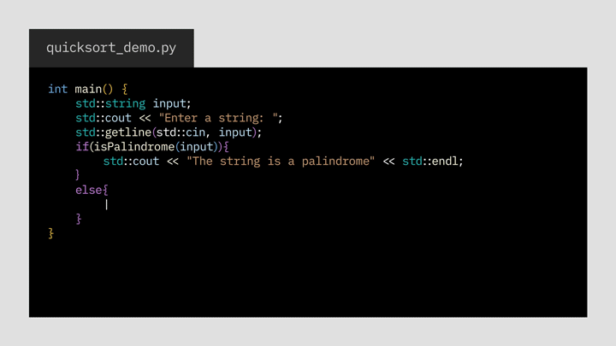
Core features and capabilities ↷
Generate Code with inline suggestions or chat
Code faster with IBM watsonx Code Assistant that suggests
AI-generated code as you type within VS Code.
↗ Generate code in two ways: within your IDE or using AI-powered chat UI interface
↗ Supported Languages: C, C++, Java, Python, Go, JavaScript and TypeScript
Check out the Interactive click-thru demo for IBM watsonx Code Assistant

Slide 20
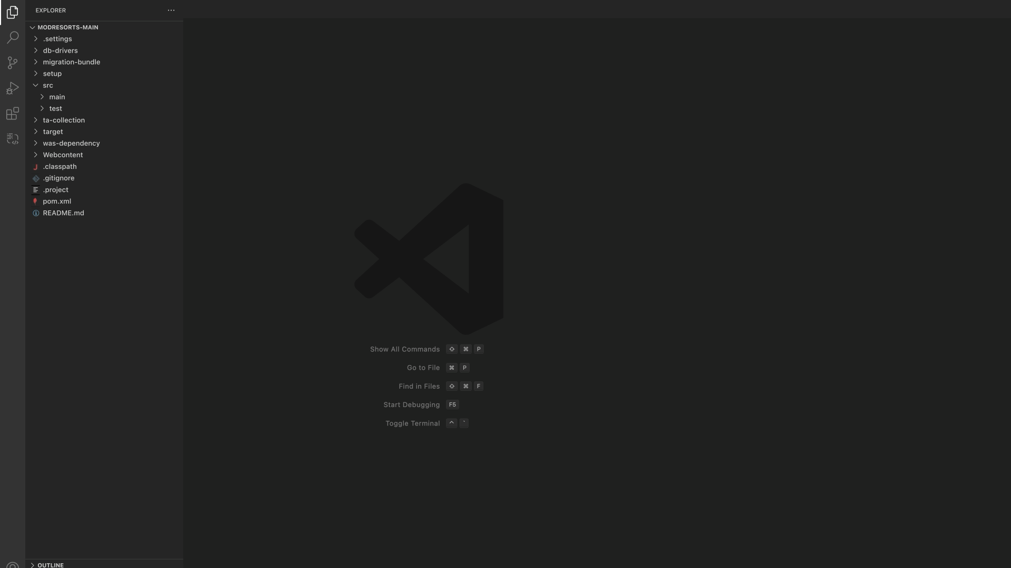
Core features and capabilities ↷
Generate Test Cases
IBM watsonx Code Assistant enables developers to generate unit tests, accelerating the overall software development lifecycle.
↗ Generate unit tests in 2 ways: within your IDE or using AI-powered chat UI interface
.
Check out the Interactive click-thru demo for IBM watsonx Code Assistant

Slide 21

WCA success story
“Client Zero”
CHALLENGES
In 2024, as part of the annual IBM watsonx Challenge, IBM allowed its own employees to demonstrate how they could overcome these challenges using watsonx Code Assistant
A small team of relatively new IBM product developers had inherited more than 50 undocumented code repositories
containing about 750 JavaScript files
Faced with a large codebase that was poorly documented and understood, the team was potentially looking at weeks
of manual analysis in order to decipher and properly document the code (over 3 min to understand a file’s purpose)
90%
SOLUTIONS
Developers achieved significant efficiency gains and extended skills with AI code explanation using watsonx Code Assistant:
    Code generation: WCA generated a script to scan all JavaScript assets and flag those requiring documentation
    Code explanation: WCA analyzed code to provide a one-sentence summary of each file’s purpose and functionality
    Code documentation: WCA generated high quality code documentation, addressing knowledge gaps in codebases
If extended across 50 repositories, the developer estimated what would have taken months can be accomplished in 1 week.
The team can now focus on more strategic activities — while maintaining a high level of code quality and explainability.
of time saved in understanding and documenting code
15x
faster summarization
for the entire contents of a JavaScript file
(3 minutes per asset reduced to 12 sec)

Slide 22

IBM watsonx
Code Assistant for Z
Accelerate mainframe modernization, across the application lifecycle

Slide 23



Mainframe application modernization challenges
Agility
With enterprise DevOps,
the clients have gone from doing code commits once a quarter to 20 times a day
Skills
Reduce the talent gap
using generative AI with common tooling and processes across platforms
Manual
Increase automation
across the application development lifecycle to improve productivity and time-to-market
How
What are the proven patterns (e.g., refactoring) and best practices for modernizing mainframe applications

Slide 24
Accelerated application lifecycle with IBM watsonx Code Assistant for Z
Understand
application landscape
with auto-discovery
Transform language
Modernize code
Refactor
to modular business
service
Validate
outcomes with auto-generated tests
Objectives
Address skills and productivity challenges with automation
and AI
Ensure IBM Z® qualities
of service with mixed language interoperability
Align with industry standardDevOps approaches
Code Generation
Code Explanation
Transform
code with optimized
design and architecture
Optimize
code to increase performance
Tailor your journey based on your application modernization and development needs
Code Generation tech available now, GA 2Q 2025

Slide 25
Mainframe developers need to understand and document code
Reading several lines of code and finding no outdated
or wrong comments / documentation
Looking for SME’s to help – there are only few in the company, which all are extremely busy
Trying to further understand the code by myself – just needing to go back and forth with SME’s as there are several issues that are not easy to understand
After making updates to the code, manually writing-up documentation takes even more time spent in tedious
repetitive work
User journey
today

Slide 26
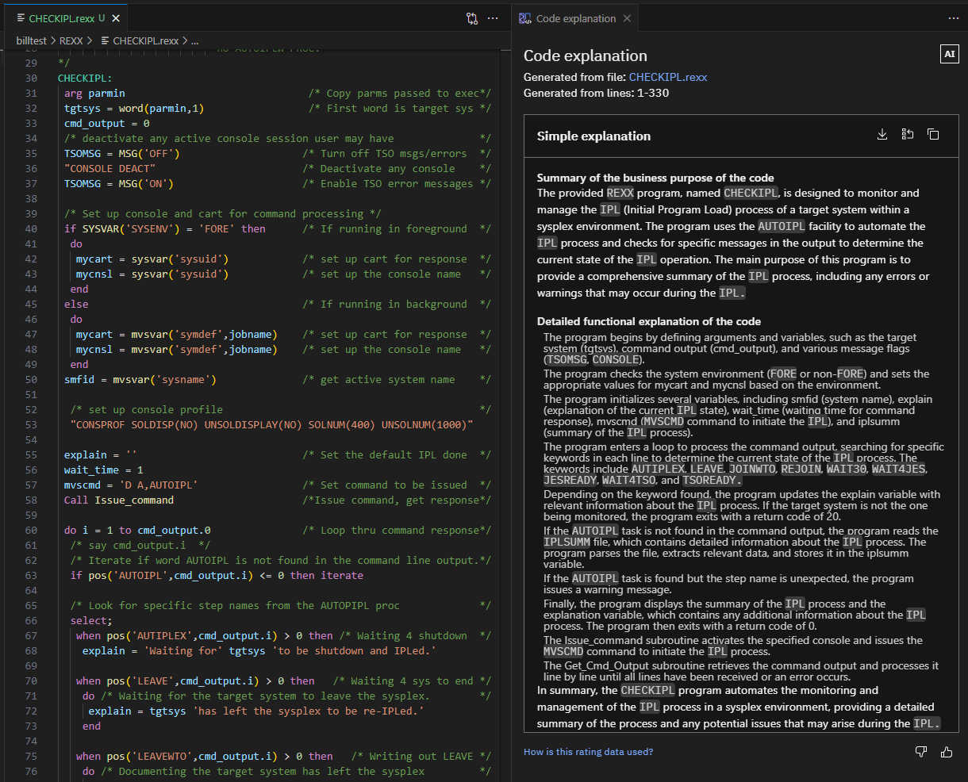

Core features and capabilities ↷
Understand and document your mainframe code faster
IBM watsonx Code Assistant for Z delivers mainframe code explanations and insights – reducing the knowledge gap and reliance on SMEs, and improving documentation.
↗ Engage with understanding and explaining code in two ways: within an IDE or using AI-powered chat UI interface
↗ Available SaaS or On Prem
↗ Supports mainframe languages: COBOL, PL/I, JCL, REXX
↗ Coming soon: Assembler Support, Augment Explanations with Client Data Sources
Check out the Interactive click-thru demo for IBM watsonx Code Assistant for Z

Slide 27
How is IBM watsonx Code Assistant for Z different?
IBM expertise and knowledge base
High quality, mainframe-specific data sets curated by IBM SMEs for model training and evaluation, including z/TPF
Designed for mainframe use cases - Option to include (or not include) comments in explanation
IP in model
evaluation methods
Evaluation metrics, created by IBM Research, are specific for mainframe code explanation use-cases and include response completeness, conciseness, and correctness
Evaluation pipeline and dashboard for model comparisons ensures a continuous model improvement
Golden prompts
Extensive Prompt engineering, developed with sponsor users, to create golden prompts for Code Explanation
Enables developers to easily use the AI-Assistant without needing to become
prompt engineers
Enables consistent outcomes and experiences across teams
Quality assurance of
the LLM and Prompts
for ease of use and
high-quality explanations
Next Step:
Become a Sponsor User for Assember Explanation today!

Slide 28
Mainframe developers need to understand and document code
Generating a simple explanation per click to get
a high-level understanding of the code in minutes
Leveraging Code Explanation during software development to understand the code in detail – no searching for outdated documentation
Easily document new and changed code by using AI generated explanations to store as documentation or comments in the code
Benefits: | Reduce learning curve | Increase productivity | Free up SMEs | Streamline documentation
User journey
with AI assistant

Slide 29
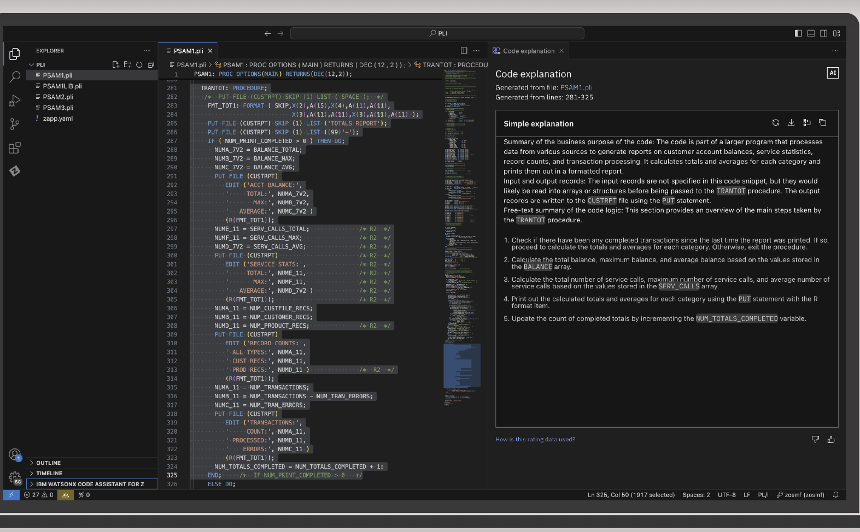
Gen-AI x IBM Z – What’s Next?
The value is growing
Common Agentic Framework will enable integrated, seamless experience across products, with client context and "Z-ness” throughout
Agentic Framework
watsonx Assistant for Z
watsonx Code Assistant
watsonx Code Assistant for Z
Transform engagement and interaction with the mainframe.
Accelerate development for multiple programming languages
Accelerate mainframe modernization, across the application lifecycle
Q&A, Z automation & insights
C, C++, Java
Assembler, with Z-ness

Slide 30
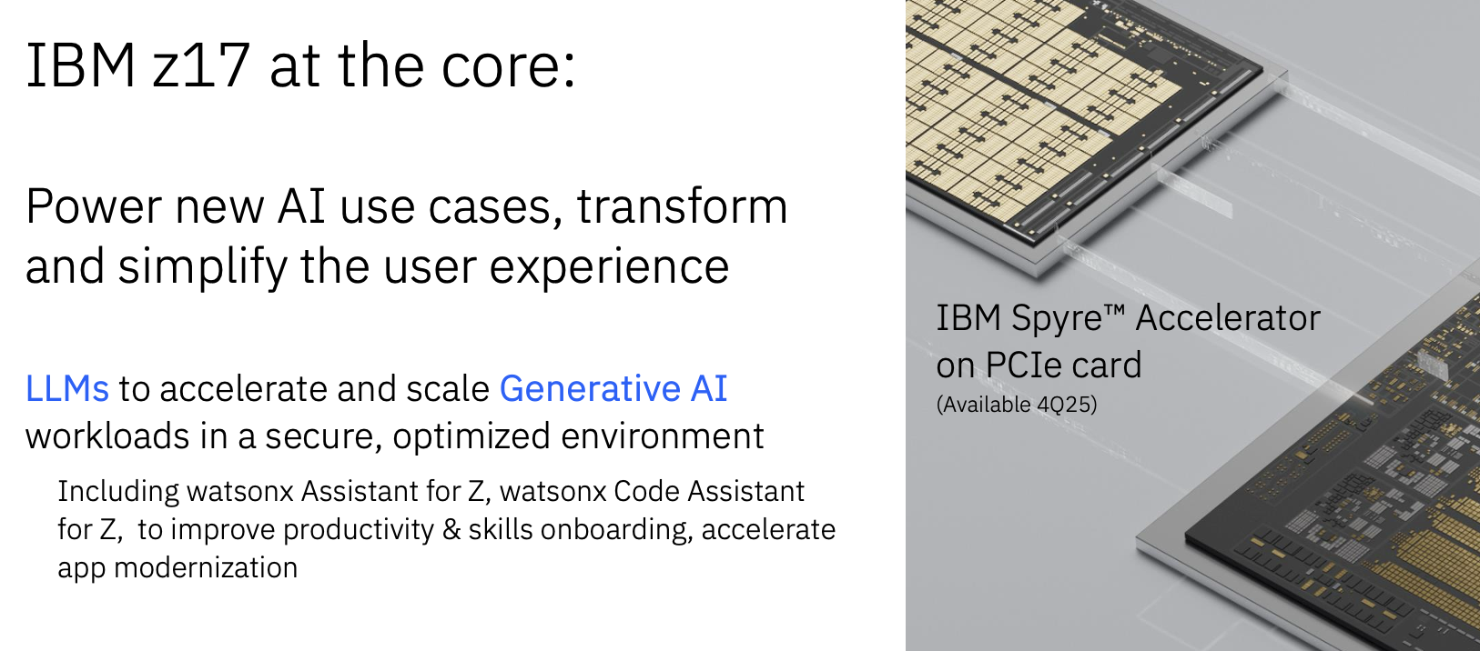
Gen-AI x IBM Z
Full Stack Solution: The IBM watsonx for Z portfolio will now be available completely on IBM Z with z17 and Spyre (no GPUs required.)

Slide 31
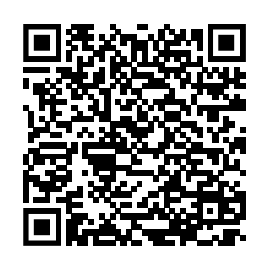
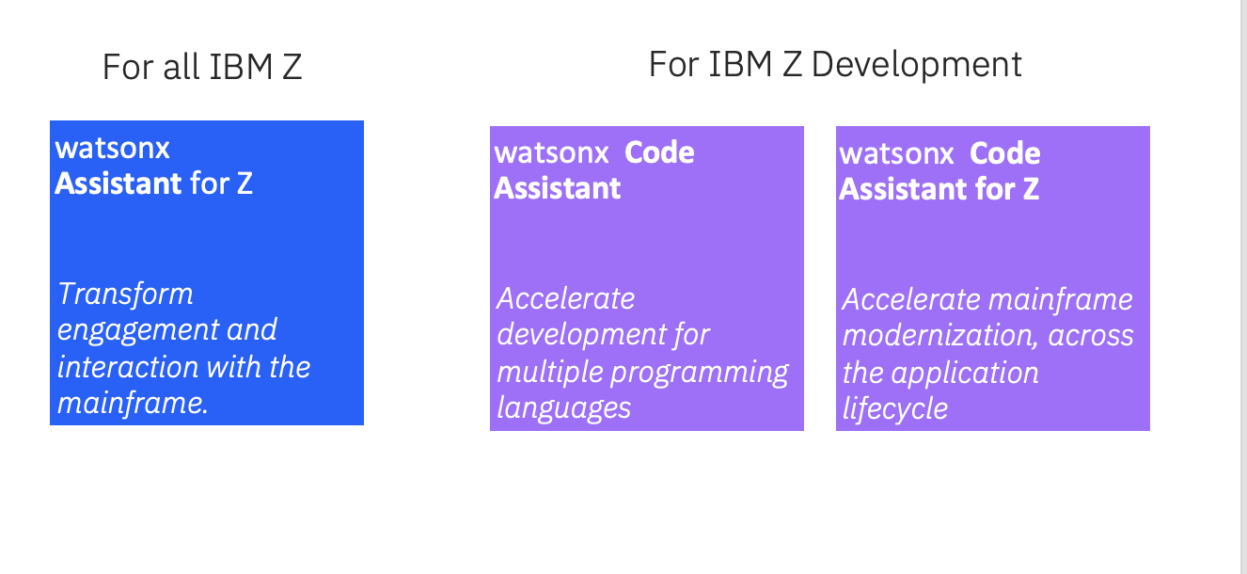
Thank you!
Explore more:
Contact: Kelly Paesano, kapaesan@us.ibm.com
Follow our Community Page: Gen AI on IBM Z
Request a demo and/or pilot
Link here.
Visit the Product Page
Link here.
Visit the Product Page
Link here
Request a demo and/or pilot.
Link Here
Visit the Product Page
Link Here

