Slide 1
IBM InformationServer DataStage PX
Lookup Stage: A Deep Dive
Gary Foster Sr. Software Engineer
2015/05/14
Notes:
Welcome everyone
In this presentation I will review the Lookup Stage for DataStage Parallel Job designs
To get the most of this presentation you should have prior experience with :
PX job design
Parallel Processing concepts
General Lookup Stage usage
Most of this material has been gathered by extensive use of the software over years of development and consulting experience. I encourage you to try these techniques yourself to see which approach provides the best performance for your solution. No two environments are the same, so techniques that work for one environment may not produce the same results in another. By knowing how the lookup stage works behind the scenes you will be able to make job design changes based on your environment and topology choices.

Slide 2
Objectives
Lookup Types
Terminology
Dissect the Lookup steps
Job design vs actual operation
Tuning and platform Considerations
Range Lookup & APT_NO_SORT_INSERTION
Case Study
Conclusion/Questions
Notes:
In the course of this presentation we will review the 3 lookup types,
Discuss terminology to keep everyone on the same page, especially when working with support,
We will look “under the hood” of the lookup stage, to see how different usage affects resources and performance,
Also we’ll see how job design choices can affect resources and performance,
Then we will review some tuning and specific information relating to different platforms.
We will review the required Range Lookup job deisgn changes when used with APT_NO_SORT_INSERTION Flag.
Finally, In the Case Study I’ll compare several lookup jobs using the different options we will review in this presentation. You will see that performance is directly related to the options and understanding how these job design choices affect performance will allow for a better overall solution.

Slide 3
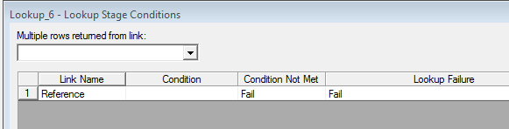
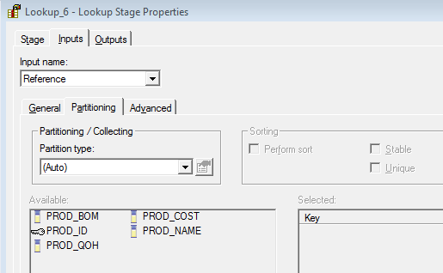
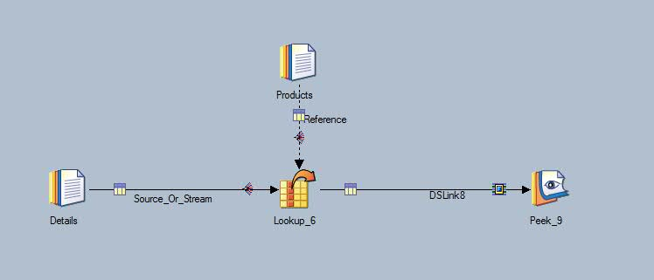
Lookup Types
Typical Lookup
Benefits
  No sort required
  No partitioning required.
Notes:
1st Example is of a typical lookup stage.
I call it typical because we see this type of job design with little to no changes in the default settings.
This job design utilizes “Auto” partitioning for both input links
There is no reject information link or rules
And matches are done against a single key
No sort or partitioning is required on either of the source or reference links. And results can be had very quickly with smaller lookup data sets.
Note: Please use clear and concise naming conventions for all of your stages and links.

Slide 4

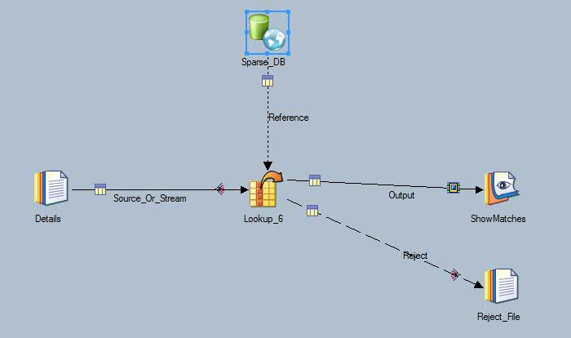
Lookup Types
Sparse Lookup
Requires database stage
DB performance
Notes:
The Sparse Lookup requires a DB stage. Typically you’ll see an Oracle or DB2 Connector stage, or Enterprise DB stage used with this lookup.
What makes this a Sparse Lookup is the DB stage properties, not in the properties of the lookup stage itself.
Typically sparse lookups are used for smaller quantities of source rows as the number of source rows controls the number of queries run on the DB.
For example, if you have 1,000,000 source rows, then 1,000,000 queries will be run on the DB.
Because of this make sure your lookup table is indexed on the correct keys and the table and DB is in good health.
Typically sparse lookups are not as performant as in-memory lookups, however, based on data logistics it may be the better choice. Benchmarking you job using each technique will provide best analysis for your solution.
From IBM Doc: For scenarios where the number of input rows is less than one per cent of the number of reference rows in a DB2 or Oracle table, a Sparse Lookup might be appropriate

Slide 5
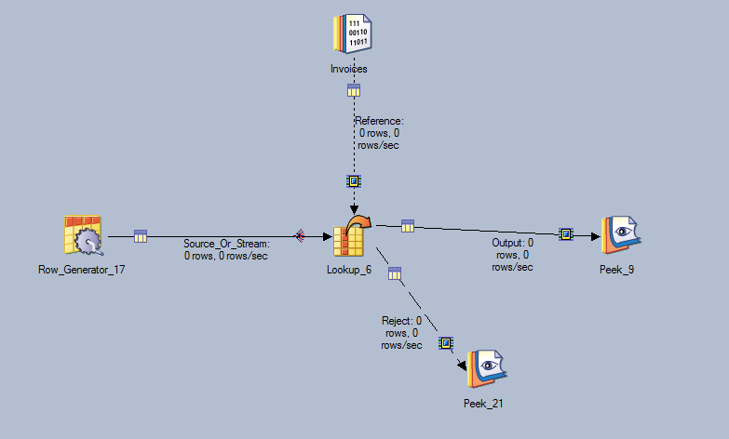
Lookup Types
Range Lookup
Additional data sort requirement
Automatically done for you
Notes:
In this example we have the Range Lookup. The Range Lookup was introduced with DataStage version 8, and requires additional preparation of the lookup data which is normally done automatically by the framework. Will cover more details later in the presentation, but wanted to mention this as a possible performance hit for the additional sort.

Slide 6
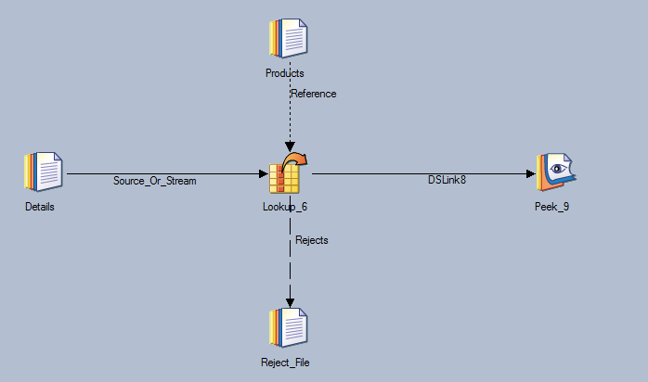
Terminology
Naming
Link Types
  Source/Stream – Primary Link
  Reference - Dotted
  Reject - Dashed
Notes:
There are 3 types of links (or virtual datasets) on the PX canvas. I turned off the Link markers to show the links a little better here.
Source/Stream – typically moves data to be processed from one stage to another, usual partitioning rules apply. Stream links are solid and point in the direction of data flow.
Reference – special type of link that also does other “work”, default partitioning rules can be different for the lookup stage. Reference links are “dotted” as you can see in the job design here.
Reject – avenue for special data handling, standard partitioning rules apply here as well. Reject links are shown as “dashed lines”.

Slide 7
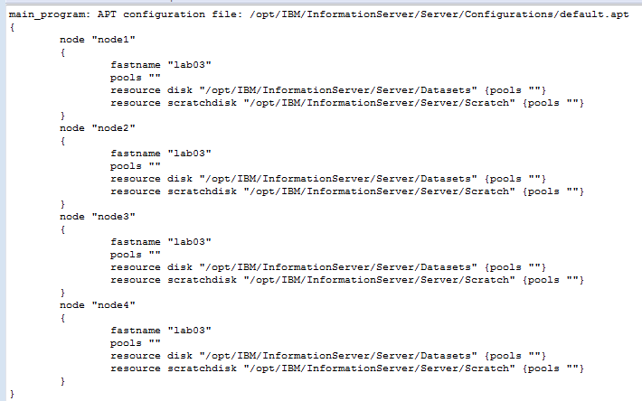
Terminology
Configuration File
Degree of Parallelism
Resource Disk
Scratch Disk
Notes:
This is a sample configuration file, it’s also the one I used in the case study later in the presentation.
Items to Note:
The “fastname” is the actual host or server where work is carried out. OSH processes are run here to complete that partition’s tasks.
The “resource disk” is the disk area where those tasks will store and share data. This can be shared filesystems but should be fast reliable I/O.
The “scratchdisk” is where buffers are written, this should be local filesystem or very fast I/O.
Pools are used to narrow down or focus specific tasks to be run on a specific node or resource.
The number of nodes or degree of parallelism (this translate to number of partitions) is determined by the configuration file used to run the job.
In a divide and conquer scheme, adding more nodes usually increases performance, IF you job is scalable.

Slide 8
Terminology
Lookup Table – Reference Link
Lookup Table File
  Resource Disk area
MMAP
  File -> Memory
  Fast Random Access
  Shared
Example of typical lookup table for Products Data (10M)
Notes:
The Reference Link:
Of the 2 types of input links – the reference link controls a lot of the lookup functionality. We will discuss partitioning methods on the reference link and the way the lookup tables are affected by the different options available to the developer.
For non-sparse lookups, each reference link will have at least one “Lookup Table” and that data is stored in the Resource Disk Area defined by the configuration file.
C++ mmap functionality is used to map this lookup table (a proprietary structure) into memory.
The reason we use memory is it provides better performance for random access, and memory segments can be shared for multiple partitions, so for all partitions only 1 copy of the lookup data is required.
The Lookup table filename contains process ID, date/time and other keys to make it unique.
Question:
If we are using a 4 node configuration file, why is there only 1 lookup table? Will the lookup not run in parallel? We will answer that in the next section.

Slide 9
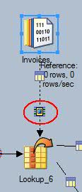
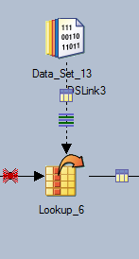
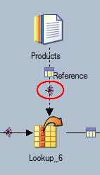
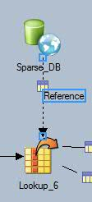
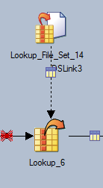
Terminology
Partitioning Terms – Reference Link
Auto
  All other stages
  Lookup Stage default Entire
Fan Out
Auto
Sparse
LU Fileset
Same
Notes:
We have different types of lookups and also have different partitioning markers to show how the lookups were meant to run.
Note the markers denoting different partitioning types or no partitioning at all.
* Sequential to Parallel also referred to as “fan out”
* “Auto partitioning”
* Sparse lookups and Lookups utilizing a Lookup Fileset have no partitioning options.
Sparse lookup requires no partitioning because the data is being fetched as needed. We do not store the data locally, so no need to partition it.
In the job using a Lookup File Set, the partitioning has already been set when the Fileset was created. There is no option to change partitioning or keys in this type of job design.
*. “Same partitioning” which has a profound effect on the lookup as we will see in a bit.

Slide 10
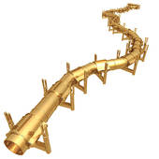

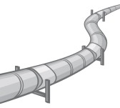
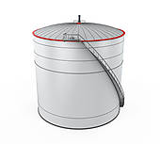
Terminology
Lookup Operations
Create Lookup Table (OS/Memory)
  Number and size determined by reference link partition type
Lookup Match Operation
  Shared memory
Pipeline Processing
Notes:
2 different Operating System processes for each lookup stage:
Create Lookup Table (APT_LUTCreateOp) - builds the Lookup Table File and maps to memory
Match (lookup) Operation (APT_LUTProcessOp) – uses the Lookup Table in memory to match source data based on the keys.
A word about pipeline processing: Think of a water or oil pipeline, it originates from the source and is a continuous flow until the destination. There are no storage tanks along the way to disrupt the flow. We want our data to do the same, As long as the buffers are contained in memory, we have data “flowing”, once they have to be offloaded to disk, we should expect loss of performance because of the additional overhead of I/O. This will become more evident when we get deeper into the Lookup Table Create Operation.

Slide 11
Terminology
Lookup Operations
SMP
  All processes are executed on a single engine tier
  Limited CPU
  Memory segments can be shared
MPP
  Dynamic CPU
  Lookup Tables cannot be shared in memory across nodes
  Lookup data can be duplicated causing additional network traffic
Notes:
With a good handle on terminology, we can now discuss some topology differences:
SMP - Symmetric Multiprocessing
Typically server has multiple CPUs
Multiple OS processes running simultaneously
Since all processes run on a single Server (Engine tier) memory can be shared across multiple processes (stages/partitions)
MPP – Massively Parallel Processing
Cluster/GRID configurations
Multiple physical Servers
Network use increased
We will discuss how lookup usage affects resources on each type of topology and what you should expect when migrating from SMP to MPP.

Slide 12
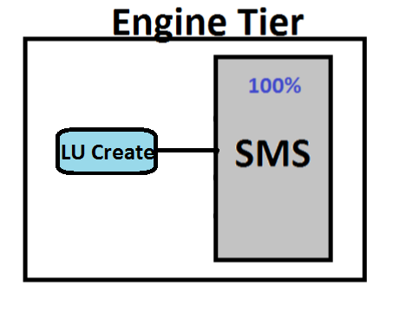
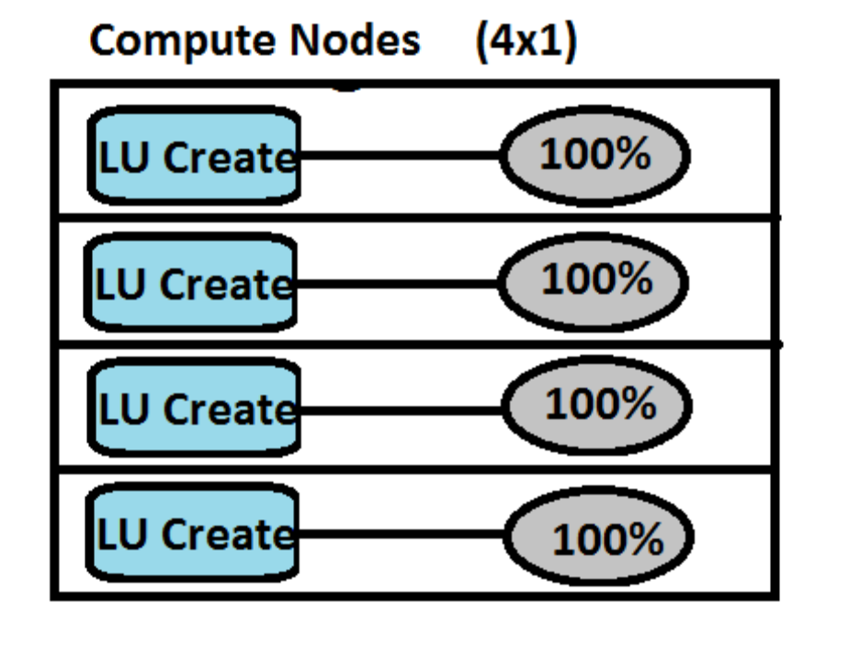
Lookup Step 1
Create Lookup Table (APT_LUTCreateOp)
Number and size determined by reference link partition type
  Default – Auto “Entire”
  100% of lookup data in a single structure
  SMP/MPP
  4 node config SMP 4 node config MPP
Compute 1
Compute 2
Compute 3
Compute 4
Notes:
The first thing we need to do before we can match data is build a structure that will hold the reference data and load that data into memory. This is the Lookup Table Create operation.
We discussed how the configuration file determines the degrees of parallelism used for the parallel stages, but look what is happening to the left picture for the create step.
For the reference link of the lookup stage, “Auto“ partitioning does not mean use the partitioning method set in the previous stage. It also doesn’t mean use round robin for “sequential to parallel” partitioning (like for all other stages). It means use “Entire” partitioning.
Why? Remember that when the lookup is running in parallel all the lookup processes can “share” the reference data in memory (Shared Memory Segment). This allows for many degrees of parallelism for the lookup match step to access all the reference data from one place. Because of this no special partitioning is required for either input link to the Lookup stage.
This is good for SMP, not so good for MPP. The right picture shows we are pushing 4x the data across the network because each physical server need it’s own copy of the data (remember we are using “entire” by default) so each lookup match process is expecting 100% of the data to be available for use. For small reference data this is not a problem, but, often times data quantities grow and the question is ultimately asked “what is happening to performance with the larger data quantities”?

Slide 13
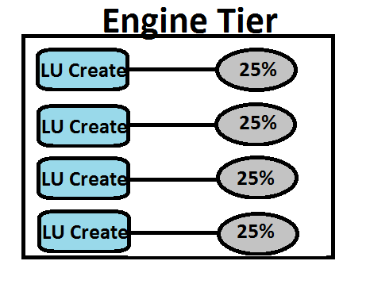
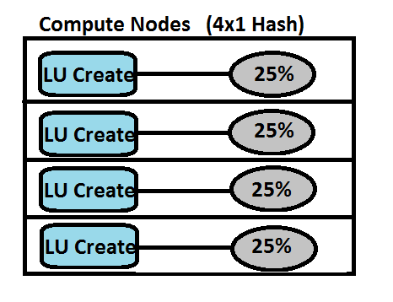
Lookup Step 1
Create Lookup Table (APT_LUTCreateOp)
Number and size determined by reference link partition type
  Keyed (Hash)
  required on both inputs
  Even distribution of keys
  SMP/MMP
Notes:
So now, we can compare the change of the partitioning method from “auto” which is the same as “entire” to a keyed partitioning method. Hash or modulus usually provides the best distribution of keys, but not always, know your data! With hash, there are now multiple Lookup Create Operations, each working on it’s own subset of the data. For both SMP and MPP we have a win because we are using parallel operations AND each create operation is dealing with smaller sets of data. Also on MPP we are only pushing 100% of the data across the network instead of 400% as with Entire.
Drawbacks? When partitioning reference data you must also partition the source data in the same manner. SMP partitioning is done in memory, so this is done very efficiently. MPP partitioning and repartitioning is done across network, so weigh the cost of repartitioning the source data.

Slide 14
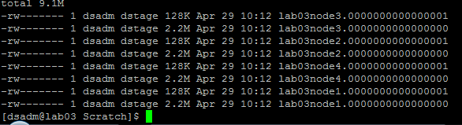






Lookup Step 1
Create Lookup Table (APT_LUTCreateOp)
What happens to Source Data
  Buffers -> Scratch
  Additional disk I/O
  I/O Contention
  Breaks pipeline concept
Memory
Source
Look Up
Virtual Dataset
Notes:
Speaking of source data, we cannot process any data from lookup stage until the lookup table is built and mapped. If all input data is being processed at the same time, both source and reference data, what happens to the source data while the reference data is being put into the lookup table?
Buffering - Rows of source data is “buffered” into memory until a threshold is reached, then that block of data is written out to disk as a file. These buffers are written to scratch. Any physical I/O is costly. Pipeline concept is to keep all data moving not resting.

Slide 15
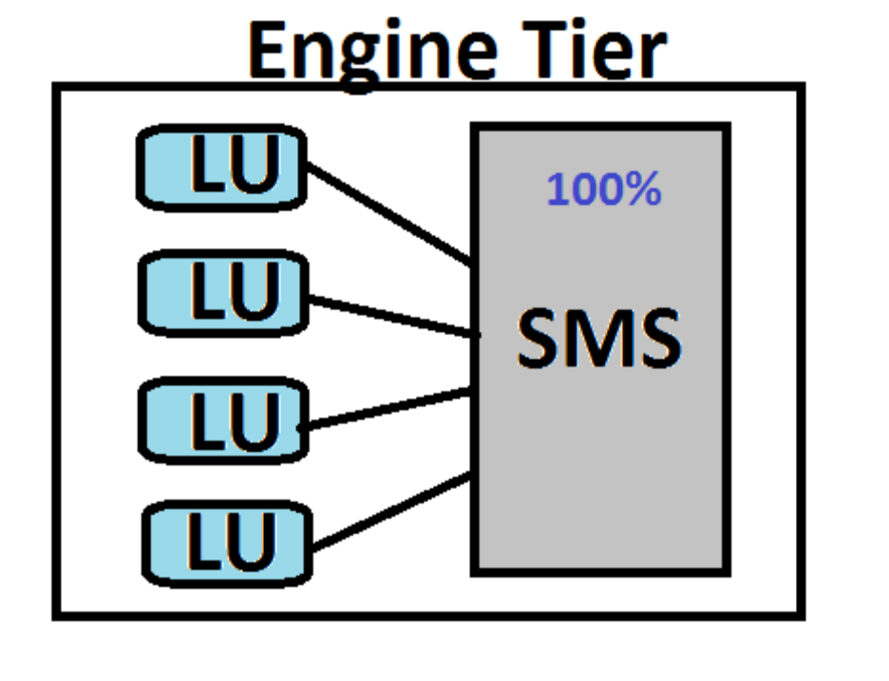
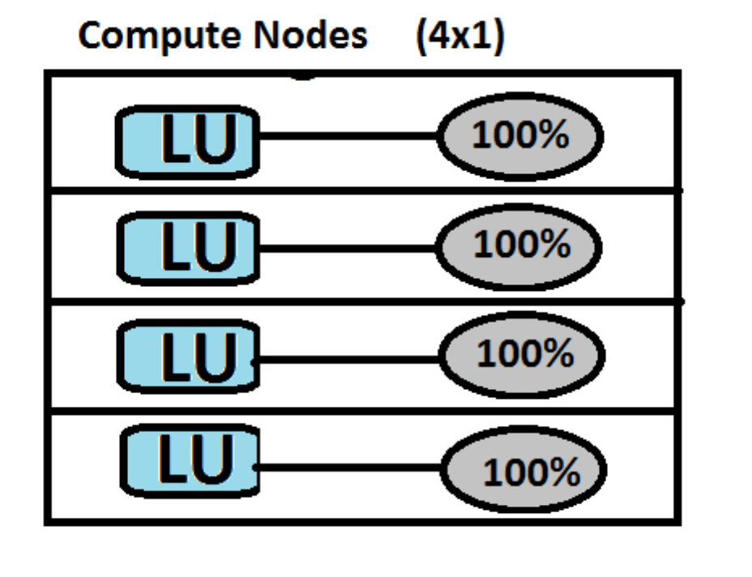
Lookup Step 2
Lookup Operation (APT_LUTProcessOp)
Number of processes determined by config file
  Default – Auto “Entire”
  No sort or partitioning required for either input
  SMP/MMP
  4 node config SMP 4 node config MMP
Notes:
Now we get to the bulk of the work, where the lookup is actually processing or matching data.
Here we see how the single shared memory segment is created so all Lookup match processes on the SMP side can access a single copy of the data.
Benefit, no sort or partitioning is required for either input link for SMP or MPP.
Drawbacks:
Large memory structures needed to manipulate and search for the data. SMP requires an 859MB lookup table for our Products table.
The MPP model will produce duplicate data, which is transferred over the network. Roughly 3.36GB of lookup data will be moved across the network with our 4 node sample configuration file.

Slide 16
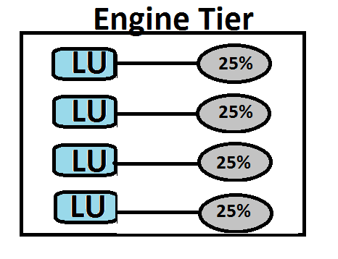
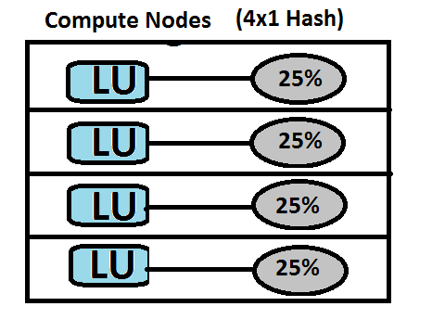
Lookup Step 2
Lookup Operation (APT_LUTProcessOp)
Number and size determined by reference link partition type
  Keyed partitioning (Hash)
  Required on each input link
  Even distribution of keys
  SMP/MMP
Notes:
Here is an example of the lookup match step with Hash partitioning, assuming even distribution of keys we only deal with 25% of the data for each partition.
Benefits:
Both SMP/MPP– smaller memory structures to deal with, smaller objects needed to match the data.
MPP – less network traffic 3.36GB vs 859MB
Drawbacks:
Like Partitioning methods are required on both input links to the lookup stage

Slide 17
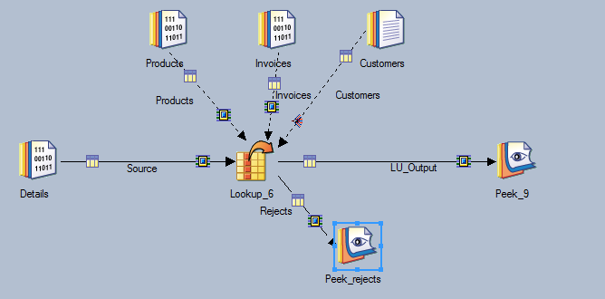
Job Design vs Actual Operation
Single stage - multiple reference links
  Multiple lookup tables per operation
  Limits partitioning options
  Limit to one link for duplicate rows
  Limit to one reject link per stage
Notes:
Now we can discuss different design strategies.
Here we see a Lookup Stage with multiple reference links for inputs. This may make your job design look easier to read, but how does it affect how the lookup actually operates? What are the trade offs for using this type of job design?
Here are some observations:
You are forced to use a single partitioning method that will work for ALL reference links, since odds are not in your favor that all lookup operations will have the same key involved, you probably cannot rely on the source data being correctly partitioned properly for every reference link. That will force you to use auto/entire on all reference links to make sure every partition can see all the data required to make a match.
We’ve already seen how the sequential operation for the “lookup table create” step using the “auto/entire” partitioning affects the lookup table size.
The single lookup stage actually builds one lookup table per reference link, but since we are using a single stage, the single lookup create step has to do this for each reference link, causing more work for a single OS process.
Stage properties only allows for one reference link to provide duplicate rows.
Reject data will be combined to one reject link. Limiting the ability to see which reference data was insufficient for the match.

Slide 18
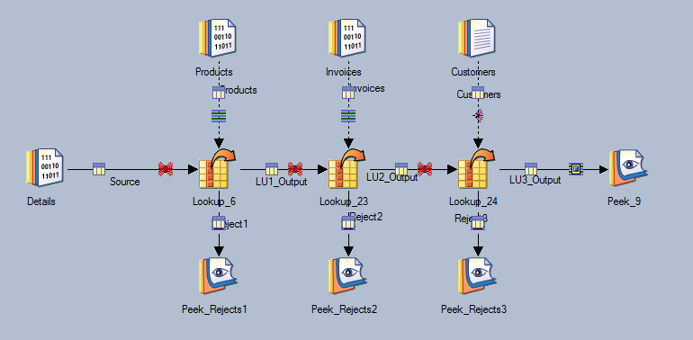
Job Design vs Actual Operation
Multiple stages - single reference link
  More partitioning options
  Specific reject links
  Duplicate Rows
Notes:
Now, let’s look at a different design that produces the same results.
Benefits:
We can take advantage of better partitioning methods for each reference link.
We can take advantage of higher level of detail for rejects.
And we have more options for allowing duplicate rows.

Slide 19
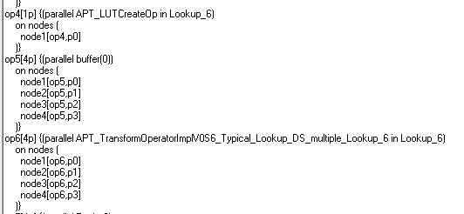


Job Design vs Actual Operation
Single stage - multiple reference links
  Dump Score
  26 processes on 4 nodes.
Notes:
Here is our first look at the dump score. This is a very handy tool for looking into what the framework is actually doing with your job design.
I would recommend you learn how to use this information, use it as a tool for tracking down partitioning and performance issues.
Job with single lookup stage with 3 reference links and a single reject link, produces approximately 26 OS processes that run on 4 nodes.
Dump score shows LUTCreateOp running on 1 node (creating 3 Lookup tables, each with 100% of it’s lookup data).

Slide 20
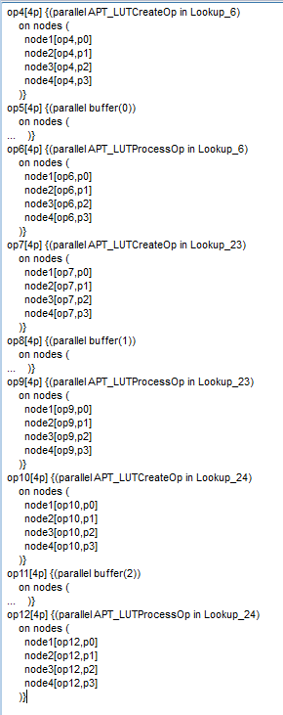
Job Design vs Actual Operation
Multiple stages - single reference link
  Dump Score
  65 processes on 4 nodes.
Notes:
More workers to distribute the load more effectively. Same pile of dirt, but with 4 workers, the task can be completed more quickly.
The job design with the 3 lookup stages utilizing a keyed partitioning method allows for more workers on the same amount of data.
The dump score provided here shows that this job now uses 65 OS processes, showing multiple LUTCreateOp steps that are running in parallel.
Each lookup has a smaller lookup table to deal with initially and during the match step.
But what are the drawbacks:
This job design utilizes more OS processes resulting in higher CPU utilization.
When a single job utilizes more CPU, you can’t run as many jobs simultaneously.
Thus the scheduling delimia: Do I run fewer jobs faster or more jobs at the same time?

Slide 21
Tuning and Configuration
Topology
  SMP
    Limited resources
    Design/scheduling
      Faster job runs
      More jobs running simultaneously
    More processes = more resources = better performance (single job)
      CPU
      Memory
      Network
Notes:
With that question we get more into the different types of topologies:
SMP - CPU, memory, and Disk is usually fairly static. You cannot just add resources on the fly if needed for a change in scheduling of jobs.
Contiguous memory allocation can be a problem with larger shared memory segments. This is less of a problem with multiple smaller memory segments as found with hash partitioning. SMP also leaves network free for reaching out to other source or targets like DB queries or DB loads.
Scheduling may not be an option based on your solution, in that case, error on the side of performance.
It is easier to prove a single job runs well by itself, and when CPU is fully utilized, a case can be made to increase resources or adjust job scheduling accordingly to allow for larger jobs to complete in a timely manner.

Slide 22

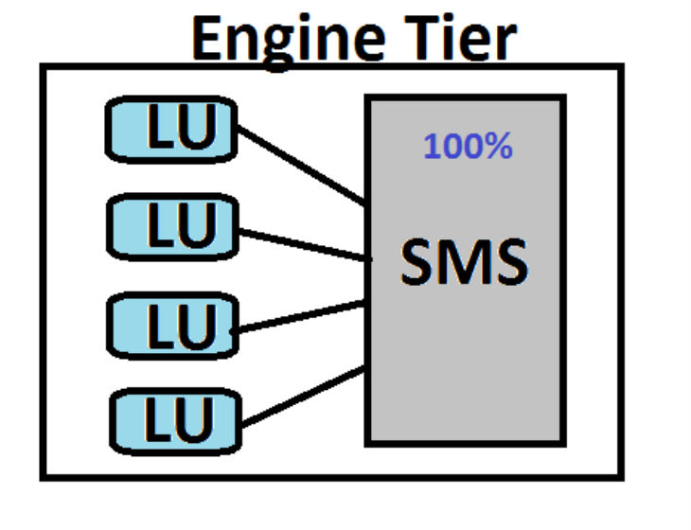
Tuning and Configuration
Topology
  SMP
Notes:
Here we have a side by side look at Hash partitioning vs Auto/Entire for the Lookup match operation for SMP.
Remember the grey areas are representing both memory and file space.
Not much difference here that will affect performance. Basically a trade off when you compare in-memory partitioning of the source data to smaller structures for lookup tables for the reference links.

Slide 23
Tuning and Configuration
Topology
  MPP
    Dynamic resources
    Design/scheduling
      Faster job runs &
      More jobs running simultaneously
    More processes = more resources = better performance (multiple jobs)
      CPU (dynamic)
      Memory (dynamic)
      Network (problem?)
        Repartitioning
Notes:
In contrast to SMP, MPP allows for dynamic CPU, memory and disk allocation.
Utilizing compute nodes from a pool of available resources allows each job to work in an environment that should provide best case for resources.
However, MPP will increase network traffic, so watch for this and benchmark what your network can handle.
Watch for network contention in jobs that do a lot of repartitioning as well as reaching out to other source or targets like DB queries or DB loads.

Slide 24
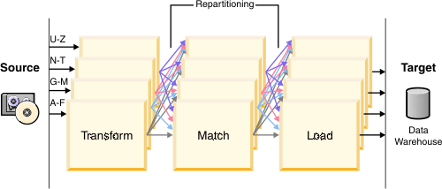
Tuning and Configuration
Topology
  MPP
  Network (problem?)
    Repartitioning increases network traffic between nodes
Notes:
Here is an example of job stages that repartitions data between each stage.
The colored lines represent possible network traffic between stages. Network can be very fast, or very costly, know your network configuration and test to see if it is causing your performance problems.

Slide 25
Tuning and Configuration
Tuning
  $APT_LUTCREATE_NO_MMAP
  Setting this environment variable will force lookup tables to be created using malloced memory. By default lookup table creation is done using memory mapped files. There may be situations depending on the OS configuration or file system where writing to memory mapped files causes poor performance. In these situations this variable can be set so that malloced memory is used, which should boost performance.
  $APT_LUTCREATE_FIXEDBLOCK
  When defined sets the size in MB of the memory block that is used to buffer records being read by the lookup create operator. When this isn't set the default value is 1MB. Setting this environment variable to 0 will disable block buffering of input records causing each individual record to be written to disk upon being read.
  $APT_NO_SORT_INSERTION
  When defined, turns off automatic insertion of sorting based on operator requirements.
  $APT_NO_PART_INSERTION
  When defined, turns off automatic insertion of partitioners based on operator requirements.
Notes:
Here we have a couple of environment variables that affect the lookup stage and job tuning in general.
Depending on your OS, you may need to set APT_LUTCREATE_NO_MMAP=true or fine tune APT_LUTCREATE_FIXEDBLOCK to see if you get an improvement in lookup performance.
APT_NO_SORT_INSERTION and APT_NO_PART_INSERTION will turn off the framework’s decision making logic to automatically add sorts and partitions to the “score” to ensure the data is processed cleanly. Use this at your own risk, these are normally only used by advanced developers that understand the consequences of incorrect job design and these flags.

Slide 26
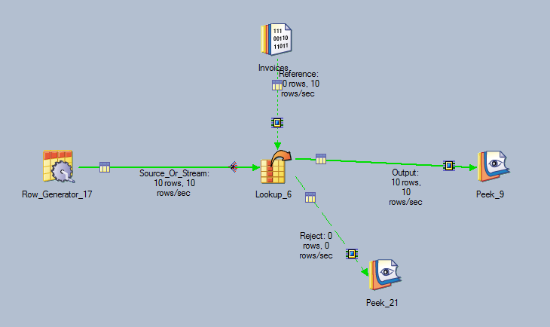
Range Lookup & APT_NO_SORT_INSERTION
Default behavior
  Special handling of data – requires sort
  Behind the scenes
  op2[1p] {(parallel inserted tsort operator {key={value=Invoice_ID, subArgs={asc}}, key={value=invoice_date, subArgs={asc}}}(0) in Lookup_6)
Notes:
The Range lookup requires some additional processing that you may not be aware of.
The framework will automatically add the correct sorts and partition operations in the background to allow the Range Lookup to process data correctly.
Here we have a job design using a range lookup, and as you can see there is no sort stages here. The job work correctly because by default the APT_NO_SORT_INSERTION is not set.
If we change the environment variable APT_NO_SORT_INSERTION to “true” this turns off this automatic feature and we must manually prepare the data correctly to get the desired results.

Slide 27
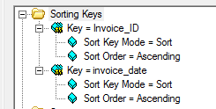
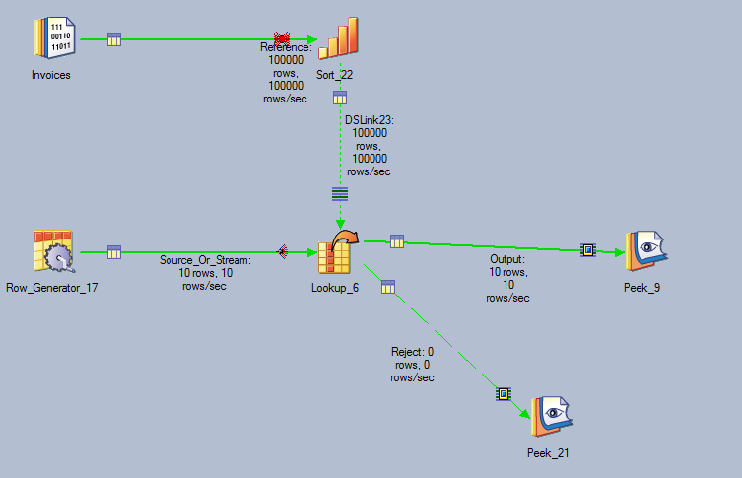
Range Lookup & APT_NO_SORT_INSERTION
Non- Default behavior (with APT_NO_SORT_INSERTION = true)
  Insert manual sort
    Equity keys first
    Range key ascending
Notes:
Here we have the range lookup, but now we have set $APT_NO_SORT_INSERTION = true
There will be no sort operation added by the framework, and the job will abort.
So what are the steps required to ensure the data is prepared correctly for a Range Lookup with APT_NO_SORT_INSERTION set?
First we will insert a sort stage and set the sort keys to use the equity Keys defined in the lookup first, then the Range Key in ascending order.

Slide 28
Range Lookup & APT_NO_SORT_INSERTION
Non- Default behavior (with APT_NO_SORT_INSERTION)
  Partition the data for the sort
Notes:
Second we need to partition the reference data for the sort.
You can use entire, but remember this will provide 100% of the data for each partition, this increases the sort data by 300% in our 4 node configuration file.
Hash is normally the best choice here, as it reduces the amount of data for each partition into fairly equal sizes, distributed across the number of nodes used from the configuration file.

Slide 29
Range Lookup & APT_NO_SORT_INSERTION
Non- Default behavior (with APT_NO_SORT_INSERTION)
  Keep same partitioning
    Prevents distroying sort order
Notes:
Notice the same partition marker here. If you try to use hash, or entire, or any other partitioning method, this will potentially change the sort order.
DataStage does not “recognize” that the data is still sorted by any specific key after a repartition. “Same” partitioning will guarantee that the data is still recognized and processed by the previous operations upstream.

Slide 30

Range Lookup & APT_NO_SORT_INSERTION
Non- Default behavior (with APT_NO_SORT_INSERTION)
  Match partitioning on source link
Notes:
Finally, the source data must be partitioned in the same manner as the data in the reference link. This is to ensure all like keys fall within the same partition, otherwise data matches will not occur, causing job abort or incorrect data to be output from the lookup.
Once we follow these simple steps, a Range Lookup will perform and produce the same output as the prior job design.

Slide 31
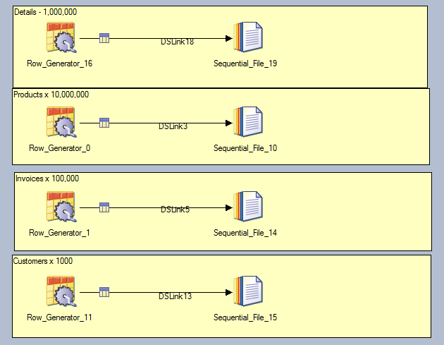
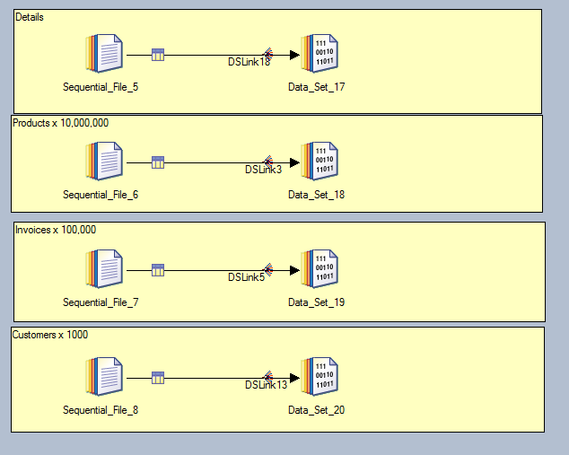

Case Study
Linux VM
  1 CPU
  4GB Memory
  1GB NIC
Sales Scenario
  Customers
  Products
  Invoices
  Sales Records
Seqential files
DataSets
Lookup FileSet
Notes:
Lab machine is very small 1 CPU Virtual Machine with 4 GB RAM running RH V5.8
We use a sales model for the data consisting of Products, Customers, Invoices and invoice details.
As you can see the data was generated with Row Generators and the whole case study can be made available to download so you can import the same jobs and data and play with what you have learned today on your own servers.

Slide 32
Case Study
Lookup jobs
Typical Lookup
Lookup using hash
Lookup using DataSet with auto partitioning
Lookup using DataSet with hash
Lookup using a Lookup File Set
Notes:
I will be taking 5 different job designs that all basically do the same thing.
Take 1 million detail rows and match that to a product listing of 10 million rows.
Since we have many customers using larger datasets, this should provide a realistic look into the performance possibilities with the changes in lookup usage.
To be fair, all the jobs will use the same source and reference data, just prepared in a different way all controlled by job design.

Slide 33
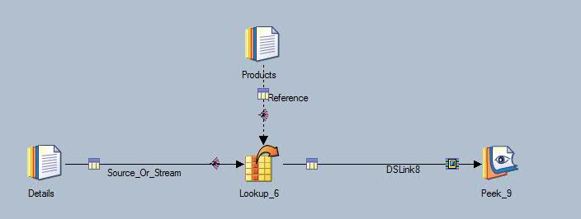
Case Study
Lookup job #1
Typical Lookup from sequential File
Source - Details 1M
Reference – Products 10M
Avg Runtime – 126 seconds
Notes:
This is typically the job design we see most. It uses sequential input, and auto partitioning.
Keys are mapped from details table field sales_product_id matching to key product_id from the products table.
Because we are good developers we expect to get 100% match.
Runtime is ~126 seconds

Slide 34
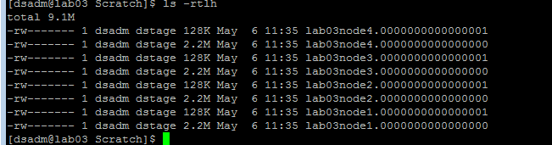
Case Study
Lookup job #1
Creates a single lookup table
  One LUTCreateOp
859MB memory/disk
Buffers source records to scratch
Notes:
Additional details for this job, it creates a single lookup table which is mapped to memory taking up 859MB of space. We have 1 LUTCreateOp running to create this table.
Rows are buffered to scratch from the source link until the lookup table is built and ready.

Slide 35
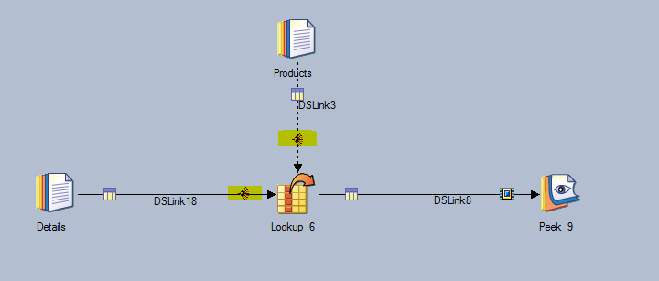
Case Study
Lookup job #2
Typical Lookup using hash
Same source/reference data
Note seq-> parallel partitioning
Avg runtime - 35 seconds
Notes:
This is basically the same job as before, except the developer decided to use a different partitioning method. When you change the reference link to use a partitioning method other than Auto/Entire you must change the source link partitioning method to match both the partitioning method and the keys. Note the difference in run times with just this simple change.

Slide 36
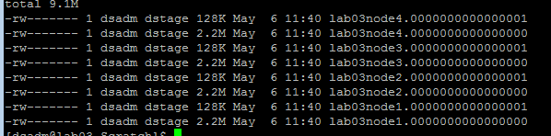
Case Study
Lookup job #2
4 lookup tables built simultaneously by 4 LUTCreateOp
Smaller structures
Buffers source data to Scratch
Notes:
Here we see the hash partitioning method creates 4 lookup tables (because of the 4 nodes in the configuration file) and these are created simultaneously so the tables are available much faster. We still have buffering, and you’ll find you may not be able to completely avoid buffering, but knowing where and why it occurs can help diagnose job design issues.

Slide 37
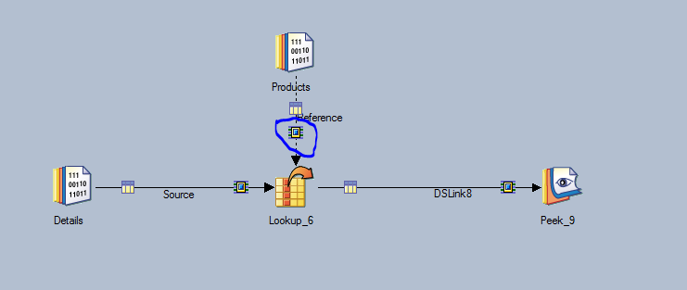
Case Study
Lookup jobs #3
Typical Lookup from DataSets with Auto/Entire
Same source/reference data
Note auto/entire partitioning
Avg runtime - 86 seconds
Notes:
This job design reads from DataStage Datasets, however the developer is using Auto (Entire) partitioning. You would expect that the reference link would automatically use the partitioning from the dataset, but it doesn’t. So watch for this common error of wasted partitioning.

Slide 38
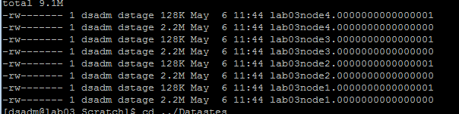
Case Study
Lookup jobs #3
Typical Lookup from DataSets with Auto/Entire
Single lookup table
  partitioning the dataset wasted
Buffering still occurs
Notes:
As you can see we only get a single lookup table even when we use a dataset to feed the reference link. There is only 1 lookup table create process and this slows down the create table operation.

Slide 39
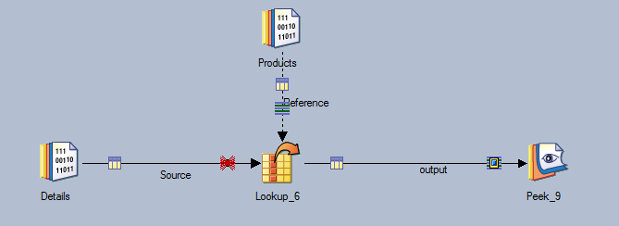
Case Study
Lookup job #4
Typical Lookup from DataSets with Hash
Same source/reference data
Avg runtime 15 seconds
Notes:
Now our developer is getting a little wiser with his job design. He knows the dataset is already partitioned on the Product_ID field so he tells the lookup to use “Same” partitioning for the reference link. Unfortunately the Details table is not partitioned on Product_ID, so we must repartition the source data. Since this is an SMP server, all repartitioning is in memory, so the overhead is reduced and the average job runtime is much smaller in comparison.

Slide 40

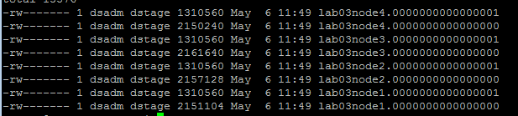
Case Study
Lookup job #4
Same size regardless of source (seq/ds)
Build time is smaller because of reduced overhead
Reference data already partitioned
Notes:
Here you see there are 4 lookup tables and data from each dataset’s partition is read into each table without any other necessary operations.

Slide 41
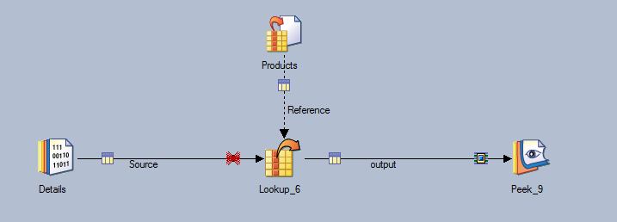
Case Study
Lookup job #5
Typical Lookup utilizing Lookup File set
Created with hash partitioning
Same source/reference data
Avg runtime 1-2 seconds
Notes:
We can go one step further with our pre-preparation of the data for the reference link. Here we have created a Lookup Fileset, where the data was hash partitioned on Product_ID AND the tables are pre-built and stored in the Resource Disk area defined for the configuration file.
Now when the job is executed, the lookup stage can quickly jump to matching data as needed, instead of working on building and rebuilding the lookup tables for each job run.

Slide 42

Case Study
Lookup job #5
Lookup fileset pre-created
Created with hash partitioning
Same size
Reduced buffering
Notes:
As you can see this is the exact same lookup table that is built for each job run, however, this was built during the creation of all the sample data. Of course if you add products to the products table, you will have to rebuild the lookup file set, however, for batch processing, this is done once for a series of job runs where tables should be consistent.

Slide 43
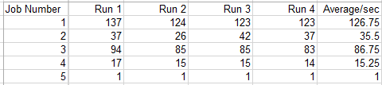
Case Study
Lookup jobs
Typical Lookup
Lookup using hash
Lookup using DataSet with auto partitioning
Lookup using DataSet with hash
Lookup using a Lookup FileSet
All jobs ran on 4 partitions with 4 LUTProcessOp
Only difference was how the source and reference data was handled.
Notes:
In conclusion, we have discussed how the lookup stage works internally for many different options on different topologies. With this knowledge, you can determine how you would like for your next job design to take advantage of the available resources, and hopefully make adjustments to existing jobs to better overall performance. Each of these jobs do basically the same function, and you can see a range of runtimes from 126 second to just a few seconds with a little planning and purpose.

Slide 44
Questions?
Important links:
Lookup Vs Join - http://www-01.ibm.com/support/knowledgecenter/SSZJPZ_9.1.0/com.ibm.swg.im.iis.ds.parjob.dev.doc/topics/c_deeref_Join_Versus_Lookup.html?lang=en
SMP vs MPP - http://www-01.ibm.com/support/knowledgecenter/SSZJPZ_8.7.0/com.ibm.swg.im.iis.productization.iisinfsv.install.doc/topics/wsisinst_pln_engscalabilityparallel.html
Pipeline Processing - http://www-01.ibm.com/support/knowledgecenter/SSZJPZ_8.7.0/com.ibm.swg.im.iis.ds.parjob.dev.doc/topics/combiningpipelineandpartitionparallelism.html
Lookup File Set Stage -http://www-01.ibm.com/support/knowledgecenter/SSZJPZ_9.1.0/com.ibm.swg.im.iis.ds.parjob.dev.doc/topics/c_deeref_Lookup_File_Set_Stage.html?lang=en
Lookup Stage - http://www-01.ibm.com/support/knowledgecenter/SSZJPZ_9.1.0/com.ibm.swg.im.iis.ds.parjob.dev.doc/topics/c_deeref_Lookup_Stage.html?lang=en
Range Lookup - http://www-01.ibm.com/support/knowledgecenter/SSZJPZ_9.1.0/com.ibm.swg.im.iis.ds.parjob.dev.doc/topics/t_deeref_Range_Lookups.html?lang=en
Sparse lookup vs Join - http://www-01.ibm.com/support/knowledgecenter/SSZJPZ_9.1.0/com.ibm.swg.im.iis.ds.parjob.dev.doc/topics/c_deeref_Join_Versus_Lookup.html?lang=en
Link Buffering - http://www-01.ibm.com/support/knowledgecenter/SSZJPZ_9.1.0/com.ibm.swg.im.iis.ds.parjob.adref.doc/topics/c_deeadvrf_Link_Buffering.html?lang=en
General Performance Tips - http://www-01.ibm.com/support/knowledgecenter/SSZJPZ_9.1.0/com.ibm.swg.im.iis.ds.parjob.adref.doc/topics/c_deeadvrf_Improving_Performance.html?lang=en
Notes:
In conclusion, I hope this presentation has provided useful information that will help your developers make correct decisions when building job designs using the Lookup Stage. This information can be used to help troubleshoot performance issues as well. Once you know where and how the lookup and buffer data is being used and stored, you can focus your troubleshooting attention to these areas.
Are there any questions regarding the Lookup Stage or information provided in this presentation?

